Slide 1
Introduction to
Future Aircraft Psychoacoustic
Study Video
Notes:
Welcome to this remote Psychoacoustic Test for the National Aeronautics and Space Administration. NASA thanks you for volunteering to complete this survey. Your time and feedback are a valuable tool as we learn about human response to noise.

Slide 2
Outline
Legal matter
Test description and its motivation
Hardware/Software Requirements
List of steps
Schedule
Next steps
Psychoacoustic Sound Study—Introduction Video
Notes:
After going over a brief but important legal matter, that is, your privacy, the next seven slides will introduce you to the survey, the hardware and software requirements, the steps and facets of the survey, a schedule, and instructions for your next steps.

Slide 3

Privacy/Right to Exit
Consent and Privacy
Personal information (name, email, phone number) will NOT be shared
  Zip code will be shared with your Participant Identification Number
Exit and reenter the Test at any time before test window closes
Psychoacoustic Sound Study—Introduction Video
Notes:
Be assured your personal information, that is, your name, email, and phone number, will not be shared with anyone outside of NASA and its subcontractors on this study testing group. Your zip code will be shared but it will be associated with an anonymous Participant Identification number.
We want to be clear that you are not being forced to take this test and have volunteered your time on this important study. Remember that at any time, you may exit the test. You may also reenter the test at any time before the test window time closes. However, if you fail to return in the allotted time the survey is open, your results will not be counted.

Slide 4
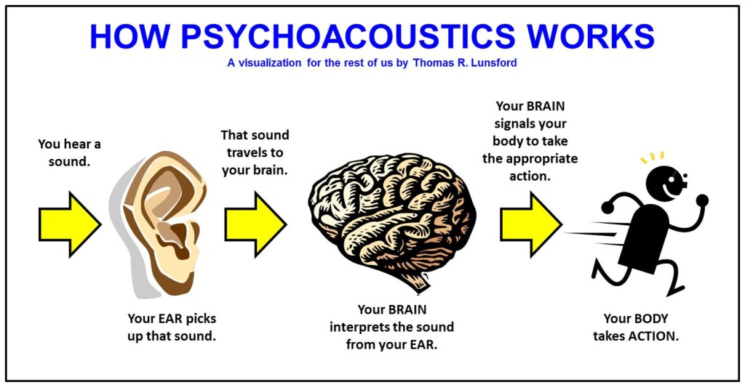
What is a psychoacoustic test and why?
Providing your reaction to sounds
Web-based survey
Rating annoyance to sounds
Increases understanding for mitigating effects of aviation noise; may inform policy-making and aircraft design
Psychoacoustic Sound Study—Introduction Video
Notes:
A psychoacoustic test is where one provides their reaction to a sound. In this test, a web-based survey will ask you to rate the annoyance of each sound you hear.
NASA is conducting this test to gain understanding of people’s reactions to certain sounds. It will increase NASA’s understanding on how to mitigate the effects of aviation noise, and this knowledge will be shared with other organizations within government, industry, and academia. These other organizations may use the results of this research to inform policy making and aircraft design.

Slide 5

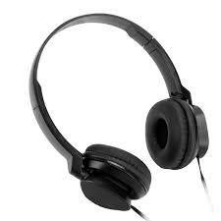
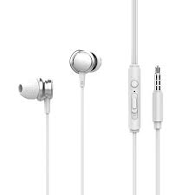
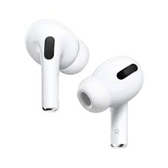
Requirements
Computer
Stable internet connection
Over ear headphones
Respite from loud events prior to taking the survey
Quiet room free of distractions
Psychoacoustic Sound Study—Introduction Video
Notes:
Please use a personal laptop or desktop computer to access the survey through a steady internet connection. Cell phones and tablets are not encouraged because this test application was not tested on these devices. We request that you wear over-the-ear headphones to listen to the sounds in the test
ACTION (Hit space bar for animation once, then again)
It is preferred that you use a wired over-the-ear headphone connected directly to your computer’s microphone or headphone port
Wireless over-the-ear headphones, for example, Bluetooth headphones, may be used if an alternative wired over-the-ear headphone is unavailable. In-ear headphones such as wired earbuds or air pods are discouraged.
ACTION (hit space bar for animation three times, third time slowly).
Please wait at least one day to conduct the survey after experiencing loud noise events, such as attending a rock concert, mowing the yard, or extensive music playing with in-ear headphones.
Please be in a quiet room free of distractions.

Slide 6
What are the steps involved?
Introduction to the test
Calibration
Familiarization
Practice Session
Test sessions
  Rate annoyance to sounds
Post-test survey
Technical Difficulties/Interfering Events
Psychoacoustic Sound Study—Introduction Video
Notes:
The steps the survey will walk you through are listed on the slide.
ACTION—Hit space bar.
First, to test how well your headset or speaker volume matches with the actual sounds being played, a verification test called “calibration” will be completed. As part of this calibration, you will rub your hands together making a noise. You will do this a couple of times and adjust your headset or speaker volume as necessary following a video demonstration. This may take approximately 5-10 minutes.
ACTION—Hit space bar.
ACTION—Hit space bar.
Then, you’ll be taken through a familiarization session which will play a sample set of sounds you might hear in the test. Some of these familiarization sounds may cause visceral or quick reactions, but you will not be answering questions on how you felt about the sounds. You will just need to listen to them. You may choose to repeat the calibration after familiarization but doing so will require you to go through the familiarization session again after calibration. If you choose not to repeat calibration, please do not adjust the volume on your computer or headphones for the remainder of the test. Adjusting the volume after familiarization will lead to misleading test results for NASA.
ACTION—Hit space bar
ACTION—Hit space bar.
A Practice Session will follow the familiarization session, and it will be time for you to practice responding to the sounds and using the software.
ACTION---Hit space bar
ACTION—Hit space bar.
Next, you’re ready for the real test sessions. There will be four test sessions, each containing 15 sounds. Each session will take between 7 to 10 minutes to complete. During the test sessions, there will be different sounds playing throughout the test you will be ranking on a scale bar. Some of these sounds may be loud and obtrusive and could startle you. Between each session you will have time to take a break, go to the bathroom, and stretch.
We ask you listen to test sounds when other unexpected sounds in your environment are not occurring, for example, the sounds of a flushing toilet or an aircraft flyover outside. Please do your best to ignore those sounds. If it is a sound that lingers for a long time, please pause the test, and continue later.
ACTION—Hit space bar.
ACTION—Hit space bar.
After the test sessions there will be an opportunity to take a post test survey where you will have an opportunity to provide feedback.
ACTION-Hit the space bar
If you experience technical difficulties, such as your internet or electricity turning off, or if you hear loud noises for an extended period, it is okay to pause, and you can continue the test within four hours. You may choose to exit the test completely and return later, but you will need to complete the test from the beginning.

Slide 7
Flowchart
Start
Test Login
Introduction Video
PC and Headphone Information
Calibration Session
Familiarization Session
Practice Video
Practice Session
Exit
Main Test Sessions
Post-Test Survey
Notes:
This flowchart is a roadmap to the test. You are currently logged in and watching the introduction video. You will next enter your computer and audio device information. If you do not know your computer and audio device brand name or model, you may choose not to enter this information. You will then be taken to do a calibration of your speakers and go through a familiarization of the testing platform. You will then watch a practice video, do a practice session, and then start the test. You will finish up with the post-test survey. If you exit the test, you will be able to continue from where you last exited. Upon reentering the test, you will be asked to adjust your computer volume to what you set it to during calibration. If you changed your audio device, then you will be asked to repeat the calibration process before continuing.

Slide 8

Next steps, Questions, and Troubleshooting
Monday March 24, 2025, until Friday, April 18, 2025.
For troubleshooting, contact proctor Floor23
  Email hello@floor23digital.com
  Phone (262) 342-6521
General questions about the test must wait.
FAQ
Next steps
  Familiarization
  Calibration
Psychoacoustic Sound Study—Introduction Video
Notes:
The test will be available from 1 AM on Monday, March 24 until midnight on Friday, April 18, 2025.
If you experience technical difficulties during the test, please contact Floor23, the test proctor NASA has hired for this survey. Floor23’s email address is hello@floor23digital.com or their telephone number is 262-342-6521. For troubleshooting, there will be a helpdesk during the duration of the test.
General questions about the test, like about the sounds to be played, cannot be answered until you have completed the test. There will be time after the test for these kinds of questions, so please feel free to ask them at the proper time. Please refer to the FAQ’s you were provided for all other questions.
Your next step is to follow the prompts for the calibration, familiarization, and practice sessions before entering the main test.

Slide 9
Thank you!
We appreciate your participation
in this very important survey for NASA
Psychoacoustic Sound Study—Introduction Video
Notes:
Thank you for participating in this very important survey for NASA. Your feedback is invaluable and will help our research greatly. Shortly, you will be watching a more detailed practice session video to familiarize yourself with the testing platform. Have a great day!

