Slide 1
Beneficiary Web Enrollment
(BWE) Portlet - Screenshots
July 2025

Slide 2
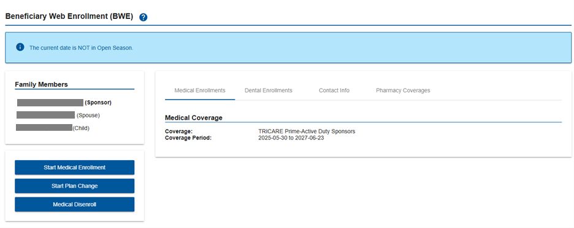
Enrollments
To begin enrollment, select the Start Medical Enrollment button.

Slide 3
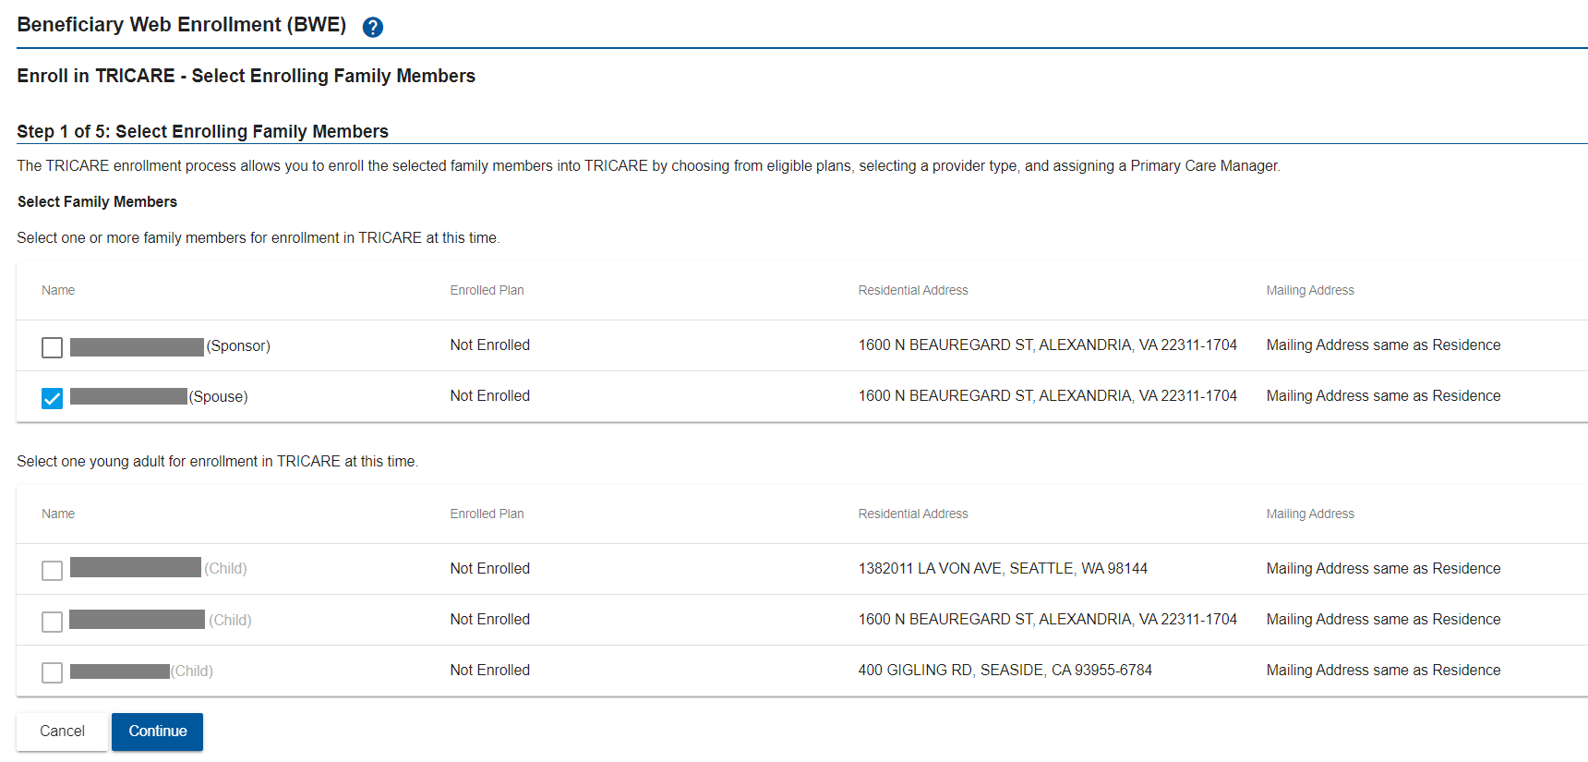
Enrollments (cont.)
Select the family member(s) to enroll, and then select the Continue button
  For TYA enrollments, family members must be enrolled one at a time

Slide 4
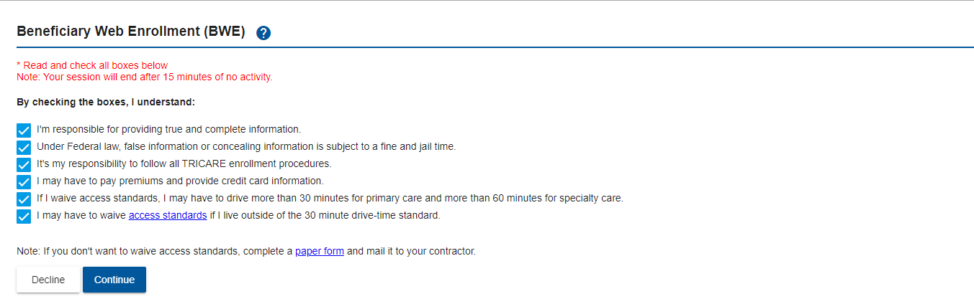
Enrollments (cont.)
Select the check boxes for Enrollment Procedure Compliance, and then select the Continue button.

Slide 5
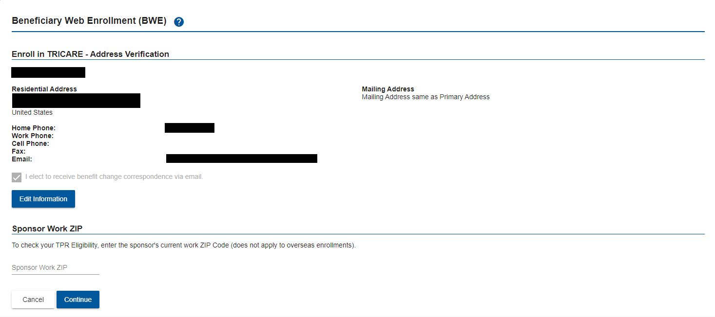
Enrollments (cont.)
Verify the address and select the Continue button.

Slide 6
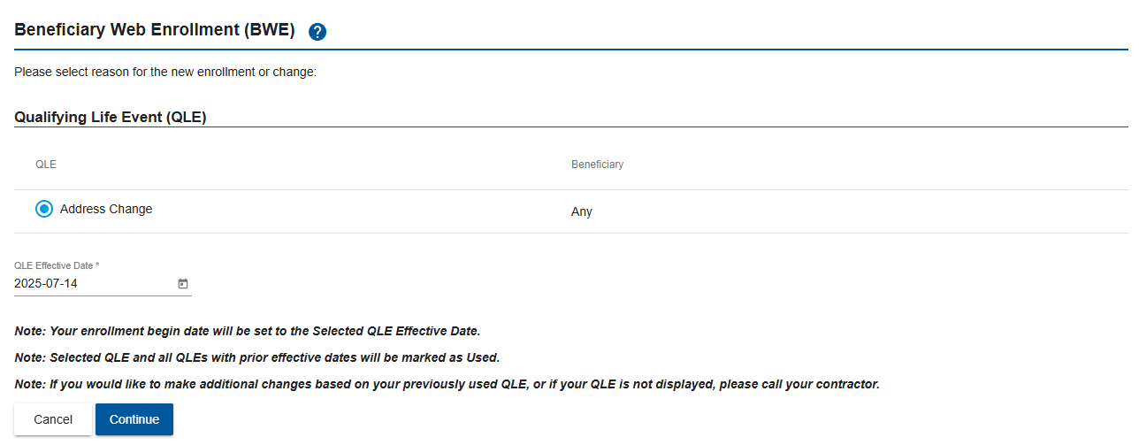
Enrollments (cont.)
Select Open Season or a QLE (if applicable) to begin enrollment
Select the Continue button

Slide 7
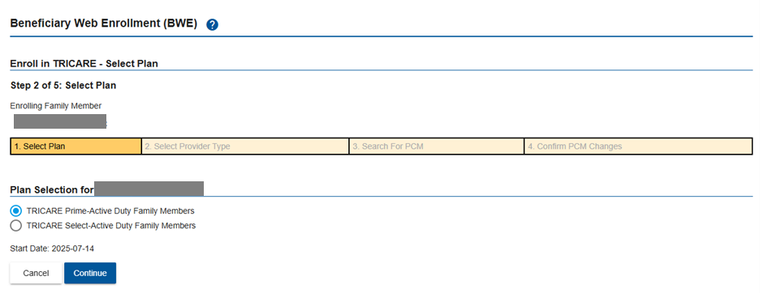
Enrollments (cont.)
Select a plan, and then select the Continue button.

Slide 8
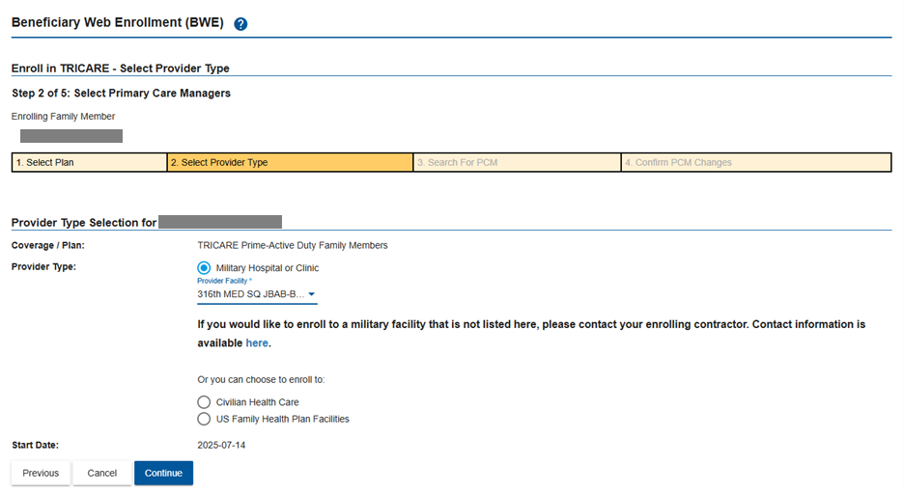
Enrollments (cont.)
Select a Provider Type, and then select the Continue button.

Slide 9
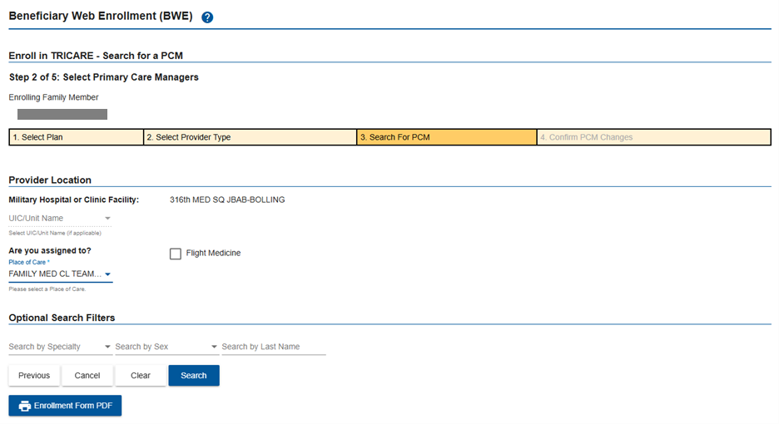
Enrollments (cont.)
Select a Provider Location/Place of Care (PLOC), and then select the Search button.

Slide 10
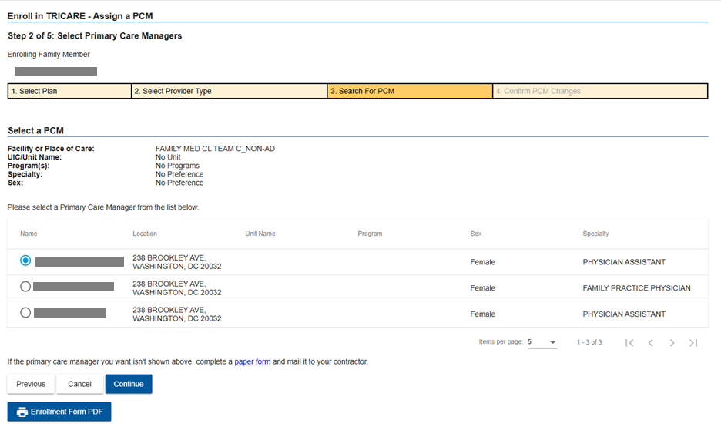
Enrollments (cont.)
Select a PCM, and then select the Continue button.

Slide 11
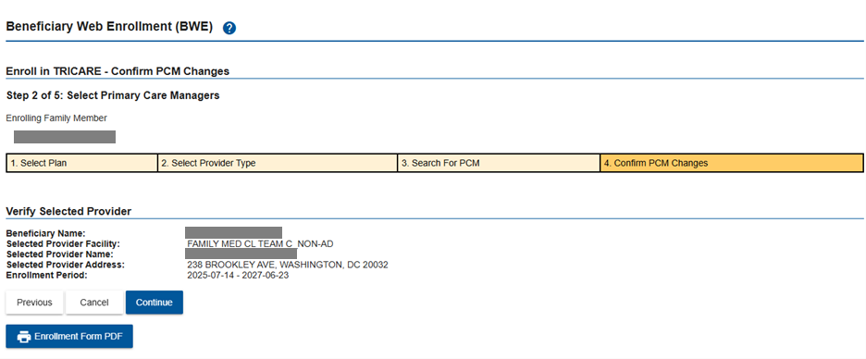
Enrollments (cont.)
Confirm PCM selection, and then select the Continue button.

Slide 12
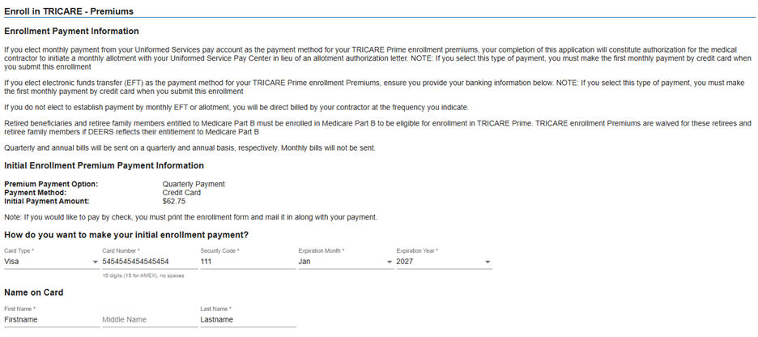
Enrollments (cont.)
The Premiums page is only displayed for plans requiring payment (top of the Premiums’ page)
Select payment options and enter payment information

Slide 13
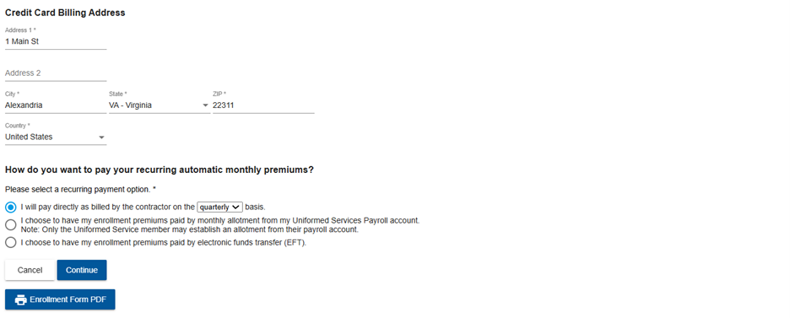
Enrollments (cont.)
Premiums page (cont.)
After enter payment information has been entered, select Continue button.

Slide 14
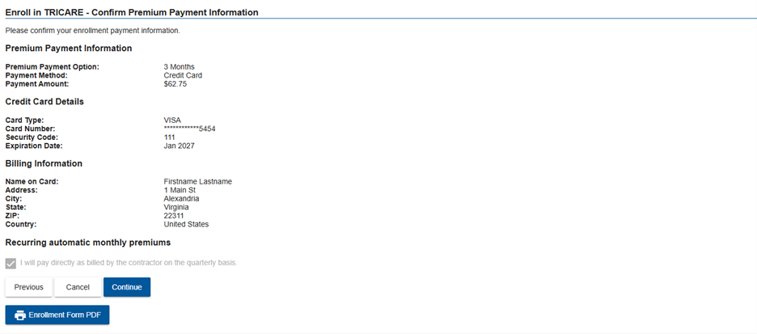
Enrollments (cont.)
Review provided Premium payment information, and then select Continue button.

Slide 15
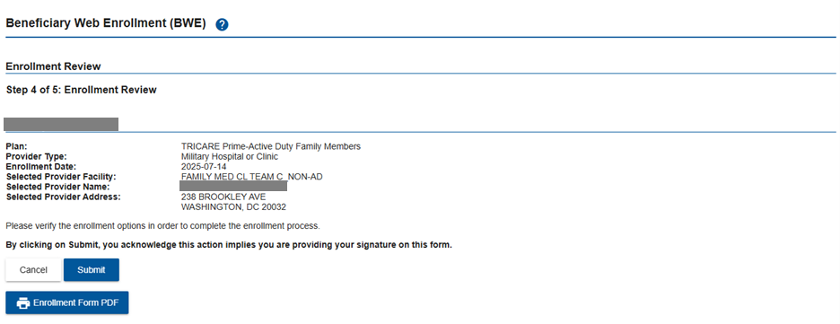
Enrollments (cont.)
Review enrollment
Optionally, select the Enrollment Form PDF button to generate a pre-populated and printable enrollment form

Slide 16
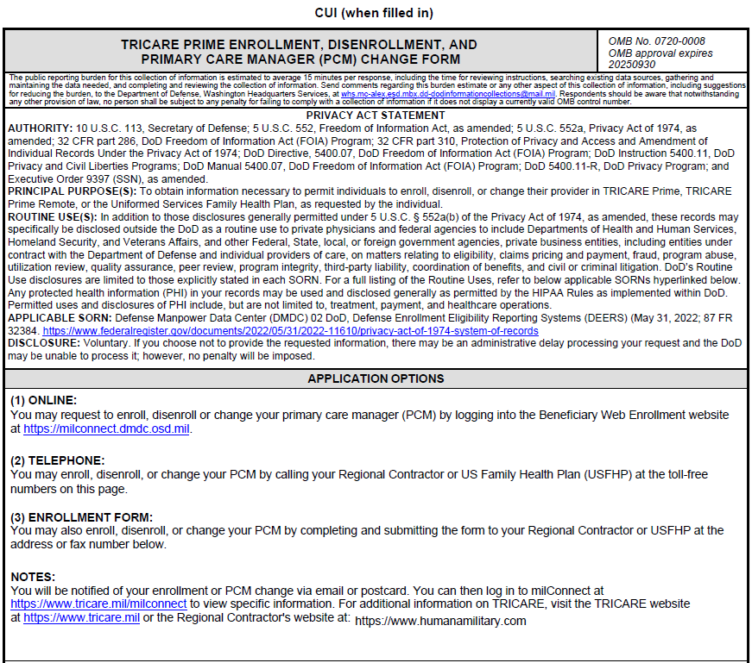
Enrollments (cont.)
Open the saved Enrollment PDF form – top of page 1.

Slide 17
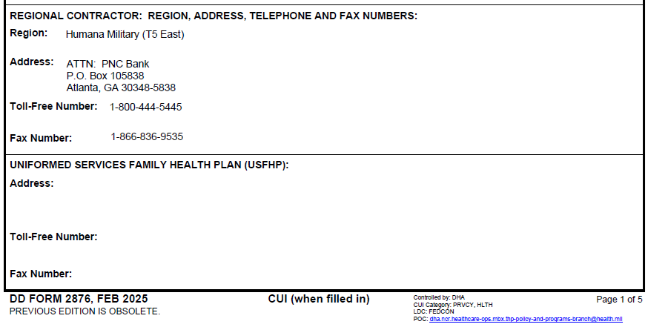
Enrollments (cont.)
Open the saved Enrollment PDF form – bottom of page 1.

Slide 18
Enrollments (cont.)
After reviewing the enrollment, select the Submit button.

Slide 19
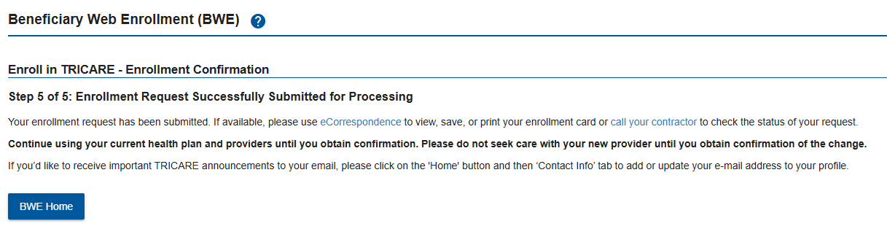
Enrollments (cont.)
Review Enrollment Confirmation, and then select BWE Home button.

Slide 20
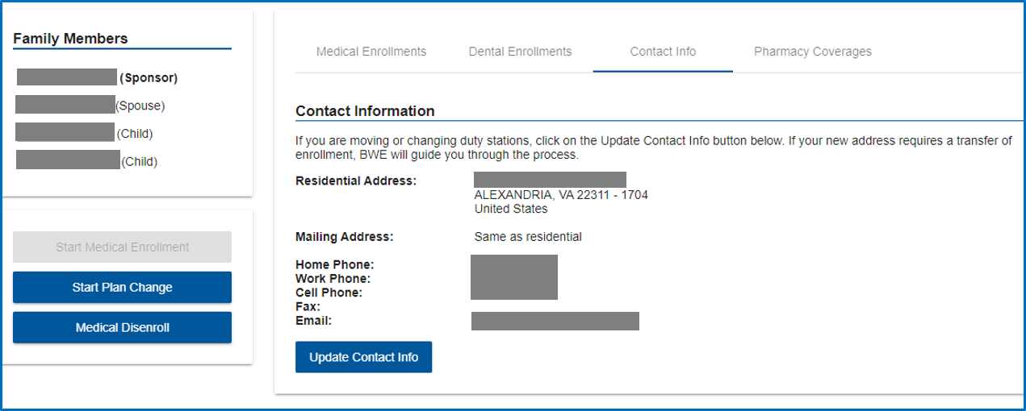
Update Address
Select the Contact Info tab, and then select the Update Contact Info button to update address information.

Slide 21
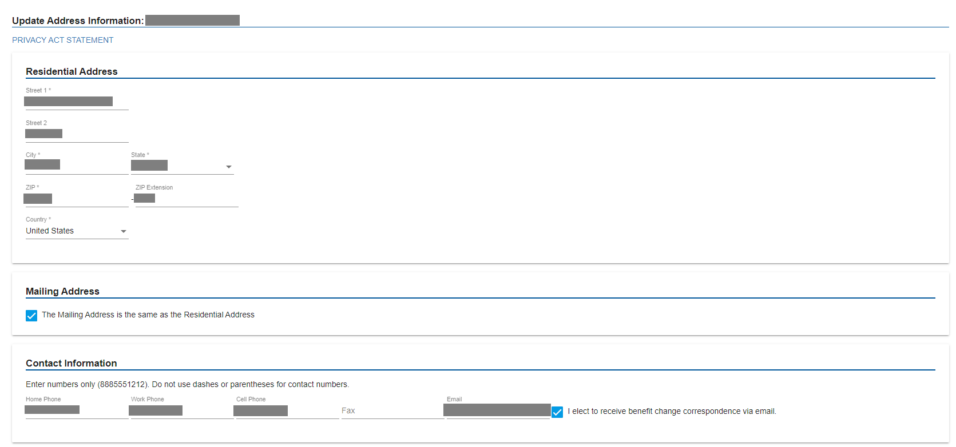
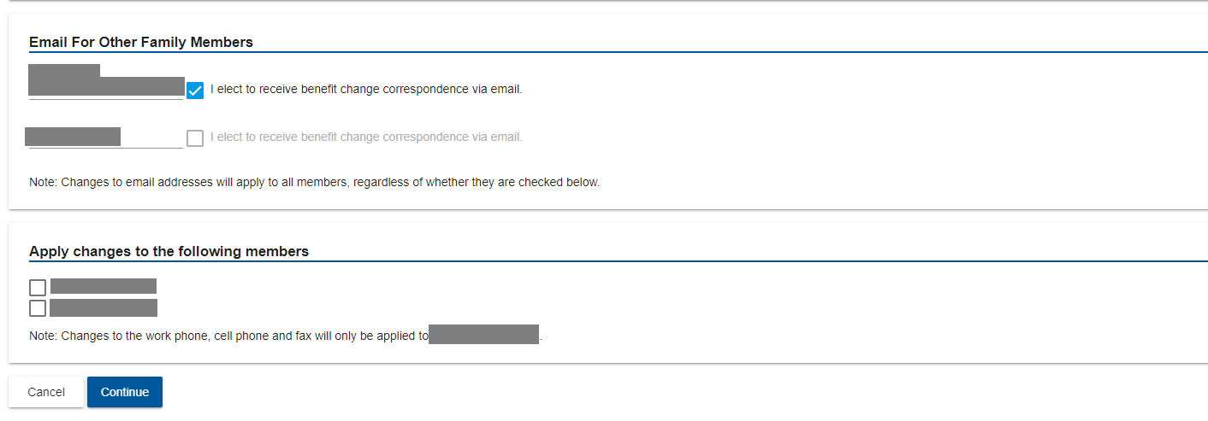
Update Address (cont.)
Verify or update contact information
Add or change other family members’ email address and preference
Select beneficiaries to whom the new address information applies, and then select Continue button

Slide 22
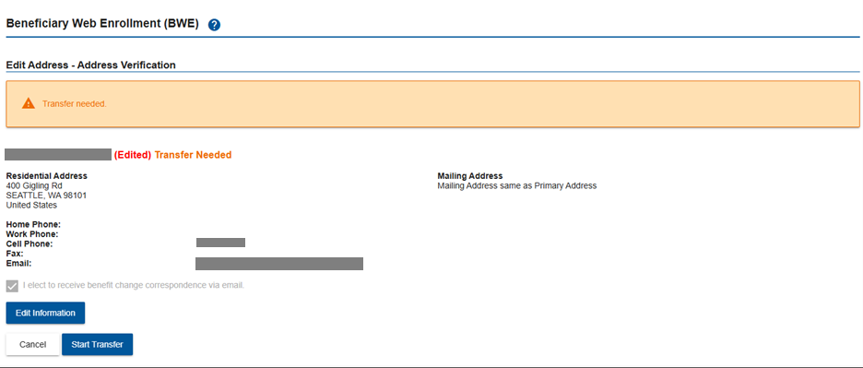
Transfer
Updating address information may prompt a plan change, transfer, or both
Select the Start Transfer button to continue

Slide 23
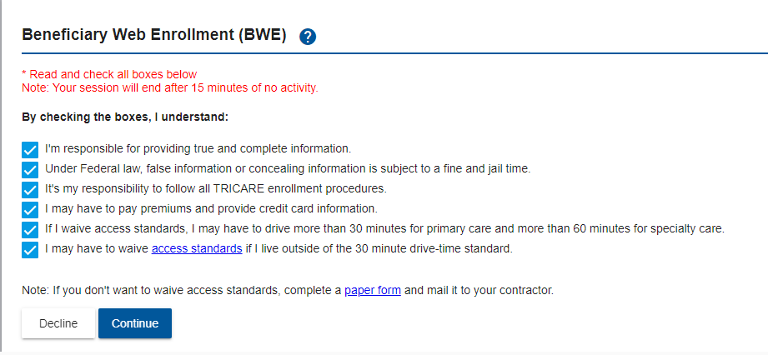
Transfer (cont.)
Select the check boxes for Enrollment Procedure Compliance, and then select the Continue button.

Slide 24
Transfer (cont.)
Select a plan, and then select the Continue button.

Slide 25
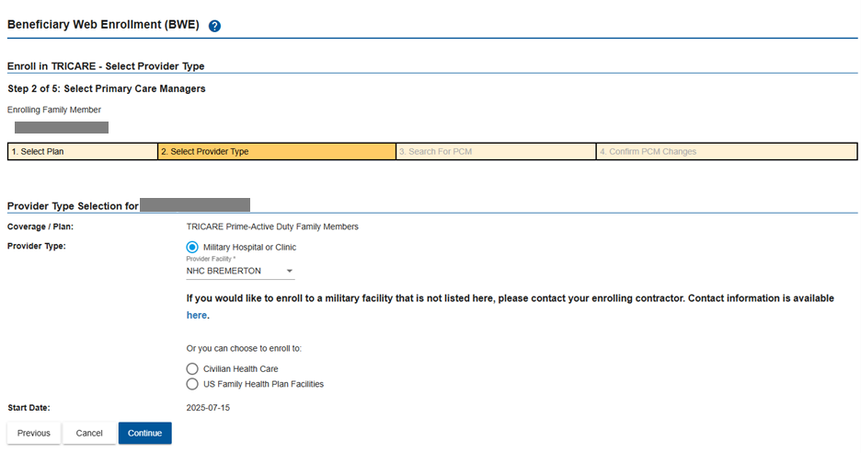
Transfer (cont.)
Select a Provider Type, then and select the Continue button.

Slide 26
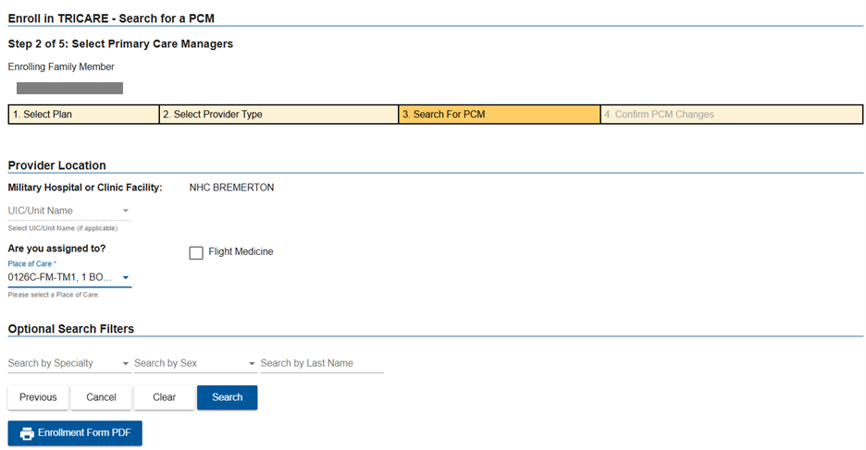
Transfer (cont.)
Select a Provider location/Place of Care, then and select the Search button.

Slide 27
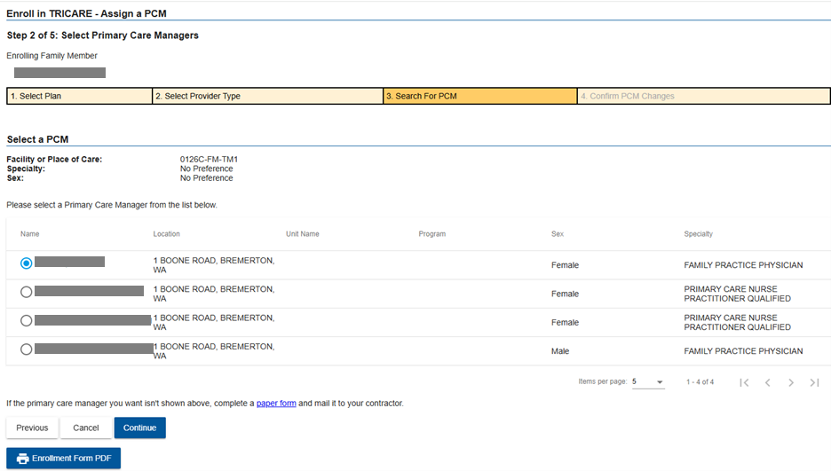
Transfer (cont.)
Select a PCM, and then select the Continue button.

Slide 28
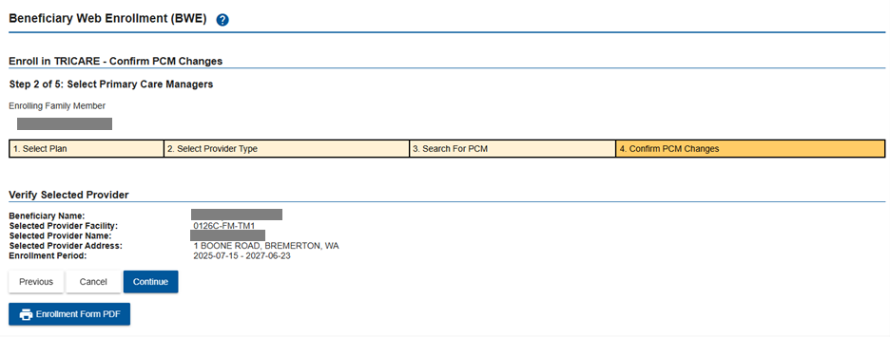
Transfer (cont.)
Verify the Selected Provider, and then select the Continue button.

Slide 29
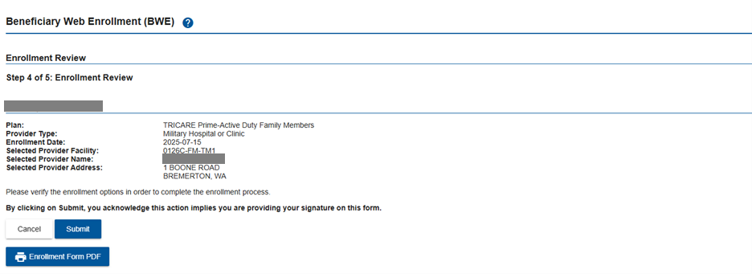
Transfer (cont.)
Select the Submit button to complete the enrollment process.

Slide 30
Transfer (cont.)
Review Enrollment Confirmation, and then select BWE Home button.

Slide 31
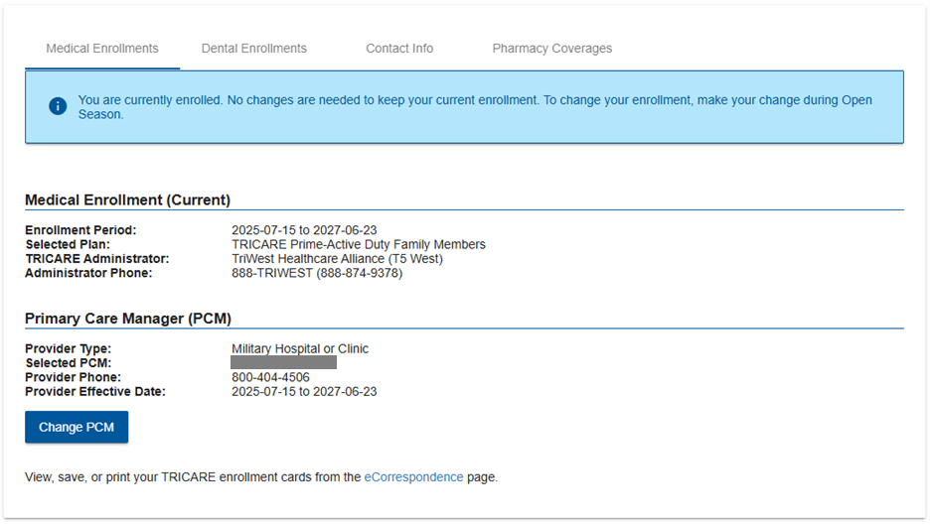
PCM Change
Navigate to the Medical Enrollments tab, and then select the Change PCM button.

Slide 32
PCM Change (cont.)
Select the check boxes for Enrollment Procedure Compliance, and then select the Continue button.

Slide 33
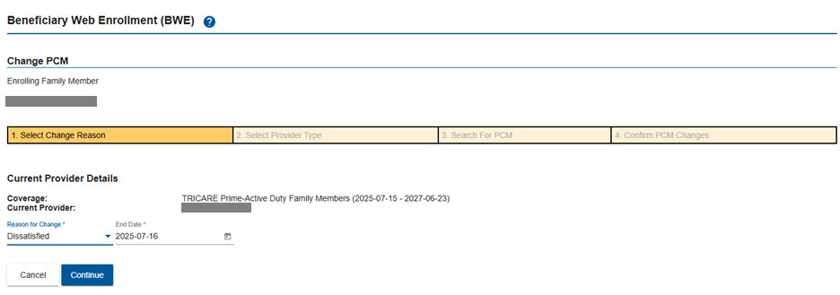
PCM Change (cont.)
Select the Reason for Change, and then select the Continue button.

Slide 34
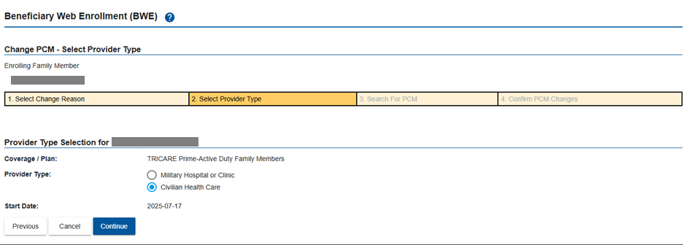
PCM Change (cont.)
Select a Provider Type, and then select the Continue button.

Slide 35
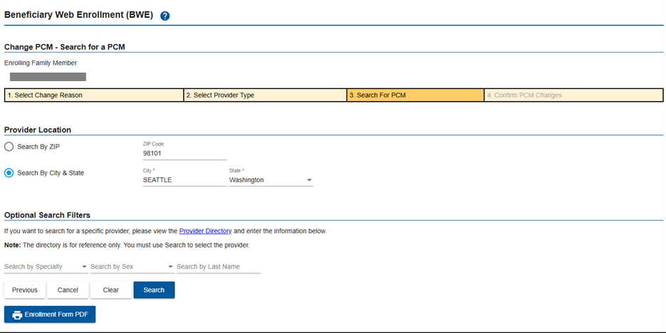
PCM Change (cont.)
Select a Provider Location/Place of Care and optional Search Filters, and then select the Search button.

Slide 36
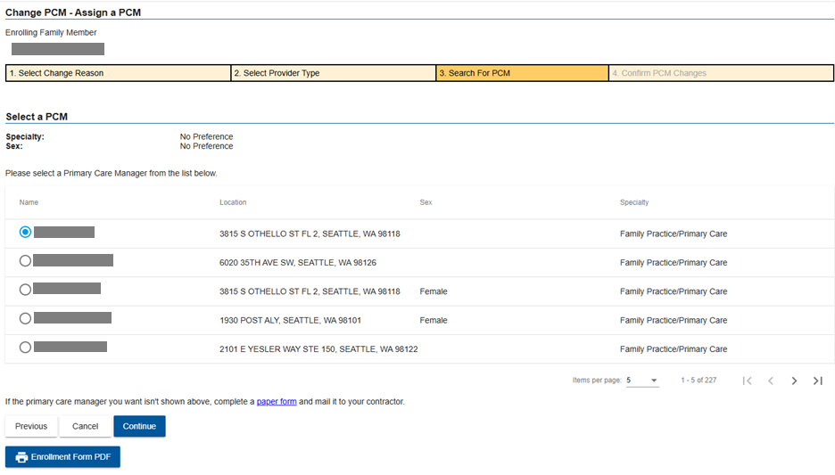
PCM Change (cont.)
Select a PCM, and then select the Continue button.

Slide 37
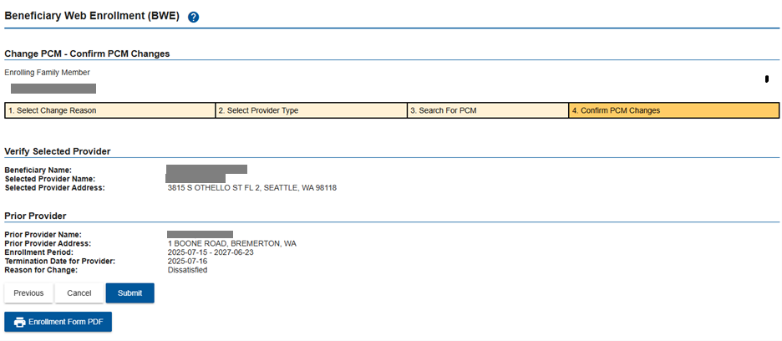
PCM Change (cont.)
Verify the selected PCM, and then select the Submit button.

Slide 38
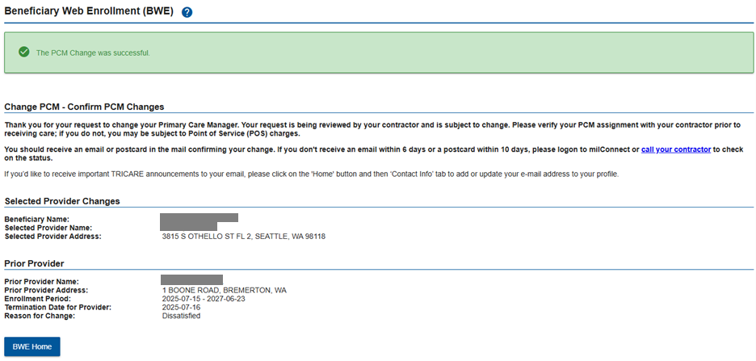
PCM Change (cont.)
Review PCM Change Confirmation, and then select BWE Home button.

Slide 39
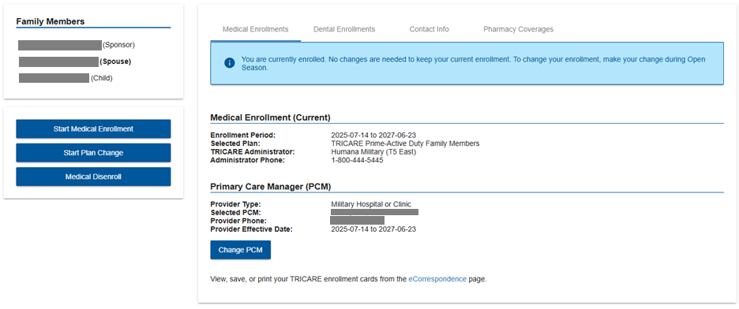
Plan Change
Select the Start Plan Change button.

Slide 40
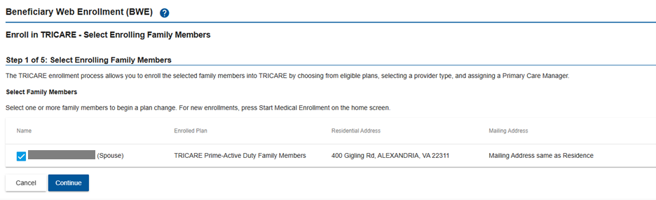
Plan Change (cont.)
Select enrolling family members and select Continue.

Slide 41
Plan Change (cont.)
Select the check boxes for Enrollment Procedure Compliance, and then select the Continue button.

Slide 42
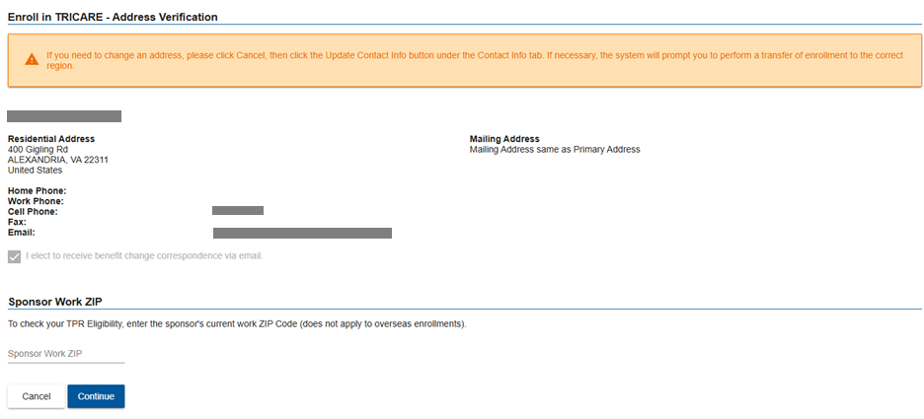
Plan Change (cont.)
Verify address information, and then select the Continue button.

Slide 43
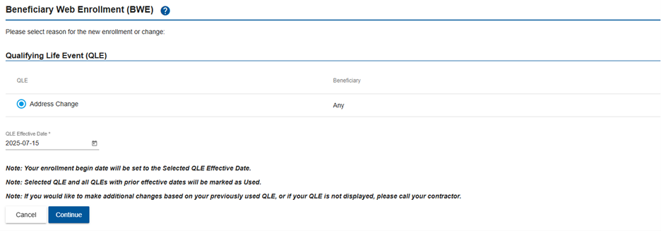
Plan Change (cont.)
Select Annual Open Season or QLE (if applicable), and then select the Continue button.

Slide 44
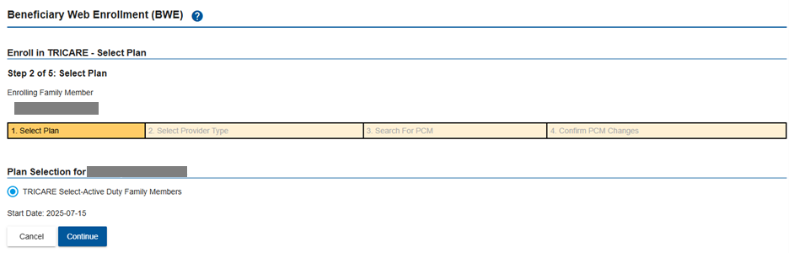
Plan Change (cont.)
Select a plan, and then select the Continue button.

Slide 45
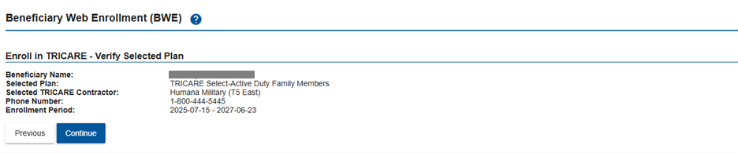
Plan Change (cont.)
Verify the selected plan, and then select the Continue button.

Slide 46
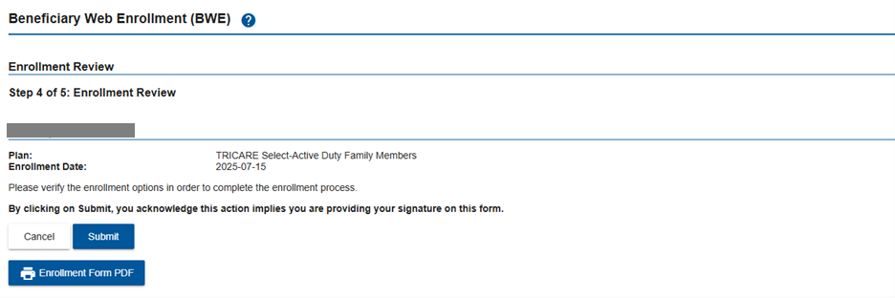
Plan Change (cont.)
Select the Submit button to complete the Plan Change process.

Slide 47
Plan Change (cont.)
Review Enrollment Confirmation, and then select BWE Home button.

Slide 48
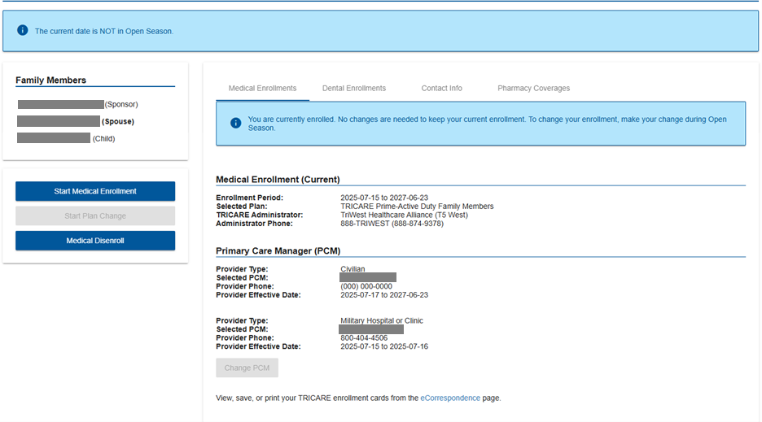
Disenrollment
Select the Medical Disenroll button to begin disenrollment.

Slide 49
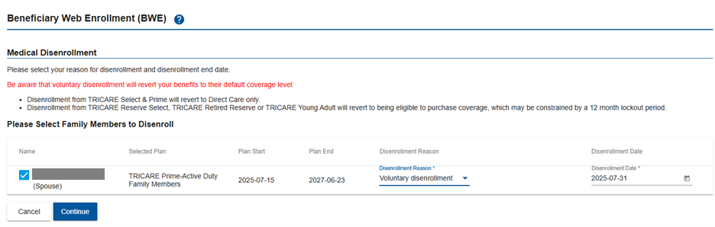
Disenrollment (cont.)
Select the family member you wish to disenroll
Choose the disenrollment reason
Select the Continue button

Slide 50
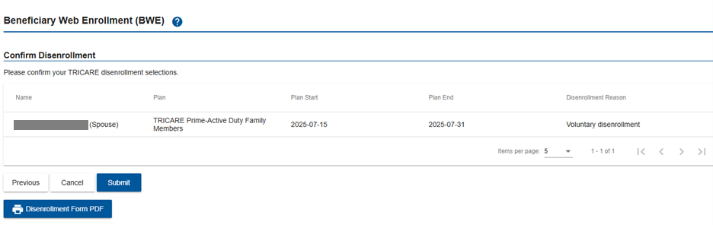
Disenrollment (cont.)
Confirm disenrollment details, and then select the Submit button.

Slide 51
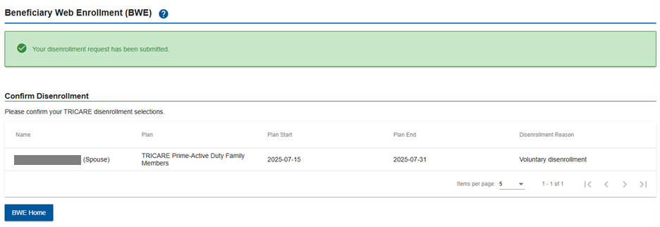
Disenrollment (cont.)
View Disenrollment confirmation, and then select the BWE Home button.

