Slide 1
SPOT-ES
OMB Control Number
0704-0460 Package
AGENCY DISCLOSURE EXPIRATION DATE
XX/XX/XXXX

Slide 2
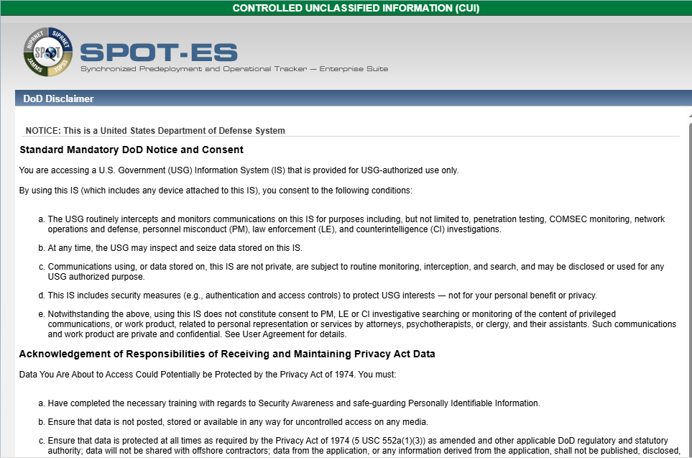
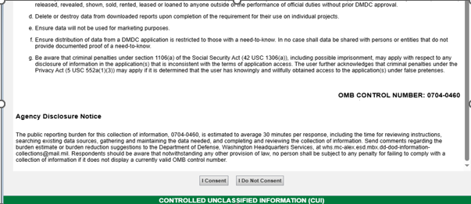

Slide 3
SPOT-ES
OMB Control Number
0704-0460 Package
ADD PERSON
SCREENSHOTS with DROPDOWNS

Slide 4
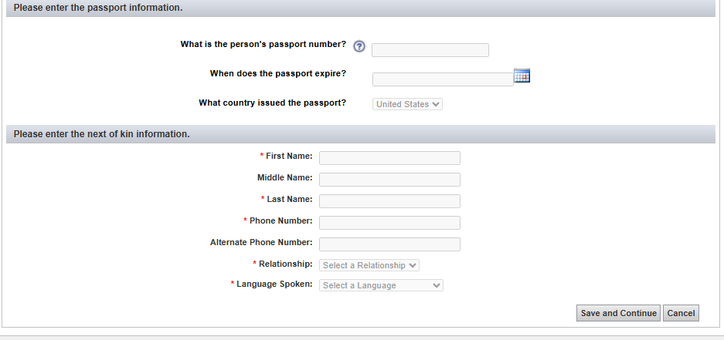

Slide 5
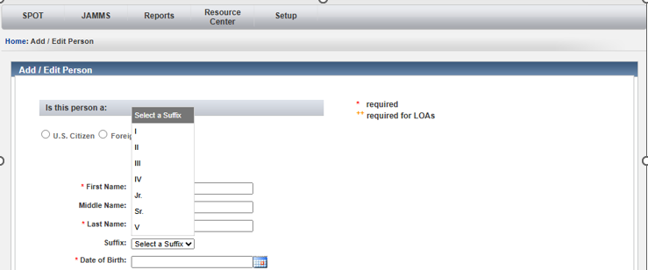
EXAMPLE RESPONSE TO “SUFFIX”

Slide 6
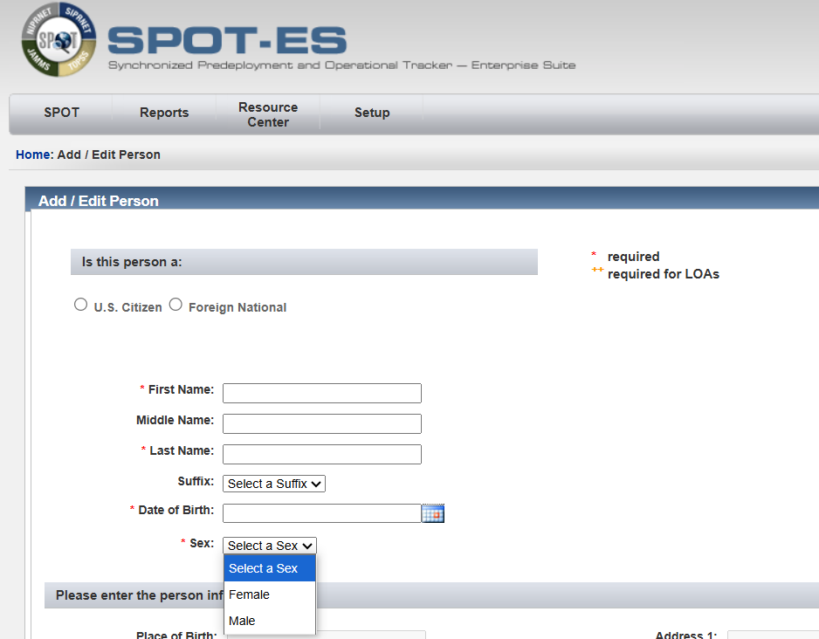
EXAMPLE RESPONSE TO “PERSONNEL CATEGORY”

Slide 7
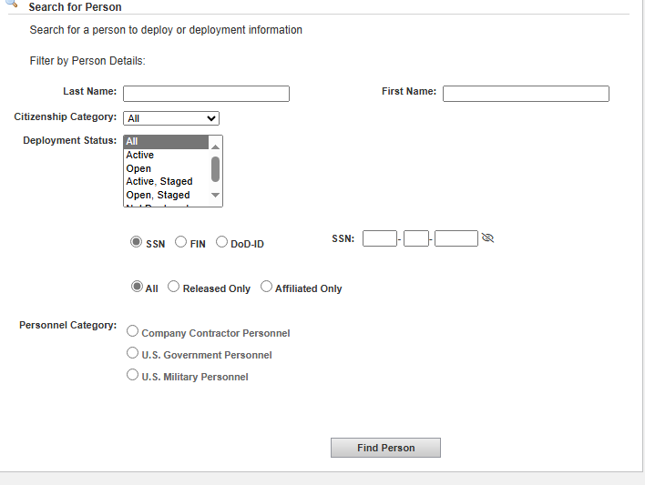
EXAMPLE RESPONSES TO “PERSONNEL CATEORY”

Slide 8
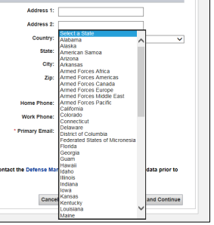
EXAMPLE RESPONSES TO “STATE”

Slide 9
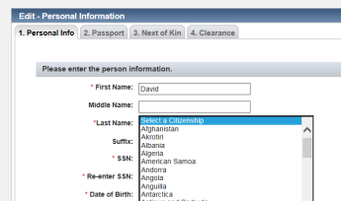
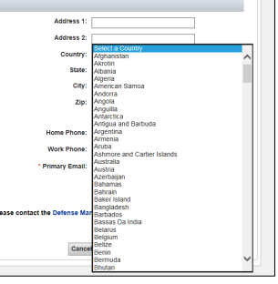
EXAMPLE REPSONSE TO “CITIZENSHIP AND COUNTRY”

Slide 10
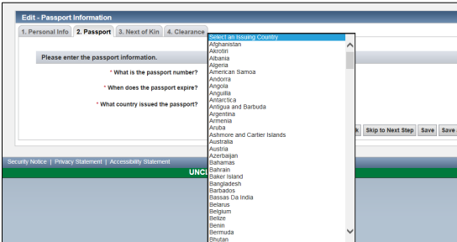
EXAMPLE RESPONSES TO “WHAT COUNTRY ISSUED THE PASSPORT”

Slide 11
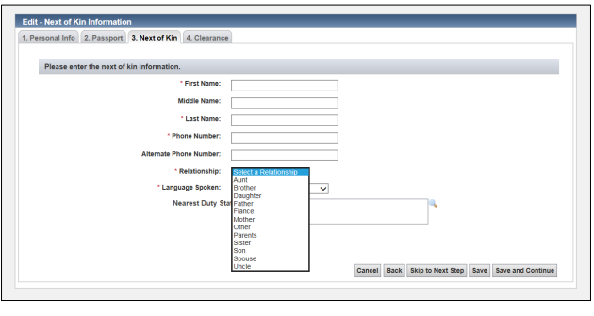
EXAMPLE RESPONSES TO “RELATIONSHIP”

Slide 12
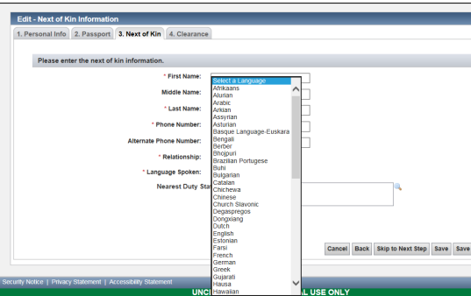
EXAMPLE RESPONSES TO “LANGUAGES SPOKEN”

Slide 13
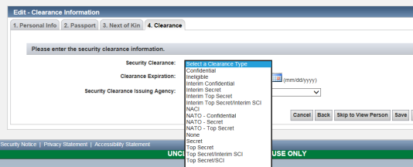
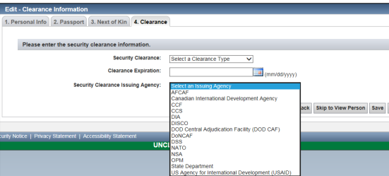
EXAMPLE RESPONSES TO “SECURITY CLEARNCE” AND “SECURITY CLEARANCE AGENCY”

Slide 14
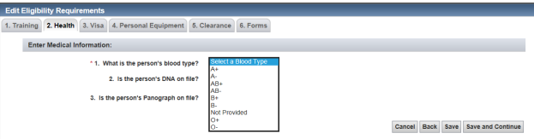
EXAMPLE RESPONSES TO “BLOOD TYPE”

Slide 15
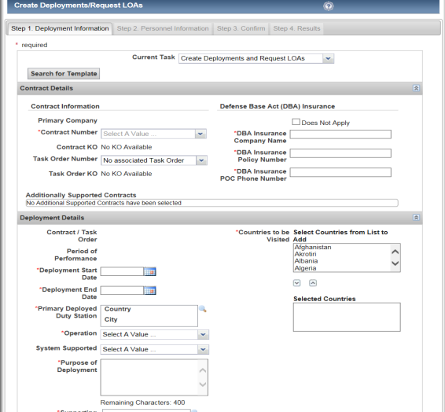
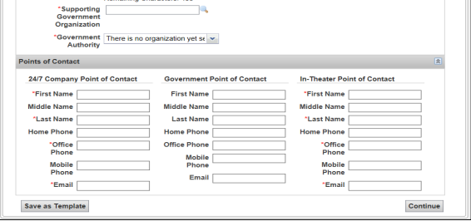
CREATE DEPLOYMENTS / REQUEST LOA SCREEN

Slide 16
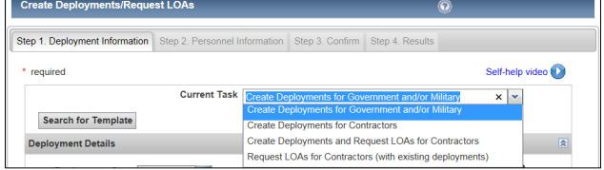
EXAMPLE RESPONSE TO “CURRENT TASK”

Slide 17
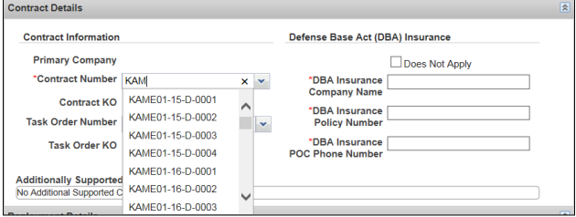
EXAMPLE RESPONSES TO “CONTRACT NUMBER”

Slide 18
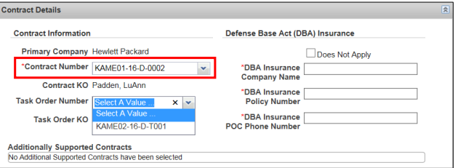
EXAMPLE RESPONES TO “TASK ORDER NUMBER”

Slide 19
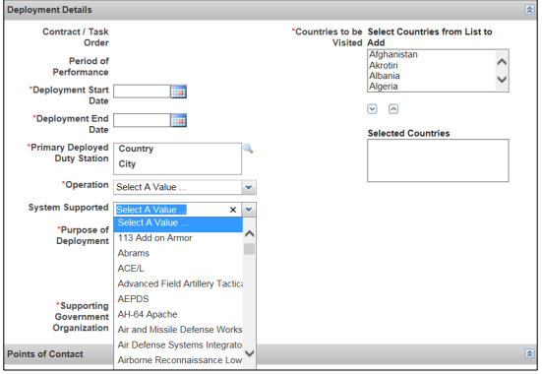
EXAMPLE RESPONSES TO “OPERATION”

Slide 20
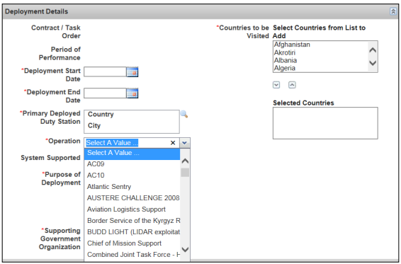
EXAMPLE RESPONSES TO “SYSTEM SUPPORTED”

Slide 21
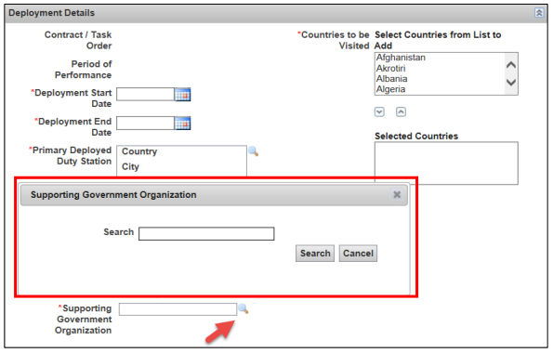
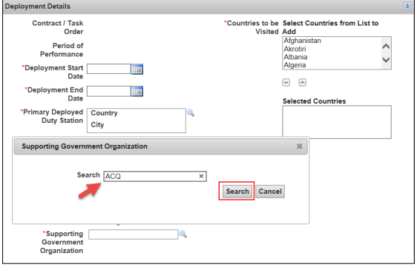
EXAMPLE RESPONSES TO “SUPPORTING GOVERNMENT ORGANIZATION”

Slide 22
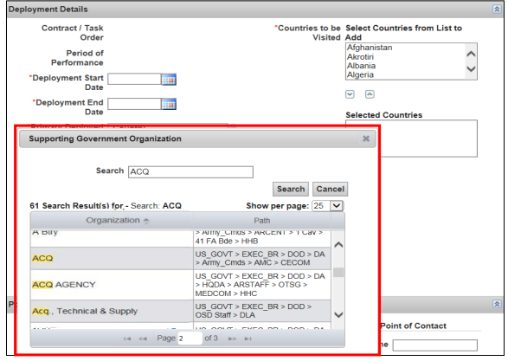
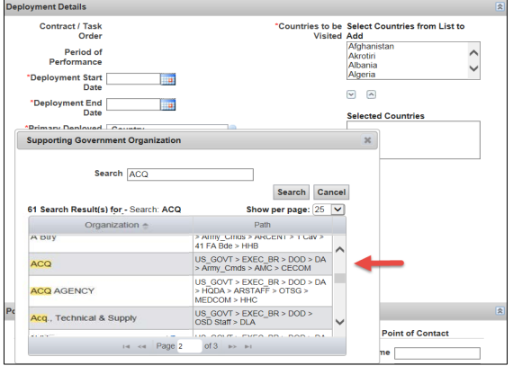
EXAMPLE RESPONSES TO “SUPPORTING GOVERNMENT ORGANIZATIONS

Slide 23
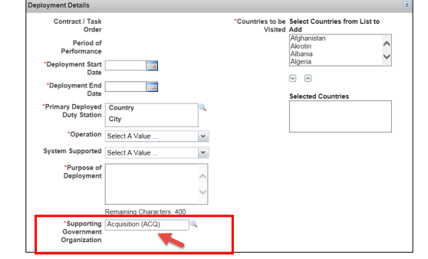
EXAMPLE RESPONSES TO “SUPPORTING GOVERNMENT ORGANIZATIONS”

Slide 24
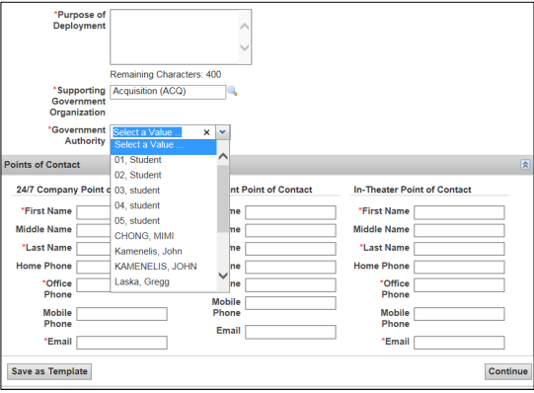
EXAMPLE RESPONSES TO “GOVERNMENT AUTHORITY”

Slide 25
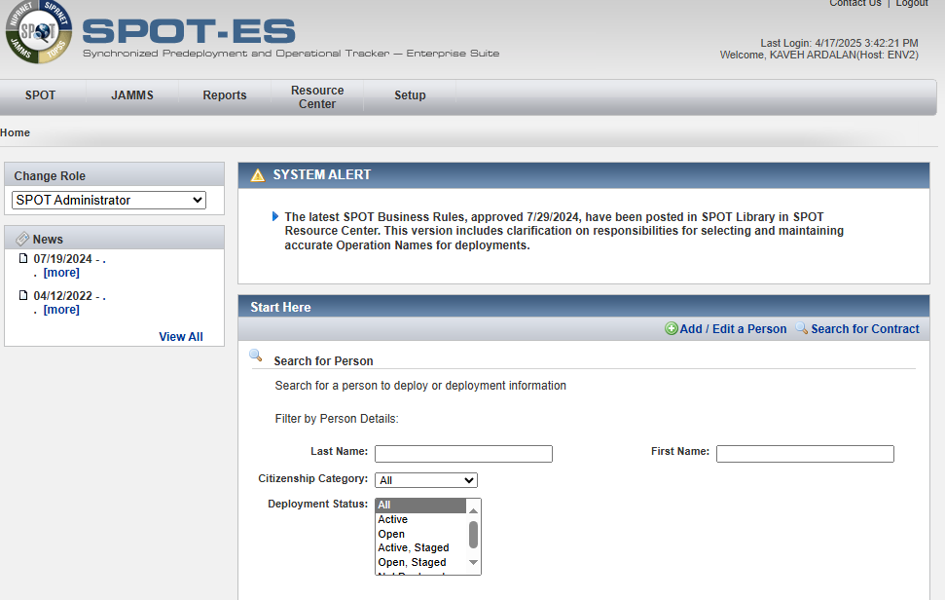
HOME, SEARCH, LOA INBOX SCREEN

Slide 26
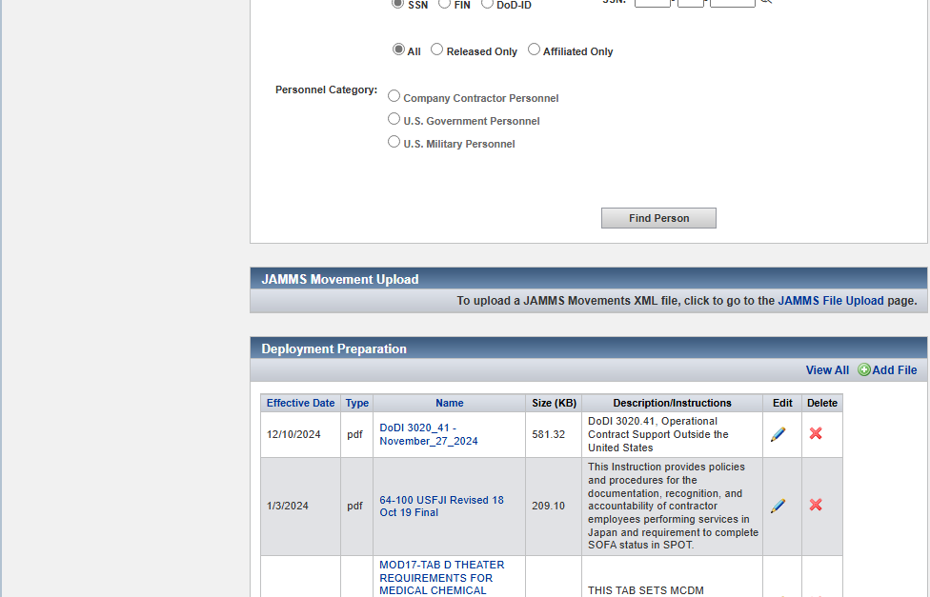

Slide 27
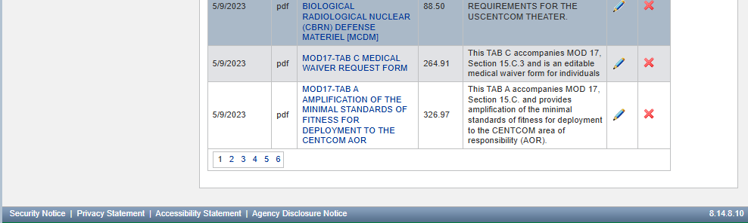

Slide 28
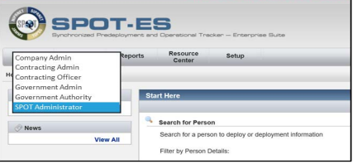
EXAMPLE RESPONSES TO “CHANGE ROLE”

Slide 29
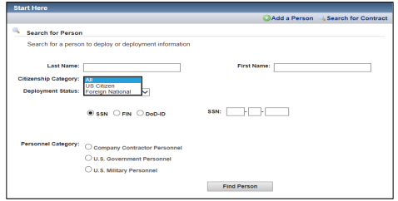
EXAMPLE RESPONSES TO “CITIZENSHIP CATEGORY”

Slide 30
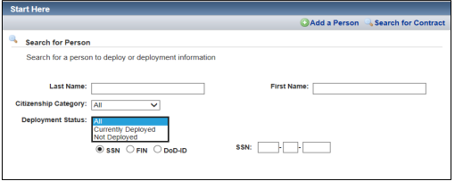
EXAMPLE RESPONSES TO “DEPLOYMENT STATUS”

Slide 31
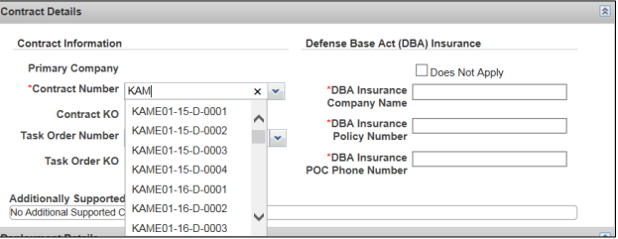
EXAMPLE RESPONSES TO “CONTRACT NUMBER”

Slide 32
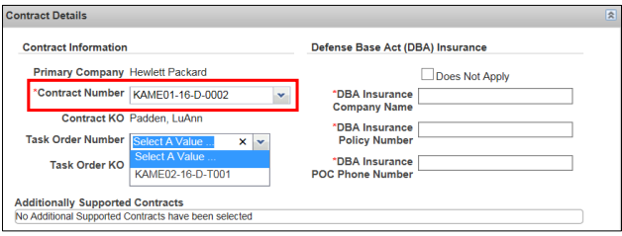
EXAMPLE RESPONSES TO “TASK ORDER NUMBER”

Slide 33
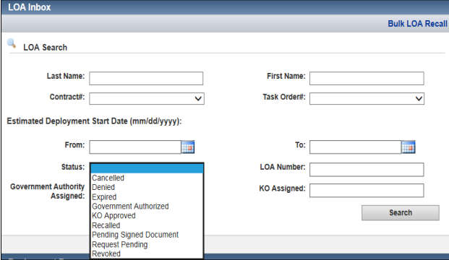
EXAMPLE RESPONSES TO “STATUS (LOA INBOX)”

