Slide 1
AIES Transitional Language & Mockup
Data shown is for demonstration purposes only, all data is fabricated

Slide 2




Help Site FAQs How-To Videos About Contact
Annual Integrated Economic Survey (AIES)
Step 1: Verify Location(s)
Below are the locations for this company that we have on file, as well as some information about those locations. Please review each one, and make changes as needed. Add any new or missing locations at the bottom of this table. Note: Updates to the industry column will be reflected in the next year’s survey.
Main Menu
Step One: Verify Locations
Below are the locations for this company that Census has on file, some information about those locations has been prefilled. Please review each one, and make changes as needed. Add any new or missing locations at the bottom of this table.
Updates to the industry column will be reflected in the next year’s survey.
Overview
Step One: Verify Locations
Name 1 - Enter/Update Name 1 | Store/Plant/ Location Identifier | Name 2 - Enter/ Update Name 2 | EIN | Number and Street - Enter/Update street address | City, town, village, etc. - Enter/Update city | State - Enter/Update state | ZIP Code - Enter/ Update ZIP Code | Industry Description
CENSUS BIRD COMPANY WHOLESALES | WHOLESALE PLANT 1 |  | 123456789 | 1004 BIRD FOOD ROAD | NEW BRIGHTON | PA | 15066 | Other Grocery and Related Products Merchant Wholesalers
CENSUS BIRD COMPANY WHOLESALES | WHOLESALE PLANT 2 |  | 123456789 | 1005 BIRD FOOD ROAD | NEW BRIGHTON | PA | 15066 | Other Grocery and Related Products Merchant Wholesalers
CENSUS BIRD COMPANY | STORE 1006 |  | 123456789 | 1006 BIRD FOOD ROAD | CRANBERRY | PA | 16319 | Pet and Pet Supplies Stores
CENSUS BIRD COMPANY | STORE 1007 |  | 123456789 | 1007 BIRD FOOD ROAD | YOUNGSTOWN | OH | 44501 | Pet and Pet Supplies Stores
CENSUS BIRD COMPANY | STORE 1008 |  | 123456789 | 1008 BIRD FOOD ROAD | BEAVER FALLS | PA | 15010 | Pet and Pet Supplies Stores
CENSUS BIRD COMPANY | STORE 1009 |  | 123456789 | 1009 BIRD FOOD ROAD | FOMBELL | PA | 16123 | Pet and Pet Supplies Stores
CENSUS BIRD COMPANY | STORE 1010 |  | 123456789 | 1010 BIRD FOOD ROAD | ELLWOOD CITY | PA | 16117 | Pet and Pet Supplies Stores
CENSUS BIRD GROOMING | STORE 1011 |  | 123456789 | 1011 FUZZY BIRDIE ROAD | NEW BRIGHTON | PA | 15066 | Pet Care (except Veterinary) Services
CENSUS BIRD SHELTER | STORE 1012 |  | 123456789 | 1012 BIRD ADOPTION LANE | MARS | PA | 16046 | Pet Care (except Veterinary) Services
Step Two: Company Data
Step Three: Detailed Data
Additional Help
Review & Submit
Check box to indicate Step One is complete:
I have verified the location information and added any missing locations.
Continue to Company Data

Slide 3

Help Site FAQs How-To Videos About Contact
Annual Integrated Economic Survey (AIES)
Step 1: Verify Location(s)
Below are the locations for this company that we have on file, as well as some information about those locations. Please review each one, and make changes as needed. Add any new or missing locations at the bottom of this table. Note: Updates to the industry column will be reflected in the next year’s survey.
Main Menu
Step One: Verify Locations
Below are the locations for this company that Census has on file, some information about those locations has been prefilled. Please review each one, and make changes as needed. Add any new or missing locations at the bottom of this table.
Updates to the industry column will be reflected in the next year’s survey.
Overview
Thank you for completing Step One: Verify Locations. You may return to this screen to make updates if needed. Next you will complete Step Two: Company Data.
Step One: Verify Locations Complete
Step One: Verify Locations
Name 1 - Enter/Update Name 1 | Store/Plant/ Location Identifier | Name 2 - Enter/ Update Name 2 | EIN | Number and Street - Enter/Update street address | City, town, village, etc. - Enter/Update city | State - Enter/Update state | ZIP Code - Enter/ Update ZIP Code | Industry Description
CENSUS BIRD COMPANY WHOLESALES | WHOLESALE PLANT 1 |  | 123456789 | 1004 BIRD FOOD ROAD | NEW BRIGHTON | PA | 15066 | Other Grocery and Related Products Merchant Wholesalers
CENSUS BIRD COMPANY WHOLESALES | WHOLESALE PLANT 2 |  | 123456789 | 1005 BIRD FOOD ROAD | NEW BRIGHTON | PA | 15066 | Other Grocery and Related Products Merchant Wholesalers
CENSUS BIRD COMPANY | STORE 1006 |  | 123456789 | 1006 BIRD FOOD ROAD | CRANBERRY | PA | 16319 | Pet and Pet Supplies Stores
CENSUS BIRD COMPANY | STORE 1007 |  | 123456789 | 1007 BIRD FOOD ROAD | YOUNGSTOWN | OH | 44501 | Pet and Pet Supplies Stores
CENSUS BIRD COMPANY | STORE 1008 |  | 123456789 | 1008 BIRD FOOD ROAD | BEAVER FALLS | PA | 15010 | Pet and Pet Supplies Stores
CENSUS BIRD COMPANY | STORE 1009 |  | 123456789 | 1009 BIRD FOOD ROAD | FOMBELL | PA | 16123 | Pet and Pet Supplies Stores
CENSUS BIRD COMPANY | STORE 1010 |  | 123456789 | 1010 BIRD FOOD ROAD | ELLWOOD CITY | PA | 16117 | Pet and Pet Supplies Stores
CENSUS BIRD GROOMING | STORE 1011 |  | 123456789 | 1011 FUZZY BIRDIE ROAD | NEW BRIGHTON | PA | 15066 | Pet Care (except Veterinary) Services
CENSUS BIRD SHELTER | STORE 1012 |  | 123456789 | 1012 BIRD ADOPTION LANE | MARS | PA | 16046 | Pet Care (except Veterinary) Services
Step Two: Company Data
Step Three: Detailed Data
Continue to Company Data
Additional Help
Check box to indicate Step One is completed
Continue to Company Data

Slide 4
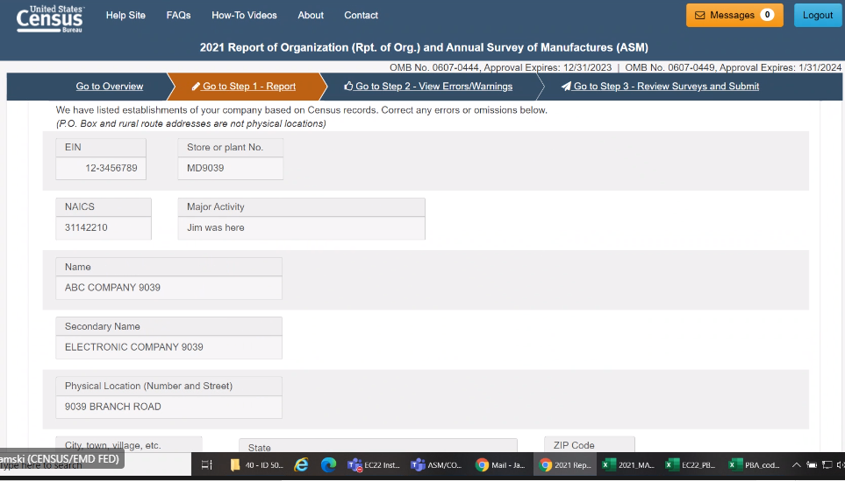

Help Site FAQs How-To Videos About Contact
Annual Integrated Economic Survey (AIES)
Step 1: Verify Location(s)
Below are the locations for this company that we have on file, as well as some information about those locations. Please review each one, and make changes as needed. Add any new or missing locations at the bottom of this table. Note: Updates to the industry column will be reflected in the next year’s survey.
Main Menu
Step Two: Company Data
We have listed your company data based on Census records. Correct any errors or omissions below. Please check the box at the bottom of the screen to indicate Step Two has been completed before completing Step Three: Detailed Data.
Overview
Step One: Verify Locations
Step Two: Company Data
Step Three: Detailed Data
Additional Help
Review & Submit
Check box to indicate Step Two is complete:
I have verified the company information above.
Continue to Detailed Data

Slide 5
Help Site FAQs How-To Videos About Contact
Annual Integrated Economic Survey (AIES)
Step 1: Verify Location(s)
Below are the locations for this company that we have on file, as well as some information about those locations. Please review each one, and make changes as needed. Add any new or missing locations at the bottom of this table. Note: Updates to the industry column will be reflected in the next year’s survey.
Main Menu
Step Two: Company Data
We have listed your company data based on Census records. Correct any errors or omissions below. Please check the box at the bottom of the screen to indicate Step Two has been completed before completing Step Three: Detailed Data.
Overview
Thank you for completing Step Two: Company Data. You may return to this screen to make updates if needed. Lastly, you will complete Step Three: Detailed Data.
Step Two: Company Data Complete
Step One: Verify Locations
Step Two: Company Data
Step Three: Detailed Data
Continue to Detailed Data
Additional Help
Check box to indicate Step Two is complete:
I have verified the company information above.
Continue to Detailed Data

Slide 6
Help Site FAQs How-To Videos About Contact
Annual Integrated Economic Survey (AIES)
Step 1: Verify Location(s)
Below are the locations for this company that we have on file, as well as some information about those locations. Please review each one, and make changes as needed. Add any new or missing locations at the bottom of this table. Note: Updates to the industry column will be reflected in the next year’s survey.
Main Menu
Step Three: Detailed Data
Welcome to your customized reporting spreadsheet. You can find a listing of all your locations and corresponding information on the Survey tab. You will fill in all the information from your company by either industry (in the first block of rows) or establishment (in the second block of rows).
Overview
Step One: Verify Locations
Overview
Survey
Products
Instructions
Tutorial
Name 1 - Enter/Update Name 1 | Store/Plant/ Location Identifier | Name 2 - Enter/ Update Name 2 | EIN | Number and Street - Enter/Update street address | City, town, village, etc. - Enter/Update city | State - Enter/Update state | ZIP Code - Enter/ Update ZIP Code | Industry Description
CENSUS BIRD COMPANY WHOLESALES | WHOLESALE PLANT 1 |  | 123456789 | 1004 BIRD FOOD ROAD | NEW BRIGHTON | PA | 15066 | Other Grocery and Related Products Merchant Wholesalers
CENSUS BIRD COMPANY WHOLESALES | WHOLESALE PLANT 2 |  | 123456789 | 1005 BIRD FOOD ROAD | NEW BRIGHTON | PA | 15066 | Other Grocery and Related Products Merchant Wholesalers
CENSUS BIRD COMPANY | STORE 1006 |  | 123456789 | 1006 BIRD FOOD ROAD | CRANBERRY | PA | 16319 | Pet and Pet Supplies Stores
CENSUS BIRD COMPANY | STORE 1007 |  | 123456789 | 1007 BIRD FOOD ROAD | YOUNGSTOWN | OH | 44501 | Pet and Pet Supplies Stores
CENSUS BIRD COMPANY | STORE 1008 |  | 123456789 | 1008 BIRD FOOD ROAD | BEAVER FALLS | PA | 15010 | Pet and Pet Supplies Stores
CENSUS BIRD COMPANY | STORE 1009 |  | 123456789 | 1009 BIRD FOOD ROAD | FOMBELL | PA | 16123 | Pet and Pet Supplies Stores
CENSUS BIRD COMPANY | STORE 1010 |  | 123456789 | 1010 BIRD FOOD ROAD | ELLWOOD CITY | PA | 16117 | Pet and Pet Supplies Stores
CENSUS BIRD GROOMING | STORE 1011 |  | 123456789 | 1011 FUZZY BIRDIE ROAD | NEW BRIGHTON | PA | 15066 | Pet Care (except Veterinary) Services
CENSUS BIRD SHELTER | STORE 1012 |  | 123456789 | 1012 BIRD ADOPTION LANE | MARS | PA | 16046 | Pet Care (except Veterinary) Services
Step Two: Company Data
Step Three: Detailed Data
Additional Help
Review & Submit
Check box to indicate Step Three is complete:
I have verified the survey information.
Continue to Review & Submit

