Slide 1
Focus groups basic rules
I will be asking questions and there are no right or wrong answers.
Be respectful of other's people comments.
Only one person speaks at a time, and we’d like everyone to get a turn.
Time is limited.
Please keep your camera on.
Please keep what everyone says here private.
Don’t identify your residents by name.

Slide 2
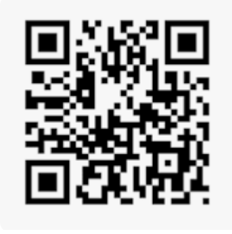
Example QR code - Wikipedia

Slide 3
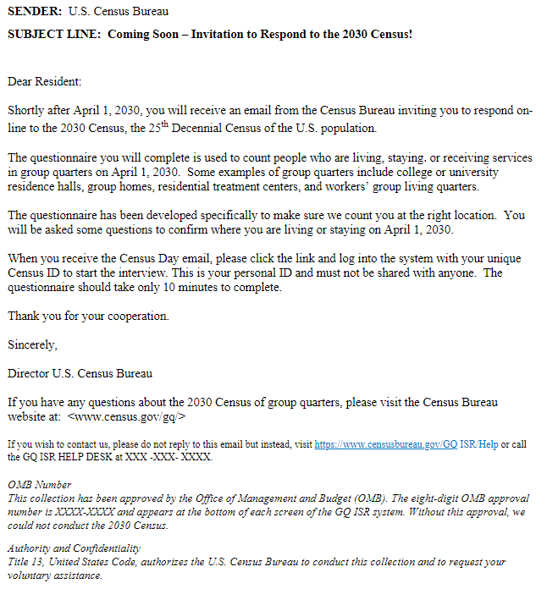
Example email

