Slide 1
Electronic Group Quarters Advance Contact Instrument Wireframe

Slide 2
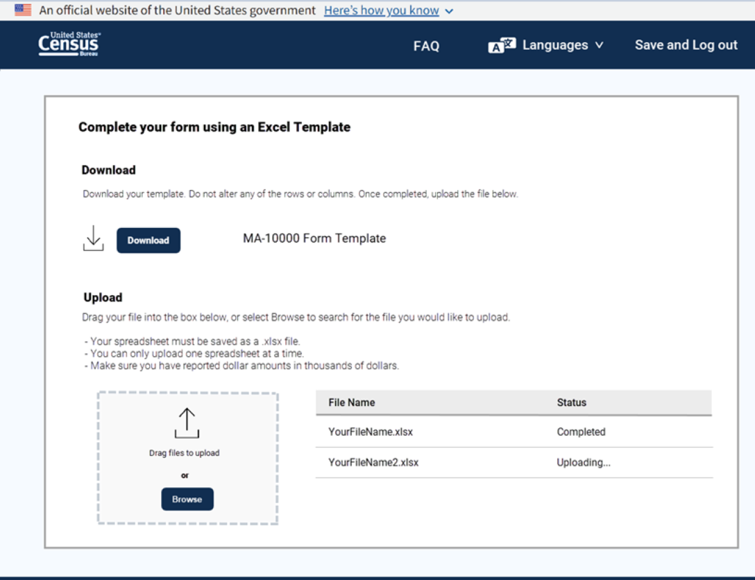
WELCOME
Please read GQ ADMIN Resources for full instructions on using this system
CONTACT US
GQ ADMIN Resources
LOGOUT
GQ ADMINISTRATOR WELCOME PAGE
You have logged on to the:
Group Quarters Advance Contact (GQAC) Internet Questionnaire
for Reporting Group Quarters Information
During the GQAC interview, you will be asked to:
Review a list of the Group Quarters (GQs) you are responsible for, and report issues, if necessary.
Verify/Provide a MAXIMUM POPULATION COUNT and provide an EXPECTED POPULATION COUNT for each GQ.
Answer a series of questions about each GQ, select an enumeration method and schedule a date and time for the enumeration, if applicable.
Today
IS:
FINISH
by:
Click Here to CONTINUE
XXXX
XXXX

Slide 3
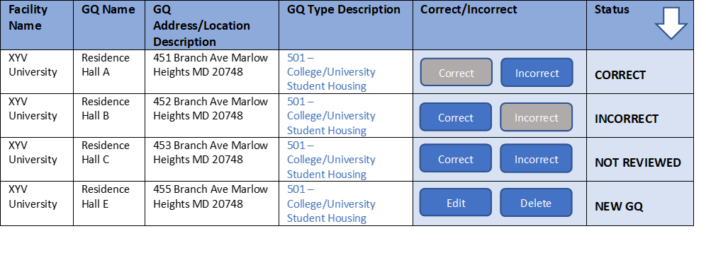
REVIEW GQS
Today
IS:
FINISH
by:
CONTACT US
GQ ADMIN Resources
LOGOUT
XXXX
XXXX
Review your Group Quarters
Below is a sortable list of your GQs to review. If the information is correct, select CORRECT. If the information is incorrect, select INCORRECT.
Showing 1 to 4 of 10 entries
Previous 1 2 Next
CLICK HERE TO WATCH A VIDEO ON HOW TO REVIEW YOUR GQS
Click to DOWNLOAD GQs for your review off-line
Click HERE to ADD New GQs
Confirm and Submit

Slide 4
GQ INCORRECT REASONS
CONTACT US
GQ ADMIN Resources
LOGOUT
XYZ UNIVERSITY, RESIDENCE HALL B, 123 Silver Hill RD,
Suitland MD 20746
INCORRECT
What is the reason(s) that the information for this GQ is incorrect? (Select all that apply)
NOTE: The Census Bureau will evaluate all corrections to determine if the changes will be applied. You will not see these corrections in your list of GQs.
Facility Name is incorrect
GQ Name is incorrect
GQ Address is incorrect
GQ Type Description is imcorrect
It is no longer a GQ
It has moved to another location (new address)
GQ Name and Address is a Duplicate of another GQ
Cancel
Save and Continue

Slide 5
GQ ADDRESS INCORRECT
CONTACT US
GQ ADMIN Resources
LOGOUT
XYZ UNIVERSITY, RESIDENCE HALL B, 123 Silver Hill RD,
Suitland MD 20746
INCORRECT
You Selected: GQ Address is Incorrect
GQ NAME:
Street Number:
Street Name:
City:
State:
Zip Code:
Residence Hall B
123
Silver Hill Rd
Suitland
MD
20746
Save and Continue

Slide 6
REVIEW GQS
Today
IS:
FINISH
by:
CONTACT US
GQ ADMIN Resources
LOGOUT
XXXX
XXXX
Review your Group Quarters
Below is a sortable list of your GQs to review. If the information is correct, select CORRECT. If the information is incorrect, select INCORRECT.
Showing 1 to 4 of 10 entries
Previous 1 2 Next
CLICK HERE TO WATCH A VIDEO ON HOW TO REVIEW YOUR GQS
Click to DOWNLOAD GQs for your review off-line
Click HERE to ADD New GQs
Confirm and Submit

Slide 7
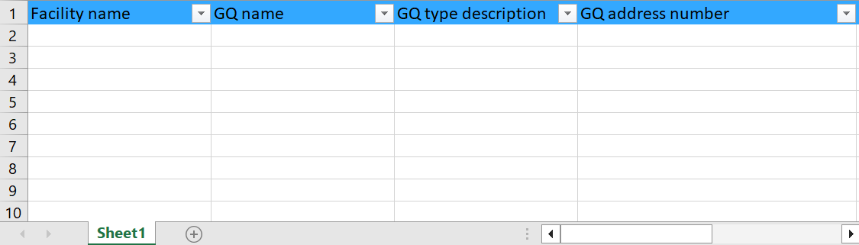
Add GQS
CONTACT US
GQ ADMIN Resources
LOGOUT
Add Group Quarters not on your list in the table below.
Go Back
Save and Continue
Go Back
Save and Continue

Slide 8
Transition Page
CONTACT US
GQ ADMIN Resources
LOGOUT
Thank you for reviewing your GQs. Next, we will ask for additional information about each of your GQs.
Continue

Slide 9
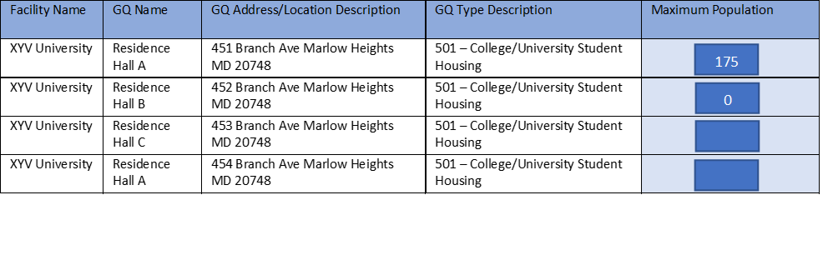
Max Pop
CONTACT US
GQ ADMIN Resources
LOGOUT
1. Please verify or enter the MAXIMUM NUMBER OF PEOPLE who can live or stay at each GQ. If you do not know the exact number, please provide an estimate. If no one can live or stay there, enter ‘0’ (zero). Do not leave blank.
Showing 1 to 4 of 10 entries
Previous 1 2 Next
Save and Continue

Slide 10
Max Pop Zero
'Max Pop Zero' screen will pop up when the Max Pop is selected as ZERO.
For every address where the Max Pop is Zero the window will be displayed.
Save and Continue will trigger every address with MAX POP = ZERO FIRST
CONTACT US
GQ ADMIN Resources
LOGOUT
For XYZ University, RESIDENCE HALL A, 451 Branch AVE
Marlow Heights MD 20748:
1a. Why can no one live or stay at this GQ? Please select a reason below.
1b. What was the last date that someone lived or stayed at this GQ?
Closed/Not Operating
Don't Know
Demolished/Burned Out
Month
Year
January
February
2023
2024
Uninhabitable (Open to elements/condemned/Under Construction)
Enter additional information below:
Non Residential
Type Text Here
Other - Please explain in NOTES
Go Back
Save and Continue

Slide 11
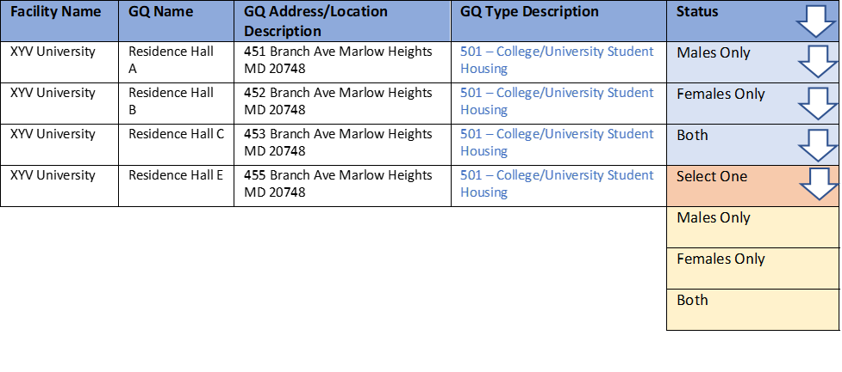
GQ Serves Males/Females
Today
IS:
FINISH
by:
CONTACT US
GQ ADMIN Resources
LOGOUT
3. Does this GQ serve males only, females only, or both males and females? Please make your selection from the dropdown menu.
XXXX
XXXX
Showing 1 to 4 of 10 entries
Previous 1 2 Next
Save and Continue

Slide 12
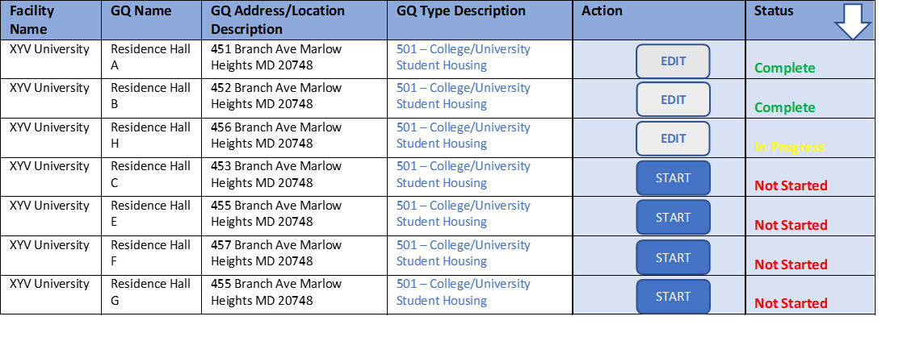
Select GQ from list to select its enumeration method
Today
IS:
FINISH
by:
CONTACT US
GQ ADMIN Resources
LOGOUT
XXXX
XXXX
Click START for each GQ to select a method that will be used to count your residents:
Showing 1 to 7 of 10 entries
Previous 1 2 Next
Save and Logout
Confirm and Submit

Slide 13

Select Enum method for selected GQ
CONTACT US
GQ ADMIN Resources
LOGOUT
This full list of options will be modified for specific GQ types (not all GQ types are eligible for all enumeration options).
Today
IS:
FINISH
by:
For XYZ University, RESIDENCE HALL A, 451 Branch Ave
Marlow Heights MD 20748
XXXX
XXXX
1. Please select one of the enumeration methods available to your GQ.
CLICK HERE TO WATCH THE VIDEOS ABOUT THE ENUMERATION METHODS AVAILABLE TO YOUR GQ
GQ Internet Self-Response (GQ ISR)
Electronic Response Data Transfer (eResponse)
In-Person Interview
Drop Off/Pick up of Questionnaires
Paper Response Data Collection (Paper Listings)
Facility Self-Enumeration
Save and Continue

Slide 14
Apply enumeration method to more than one GQ?
CONTACT US
GQ ADMIN Resources
LOGOUT
Today
IS:
FINISH
by:
You selected
Electronic Response Data Transfer (eReponse) for
XYZ University, RESIDENCE HALL A, 451 Branch Ave
Marlow Heights MD 20748
XXXX
XXXX
Do you want to apply this enumeration method to MORE THAN ONE of your GQs?
YES
NO
If you are sure, please click SAVE AND CONTINUE.
Go Back
Save and Continue

Slide 15
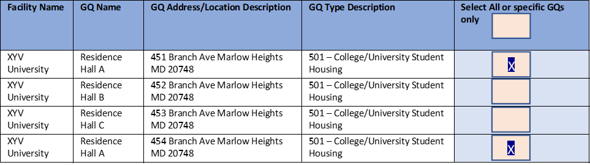
Apply enumeration method to more than one GQ? Yes
CONTACT US
GQ ADMIN Resources
LOGOUT
Today
IS:
FINISH
by:
You selected Electronic Response Data Transfer (eReponse) for
XYZ University, RESIDENCE HALL A, 451 Branch Ave Marlow Heights MD 20748
XXXX
XXXX
Showing 1 to 4 of 10 entries
If you are sure, please click SAVE AND CONTINUE.
Previous 1 2 Next
Go Back
Save and Continue

Slide 16
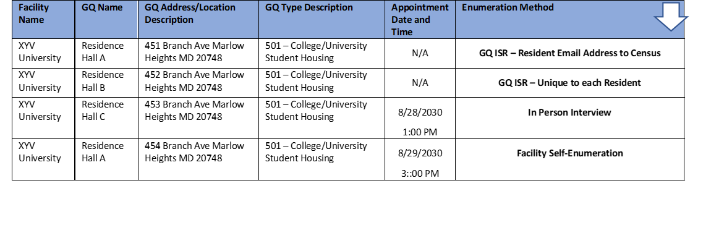
Confirmation of completed list of GQs
CONTACT US
GQ ADMIN Resources
LOGOUT
Today
IS:
FINISH
by:
Thank you.
You have completed the GQAC Internet questionnaire. Below is a list of your GQs and the selected enumeration method(s).
XXXX
XXXX
Showing 1 to 4 of 10 entries
Previous 1 2 Next
Download GQs for your records
Confirm and Submit

Slide 17
LOGOUT
CONTACT US
GQ ADMIN Resources
LOGOUT
Thank you for your time and cooperation! You will receive a confirmation email shortly.
Please Logout.
Logout

Slide 18
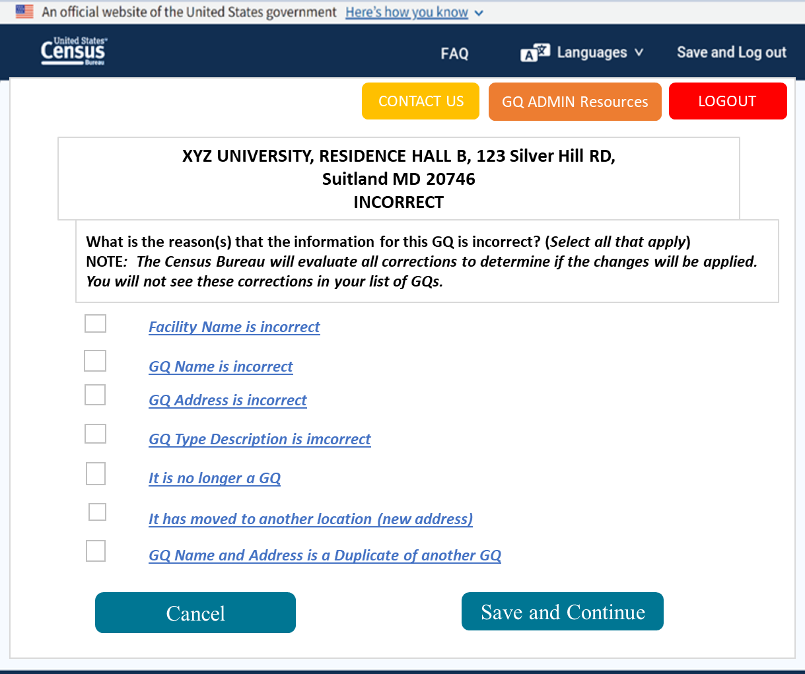
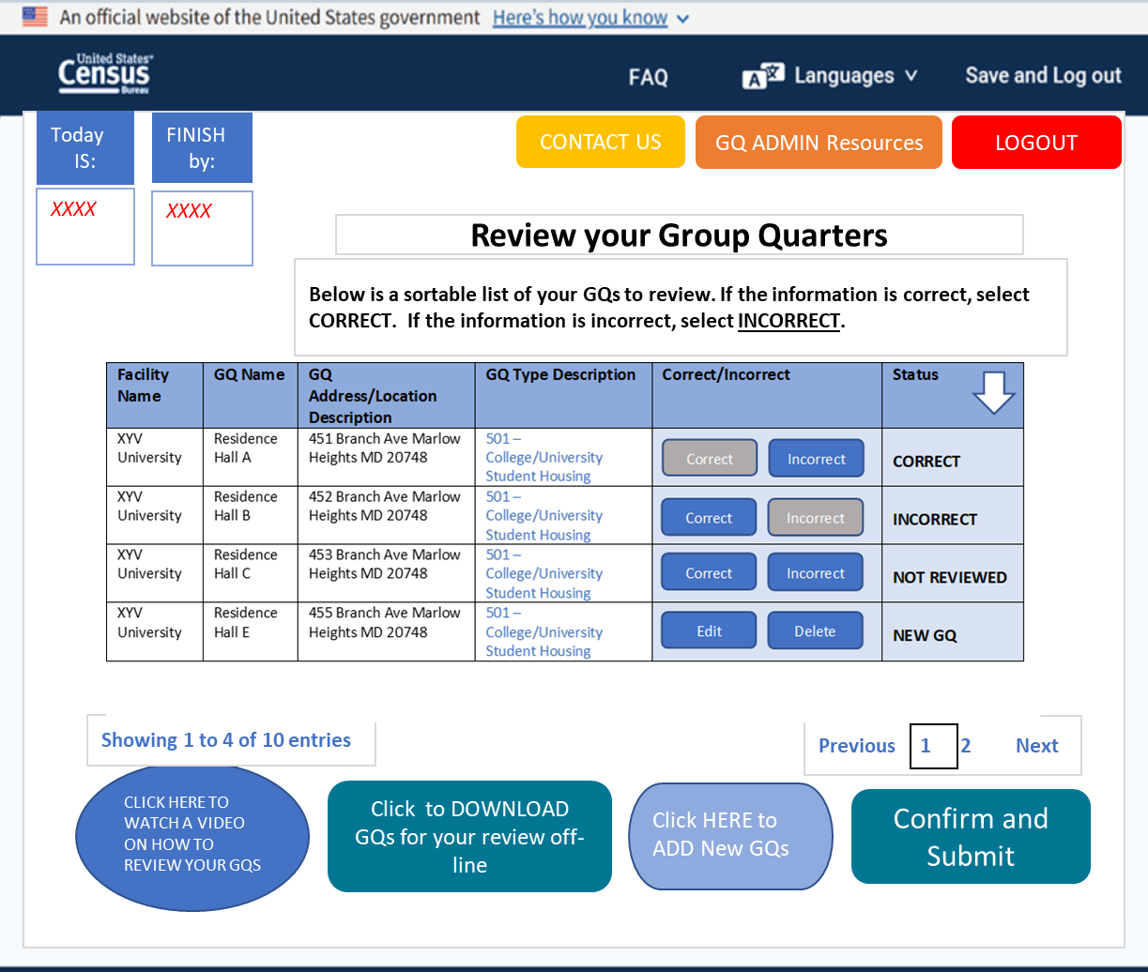
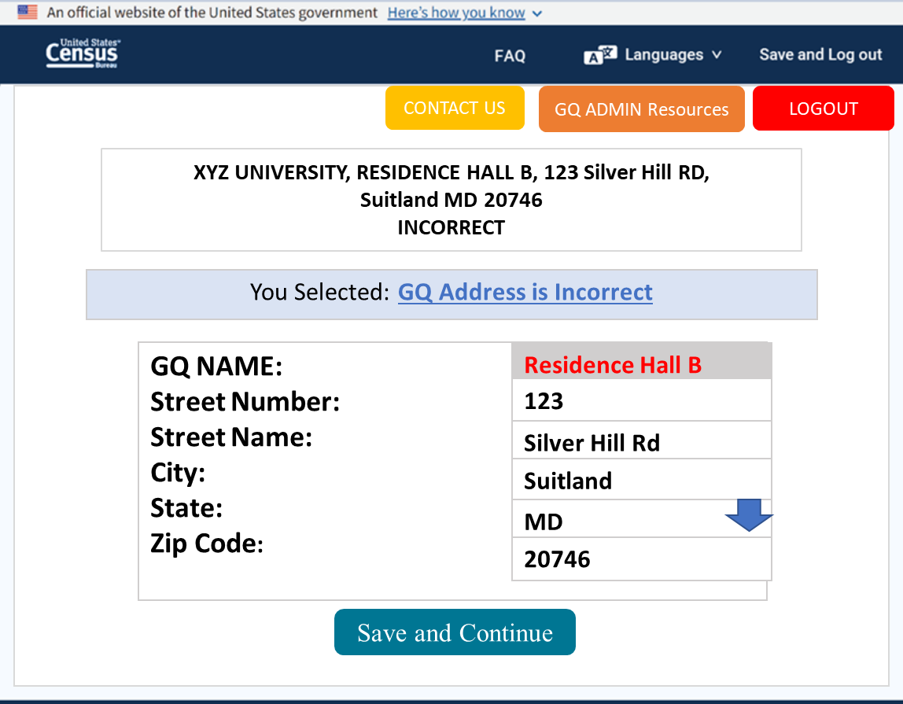
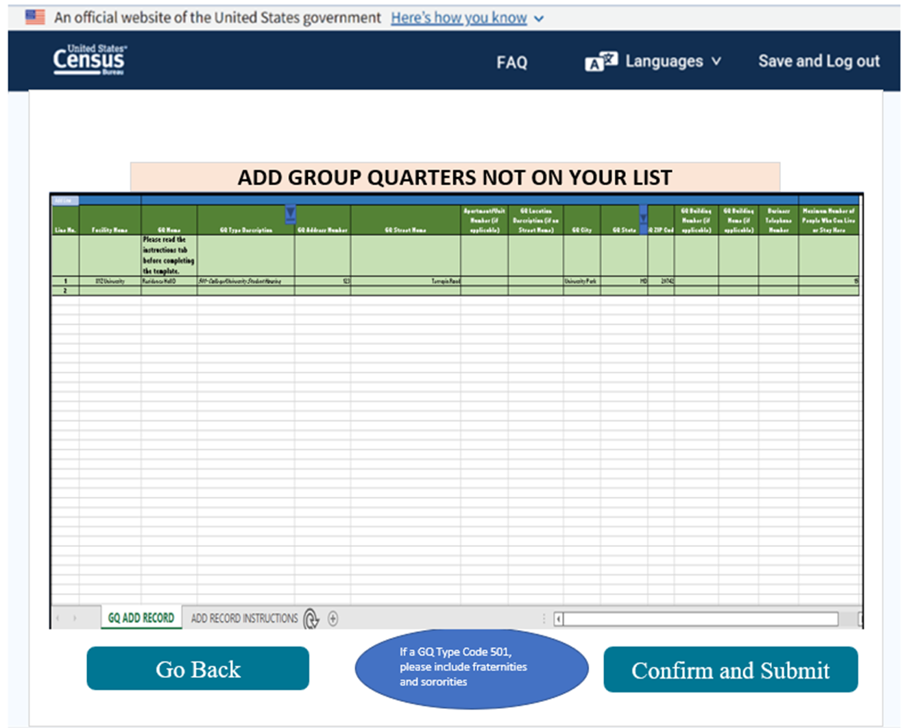
Steps FOR GQ review, correction, and adding missing GQs

Slide 19
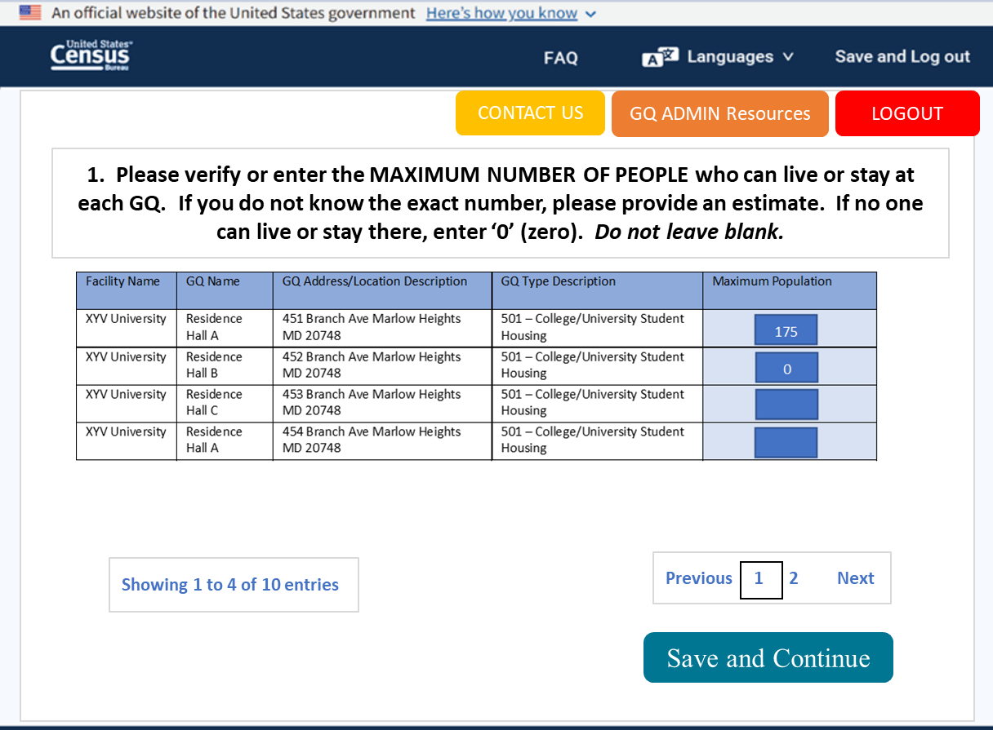
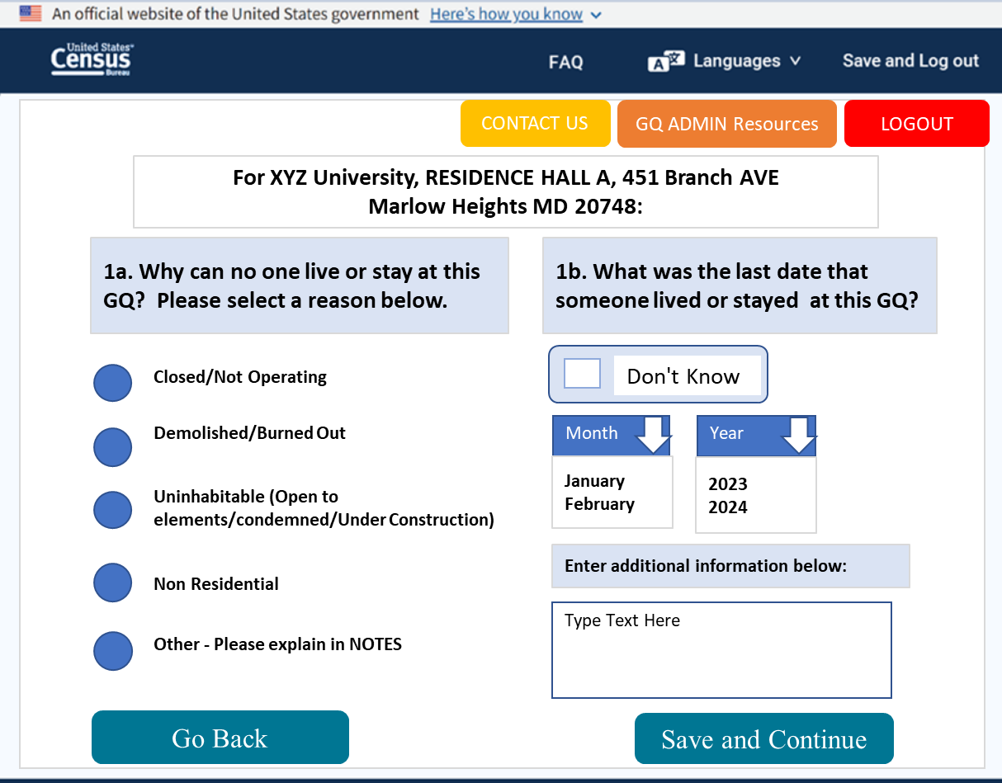
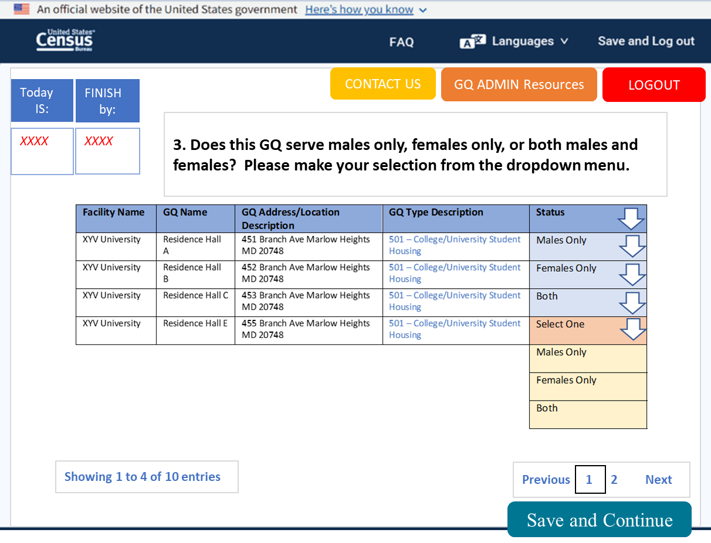
Providing information for every GQ

Slide 20
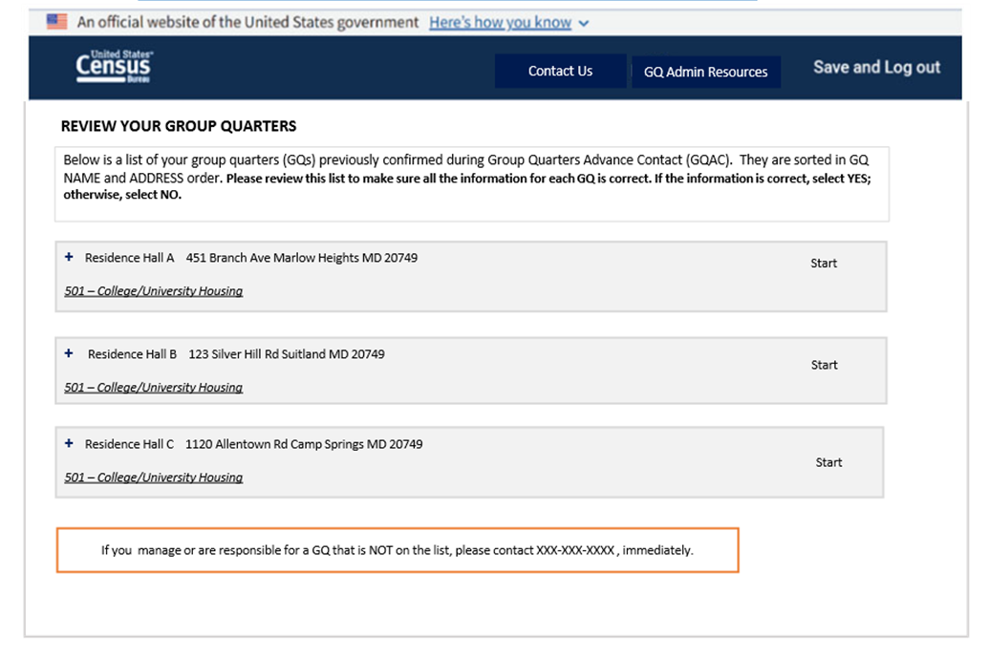
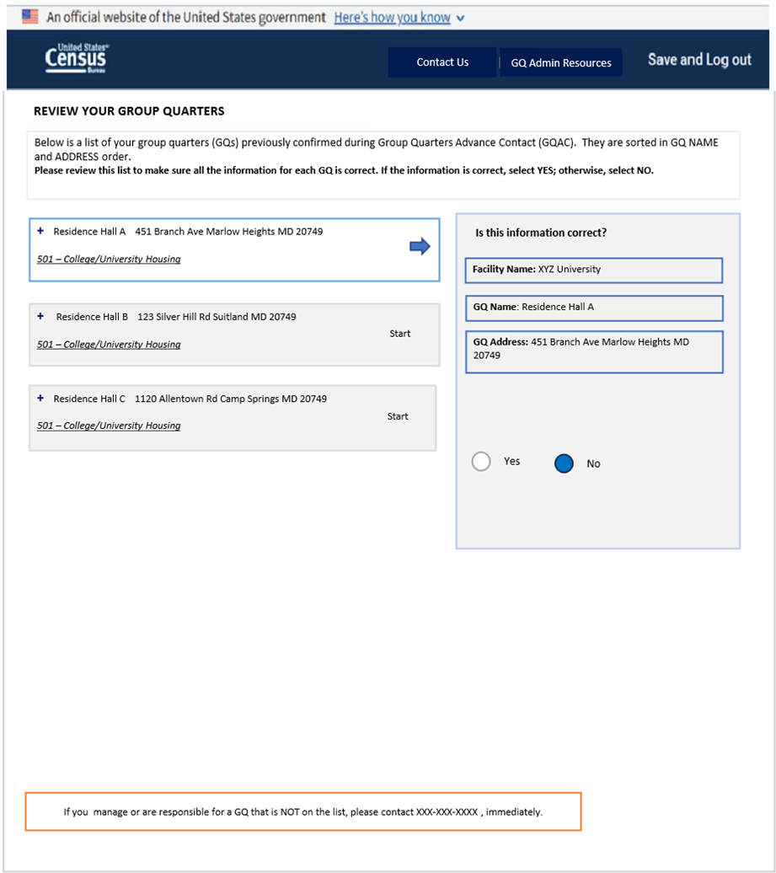
GQ Review V2

Slide 21
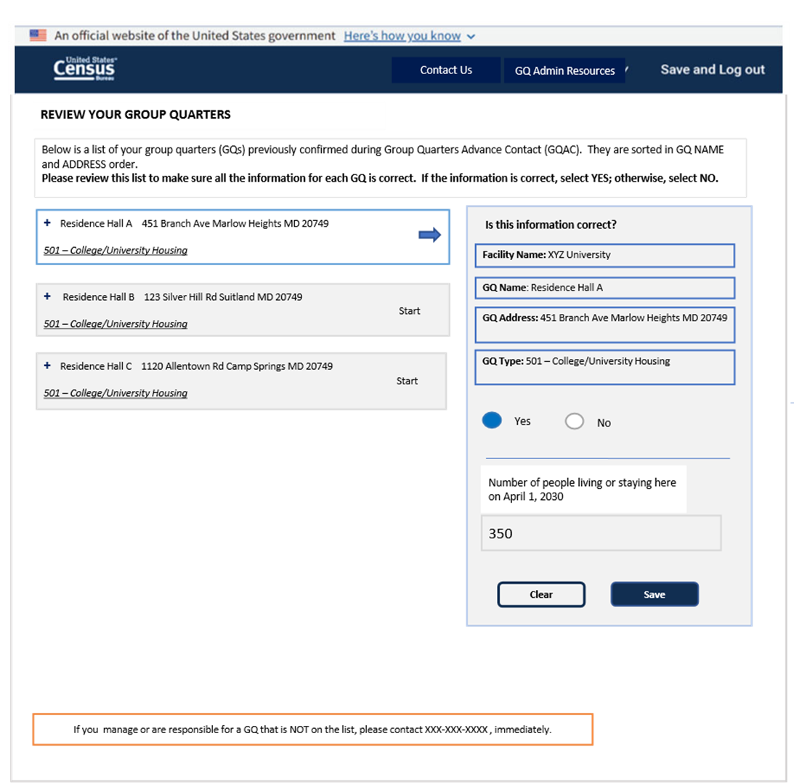
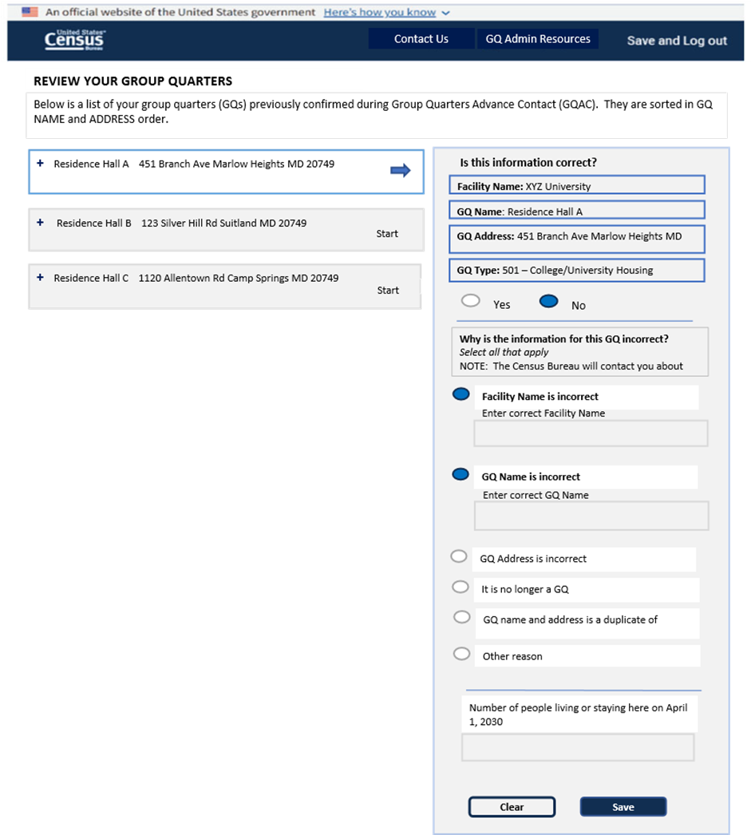

Slide 22
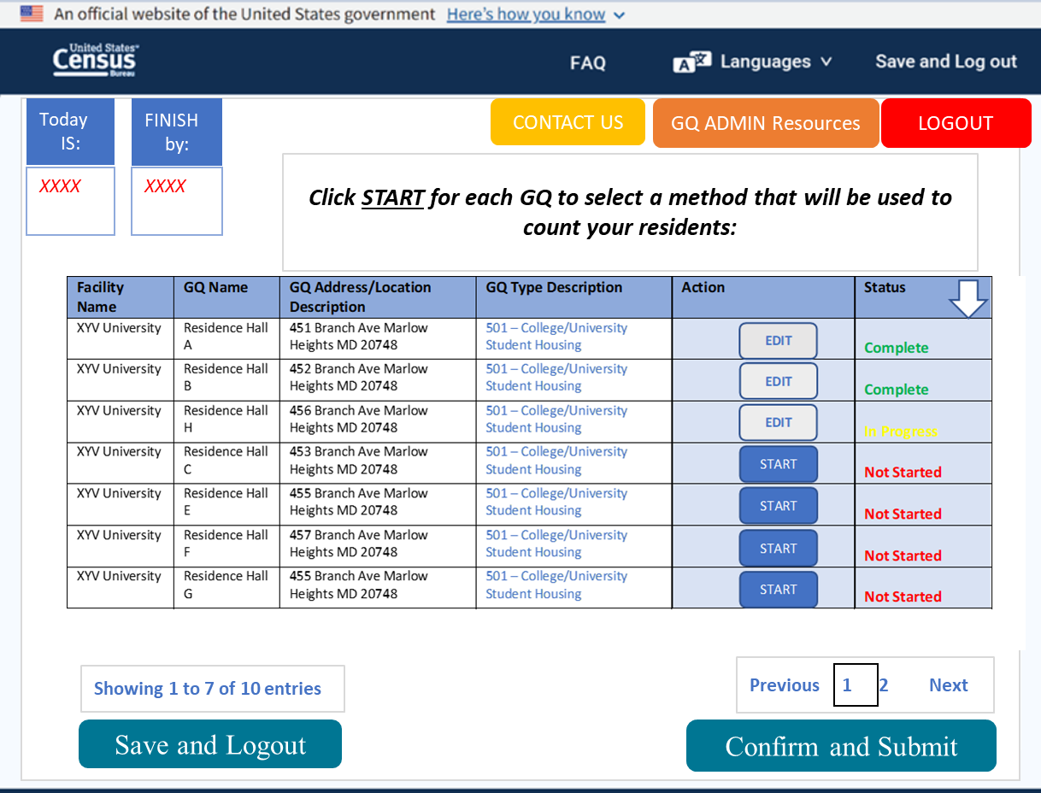
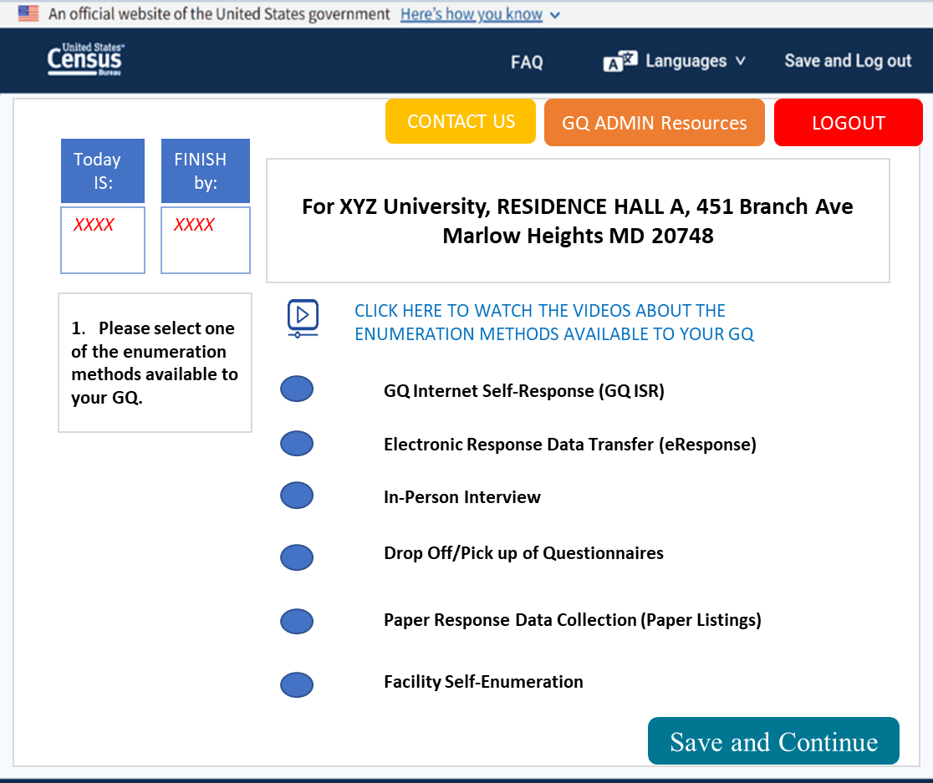
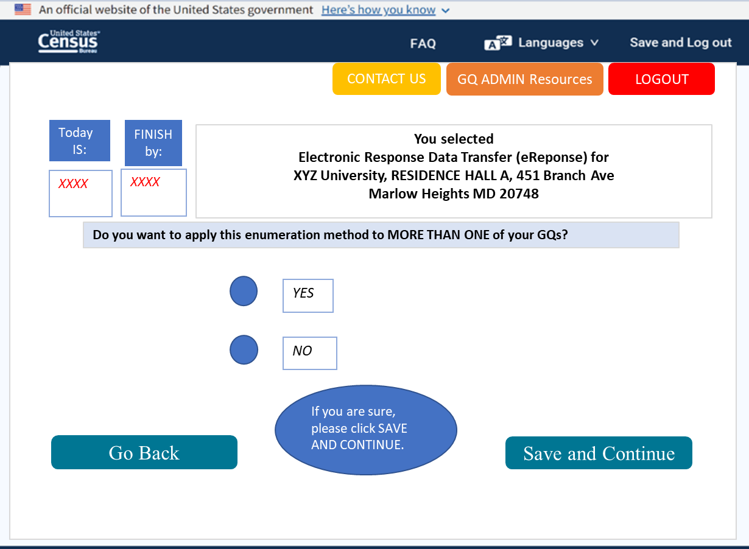
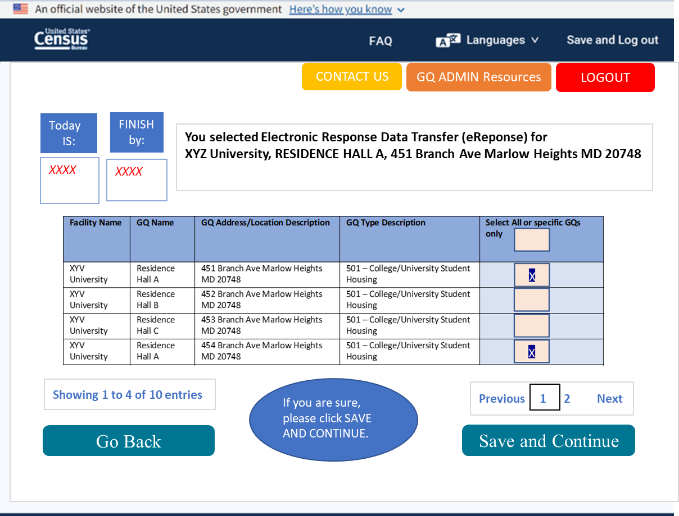
Select enumeration methods

Slide 23
Group Quarters Residents Internet Self-response Administrator Dashboard Wireframe

Slide 24
Option 1 - Census Bureau sends email invitations to GQ residents | The GQ administrator… | The Census Bureau…
 | Enters names and email addresses for residents in the system. | Sends an email to each resident with a link to the online census questionnaire.
Option 2 - GQ Administrator sends Unique ID to each resident by email | The Census Bureau… | The GQ administrator…
 | Provides a list of unique Census IDs (one for each resident) and an example email. Each Census ID is a twelve-digit code that a respondent will enter into the online census questionnaire to complete the census. | Assigns each resident a Census ID and then emails each resident 1) their Census ID, 2) a link to the census questionnaire using the example email template.
Option 3 - GQ Administrator sends GQ-specific questionnaire link to residents by email | The Census Bureau… | The GQ administrator…
 | Provides one unique link to the census questionnaire for each GQ. Residents of each GQ will use the same link. | Emails the GQ-specific links to residents of each GQ.
Option 4 - GQ Administrator sends generic link and GQ-specific Census IDs to residents by email | The Census Bureau… | The GQ administrator…
 | Sends a generic link to the census questionnaire and a unique Census ID for each GQ. Residents of each GQ will use the same Census ID. | Emails the questionnaire link and the GQ-specific Census IDs to residents of each GQ.
Option 5 – Census Bureau drops off paper letters to be distributed to residents | The Census Bureau… | The GQ administrator…
 | Drops off a set of paper invitation letters and paper census forms at a time selected by the administrator. Each letter is pre-printed with the name and address of a specific GQ and a unique ID for each resident. | Distributes the letters and census forms to residents of each GQ.

Slide 25
Option 1 Start Page
Contact Us
GQ Admin Resources
GQ-ISR – GQ Administrator Sends Email Addresses to the Census Bureau
Please select the method that you would like to use to provide the names and email addresses of the people who lived or stayed in each of your GQs on April 1, 2030.
Once you select a reporting method, it cannot be changed.
DOWNLOAD/
UPLOAD A SPREADSHEET
Download an Excel file template, enter the information for each group quarters, and upload the file with the information in it.
COMPLETE ONLINE SPREADSHEET
Enter the information for each group quarters into an online spreadsheet format.
OR
Save and Continue

Slide 26

Option 1 – Select GQ to enter resident roster using online spreadsheet
Contact Us
GQ Admin Resources
Select a GQ to enter resident roster using an online spreadsheet.
CLICK HERE TO WATCH A VIDEO ABOUT HOW TO ENTER RESIDENT INFORMATION IN THE SPREADSHEET
Select a GQ to start entering Resident Names and Email Addresses.
Status
Complete
In progress
Not Started
Today is:
Finish by:
April 1, 2030
April 8, 2030
Save and Continue
Save and Continue

Slide 27
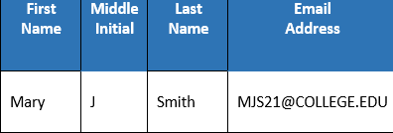
Option 1 – Enter resident roster for selected GQ in online spreadsheet
Contact Us
GQ Admin Resources
Enter resident roster information for the selected GQ in the online spreadsheet below.
<- go back
You selected
RESIDENCE HALL A, 451 Branch AVE Marlow Heights MD 20748
Enter the First Name, Middle Name (optional), Last Name (s), and Email Address (required) for each resident of this GQ. Make sure the number of people you enter is the same as the number of people you previously told us were living or staying there on April 1, 2030.
MIDDLE NAME
LAST NAME (S)
Example:
MIDDLE NAME
LAST NAME (S)
Download file for your records
Submit

Slide 28
Return to Option 1 Start Page, download spreadsheet
Contact Us
GQ Admin Resources
GQ-ISR – GQ Administrator Sends Email Addresses to the Census Bureau
Please select the method that you would like to use to provide the names and email addresses of the people who lived or stayed in each of your GQs on April 1, 2030.
Once you select a reporting method, it cannot be changed.
DOWNLOAD/
UPLOAD A SPREADSHEET
Download an Excel file template, enter the information for each group quarters, and upload the file with the information in it.
COMPLETE ONLINE SPREADSHEET
Enter the information for each group quarters into an online spreadsheet format.
OR
Save and Continue

Slide 29
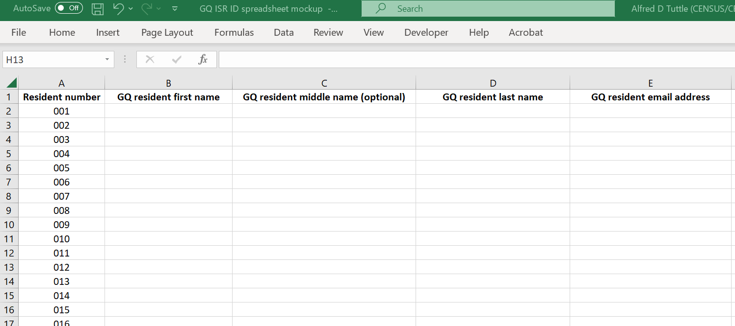
Option 1 – Submit resident roster via Excel template

Slide 30

Options 2 – Start page
Contact Us
GQ Admin Resources
Download/View List of Resident Census IDs for each GQ.
CLICK HERE TO WATCH A VIDEO ABOUT HOW TO DOWNLOAD AND SEND CENSUS IDs TO YOUR RESIDENTS
Click Here to Download a Microsoft Excel File of Resident Census IDS for each GQ
Today is:
Finish by:
Continue
April 1, 2030
April 8, 2030

Slide 31
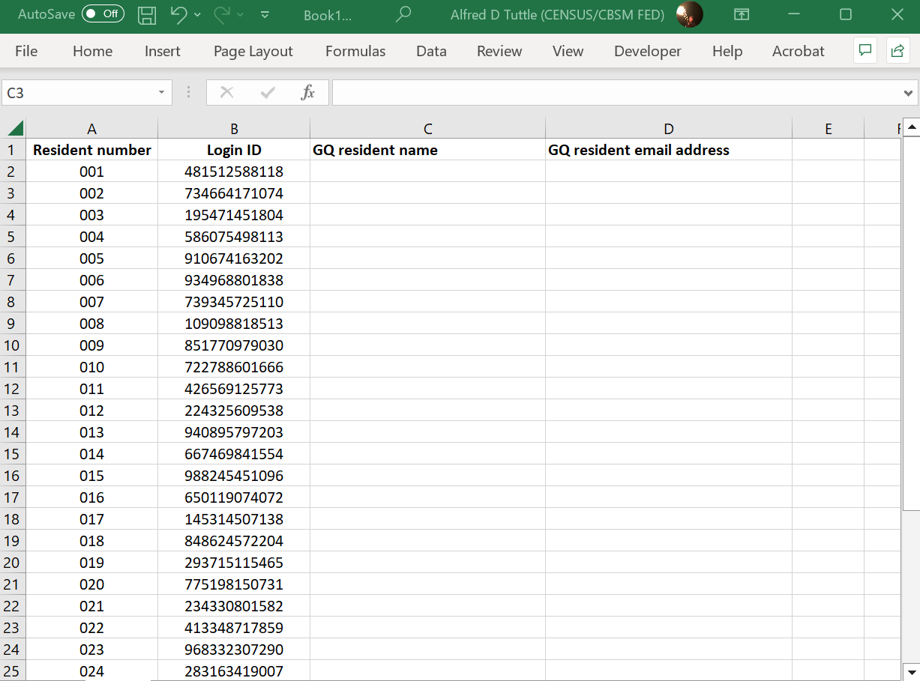
Option 2 – Downloaded IDs

Slide 32
OPTION 2 – Full instructions
Contact Us
GQ Admin Resources
Please read GQ ADMIN Resources for full instructions.
1. You have downloaded a list of unique RESIDENT CENSUS IDs for each of your GQs. The number of RESIDENT CENSUS IDs must equal the number of people who lived or stayed in that GQ on April 1, 2030. Please check your DOWNLOADS folder for this file and copy to a folder on your computer that you will recognize.
2. Download the sample GQ RESIDENT INSTRUCTION LETTER and REMINDER LETTER. Save these documents to a folder on your computer that you will recognize.
3. Assign a resident to each unique RESIDENT CENSUS ID.
A. Open the Microsoft Excel file of RESIDENT CENSUS IDs.
B. If you have a file containing the names and email addresses of residents by GQ, open that file.
C. For each resident of a GQ, paste their name and email address next to one of the unique Resident Census IDs for that GQ. Repeat this step for each GQ.
D. After you have assigned a resident to each Census ID in the Excel file, save the file with a name you will remember.
4. For each GQ, prepare a separate copy of the letter.
A. Open the sample GQ RESIDENT INSTRUCTION LETTER.
B. In the signature section, enter your name, the GQ name, and if applicable, the facility name.
C. Save this copy of the letter for the GQ you entered in the signature section.
5. For each resident of a GQ, prepare and send a separate email:
A. Copy and paste the contents of the letter for that GQ into the body of an email.
B. Enter the resident's email address into the "To" field, and then paste their unique RESIDENT CENSUS ID (which you assigned to them during step 3) into the indicated space within the body of the email.
C. Send the email.
6. Repeat step 5 for every resident of each GQ.
Click Here to Download the RESIDENT LETTER
Respond.census.gov/2030
Click Here to Download the REMINDER EMAIL
WATCH A VIDEO ABOUT HOW TO DOWNLOAD AND SEND CENSUS IDS TO YOUR RESIDENTS
Continue

Slide 33
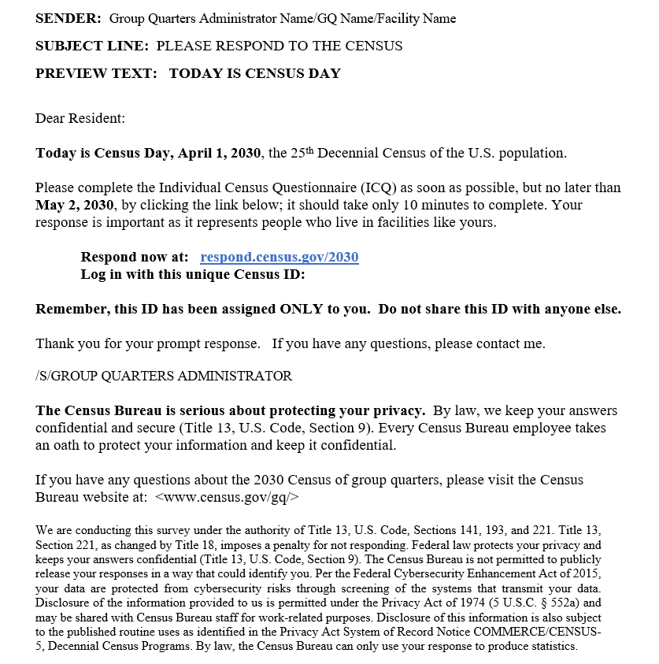
OPTION 2 – Email template example

Slide 34
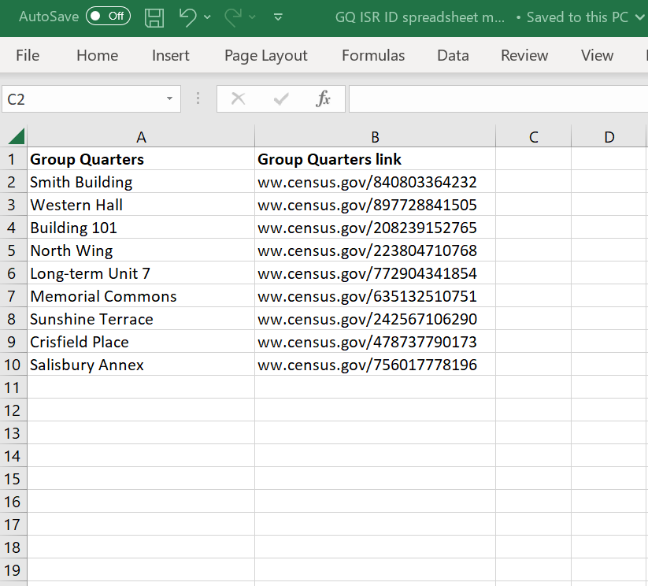
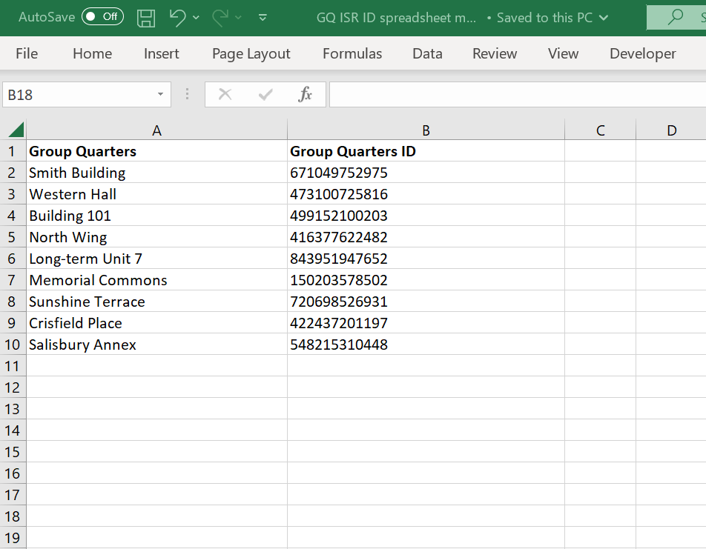
Option 3 - GQ Administrator sends GQ-specific questionnaire link to residents by email
Option 4 - GQ Administrator sends generic link and GQ-specific Census IDs to residents by email

Slide 35
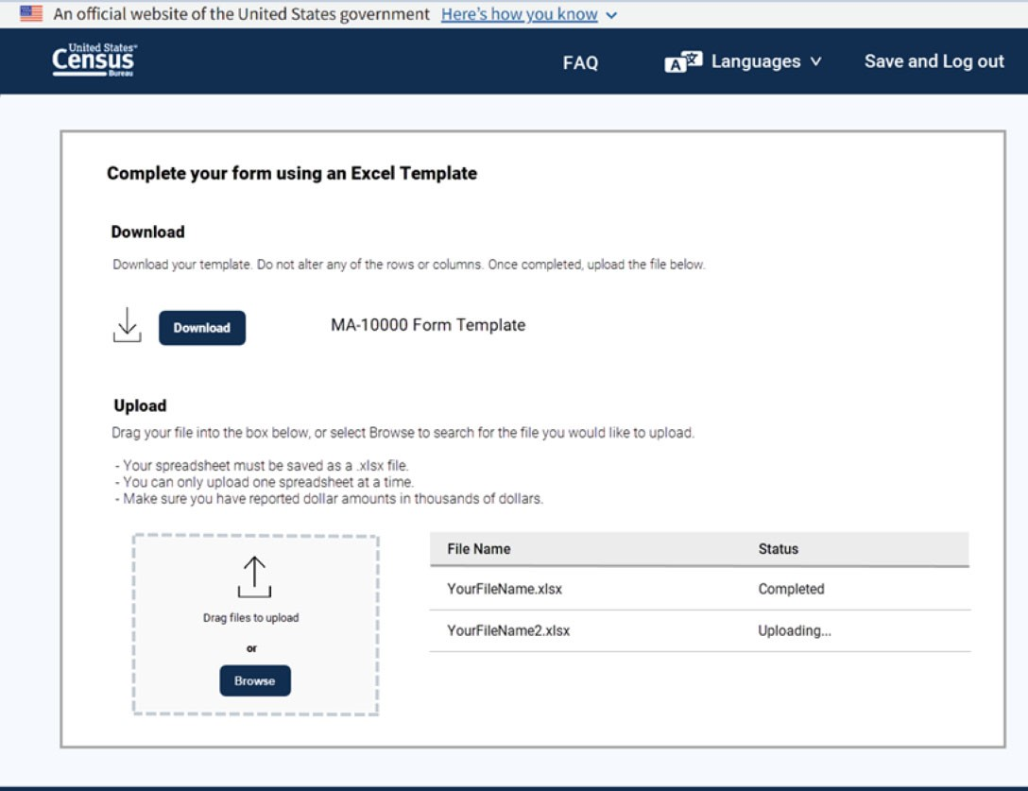
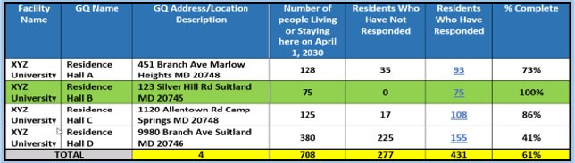
Monitor responses for each GQ
Contact
Us
GQ
Admin
Resources
Screen 27
‐
Option
1
GQ
ADMINISTRATOR
REPORT
DASHBOA
RD
Report Dashboard – The table below shows response rates for each of your GQs. Click the links in the “Residents Who Have Responded” column to see the names of those who have responded in each GQ. Please send reminders to residents who have not yet completed their census form using the reminder email template.
Report
Dashboard
Today
Finish
by:
i
s:
Click here to download the GQ resident reminder email
May
2
April
,
1
,
203
2030
0

Slide 36
Enumeration Method Descriptions
For reference during interview if needed.

Slide 37
eResponse
GQ Administrator/facility contact uploads their data/files to the Census Bureau portal and template.
An ideal method especially for larger facilities like prisons and college/university student housing.
GQs need someone who is IT savvy to create the file for the upload.
All GQs that chose this method but have not responded by May 1, 2020 will be sent to the field for follow up.
GQ Resident Internet Self-Response (ISR)
GQ residents are able to complete their own census forms using a secure website.
The Census Bureau provides URLs for the online census form and login credentials
GQ administrators are able to share the URLs and login credential with their residents via email.
Census Bureau staff can also drop off paper letters with the URLs and login credentials that can be physically distributed to GQ residents.
GQ administrators are able to monitor response progress for individual GQs and send email reminders to residents who have not yet responded.
In-Person Interview
Enumerators use paper Individual Census Questionnaires to conduct the interview.
Very time consuming. This method is best for locations with a small number of residents or when you can have multiple enumerators to help conduct interviews at the same time.
Not ideal for GQs whose residents have varied schedules like college students, may have issues with answering questions or be alarmed by a stranger approaching them.

Slide 38
Paper Response Data Collection (paper listings)
An Enumerator picks up a paper spreadsheet or listing of all the residents at the GQ. The spreadsheet should include all the requested demographic information as specified by the Census Bureau.
All paper listings are sent to a processing center for keying and data capture.
Ideal for larger GQs.
Minimizes the time an Enumerator must spend at the facility.
Census needs to ensure facility will only provide demographic and usual home elsewhere data and to exclude Social Security Numbers and other PII.
Facility Self-Enumeration
Only offered to health care facilities, correctional facilities, and military quarters.
CFS trains facility contact person to conduct enumeration of their own facility.
Very time consuming for the facility personnel, but it minimizes the need to have a census employee on the premises especially if there are security or privacy concerns on the part of the facility.
Census will not compensate facility personnel that conduct the enumeration.
Drop off/Pick up of Questionnaires
Enumerators will drop off ICQ packets for each resident in the GQ and schedule a time to pick them up.
Requires some help from the facility such as providing a list of current resident/clients and possible passing out and collecting forms.
Will use ICQs, ICQ Envelopes, and GQ Envelopes

Slide 39
GQ Resident Internet Self-Response (ISR) Options
Option 1: GQ Administrator provides residents’ names and email addresses to the Census Bureau
GQ Administrator inputs the names and email addresses of the residents/clients into the system. The system emails the residents reminders to complete the GQ ISR questionnaire.
Option 2: GQ Administrator sends unique ID to each resident
The system provides a list of unique Census IDS to the GQ administrator and an example email that they can send to their residents. The GQ administrator assigns each resident their unique Census ID outside of the system, and then emails each resident a link to the GQ ISR questionnaire, along with their Census ID and instructions.
Option 3: GQ Administrator sends customized questionnaire link to residents of each GQ
The system will send the GQ Administrator a customized link to the GQ ISR questionnaire, which will contain a unique identifier for each GQ. The GQ Administrator will email the residents that customized link, along with instructions for completing the GQ ISR questionnaire.
Option 4: GQ Administrator distributes the link and ID
The Census Bureau sends a generic questionnaire link and one unique Census ID via email for each GQ to the GQ Administrator (or the information can be made available on the GQ Administrator Dashboard).​ The GQ Administrator will email the residents the link and the same Census ID, along with instructions for completing the GQ ISR questionnaire. ​
Option 5: GQ ISR Paper Drop-Off
The Enumerator drops off the appropriate number of GQ ISR invitation letters/flyers and hardcopy Individual Census Questionnaires (ICQs) based on the Census Day Population Count. The invitation letters/flyers would be pre-printed for each GQ that selects this GQ ISR method, so that the specific GQ name and GQ login ID will be printed on it. The GQ Administrator distributes the flyer/ICQ to each resident. The resident has the choice to complete their questionnaire online (GQ ISR) or complete the ICQ.

Slide 40
OPTION 1: GQ Administrator sends Email Addresses to Census
GQ Administrator enters Census Day Population Count into the GQ ISR dashboard.
GQ Administrator inputs the names and email addresses of the residents/clients into the Census system.
The system will assign a Census ID to each resident, and then send each resident a link to the GQ ISR questionnaire, along with their Census ID and instructions.
The system creates a list (report/dashboard) of Census IDs with no response submitted. The GQ admin will have the option to download this list.
The system emails the residents reminders to complete the GQ ISR questionnaire.

Slide 41
OPTION 2: GQ Administrator Sends Unique ID to Each Resident
GQ Administrator enters Census Day Population Count into the GQ ISR dashboard.
The Census system will provide a list of Census IDS to the GQ admin. Census will also provide the administrator with an example email that they can send to their residents (downloadable from GQ ISR Dashboard).
The GQ administrator assigns each resident a census-provided Census ID outside of the Census system, and then emails each resident a link to the GQ ISR questionnaire, along with their Census ID and instructions.
The system creates a list (report/dashboard) of Census IDs with no response submitted and a list of residents who have responded. The GQ admin will have the option to download this list(s), so that they can link it to their offline list of assigned IDs and manually track who has or hasn’t responded.
The GQ administrator follows up with nonresponding residents.

Slide 42
OPTION 3: GQ Administrator Sends Questionnaire Link to Residents
GQ Administrator enters Census Day Population count into the GQ ISR dashboard.
Census will send the GQ Administrator a customized link to the GQ ISR questionnaire, which will have the GQ ISR link embedded in it.
The GQ Administrator will email the residents that customized link, along with instructions for completing the GQ ISR questionnaire. When each resident responds, the system will generate and assign them a resident Census ID that is linked to the GQ ID.
The system creates a list (report/dashboard) of Census IDs with the names of residents who have responded. The GQ Administrator will have the option to download this list(s).
The GQ administrator will have to determine who has not responded and follows up with nonresponding residents.

Slide 43
OPTION 4: GQ Administrator Distributes the Link and ID
GQ Administrator enters Census Day Population Count into the GQ ISR dashboard.​
The Census Bureau sends the questionnaire link and one Census ID for each GQ via email to the GQ Administrator (or the information can be made available on the GQ Administrator Dashboard).​
The GQ Administrator will email the residents the link and the same Census ID, along with instructions for completing the GQ ISR questionnaire. ​
​The system creates a list (report/dashboard) of Census IDs with the names of residents who have responded. The GQ Administrator will have the option to download this list(s).
The GQ administrator will have to determine who has not responded and follows up with nonresponding residents.

Slide 44
OPTION 5: GQ ISR Drop Off Option
GQ Administrator makes an appointment for the Enumerator to drop off census materials after providing them with the Census Day Population Count.
The Enumerator drops off the appropriate number of GQ ISR invitation letters/flyers and hardcopy Individual Census Questionnaires (ICQs) based on the Census Day Population Count.
The invitation letters/flyers would be pre-printed for each GQ that selects this GQ ISR method, so that the specific GQ name and GQ login ID will be printed on it.
The GQ Administrator distributes the flyer/ICQ to each resident. The resident has the choice to complete their questionnaire online (GQ ISR) or complete the ICQ.
The Enumerator will pick up the ICQs on an agreed upon date. If a resident responded via the GQ ISR, the Enumerator would download a list of those residents and will know how many ICQs would need to be picked up or completed based on the population count.

