Slide 1
Debriefing slides
2024 National Census Survey

Slide 2
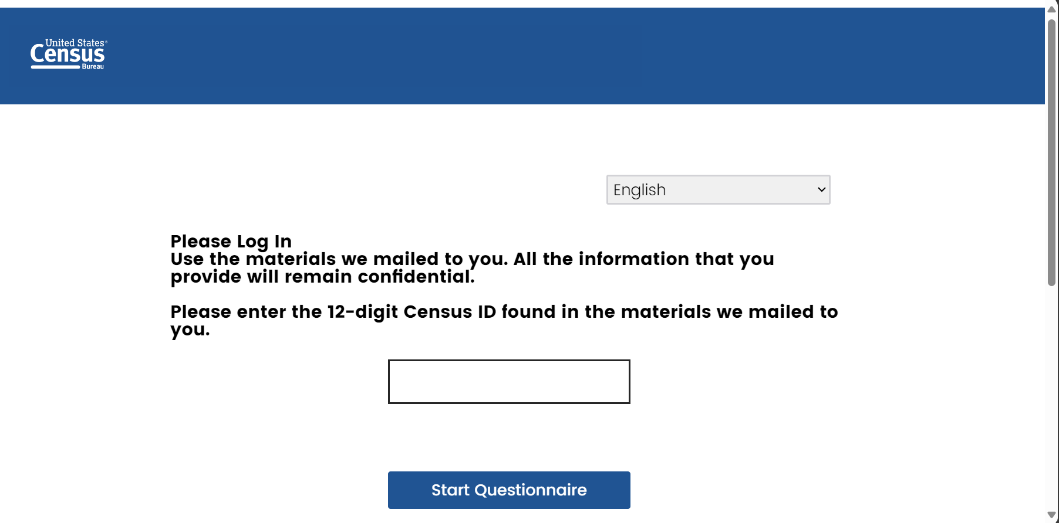
Finding the ID
Image of the paper or postcard with the ID

Slide 3
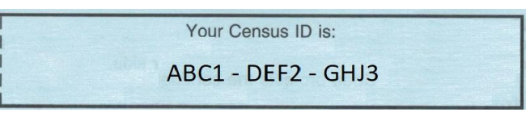

Census IDs

Slide 4
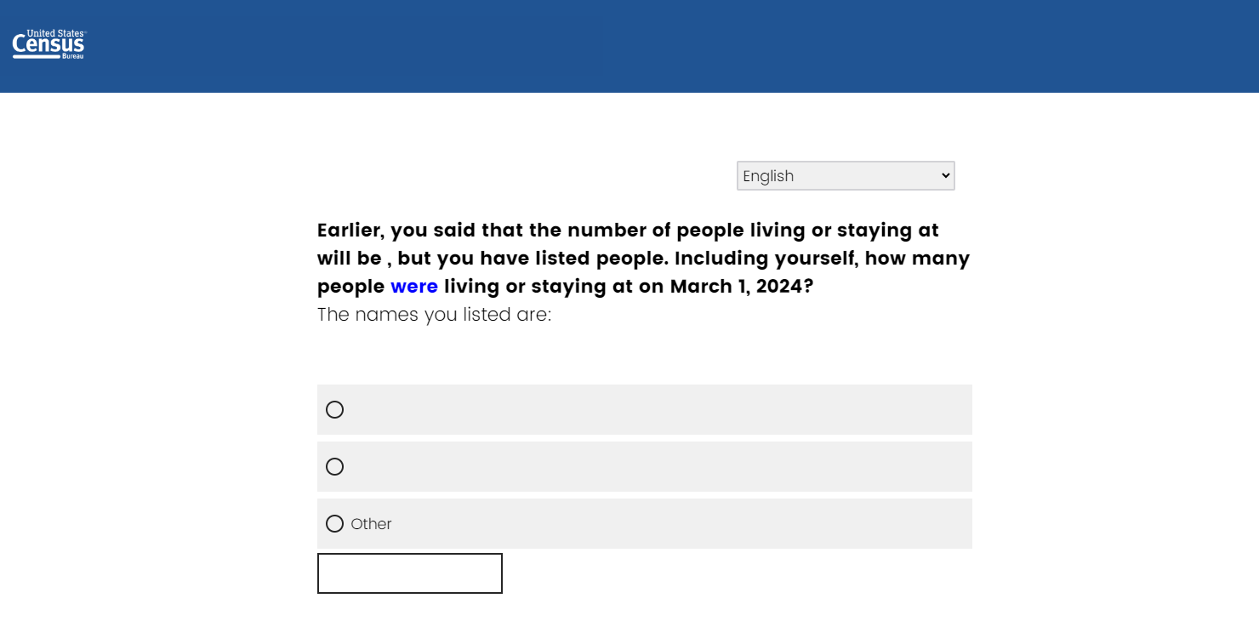

Slide 5
Future generations would like to know what you have to say. Consider writing a message that will become publicly available after 72 years. Help

Slide 6
Version 1
Future generations would like to know what you have to say. Consider writing a message that will become publicly available after 72 years. Help
Version 2
Before you submit your responses, we’d like to give you an opportunity to leave a message for future generations. The Census Bureau will make these messages available to the public after 72 years. Consider sharing your message below. Help
Version 3
Consider writing a message for future generations. Your message will become publicly available after 72 years. Help

Slide 7
More information
The information you voluntarily share in this question can be used by future generations to gain a perspective about this time in history or to learn more about you and your family. By participating, you are helping to create a trove of stories for future generations to study, use, and enjoy.
You have 500 characters to write your message which won’t be released for 72 years. This opportunity is only available in the online questionnaire.

Slide 8
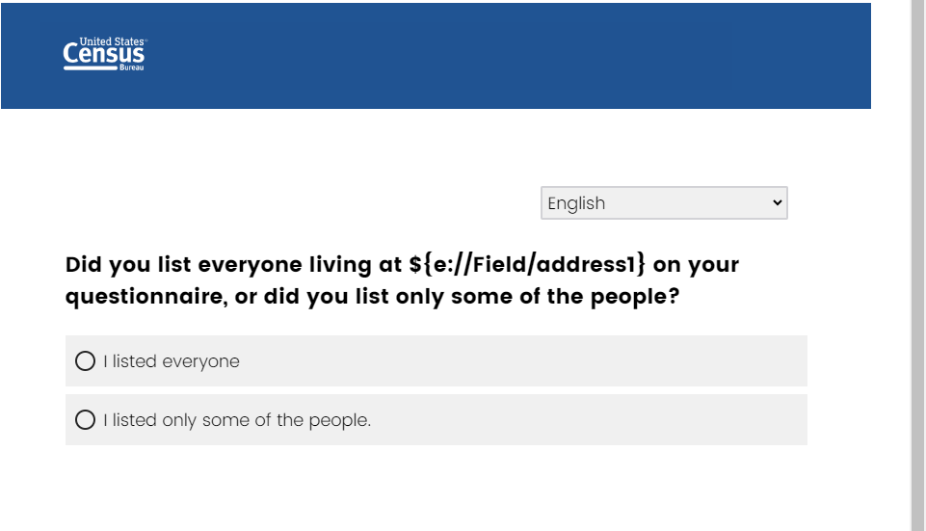

Slide 9
The Census Bureau needs to count everyone living or staying at [FILL ADDRESS].
Please provide contact information for the people that you did not list on your questionnaire so the Census Bureau can text or email them their 2024 National Census Survey link.
Name: [ ]
Cell phone: [ ]
Email: [ ]
Notes:
Efficacy
-how many provide info
-how many come into survey from this info
-how many are added to roster based on these new completes
-some comparison to average burden?
influence on attitudes
-reactions to being asked the info
-breakoffs (compared to other screens)

Slide 10
Email
Email subject line | Respond to a U.S. Census Bureau Survey
Preview Text | Your response is critical to prepare for the next census.
Body | A Message from the U.S. Census Bureau Your household has been selected to participate in the 2024 National Census Survey to help prepare for the next census. Please answer this 10-minute survey by October 30, 2024. Follow the two steps below to provide your response to this survey: Go to www.census.gov/2024survey Enter your Census ID: xxxx-xxxx-xxxx. Your response matters. The survey helps your local government, businesses, and nonprofit organizations meet the needs of your community. As a representative of your community, you are the voice that informs us about these needs. You are required by law to complete this survey (Title 13, U.S. Code, Sections 141, 193, and 221). If you need more information, please call toll-free 1-833-783-4700. Thank you. Your response is greatly appreciated. This collection of information has been approved by the Office of Management and Budget (OMB). The eight-digit OMB approval number is XXXX-XXXX. If this number were not displayed, we could not conduct the survey.

Slide 11
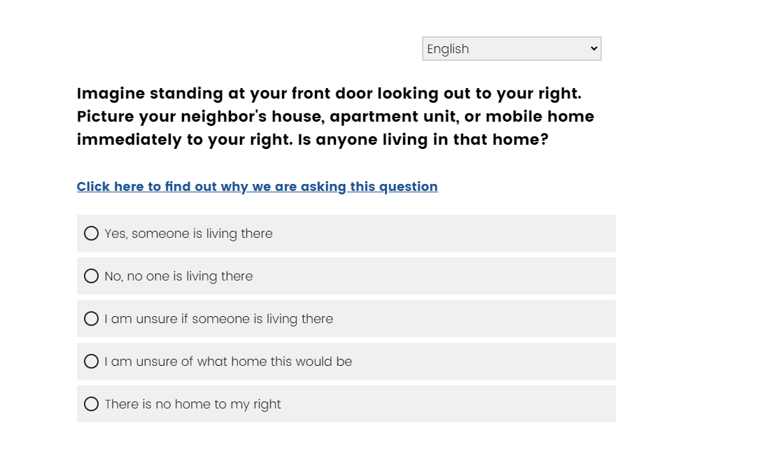
Version 1

Slide 12
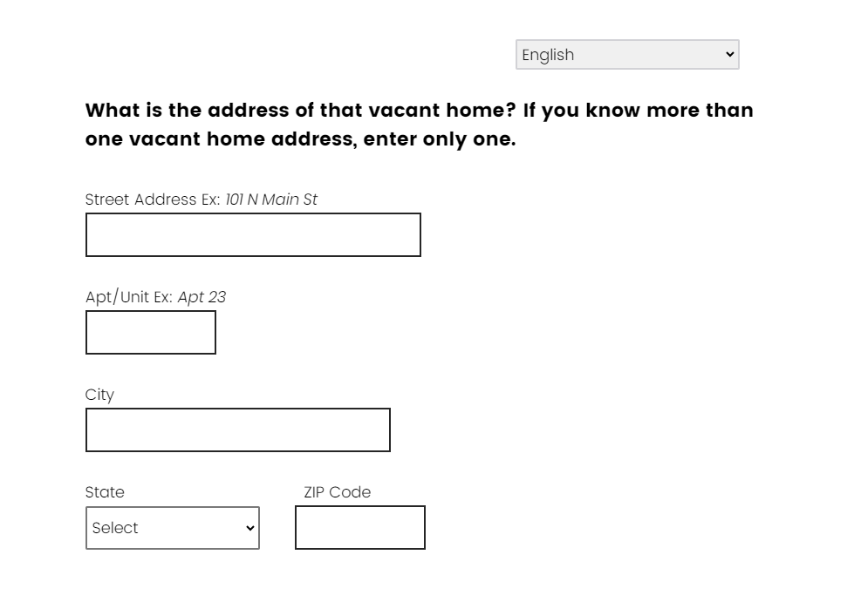
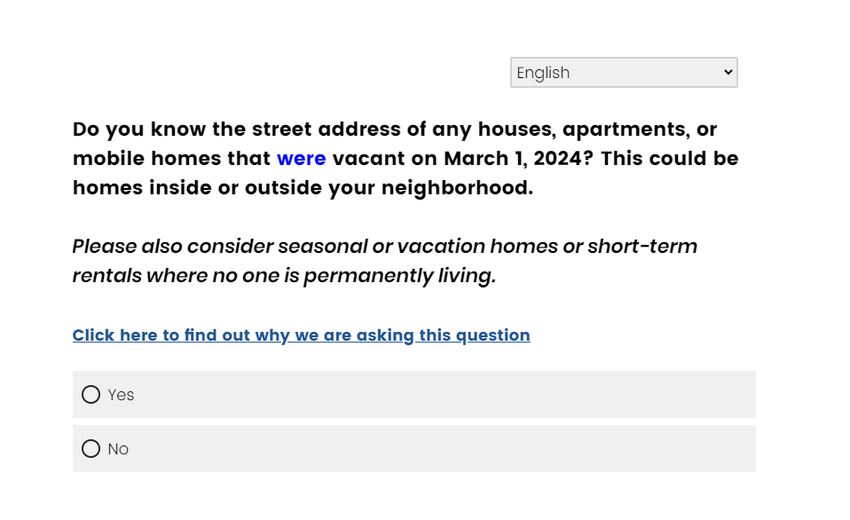
Version 2

Slide 13
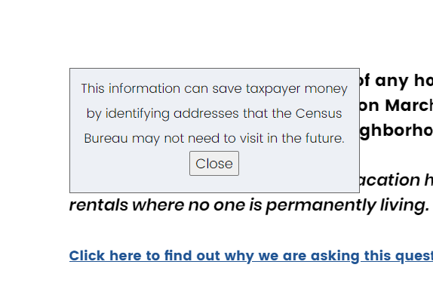
Help text

