Slide 1
Debriefing slides
2025 Census Survey
(Programmed in Qualtrics)

Slide 2
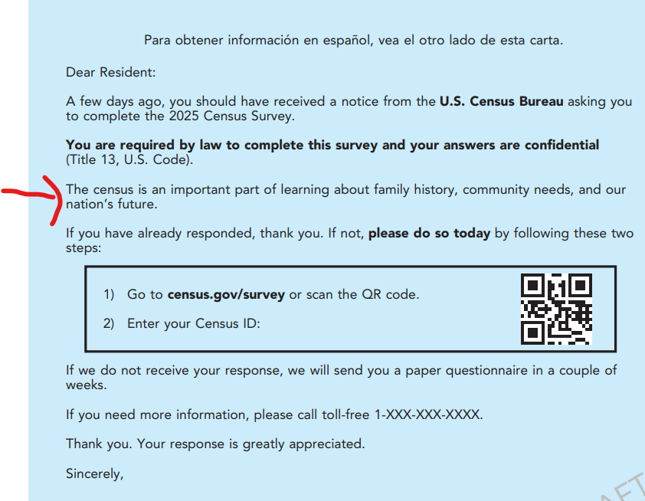
Messaging on Letter 2
Probe: In the second letter (Mailing 3), you saw this message with the red arrow pointing to it. We talked about it earlier. On the next page, you will see several alterative messages. Think about which message is the clearest. We also want to know if any of the messages motivate you to respond to the census.

Slide 3
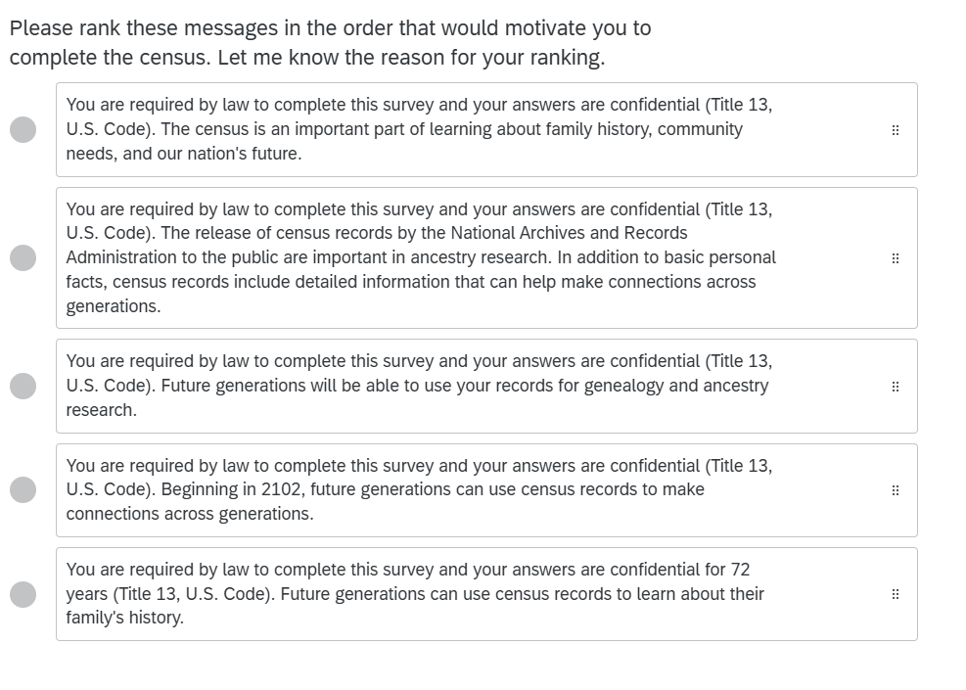
Other messages
Observe any comments on the use of “your” any comments on the use of “2102” for the date and “72”. Probe on those three messages if no comments were elicited. Tell me more about what you think of the message #x that reads [Read aloud].

Slide 4
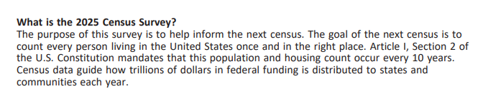
Frequently asked question
Probe: In the first and fourth mailing there was an insert with answers to frequently asked questions. Look at this question and answer. What does it mean in your own words? Do you have any feedback on the answer.

Slide 5
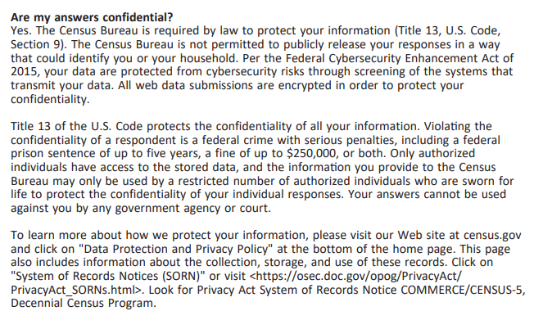
FAQ
Probe: Please read this question and the third paragraph in the answer. What does it mean in your own words? Do you have any feedback on that paragraph?

Slide 6
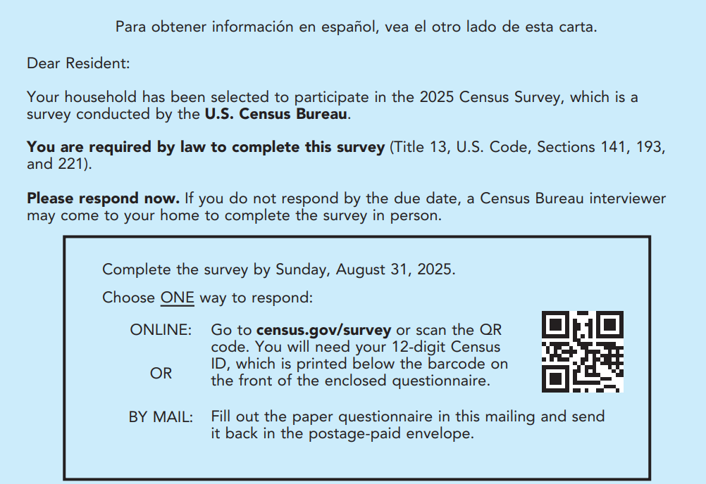
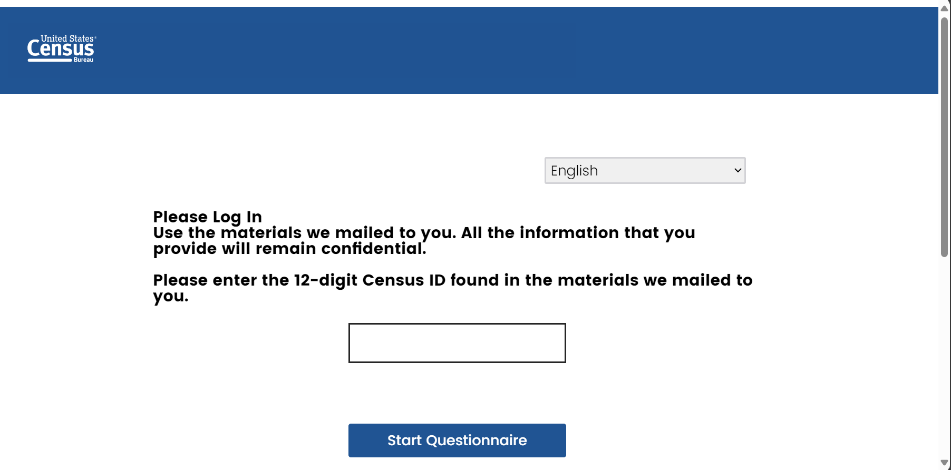
Finding the ID on Mailing 4
Probe: Pretend you got to the survey login screen (on the right side). Please read the screen. Pretend you wanted to find your Census ID.
Look at Mailing 4 and let us know what you would do to find the ID.

Slide 7


Census IDs
Probe: The ID you entered was 12 digits. For security reasons, sometimes IDs need to include letters and numbers like the example on the left. Sometimes to meet security requirements, IDs need to have more digits, like the 16 digit ID on the right side. Do you have any preference for IDs? That is, would you prefer to enter an ID with letters and numbers or a longer ID with just numbers, or does not matter to you? Please tell me more about your preference.

Slide 8
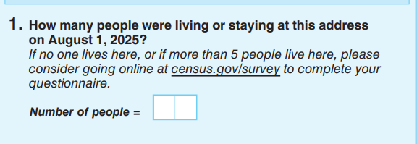
Paper questionnaire
Image of the paper questionnaire with the instruction for large households
On the screen is Question 1 on the first page of the paper questionnaire. You can also look at your paper questionnaire, if you’d like.
Please tell me in your own words what the instruction beneath the question means.
(If they filled out the paper questionnaire and didn’t spontaneously comment on the instruction, ask) Did you see the instruction when you completed your paper questionnaire or did you not see it?
Do you have any other thoughts about that instruction?

Slide 9
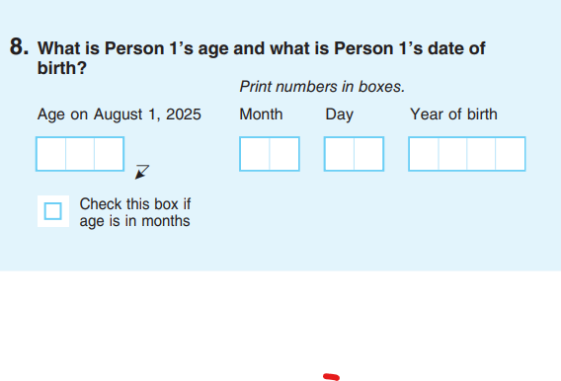
Paper questionnaire
Image of the paper questionnaire with date of birth and age instruction
On the screen is a picture of the age and date of birth question on the paper questionnaire. You can also look at your paper questionnaire, if you’d like.
Please tell me in your own words how (respondents should answer/you answered) that question.
Now I’m going to give you a few scenarios:
  If a household member was 10 years old, how would you answer this question for them?
  If a household member was 1 year old, how would you answer this question for them?
  If a household member was 6 months old how would you answer this question for them?

Slide 10
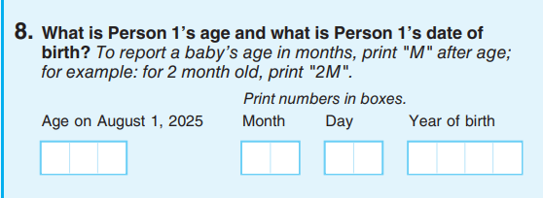
Paper questionnaire
Image of the alternate date of birth and age instruction
Now take a look at this alternative design. On the screen is a picture of a different age and date of birth question.
Please tell me in your own words how respondents should answer that question.
Now I’m going to give you the same scenarios:
  If a household member was 10 years old, how would you answer this question for them?
  If a household member was 1 year old, how would you answer this question for them?
  If a household member was 6 months old how would you answer this question for them?

Slide 11
Paper questionnaire
First image
Second image
Probe: What are your thoughts about the two different designs? Is there one you feel is easier to understand?

Slide 12
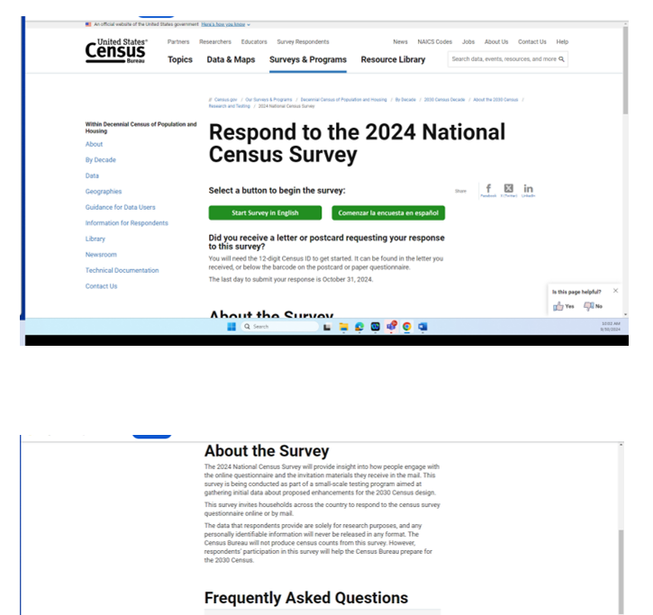
Landing page for online survey:
Go to landing page:
URL
OMB NOTE: Image is from last landing page, but 2025 will be similar

Slide 13
Tasks for Landing page
Imagine you wanted to know more about what questions the survey would ask. What would you do? [have P carry out task on all]
Imagine you later realized that you made a mistake in the online form. Use the FAQ search tool to tell me what you would do in this situation.
Imagine you wanted to get a job at the Census Bureau. What would you do?
What other questions do you have about the 2025 Census Survey?

Slide 14
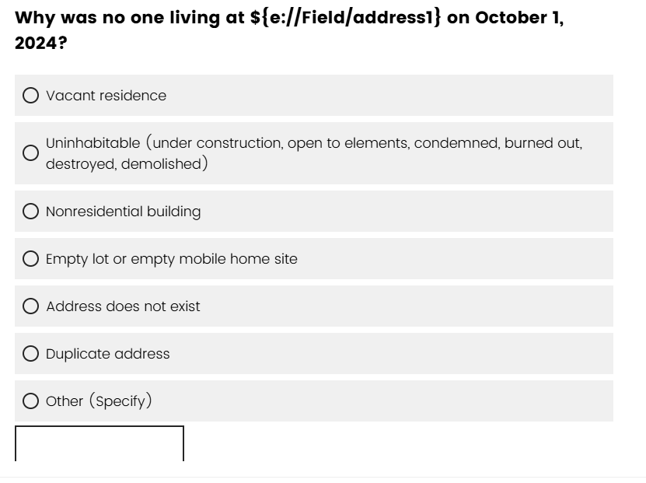
Screen 1
OMB NOTE: We will update slide with correct Census Day and 101 Main Street.
We have a few scenarios, and we want to know how you will answer some questions based on the task
  Pretend that the occupant moved out and the home is being renovated before it goes on the market. How would you answer this question?
  What about if the occupant got sick and had to move to a rehab for a while. How would you answer this question?
  Now pretend that the home that received the Census Survey invitation is a vacation home. How would you answer this question?
  What does the word “vacant” mean to you in the first option? Please give some examples of what this might refer to.

Slide 15
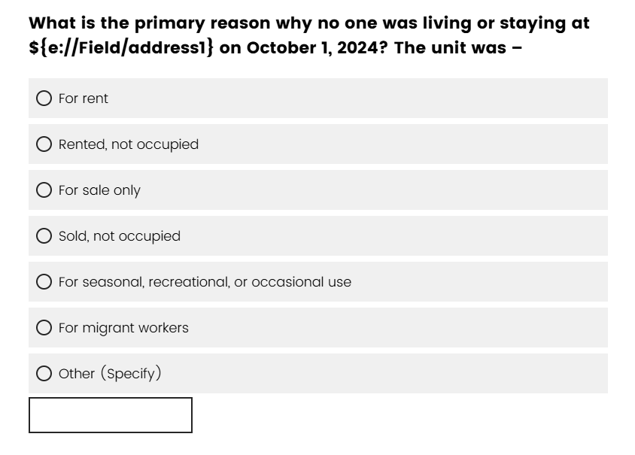
Screen 2
OMB NOTE: We will update slide with correct Census Day and 101 Main Street.
What would you select on this screen? [for each earlier task]

Slide 16
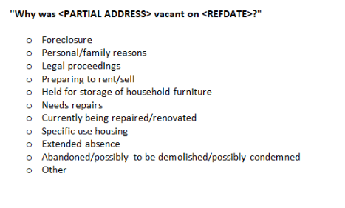
Screen 3
OMB NOTE: We will update slide with correct Census Day and 101 Main Street.
What would you select on this screen?
At the end of the 4 tasks.
  Take a look at the response choices and give me an example or two of situations that might fall into each option.

Slide 17
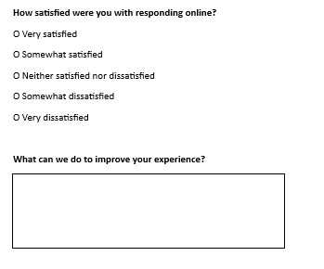
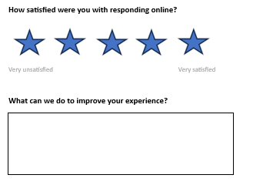
Satisfaction
Cog probe: At the end of the online questionnaire we allow users to rate their experience. Please take a look at two versions of this question and let me know what you think of each one and if you prefer one over the other.

