Slide 1
NASA C3RS
https://c3rs.arc.nasa.gov/report/electronic.html

Slide 2


Slide 3


Slide 4
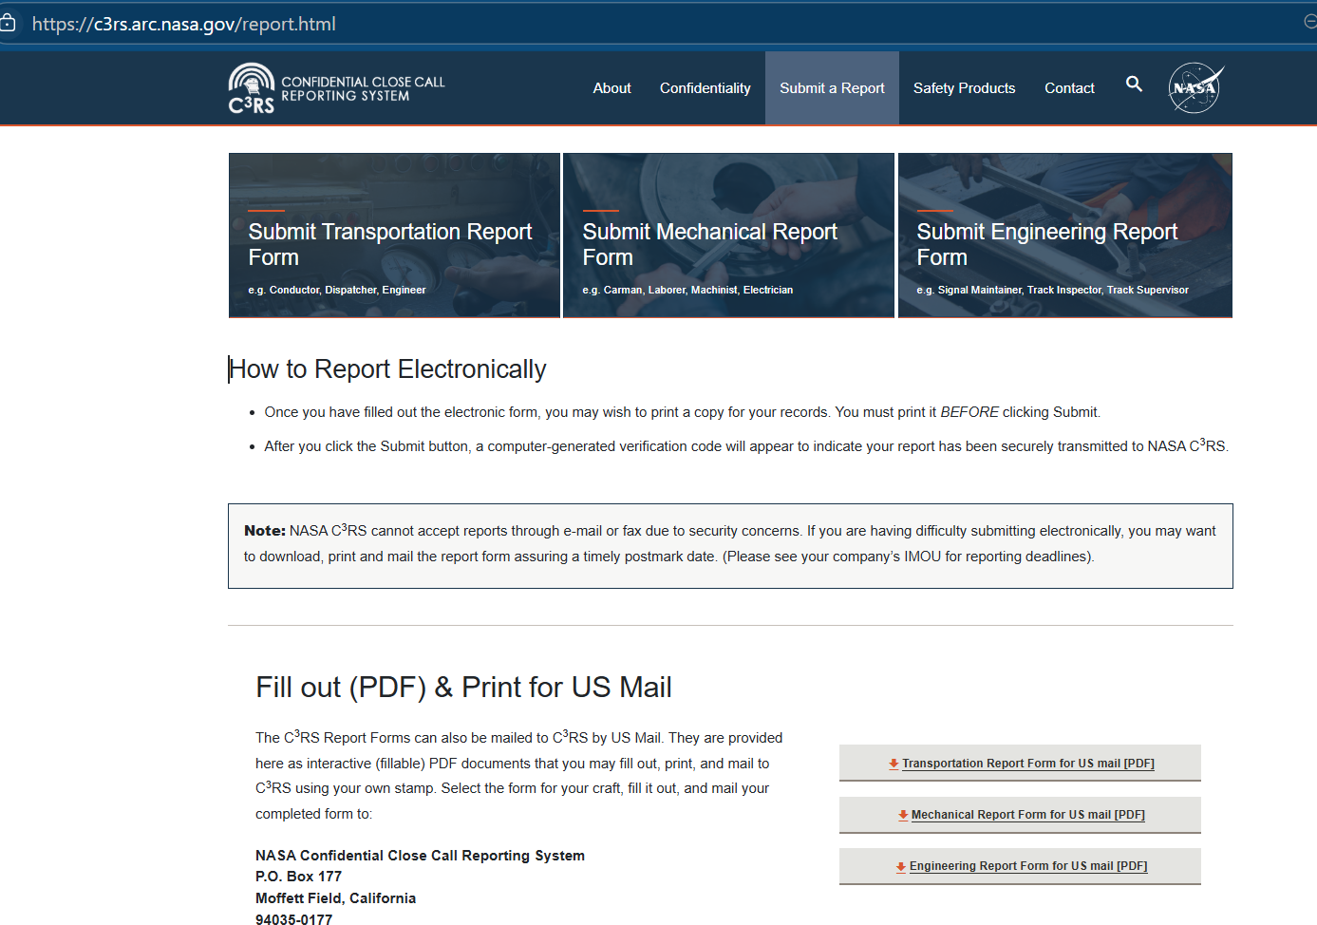

Slide 5


Slide 6
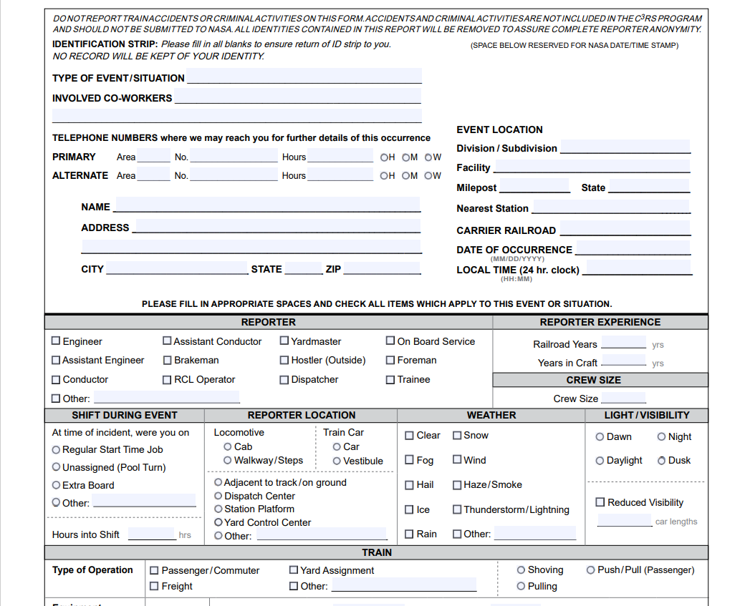

Slide 7
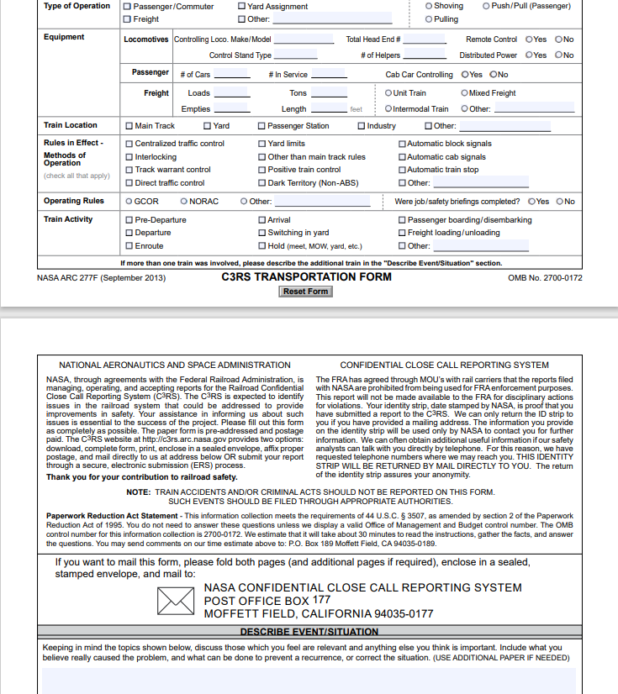

Slide 8
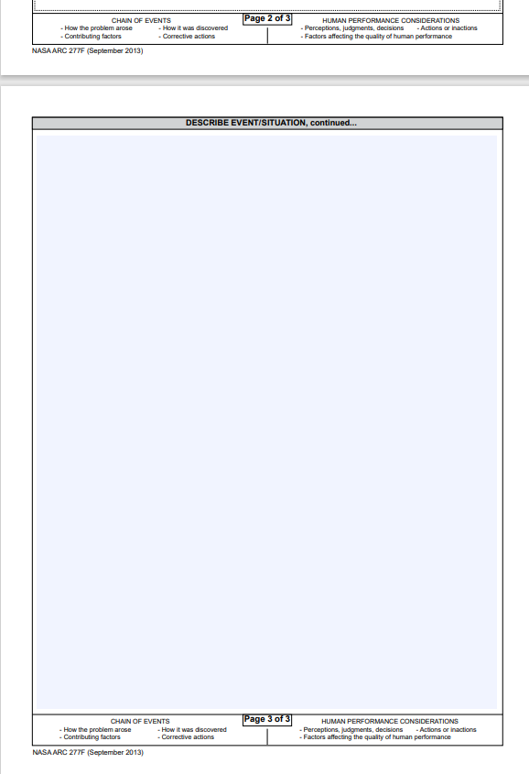

Slide 9



Slide 11
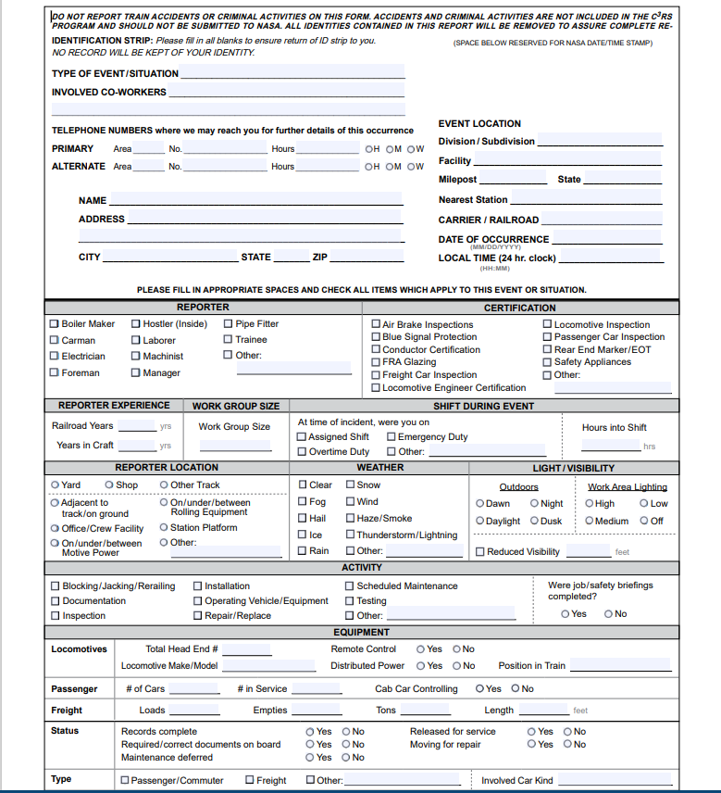

Slide 12
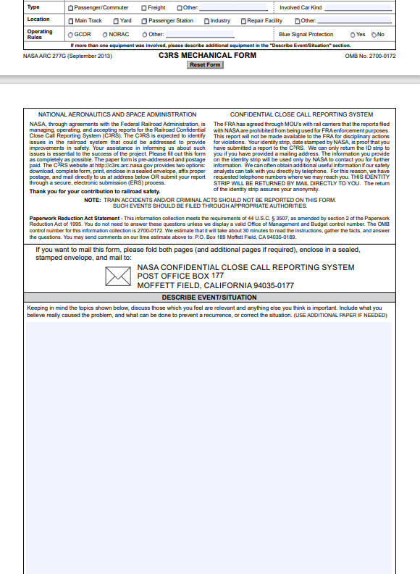

Slide 13
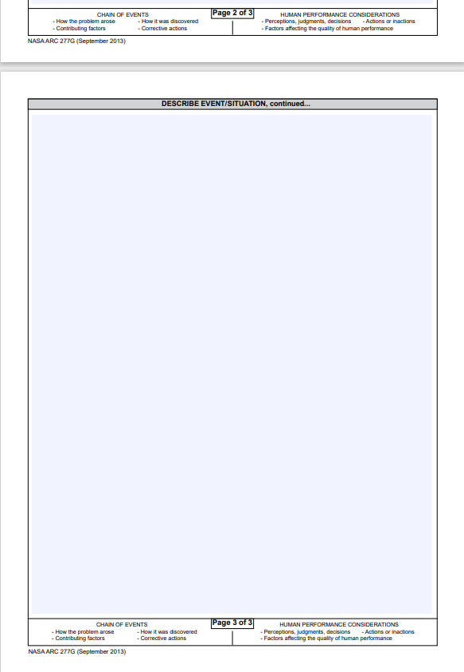

Slide 14


Slide 15


Slide 16
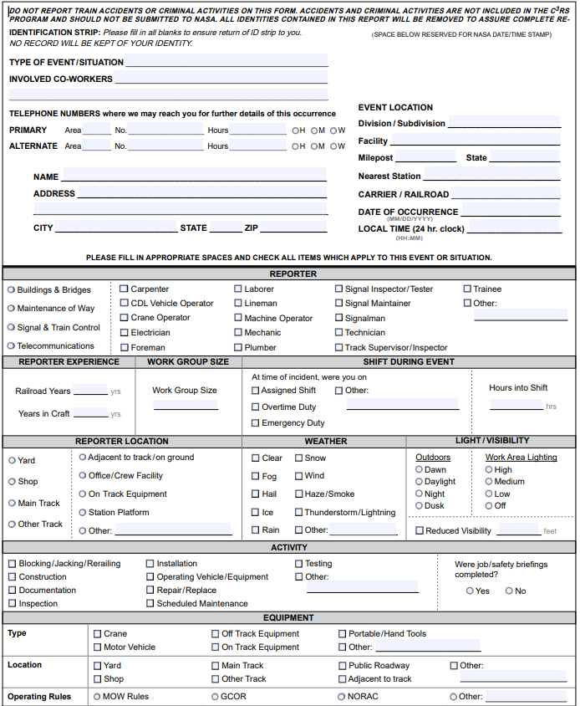

Slide 17
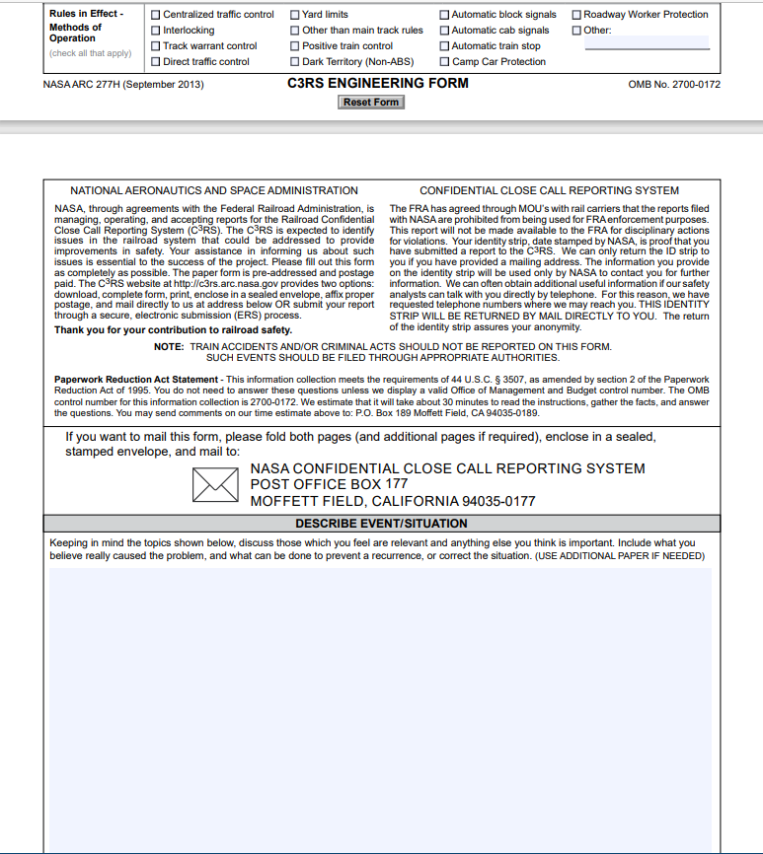

Slide 18
