Slide 1
TSCA Section 8(a) Nanoscale
EPA Form No. 9600-07
OMB Control No. 2070-0224
Expiration 11/30/2025

Slide 2
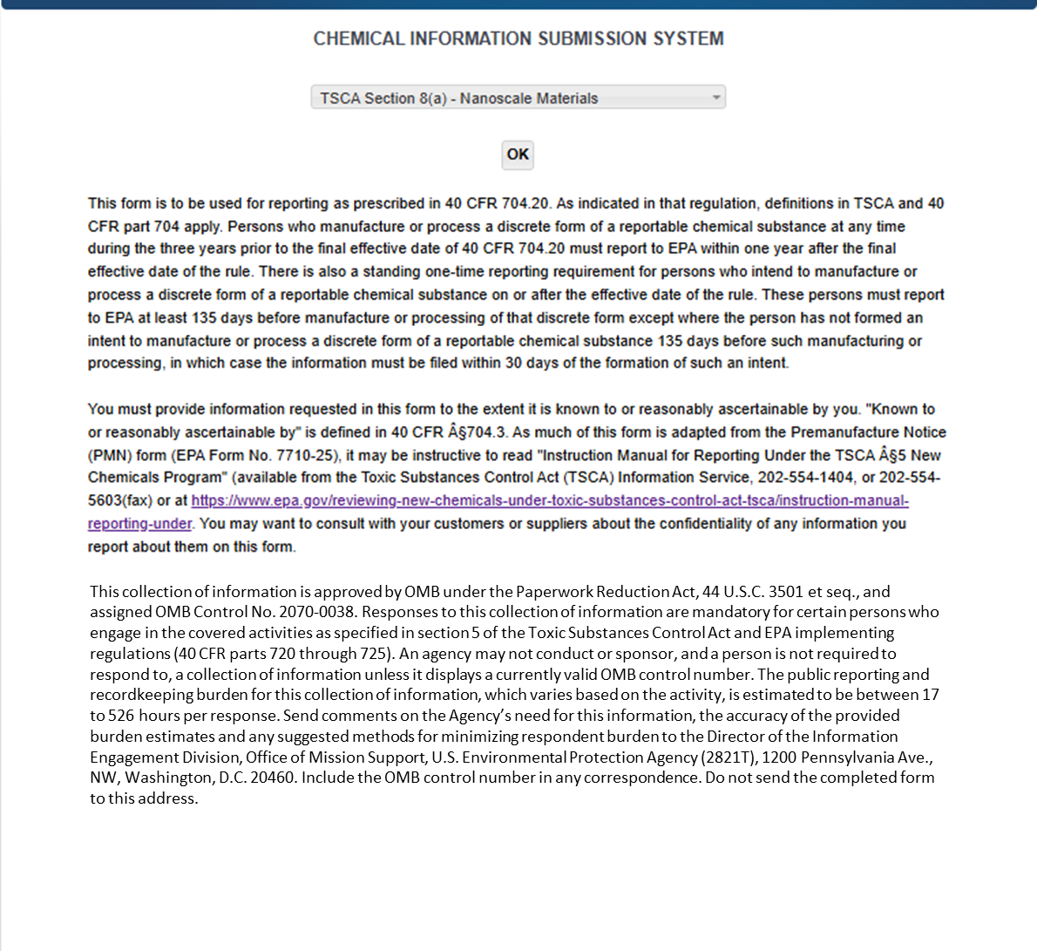
OMB Control No. 2070-0224
Expiration 11/30/2025
This collection of information is approved by OMB under the Paperwork Reduction Act, 44 U.S.C. 3501 et seq. (OMB Control No. 2070-0224). Responses to this collection of information are mandatory for certain persons, as specified at 40 CFR Part 712. An agency may not conduct or sponsor, and a person is not required to respond to, a collection of information unless it displays a currently valid OMB control number. The public reporting and recordkeeping burden for this collection of information is estimated to be 0.4 to 107.5 hours per response. Send comments on the Agency’s need for this information, the accuracy of the provided burden estimates and any suggested methods for minimizing respondent burden to the Information Engagement Division Director, U.S. Environmental Protection Agency (2821T), 1200 Pennsylvania Ave., NW, Washington, D.C. 20460. Include the OMB control number in any correspondence. Do not send the completed form to this address.
EPA Form No. 9600-07

Slide 3
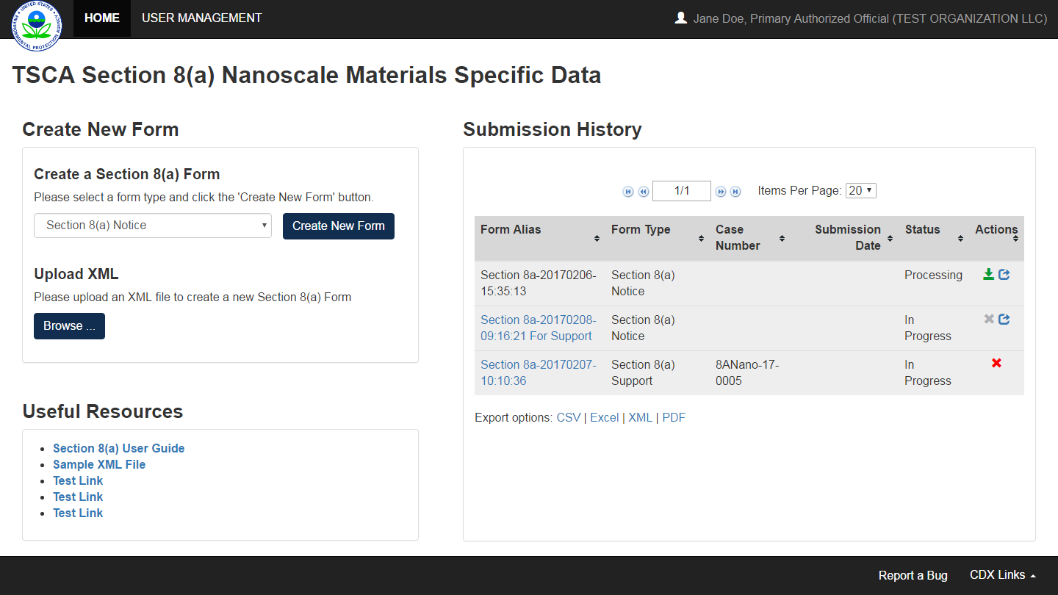
OMB Control No. 2070-0224
Expiration 11/30/2025
EPA Form No. 9600-07

Slide 4
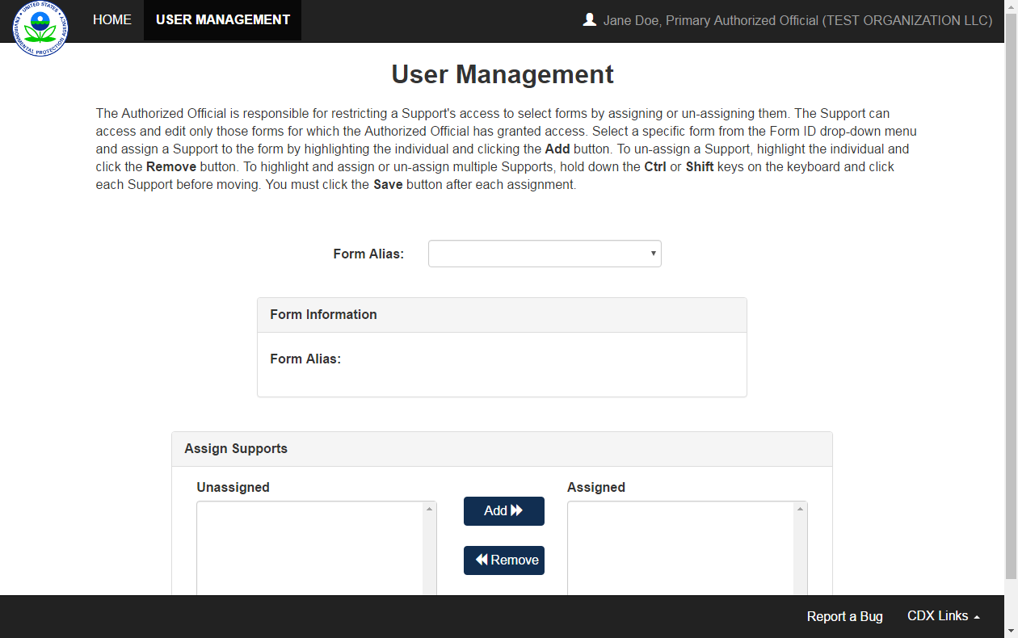
OMB Control No. 2070-0224
Expiration 11/30/2025
EPA Form No. 9600-07

Slide 5
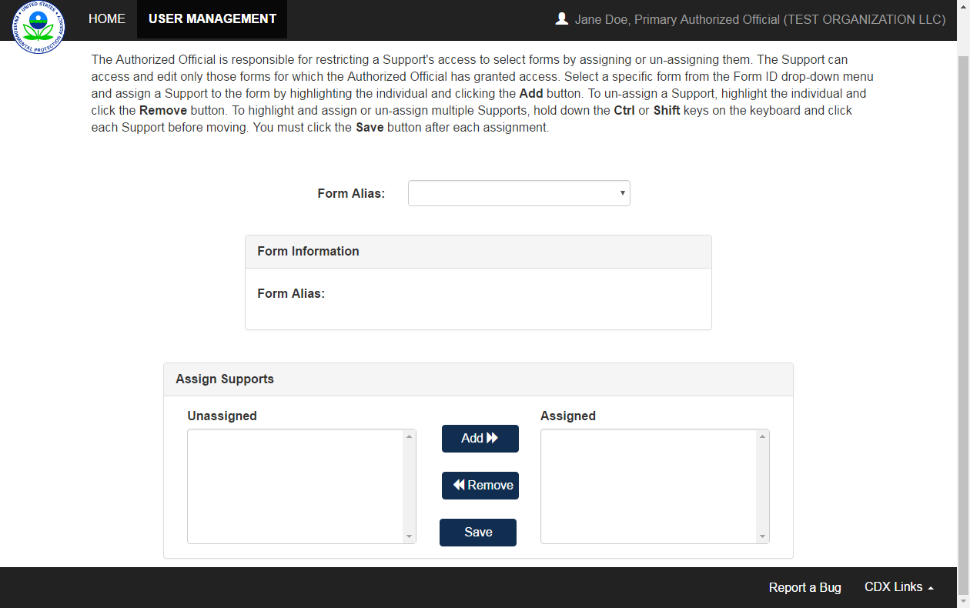
OMB Control No. 2070-0224
Expiration 11/30/2025
EPA Form No. 9600-07

Slide 6
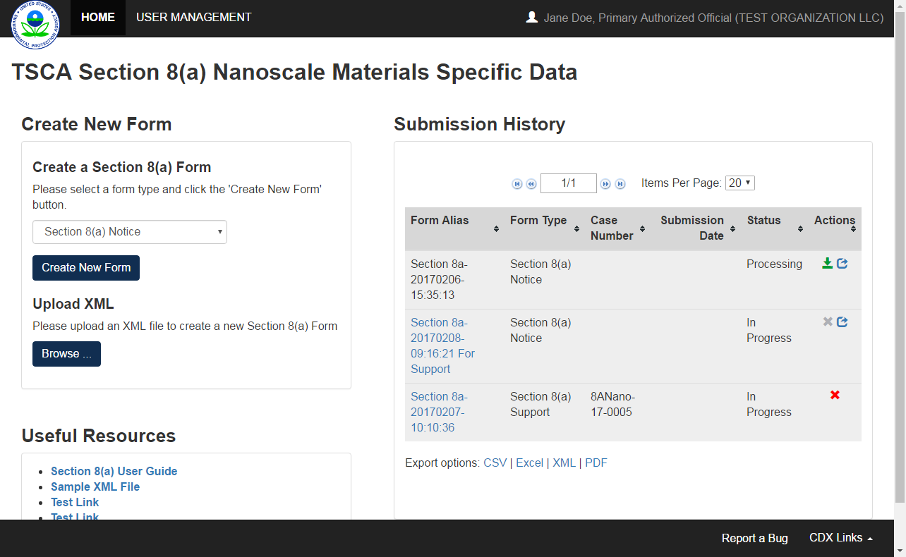
OMB Control No. 2070-0224
Expiration 11/30/2025
EPA Form No. 9600-07

Slide 7
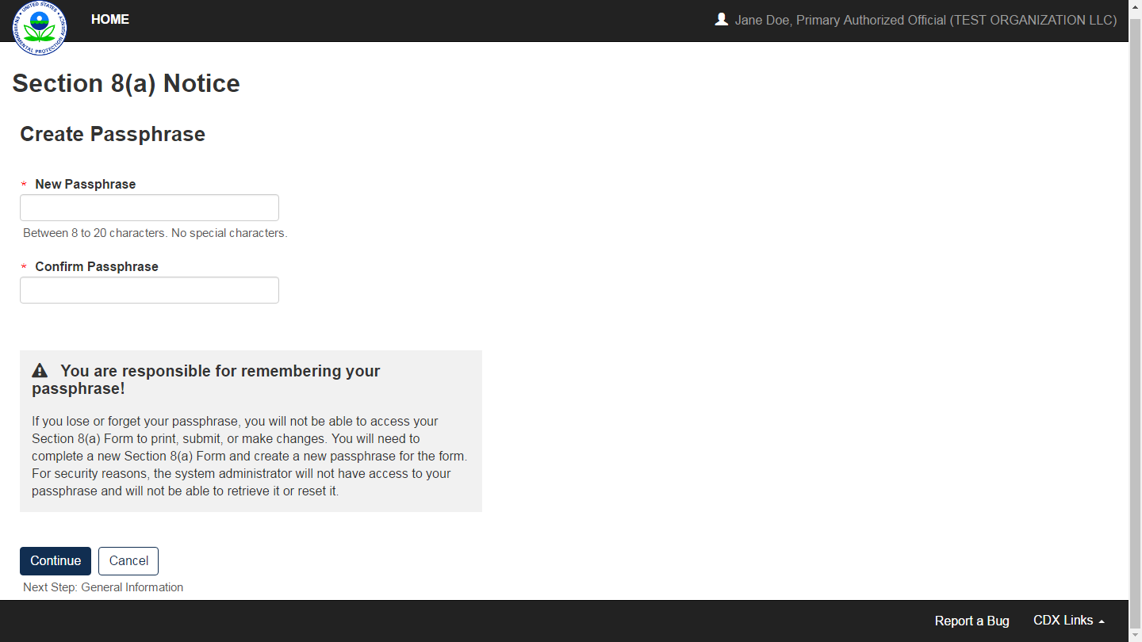
OMB Control No. 2070-0224
Expiration 11/30/2025
EPA Form No. 9600-07

Slide 8
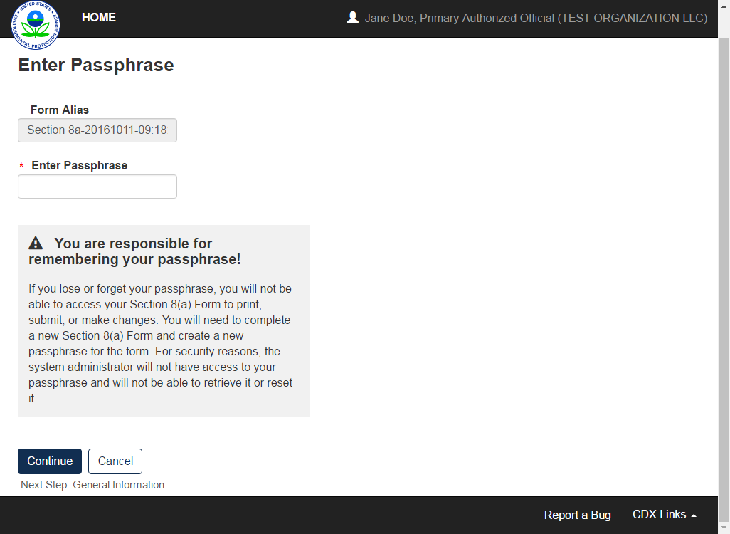
OMB Control No. 2070-0224
Expiration 11/30/2025
EPA Form No. 9600-07

Slide 9
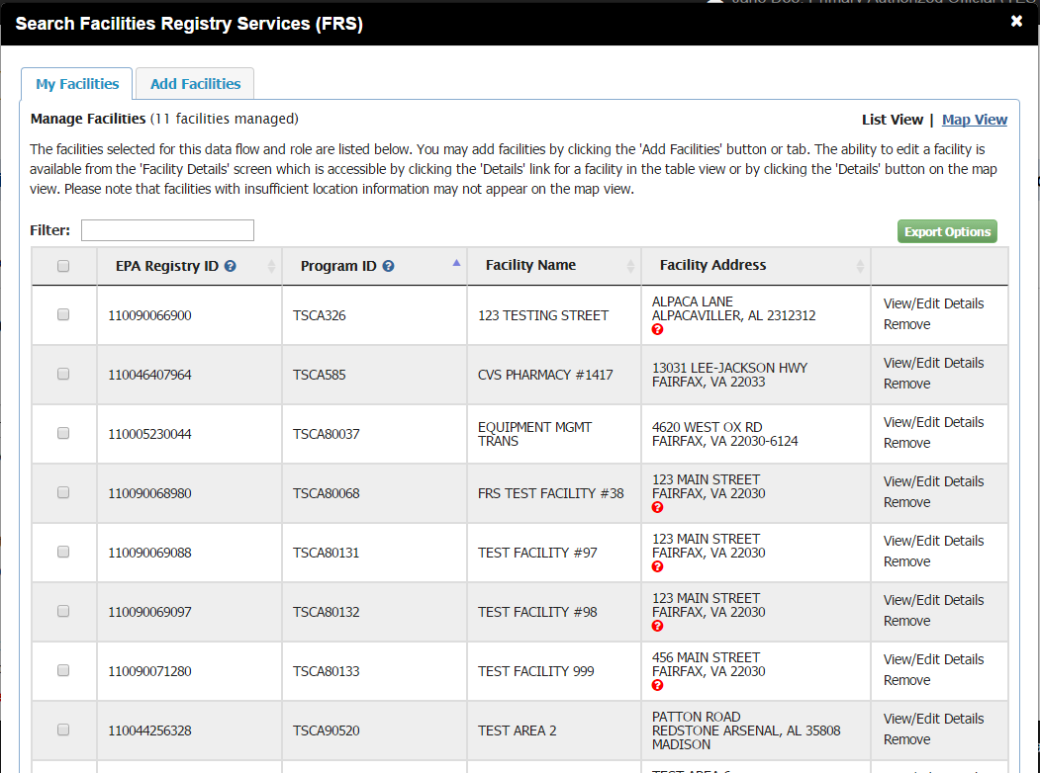
OMB Control No. 2070-0224
Expiration 11/30/2025
EPA Form No. 9600-07

Slide 10
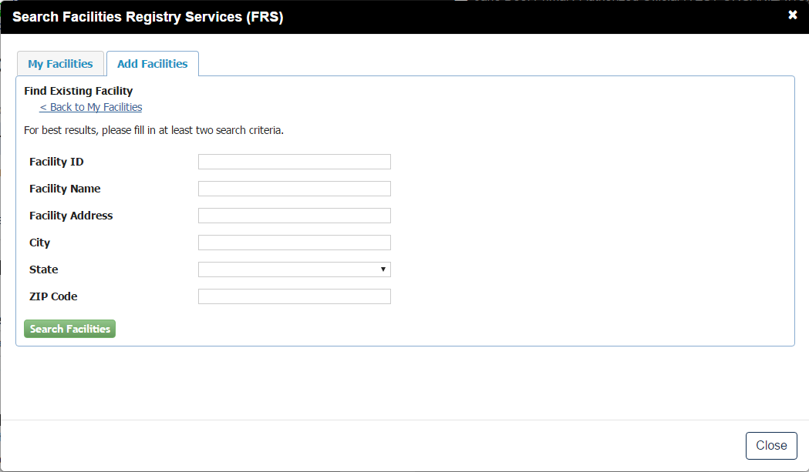
OMB Control No. 2070-0224
Expiration 11/30/2025
EPA Form No. 9600-07

Slide 11
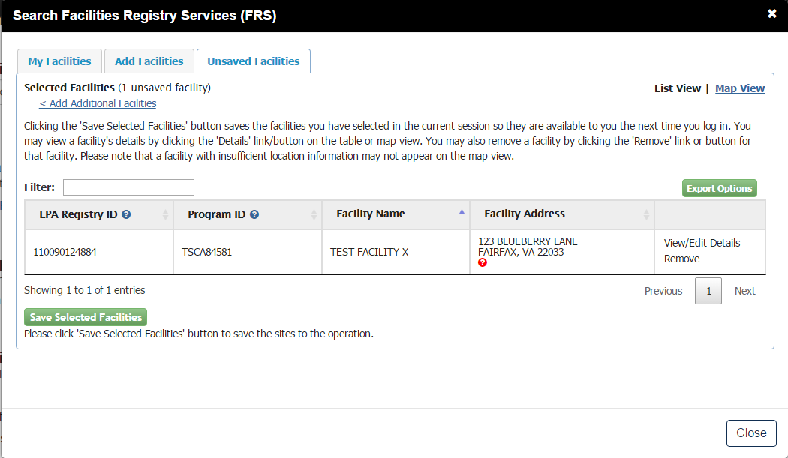
OMB Control No. 2070-0224
Expiration 11/30/2025
EPA Form No. 9600-07

Slide 12
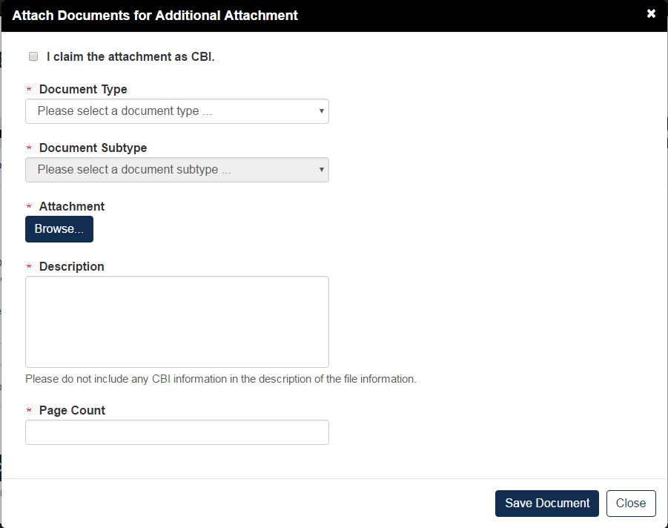
OMB Control No. 2070-0224
Expiration 11/30/2025
EPA Form No. 9600-07

Slide 13
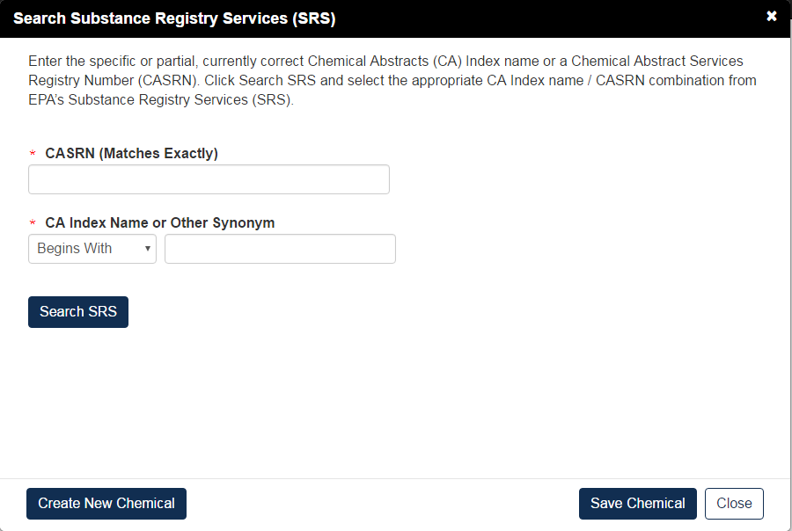
OMB Control No. 2070-0224
Expiration 11/30/2025
EPA Form No. 9600-07

Slide 14
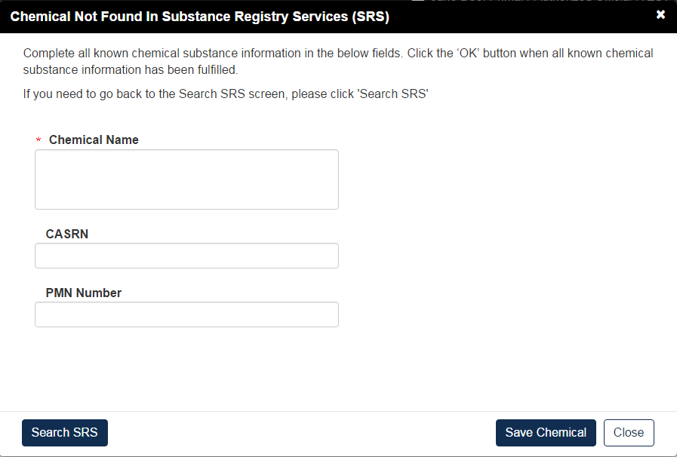
OMB Control No. 2070-0224
Expiration 11/30/2025
EPA Form No. 9600-07

Slide 15
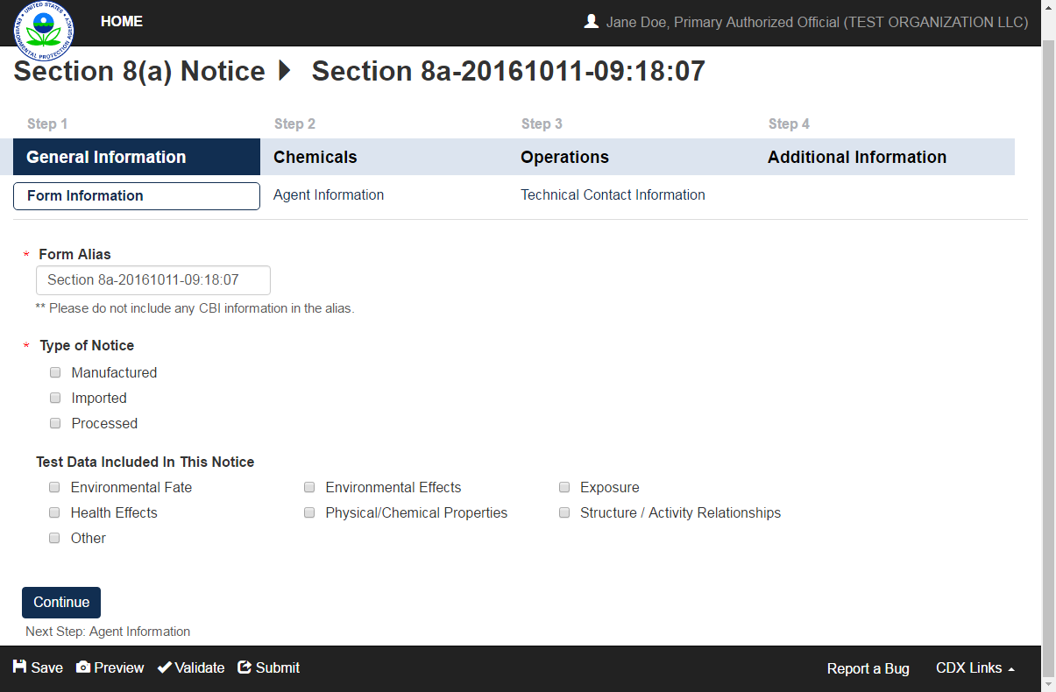
OMB Control No. 2070-0224
Expiration 11/30/2025
EPA Form No. 9600-07

Slide 16
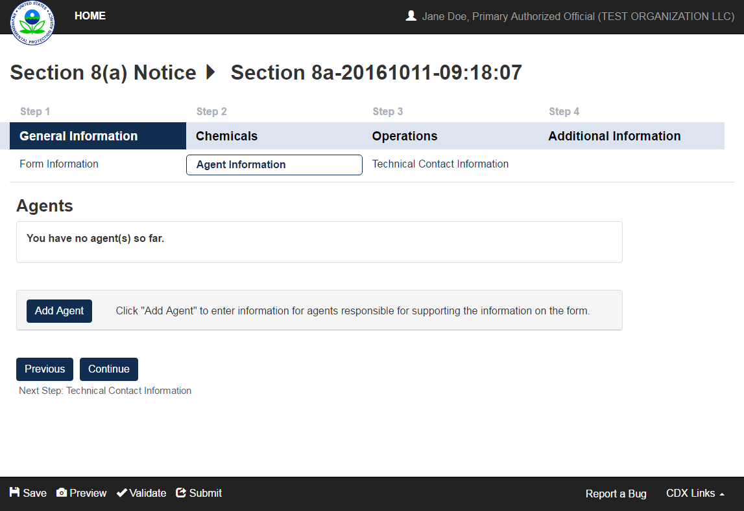
OMB Control No. 2070-0224
Expiration 11/30/2025
EPA Form No. 9600-07

Slide 17
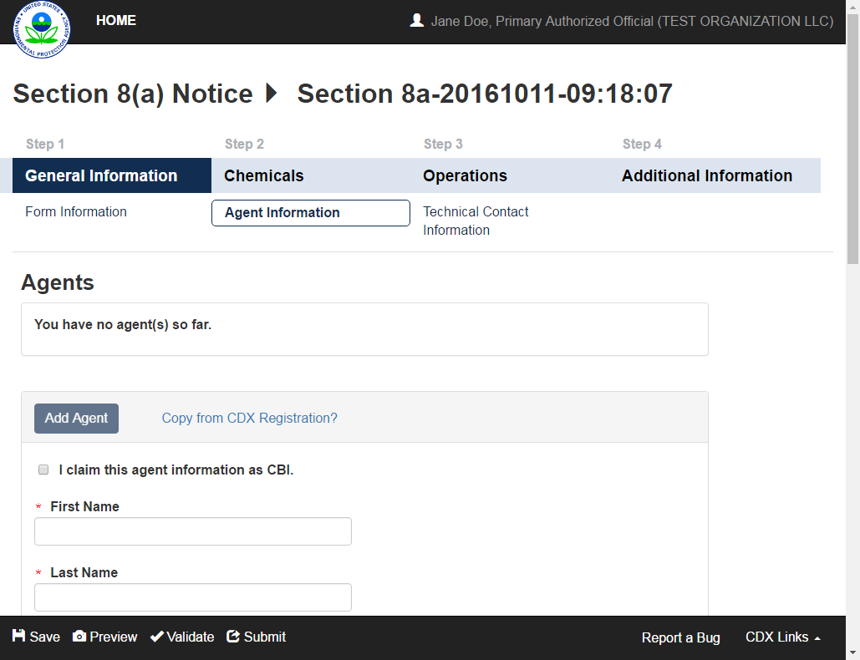
OMB Control No. 2070-0224
Expiration 11/30/2025
EPA Form No. 9600-07

Slide 18
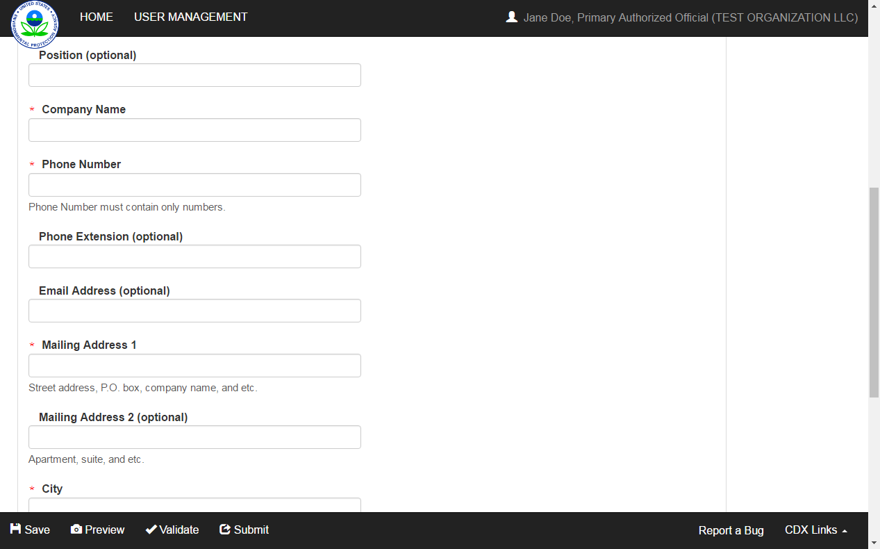
OMB Control No. 2070-0224
Expiration 11/30/2025
EPA Form No. 9600-07

Slide 19
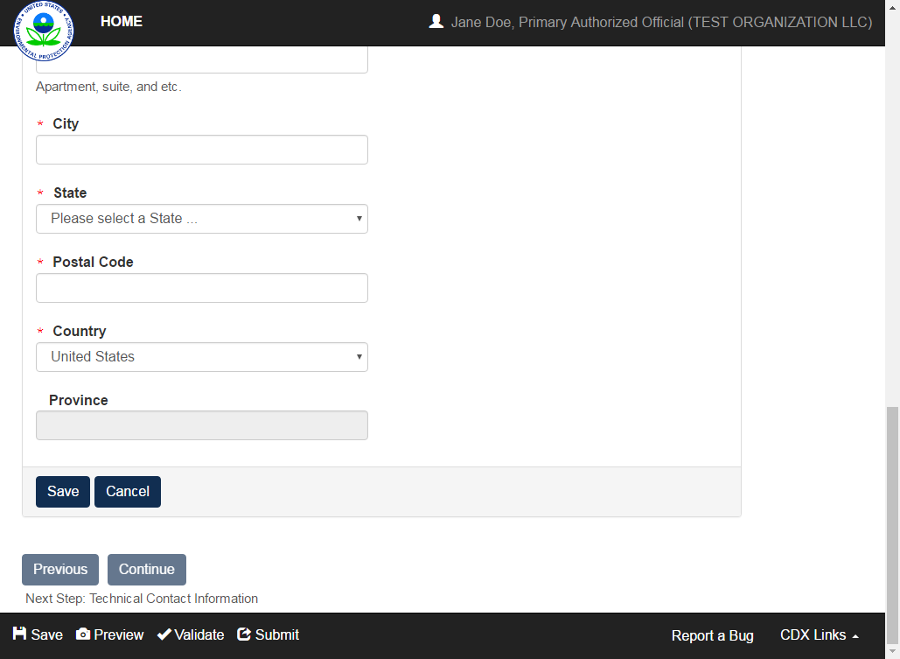
OMB Control No. 2070-0224
Expiration 11/30/2025
EPA Form No. 9600-07

Slide 20
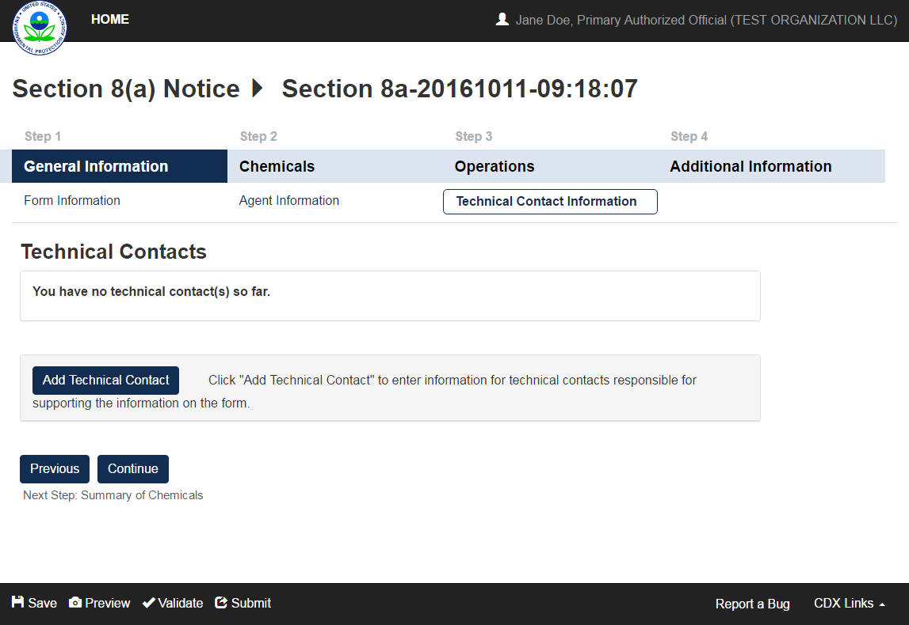
OMB Control No. 2070-0224
Expiration 11/30/2025
EPA Form No. 9600-07

Slide 21
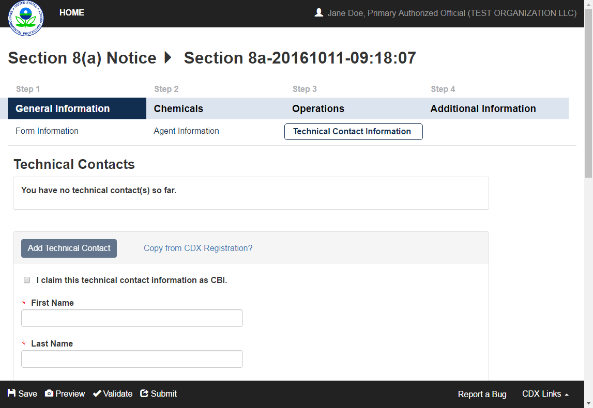
OMB Control No. 2070-0224
Expiration 11/30/2025
EPA Form No. 9600-07

Slide 22
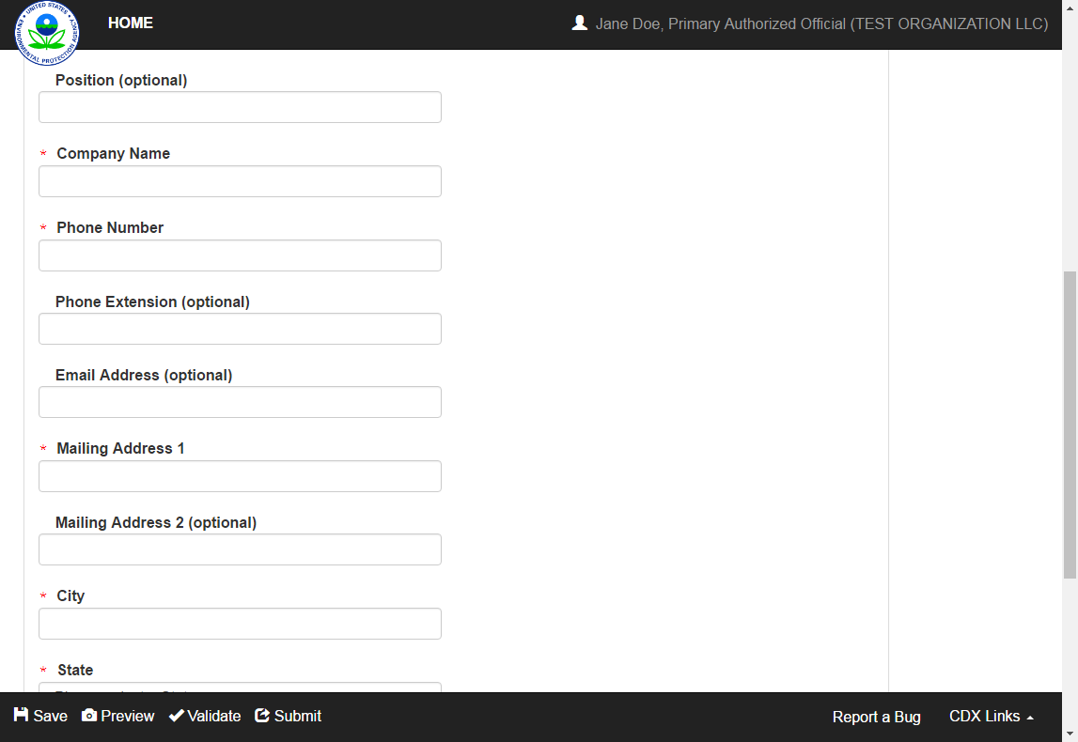
OMB Control No. 2070-0224
Expiration 11/30/2025
EPA Form No. 9600-07

Slide 23
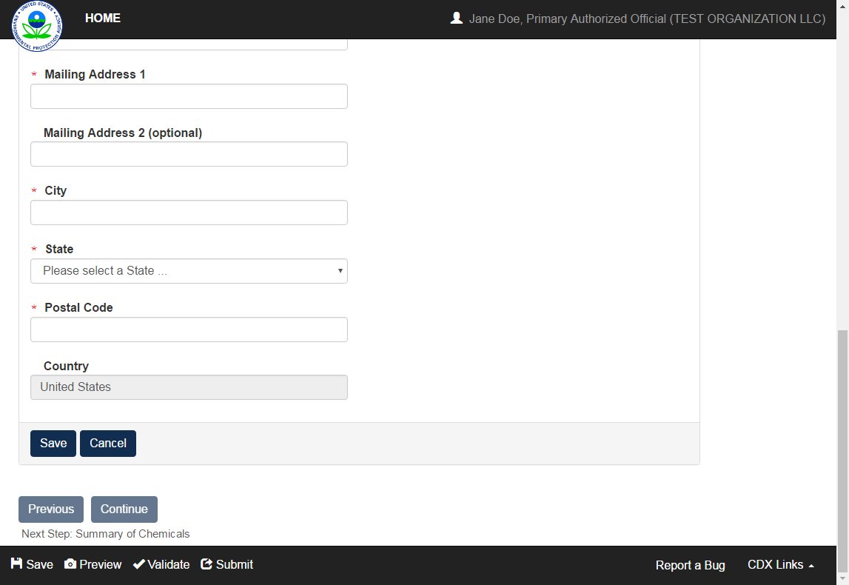
OMB Control No. 2070-0224
Expiration 11/30/2025
EPA Form No. 9600-07

Slide 24
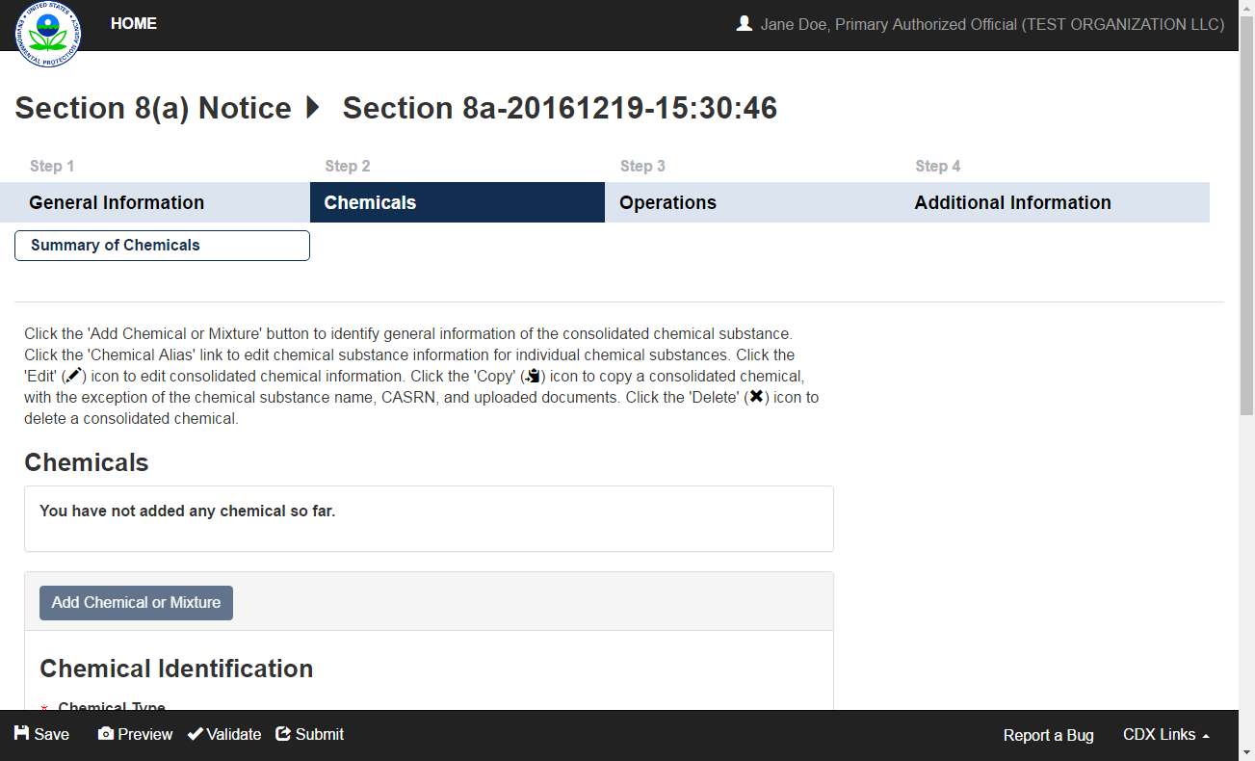
OMB Control No. 2070-0224
Expiration 11/30/2025
EPA Form No. 9600-07

Slide 25
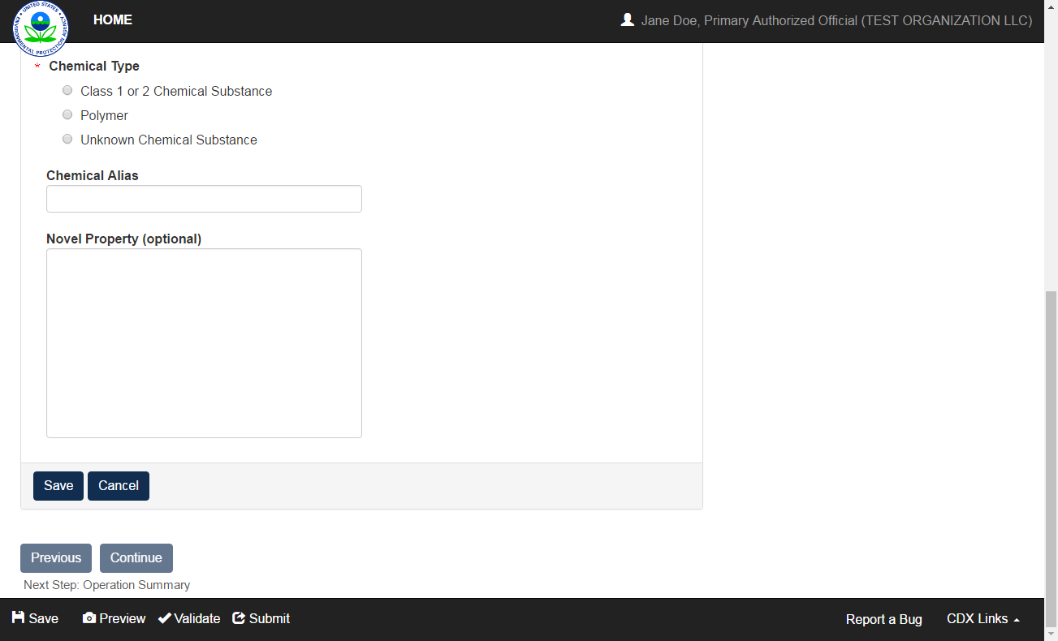
OMB Control No. 2070-0224
Expiration 11/30/2025
EPA Form No. 9600-07

Slide 26
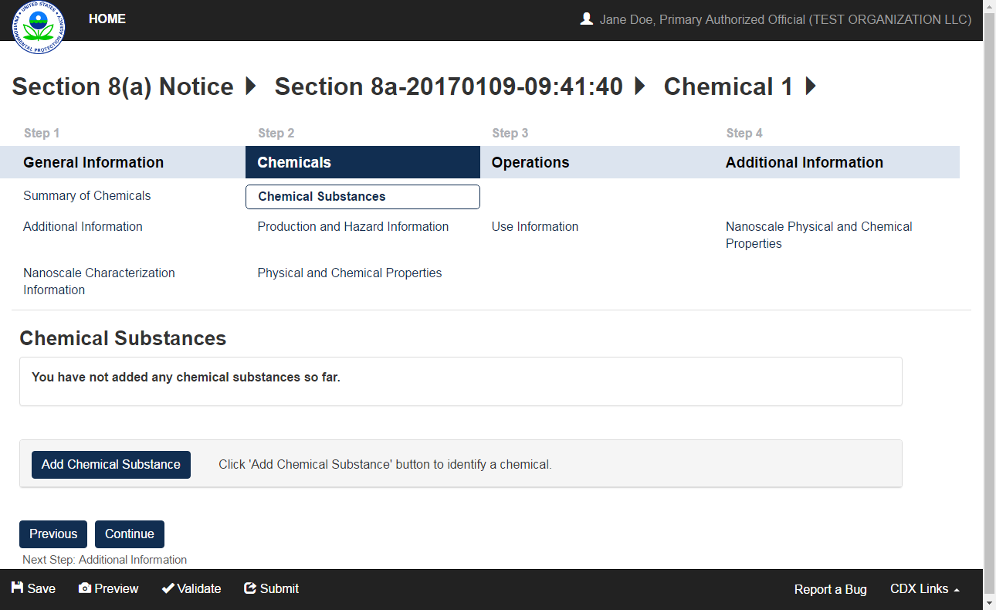
OMB Control No. 2070-0224
Expiration 11/30/2025
EPA Form No. 9600-07

Slide 27
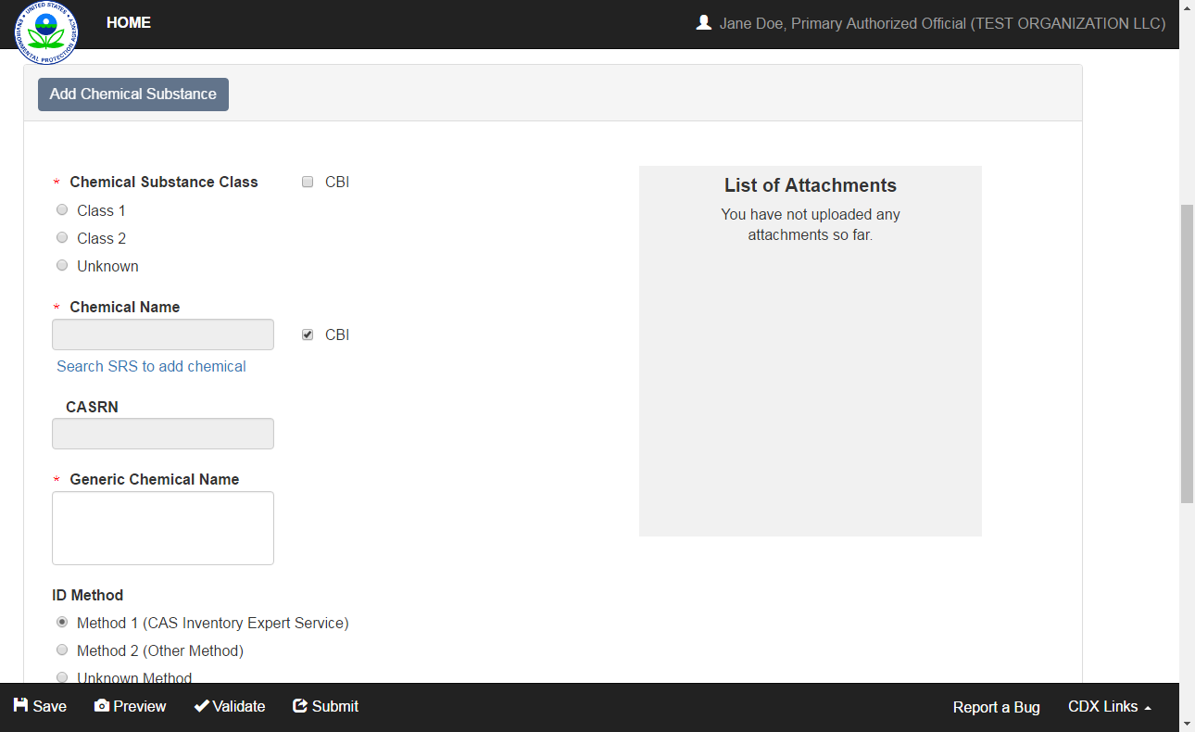
OMB Control No. 2070-0224
Expiration 11/30/2025
EPA Form No. 9600-07

Slide 28

OMB Control No. 2070-0224
Expiration 11/30/2025
EPA Form No. 9600-07

Slide 29
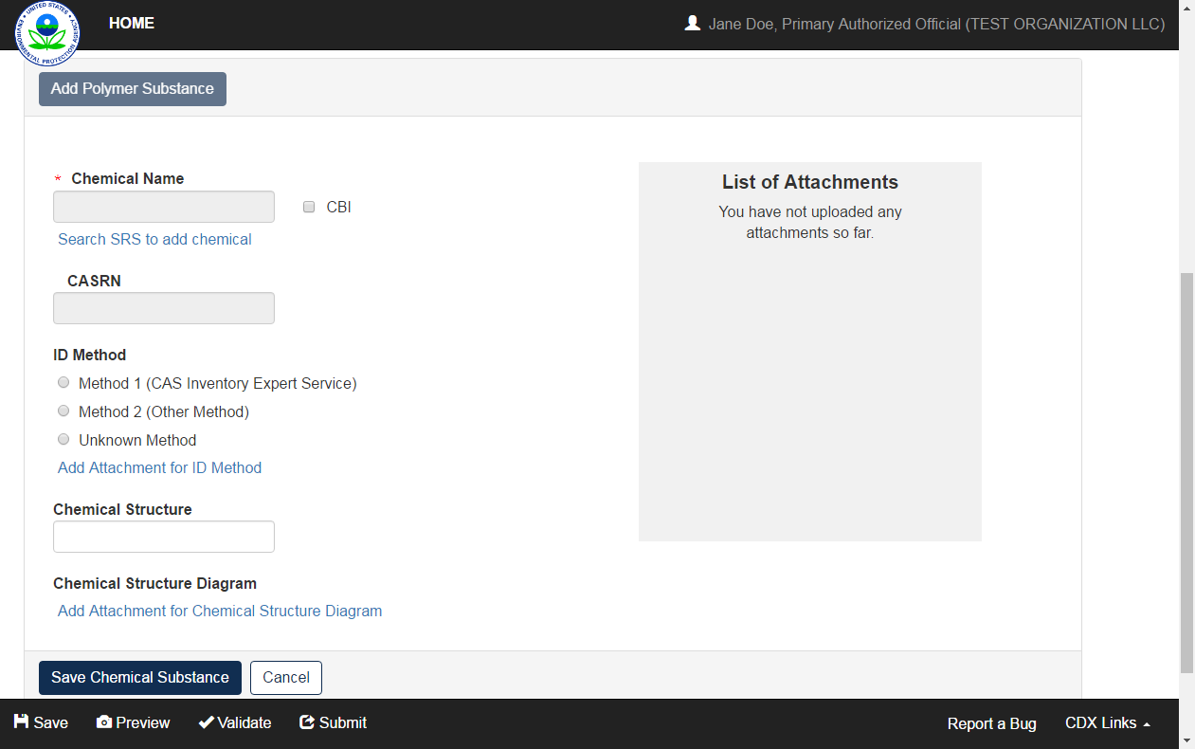
OMB Control No. 2070-0224
Expiration 11/30/2025
EPA Form No. 9600-07

Slide 30
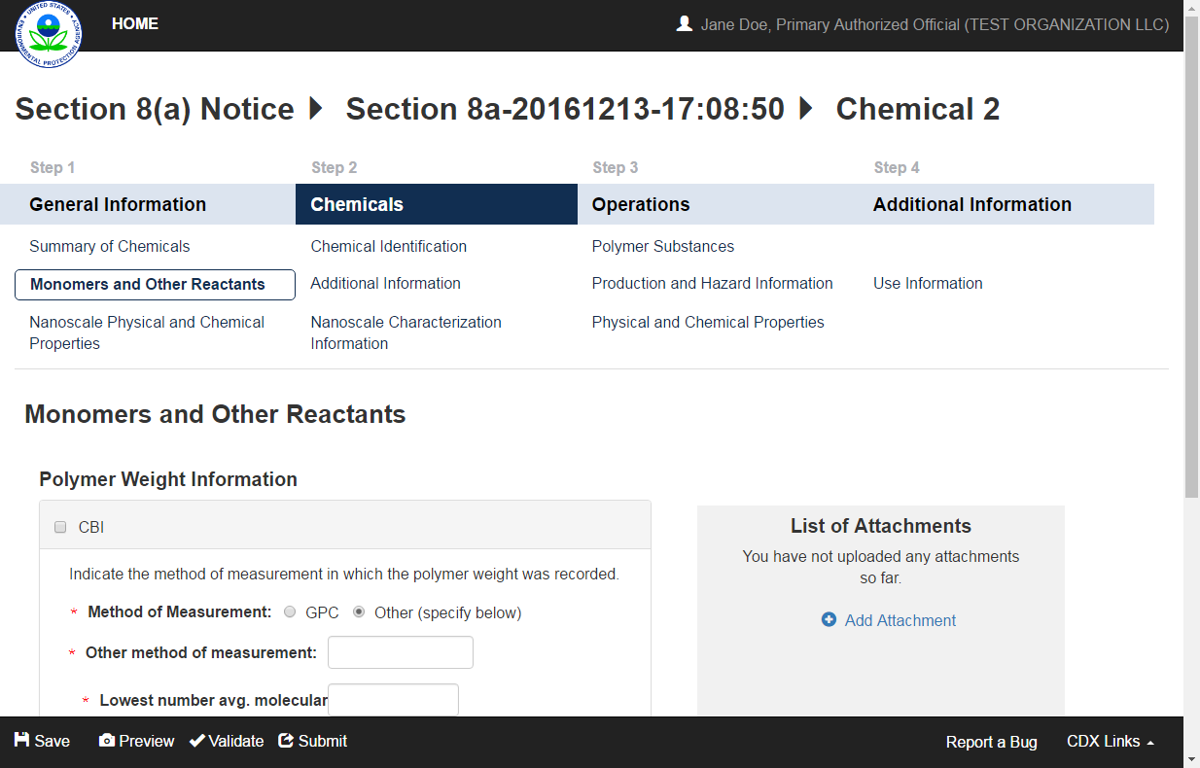
OMB Control No. 2070-0224
Expiration 11/30/2025
EPA Form No. 9600-07

Slide 31
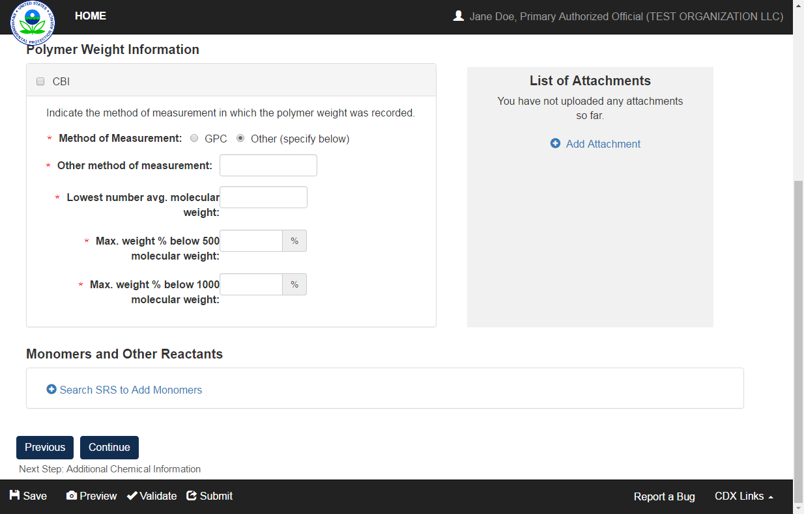
OMB Control No. 2070-0224
Expiration 11/30/2025
EPA Form No. 9600-07

Slide 32
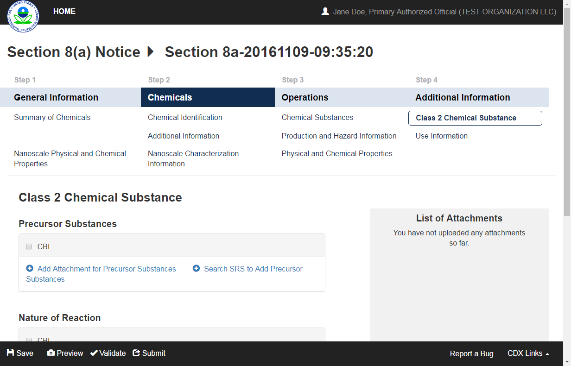
OMB Control No. 2070-0224
Expiration 11/30/2025
EPA Form No. 9600-07

Slide 33
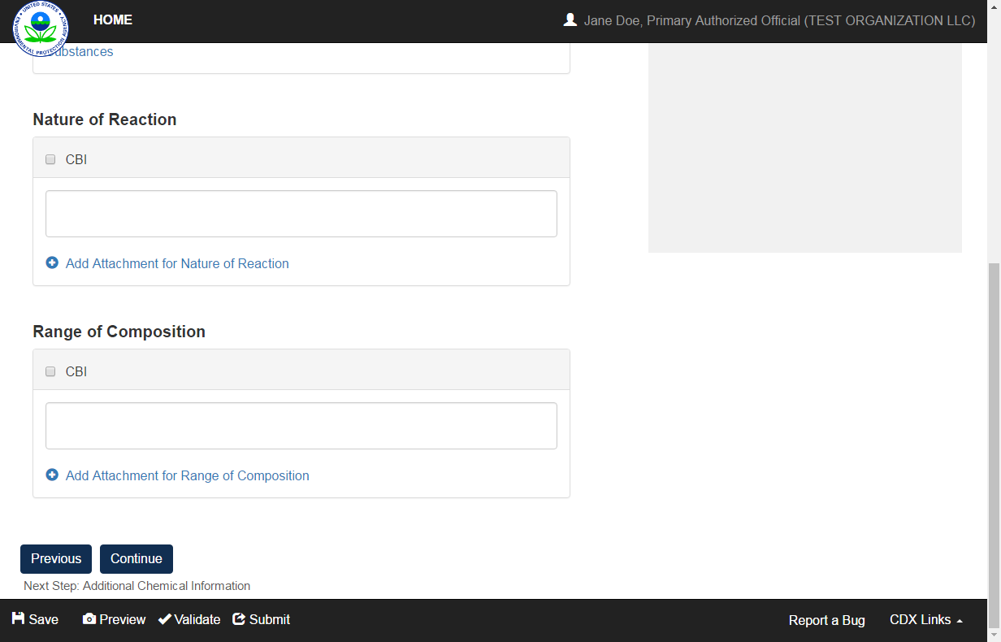
OMB Control No. 2070-0224
Expiration 11/30/2025
EPA Form No. 9600-07

Slide 34
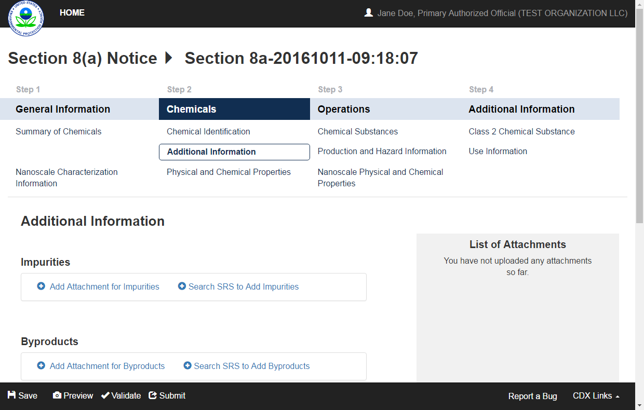
OMB Control No. 2070-0224
Expiration 11/30/2025
EPA Form No. 9600-07

Slide 35
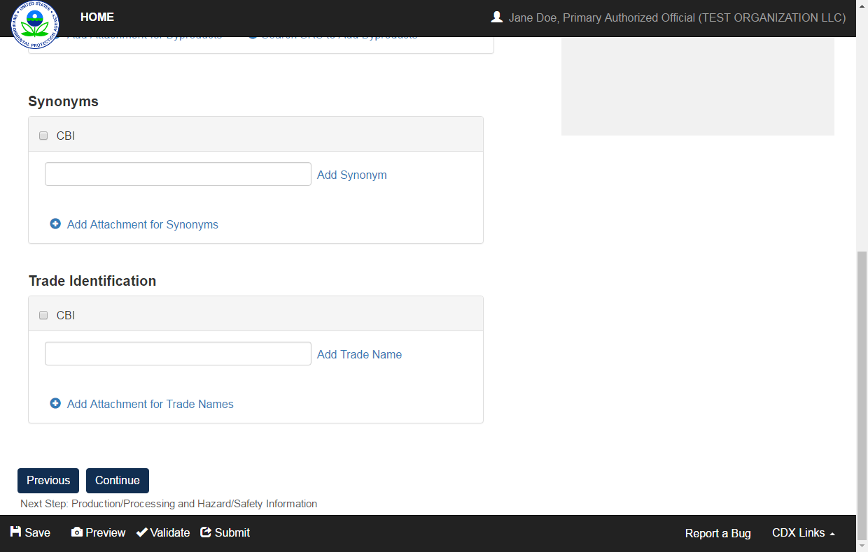
OMB Control No. 2070-0224
Expiration 11/30/2025
EPA Form No. 9600-07

Slide 36
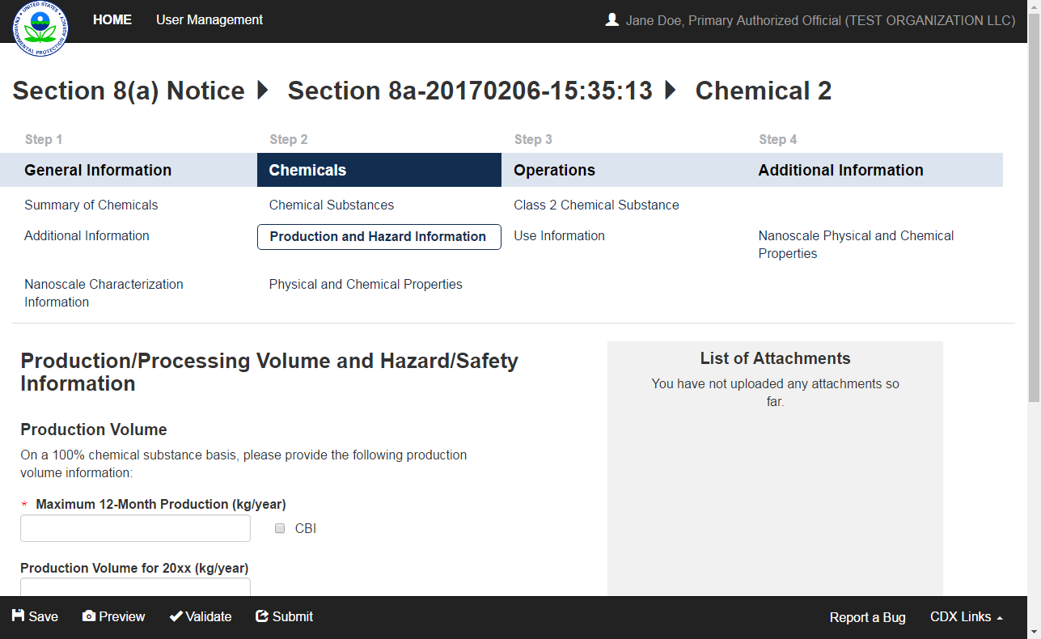
OMB Control No. 2070-0224
Expiration 11/30/2025
EPA Form No. 9600-07

Slide 37
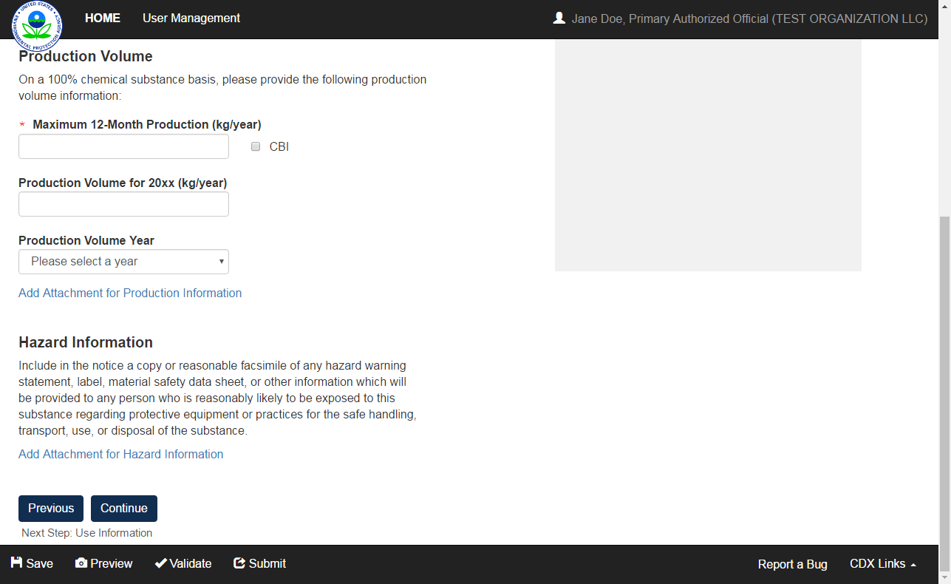
OMB Control No. 2070-0224
Expiration 11/30/2025
EPA Form No. 9600-07

Slide 38
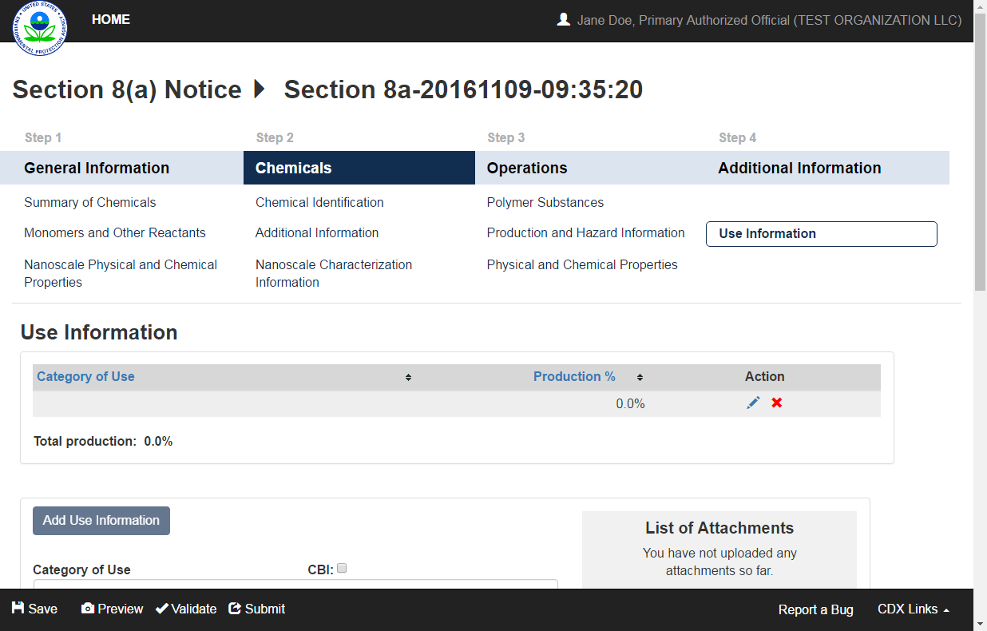
OMB Control No. 2070-0224
Expiration 11/30/2025
EPA Form No. 9600-07

Slide 39
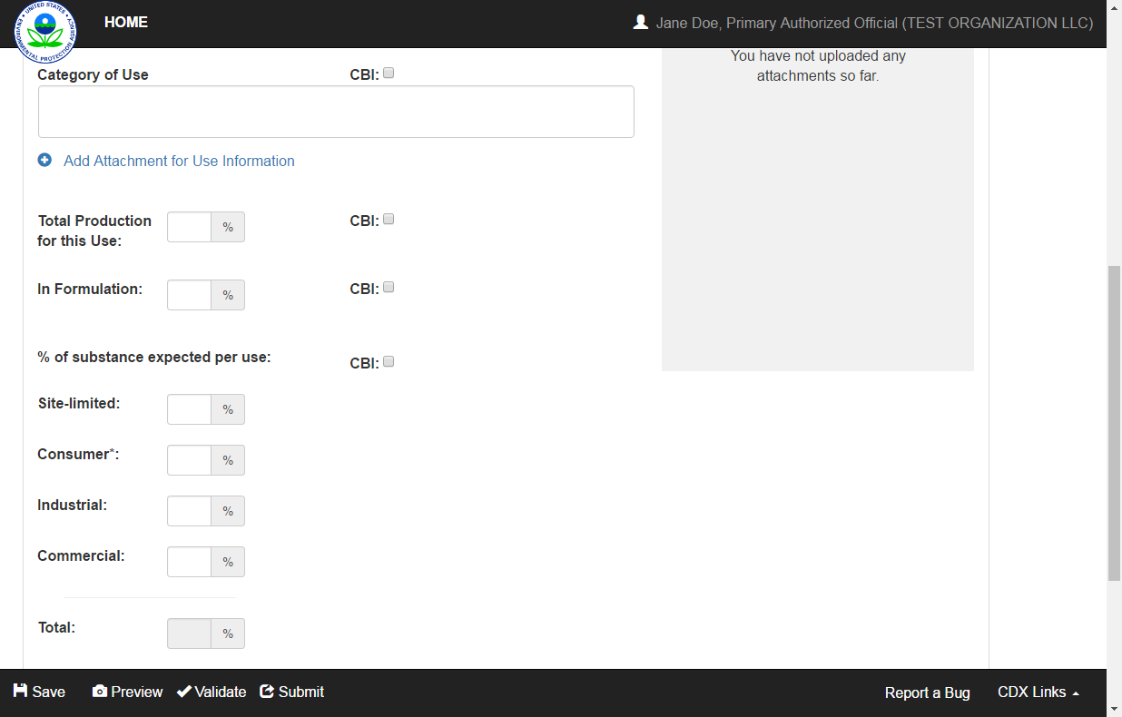
OMB Control No. 2070-0224
Expiration 11/30/2025
EPA Form No. 9600-07

Slide 40
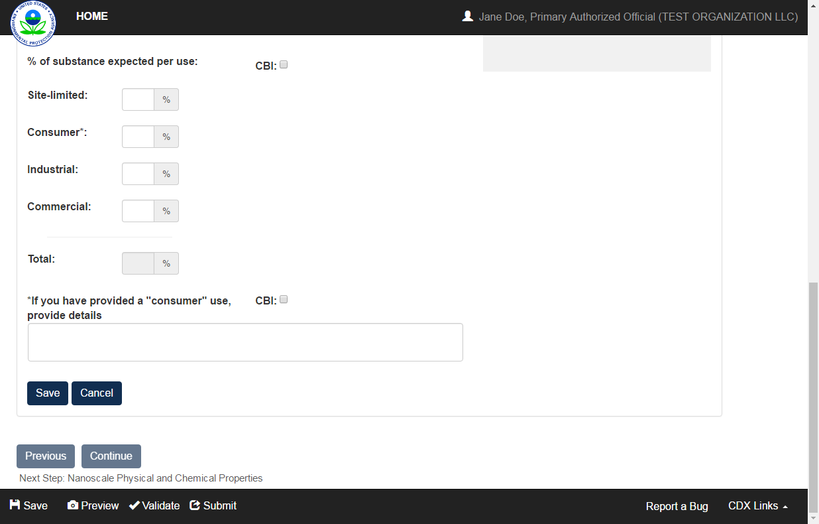
OMB Control No. 2070-0224
Expiration 11/30/2025
EPA Form No. 9600-07

Slide 41
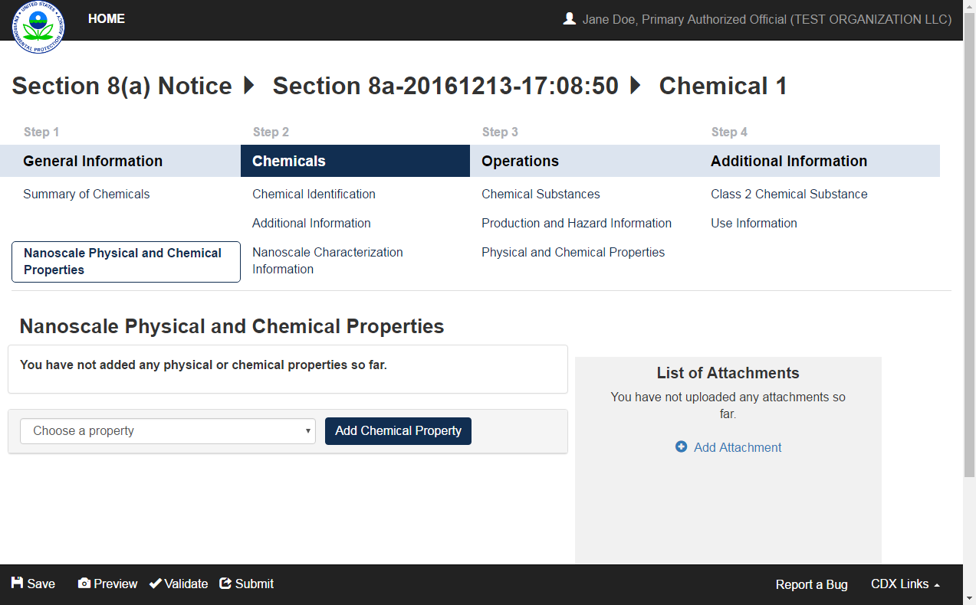
OMB Control No. 2070-0224
Expiration 11/30/2025
EPA Form No. 9600-07

Slide 42
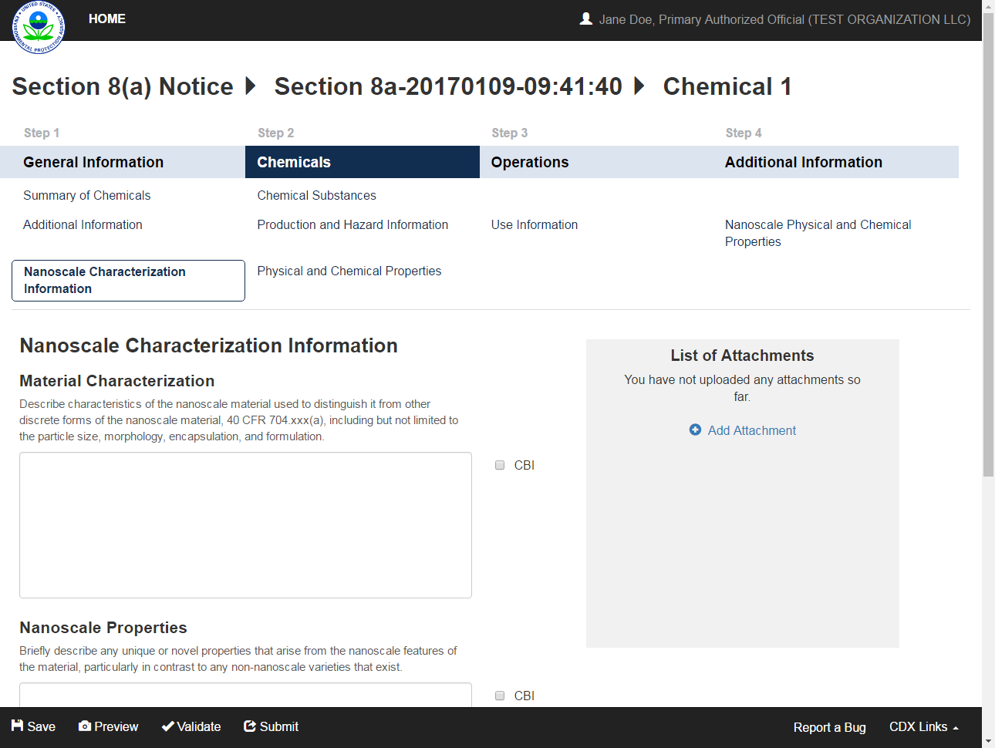
OMB Control No. 2070-0224
Expiration 11/30/2025
EPA Form No. 9600-07

Slide 43
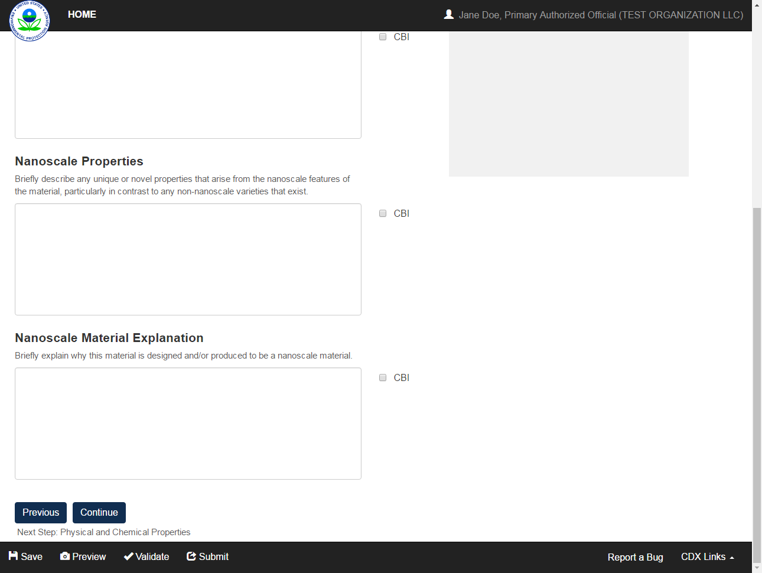
OMB Control No. 2070-0224
Expiration 11/30/2025
EPA Form No. 9600-07

Slide 44
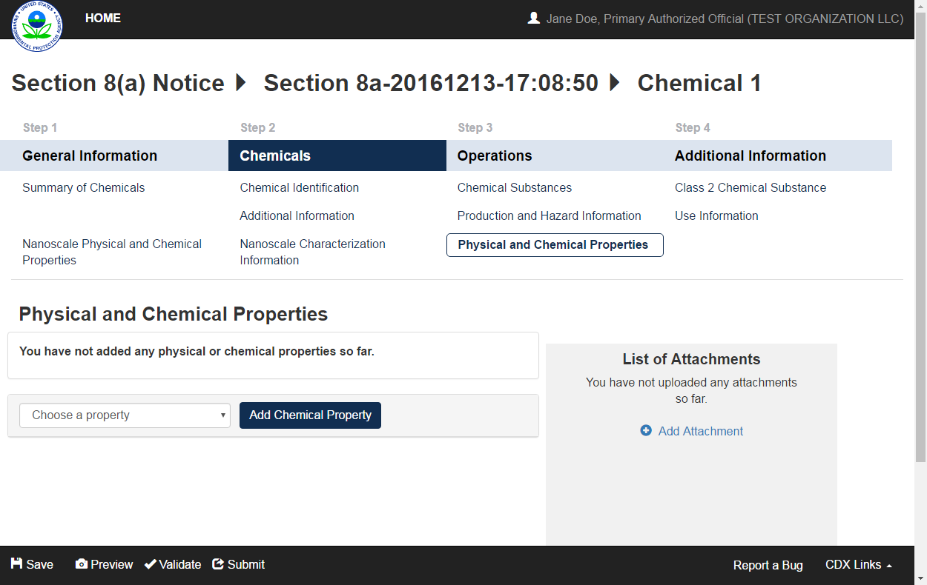
OMB Control No. 2070-0224
Expiration 11/30/2025
EPA Form No. 9600-07

Slide 45
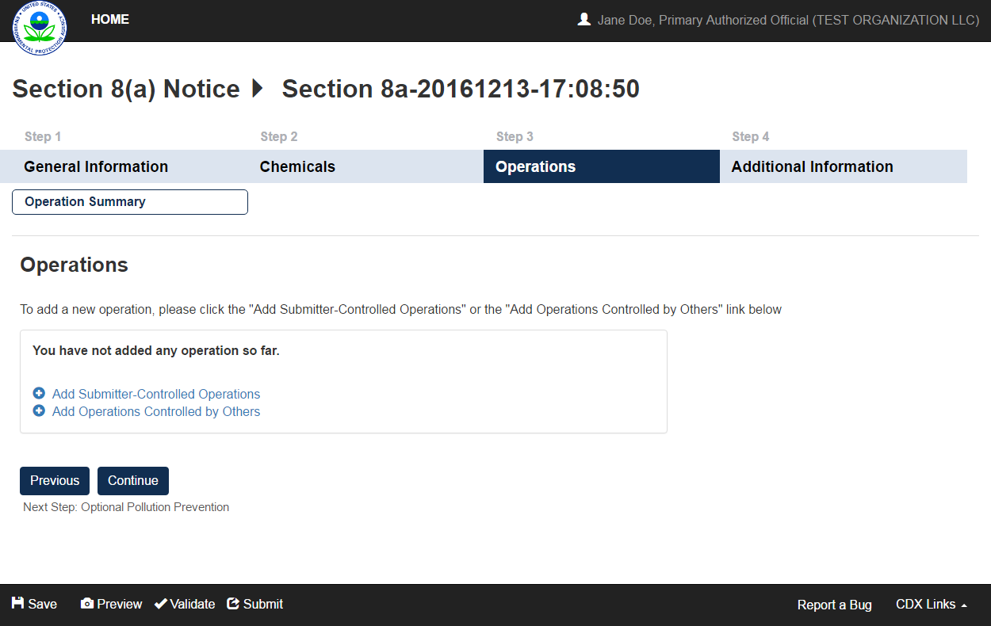
OMB Control No. 2070-0224
Expiration 11/30/2025
EPA Form No. 9600-07

Slide 46
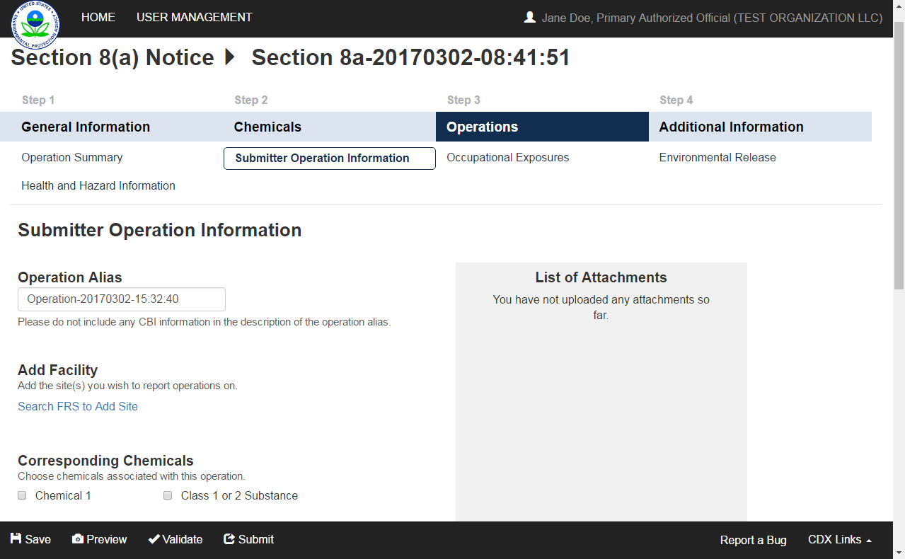
OMB Control No. 2070-0224
Expiration 11/30/2025
EPA Form No. 9600-07

Slide 47
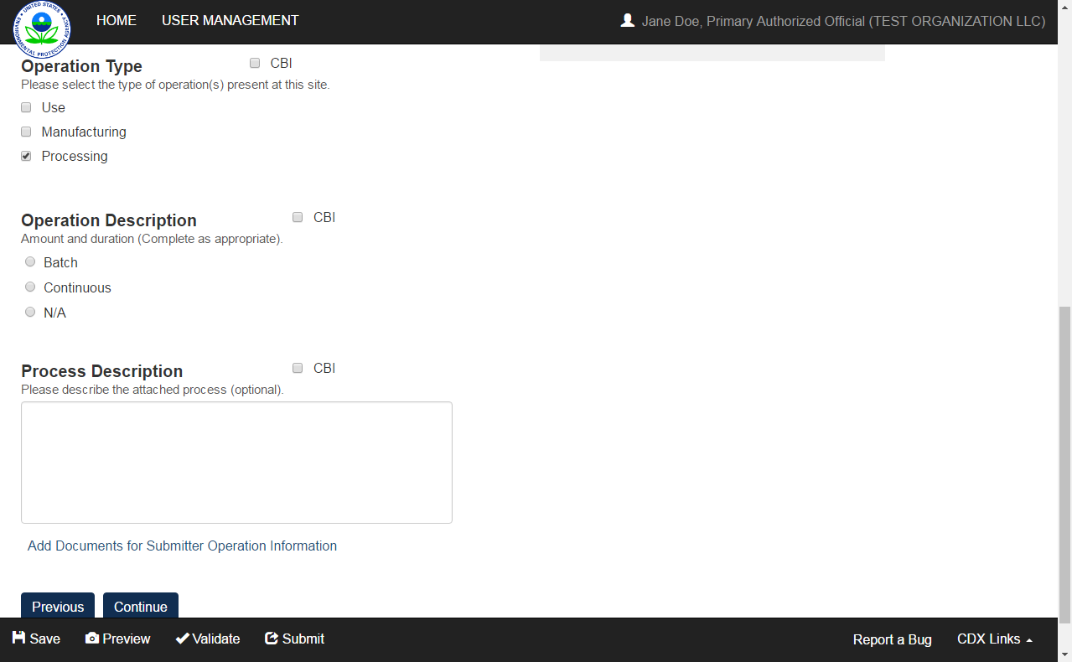
OMB Control No. 2070-0224
Expiration 11/30/2025
EPA Form No. 9600-07

Slide 48
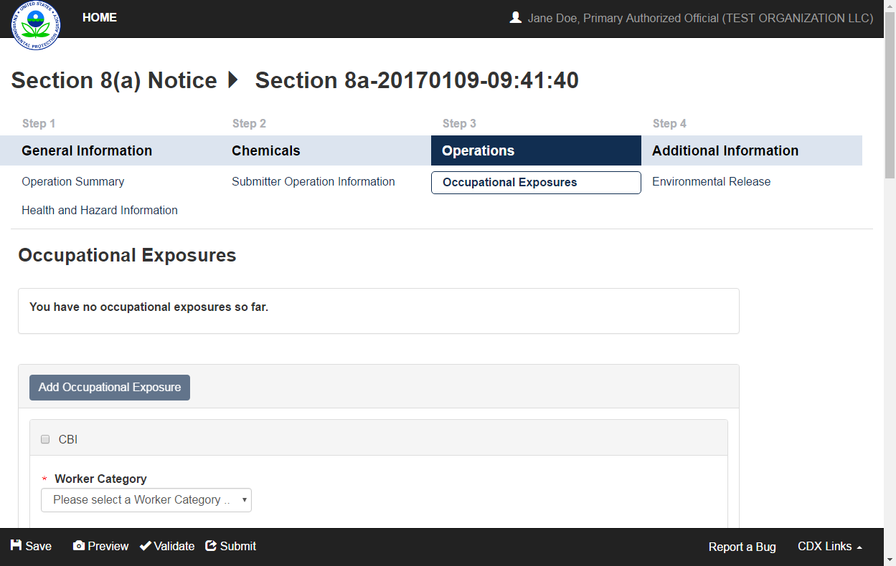
OMB Control No. 2070-0224
Expiration 11/30/2025
EPA Form No. 9600-07

Slide 49
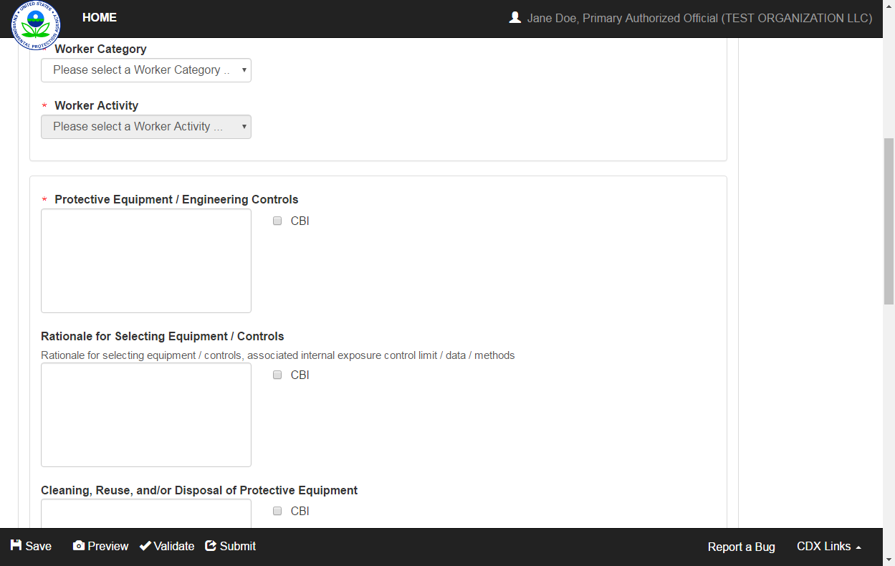
OMB Control No. 2070-0224
Expiration 11/30/2025
EPA Form No. 9600-07

Slide 50
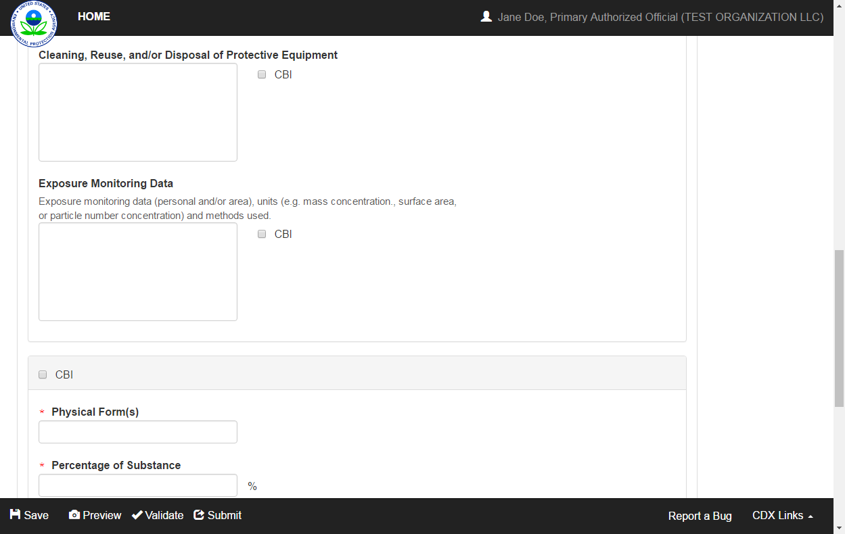
OMB Control No. 2070-0224
Expiration 11/30/2025
EPA Form No. 9600-07

Slide 51
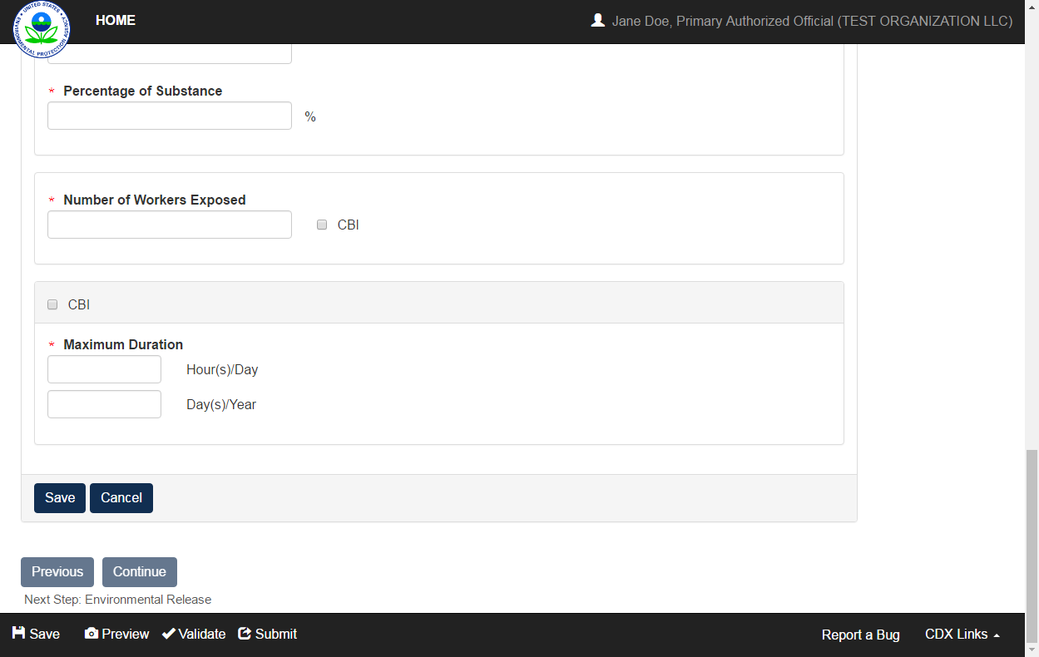
OMB Control No. 2070-0224
Expiration 11/30/2025
EPA Form No. 9600-07

Slide 52
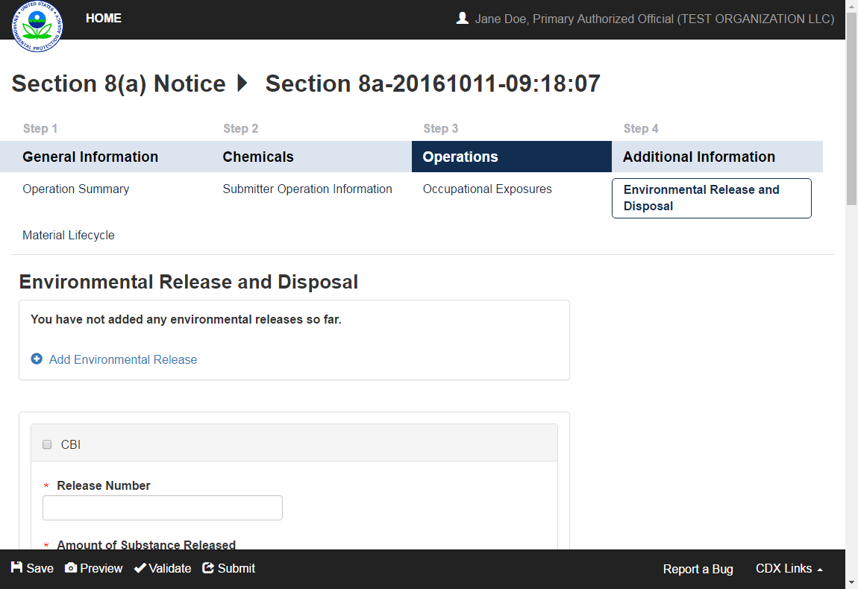
OMB Control No. 2070-0224
Expiration 11/30/2025
EPA Form No. 9600-07

Slide 53

OMB Control No. 2070-0224
Expiration 11/30/2025
EPA Form No. 9600-07

Slide 54

OMB Control No. 2070-0224
Expiration 11/30/2025
EPA Form No. 9600-07

Slide 55

OMB Control No. 2070-0224
Expiration 11/30/2025
EPA Form No. 9600-07

Slide 56

OMB Control No. 2070-0224
Expiration 11/30/2025
EPA Form No. 9600-07

Slide 57

OMB Control No. 2070-0224
Expiration 11/30/2025
EPA Form No. 9600-07

Slide 58

OMB Control No. 2070-0224
Expiration 11/30/2025
EPA Form No. 9600-07

Slide 59

OMB Control No. 2070-0224
Expiration 11/30/2025
EPA Form No. 9600-07

Slide 60

OMB Control No. 2070-0224
Expiration 11/30/2025
EPA Form No. 9600-07

Slide 61


OMB Control No. 2070-0224
Expiration 11/30/2025
EPA Form No. 9600-07

Slide 62

OMB Control No. 2070-0224
Expiration 11/30/2025
EPA Form No. 9600-07

Slide 63

OMB Control No. 2070-0224
Expiration 11/30/2025
EPA Form No. 9600-07

Slide 64

OMB Control No. 2070-0224
Expiration 11/30/2025
EPA Form No. 9600-07

Slide 65

OMB Control No. 2070-0224
Expiration 11/30/2025
EPA Form No. 9600-07

Slide 66

OMB Control No. 2070-0224
Expiration 11/30/2025
EPA Form No. 9600-07

Slide 67

OMB Control No. 2070-0224
Expiration 11/30/2025
EPA Form No. 9600-07

Slide 68

OMB Control No. 2070-0224
Expiration 11/30/2025
EPA Form No. 9600-07

Slide 69

OMB Control No. 2070-0224
Expiration 11/30/2025
EPA Form No. 9600-07

Slide 70

OMB Control No. 2070-0224
Expiration 11/30/2025
EPA Form No. 9600-07

Slide 71
OMB Control No. 2070-0224
Expiration 11/30/2025
EPA Form No. 9600-07

Slide 72
OMB Control No. 2070-0224
Expiration 11/30/2025
EPA Form No. 9600-07

Slide 73

OMB Control No. 2070-0224
Expiration 11/30/2025
EPA Form No. 9600-07

Slide 74

OMB Control No. 2070-0224
Expiration 11/30/2025
EPA Form No. 9600-07

Slide 75

OMB Control No. 2070-0224
Expiration 11/30/2025
EPA Form No. 9600-07

Slide 76

OMB Control No. 2070-0224
Expiration 11/30/2025
EPA Form No. 9600-07

Slide 77

OMB Control No. 2070-0224
Expiration 11/30/2025
EPA Form No. 9600-07

Slide 78

OMB Control No. 2070-0224
Expiration 11/30/2025
EPA Form No. 9600-07

Slide 79

OMB Control No. 2070-0224
Expiration 11/30/2025
EPA Form No. 9600-07

Slide 80

OMB Control No. 2070-0224
Expiration 11/30/2025
EPA Form No. 9600-07

Slide 81

OMB Control No. 2070-0224
Expiration 11/30/2025
EPA Form No. 9600-07

Slide 82

OMB Control No. 2070-0224
Expiration 11/30/2025
EPA Form No. 9600-07

Slide 83

OMB Control No. 2070-0224
Expiration 11/30/2025
EPA Form No. 9600-07

Slide 84

OMB Control No. 2070-0224
Expiration 11/30/2025
EPA Form No. 9600-07

Slide 85

OMB Control No. 2070-0224
Expiration 11/30/2025
EPA Form No. 9600-07

Slide 86

OMB Control No. 2070-0224
Expiration 11/30/2025
EPA Form No. 9600-07

Slide 87

OMB Control No. 2070-0224
Expiration 11/30/2025
EPA Form No. 9600-07

Slide 88

OMB Control No. 2070-0224
Expiration 11/30/2025
EPA Form No. 9600-07

Slide 89

OMB Control No. 2070-0224
Expiration 11/30/2025
EPA Form No. 9600-07

Slide 90

OMB Control No. 2070-0224
Expiration 11/30/2025
EPA Form No. 9600-07

Slide 91
OMB Control No. 2070-0224
Expiration 11/30/2025
EPA Form No. 9600-07

Slide 92
OMB Control No. 2070-0224
Expiration 11/30/2025
EPA Form No. 9600-07

Slide 93

OMB Control No. 2070-0224
Expiration 11/30/2025
EPA Form No. 9600-07

Slide 94

OMB Control No. 2070-0224
Expiration 11/30/2025
EPA Form No. 9600-07

Slide 95

OMB Control No. 2070-0224
Expiration 11/30/2025
EPA Form No. 9600-07

Slide 96

OMB Control No. 2070-0224
Expiration 11/30/2025
EPA Form No. 9600-07

Slide 97

OMB Control No. 2070-0224
Expiration 11/30/2025
EPA Form No. 9600-07

Slide 98

OMB Control No. 2070-0224
Expiration 11/30/2025
EPA Form No. 9600-07

Slide 99

OMB Control No. 2070-0224
Expiration 11/30/2025
EPA Form No. 9600-07

Slide 100

OMB Control No. 2070-0224
Expiration 11/30/2025
EPA Form No. 7710-25

Slide 101

OMB Control No. 2070-0224
Expiration 11/30/2025
EPA Form No. 9600-07

Slide 102

OMB Control No. 2070-0224
Expiration 11/30/2025
EPA Form No. 9600-07

