Slide 1
TSCA Section 5 Biotech
EPA Form No. 6300-07
OMB Control No. 2070-0038
Expiration 12/31/2025

Slide 2
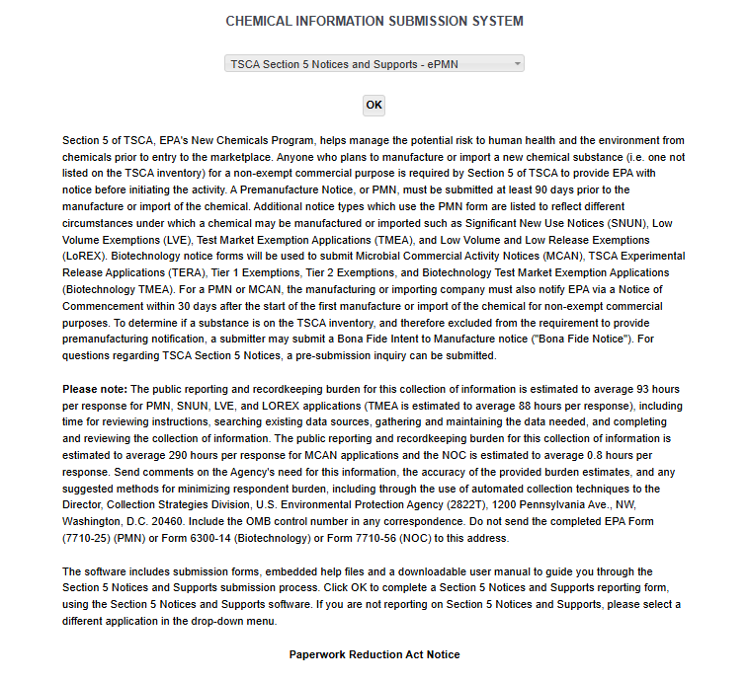
OMB Control No. 2070-0038
Expiration 12/31/2025
EPA Form No. 6300-07

Slide 3
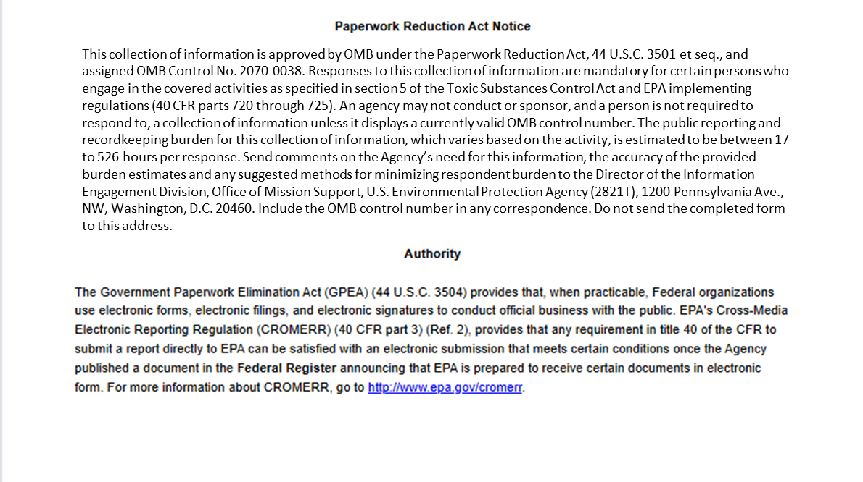
OMB Control No. 2070-0038
Expiration 12/31/2025
EPA Form No. 6300-07

Slide 4
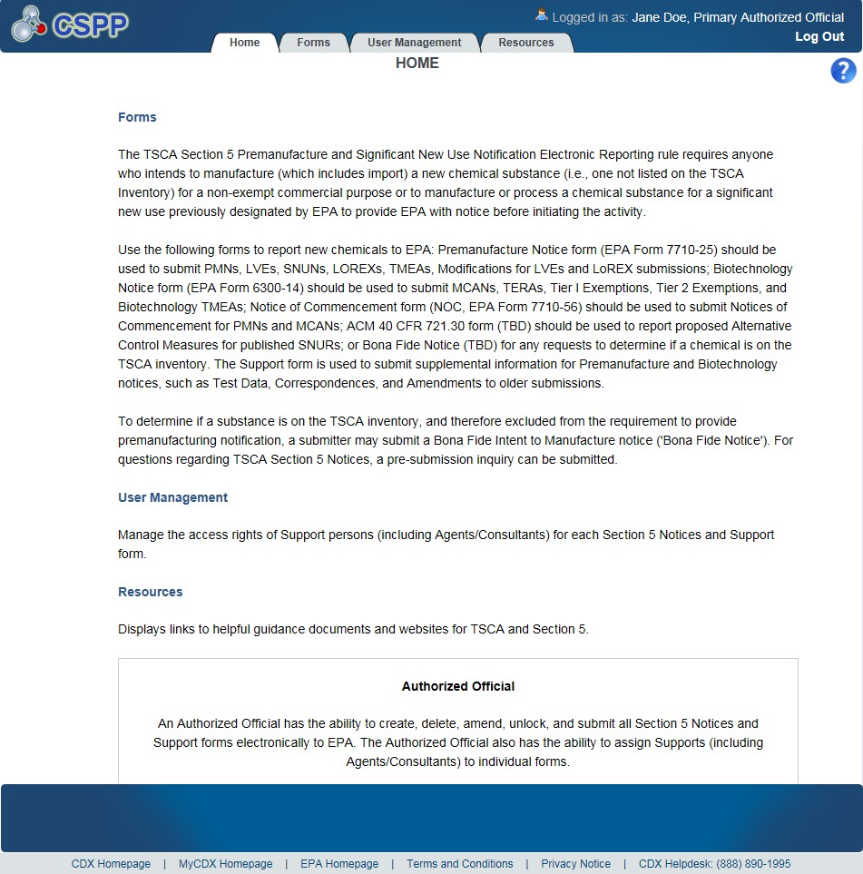
OMB Control No. 2070-0038
Expiration 12/31/2025
EPA Form No. 6300-07

Slide 5
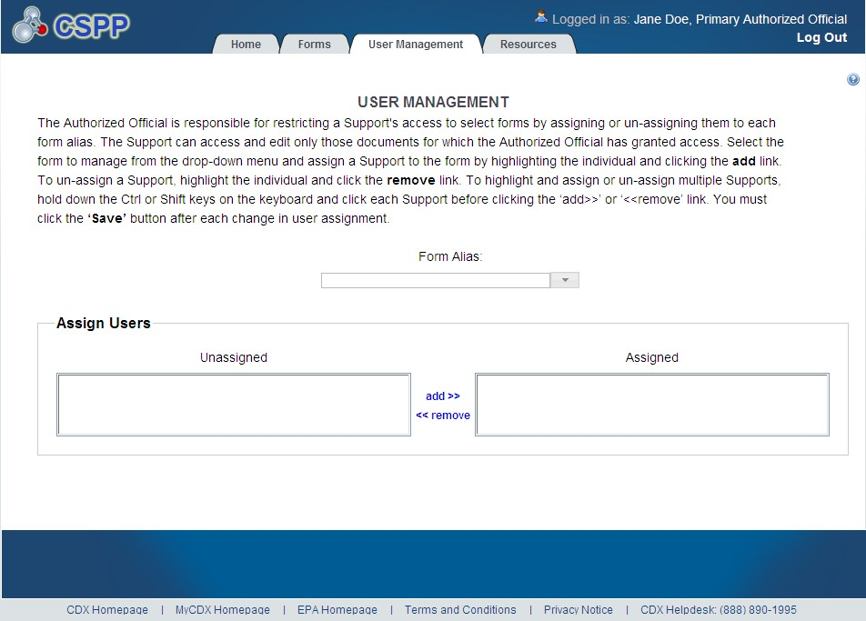
OMB Control No. 2070-0038
Expiration 12/31/2025
Exhibit
3
-
5
User Management Screen
EPA Form No. 6300-07

Slide 6
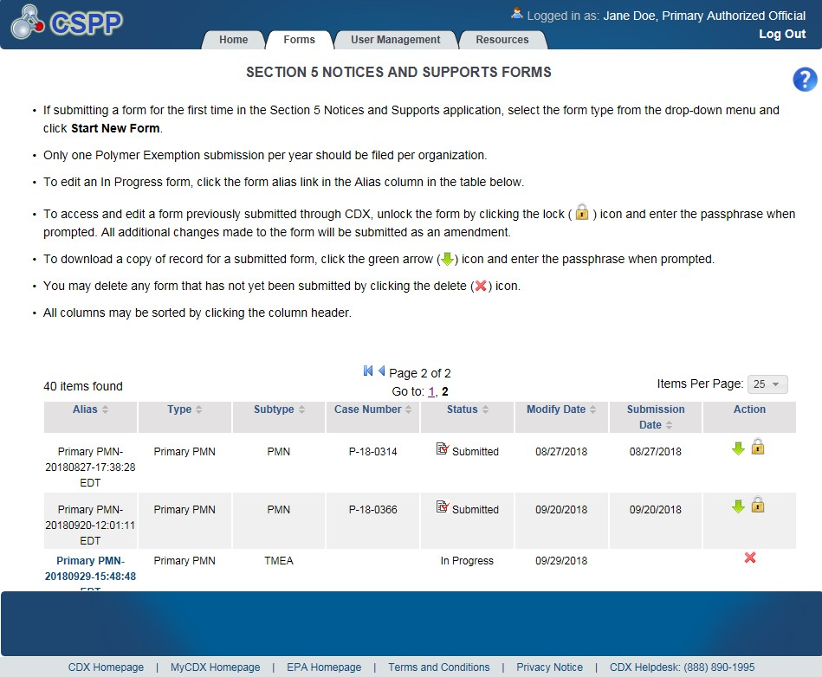
OMB Control No. 2070-0038
Expiration 12/31/2025
EPA Form No. 6300-07

Slide 7
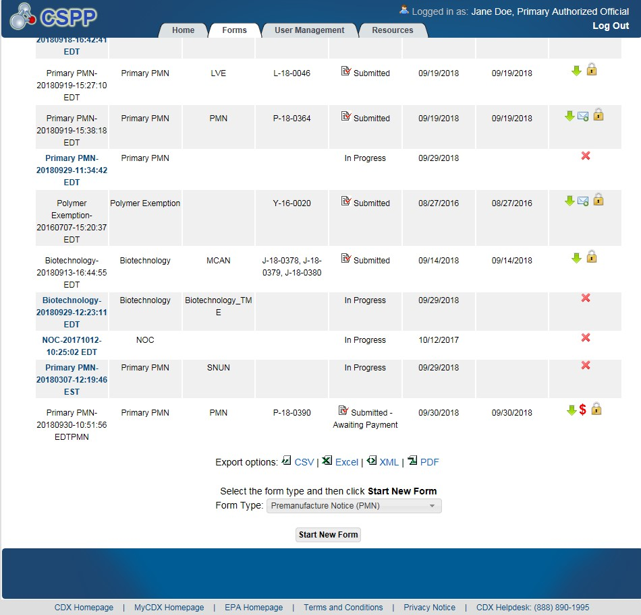
OMB Control No. 2070-0038
Expiration 12/31/2025
EPA Form No. 6300-07

Slide 8
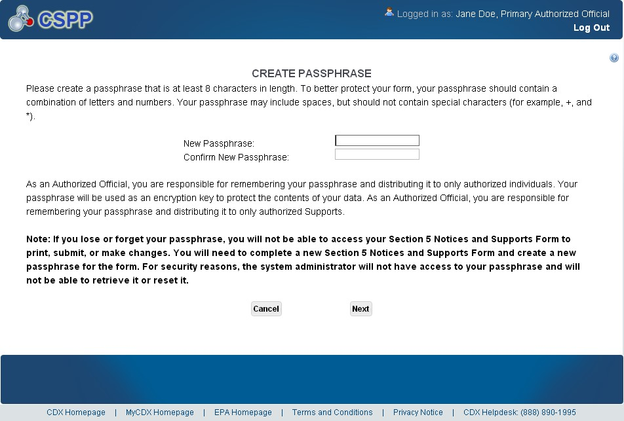
OMB Control No. 2070-0038
Expiration 12/31/2025
Exhibit
3
-
8
Create Passphrase Scr
een
EPA Form No. 6300-07

Slide 9
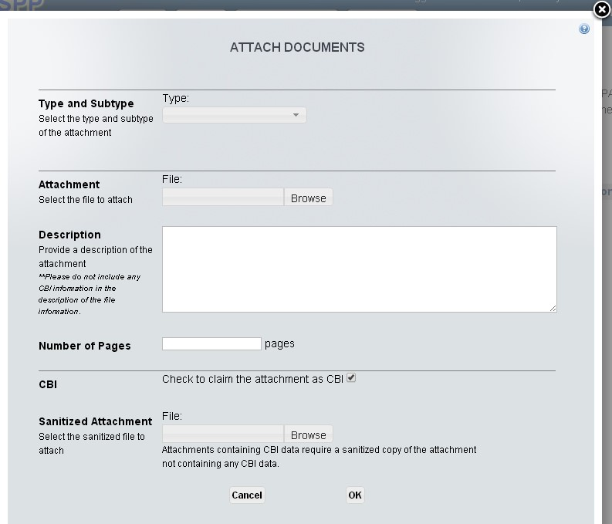
OMB Control No. 2070-0038
Expiration 12/31/2025
Exhibit
3
-
10
Attach Documents
Pop
-
Up
Window
EPA Form No. 6300-07

Slide 10
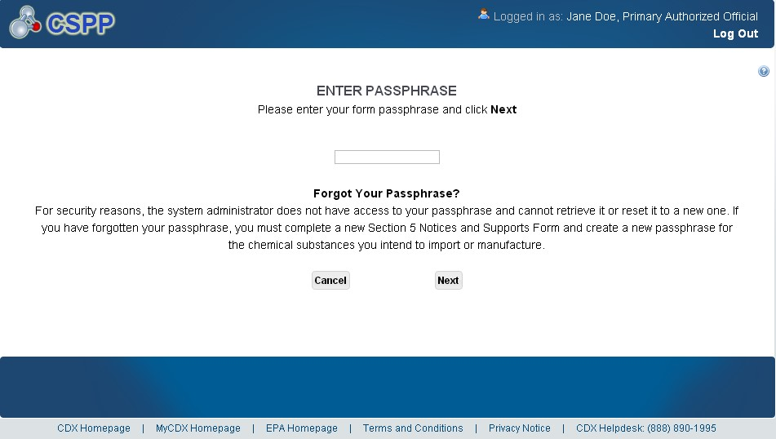
OMB Control No. 2070-0038
Expiration 12/31/2025
Exhibit
3
-
11
Enter Passphrase Screen
EPA Form No. 6300-07

Slide 11
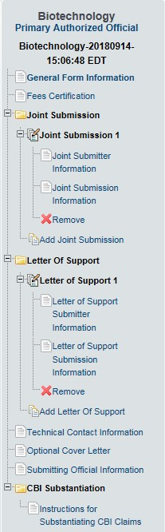
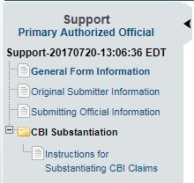
OMB Control No. 2070-0038
Expiration 12/31/2025
EPA Form No. 6300-07

Slide 12
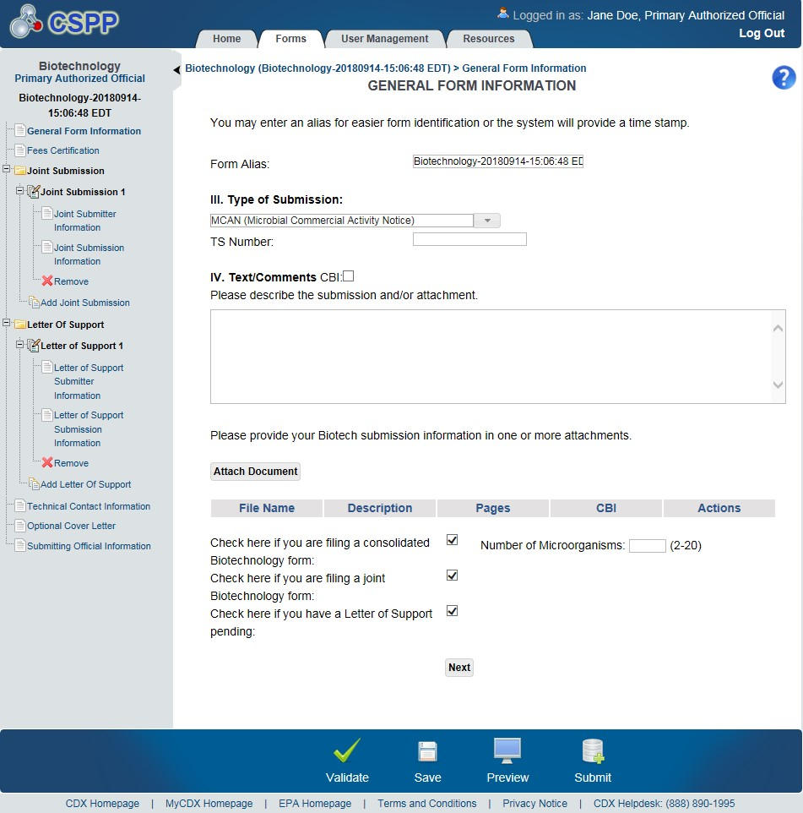
OMB Control No. 2070-0038
Expiration 12/31/2025
EPA Form No. 6300-07

Slide 13
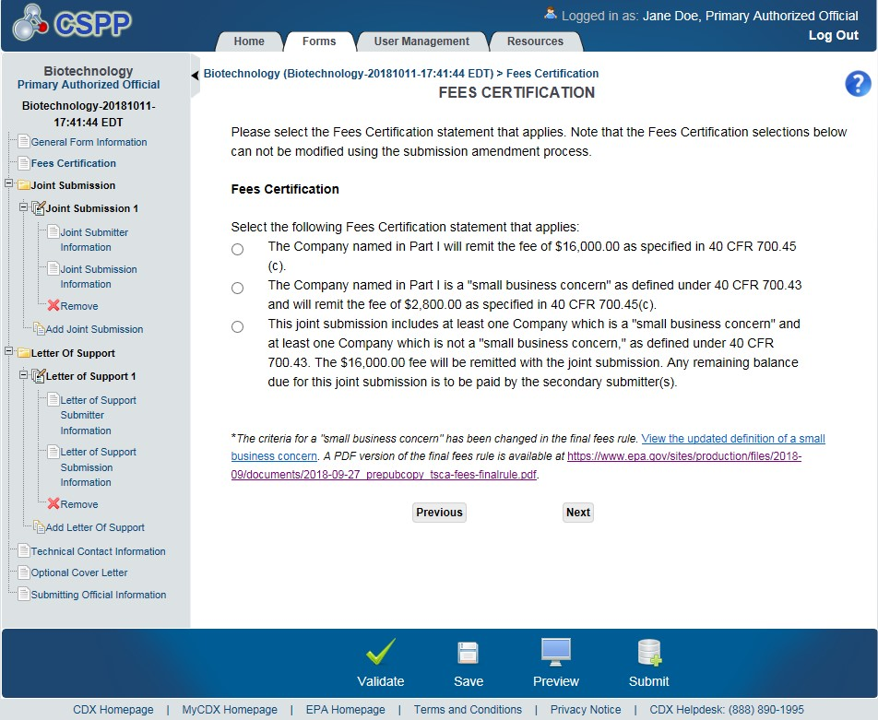
OMB Control No. 2070-0038
Expiration 12/31/2025
EPA Form No. 6300-07

Slide 14
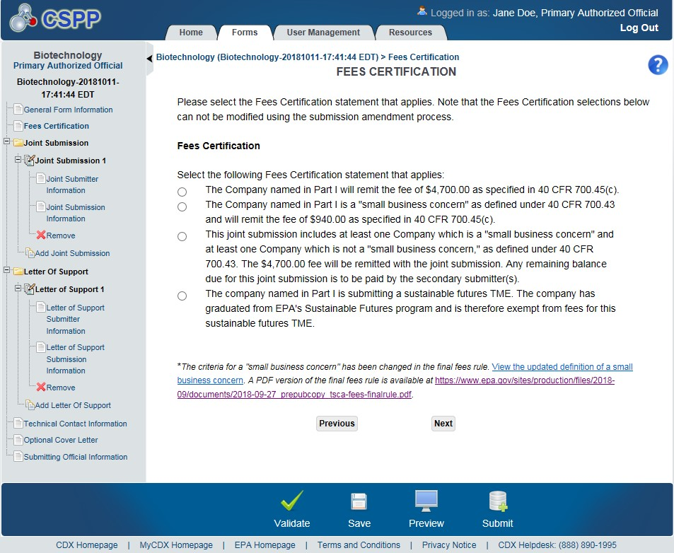
OMB Control No. 2070-0038
Expiration 12/31/2025
EPA Form No. 6300-07

Slide 15
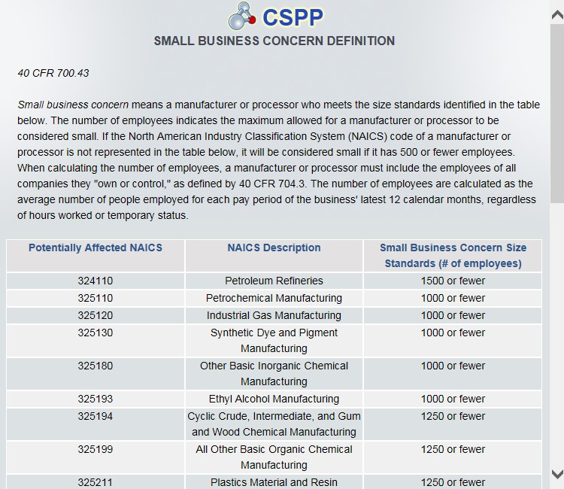
OMB Control No. 2070-0038
Expiration 12/31/2025
EPA Form No. 6300-07

Slide 16
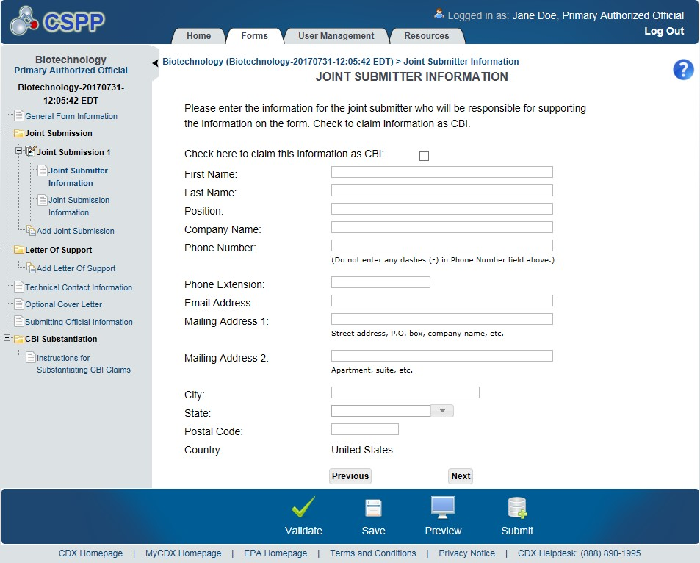
OMB Control No. 2070-0038
Expiration 12/31/2025
EPA Form No. 6300-07

Slide 17
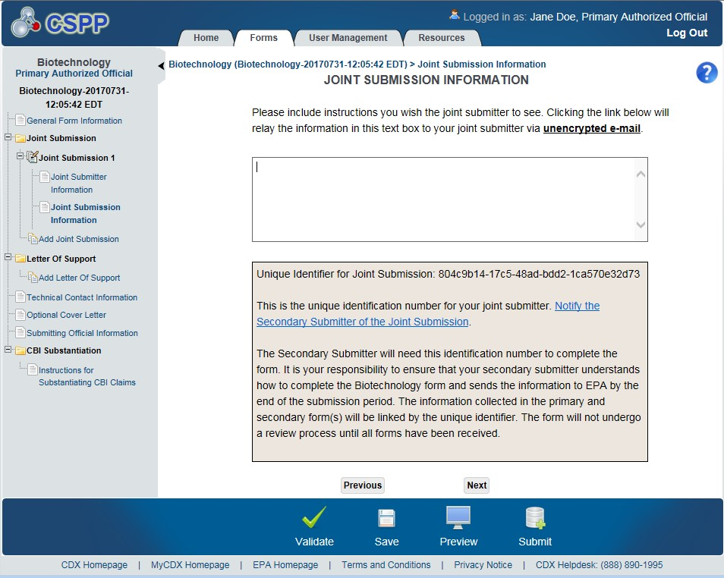
OMB Control No. 2070-0038
Expiration 12/31/2025
EPA Form No. 6300-07

Slide 18
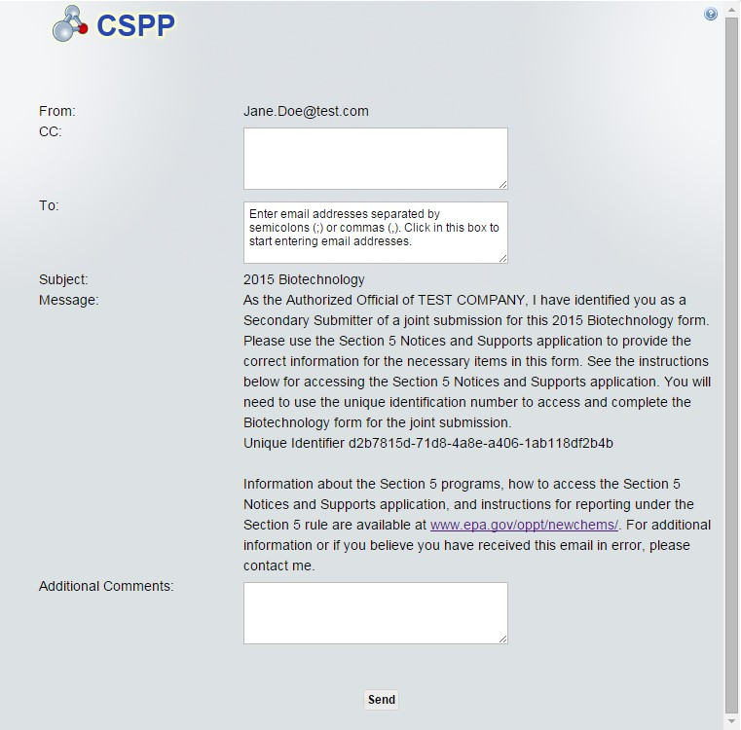
OMB Control No. 2070-0038
Expiration 12/31/2025
EPA Form No. 6300-07

Slide 19
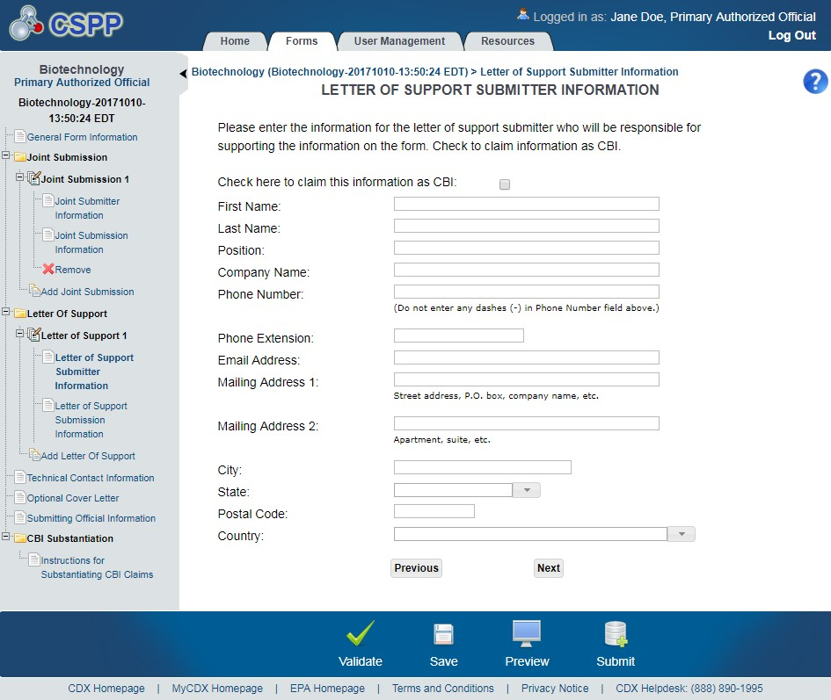
OMB Control No. 2070-0038
Expiration 12/31/2025
EPA Form No. 6300-07

Slide 20
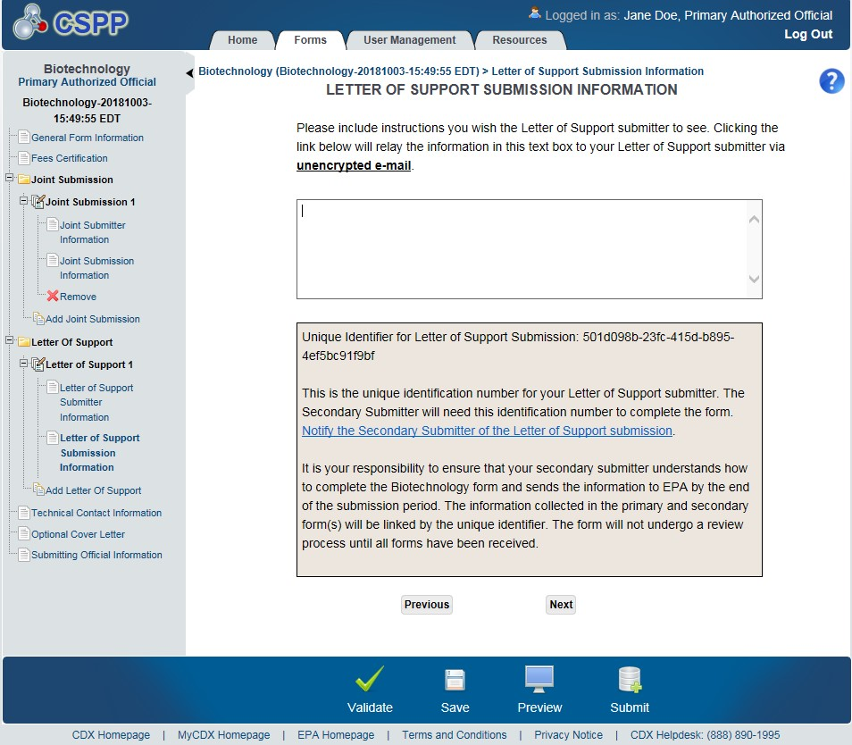
OMB Control No. 2070-0038
Expiration 12/31/2025
EPA Form No. 6300-07

Slide 21
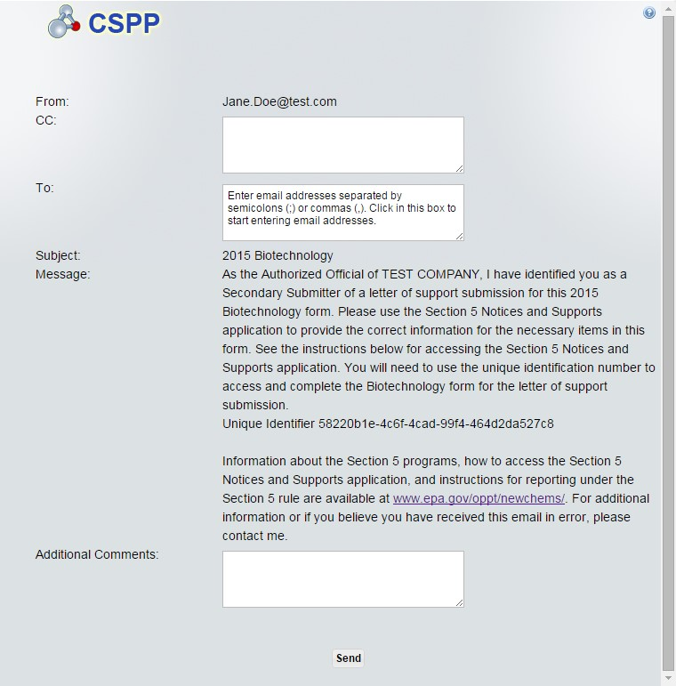
OMB Control No. 2070-0038
Expiration 12/31/2025
EPA Form No. 6300-07

Slide 22
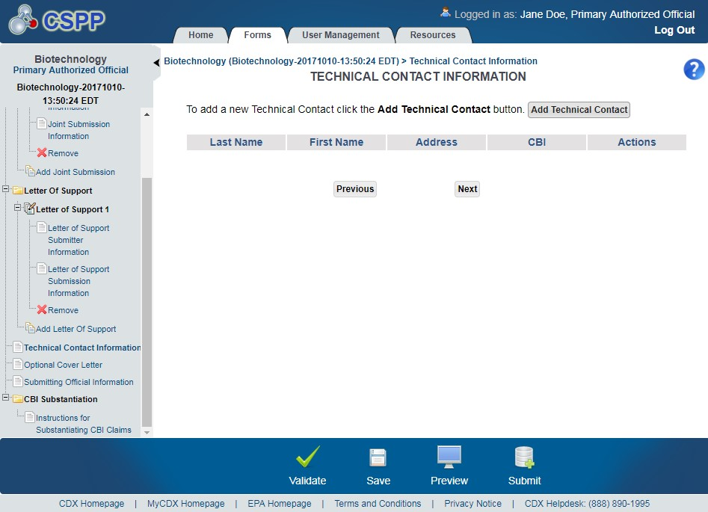
OMB Control No. 2070-0038
Expiration 12/31/2025
EPA Form No. 6300-07

Slide 23
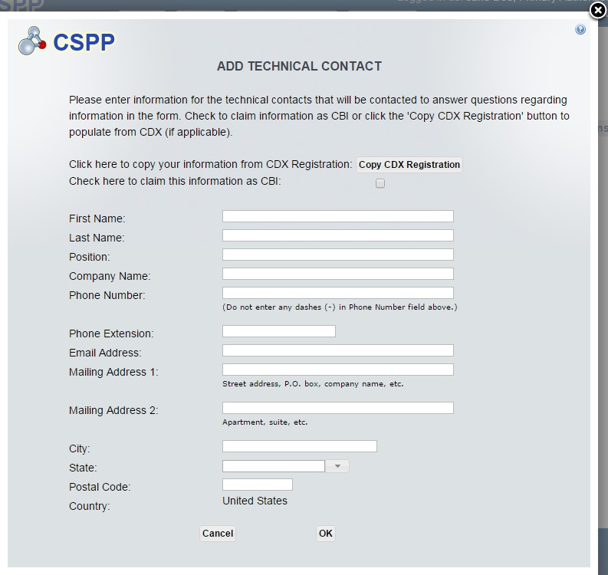
OMB Control No. 2070-0038
Expiration 12/31/2025
EPA Form No. 6300-07

Slide 24
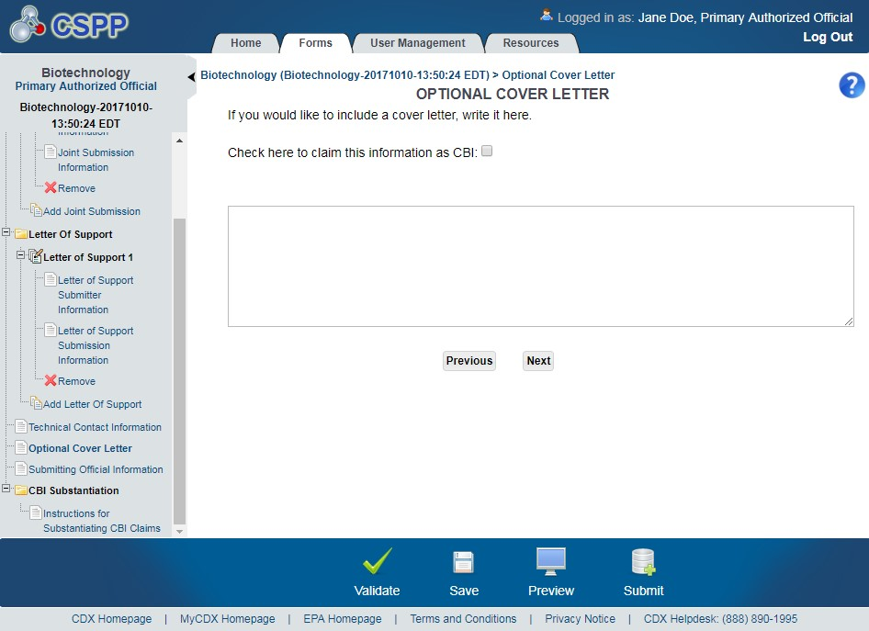



OMB Control No. 2070-0038
Expiration 12/31/2025
Navigation:
)
located in the bottom action bar to validate the form.
Click the ‘Validate’ icon (
)
located in the bottom action bar to perform a global save on the form.
Click the ‘Save’ icon (
)
located in the bottom action bar to view a P
Click the ‘Preview’ icon (
DF preview of the
EPA Form No. 6300-07

Slide 25
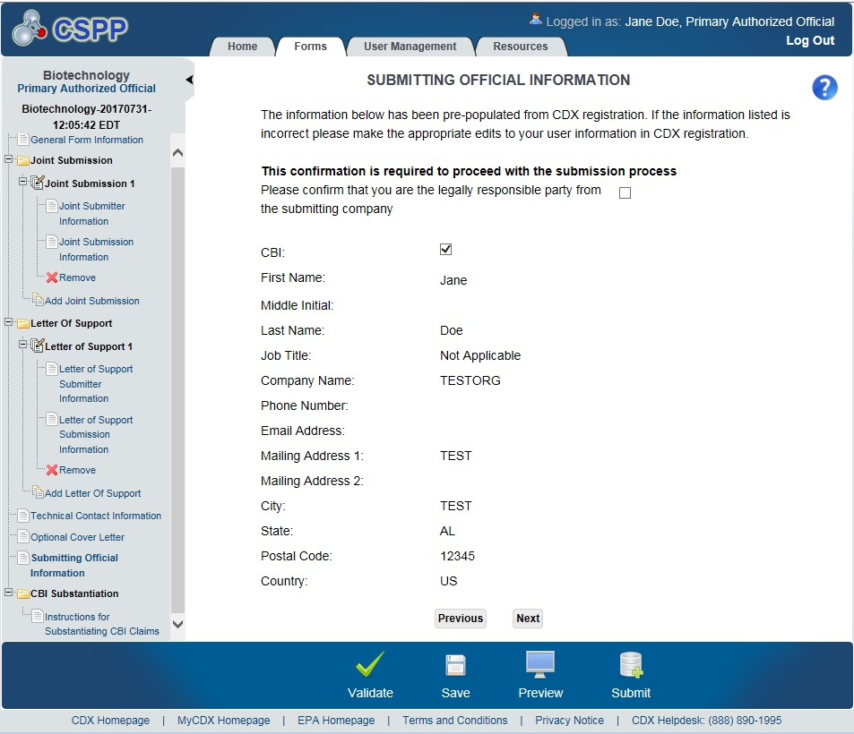
OMB Control No. 2070-0038
Expiration 12/31/2025
EPA Form No. 6300-07

Slide 26
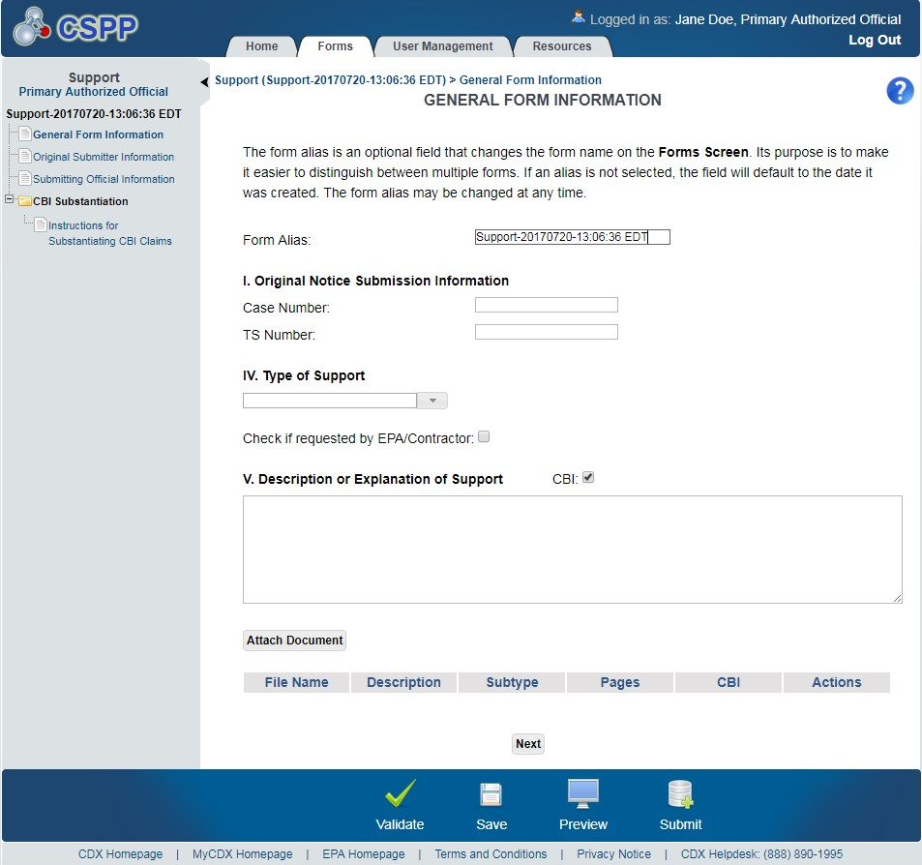
OMB Control No. 2070-0038
Expiration 12/31/2025
EPA Form No. 6300-07

Slide 27
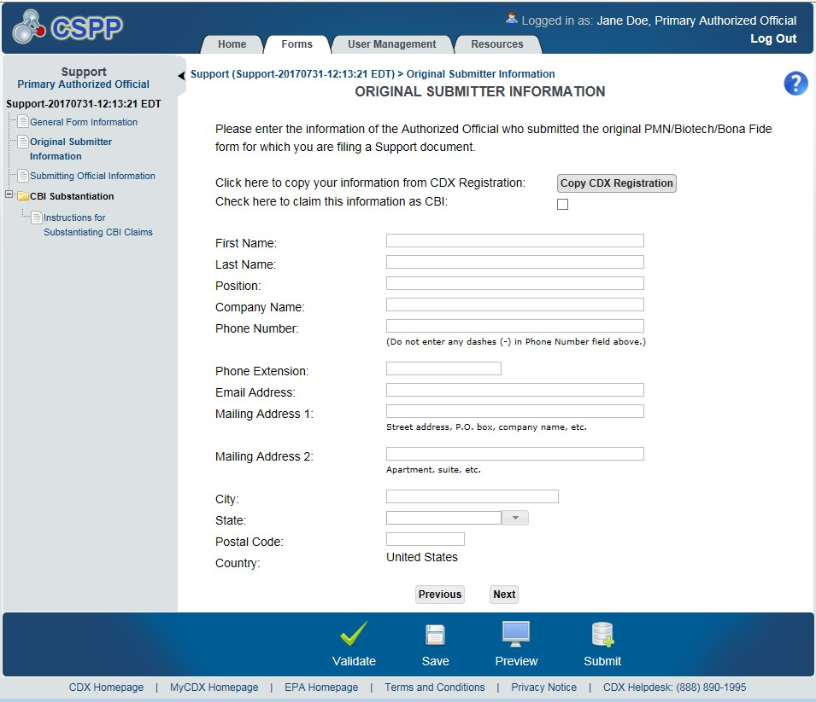
OMB Control No. 2070-0038
Expiration 12/31/2025
Navigat
ion:
)
located in the bottom action bar to validate the form.
Click the ‘Validate’ icon (
)
located in the bottom action bar to save the overall form. Click the
EPA Form No. 6300-07
Click the ‘Save’ icon (
)
located in the bottom action bar to generate a PDF preview of the form.
‘Preview’ icon (

Slide 28
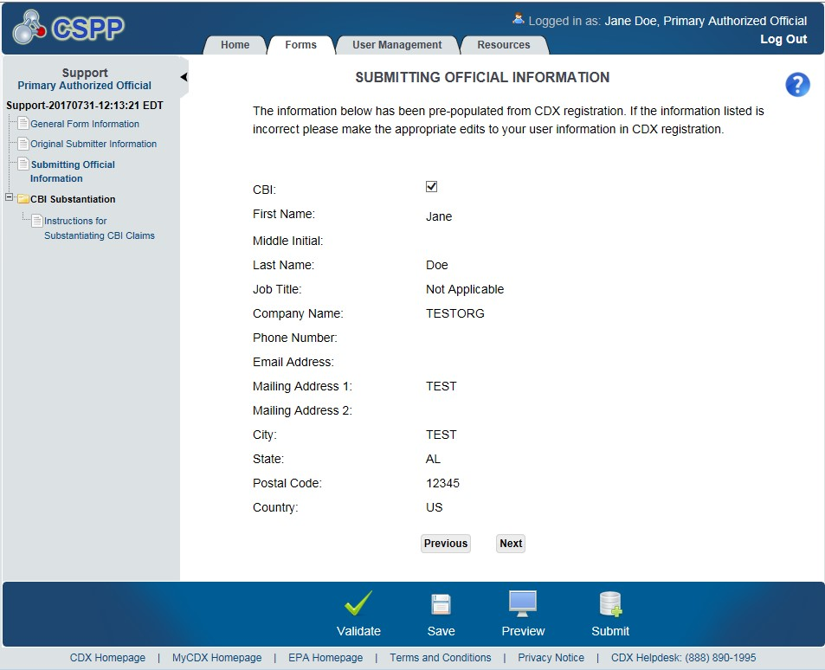
OMB Control No. 2070-0038
Expiration 12/31/2025
EPA Form No. 6300-07

Slide 29
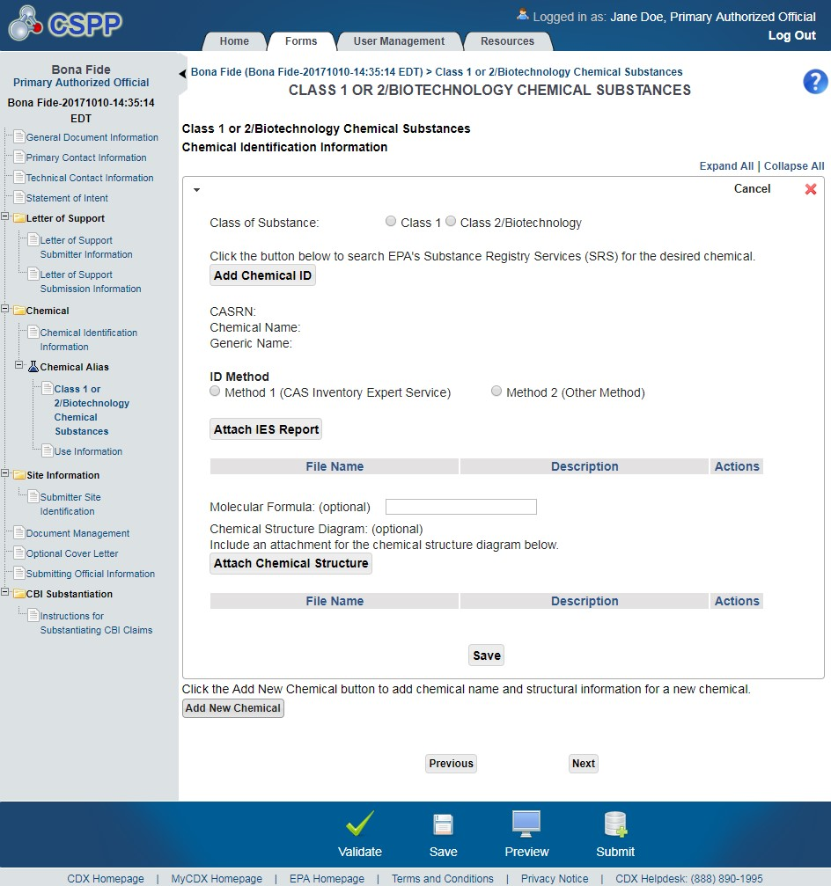
OMB Control No. 2070-0038
Expiration 12/31/2025
EPA Form No. 6300-07

Slide 30
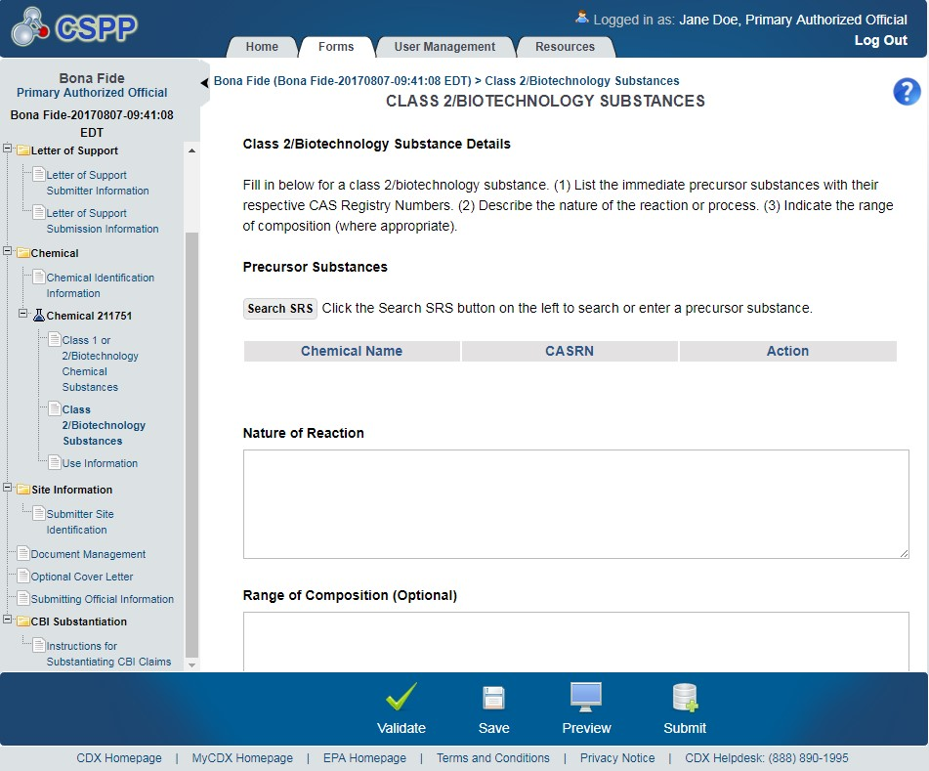
OMB Control No. 2070-0038
Expiration 12/31/2025
EPA Form No. 6300-07

Slide 31
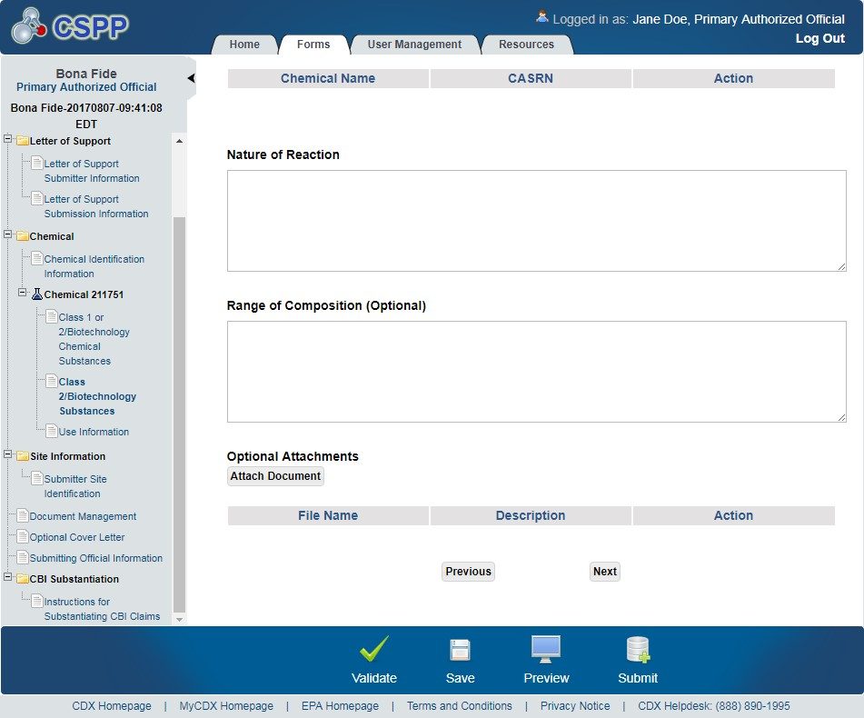
OMB Control No. 2070-0038
Expiration 12/31/2025
EPA Form No. 6300-07

Slide 32
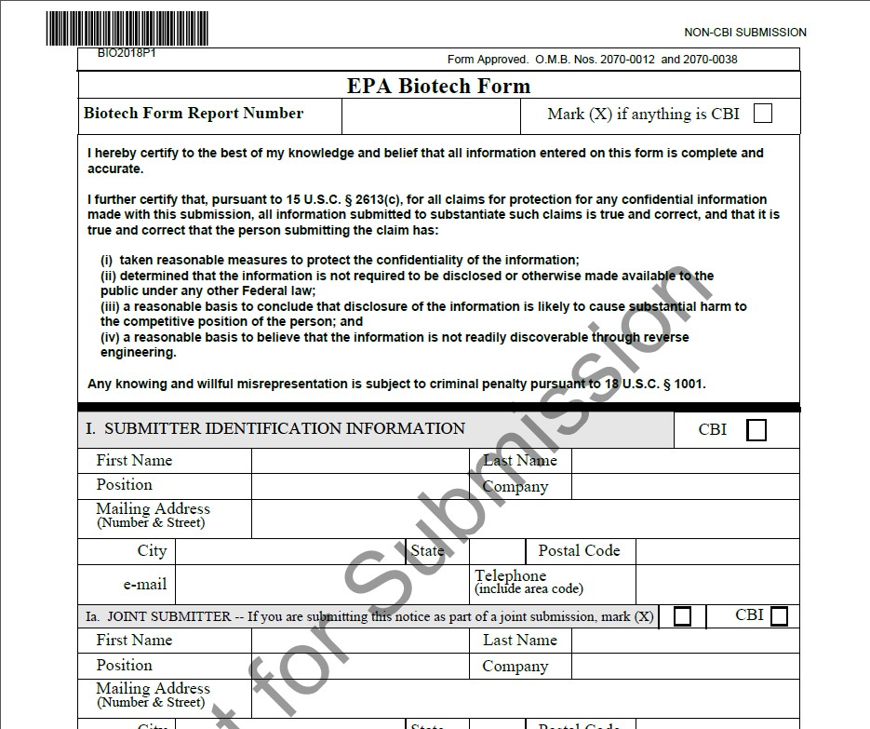
OMB Control No. 2070-0038
Expiration 12/31/2025
EPA Form No. 6300-07

Slide 33
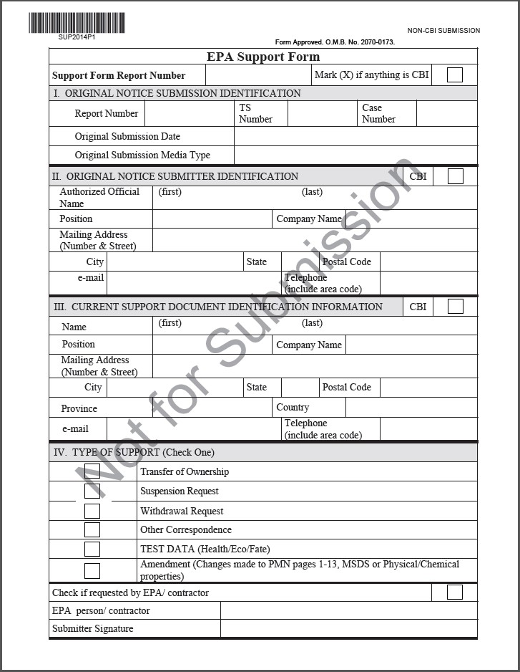
OMB Control No. 2070-0038
Expiration 12/31/2025
EPA Form No. 6300-07

Slide 34
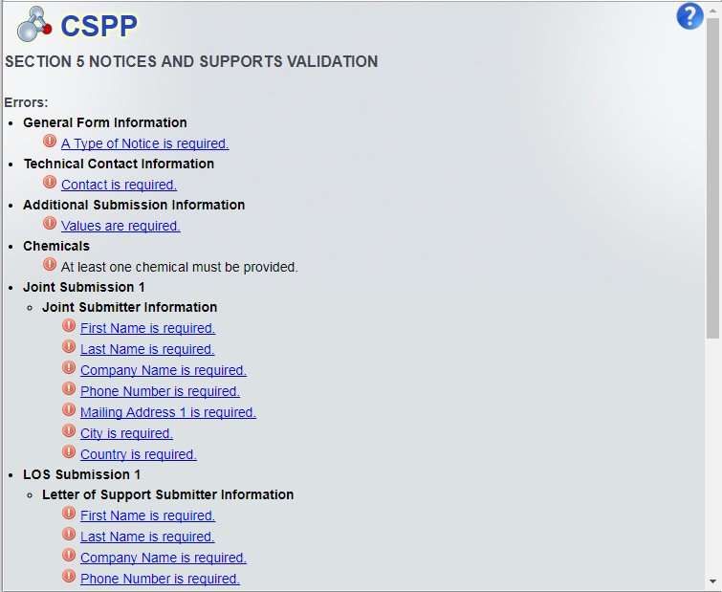
OMB Control No. 2070-0038
Expiration 12/31/2025
EPA Form No. 6300-07

Slide 35
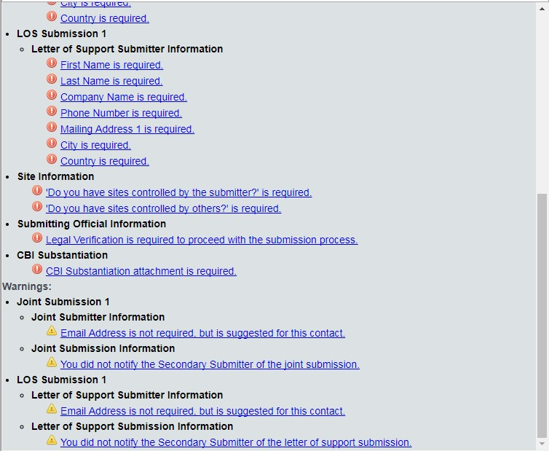
OMB Control No. 2070-0038
Expiration 12/31/2025
EPA Form No. 6300-07

Slide 36
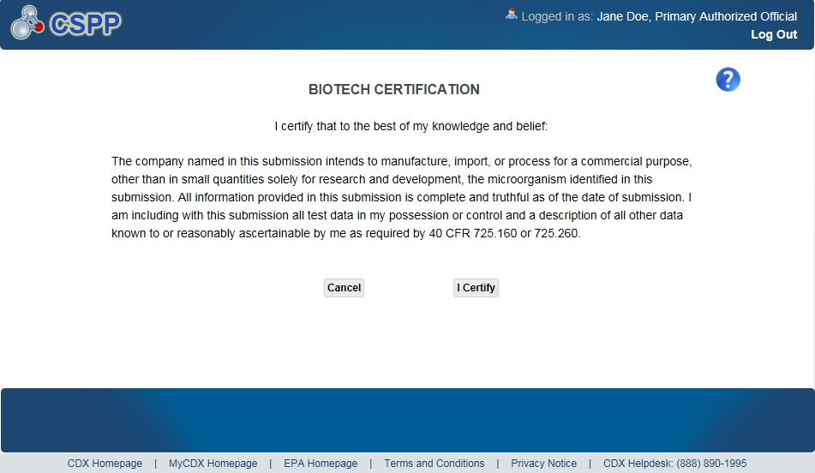
OMB Control No. 2070-0038
Expiration 12/31/2025
Exhibit
14
-
3
Biotech
Certification Screen
EPA Form No. 6300-07

Slide 37
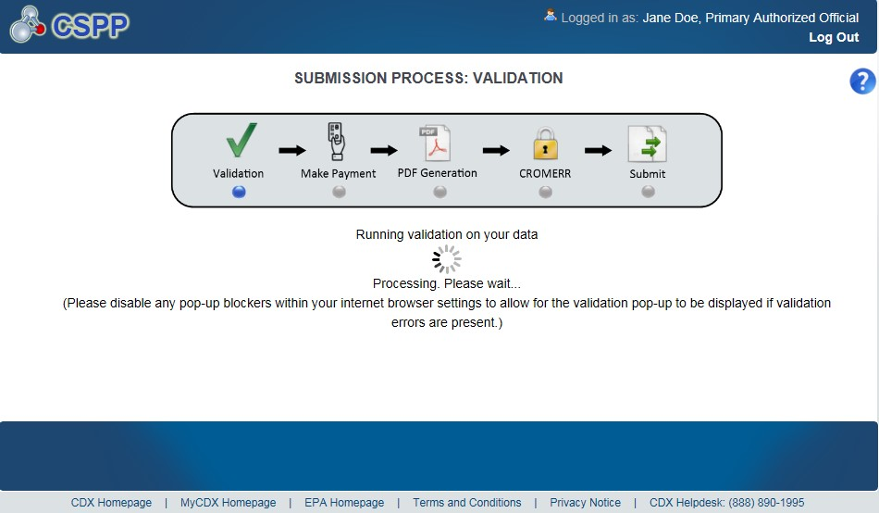
OMB Control No. 2070-0038
Expiration 12/31/2025
EPA Form No. 6300-07

Slide 38
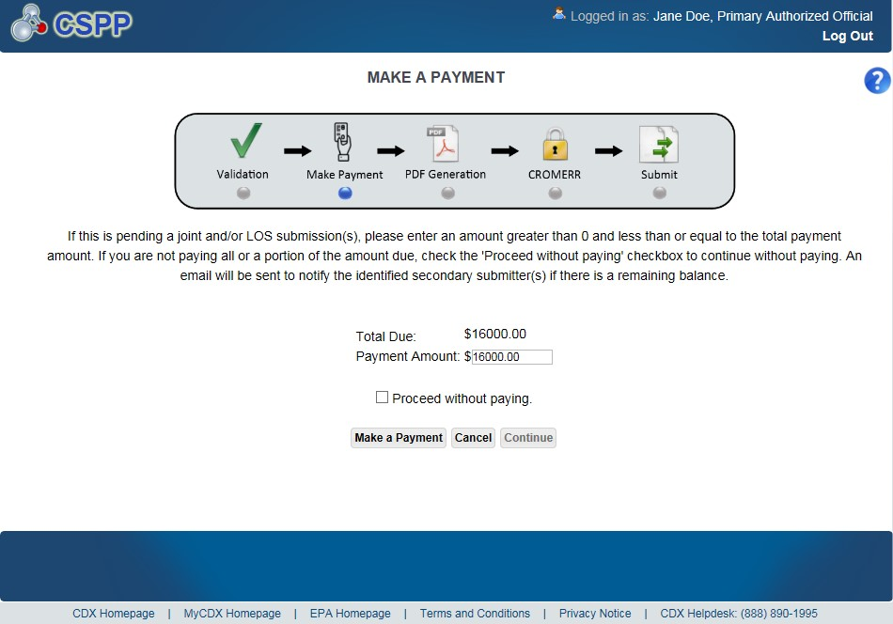
OMB Control No. 2070-0038
Expiration 12/31/2025
Exhibit
14
-
5
Make a Payment Screen
EPA Form No. 6300-07

Slide 39
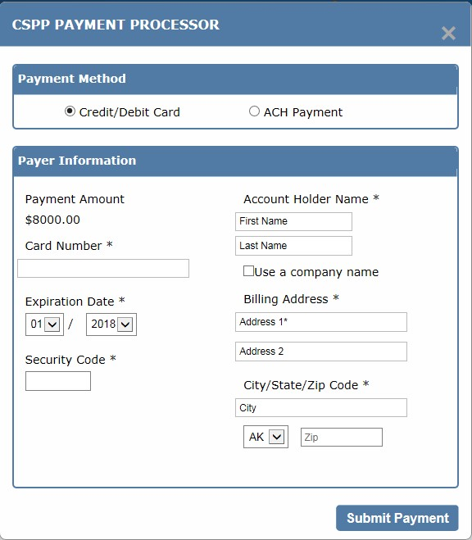
OMB Control No. 2070-0038
Expiration 12/31/2025
EPA Form No. 6300-07

Slide 40
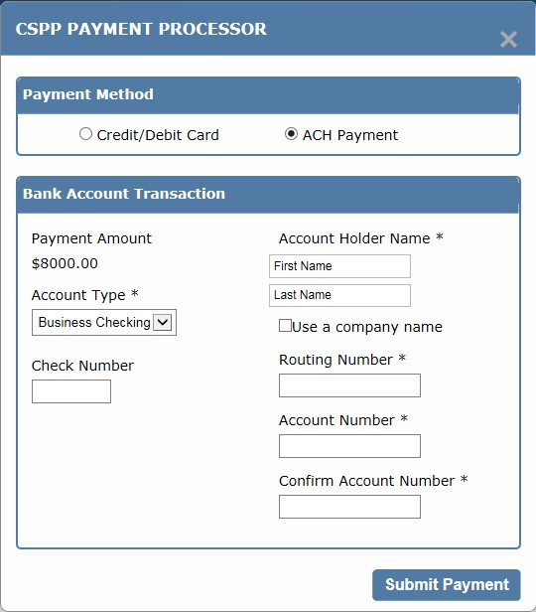
OMB Control No. 2070-0038
Expiration 12/31/2025
EPA Form No. 6300-07

Slide 41
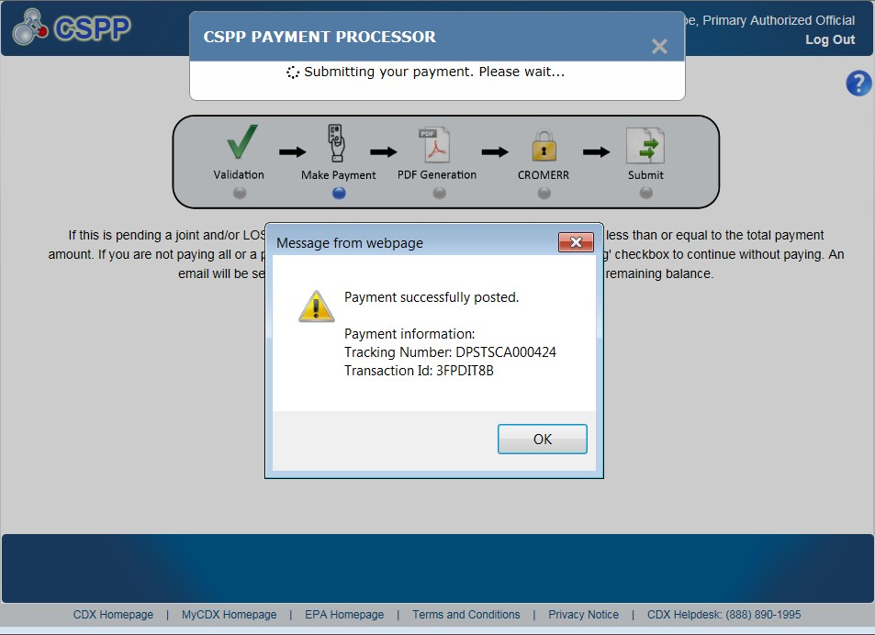
OMB Control No. 2070-0038
Expiration 12/31/2025
Exhibit
14
-
8
Successful Payment
EPA Form No. 6300-07

Slide 42
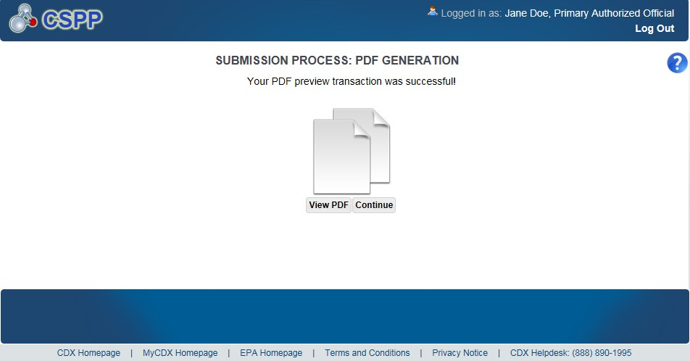
OMB Control No. 2070-0038
Expiration 12/31/2025
EPA Form No. 6300-07

Slide 43
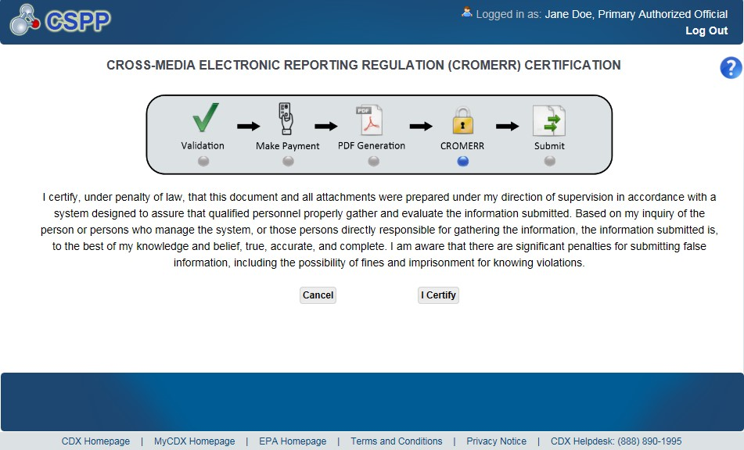
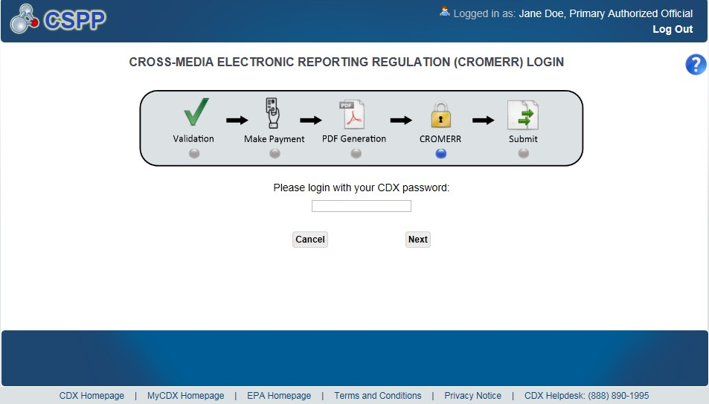
OMB Control No. 2070-0038
Expiration 12/31/2025
EPA Form No. 6300-07

Slide 44
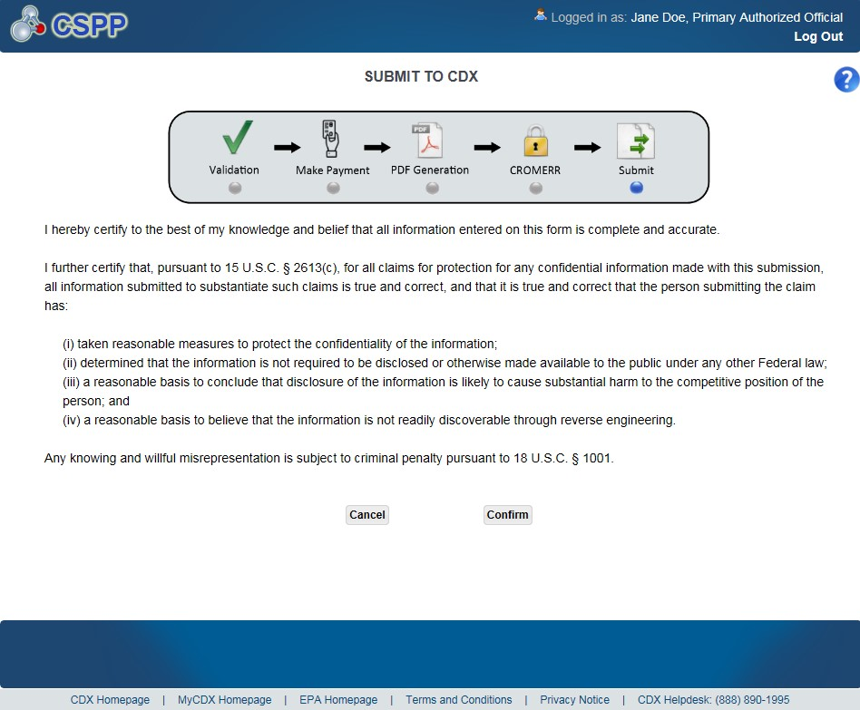
OMB Control No. 2070-0038
Expiration 12/31/2025
Exhibit
14
-
17
Submit
t
o CDX Screen
EPA Form No. 6300-07

Slide 45
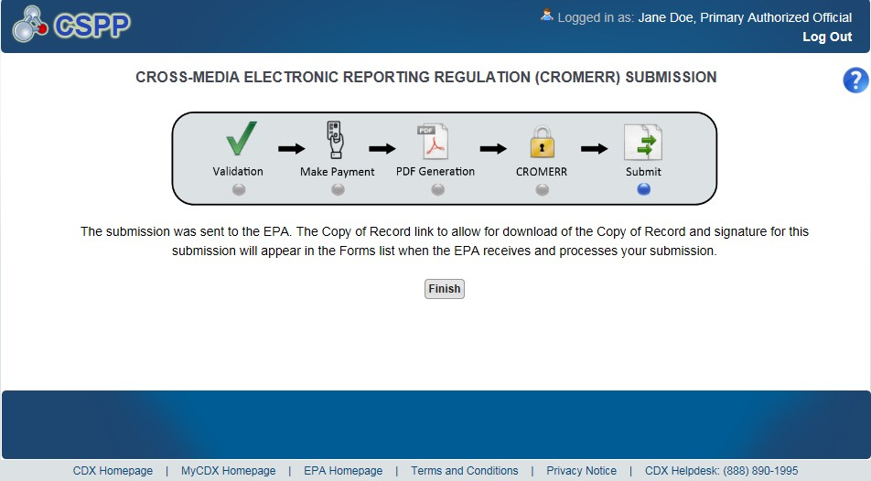
OMB Control No. 2070-0038
Expiration 12/31/2025
EPA Form No. 6300-07

Slide 46
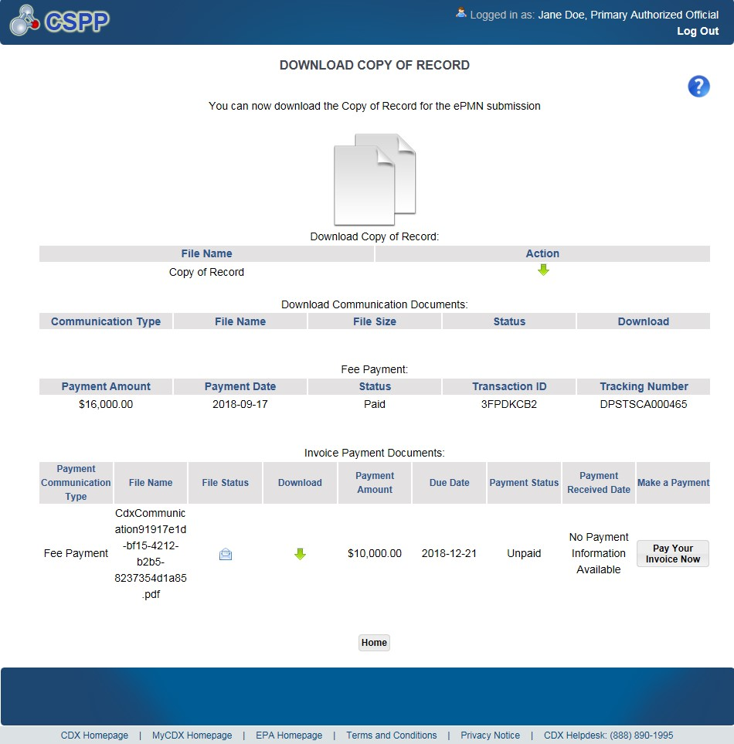
Exhibit
15
-
1
Download C
opy of Record Screen
OMB Control No. 2070-0038
Expiration 12/31/2025
EPA Form No. 6300-07

Slide 47
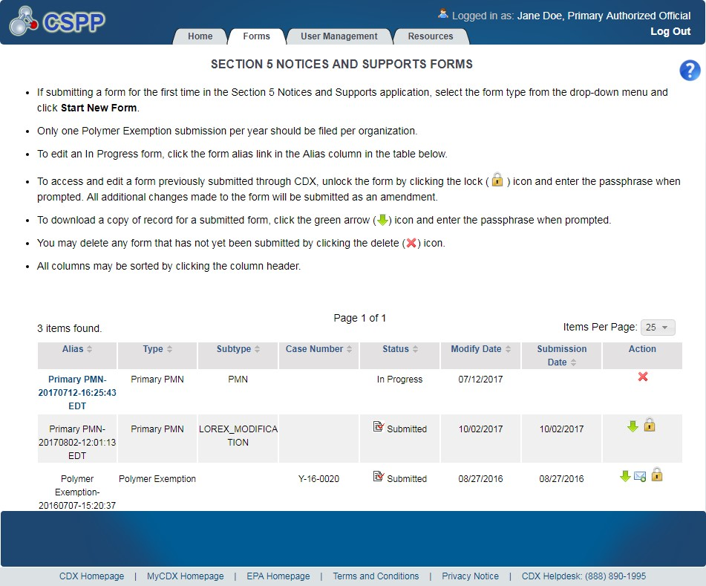
OMB Control No. 2070-0038
Expiration 12/31/2025
EPA Form No. 6300-07

Slide 48
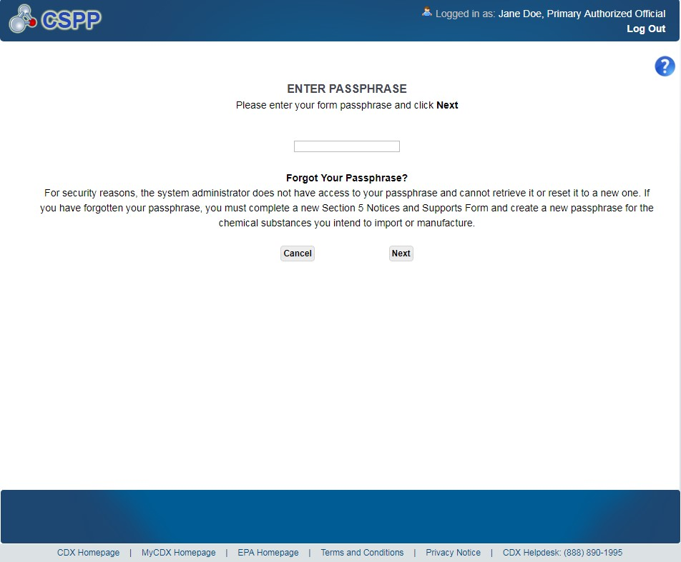
OMB Control No. 2070-0038
Expiration 12/31/2025
Exhibit
16
-
4
Enter Passphrase Screen
EPA Form No. 6300-07

Slide 49
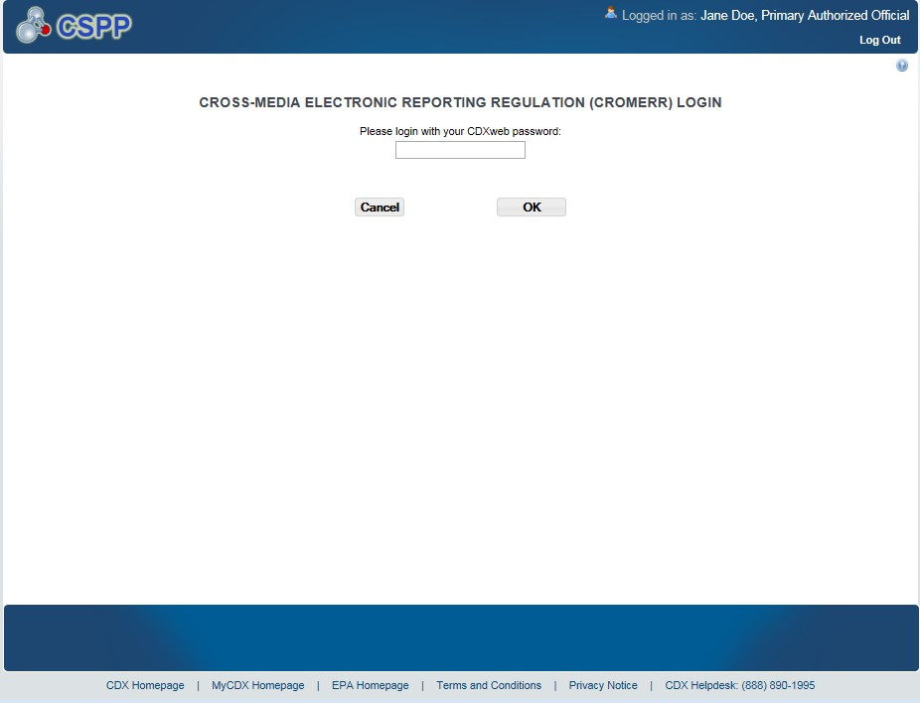
OMB Control No. 2070-0038
Expiration 12/31/2025
EPA Form No. 6300-07

Slide 50


OMB Control No. 2070-0038
Expiration 12/31/2025
EPA Form No. 6300-07
Navigation:
)
, a prompt will display to confirm the
After clicking the ‘Lock’ icon (

Slide 51

OMB Control No. 2070-0038
Expiration 12/31/2025
EPA Form No. 6300-07

Slide 52

OMB Control No. 2070-0038
Expiration 12/31/2025
EPA Form No. 6300-07

