Slide 1
TSCA Section 5 Premanufacture Notice (PMN)
EPA Form No. 7710-25
OMB Control No. 2070-0038
Expiration 12/31/2025

Slide 2
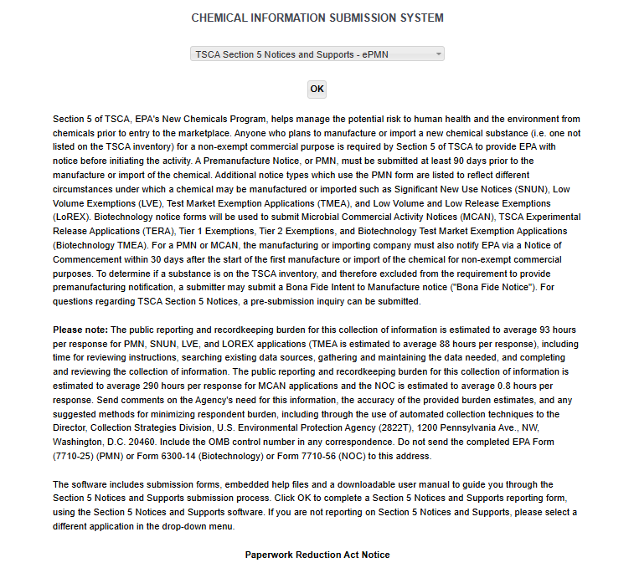
OMB Control No. 2070-0038
Expiration 12/31/2025
EPA Form 7710-25

Slide 3
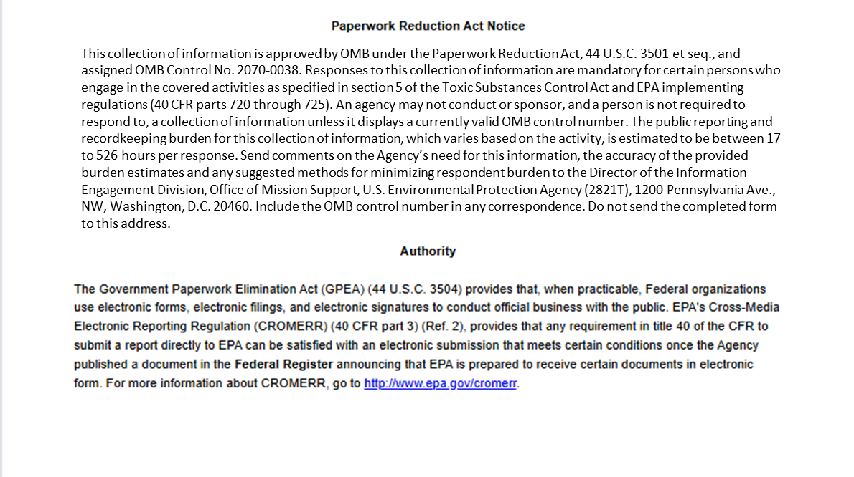
OMB Control No. 2070-0038
Expiration 12/31/2025
EPA Form 7710-25

Slide 4
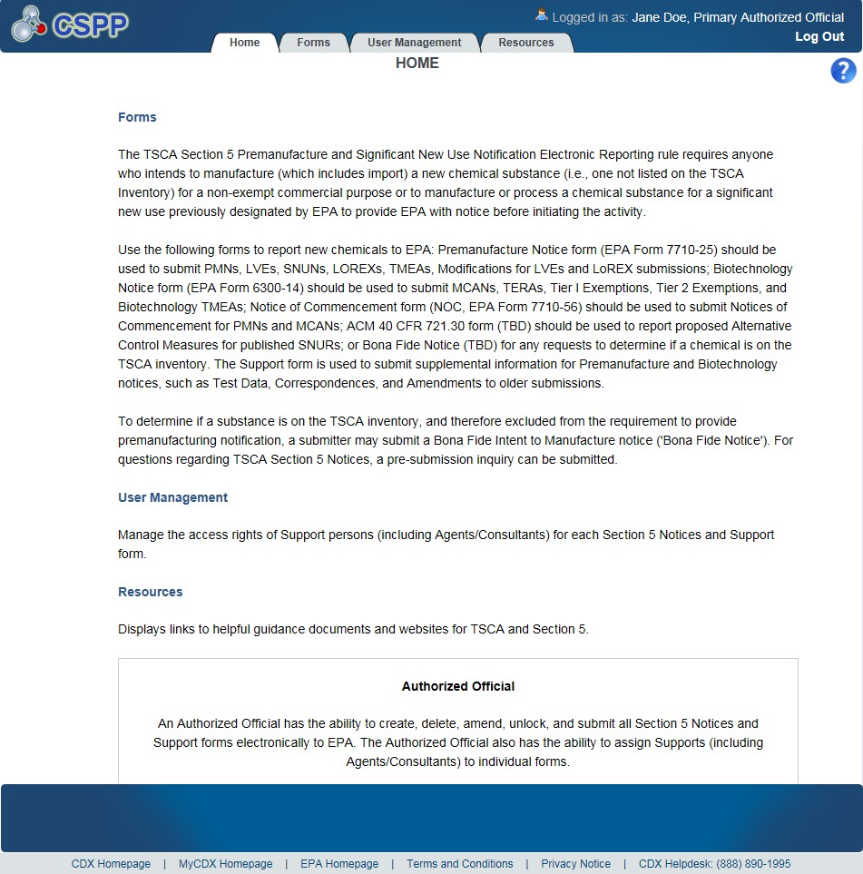
OMB Control No. 2070-0038
Expiration 12/31/2025
EPA Form 7710-25

Slide 5
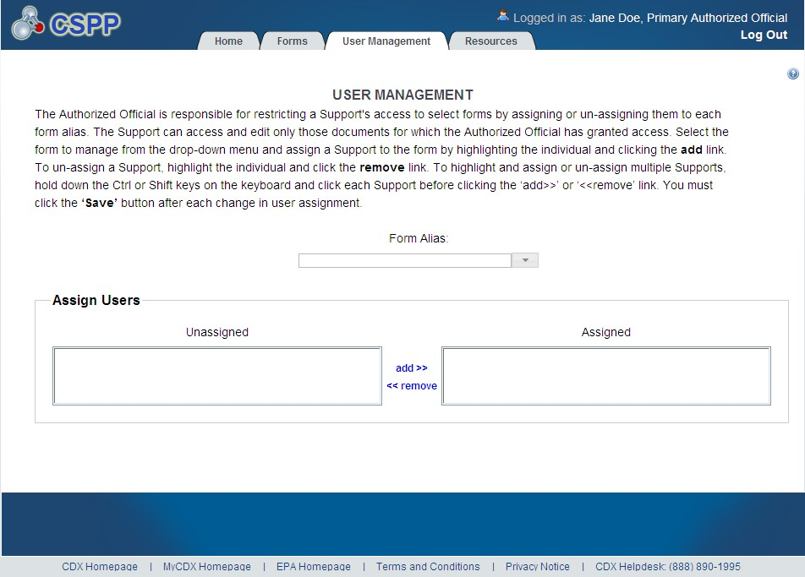
OMB Control No. 2070-0038
Expiration 12/31/2025
Exhibit
3
-
5
User Management Screen
EPA Form 7710-25

Slide 6
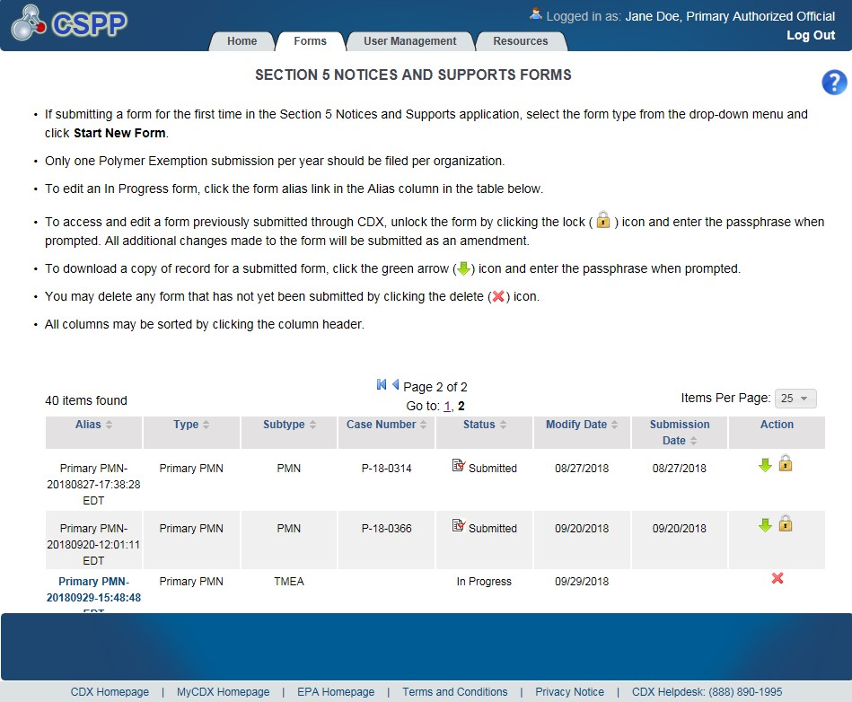
OMB Control No. 2070-0038
Expiration 12/31/2025
EPA Form 7710-25

Slide 7
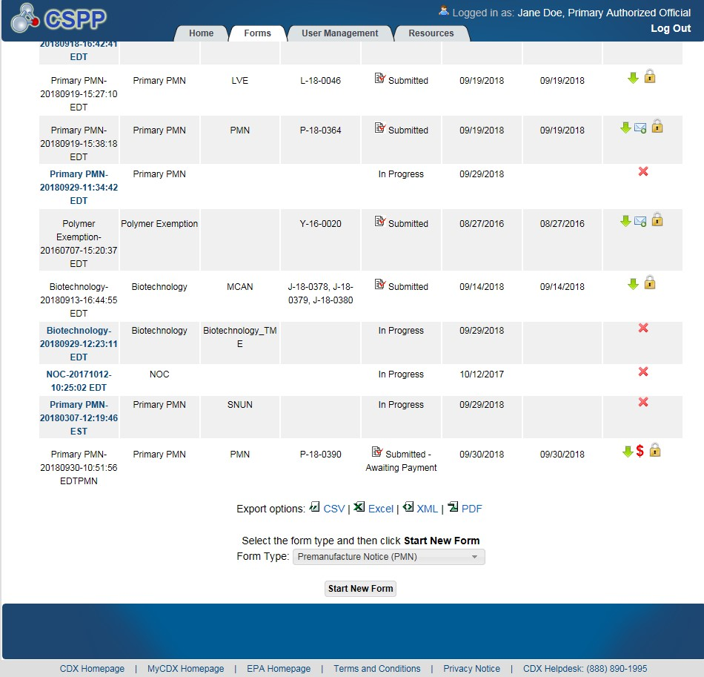
OMB Control No. 2070-0038
Expiration 12/31/2025
EPA Form 7710-25

Slide 8
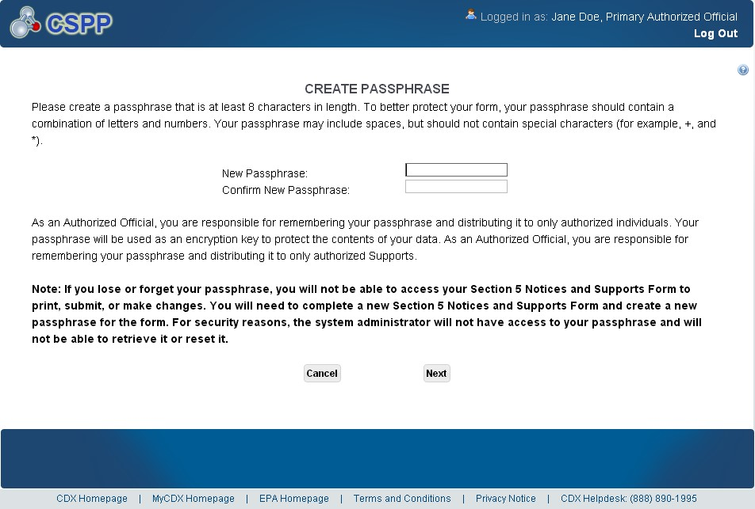
OMB Control No. 2070-0038
Expiration 12/31/2025
Exhibit
3
-
8
Create Passphrase Scr
een
EPA Form 7710-25

Slide 9
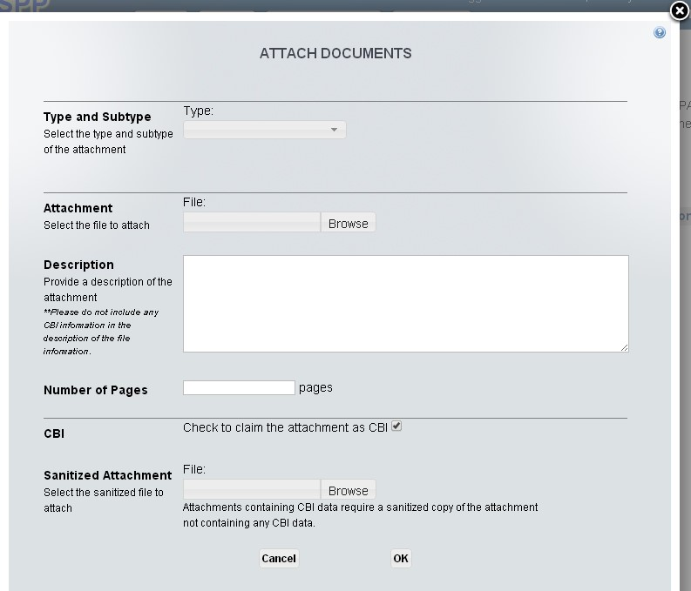
OMB Control No. 2070-0038
Expiration 12/31/2025
Exhibit
3
-
10
Attach Documents
Pop
-
Up
Window
EPA Form 7710-25

Slide 10
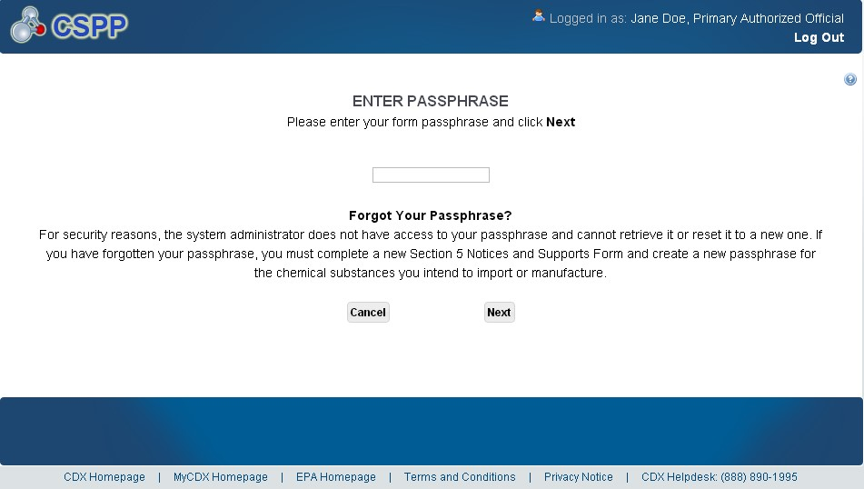
OMB Control No. 2070-0038
Expiration 12/31/2025
Exhibit
3
-
11
Enter Passphrase Screen
EPA Form 7710-25

Slide 11
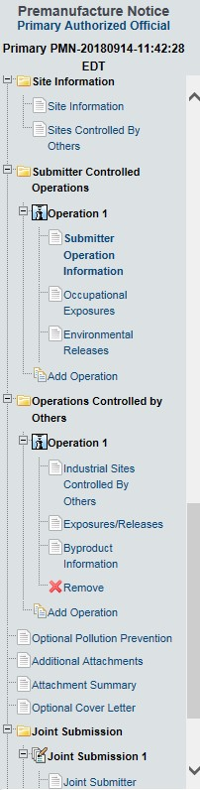
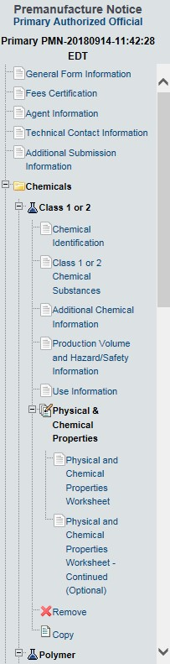
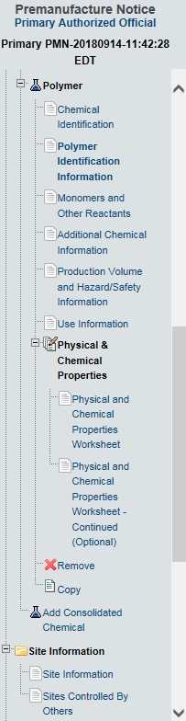
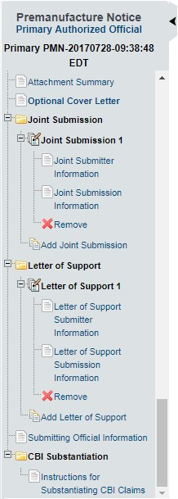
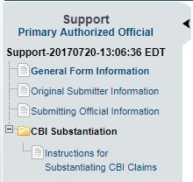
OMB Control No. 2070-0038
Expiration 12/31/2025
EPA Form 7710-25

Slide 12
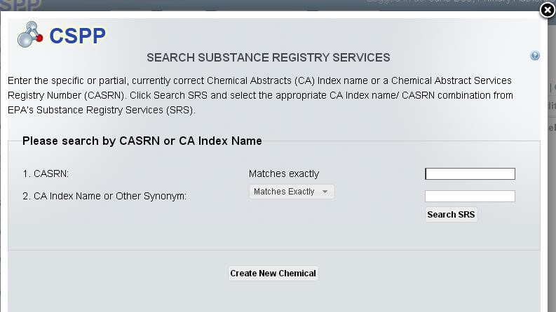
OMB Control No. 2070-0038
Expiration 12/31/2025
EPA Form 7710-25

Slide 13
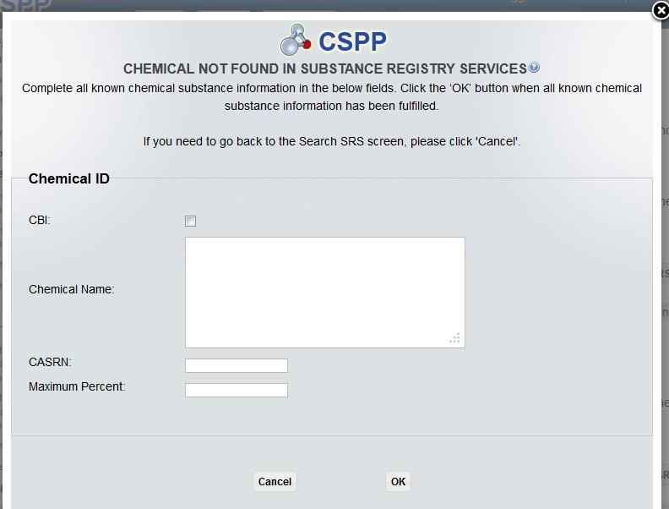
OMB Control No. 2070-0038
Expiration 12/31/2025
EPA Form 7710-25

Slide 14
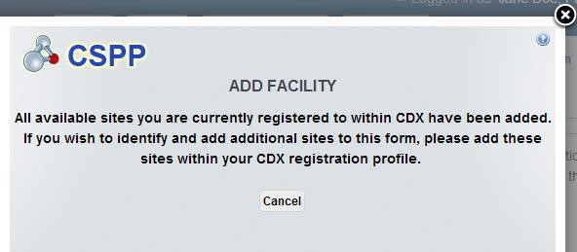
OMB Control No. 2070-0038
Expiration 12/31/2025
EPA Form 7710-25

Slide 15
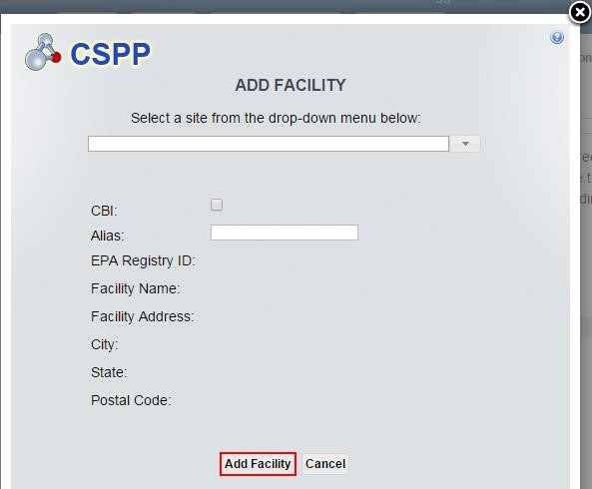
EPA Form 7710-25

Slide 16
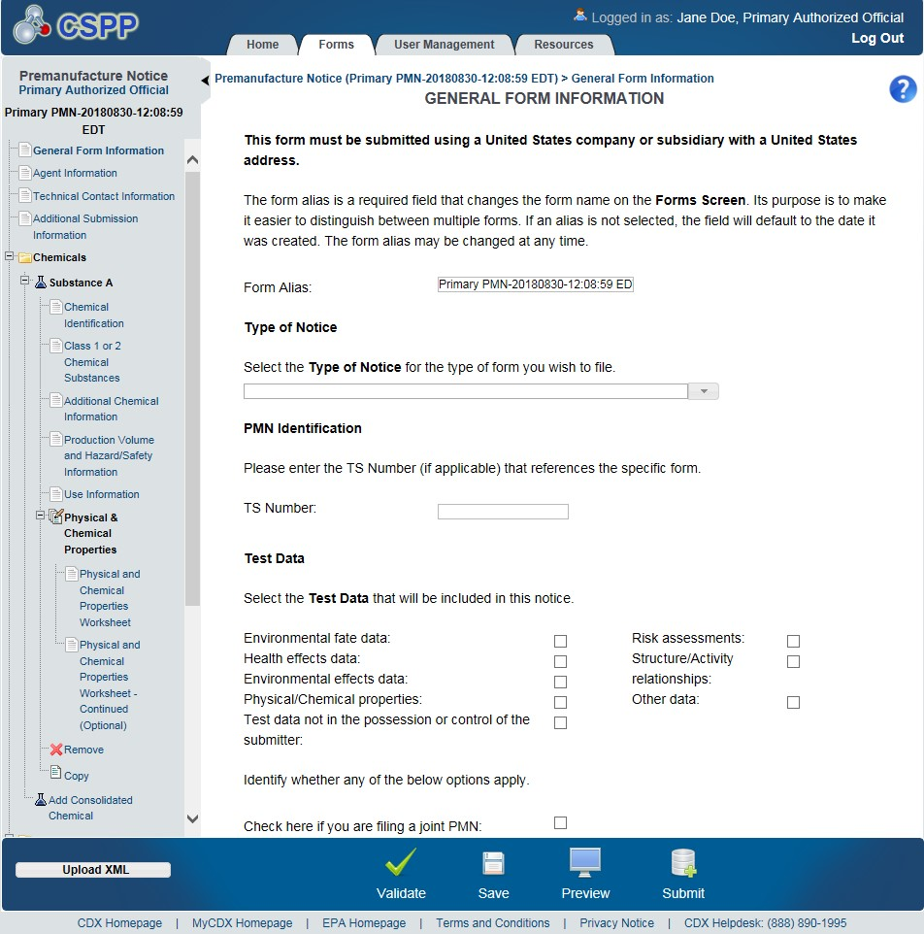
EPA Form 7710-25

Slide 17
Create the PMN Form

Slide 18
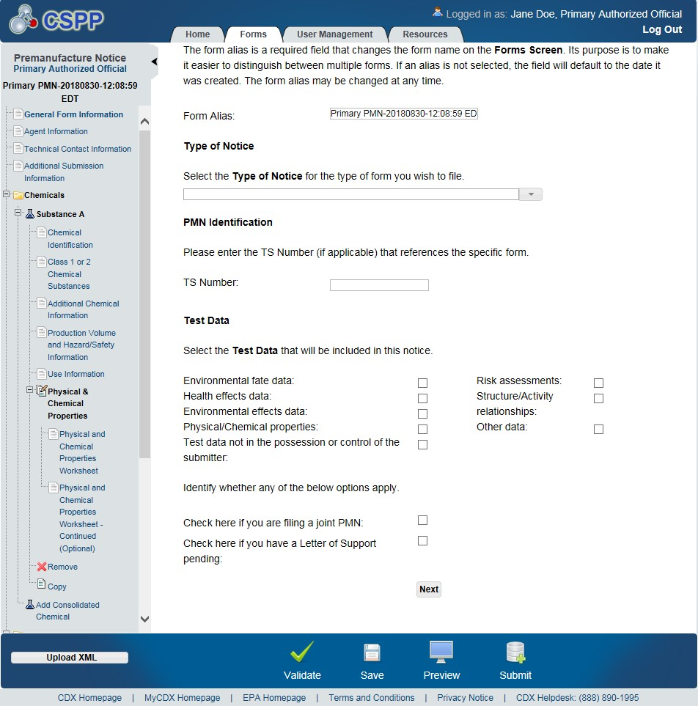
OMB Control No. 2070-0038
Expiration 12/31/2025
EPA Form 7710-25

Slide 19
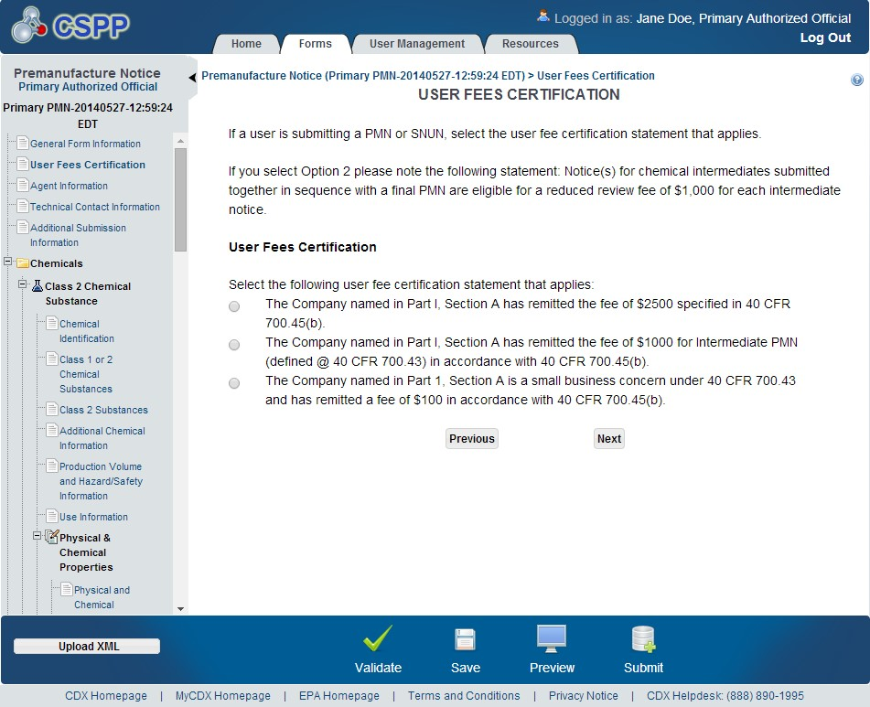
OMB Control No. 2070-0038
Expiration 12/31/2025
EPA Form 7710-25

Slide 20
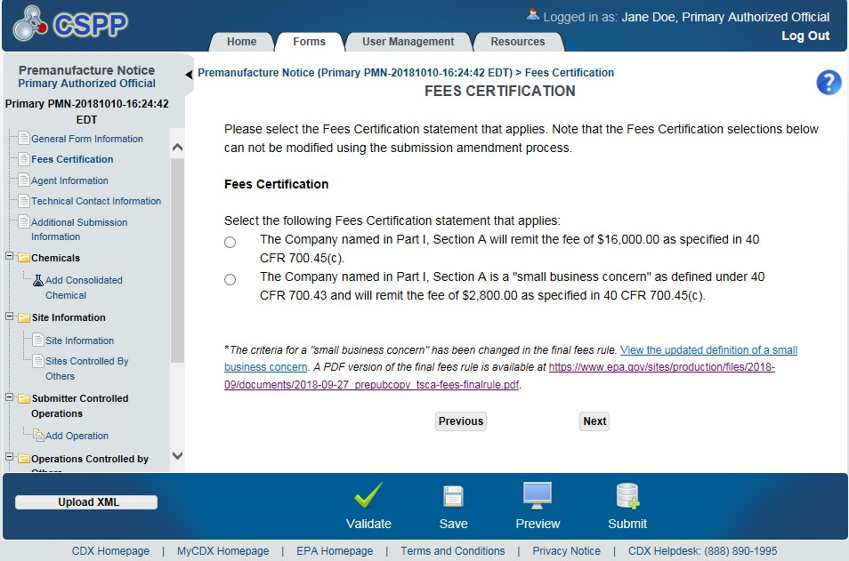
OMB Control No. 2070-0038
Expiration 12/31/2025
EPA Form 7710-25

Slide 21
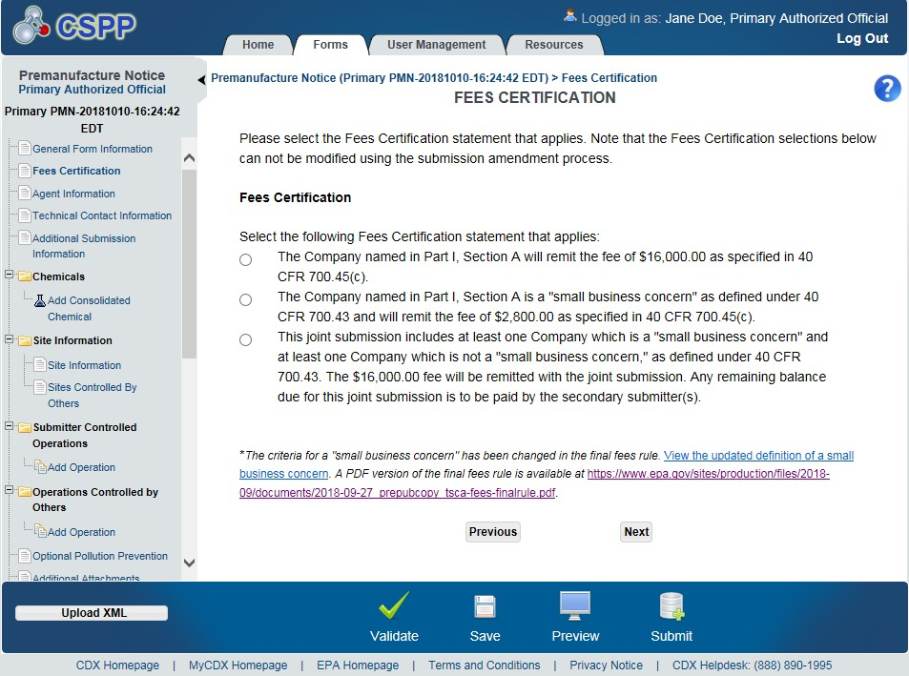
OMB Control No. 2070-0038
Expiration 12/31/2025
EPA Form 7710-25

Slide 22
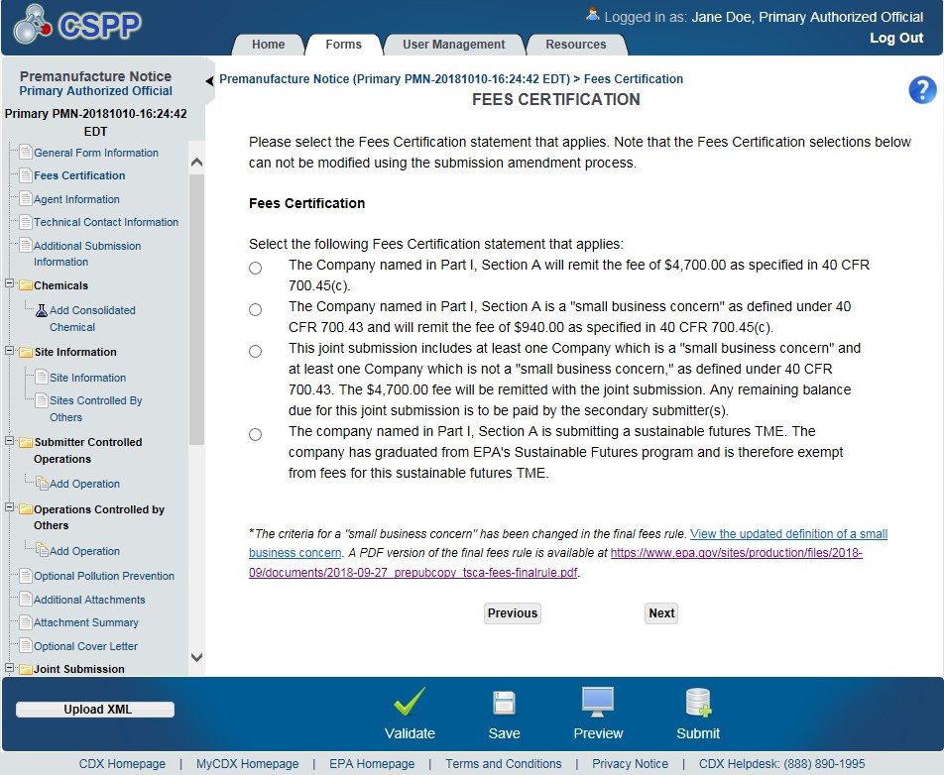
OMB Control No. 2070-0038
Expiration 12/31/2025
EPA Form 7710-25

Slide 23
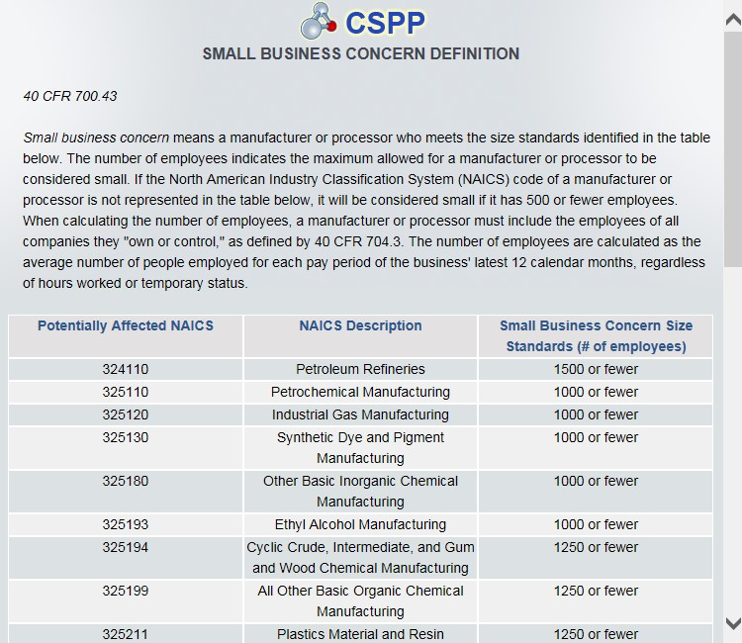
OMB Control No. 2070-0038
Expiration 12/31/2025
EPA Form 7710-25

Slide 24
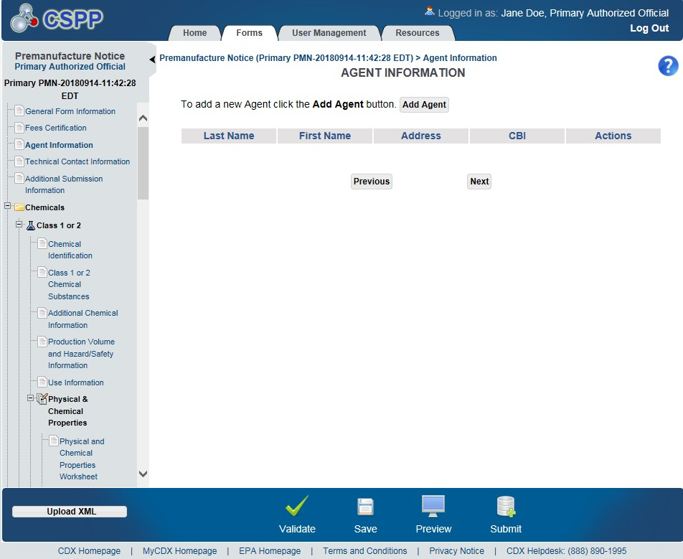
OMB Control No. 2070-0038
Expiration 12/31/2025
Exhibit
4
-
11
Agent Information Screen
(
PMN
)
EPA Form 7710-25

Slide 25
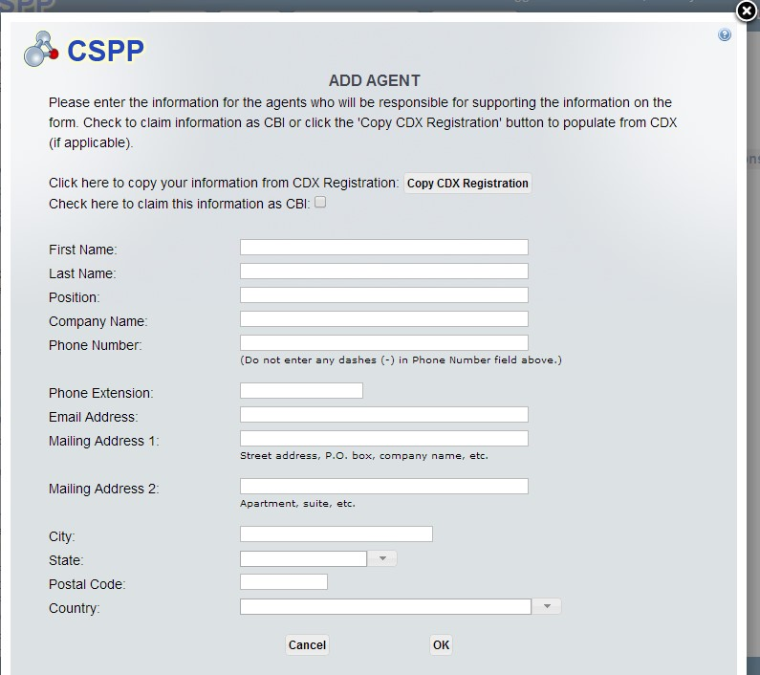
OMB Control No. 2070-0038
Expiration 12/31/2025
Exhibit
4
-
12
Add Agent
Pop
-
Up
Window
(
PMN
)
EPA Form 7710-25

Slide 26
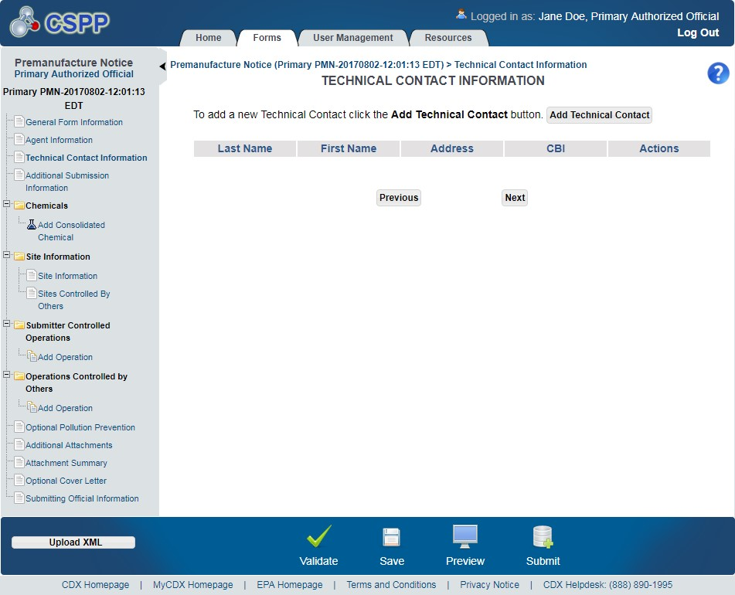
OMB Control No. 2070-0038
Expiration 12/31/2025
EPA Form 7710-25

Slide 27
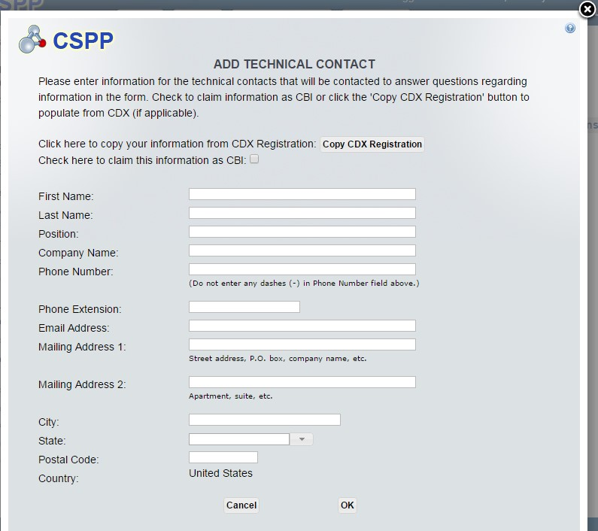
OMB Control No. 2070-0038
Expiration 12/31/2025
EPA Form 7710-25

Slide 28
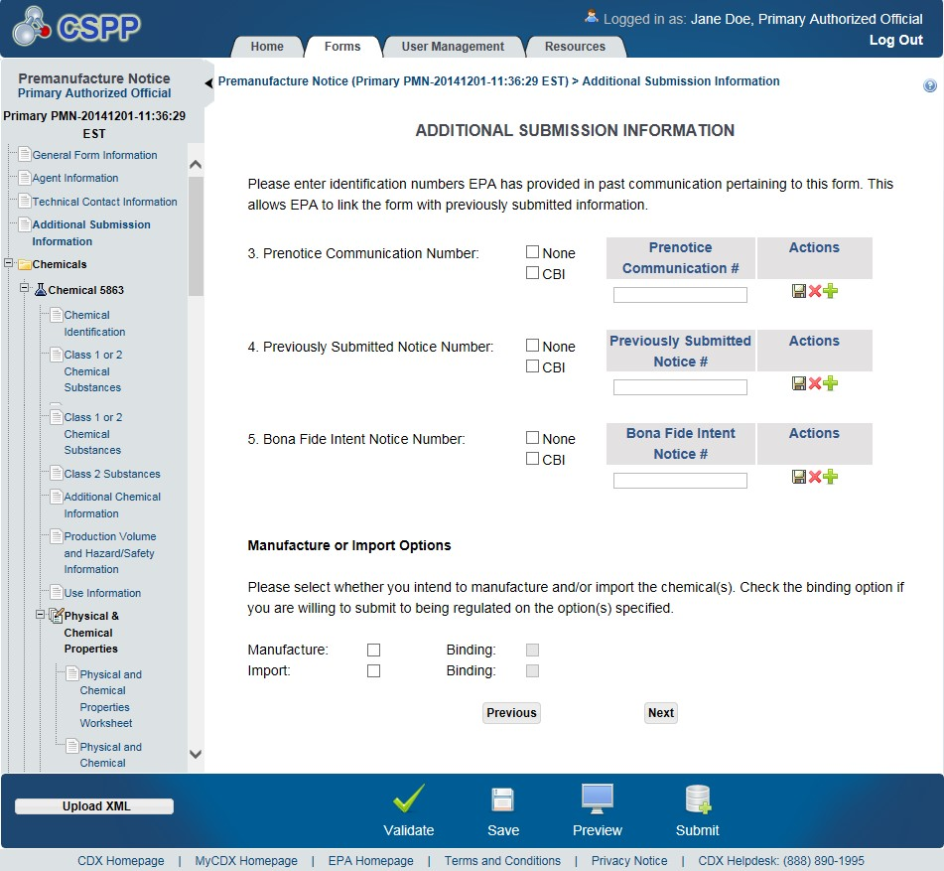
OMB Control No. 2070-0038
Expiration 12/31/2025
EPA Form 7710-25

Slide 29
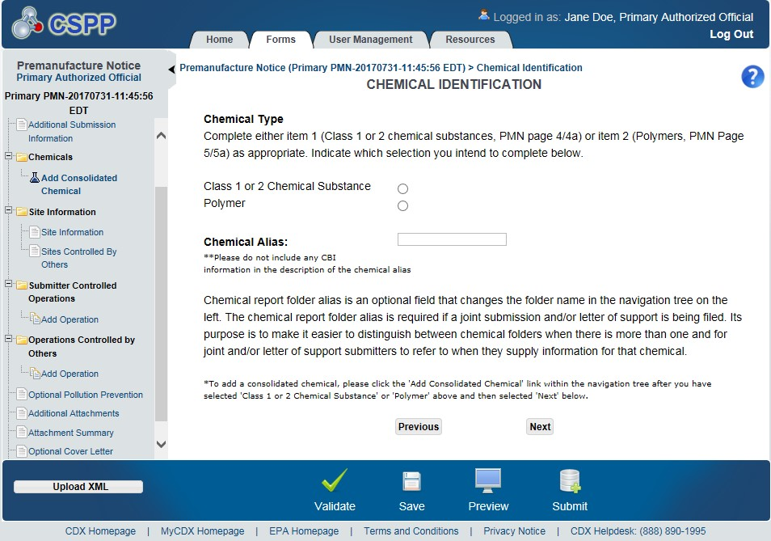
OMB Control No. 2070-0038
Expiration 12/31/2025
Exhibit
4
-
16
Chemical Identification Screen
(
PMN
)
EPA Form 7710-25

Slide 30
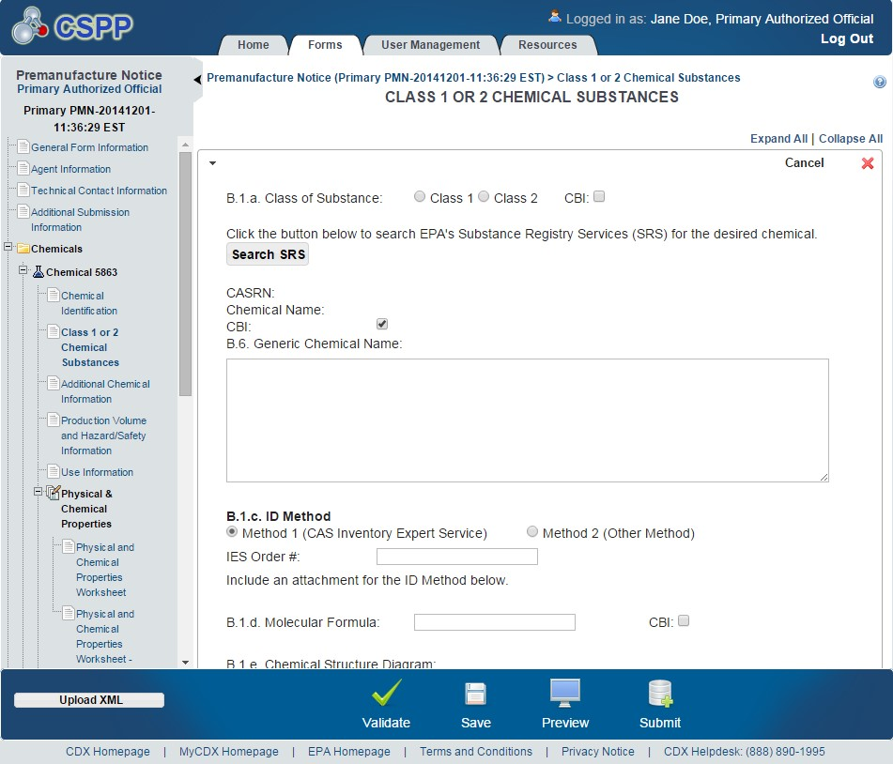
OMB Control No. 2070-0038
Expiration 12/31/2025
EPA Form 7710-25

Slide 31
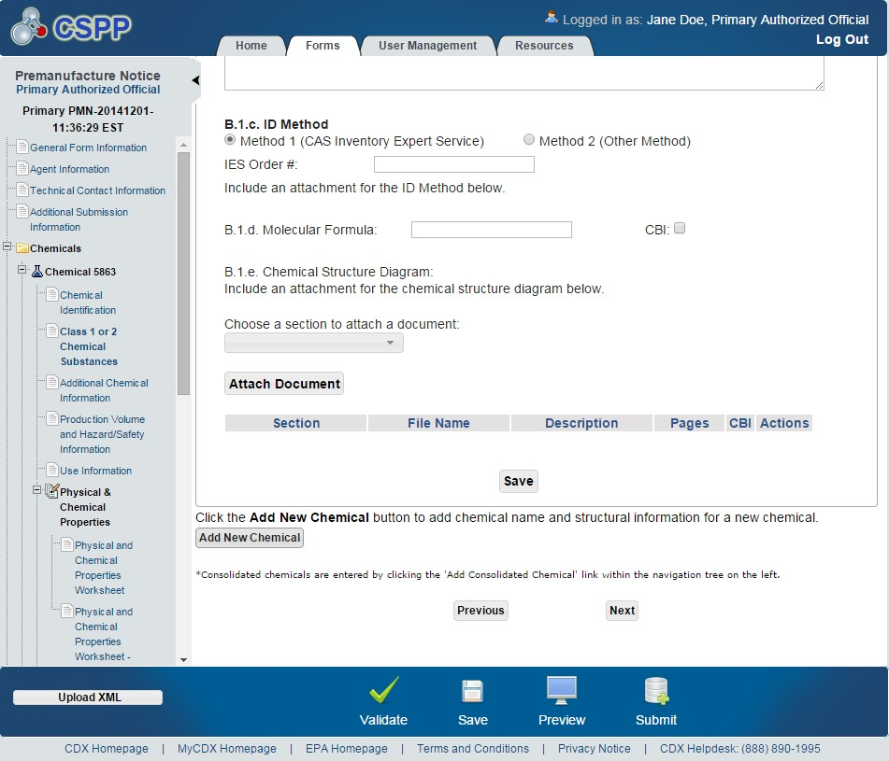
EPA Form 7710-25

Slide 32
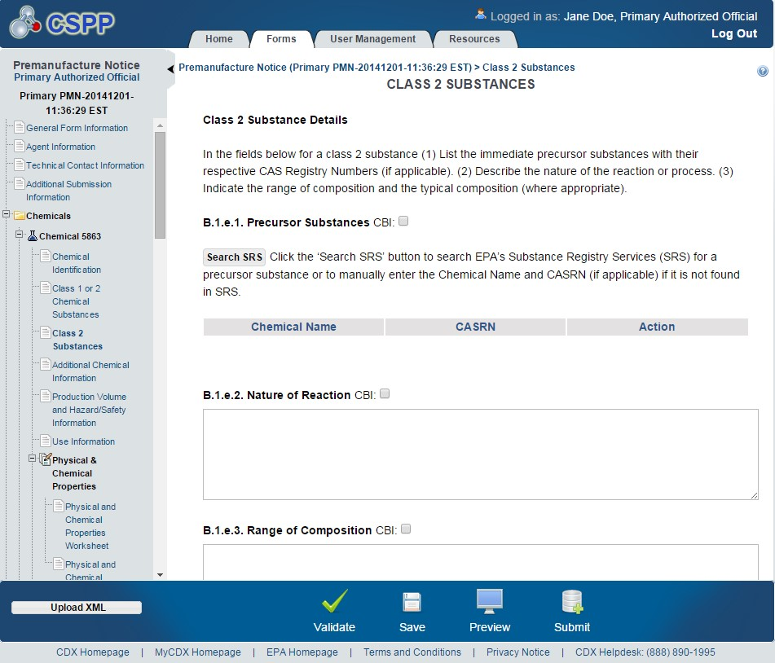
OMB Control No. 2070-0038
Expiration 12/31/2025
EPA Form 7710-25

Slide 33
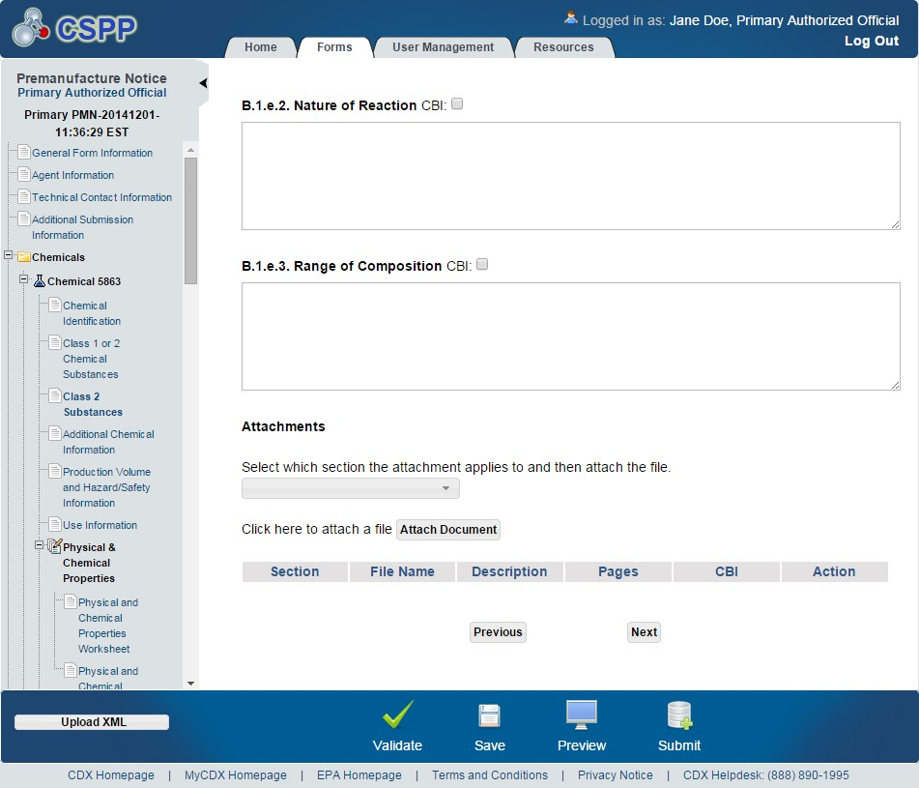
OMB Control No. 2070-0038
Expiration 12/31/2025
EPA Form 7710-25

Slide 34
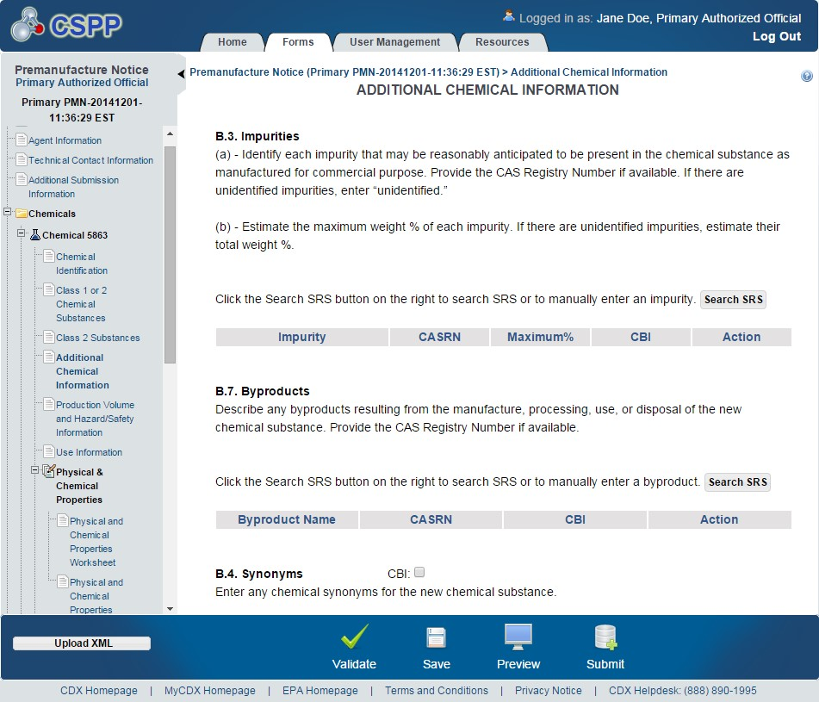
OMB Control No. 2070-0038
Expiration 12/31/2025
EPA Form 7710-25

Slide 35
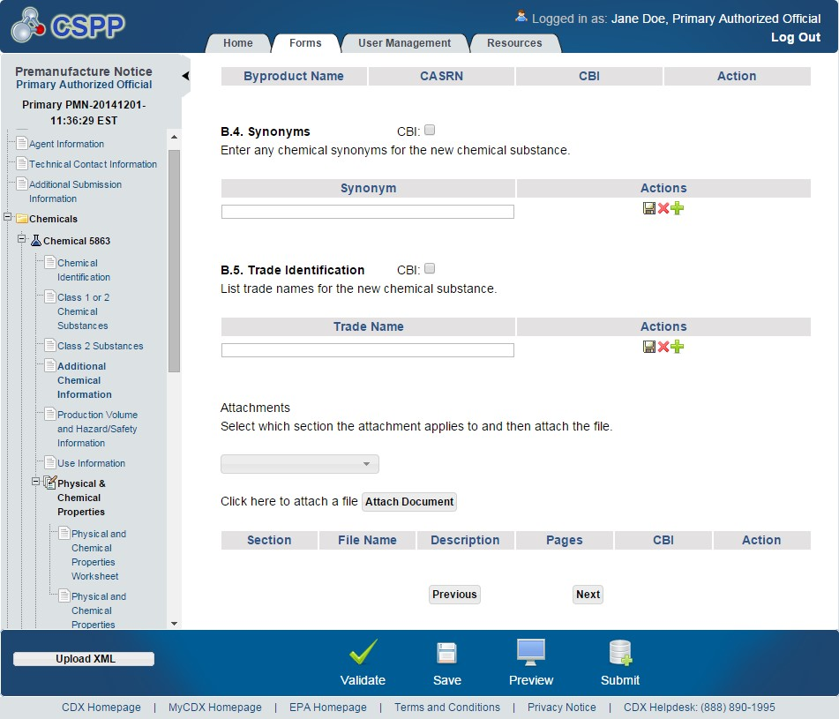
OMB Control No. 2070-0038
Expiration 12/31/2025
EPA Form 7710-25

Slide 36
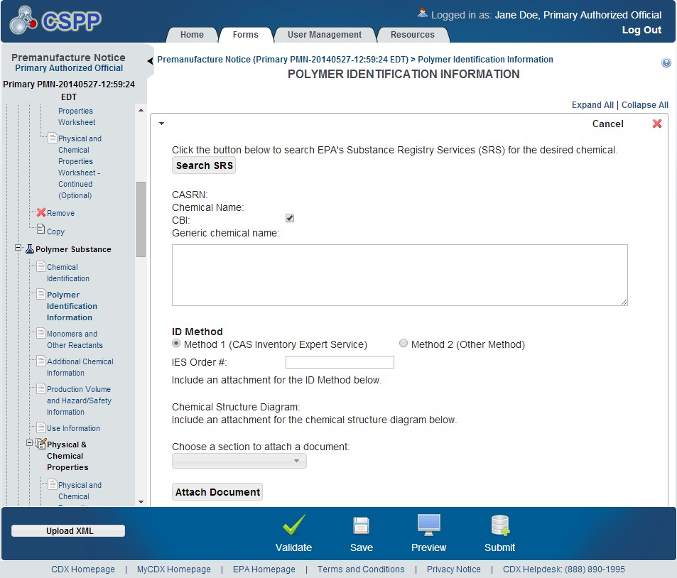
OMB Control No. 2070-0038
Expiration 12/31/2025
EPA Form 7710-25

Slide 37
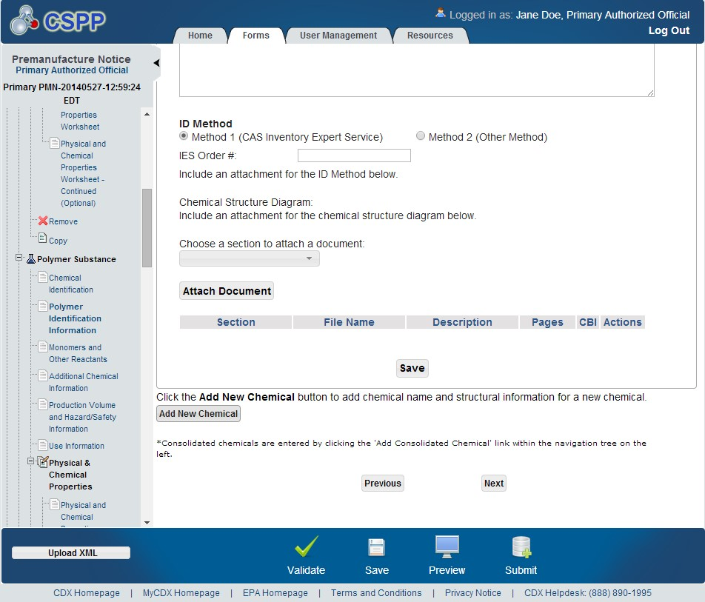
OMB Control No. 2070-0038
Expiration 12/31/2025
EPA Form 7710-25

Slide 38
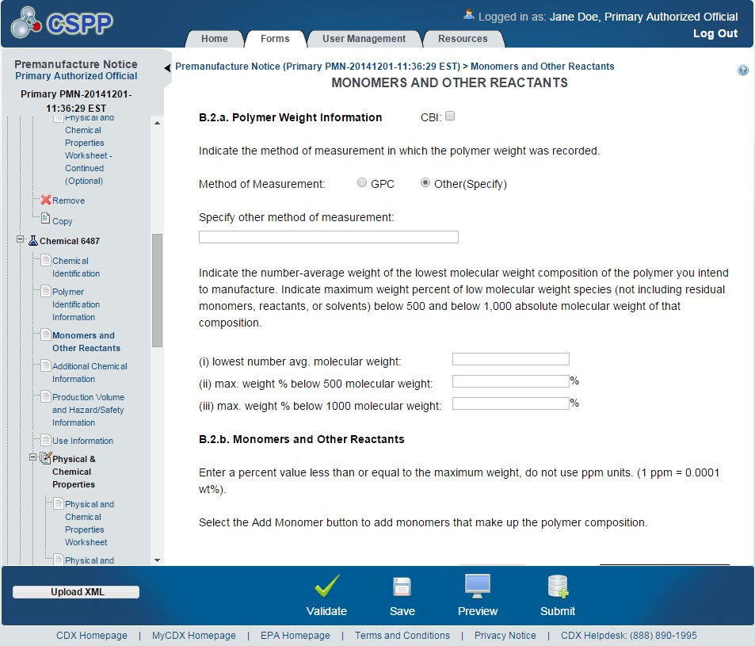
OMB Control No. 2070-0038
Expiration 12/31/2025
EPA Form 7710-25

Slide 39
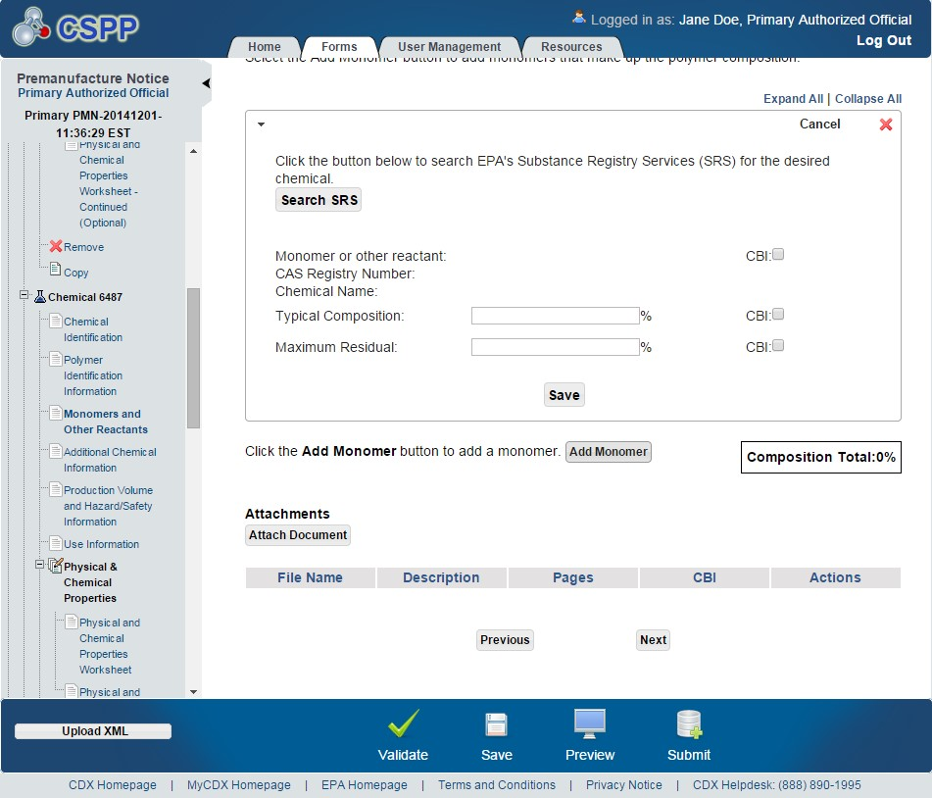
OMB Control No. 2070-0038
Expiration 12/31/2025
EPA Form 7710-25

Slide 40
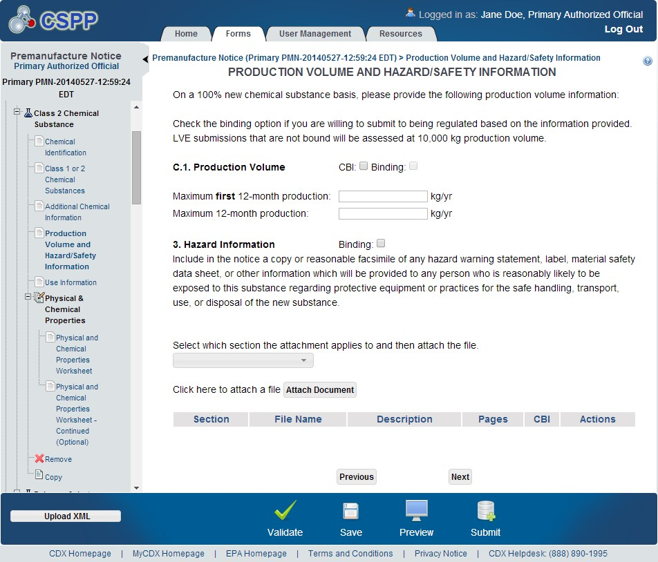
OMB Control No. 2070-0038
Expiration 12/31/2025
EPA Form 7710-25

Slide 41
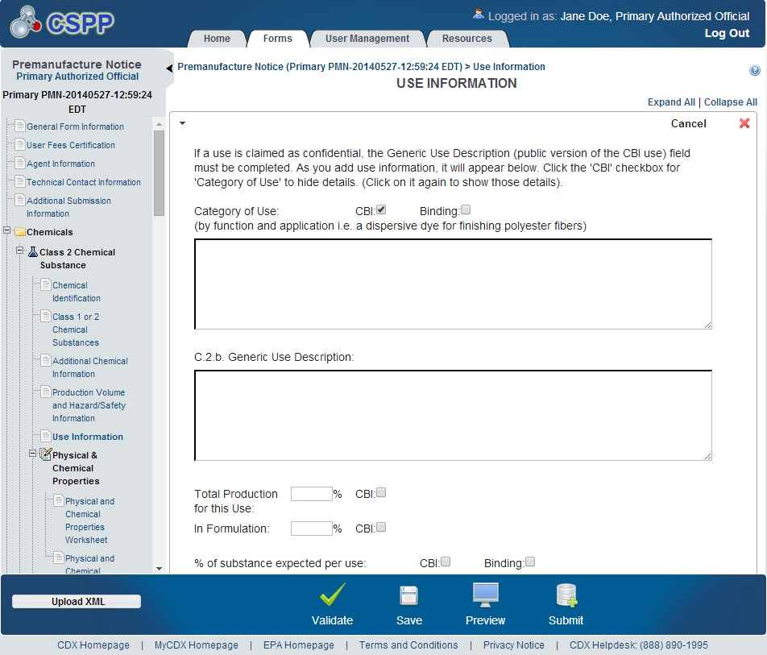
OMB Control No. 2070-0038
Expiration 12/31/2025
EPA Form 7710-25

Slide 42
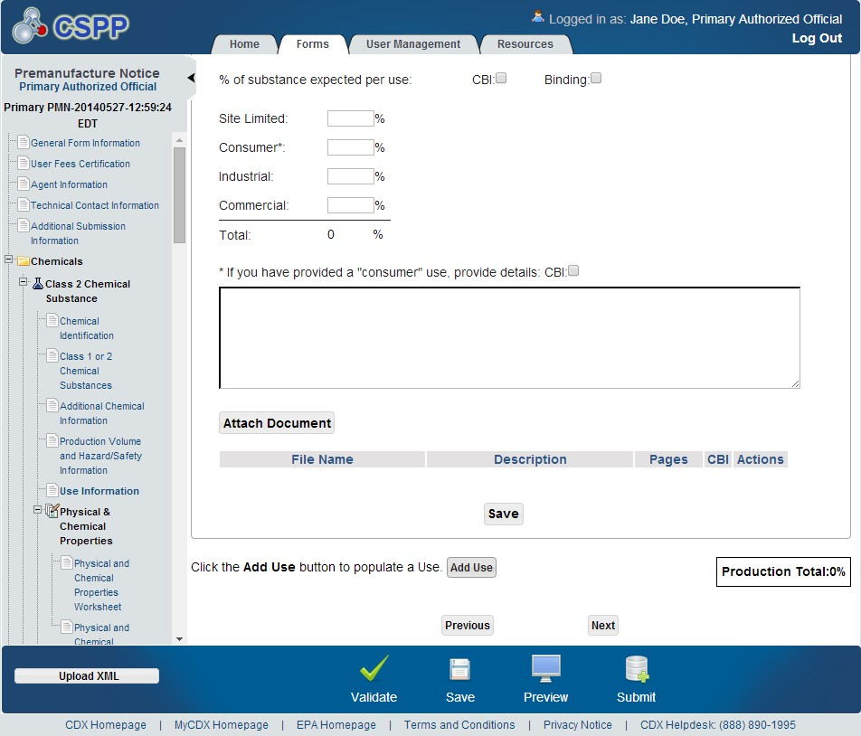
OMB Control No. 2070-0038
Expiration 12/31/2025
EPA Form 7710-25

Slide 43
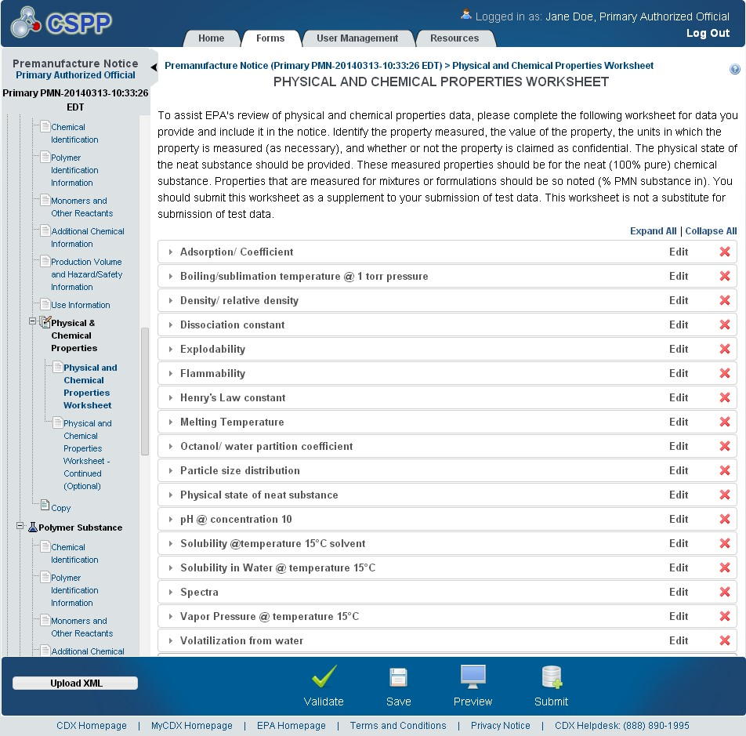
OMB Control No. 2070-0038
Expiration 12/31/2025
EPA Form 7710-25

Slide 44
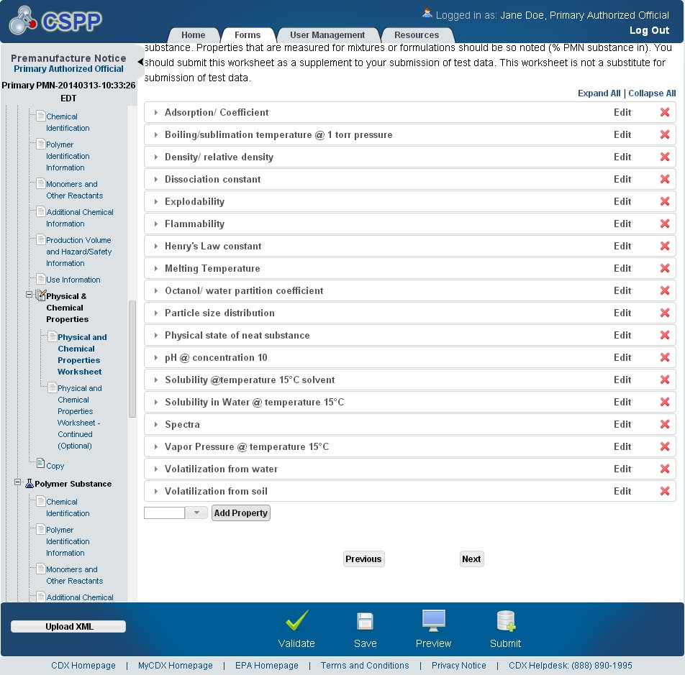
OMB Control No. 2070-0038
Expiration 12/31/2025
EPA Form 7710-25

Slide 45
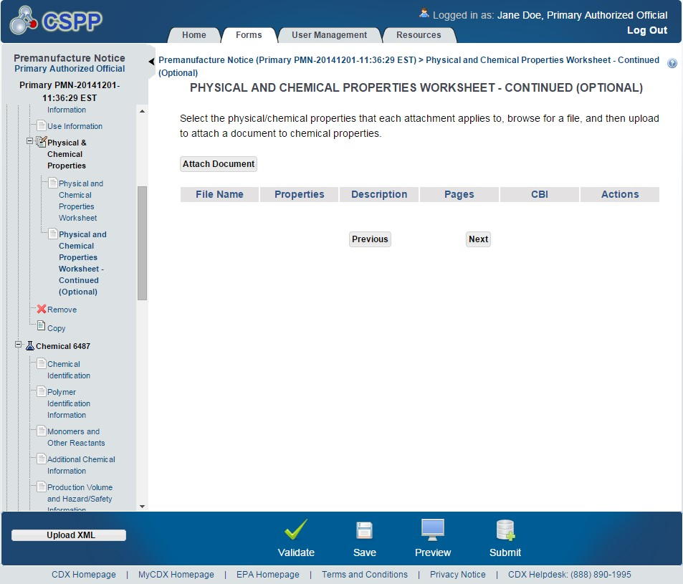
OMB Control No. 2070-0038
Expiration 12/31/2025
EPA Form 7710-25

Slide 46
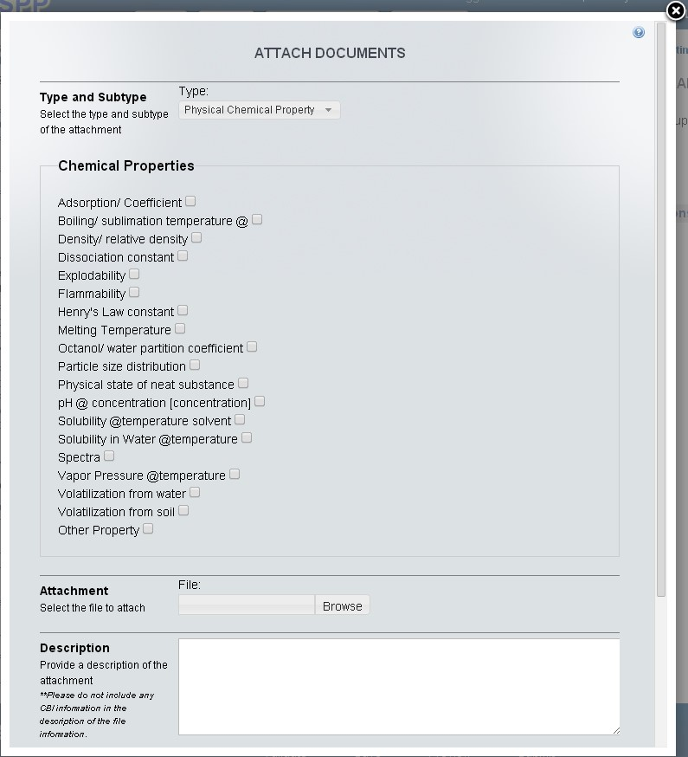
OMB Control No. 2070-0038
Expiration 12/31/2025
EPA Form 7710-25

Slide 47
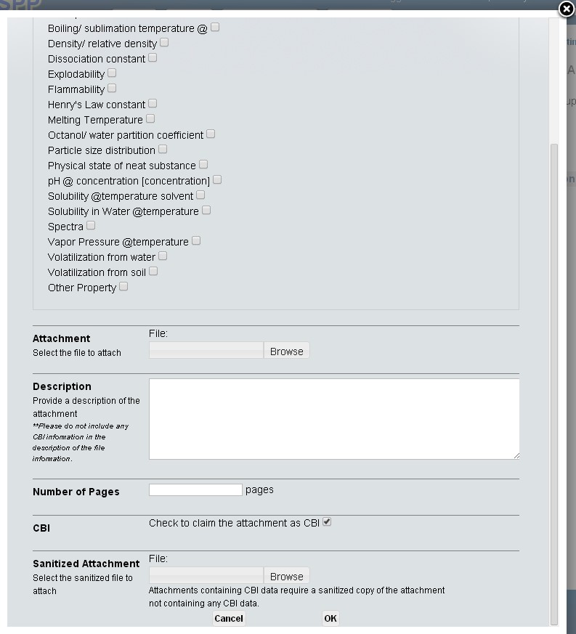
OMB Control No. 2070-0038
Expiration 12/31/2025
EPA Form 7710-25

Slide 48
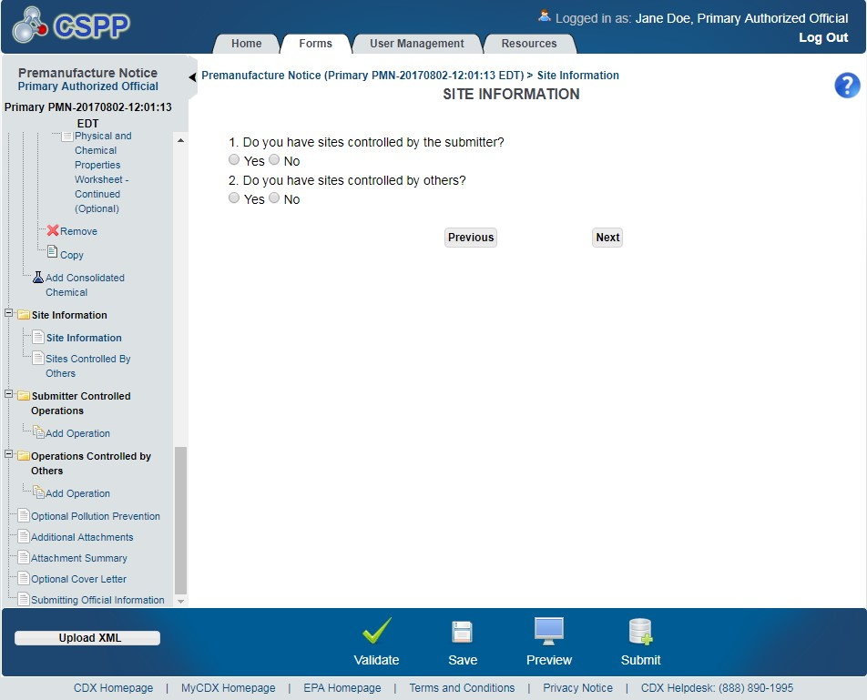
OMB Control No. 2070-0038
Expiration 12/31/2025
Exhibit
4
-
35
Site Information Screen
(
PMN
)
EPA Form 7710-25

Slide 49

OMB Control No. 2070-0038
Expiration 12/31/2025
EPA Form 7710-25

Slide 50

OMB Control No. 2070-0038
Expiration 12/31/2025
EPA Form 7710-25

Slide 51

OMB Control No. 2070-0038
Expiration 12/31/2025
EPA Form 7710-25

Slide 52

OMB Control No. 2070-0038
Expiration 12/31/2025
EPA Form 7710-25

Slide 53

OMB Control No. 2070-0038
Expiration 12/31/2025
EPA Form 7710-25

Slide 54

OMB Control No. 2070-0038
Expiration 12/31/2025
EPA Form 7710-25

Slide 55

OMB Control No. 2070-0038
Expiration 12/31/2025
EPA Form 7710-25

Slide 56

OMB Control No. 2070-0038
Expiration 12/31/2025
EPA Form 7710-25

Slide 57

OMB Control No. 2070-0038
Expiration 12/31/2025
EPA Form 7710-25

Slide 58

OMB Control No. 2070-0038
Expiration 12/31/2025
EPA Form 7710-25

Slide 59

OMB Control No. 2070-0038
Expiration 12/31/2025
EPA Form 7710-25

Slide 60

OMB Control No. 2070-0038
Expiration 12/31/2025
Exhibit
4
-
47
Byproduct Information
Screen
(
PMN
)
EPA Form 7710-25

Slide 61

OMB Control No. 2070-0038
Expiration 12/31/2025
EPA Form 7710-25

Slide 62

OMB Control No. 2070-0038
Expiration 12/31/2025
EPA Form 7710-25

Slide 63

OMB Control No. 2070-0038
Expiration 12/31/2025
Exhibit
4
-
50
Attachment Summary Screen
(
PMN
)
EPA Form 7710-25

Slide 64

OMB Control No. 2070-0038
Expiration 12/31/2025
Exhibit
4
-
51
Optional Cover Letter Screen
(
PMN
)
EPA Form 7710-25

Slide 65

OMB Control No. 2070-0038
Expiration 12/31/2025
EPA Form 7710-25

Slide 66

OMB Control No. 2070-0038
Expiration 12/31/2025
EPA Form 7710-25

Slide 67

OMB Control No. 2070-0038
Expiration 12/31/2025
EPA Form 7710-25

Slide 68

OMB Control No. 2070-0038
Expiration 12/31/2025
EPA Form 7710-25

Slide 69

OMB Control No. 2070-0038
Expiration 12/31/2025
Exhibit
14
-
17
Submit
t
o CDX Screen
EPA Form 7710-25

Slide 70

OMB Control No. 2070-0038
Expiration 12/31/2025
EPA Form 7710-25

Slide 71




OMB Control No. 2070-0038
Expiration 12/31/2025
Navigation:
)
located in the bottom
Click the ‘Validate’ icon (
a
ction bar to validate the form.
)
located in the bottom action bar to perform a global save on the form.
Click the ‘Save’ icon (
)
located in the bottom action bar to view a PDF preview of the
Click the ‘Preview’ icon (
form.
Click
)
located in the bottom action bar to begin the submission
the ‘Submit’ icon (
process.
EPA Form 7710-25

Slide 72
Support Form

Slide 73

OMB Control No. 2070-0038
Expiration 12/31/2025
EPA Form 7710-25

Slide 74


OMB Control No. 2070-0038
Expiration 12/31/2025
Navigat
ion:
)
located in the bottom action bar to validate the form.
Click the ‘Validate’ icon (
)
located in the bottom action bar to save the overall form. Click the
Click the ‘Save’ icon (
EPA Form 7710-25
)
located in the bottom action bar to generate a PDF preview of the form.
‘Preview’ icon (

Slide 75

OMB Control No. 2070-0038
Expiration 12/31/2025
EPA Form 7710-25

Slide 76
Alternative Control Measures

Slide 77

OMB Control No. 2070-0038
Expiration 12/31/2025
Exhibit
9
-
1
Contact Information Screen
(
ACM
)
EPA Form 7710-25

Slide 78

OMB Control No. 2070-0038
Expiration 12/31/2025
Exhibit
9
-
2
Add Contact
Pop
-
Up
Window
(
ACM
)
EPA Form 7710-25

Slide 79

OMB Control No. 2070-0038
Expiration 12/31/2025
Exhibit
9
-
3
Attachments Screen
(
ACM
)
EPA Form 7710-25

Slide 80

OMB Control No. 2070-0038
Expiration 12/31/2025
Exhibit
10
-
1
Preview EPMN Form Screen
(
ACM
)
EPA Form 7710-25

Slide 81
TSCA Section 5 Bona Fide/Polymer Exemption

Slide 82



OMB Control No. 2070-0038
Expiration 12/31/2025
EPA Form 7710-25

Slide 83

OMB Control No. 2070-0038
Expiration 12/31/2025
EPA Form 7710-25

Slide 84

OMB Control No. 2070-0038
Expiration 12/31/2025
EPA Form 7710-25

Slide 85

OMB Control No. 2070-0038
Expiration 12/31/2025
EPA Form 7710-25

Slide 86

OMB Control No. 2070-0038
Expiration 12/31/2025
EPA Form 7710-25

Slide 87

OMB Control No. 2070-0038
Expiration 12/31/2025
EPA Form 7710-25

Slide 88

OMB Control No. 2070-0038
Expiration 12/31/2025
EPA Form 7710-25

Slide 89

OMB Control No. 2070-0038
Expiration 12/31/2025
EPA Form 7710-25

Slide 90

OMB Control No. 2070-0038
Expiration 12/31/2025
EPA Form 7710-25

Slide 91

OMB Control No. 2070-0038
Expiration 12/31/2025
EPA Form 7710-25

Slide 92

OMB Control No. 2070-0038
Expiration 12/31/2025
EPA Form 7710-25

Slide 93

OMB Control No. 2070-0038
Expiration 12/31/2025
EPA Form 7710-25

Slide 94

OMB Control No. 2070-0038
Expiration 12/31/2025
EPA Form 7710-25

Slide 95

OMB Control No. 2070-0038
Expiration 12/31/2025
Exhibit
8
-
16
Us
e Information Screen
(
Bona Fide
)
EPA Form 7710-25

Slide 96

OMB Control No. 2070-0038
Expiration 12/31/2025
EPA Form 7710-25

Slide 97

OMB Control No. 2070-0038
Expiration 12/31/2025
EPA Form 7710-25

Slide 98

OMB Control No. 2070-0038
Expiration 12/31/2025
EPA Form 7710-25

Slide 99
Submitting Official Information

Slide 100

OMB Control No. 2070-0038
Expiration 12/31/2025
EPA Form 7710-25

Slide 101

OMB Control No. 2070-0038
Expiration 12/31/2025
EPA Form 7710-25

Slide 102

OMB Control No. 2070-0038
Expiration 12/31/2025
EPA Form 7710-25

Slide 103
CBI Substantiation

Slide 104

OMB Control No. 2070-0038
Expiration 12/31/2025
EPA Form 7710-25

Slide 105

OMB Control No. 2070-0038
Expiration 12/31/2025
EPA Form 7710-25

Slide 106

OMB Control No. 2070-0038
Expiration 12/31/2025
EPA Form 7710-25

Slide 107
Copy of Record, Validate, and Payment

Slide 108

OMB Control No. 2070-0038
Expiration 12/31/2025
EPA Form 7710-25

Slide 109

OMB Control No. 2070-0038
Expiration 12/31/2025
EPA Form 7710-25

Slide 110

OMB Control No. 2070-0038
Expiration 12/31/2025
EPA Form 7710-25

Slide 111

OMB Control No. 2070-0038
Expiration 12/31/2025
EPA Form 7710-25

Slide 112

OMB Control No. 2070-0038
Expiration 12/31/2025
Exhibit
14
-
5
Make a Payment Screen
EPA Form 7710-25

Slide 113

OMB Control No. 2070-0038
Expiration 12/31/2025
EPA Form 7710-25

Slide 114

OMB Control No. 2070-0038
Expiration 12/31/2025
EPA Form 7710-25

Slide 115

OMB Control No. 2070-0038
Expiration 12/31/2025
Exhibit
14
-
8
Successful Payment
EPA Form 7710-25

Slide 116

OMB Control No. 2070-0038
Expiration 12/31/2025
EPA Form 7710-25

Slide 117

OMB Control No. 2070-0038
Expiration 12/31/2025
EPA Form 7710-25

Slide 118
OMB Control No. 2070-0038
Expiration 12/31/2025
Exhibit
14
-
17
Submit
t
o CDX Screen

Slide 119

OMB Control No. 2070-0038
Expiration 12/31/2025
EPA Form 7710-25

Slide 120

OMB Control No. 2070-0038
Expiration 12/31/2025

Slide 121

Exhibit
15
-
1
Download C
opy of Record Screen
OMB Control No. 2070-0038
Expiration 12/31/2025
EPA Form 7710-25

Slide 122

OMB Control No. 2070-0038
Expiration 12/31/2025
EPA Form 7710-25

Slide 123

OMB Control No. 2070-0038
Expiration 12/31/2025
Exhibit
16
-
4
Enter Passphrase Screen
EPA Form 7710-25

Slide 124

OMB Control No. 2070-0038
Expiration 12/31/2025
EPA Form 7710-25

Slide 125


OMB Control No. 2070-0038
Expiration 12/31/2025
EPA Form 7710-25
Navigation:
)
, a prompt will display to confirm the
After clicking the ‘Lock’ icon (

Slide 126

OMB Control No. 2070-0038
Expiration 12/31/2025
EPA Form 7710-25

Slide 127

OMB Control No. 2070-0038
Expiration 12/31/2025
EPA Form 7710-25

