Slide 1
§ 48(e): Energy Credits Online (ECO) Application Wireframes
July 13, 2023

Slide 2
Appendix
Conditional Questions, Documentation, and Attestations for:
Categories 1b – 1d
Categories 2a – 2b
Categories 3a – 3b
Categories 4a – 4b

Slide 3
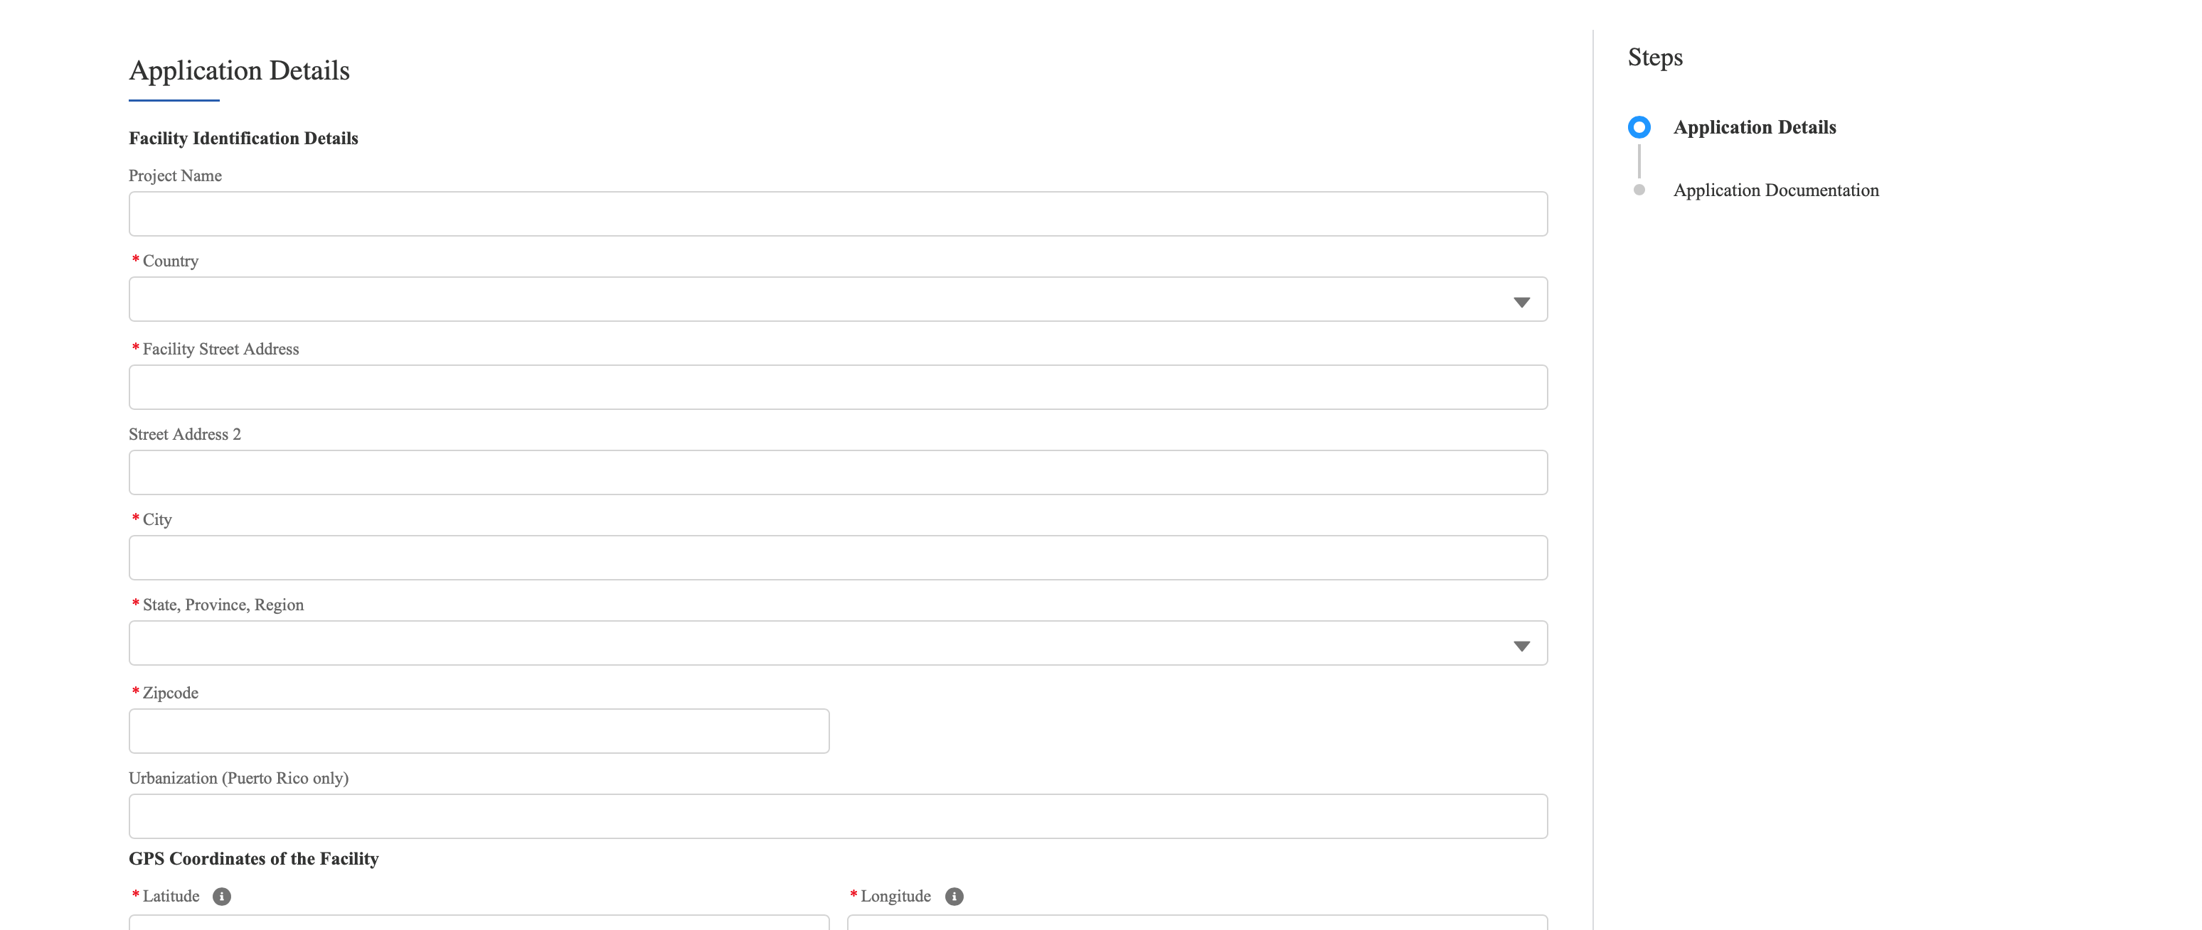

Application for Allocation
2a
Applicants will be prompted to enter all Facility Information and Details including address, latitude/longitude, technology type, facility size, cost, etc.
Applicants will enter all Facility Identification Details including optional Project Name and Facility Street Address.

Slide 4
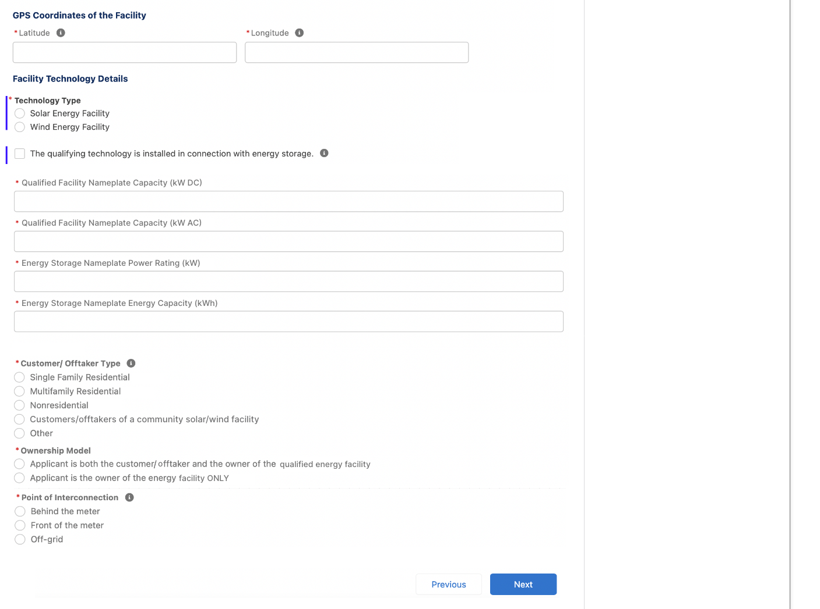

Application for Allocation
2a
Applicants will be prompted to enter all Facility Information and Details including address, latitude/longitude, technology type, facility size, cost, etc.
Applicants will enter the facility Latitude and Longitude.
Applicants will select the facility Technology Type (Solar or Wind) and identify if the facility includes Energy Storage.
Applicants will enter the energy generating capacity of the facility.
Note: fields are conditional based on the technology type selected and energy storage identification. For example, if I select Wind and no energy storage, I will be prompted to complete only Nameplate Capacity (kW AC)
Applicants will be prompted to enter Facility Usage details including Customer Type, Ownership Model, Point of Interconnection, and Additional Selection Criteria.
Note: Facility Usage is conditional for each subcategory based on requirements outlined in guidance. Questions and response options will differ across each subcategory.
Once all required fields have been completed, applicants will select Next to move on to required documentation.

Slide 5
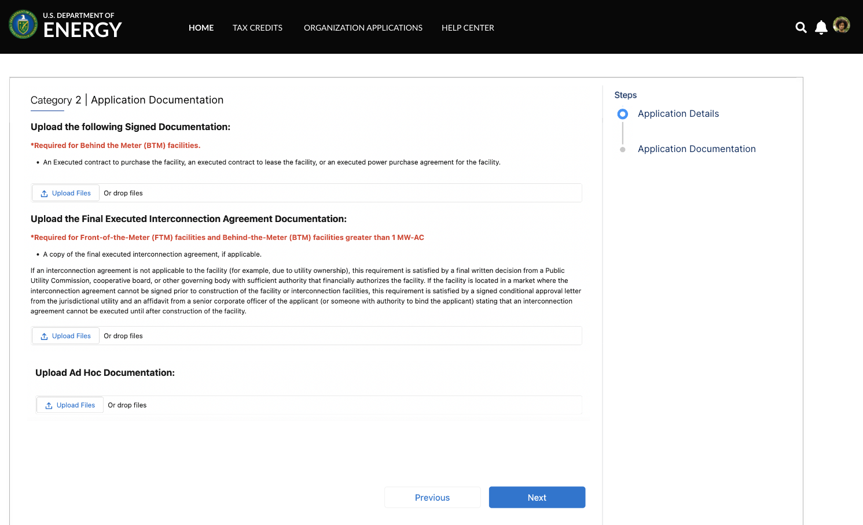

Application for Allocation
2a
Applicants will be prompted to attach all required documents.
executed
Applicants will be prompted to attach all required documents per category requirements outlined in the NPRM.
Note: Documentation requirements are conditional based on subcategory chosen by the applicant.
Once required documents have been attached, applicants will select Next to review their application prior to submission.

Slide 6
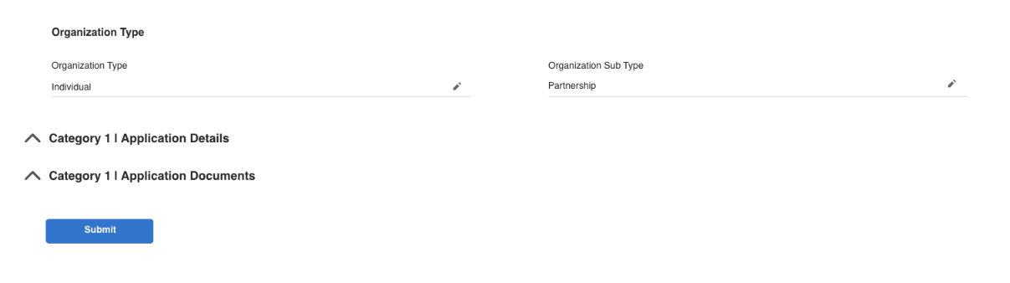
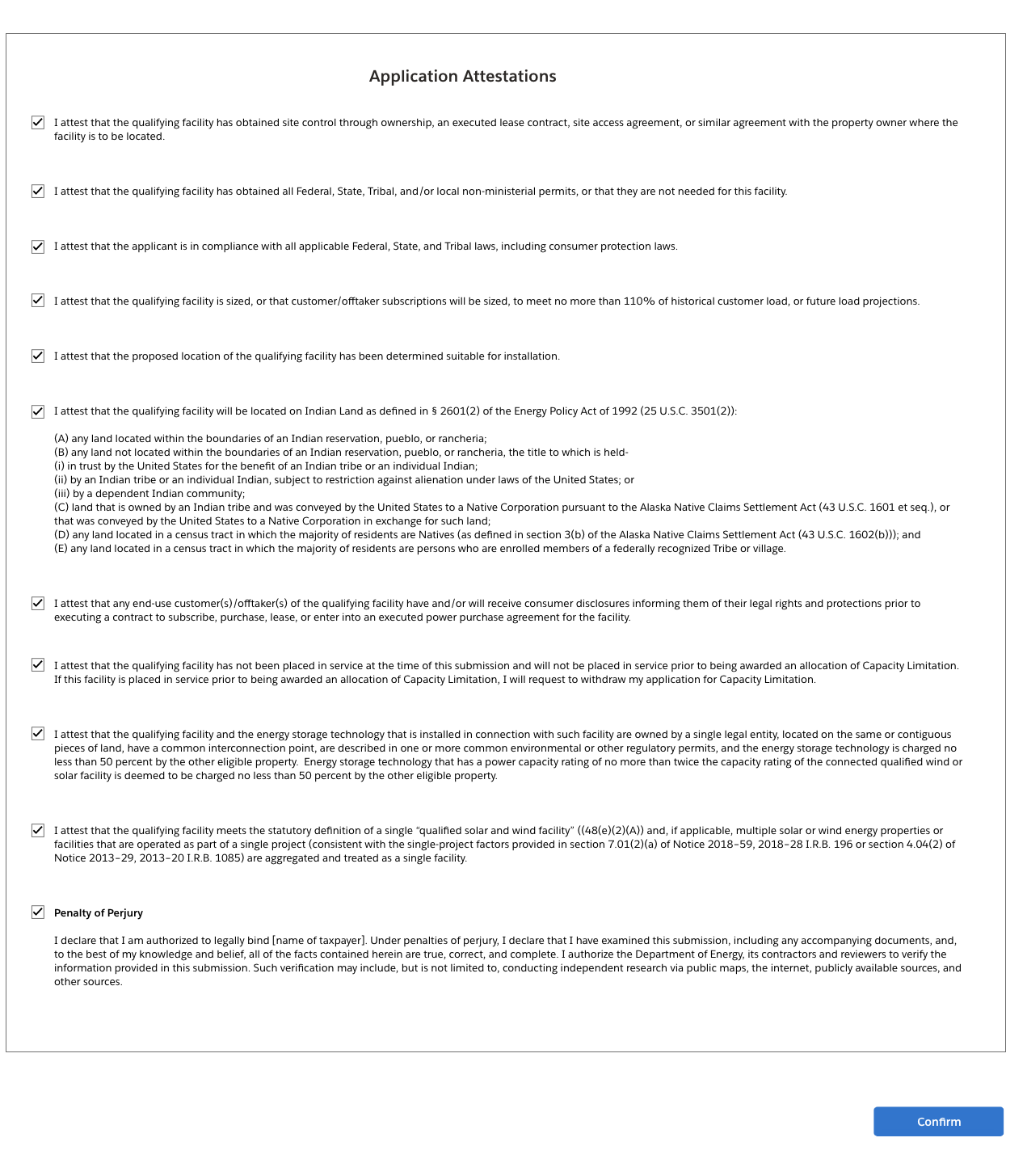
Application for Allocation
2a
Applicants will be prompted to review all information prior to submission.
Applicants will select Submit and be prompted to agree to required Attestations.
Applicants will be required to Attest to all required Attestations prior to submission.
Note: all Attestations are conditional based on subcategory selected and applicant responses.
Once applicants have attested, they can confirm submission of their 48(e) application for allocation

Slide 7
Application for Allocation
2b
Applicants will be prompted to enter all Facility Information and Details including address, latitude/longitude, technology type, facility size, cost, etc.
Applicants will enter all Facility Identification Details including optional Project Name and Facility Street Address.

Slide 8
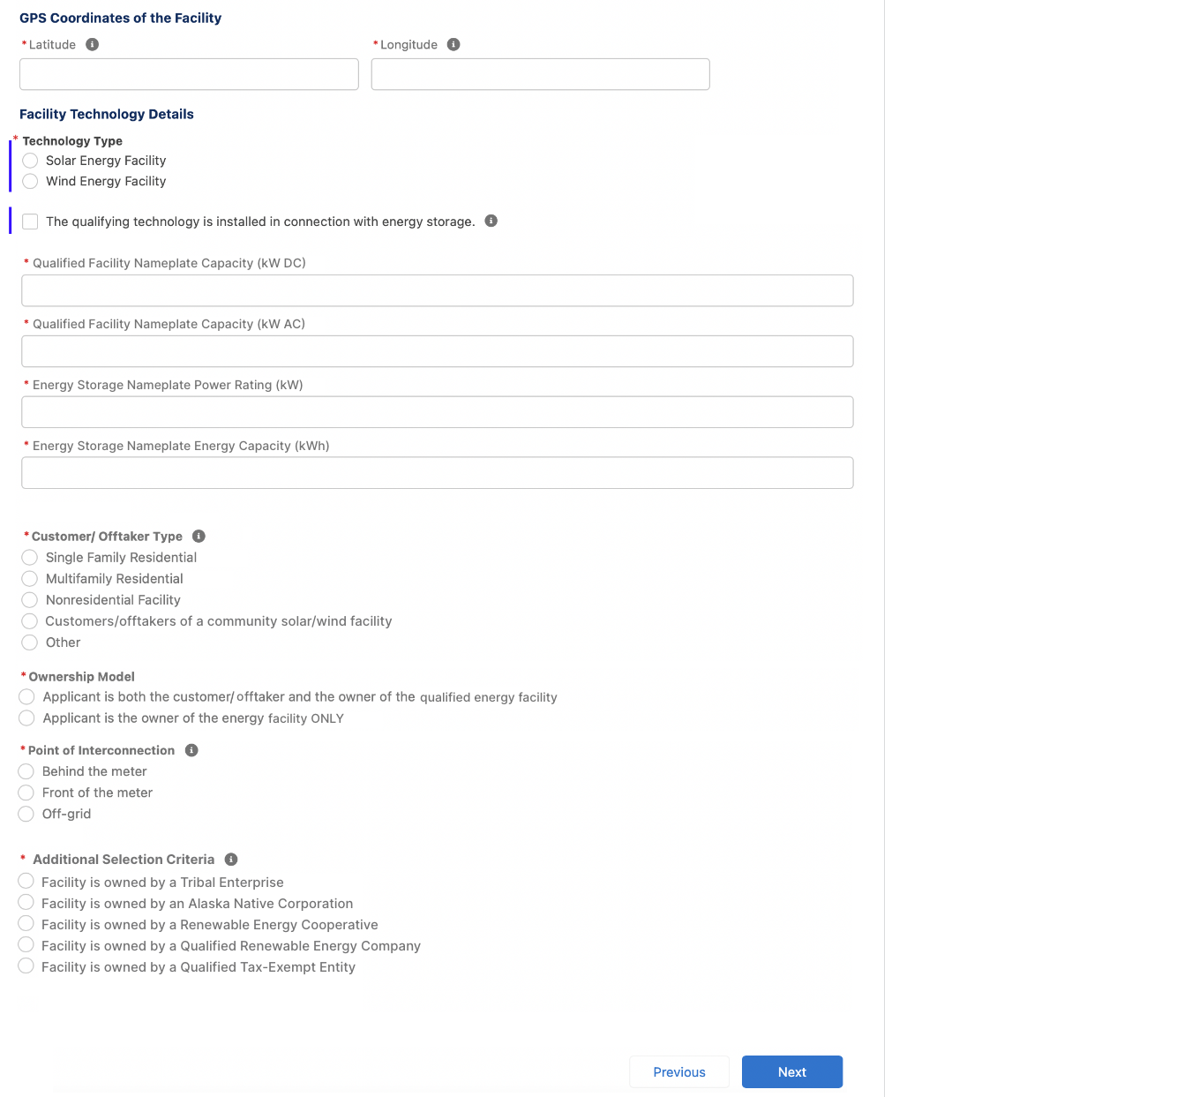
Application for Allocation
2b
Applicants will be prompted to enter all Facility Information and Details including address, latitude/longitude, technology type, facility size, cost, etc.
Applicants will enter the facility Latitude and Longitude.
Applicants will select the facility Technology Type (Solar or Wind) and identify if the facility includes Energy Storage.
Applicants will enter the energy generating capacity of the facility.
Note: fields are conditional based on the technology type selected and energy storage identification. For example, if I select Wind and no energy storage, I will be prompted to complete only Energy Generating Capacity (kW AC)
Applicants will be prompted to enter Facility Usage details including Customer Type, Ownership Model, Point of Interconnection, and Additional Selection Criteria.
Note: Facility Usage is conditional for each subcategory based on requirements outlined in guidance. Questions and response options will differ across each subcategory.
Once all required fields have been completed, applicants will select Next to move on to required documentation.

Slide 9
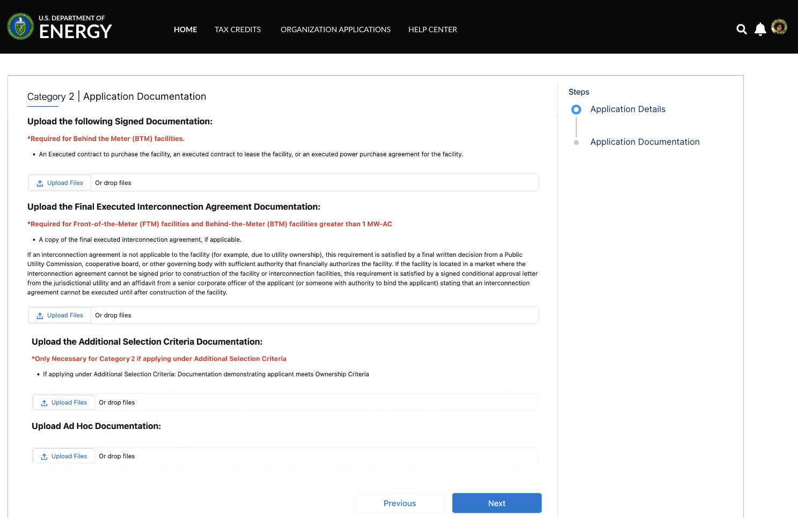
Application for Allocation
2b
Applicants will be prompted to attach all required documents.
executed
Applicants will be prompted to attach all required documents per category requirements outlined in the NPRM.
Note: Documentation requirements are conditional based on subcategory chosen by the applicant.
Once required documents have been attached, applicants will select Next to review their application prior to submission.

Slide 10
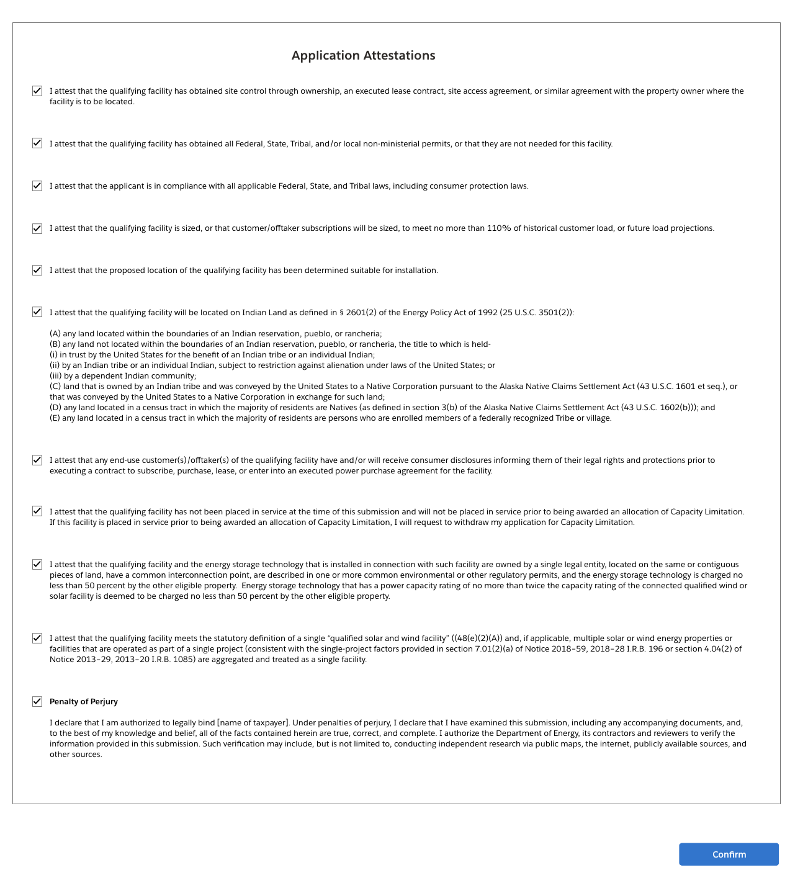
Application for Allocation
2b
Applicants will be prompted to review all information prior to submission.
Applicants will select Submit and be prompted to agree to required Attestations.
Applicants will be required to Attest to all required Attestations prior to submission.
Note: all Attestations are conditional based on subcategory selected and applicant responses.
Once applicants have attested, they can confirm submission of their 48(e) application for allocation

Slide 11
Application for Allocation
3a
Applicants will be prompted to enter all Facility Information and Details including address, latitude/longitude, technology type, facility size, cost, etc.
Applicants will enter all Facility Identification Details including optional Project Name and Facility Street Address.

Slide 12
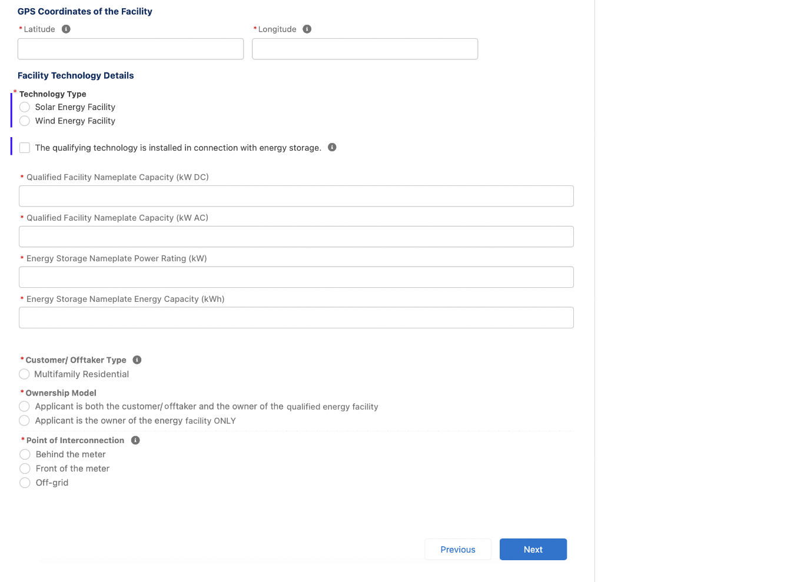
Application for Allocation
3a
Applicants will be prompted to enter all Facility Information and Details including address, latitude/longitude, technology type, facility size, cost, etc.
Applicants will enter the facility Latitude and Longitude.
Applicants will select the facility Technology Type (Solar or Wind) and identify if the facility includes Energy Storage.
Applicants will enter the energy generating capacity of the facility.
Note: fields are conditional based on the technology type selected and energy storage identification. For example, if I select Wind and no energy storage, I will be prompted to complete only Nameplate Capacity (kW AC)
Applicants will be prompted to enter Facility Usage details including Customer Type, Ownership Model, Point of Interconnection, and Additional Selection Criteria.
Note: Facility Usage is conditional for each subcategory based on requirements outlined in guidance. Questions and response options will differ across each subcategory.
Once all required fields have been completed, applicants will select Next to move on to required documentation.

Slide 13
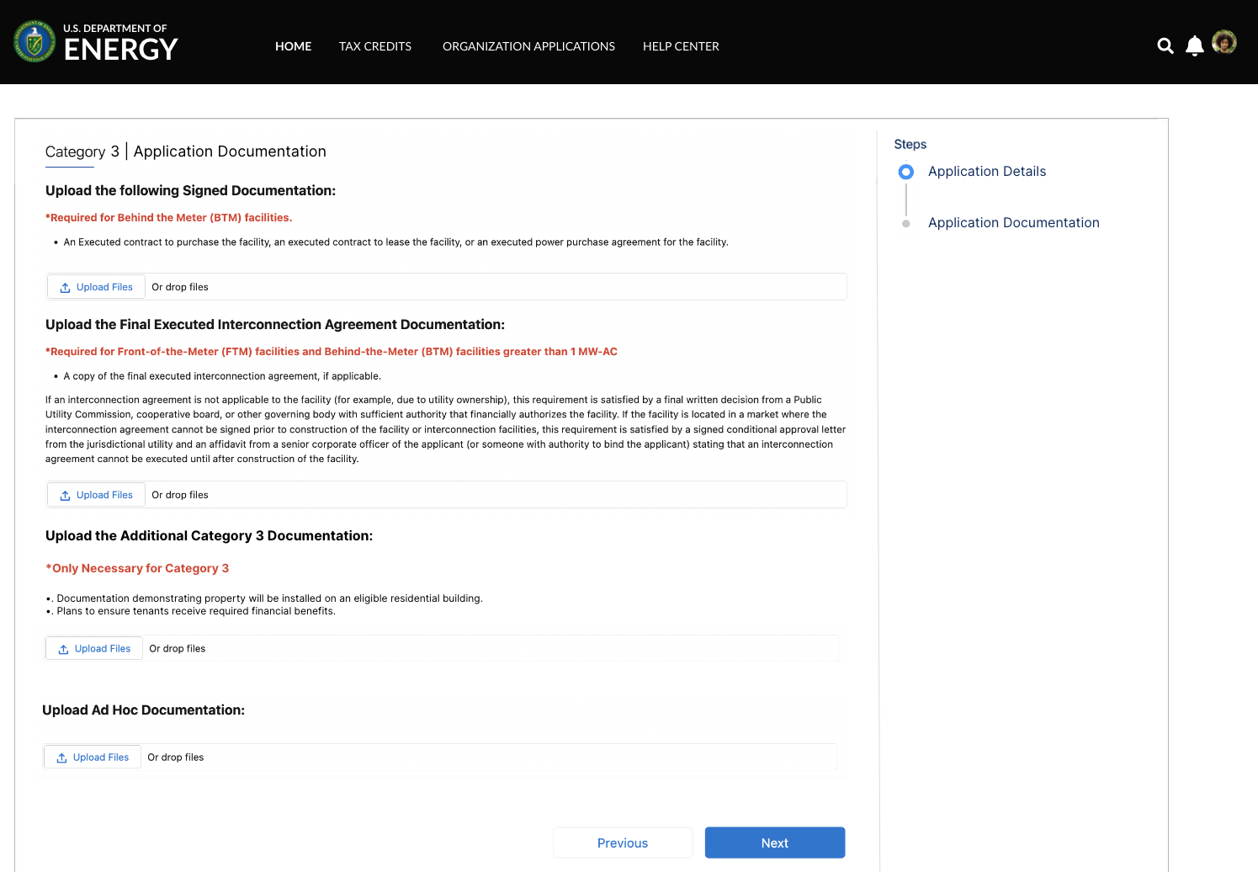
Application for Allocation
3a
Applicants will be prompted to attach all required documents.
executed
Applicants will be prompted to attach all required documents per category requirements outlined in the NPRM.
Note: Documentation requirements are conditional based on subcategory chosen by the applicant.
Once required documents have been attached, applicants will select Next to review their application prior to submission.

Slide 14
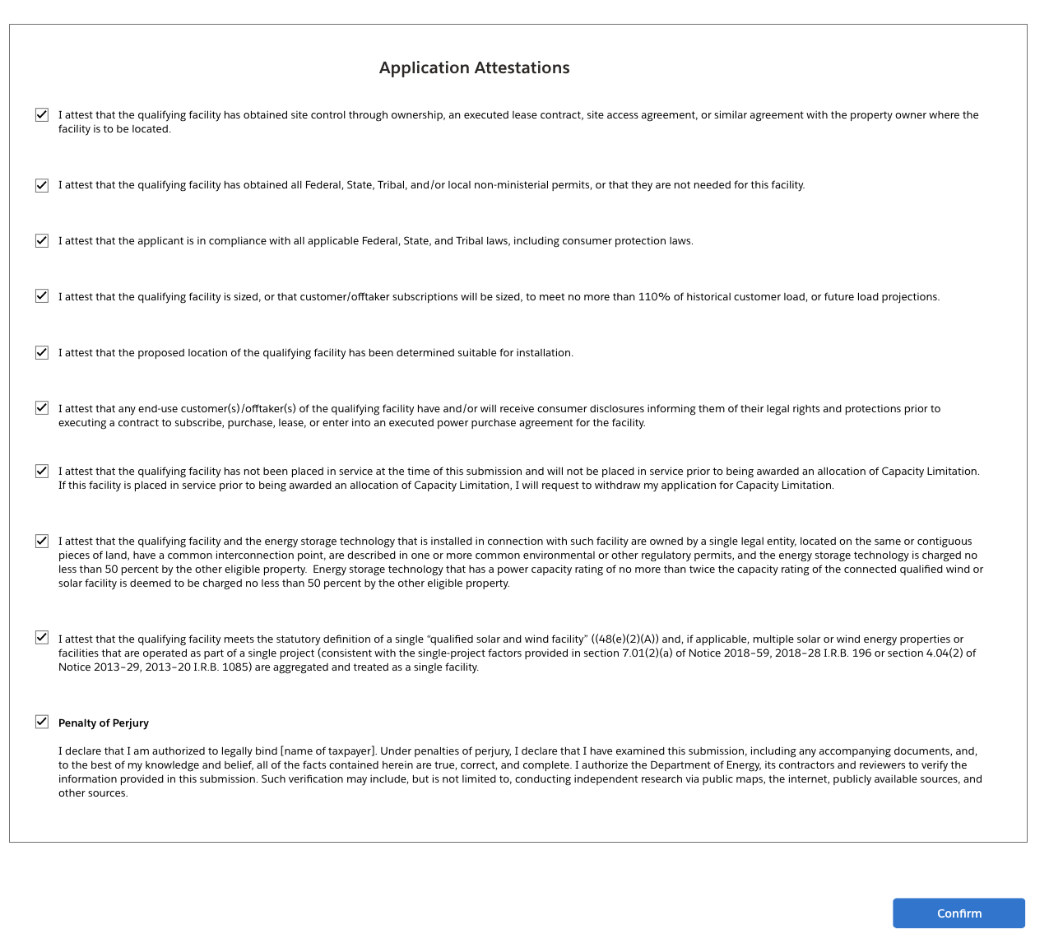
Application for Allocation
3a
Applicants will be prompted to review all information prior to submission.
Applicants will select Submit and be prompted to agree to required Attestations.
Applicants will be required to Attest to all required Attestations prior to submission.
Note: all Attestations are conditional based on subcategory selected and applicant responses.
Once applicants have attested, they can confirm submission of their 48(e) application for allocation

Slide 15
Application for Allocation
3b
Applicants will be prompted to enter all Facility Information and Details including address, latitude/longitude, technology type, facility size, cost, etc.
Applicants will enter all Facility Identification Details including optional Project Name and Facility Street Address.

Slide 16
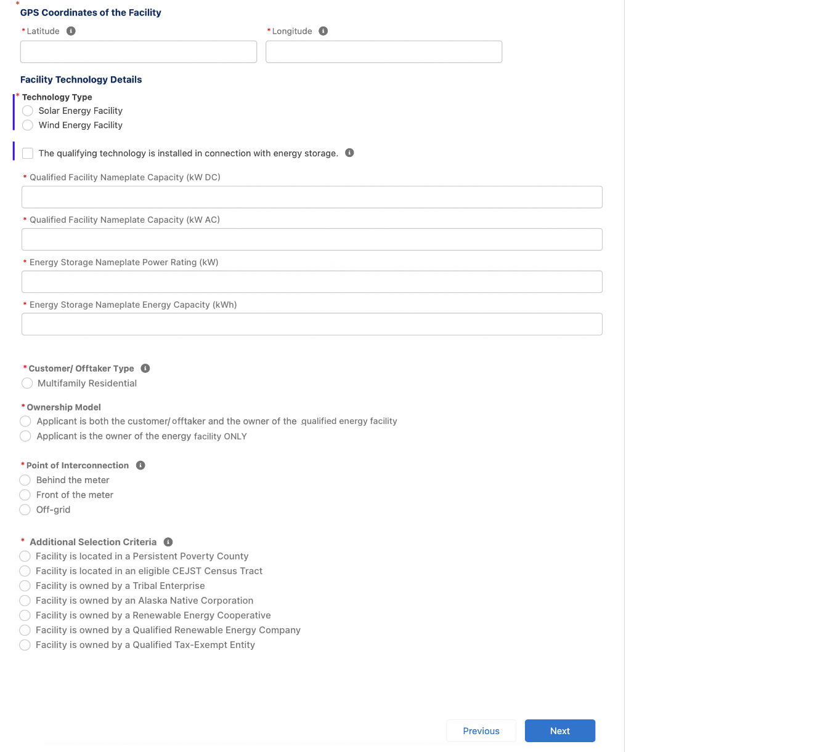
Application for Allocation
3b
Applicants will be prompted to enter all Facility Information and Details including address, latitude/longitude, technology type, facility size, cost, etc.
Applicants will enter the facility Latitude and Longitude.
Applicants will select the facility Technology Type (Solar or Wind) and identify if the facility includes Energy Storage.
Applicants will enter the energy generating capacity of the facility.
Note: fields are conditional based on the technology type selected and energy storage identification. For example, if I select Wind and no energy storage, I will be prompted to complete only Energy Generating Capacity (kW AC)
Applicants will be prompted to enter Facility Usage details including Customer Type, Ownership Model, Point of Interconnection, and Additional Selection Criteria.
Note: Facility Usage is conditional for each subcategory based on requirements outlined in guidance. Questions and response options will differ across each subcategory.
Once all required fields have been completed, applicants will select Next to move on to required documentation.

Slide 17
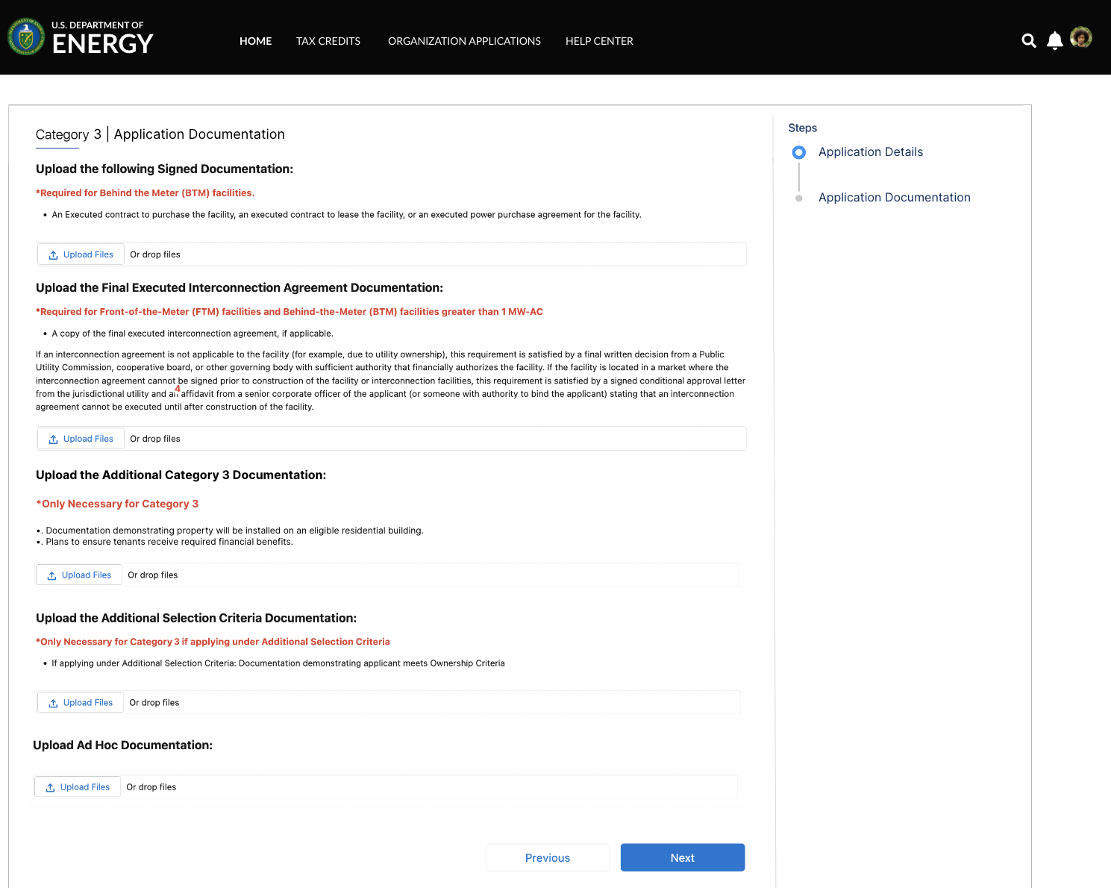
Application for Allocation
3b
Applicants will be prompted to attach all required documents.
executed
Applicants will be prompted to attach all required documents per category requirements outlined in the NPRM.
Note: Documentation requirements are conditional based on subcategory chosen by the applicant.
Once required documents have been attached, applicants will select Next to review their application prior to submission.

Slide 18
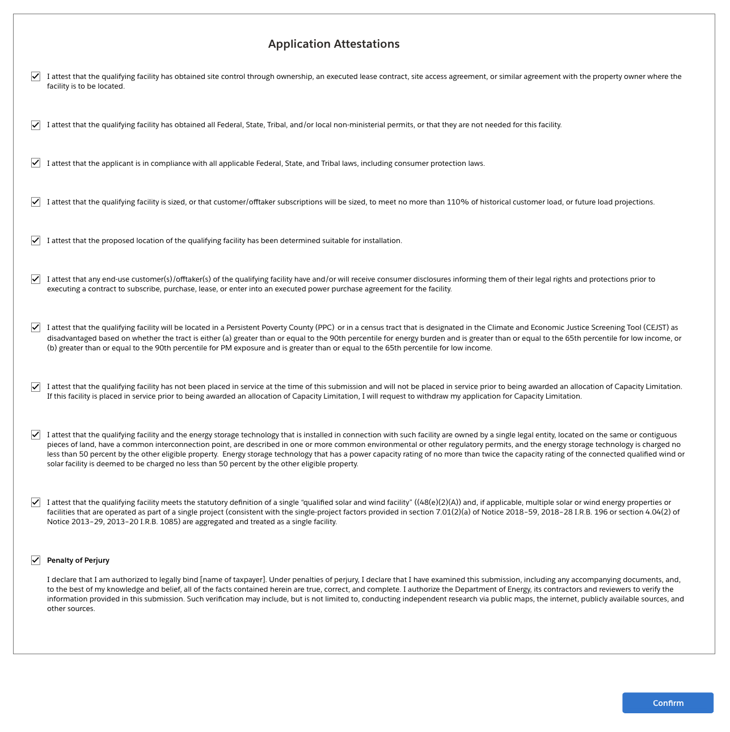
Application for Allocation
3b
Applicants will be prompted to review all information prior to submission.
Applicants will select Submit and be prompted to agree to required Attestations.
Applicants will be required to Attest to all required Attestations prior to submission.
Note: all Attestations are conditional based on subcategory selected and applicant responses.
Once applicants have attested, they can confirm submission of their 48(e) application for allocation

Slide 19
Application for Allocation
4a
Applicants will be prompted to enter all Facility Information and Details including address, latitude/longitude, technology type, facility size, cost, etc.
Applicants will enter all Facility Identification Details including optional Project Name and Facility Street Address.

Slide 20
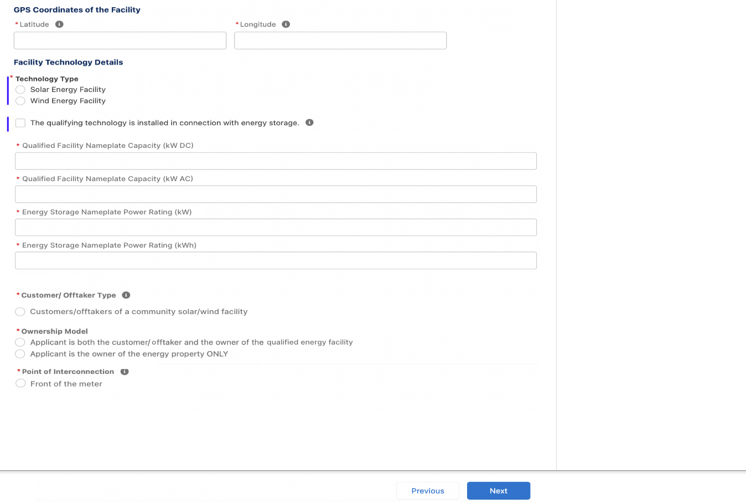
Application for Allocation
4a
Applicants will be prompted to enter all Facility Information and Details including address, latitude/longitude, technology type, facility size, cost, etc.
Applicants will enter the facility Latitude and Longitude.
Applicants will select the facility Technology Type (Solar or Wind) and identify if the facility includes Energy Storage.
Applicants will enter the energy generating capacity of the facility.
Note: fields are conditional based on the technology type selected and energy storage identification. For example, if I select Wind and no energy storage, I will be prompted to complete only Nameplate Capacity (kW AC)
Applicants will be prompted to enter Facility Usage details including Customer Type, Ownership Model, Point of Interconnection, and Additional Selection Criteria.
Note: Facility Usage is conditional for each subcategory based on requirements outlined in guidance. Questions and response options will differ across each subcategory.
Once all required fields have been completed, applicants will select Next to move on to required documentation.

Slide 21
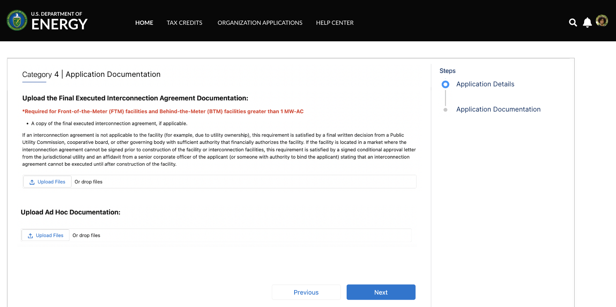
Application for Allocation
4a
Applicants will be prompted to attach all required documents.
Applicants will be prompted to attach all required documents per category requirements outlined in the NPRM.
Note: Documentation requirements are conditional based on subcategory chosen by the applicant.
Once required documents have been attached, applicants will select Next to review their application prior to submission.

Slide 22
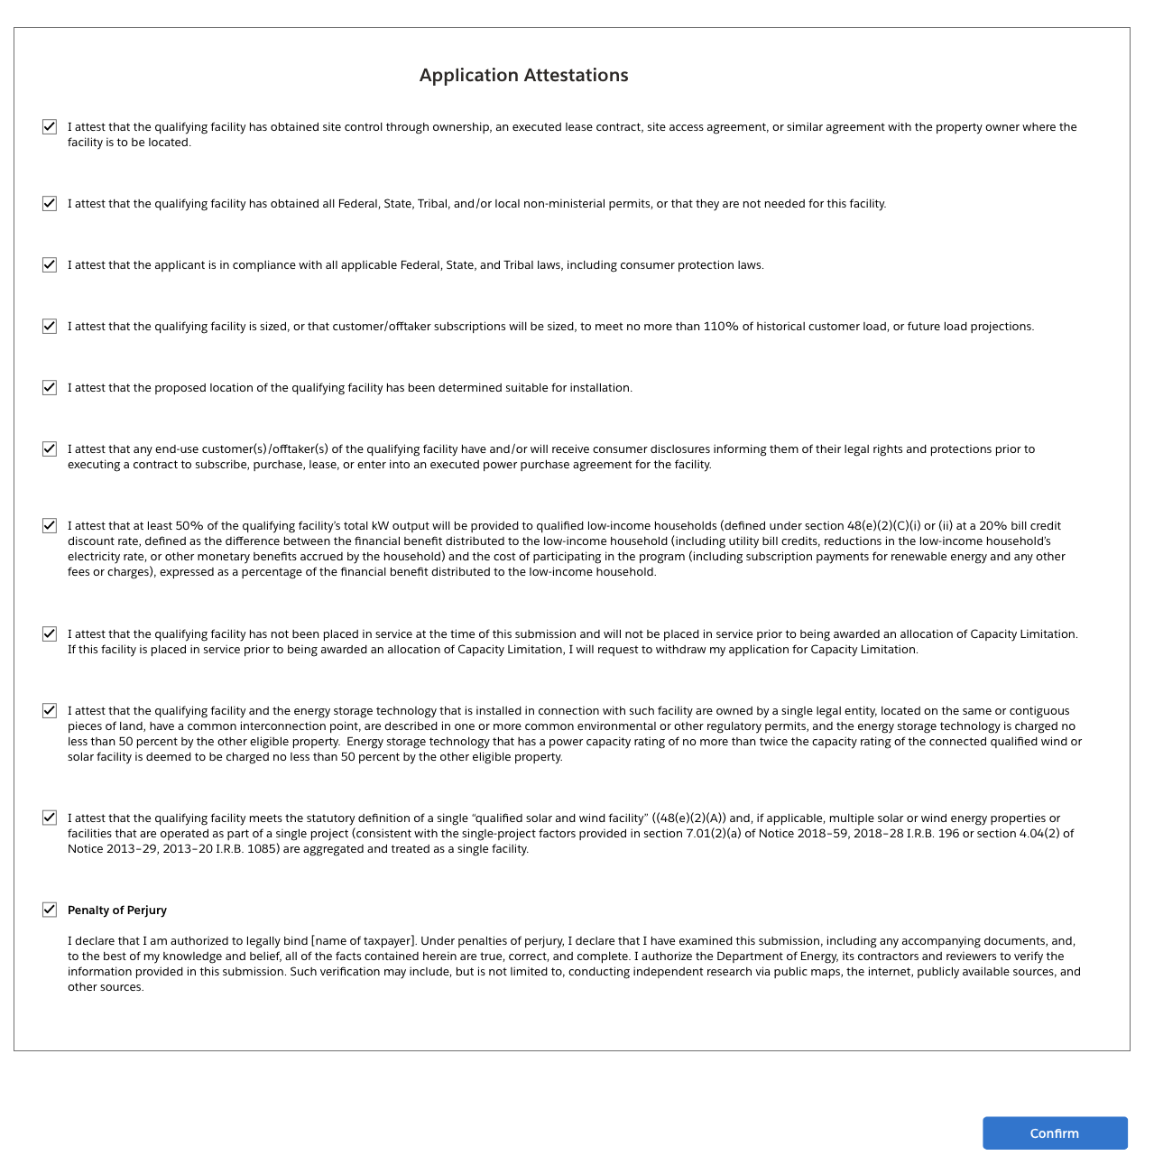
Application for Allocation
4a
Applicants will be prompted to review all information prior to submission.
Applicants will select Submit and be prompted to agree to required Attestations.
Applicants will be required to Attest to all required Attestations prior to submission.
Note: all Attestations are conditional based on subcategory selected and applicant responses.
Once applicants have attested, they can confirm submission of their 48(e) application for allocation

Slide 23
Application for Allocation
4b
Applicants will be prompted to enter all Facility Information and Details including address, latitude/longitude, technology type, facility size, cost, etc.
Applicants will enter all Facility Identification Details including optional Project Name and Facility Street Address.

Slide 24
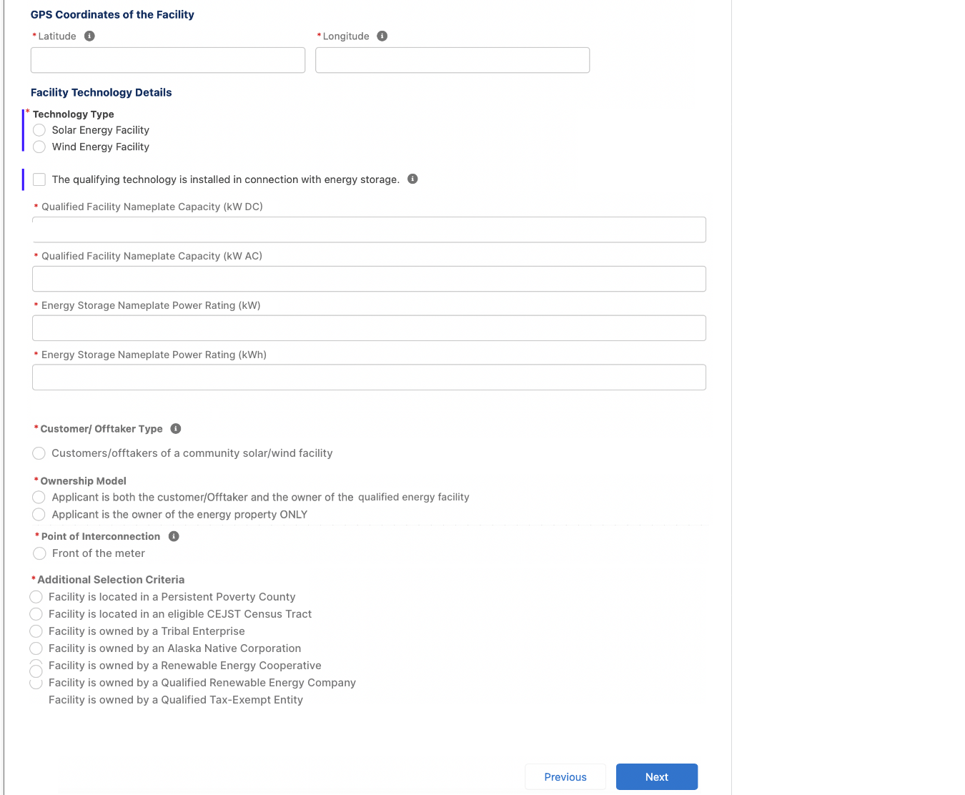
Application for Allocation
4b
Applicants will be prompted to enter all Facility Information and Details including address, latitude/longitude, technology type, facility size, cost, etc.
Applicants will enter the facility Latitude and Longitude.
Applicants will select the facility Technology Type (Solar or Wind) and identify if the facility includes Energy Storage.
Applicants will enter the energy generating capacity of the facility.
Note: fields are conditional based on the technology type selected and energy storage identification. For example, if I select Wind and no energy storage, I will be prompted to complete only Namplate Capacity (kW AC)
Applicants will be prompted to enter Facility Usage details including Customer Type, Ownership Model, Point of Interconnection, and Additional Selection Criteria.
Note: Facility Usage is conditional for each subcategory based on requirements outlined in guidance. Questions and response options will differ across each subcategory.
Once all required fields have been completed, applicants will select Next to move on to required documentation.

Slide 25
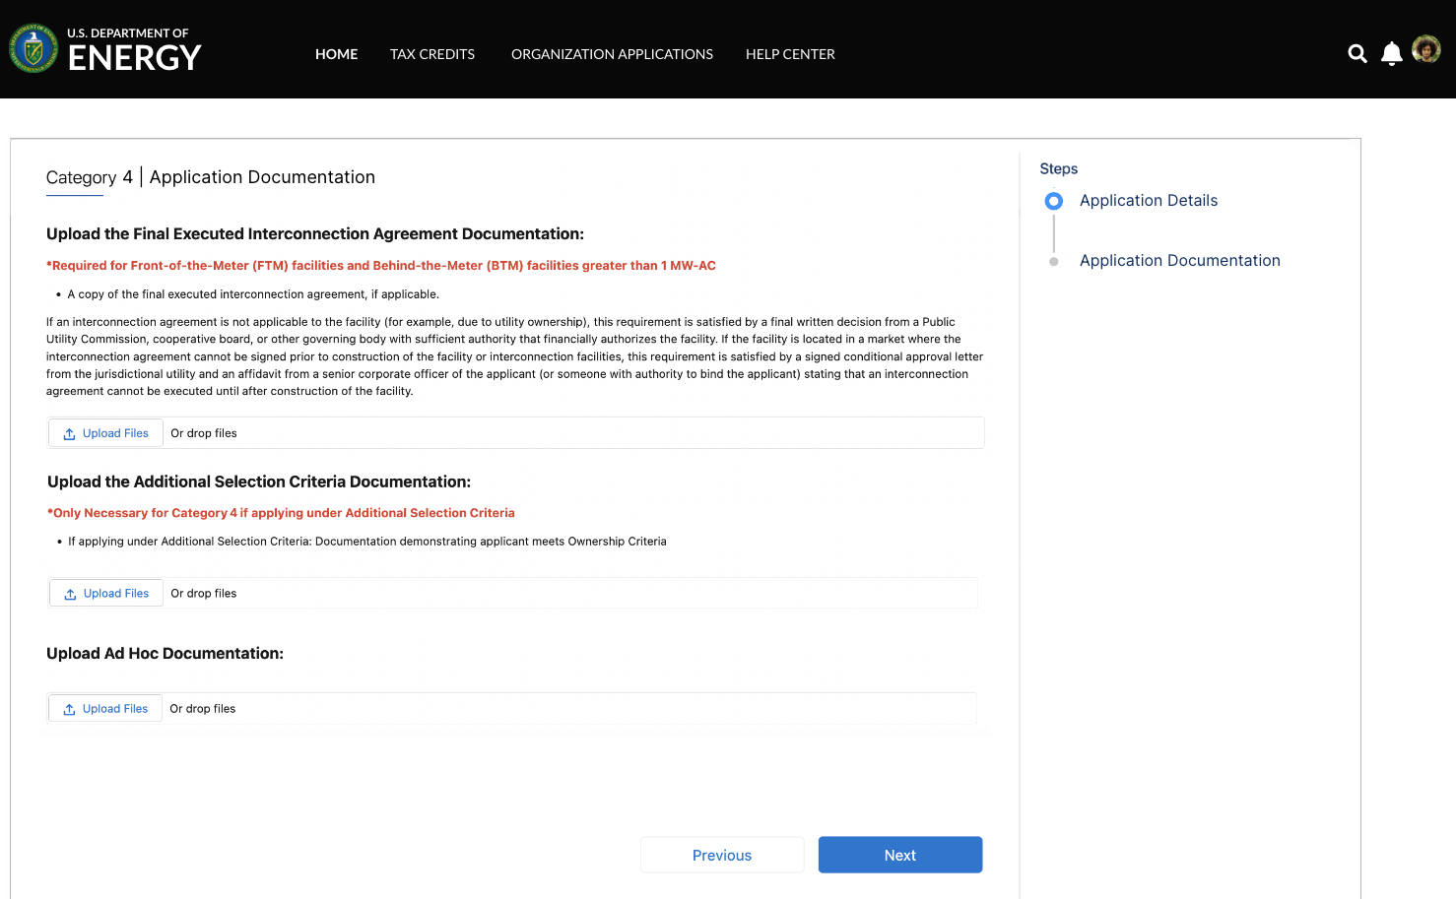
Application for Allocation
4b
Applicants will be prompted to attach all required documents.
Applicants will be prompted to attach all required documents per category requirements outlined in the NPRM.
Note: Documentation requirements are conditional based on subcategory chosen by the applicant.
Once required documents have been attached, applicants will select Next to review their application prior to submission.

Slide 26
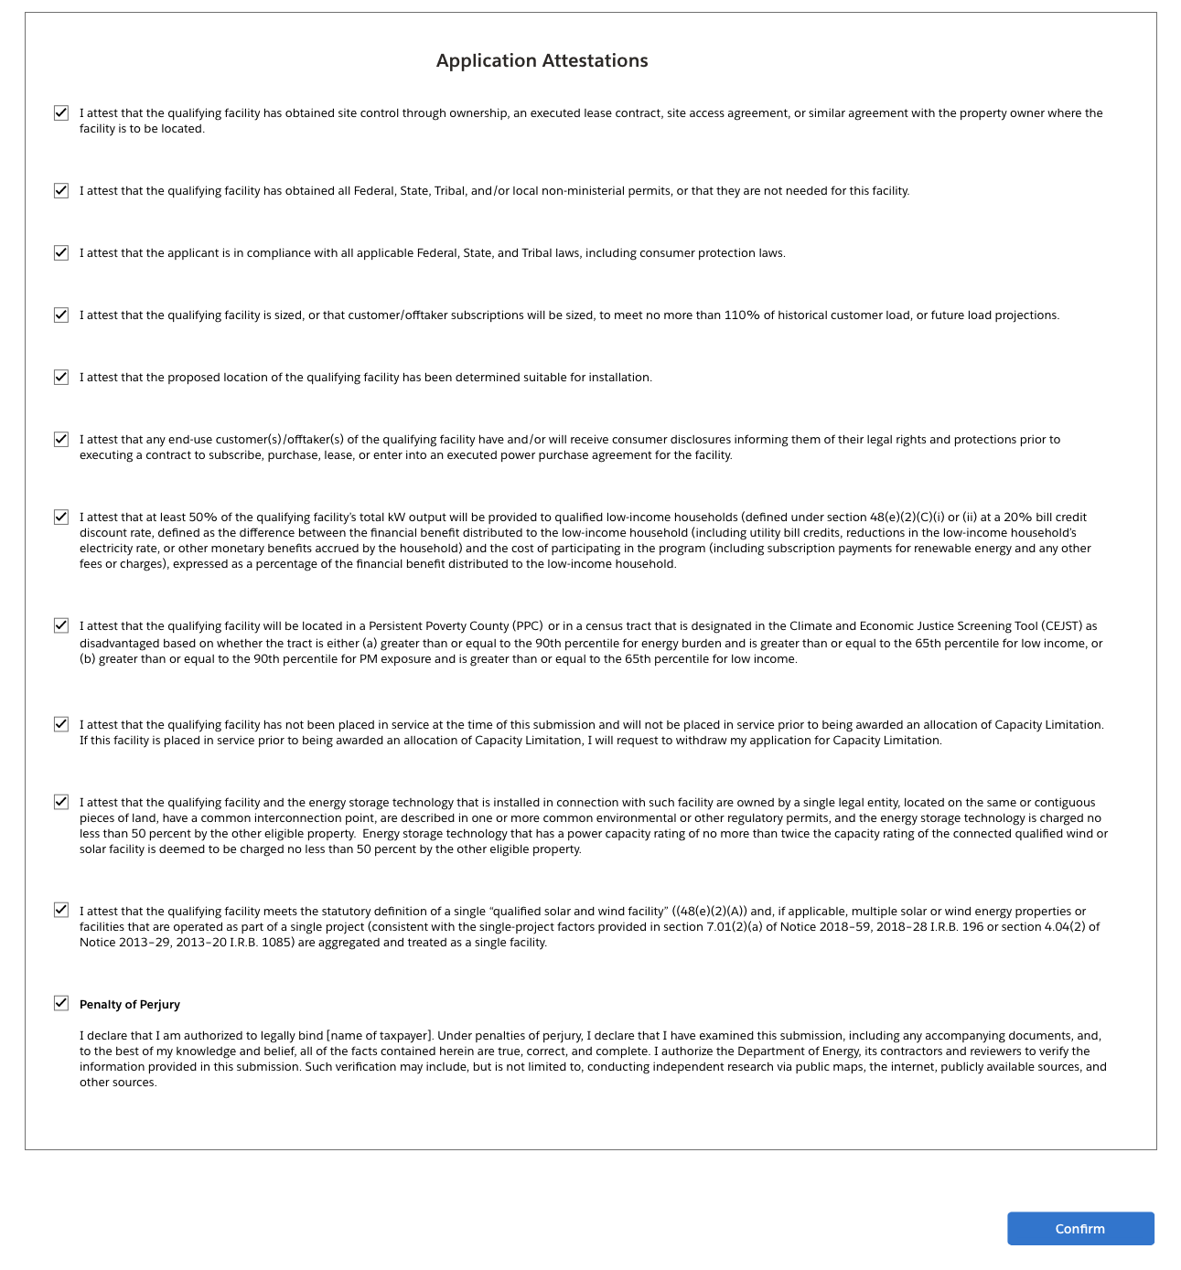
Application for Allocation
4b
Applicants will be prompted to review all information prior to submission.
Applicants will select Submit and be prompted to agree to required Attestations.
Applicants will be required to Attest to all required Attestations prior to submission.
Note: all Attestations are conditional based on subcategory selected and applicant responses.
Once applicants have attested, they can confirm submission of their 48(e) application for allocation

