Slide 1
Confidential Business Information under the Toxic Substances Control Act Substantiation
OMB Control No. 2070-0223
EPA ICR No. 2706.03
Expiration Date 8/31/2026
EPA Form PFN 7710-57

Slide 2
PRA Burden Statement
This collection of information is approved by OMB under the Paperwork Reduction Act, 44 U.5.C. 3501 et. seq. 0MB Control No. 2070-0223. Responses to this collection of information are mandatory (40 CFR 703). An agency may not conduct or sponsor, and a person is not required to respond to, a collection of information unless it displays a currently valid 0MB control number. The public reporting and recordkeeping burden for this collection of information is estimated to 135.80 hours per response. Send comments on the Agency's need for this information, the accuracy of the provided burden estimates and any suggested methods for minimizing respondent burden to the Data & Enterprise Programs Deputy Division Director (2821 T), 1200 Pennsylvania Ave., NW, Washington, D.C. 20460. Include the 0MB control number in any correspondence. Do not send the completed form to this address

Slide 3
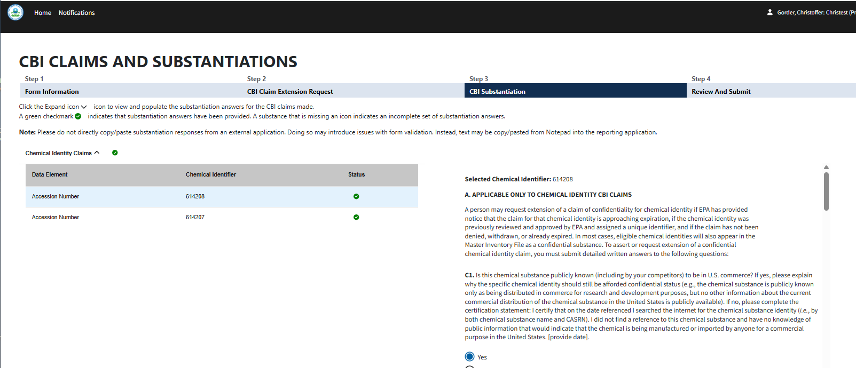
OMB Control No. 2070-0223
Expiration Date 8/31/2026
EPA Form PRN 7710-57

Slide 4
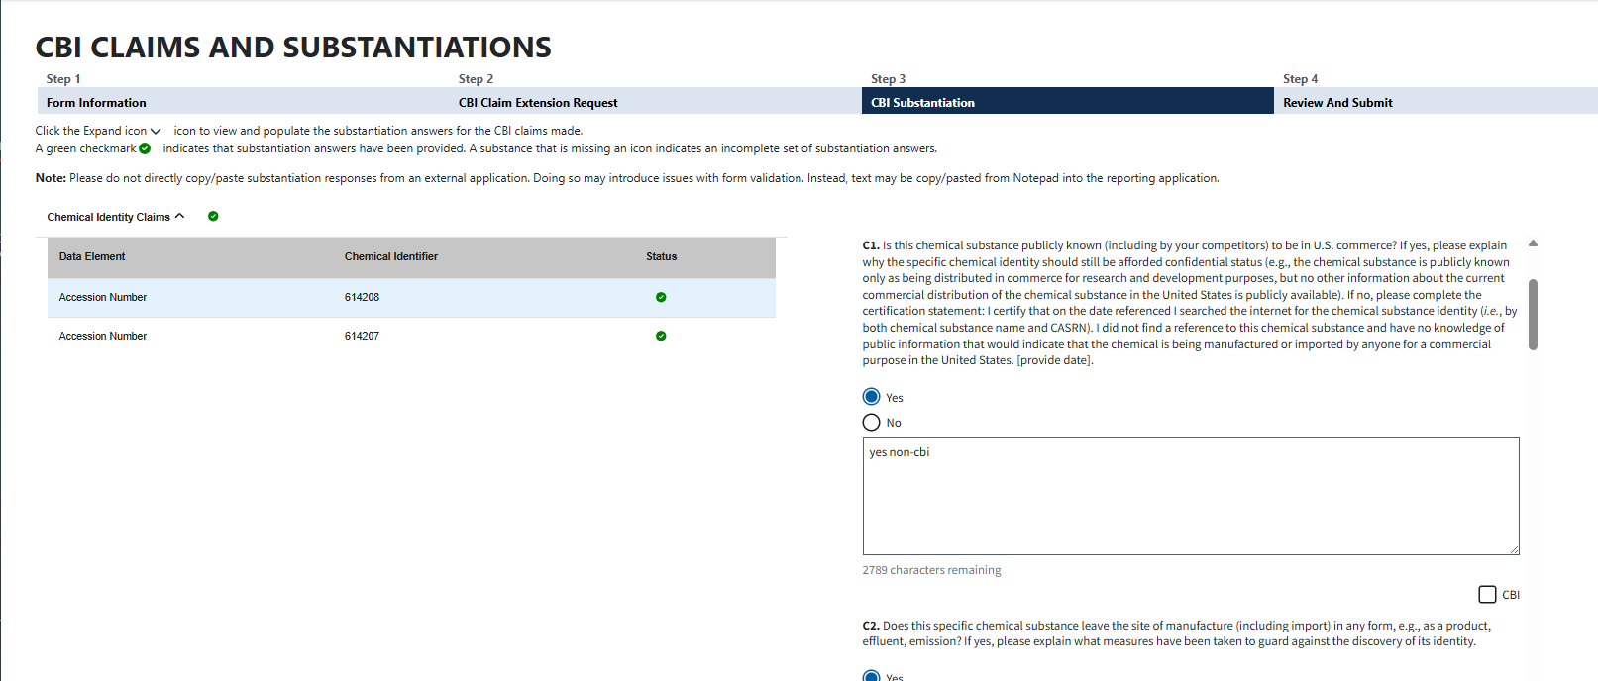
OMB Control No. 2070-0223
Expiration Date 8/31/2026
EPA Form PRN 7710-57

Slide 5
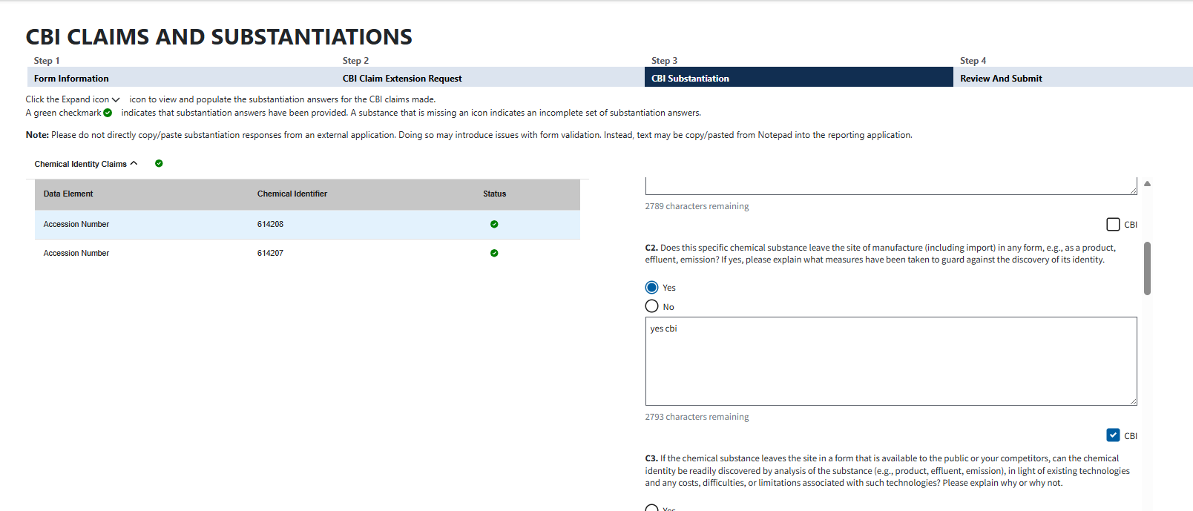
OMB Control No. 2070-0223
Expiration Date 8/31/2026
EPA Form PRN 7710-57

Slide 6
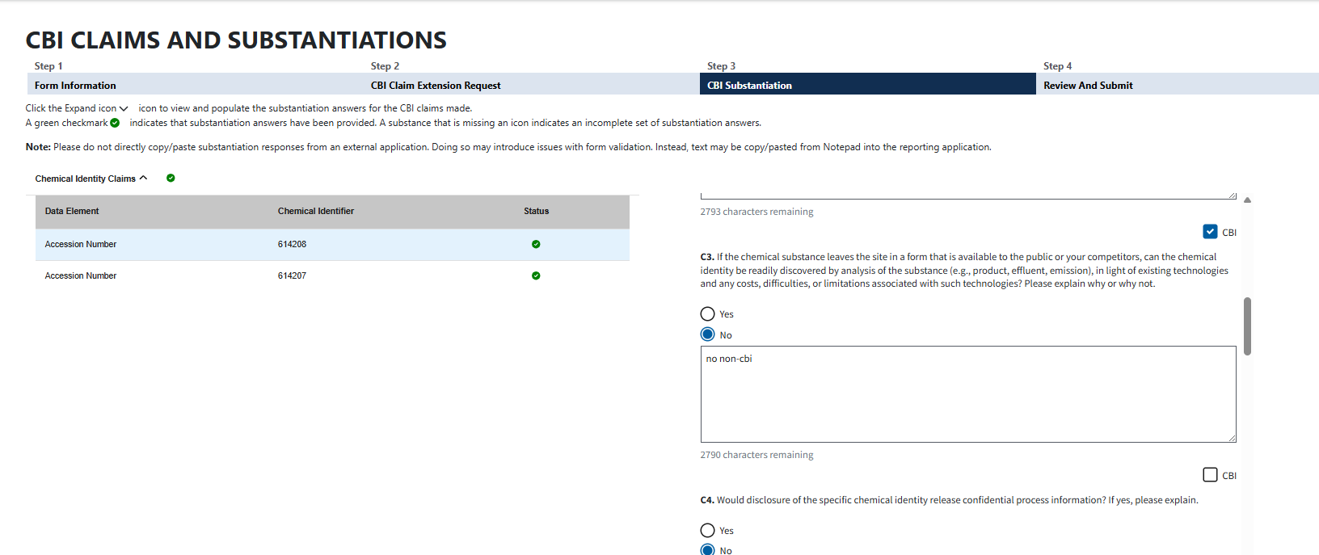
OMB Control No. 2070-0223
Expiration Date 8/31/2026
EPA Form PRN 7710-57

Slide 7
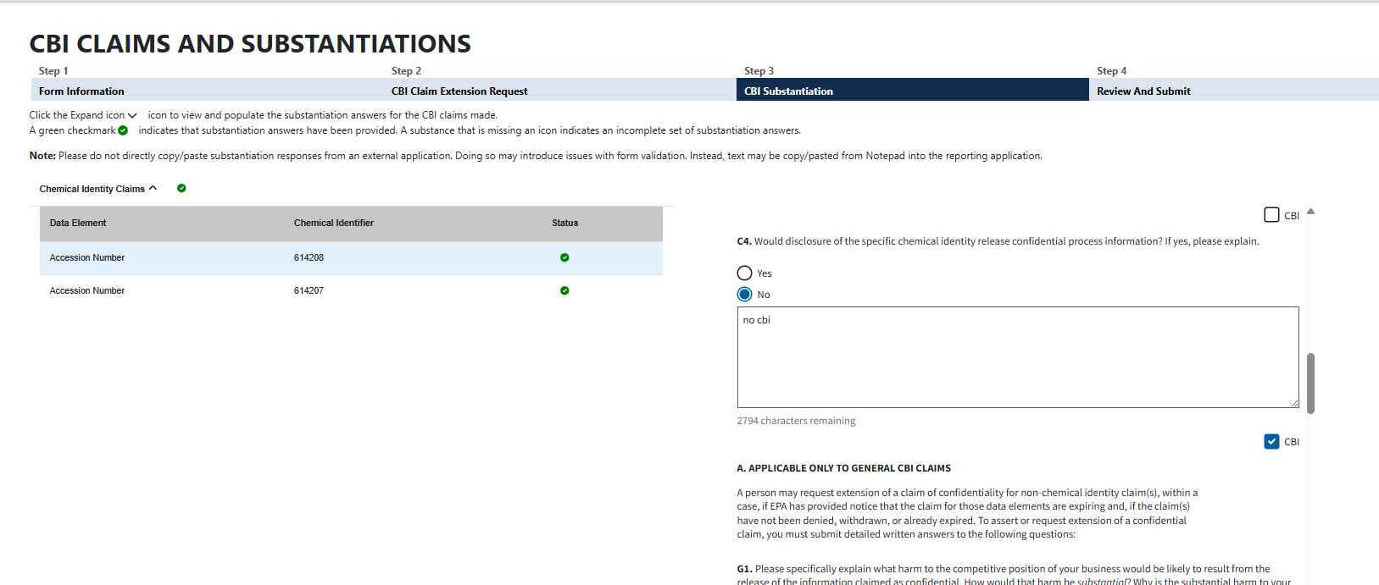
OMB Control No. 2070-0223
Expiration Date 8/31/2026
EPA Form PRN 7710-57

Slide 8
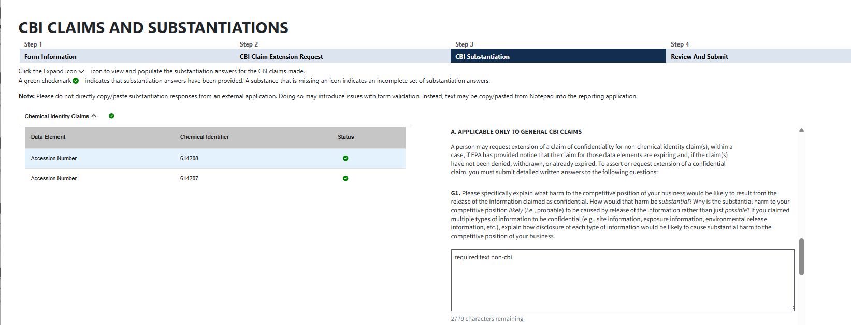
OMB Control No. 2070-0223
Expiration Date 8/31/2026
EPA Form PRN 7710-57

Slide 9
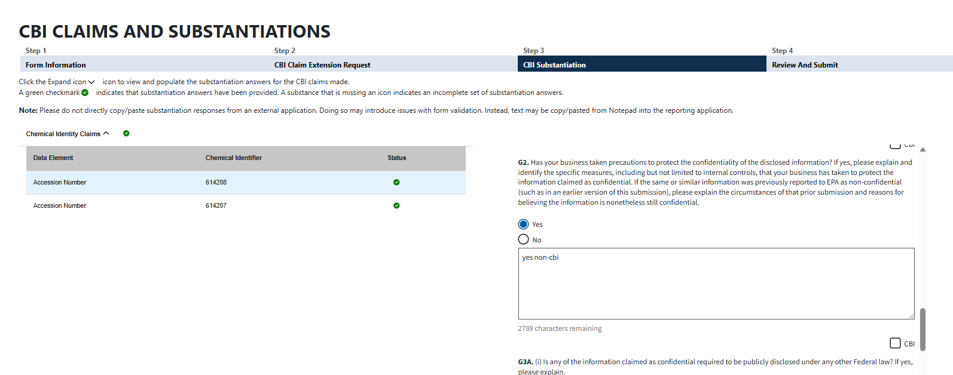
OMB Control No. 2070-0223
Expiration Date 8/31/2026
EPA Form PRN 7710-57

Slide 10
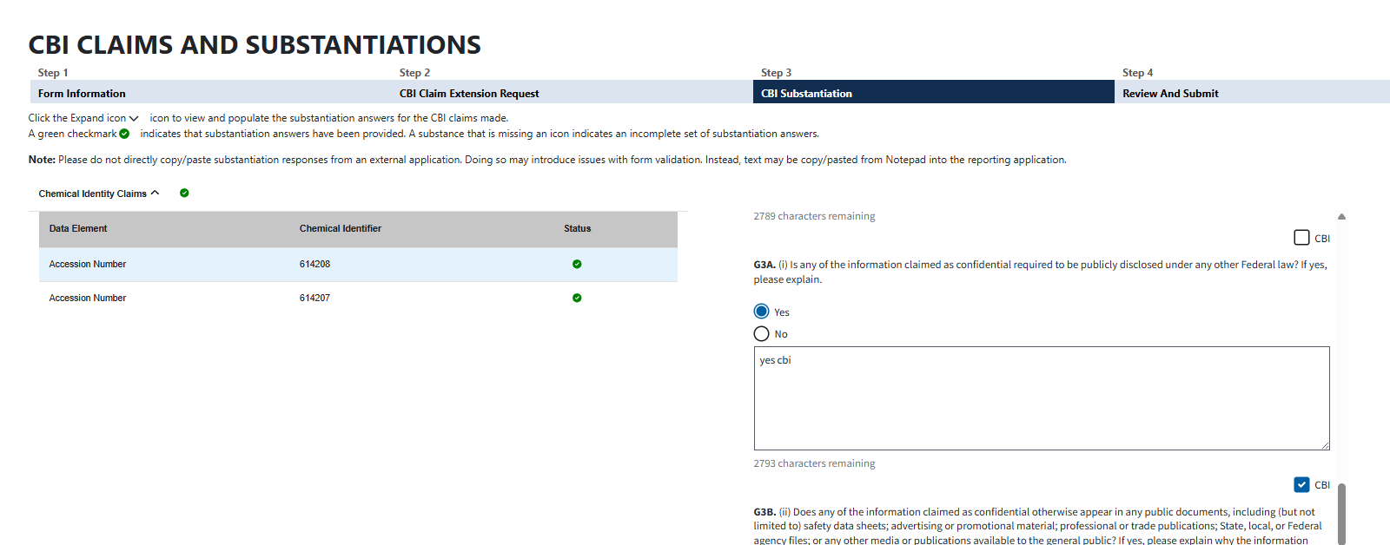
OMB Control No. 2070-0223
Expiration Date 8/31/2026
EPA Form PRN 7710-57

Slide 11
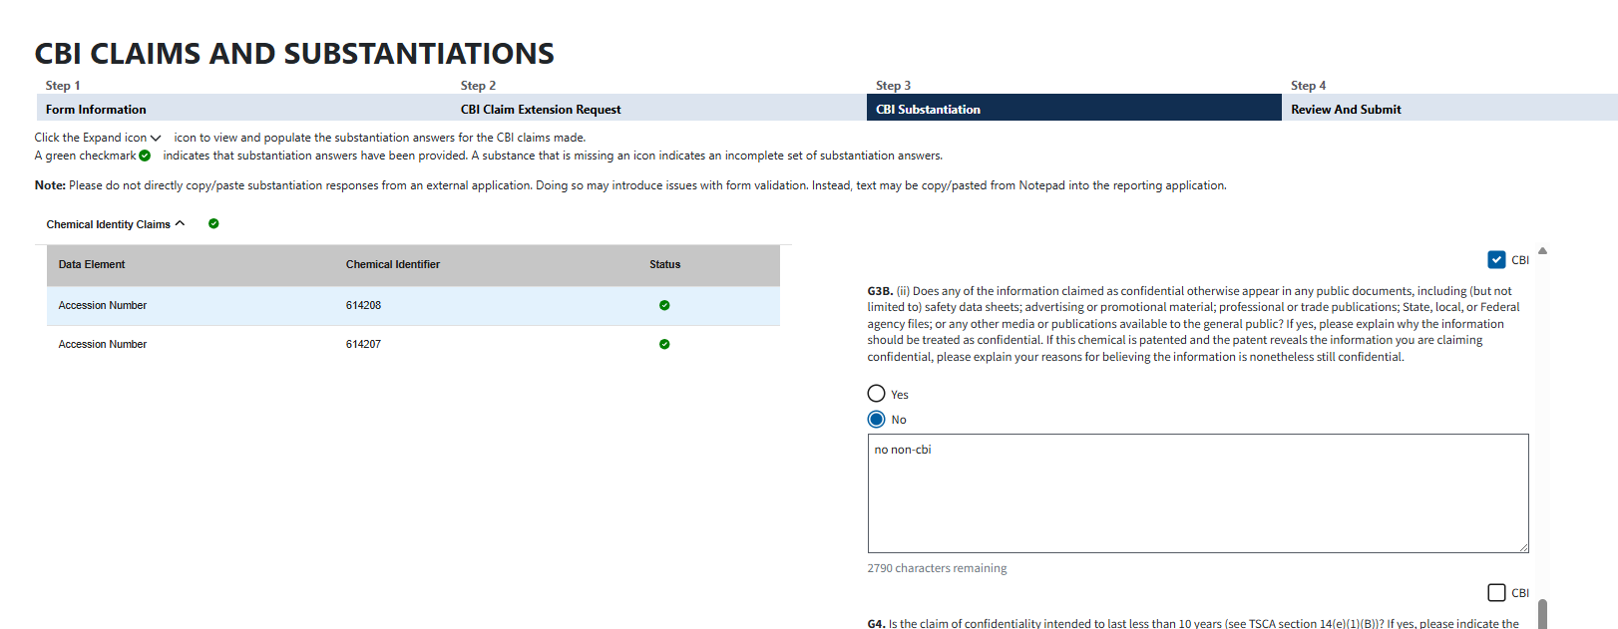
OMB Control No. 2070-0223
Expiration Date 8/31/2026
EPA Form PRN 7710-57

Slide 12
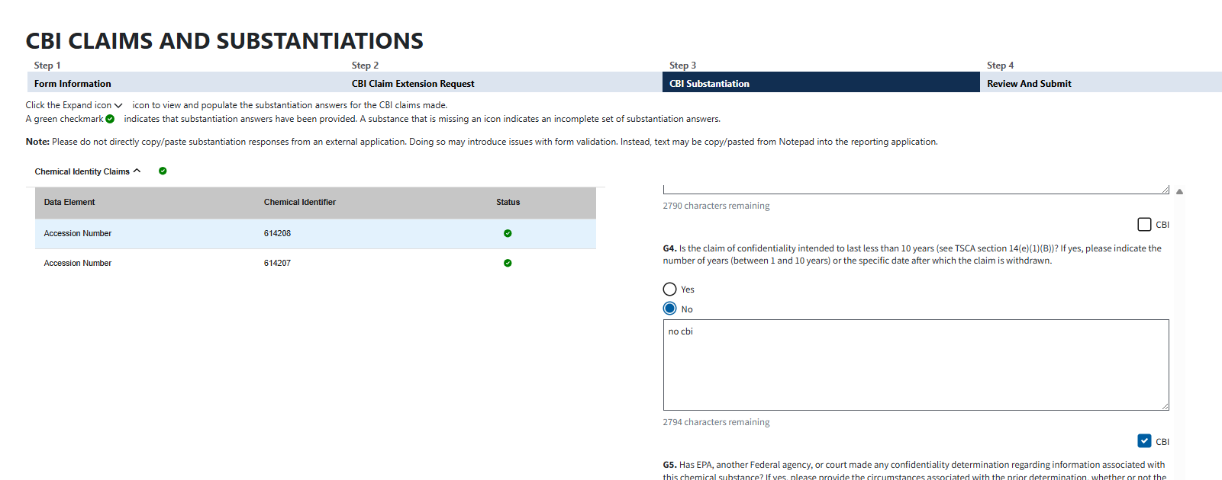
OMB Control No. 2070-0223
Expiration Date 8/31/2026
EPA Form PRN 7710-57

Slide 13
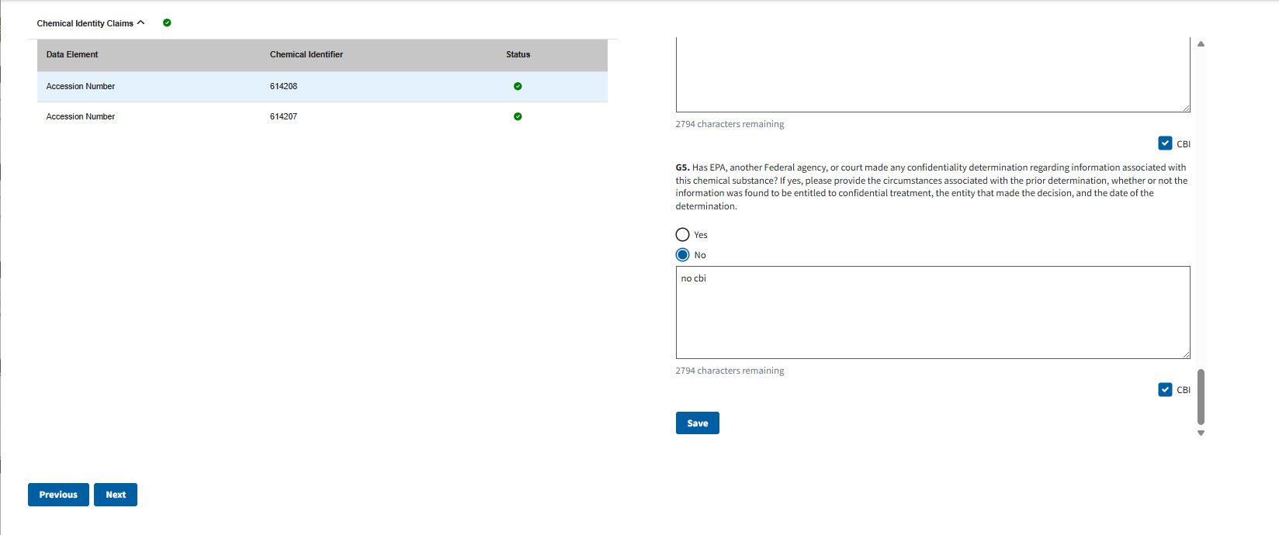
OMB Control No. 2070-0223
Expiration Date 8/31/2026
EPA Form PRN 7710-57

