Slide 1
TSCA Section 5 Notice of Commencement (NOC)
EPA Form No. 7710-56
OMB Control No. 2070-0038
Expiration 4/30/2029

Slide 2
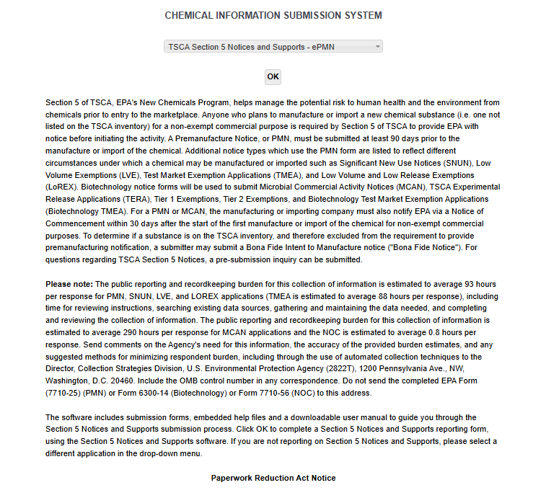
OMB Control No. 2070-0038
Expiration 4/30/2029
EPA Form No. 7710-56

Slide 3
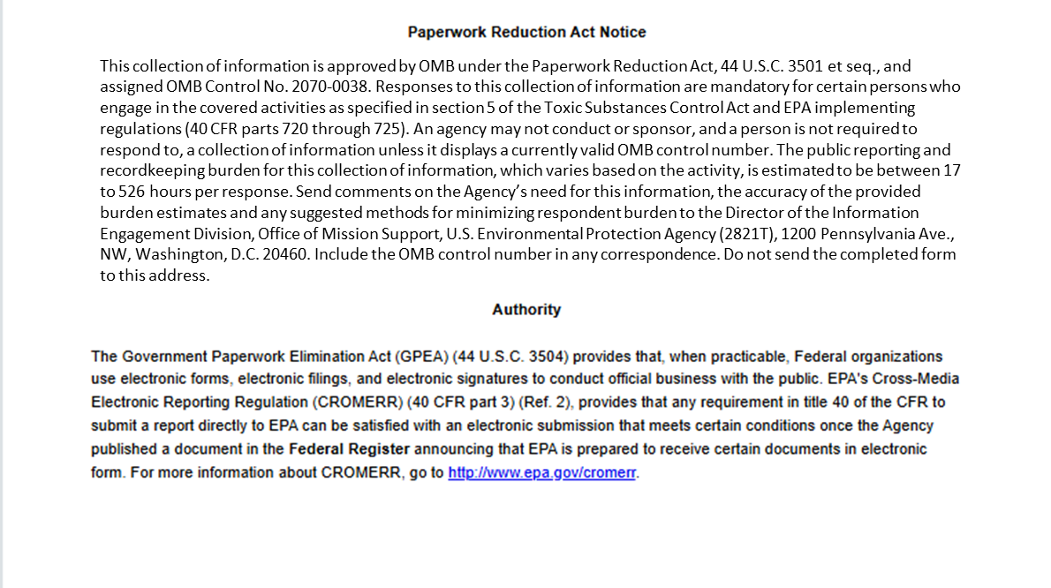
OMB Control No. 2070-0038
Expiration 4/30/2029
EPA Form No. 7710-56

Slide 4
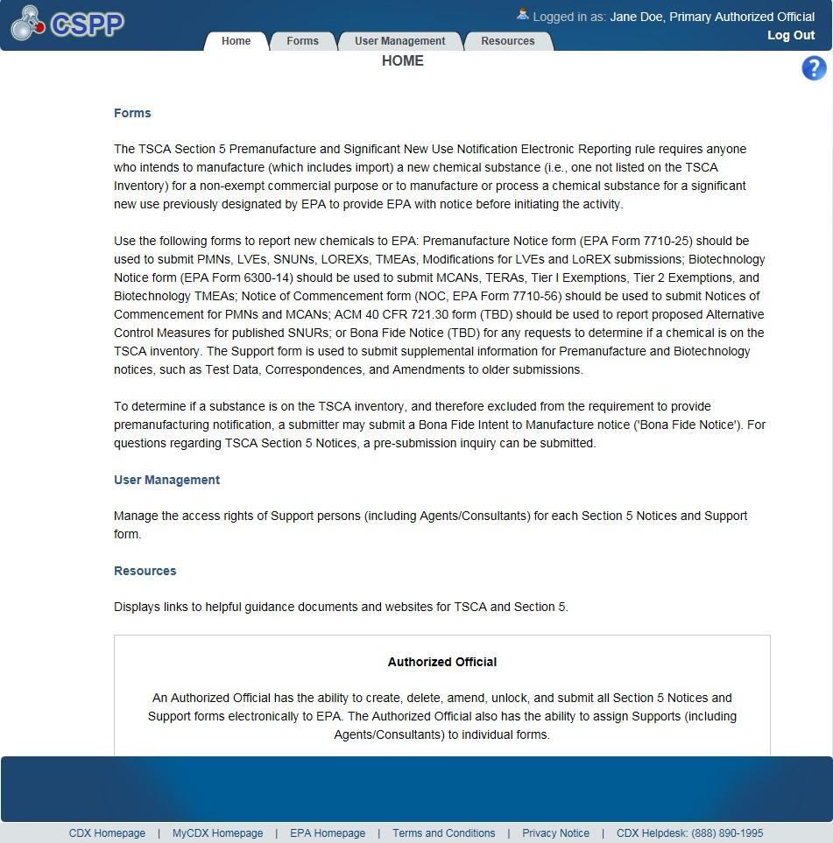
OMB Control No. 2070-0038
Expiration 4/30/2029
EPA Form No. 7710-56

Slide 5
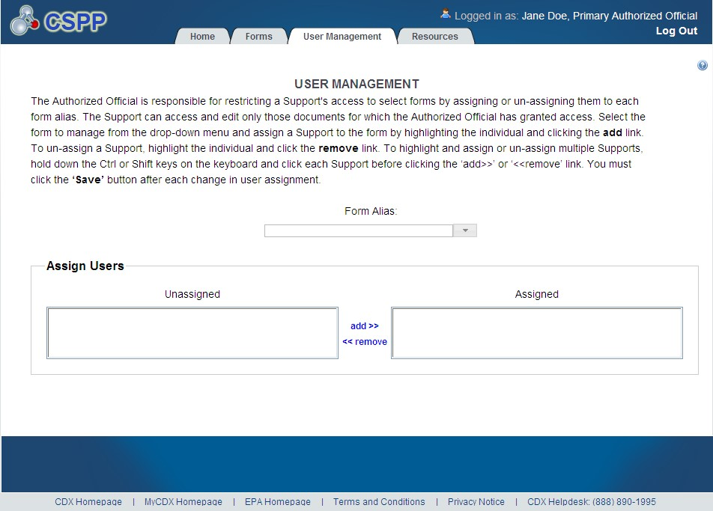
OMB Control No. 2070-0038
Expiration 4/30/2029
Exhibit
3
-
5
User Management Screen
EPA Form No. 7710-56

Slide 6
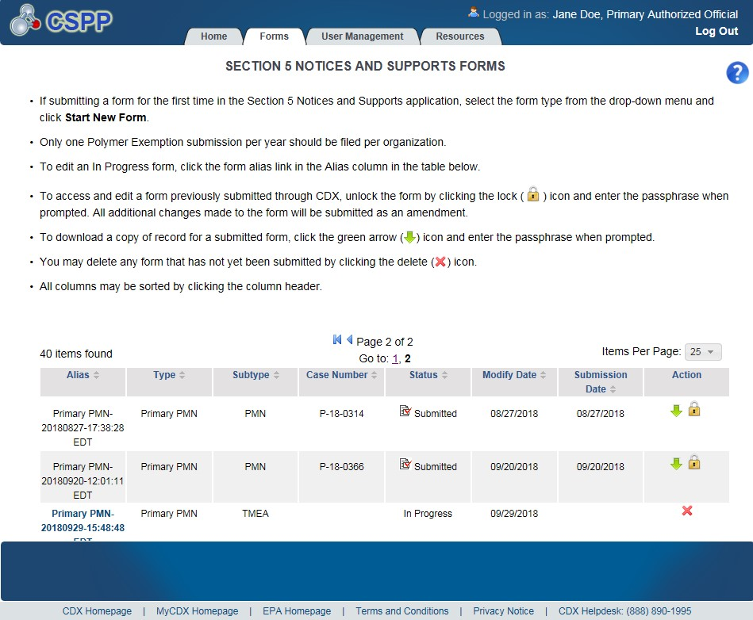
OMB Control No. 2070-0038
Expiration 4/30/2029
EPA Form No. 7710-56

Slide 7
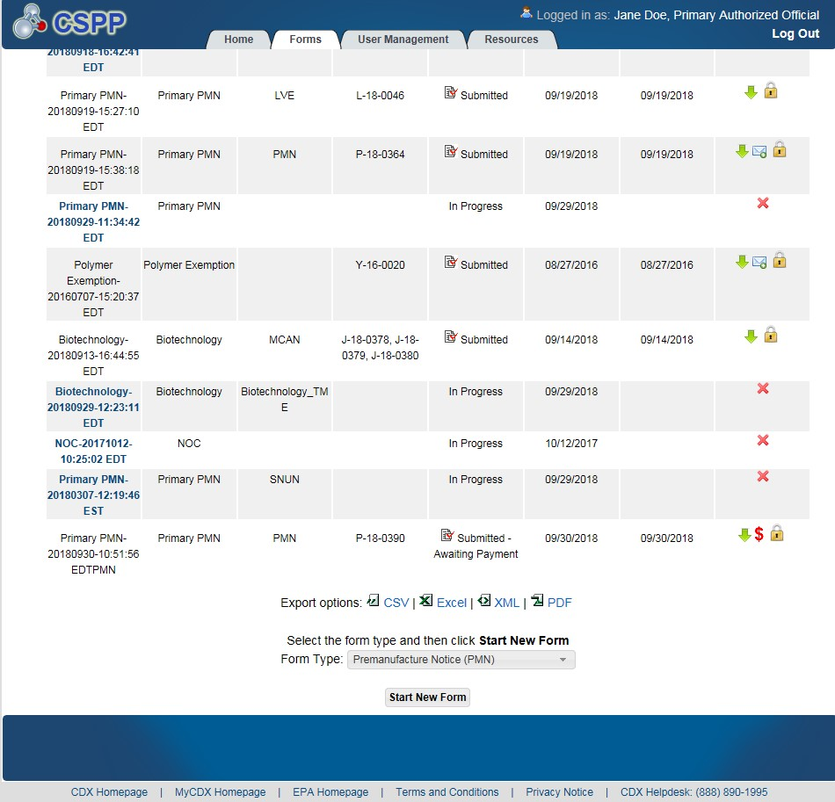
OMB Control No. 2070-0038
Expiration 4/30/2029
EPA Form No. 7710-56

Slide 8
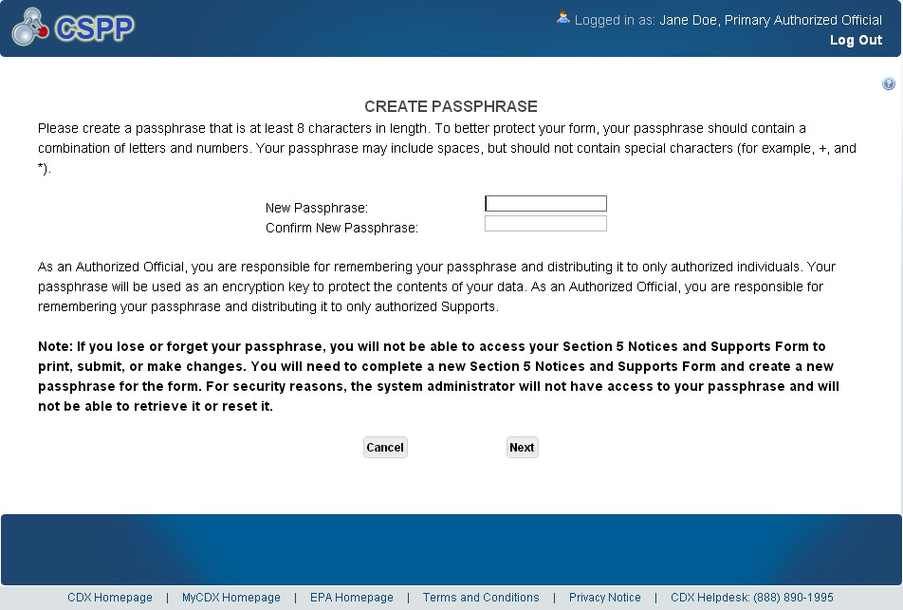
OMB Control No. 2070-0038
Expiration 4/30/2029
Exhibit
3
-
8
Create Passphrase Scr
een
EPA Form No. 7710-56

Slide 9
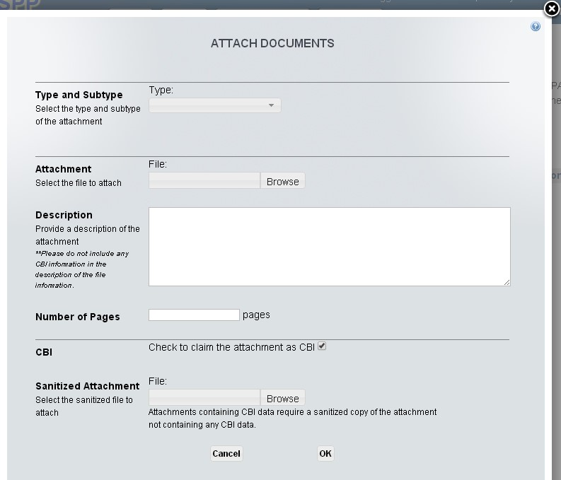
OMB Control No. 2070-0038
Expiration 4/30/2029
Exhibit
3
-
10
Attach Documents
Pop
-
Up
Window
EPA Form No. 7710-56

Slide 10
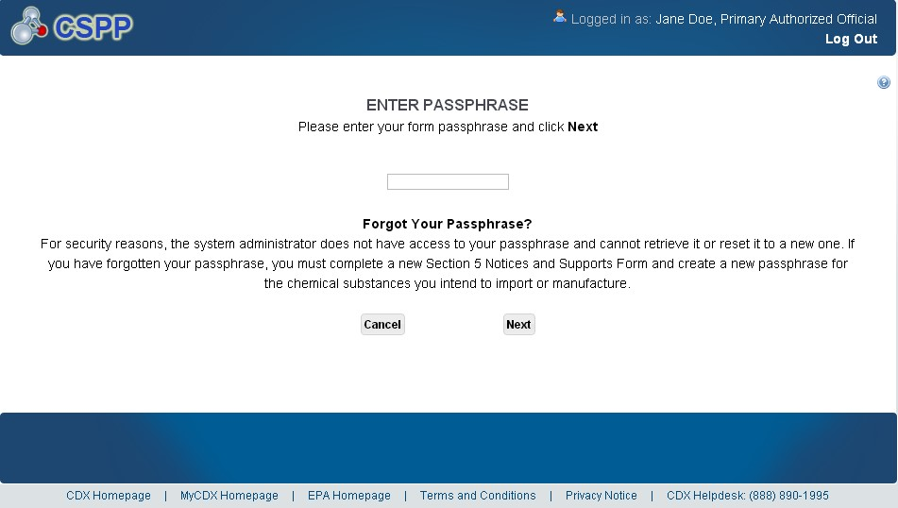
OMB Control No. 2070-0038
Expiration 4/30/2029
Exhibit
3
-
11
Enter Passphrase Screen
EPA Form No. 7710-56

Slide 11
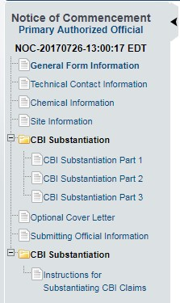
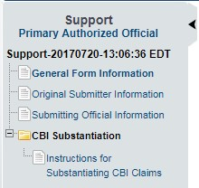
OMB Control No. 2070-0038
Expiration 4/30/2029
EPA Form No. 7710-56

Slide 12
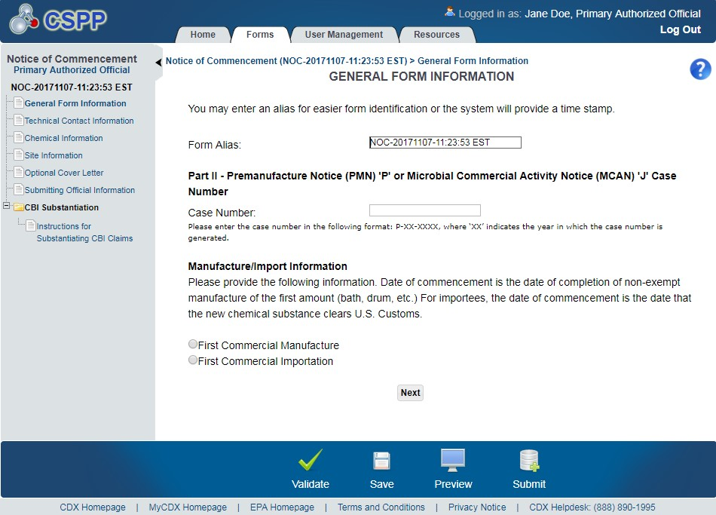
OMB Control No. 2070-0038
Expiration 4/30/2029
EPA Form No. 7710-56

Slide 13
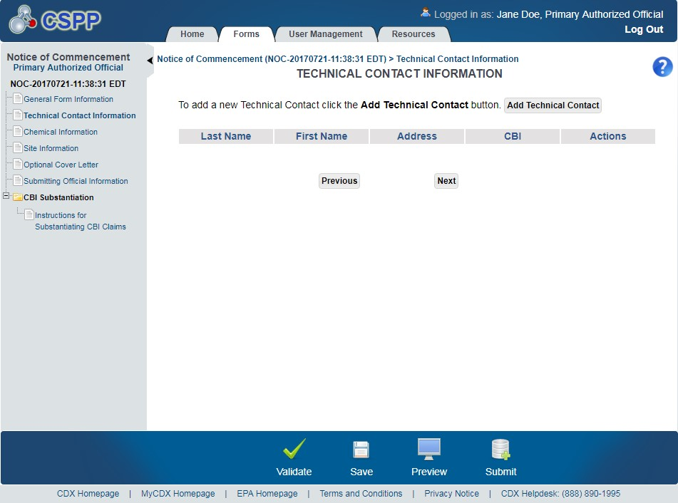
OMB Control No. 2070-0038
Expiration 4/30/2029
EPA Form No. 7710-56

Slide 14
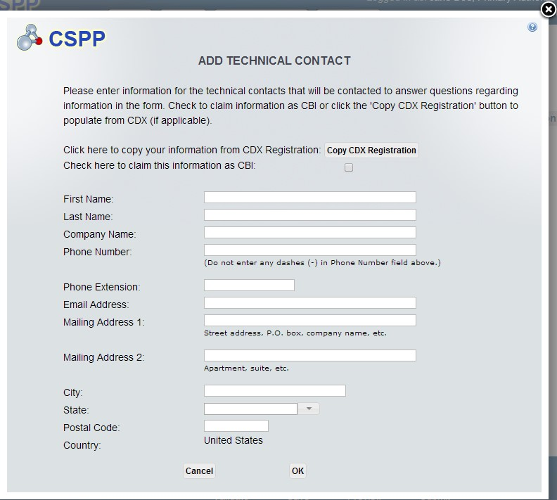
OMB Control No. 2070-0038
Expiration 4/30/2029
EPA Form No. 7710-56

Slide 15
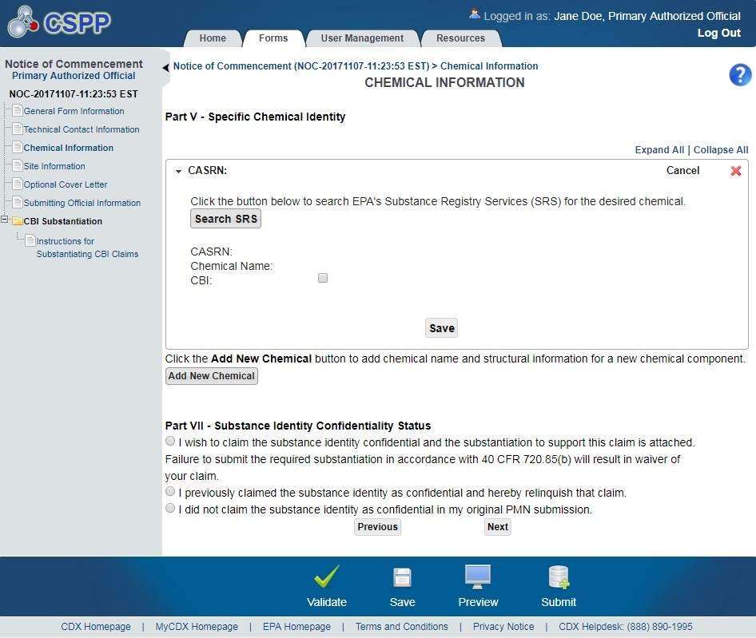
OMB Control No. 2070-0038
Expiration 4/30/2029
Exhibit
6
-
4
Chemical Information Screen
(
NOC
)
EPA Form No. 7710-56

Slide 16
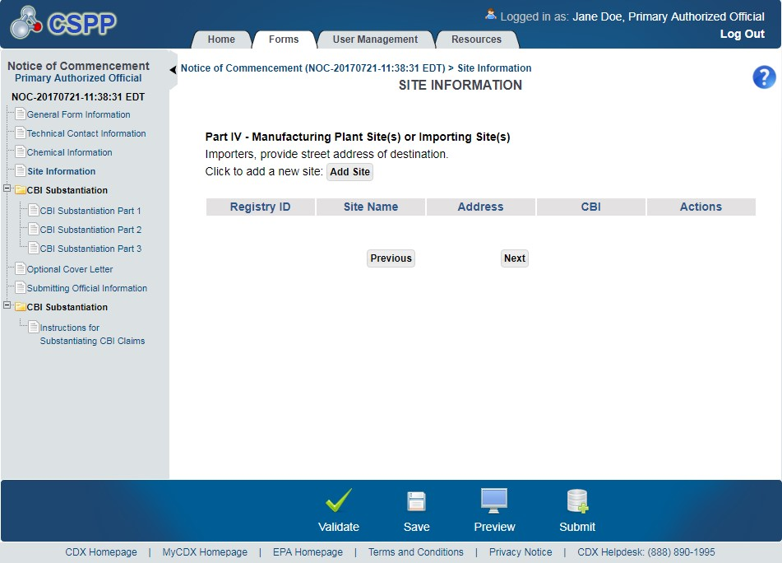
OMB Control No. 2070-0038
Expiration 4/30/2029
Exhibit
6
-
5
Site Information Screen (NOC)
EPA Form No. 7710-56

Slide 17
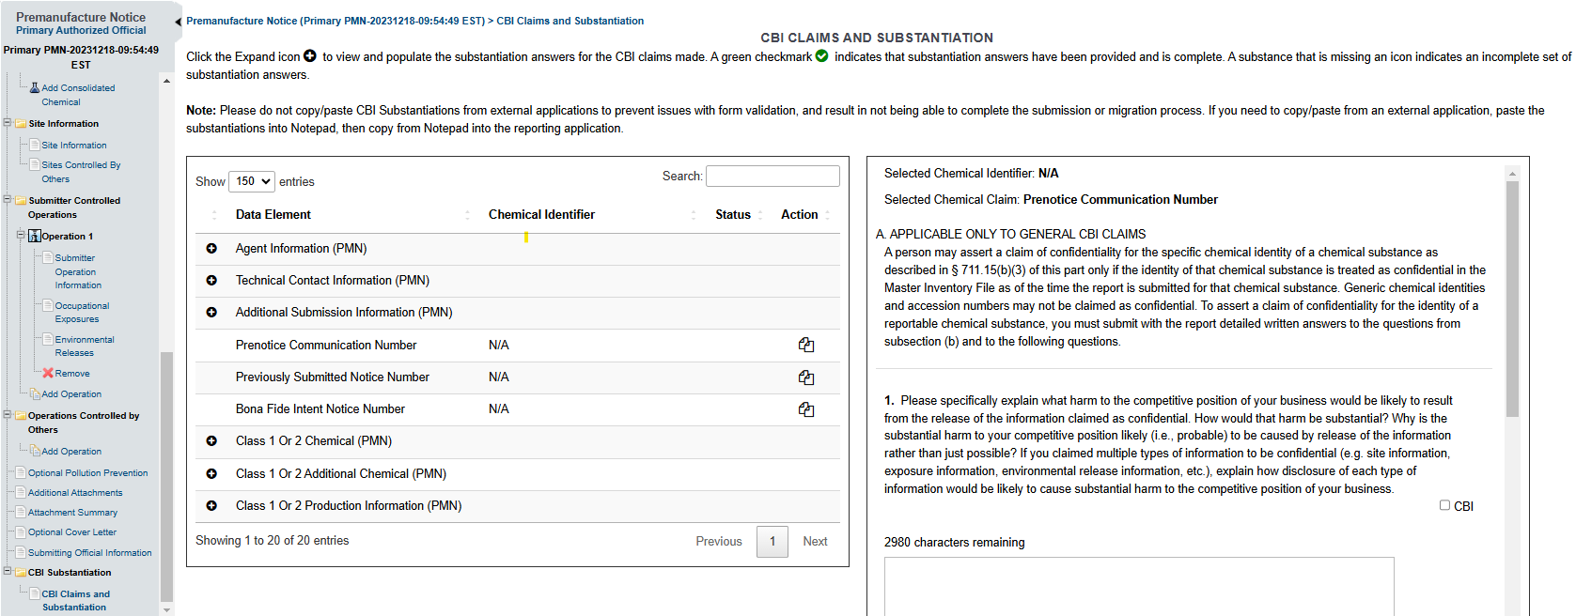
OMB Control No. 2070-0038
Expiration 4/30/2029
EPA Form No. 7710-56

Slide 18
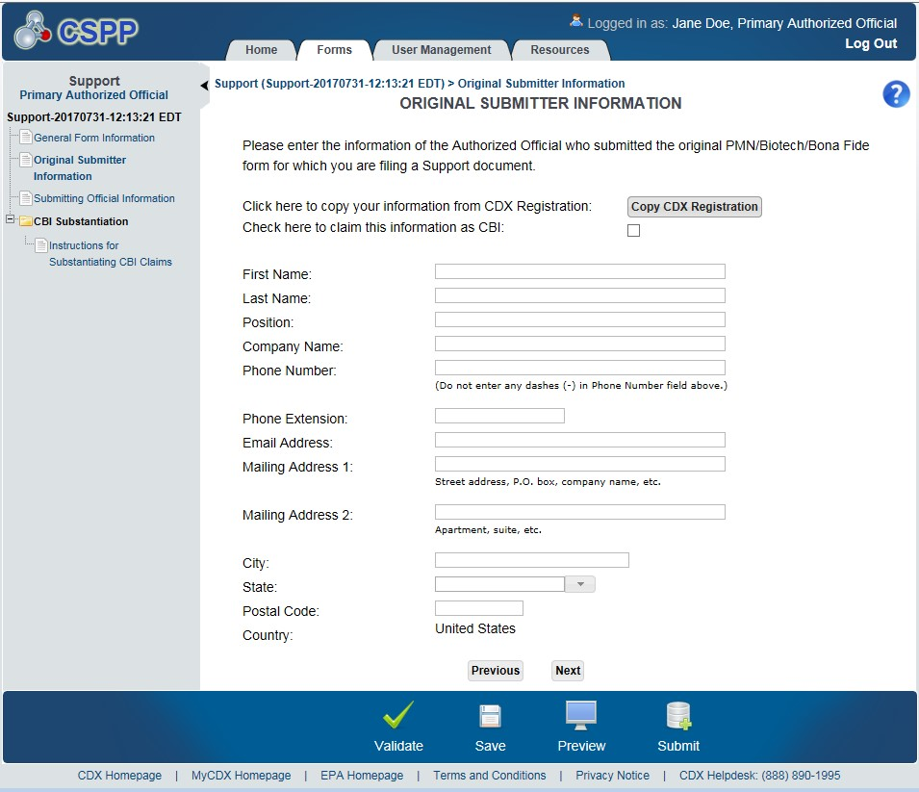



OMB Control No. 2070-0038
Expiration4/30/2029
Navigat
ion:
)
located in the bottom action bar to validate the form.
Click the ‘Validate’ icon (
)
located in the bottom action bar to save the overall form. Click the
Click the ‘Save’ icon (
EPA Form No. 7710-56
)
located in the bottom action bar to generate a PDF preview of the form.
‘Preview’ icon (

Slide 19
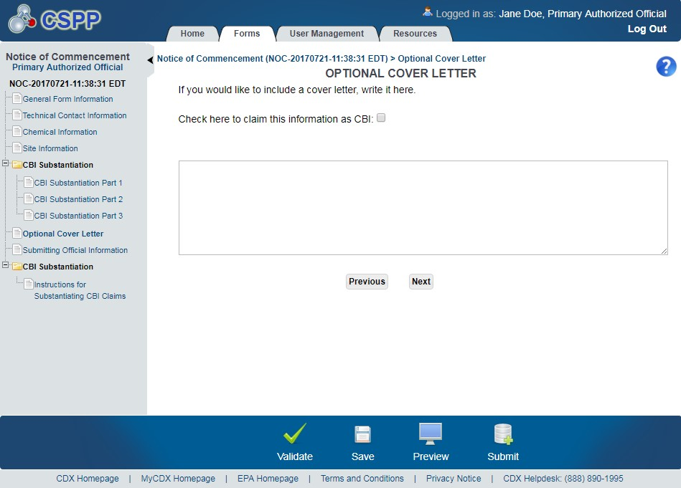
OMB Control No. 2070-0038
Expiration 4/30/2029
Navigation:
)
located in the bottom action bar to validate the form.
Click the ‘Validate’ icon (
)
located
in the bottom action bar to save the overall form. Click the
Click the ‘Save’ icon (
‘Preview’ icon (
)
to generate a PDF preview of the form. Click the ‘Next’ button to navigate to
the ‘Submitting Official Information’ screen.
EPA Form No. 7710-56

Slide 20
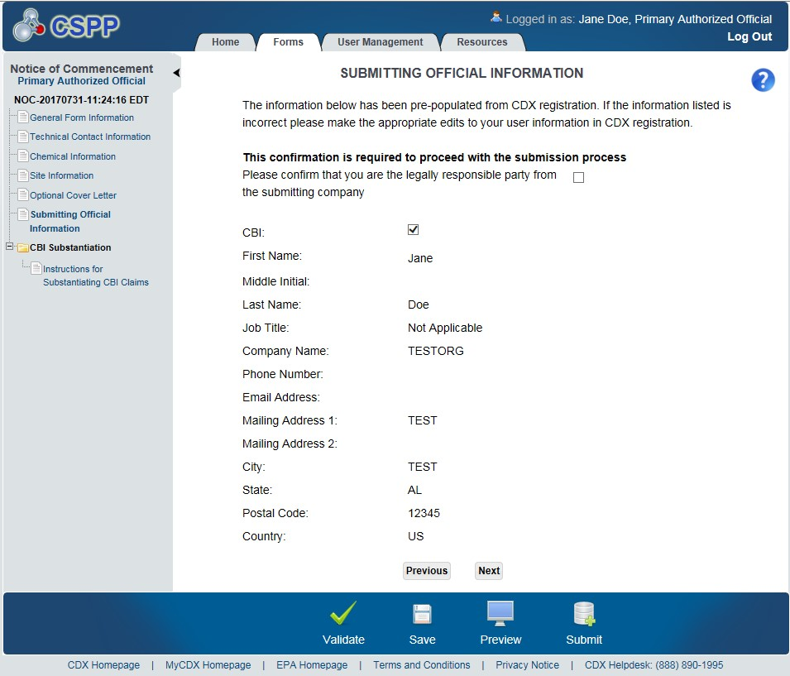
OMB Control No. 2070-0038
Expiration 4/30/2029
EPA Form No. 7710-56

Slide 21
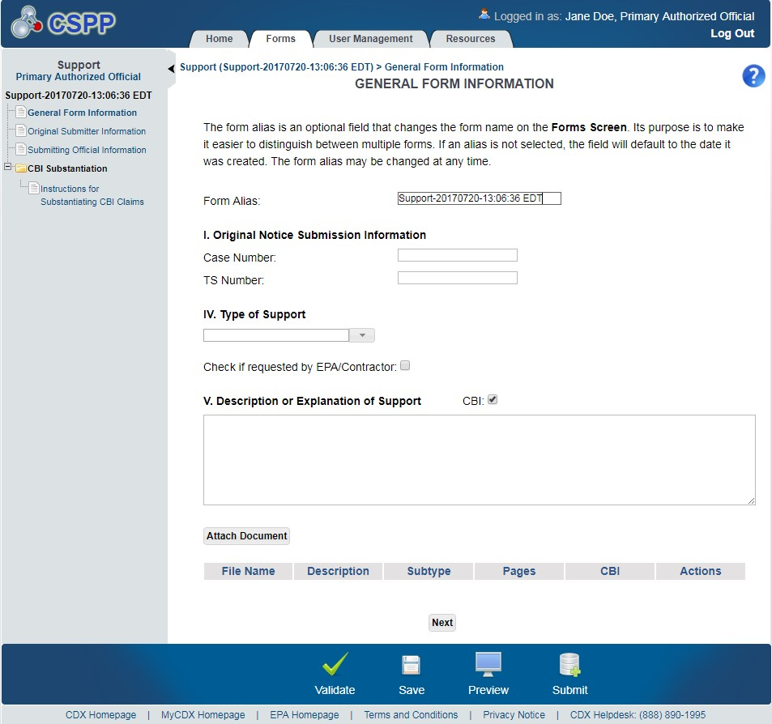
OMB Control No. 2070-0038
Expiration4/30/2029
EPA Form No. 7710-56

Slide 22
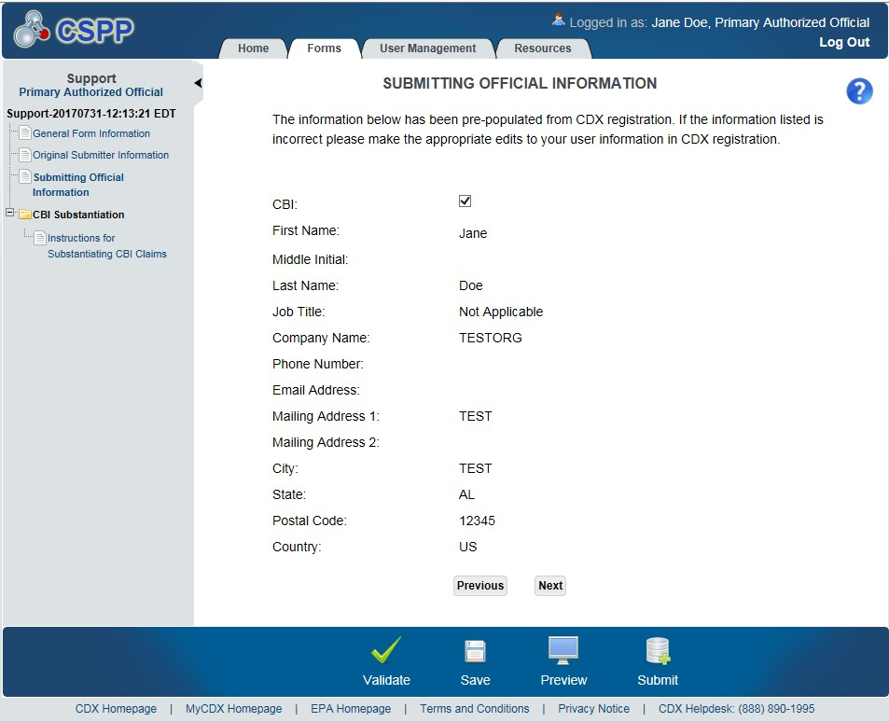
OMB Control No. 2070-0038
Expiration 4/30/2029
EPA Form No. 7710-56

Slide 23
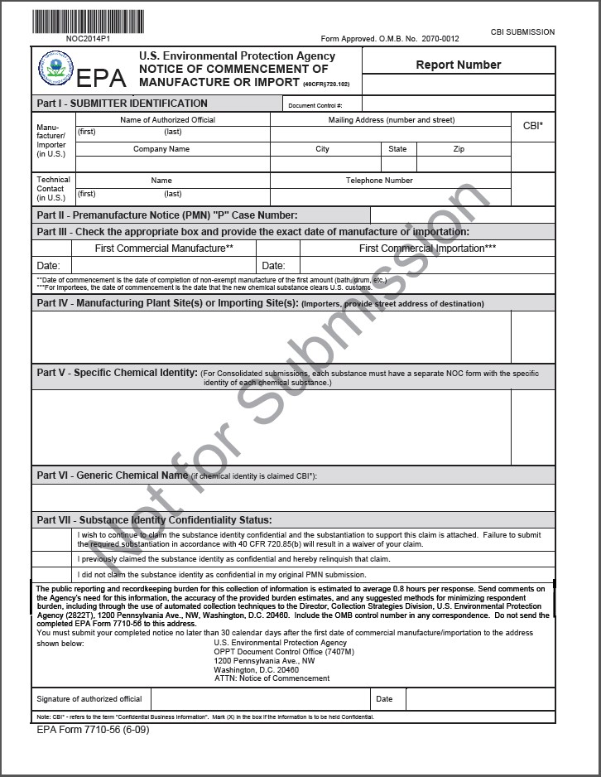
OMB Control No. 2070-0038
Expiration 4/30/2029
EPA Form No. 7710-56

Slide 24
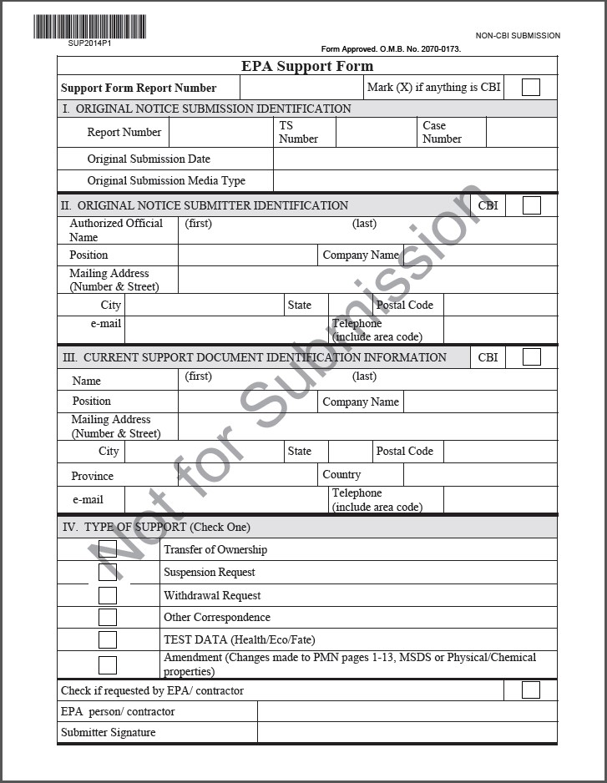
OMB Control No. 2070-0038
Expiration 4/30/2029
EPA Form No. 7710-56

Slide 25
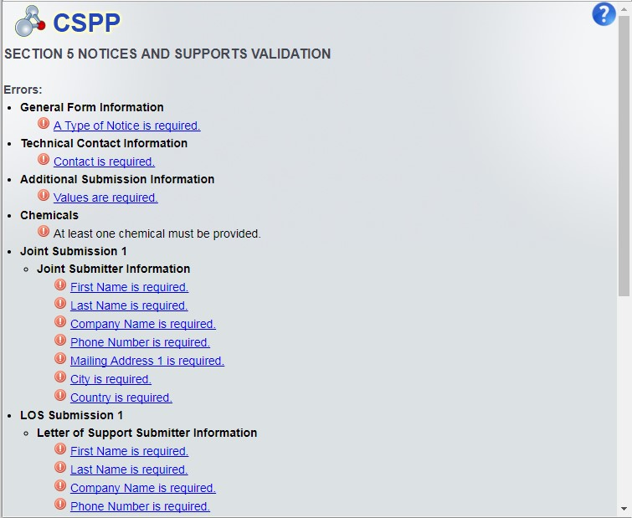
OMB Control No. 2070-0038
Expiration 4/30/2029
EPA Form No. 7710-56

Slide 26
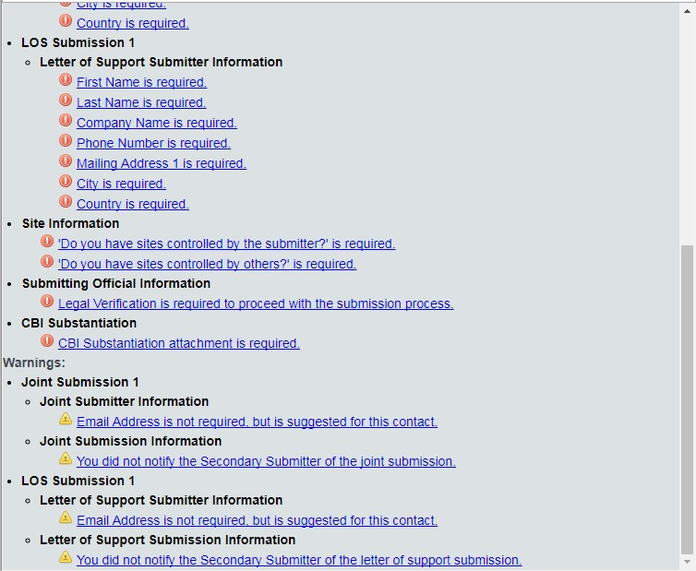
OMB Control No. 2070-0038
Expiration 4/30/2029
EPA Form No. 7710-56

Slide 27
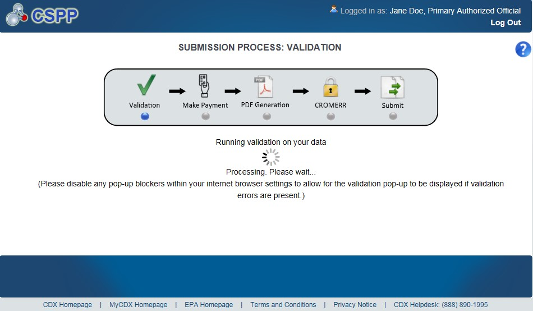
OMB Control No. 2070-0038
Expiration 4/30/2029
EPA Form No. 7710-56

Slide 28
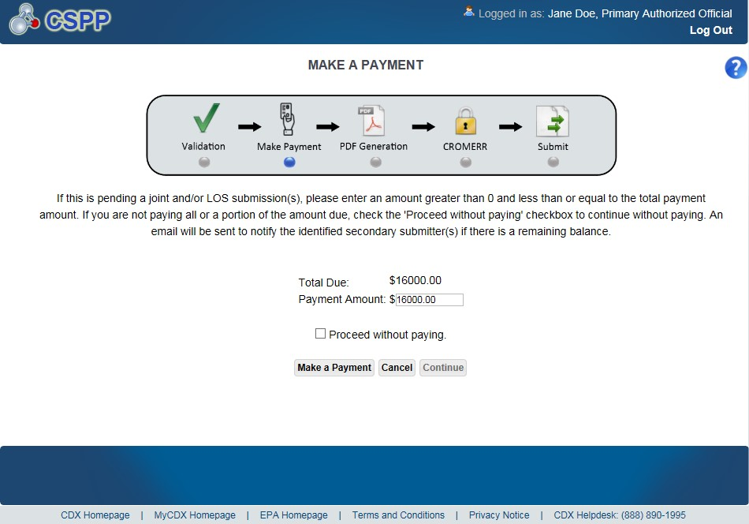
OMB Control No. 2070-0038
Expiration 4/30/2029
Exhibit
14
-
5
Make a Payment Screen
EPA Form No. 7710-56

Slide 29
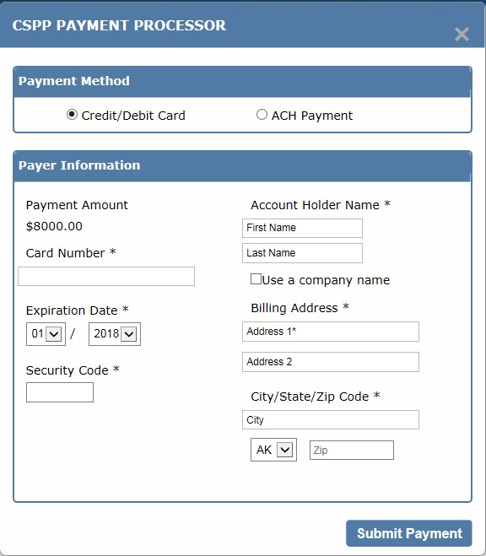
OMB Control No. 2070-0038
Expiration 4/30/2029
EPA Form No. 7710-56

Slide 30
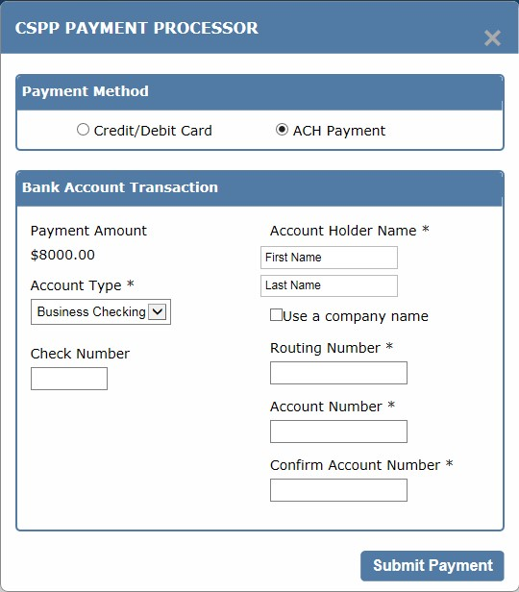
OMB Control No. 2070-0038
Expiration 4/30/2029
EPA Form No. 7710-56

Slide 31
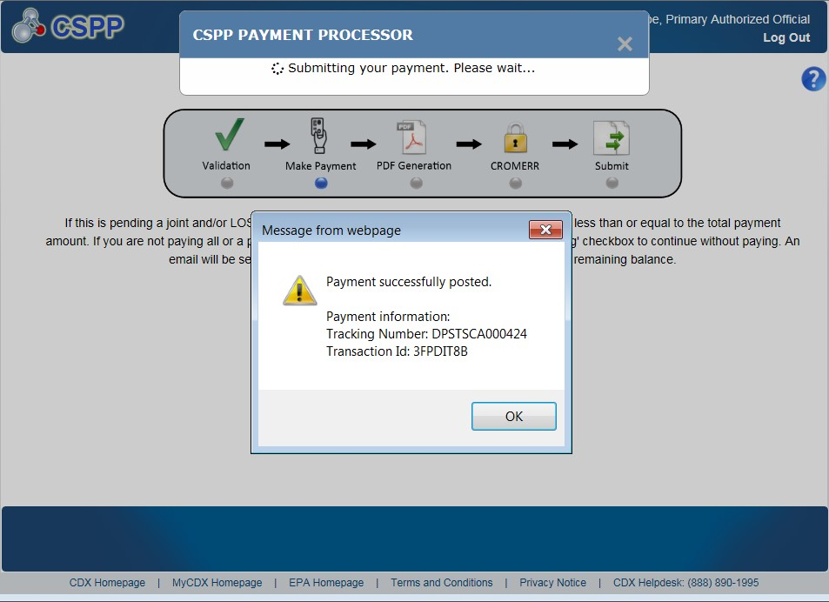
OMB Control No. 2070-0038
Expiration 4/30/2029
Exhibit
14
-
8
Successful Payment
EPA Form No. 7710-56

Slide 32
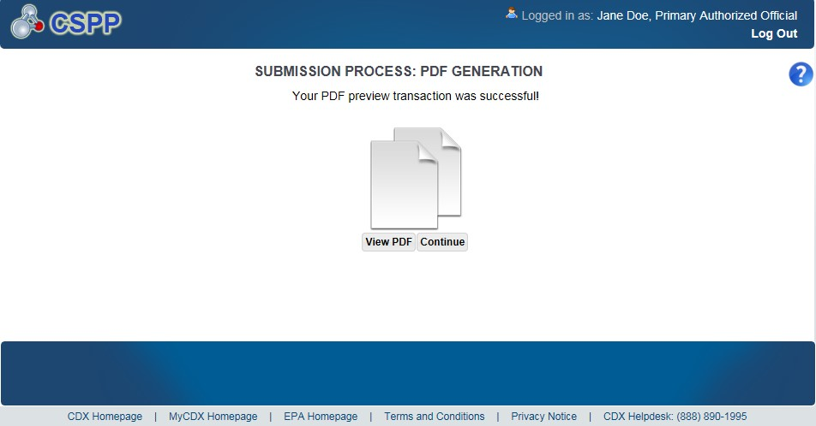
OMB Control No. 2070-0038
Expiration 4/30/2029
EPA Form No. 7710-56

Slide 33
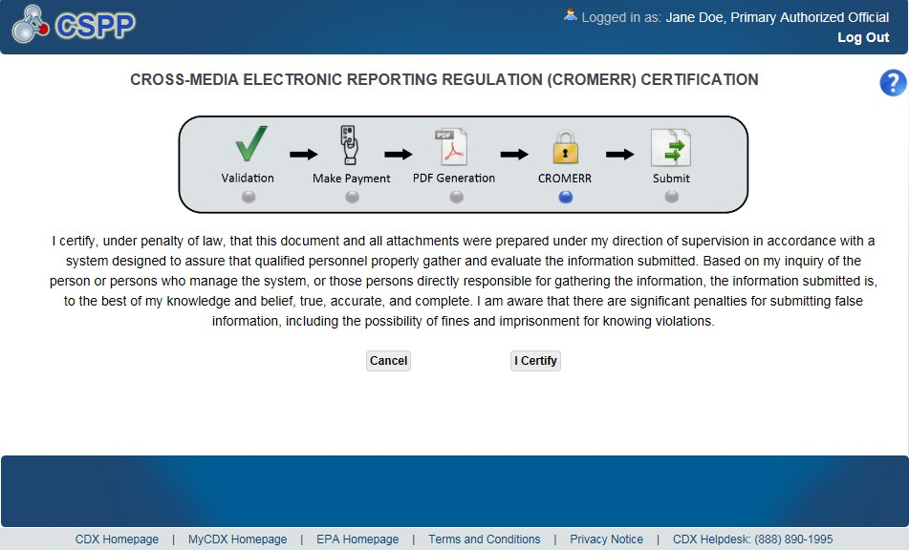
OMB Control No. 2070-0038
Expiration 4/30/2029
EPA Form No. 7710-56

Slide 34
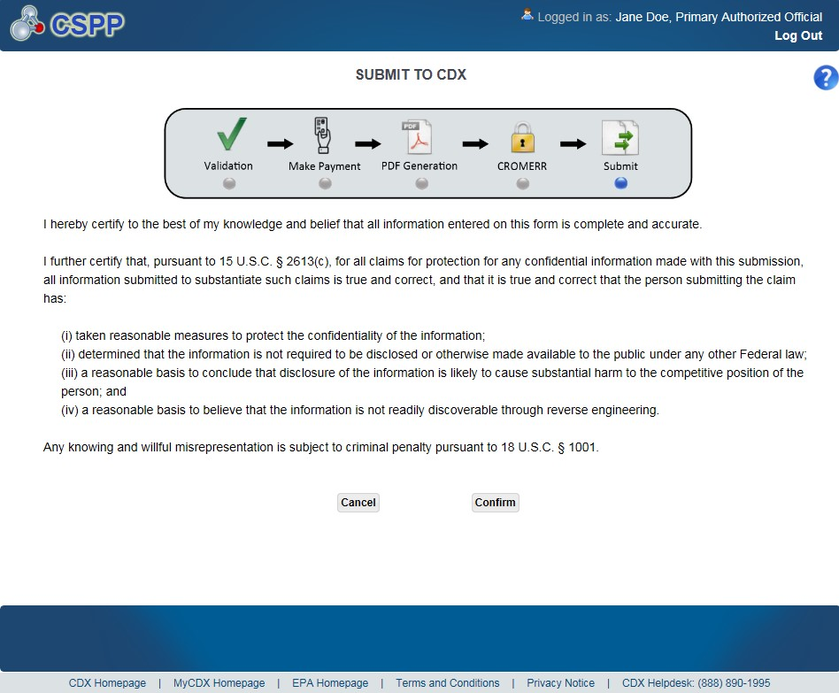
OMB Control No. 2070-0038
Expiration 4/30/2029
Exhibit
14
-
17
Submit
t
o CDX Screen
EPA Form No. 7710-56

Slide 35
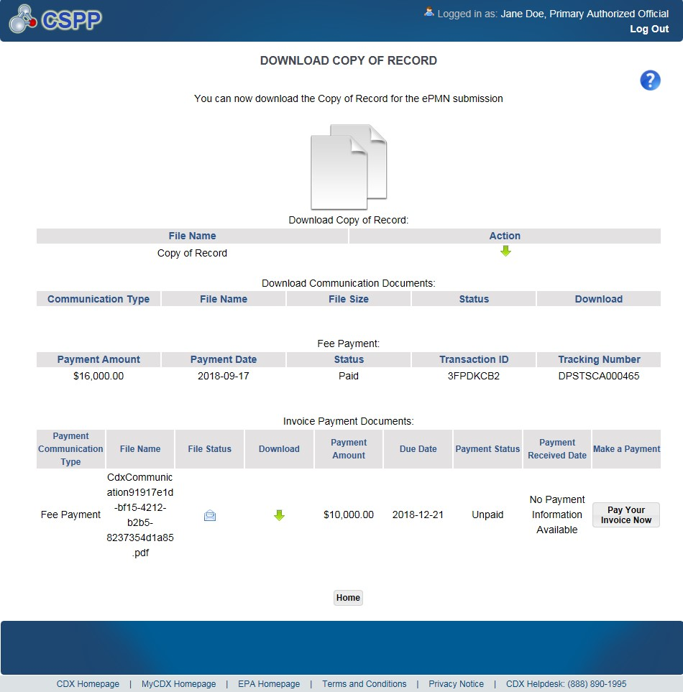
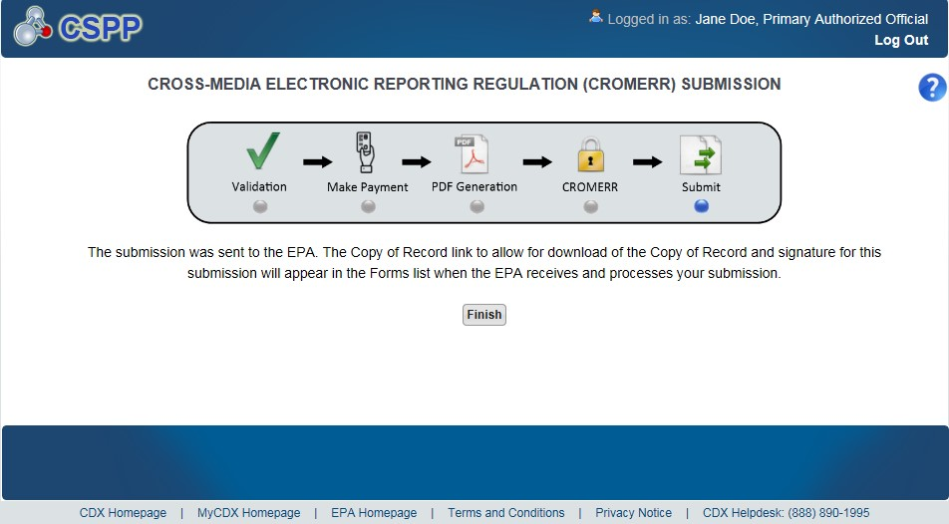
Exhibit
15
-
1
Download C
opy of Record Screen
OMB Control No. 2070-0038
Expiration 4/30/2029
EPA Form No. 7710-56

Slide 36
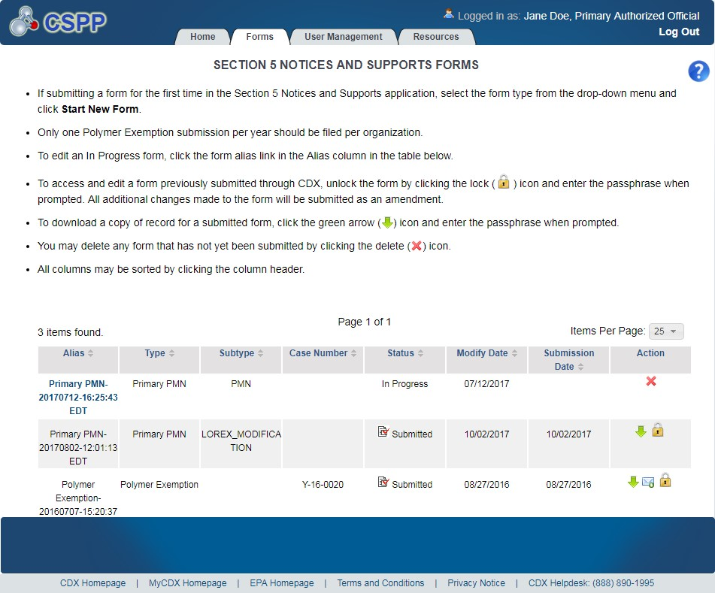
OMB Control No. 2070-0038
Expiration 12/31/2025
EPA Form No. 7710-56

Slide 37
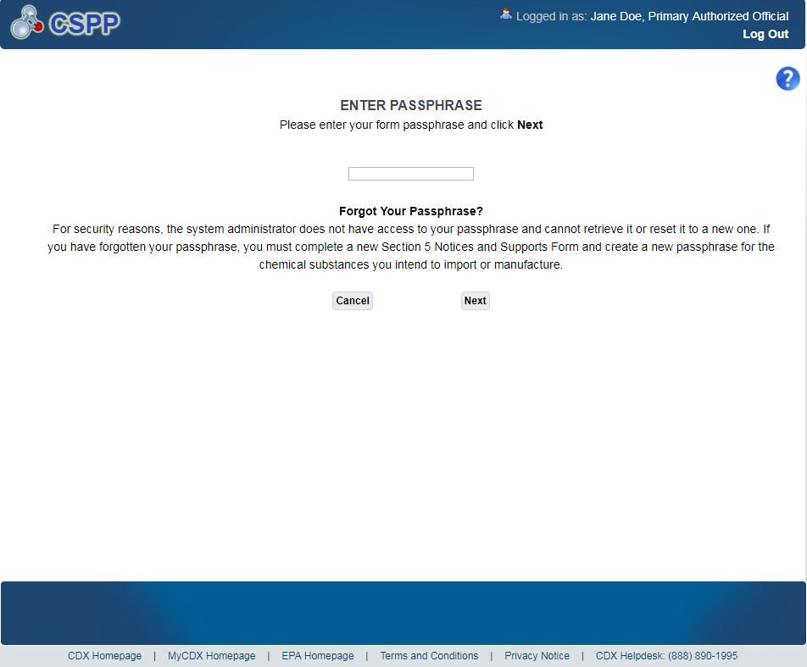
OMB Control No. 2070-0038
Expiration 12/31/2025
Exhibit
16
-
4
Enter Passphrase Screen
EPA Form No. 7710-56

Slide 38
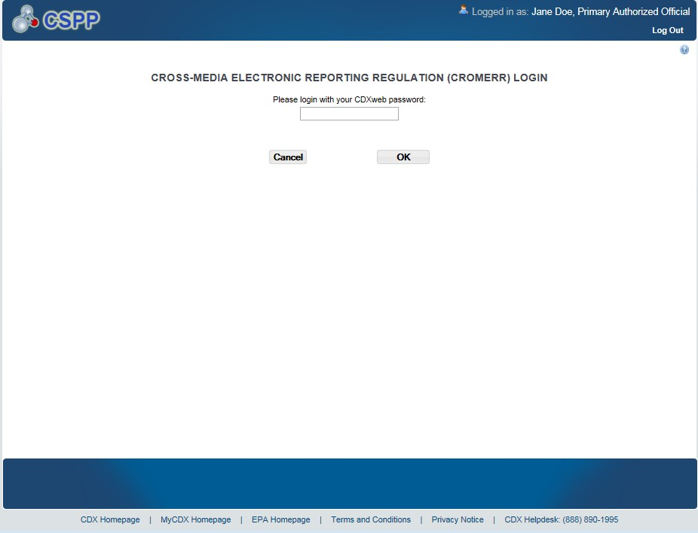
OMB Control No. 2070-0038
Expiration 12/31/2025
EPA Form No. 7710-56

Slide 39
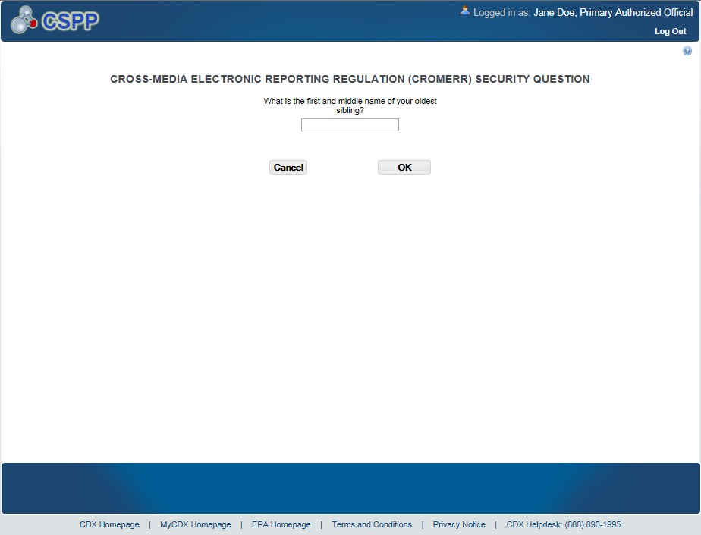
OMB Control No. 2070-0038
Expiration 12/31/2025
EPA Form No. 7710-56

Slide 40
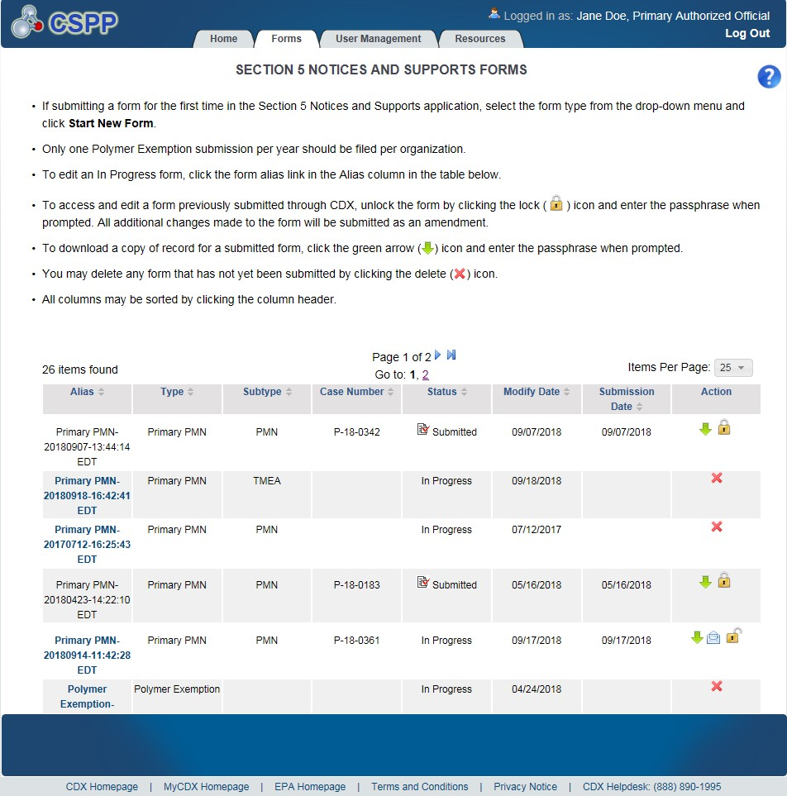
OMB Control No. 2070-0038
Expiration 12/31/2025
EPA Form No. 7710-56
Navigation:
)
, a prompt will display to confirm the
After clicking the ‘Lock’ icon (

Slide 41
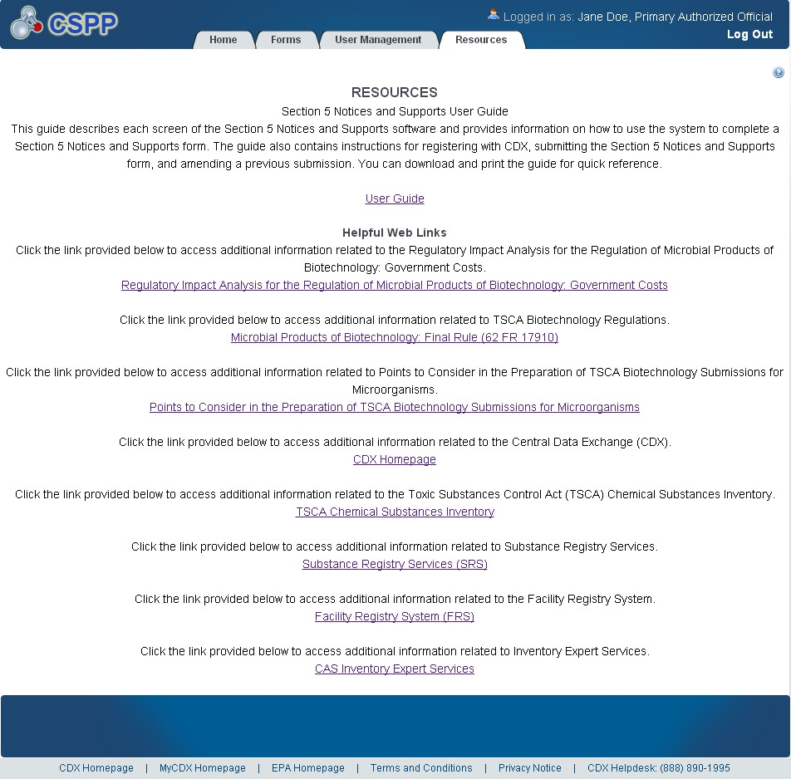
OMB Control No. 2070-0038
Expiration 12/31/2025
EPA Form No. 7710-56

Slide 42
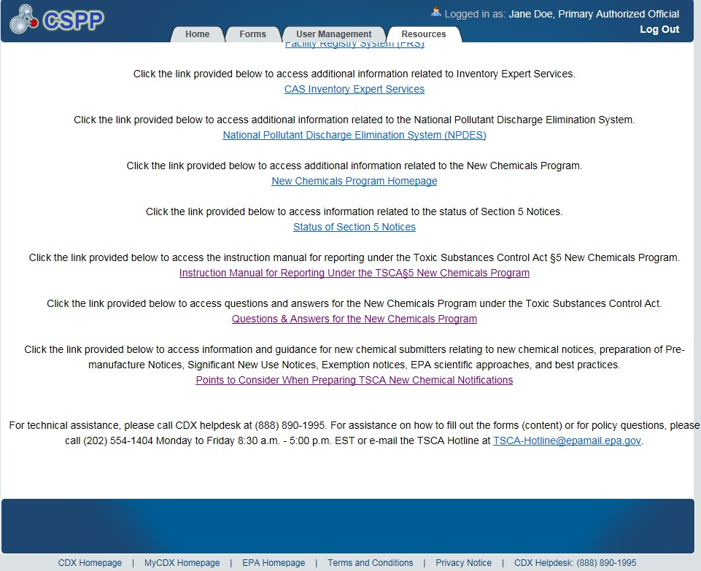
OMB Control No. 2070-0038
Expiration 12/31/2025
EPA Form No. 7710-56

