Slide 1
Chemical Data Reporting
EPA Form 9600-010
OMB Control No. 2070-0162
Expiration 10/31/2026

Slide 2
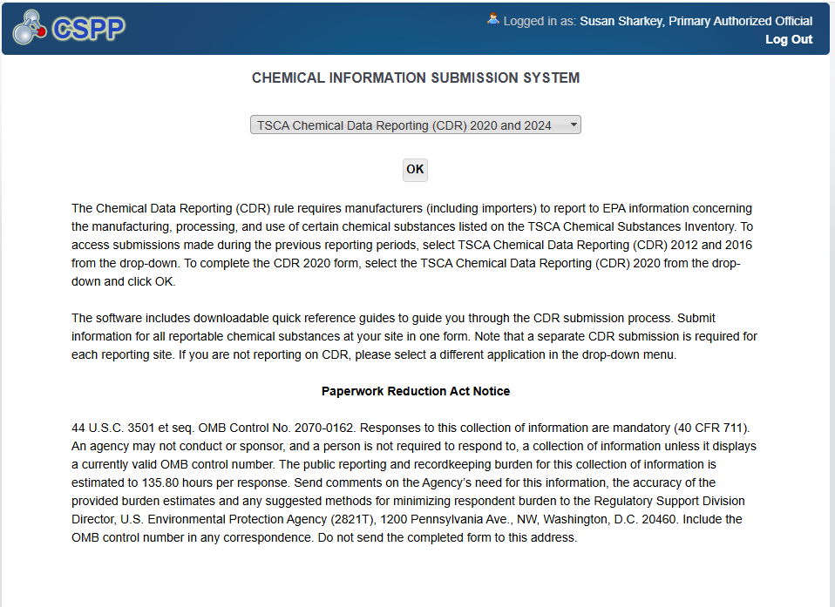
OMB Control No. 2070-0162
Expiration 10/31/2026
EPA Form 9600-010

Slide 3
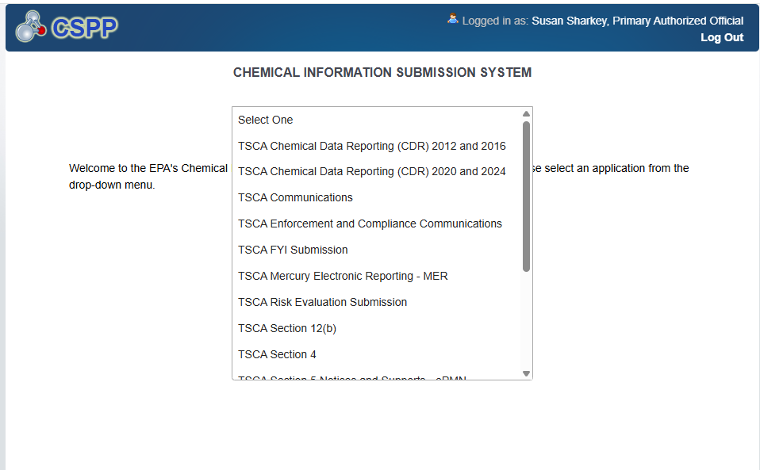
OMB Control No. 2070-0162
Expiration 10/31/2026
EPA Form 9600-010

Slide 4
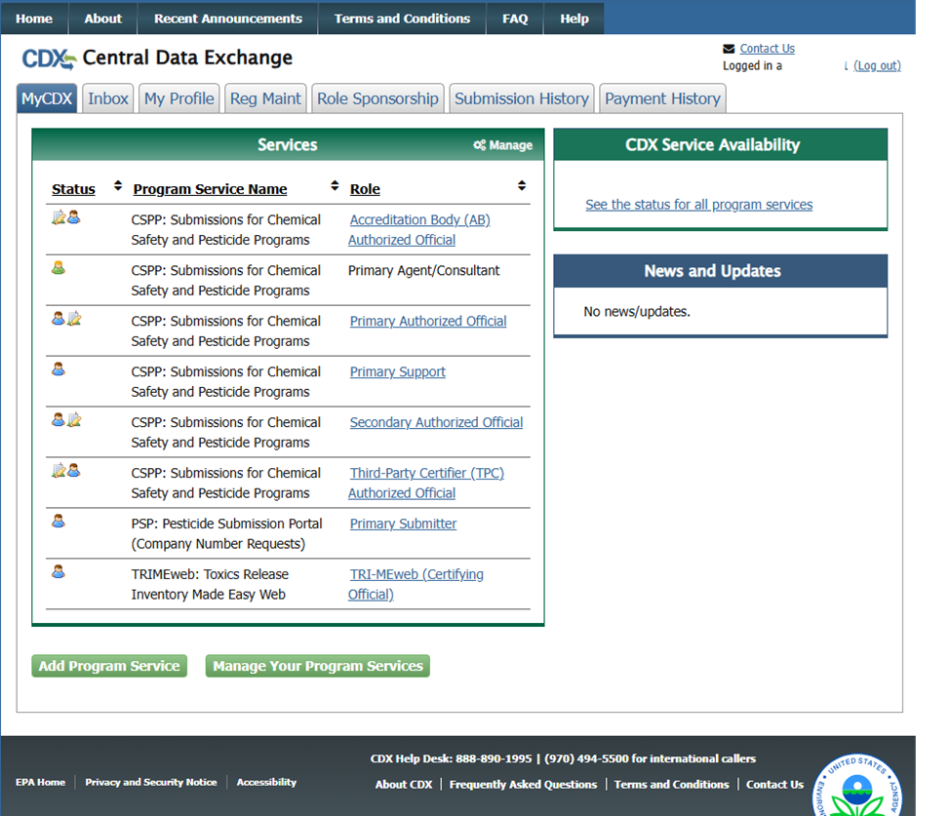
OMB Control No. 2070-0162
Expiration 10/31/2026
EPA Form 9600-010

Slide 5
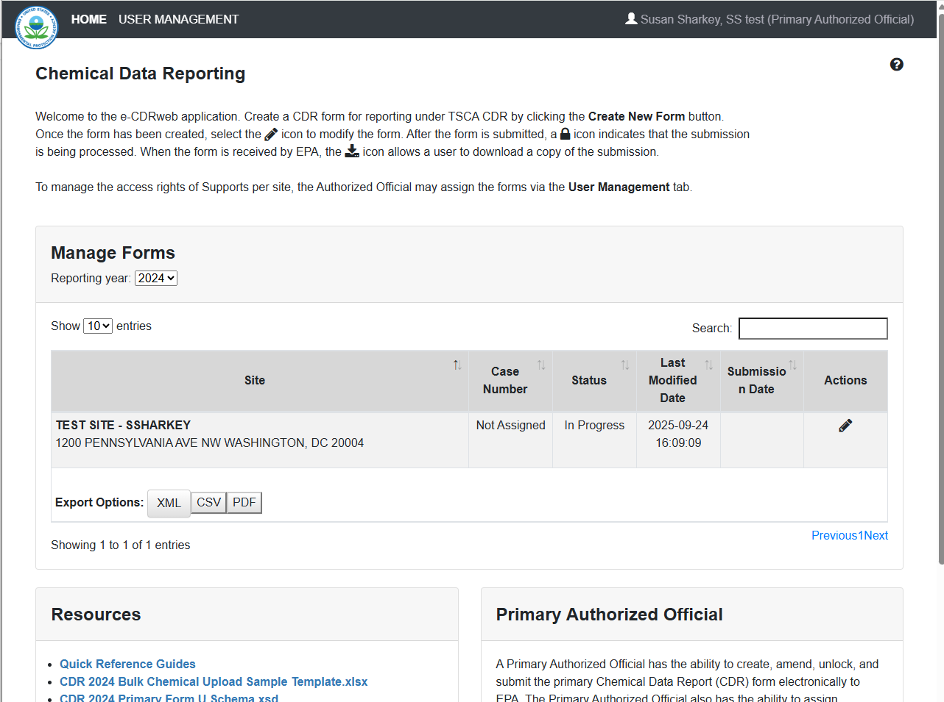
OMB Control No. 2070-0162
Expiration 10/31/2026
EPA Form 9600-010

Slide 6
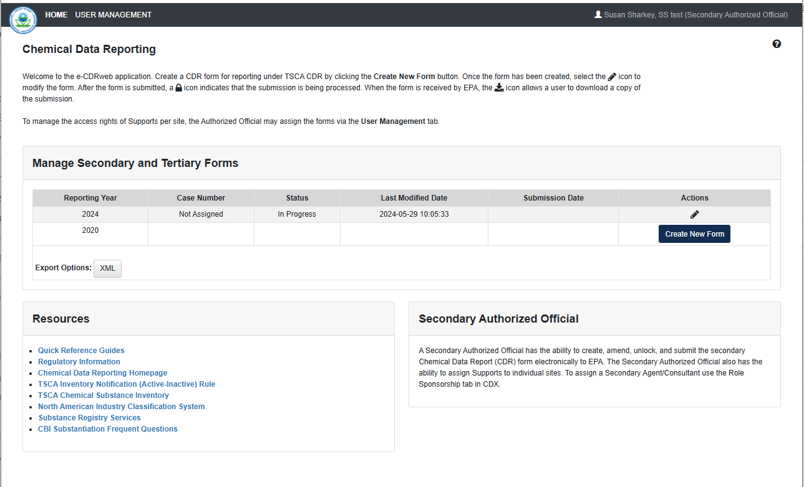
OMB Control No. 2070-0162
Expiration 10/31/2026
EPA Forms 9600-010

Slide 7
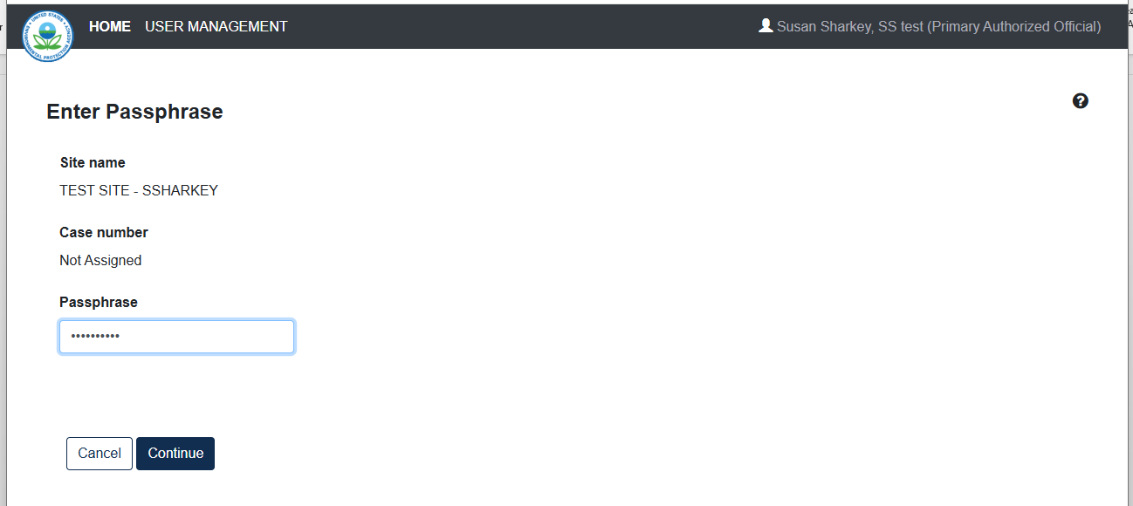
OMB Control No. 2070-0162
Expiration 10/31/2026
EPA Form 9600-010

Slide 8
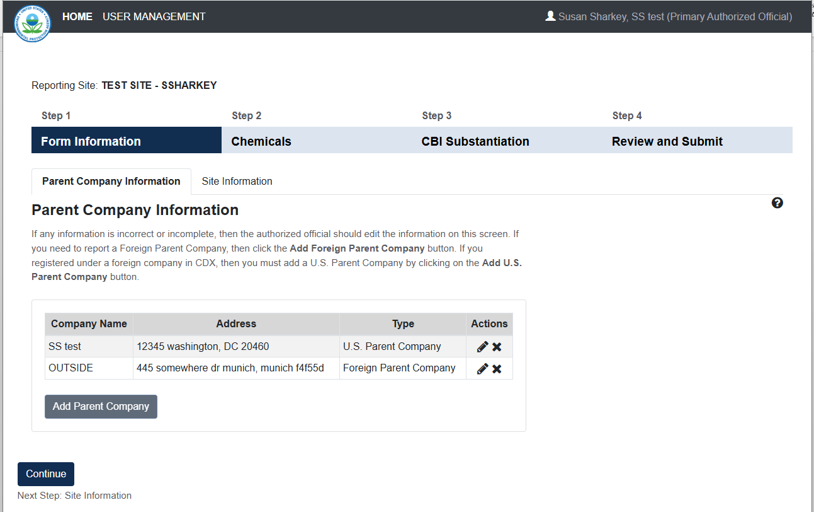
OMB Control No. 2070-0162
Expiration 10/31/2026
EPA Form 9600-010

Slide 9
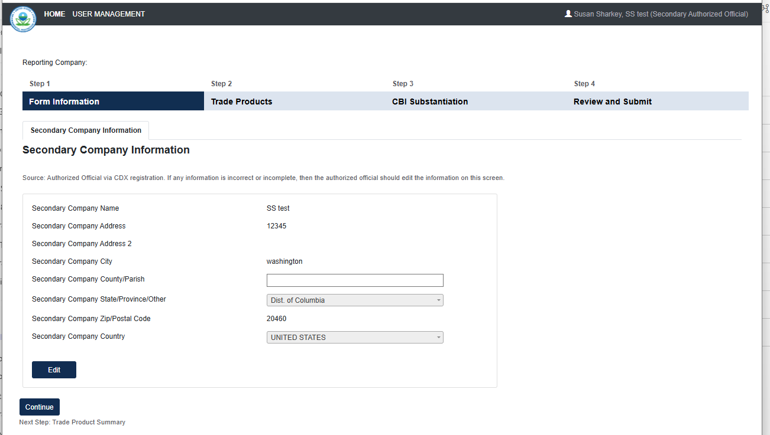
OMB Control No. 2070-0162
Expiration 10/31/2026
EPA Form 9600-010

Slide 10
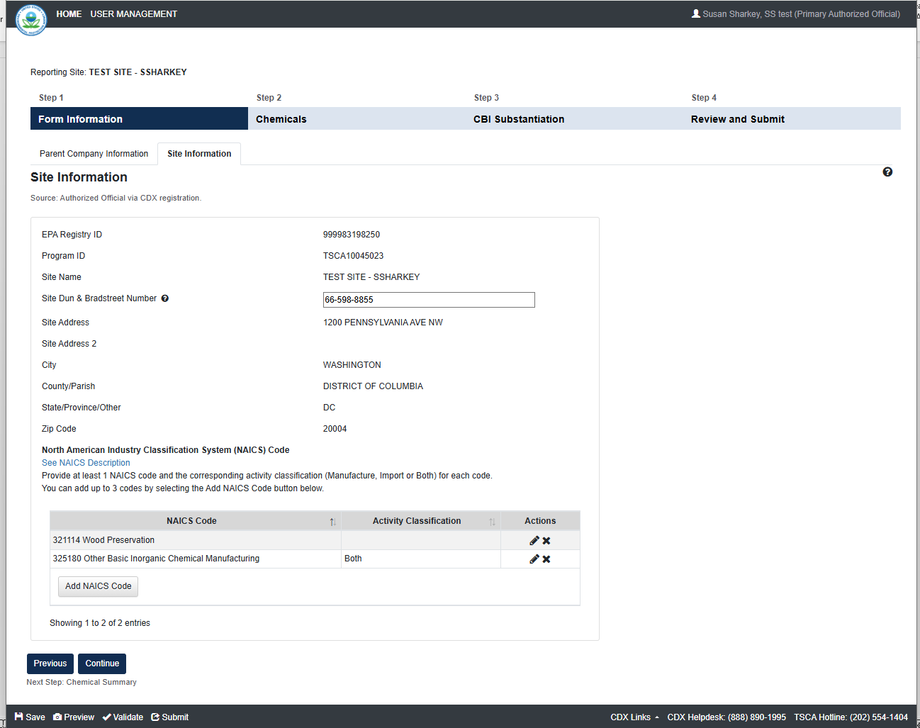
OMB Control No. 2070-0162
Expiration 10/31/2026
EPA Form 9600-010

Slide 11
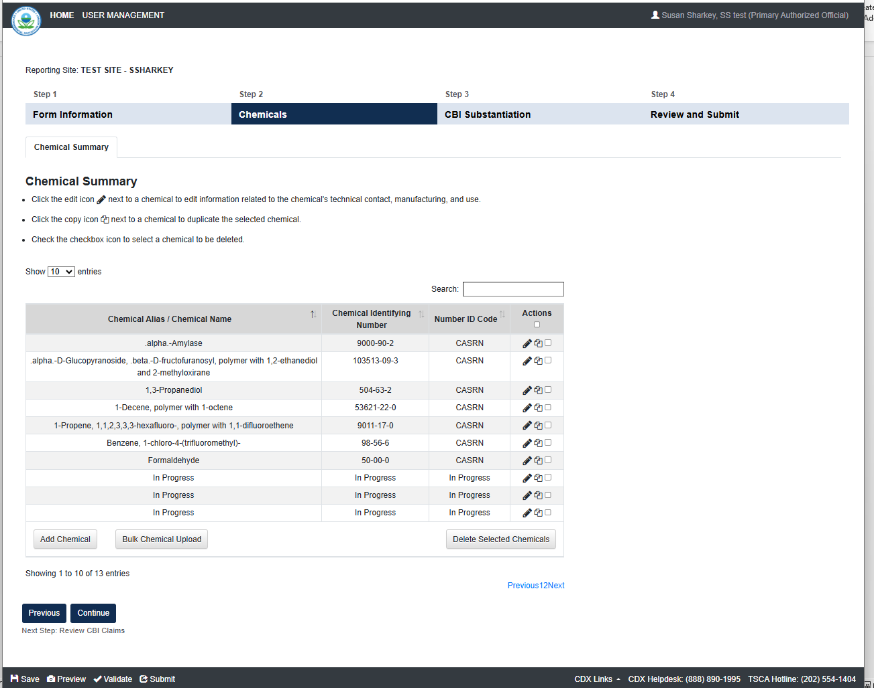
OMB Control No. 2070-0162
Expiration 10/31/2026
EPA Form 9600-010

Slide 12
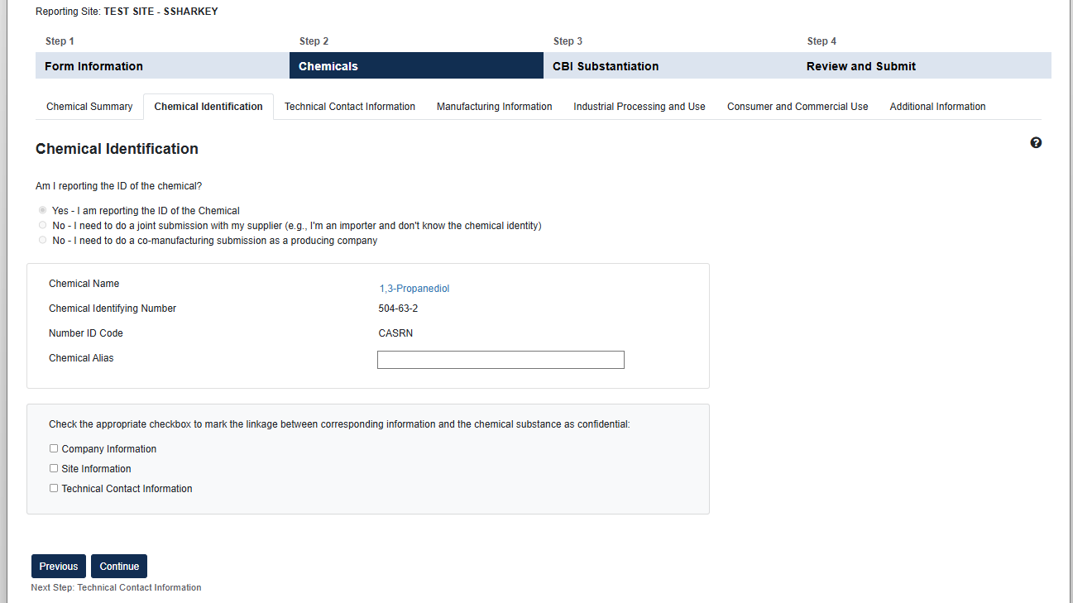
OMB Control No. 2070-0162
Expiration 10/31/2026
EPA Form 9600-010

Slide 13
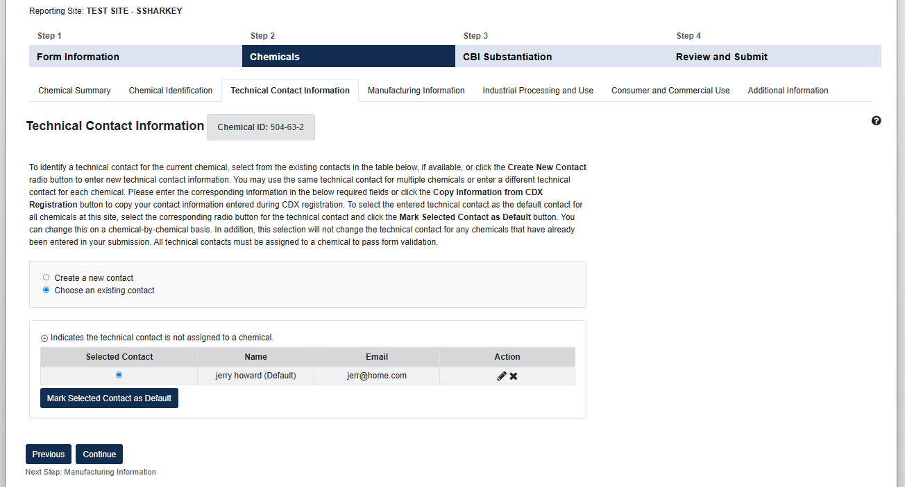
OMB Control No. 2070-0162
Expiration 10/31/2026
EPA Form 9600-010

Slide 14
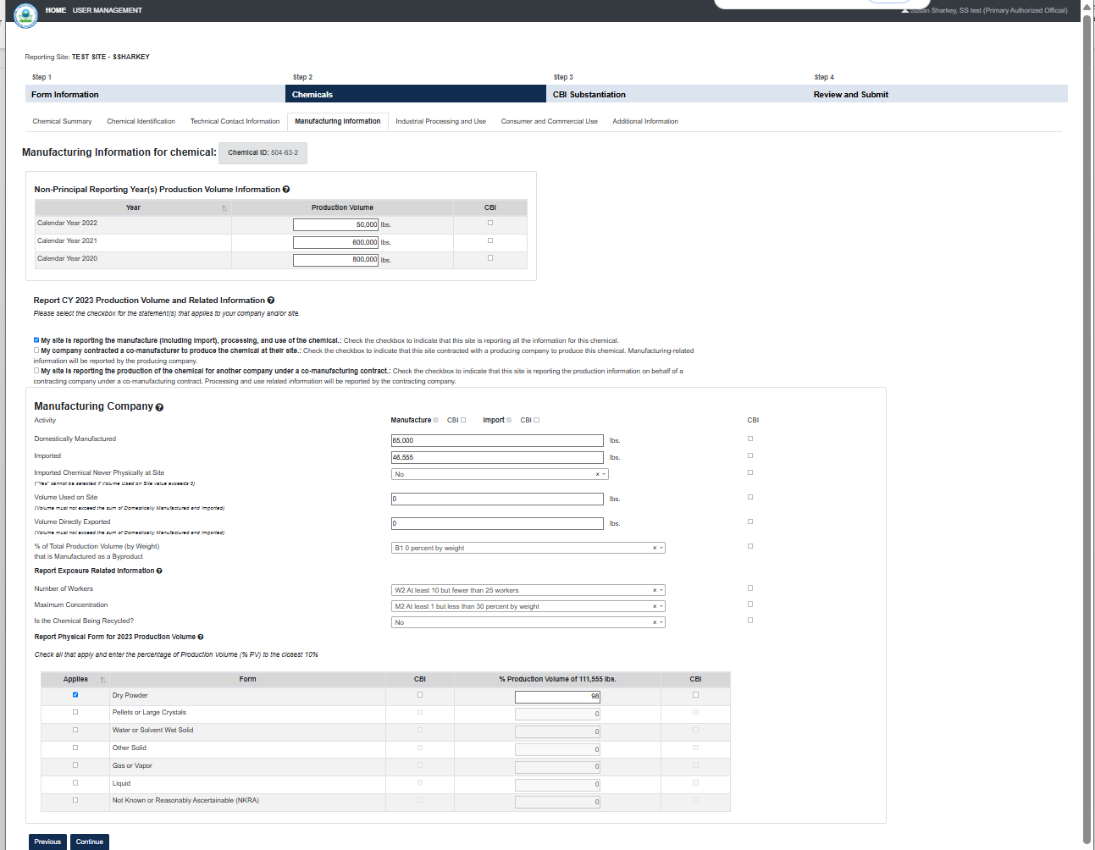
OMB Control No. 2070-0162
Expiration 10/31/2026
EPA Form 9600-010

Slide 15
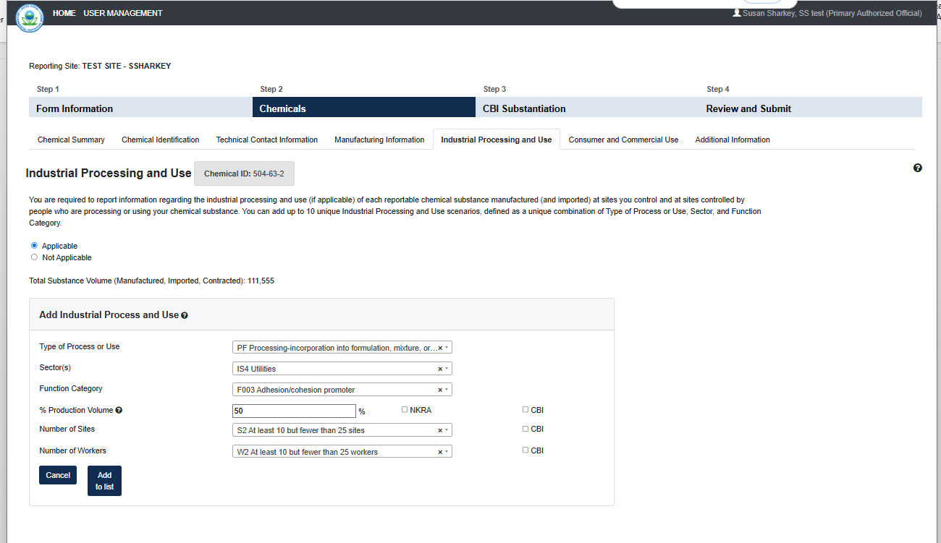
OMB Control No. 2070-0162
Expiration 10/31/2026
EPA Form 9600-010

Slide 16
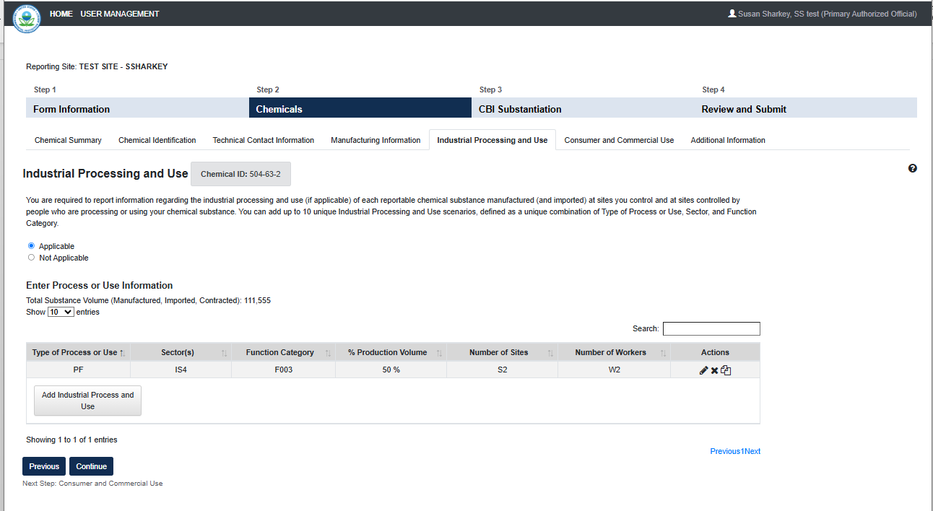
OMB Control No. 2070-0162
Expiration 10/31/2026
EPA Form 9600-010

Slide 17
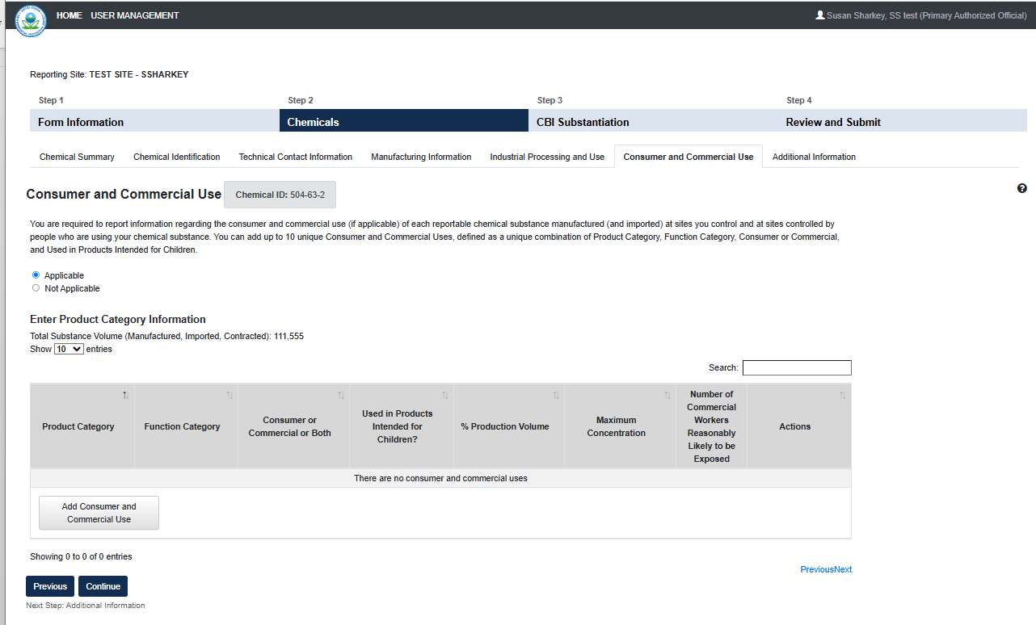
OMB Control No. 2070-0162
Expiration 10/31/2026
EPA Form 9600-010

Slide 18
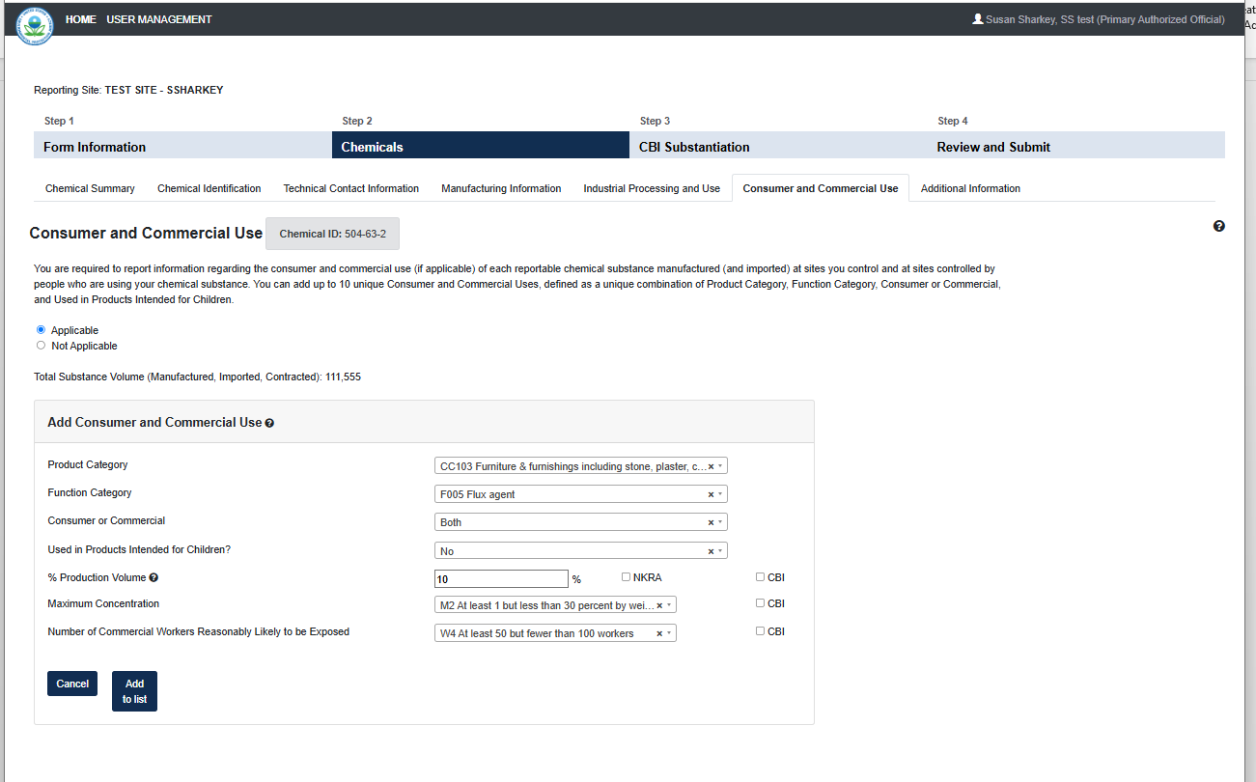
OMB Control No. 2070-0162
Expiration 10/31/2026
EPA Form 9600-010

Slide 19
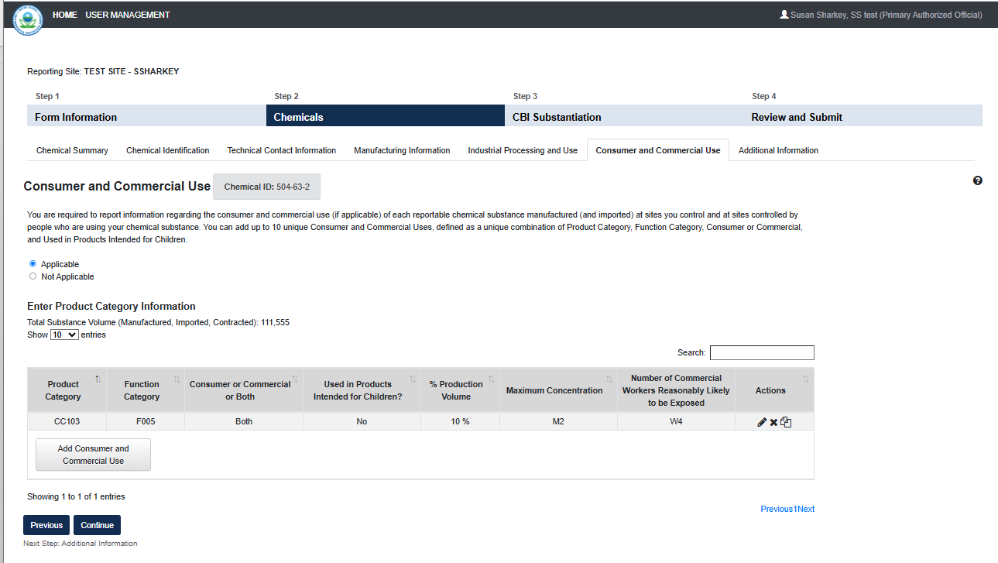
OMB Control No. 2070-0162
Expiration 10/31/2026
EPA Form 9600-010

Slide 20
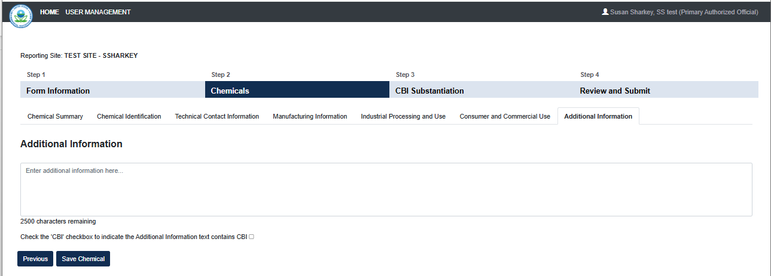
OMB Control No. 2070-0162
Expiration 10/31/2026
EPA Form 9600-010

Slide 21
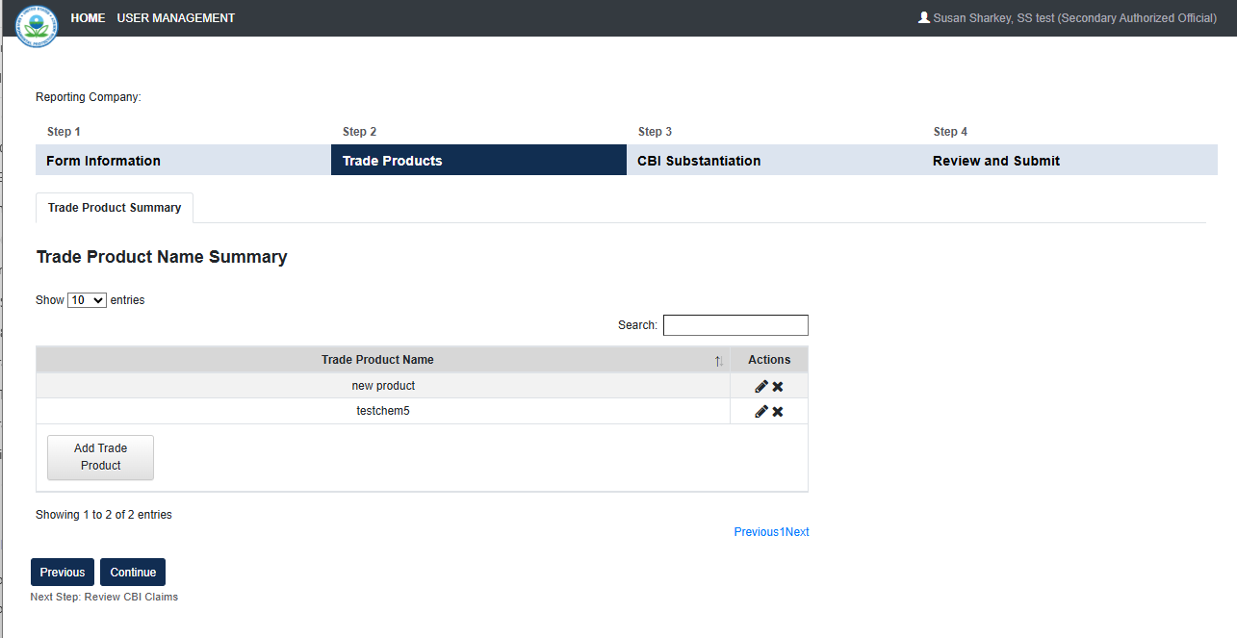
OMB Control No. 2070-0162
Expiration 10/31/2026
EPA Form 9600-010

Slide 22
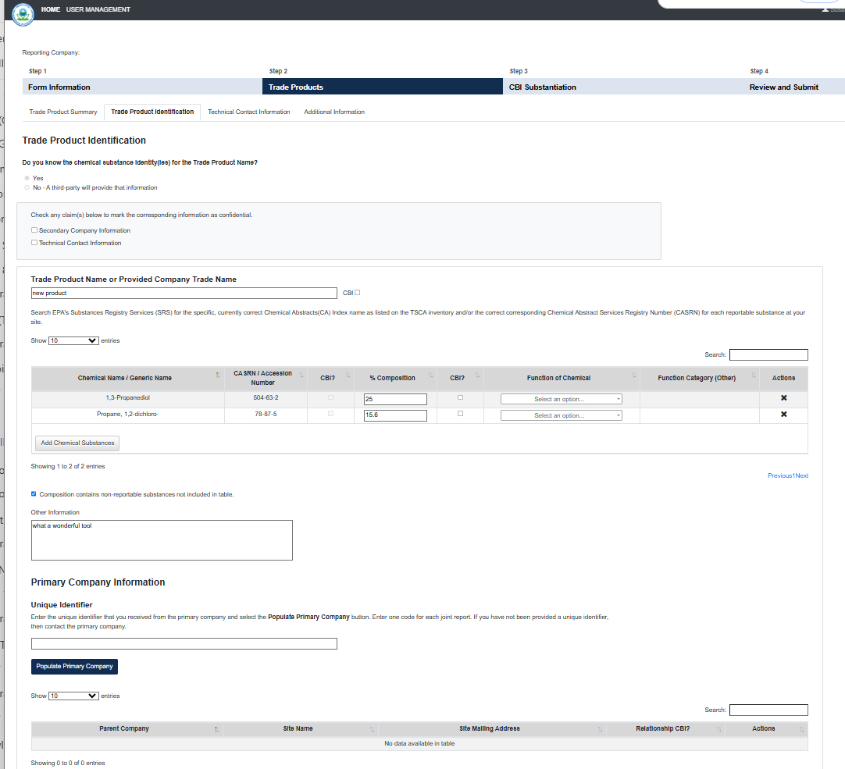
OMB Control No. 2070-0162
Expiration 10/31/2026
EPA Form 9600-010

Slide 23
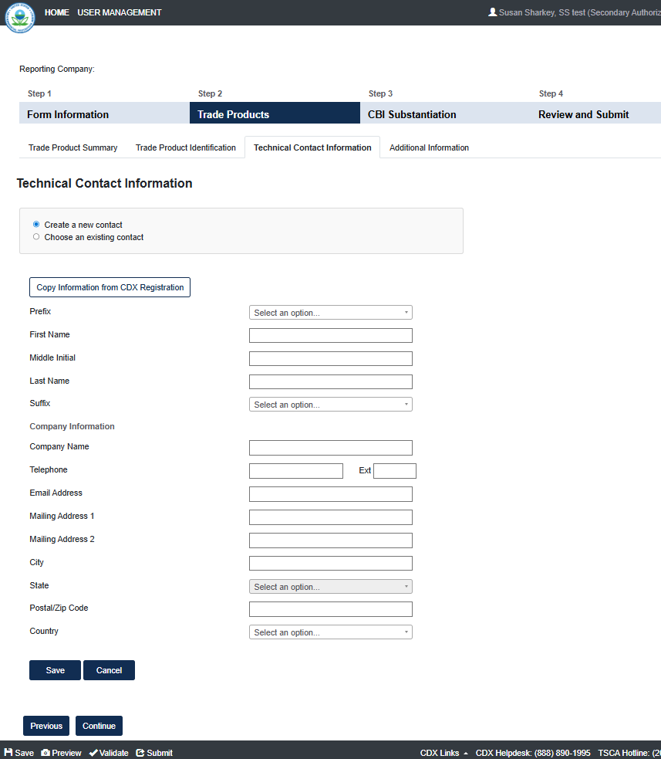
OMB Control No. 2070-0162
Expiration 10/31/2026
EPA Form 9600-010

Slide 24
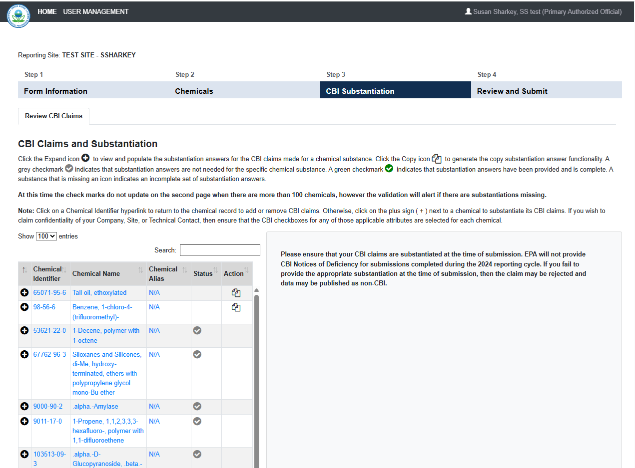
OMB Control No. 2070-0162
Expiration 10/31/2026
EPA Form 9600-010

Slide 25
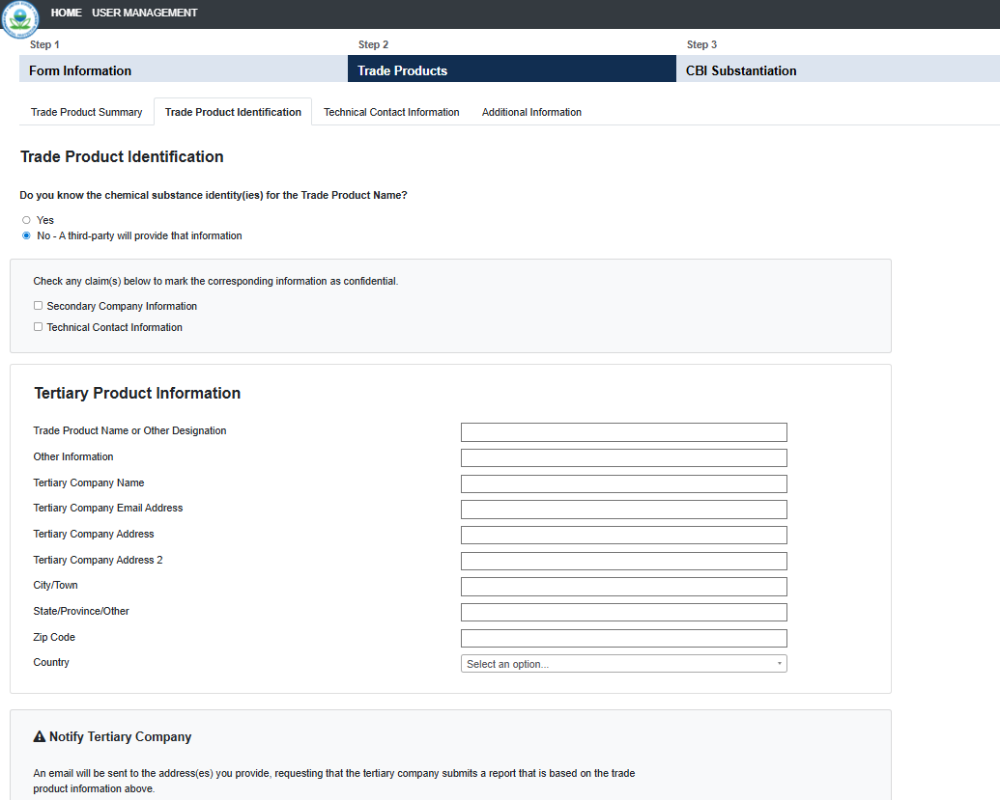
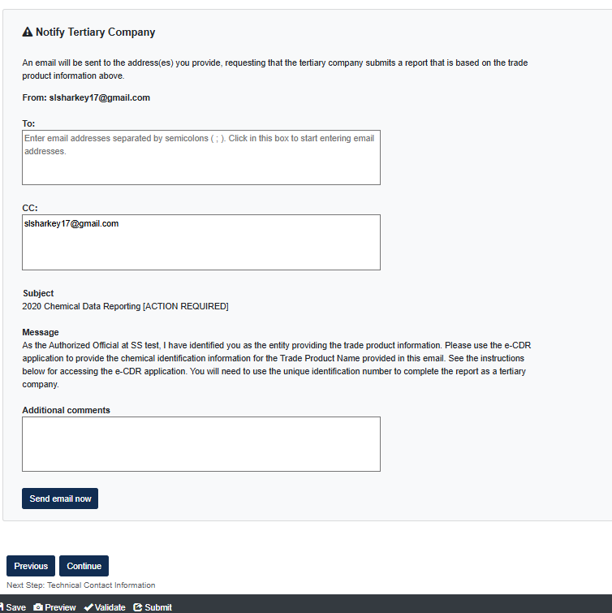
OMB Control No. 2070-0162
Expiration 10/31/2026
EPA Form 9600-010

Slide 26
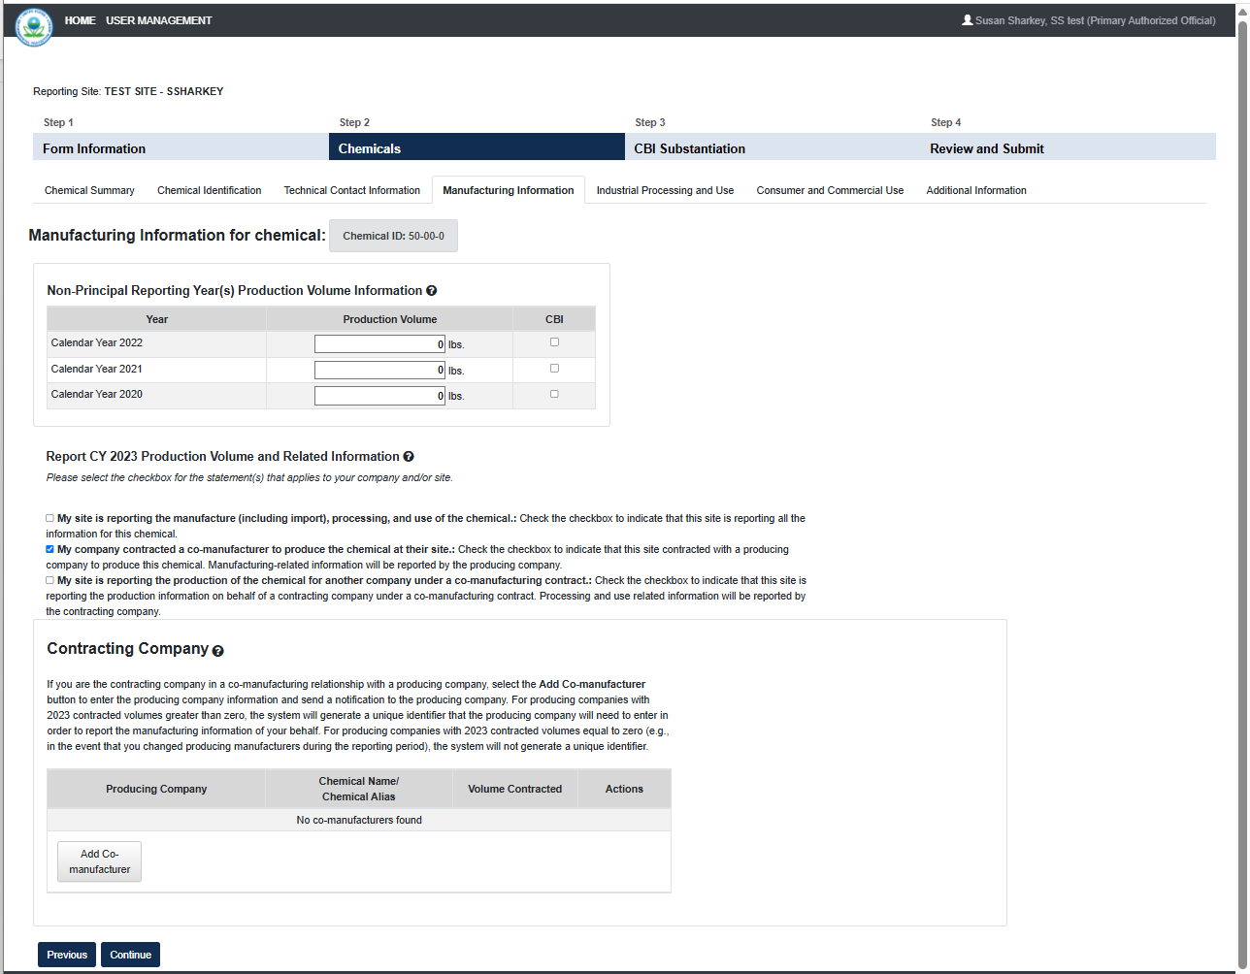
OMB Control No. 2070-0162
Expiration 10/31/2026
EPA Form 9600-010

Slide 27
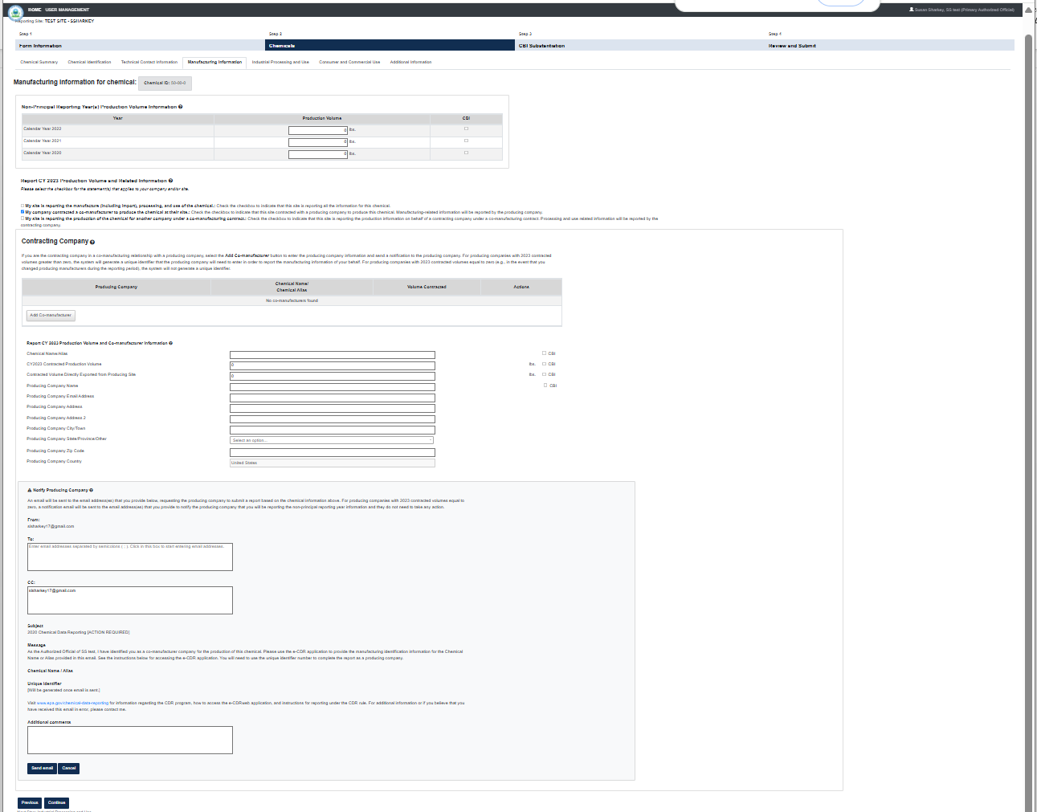
OMB Control No. 2070-0162
Expiration 10/31/2026
EPA Form
9600-010

Slide 28
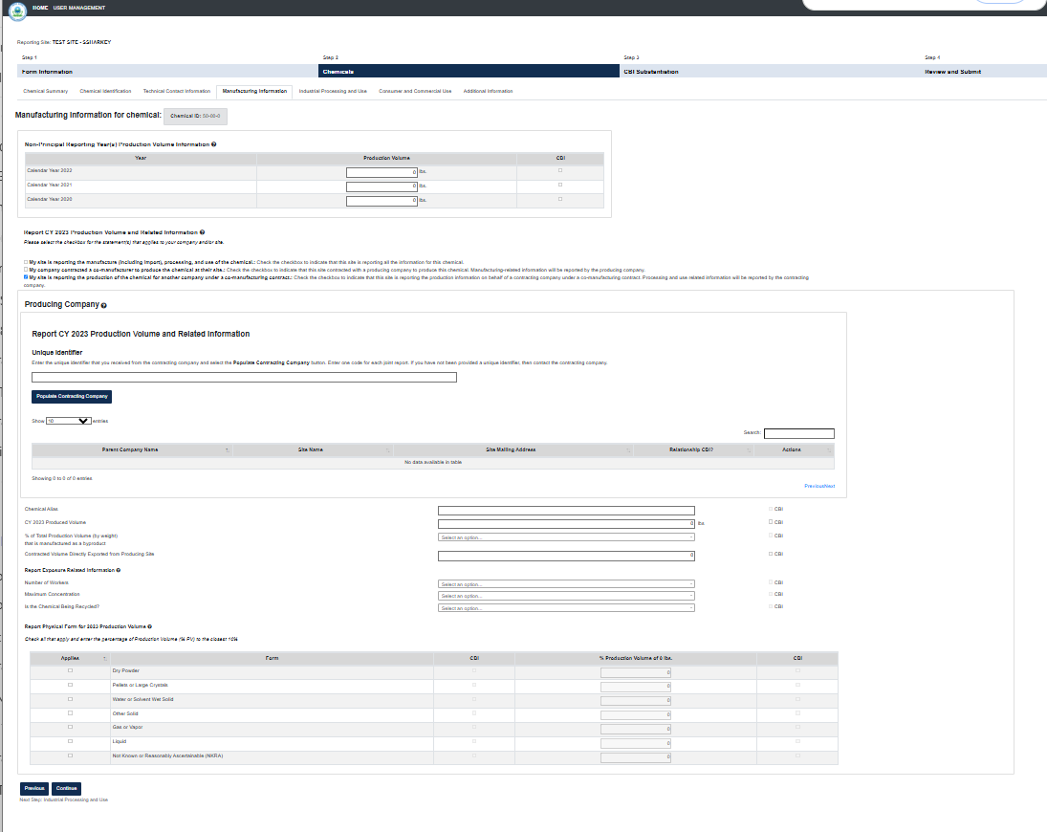
OMB Control No. 2070-0162
Expiration 10/31/2026
EPA Form 9600-010

Slide 29
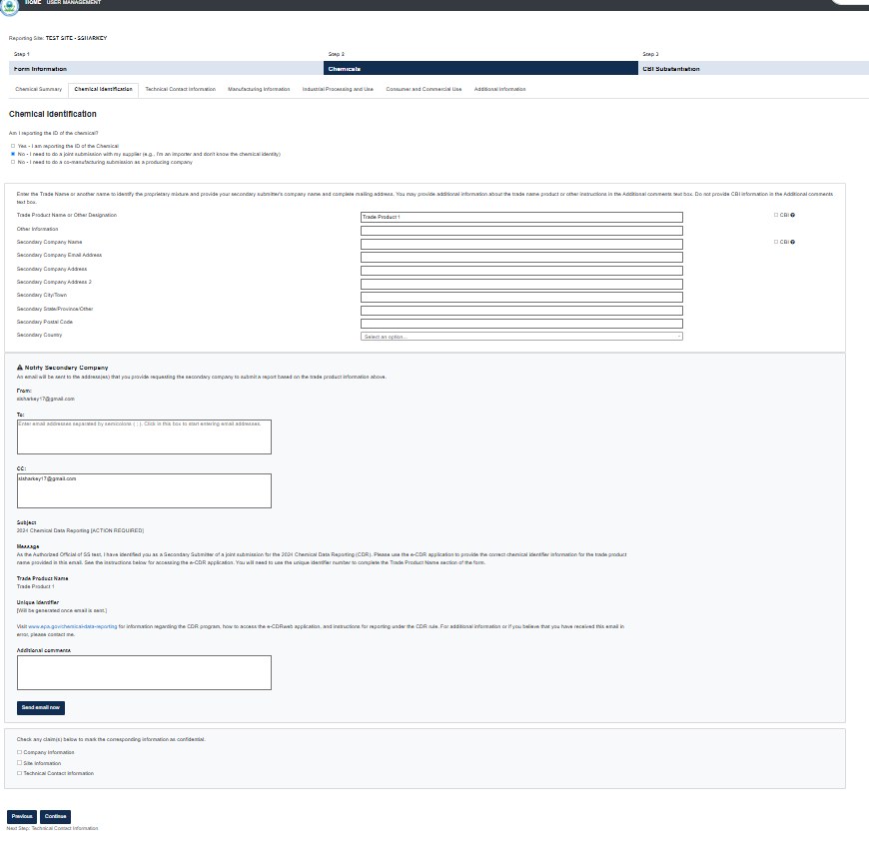
OMB Control No. 2070-0162
Expiration 10/31/2026
EPA Form 9600-010

