Slide 1
TSCA Section 8(e)
EPA Form No. 9600-030
OMB Control No. 2070-0046
Expiration 4/30/2026

Slide 2
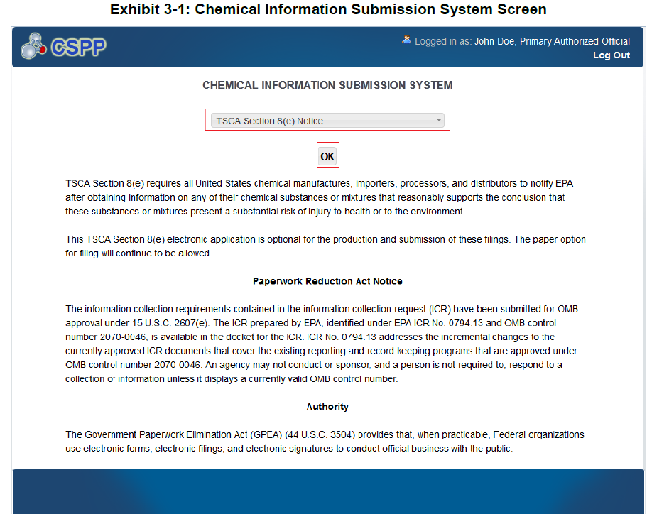
OMB Control No. 2070-0046
Expiration 4/30/2026
EPA Form 9600-030

Slide 3
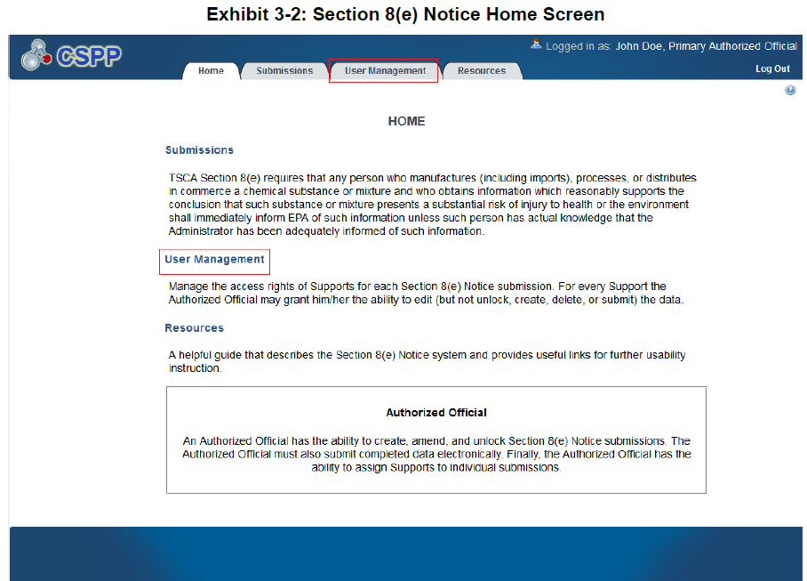
OMB Control No. 2070-0046
Expiration 4/30/2026
EPA Form 9600-030

Slide 4
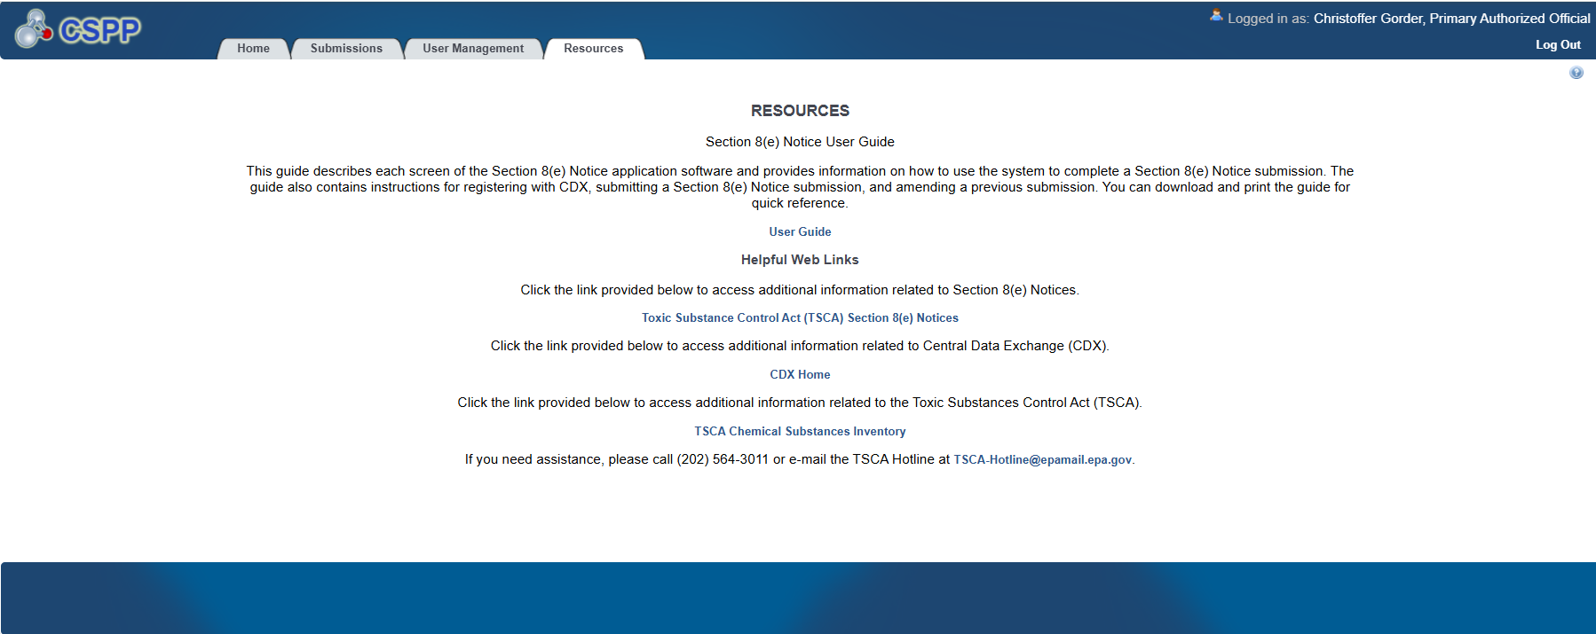
OMB Control No. 2070-0046
Expiration 4/30/2026
EPA Form 9600-030

Slide 5
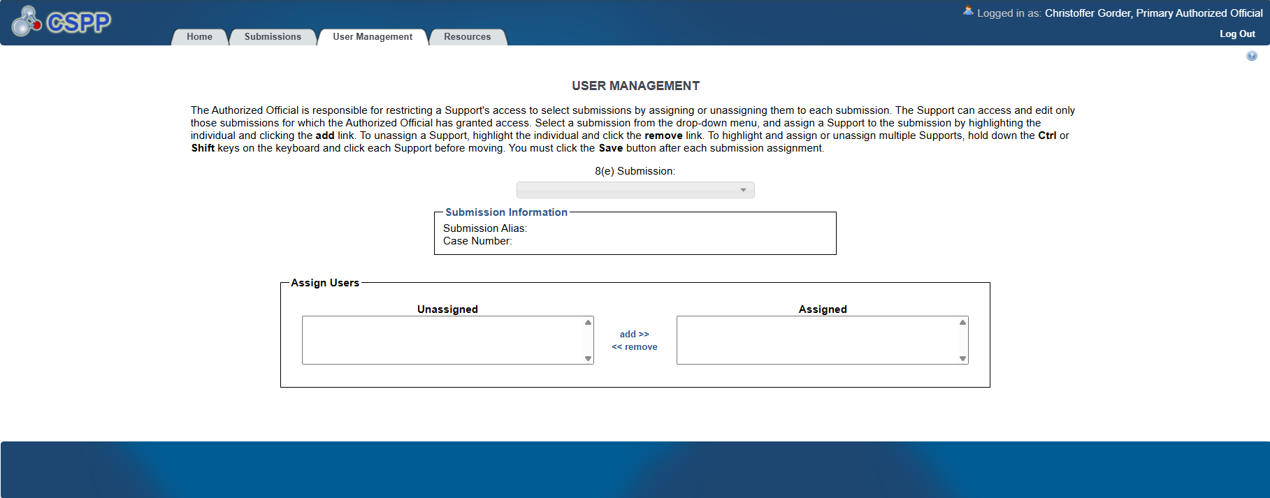
OMB Control No. 2070-0046
Expiration 4/30/2026
EPA Form 9600-030

Slide 6
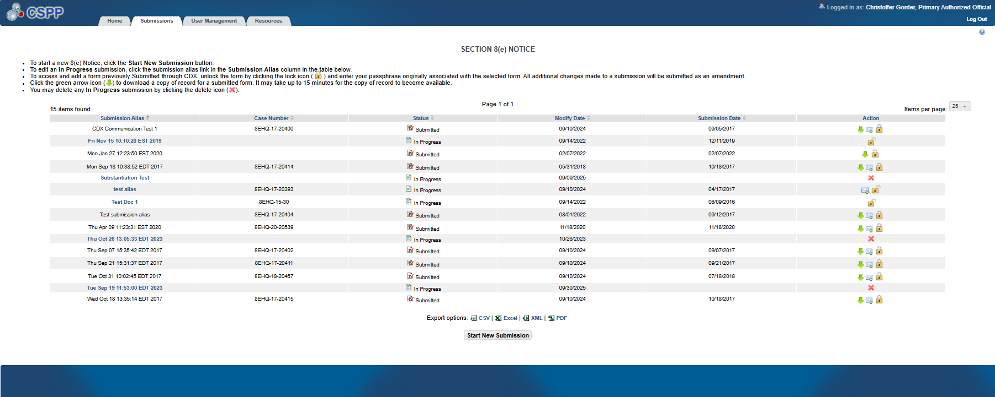
OMB Control No. 2070-0046
Expiration 4/30/2026
EPA Form 9600-030

Slide 7
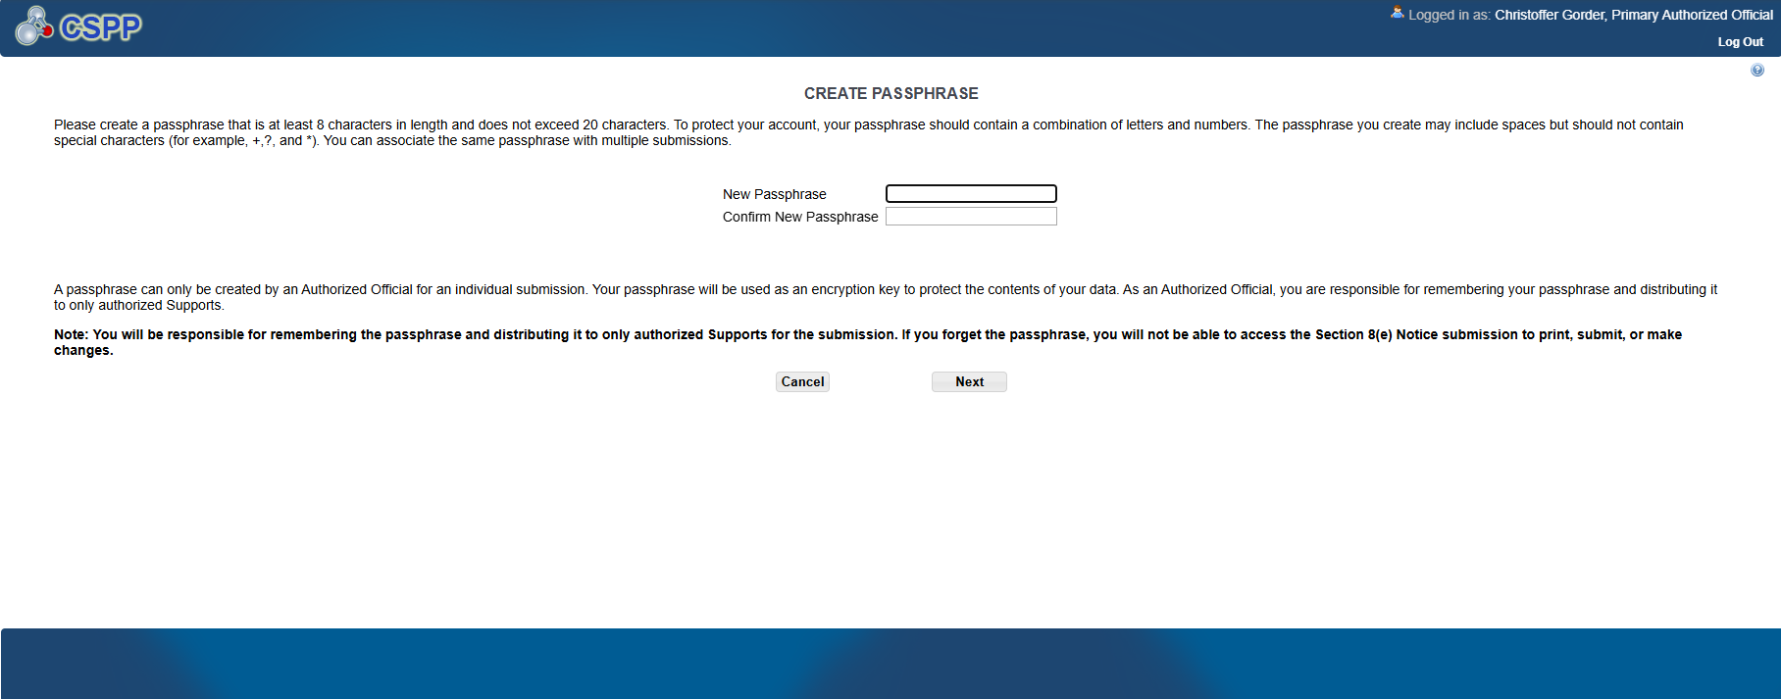
OMB Control No. 2070-0046
Expiration 4/30/2026
EPA Form 9600-030

Slide 8
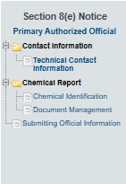
OMB Control No. 2070-0046
Expiration 4/30/2026
EPA Form 9600-030

Slide 9
OMB Control No. 2070-0046
Expiration 4/30/2026
EPA Form 9600-030

Slide 10
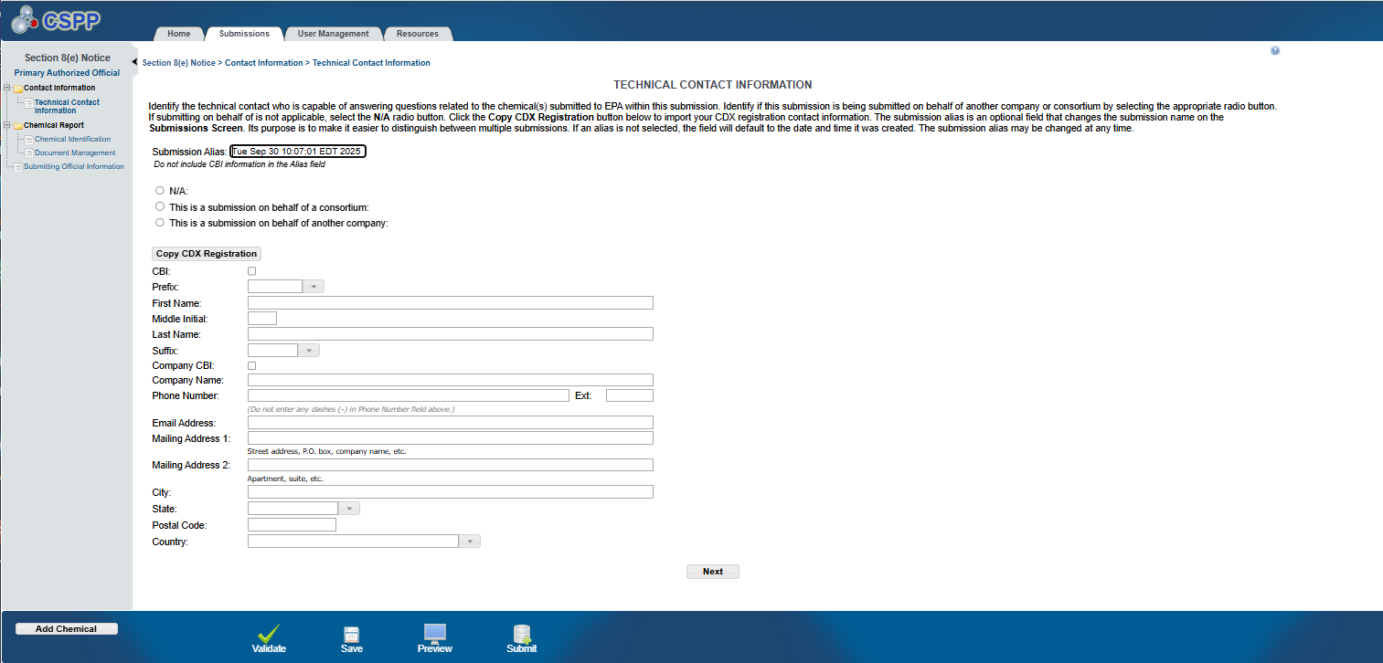
OMB Control No. 2070-0046
Expiration 4/30/2026
EPA Form 9600-030

Slide 11
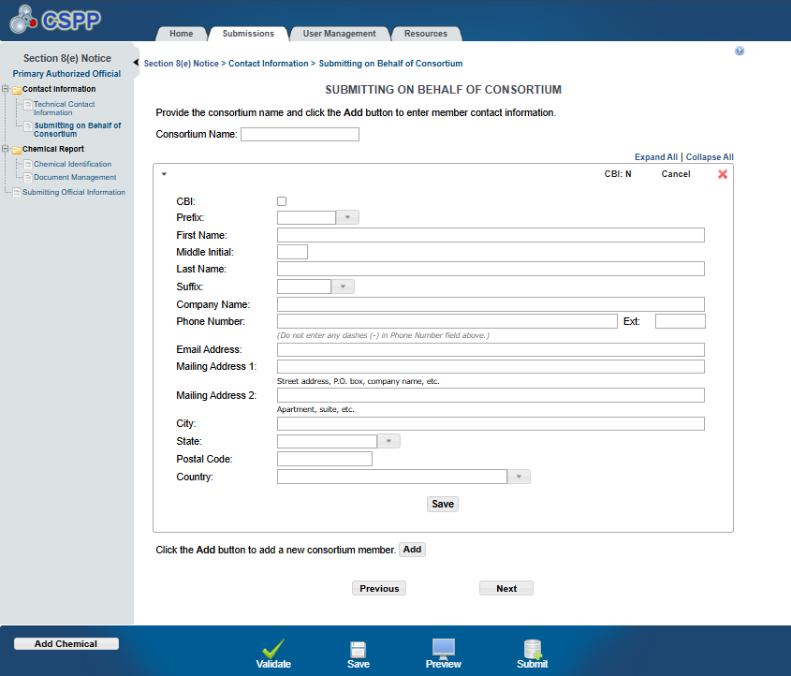
OMB Control No. 2070-0046
Expiration 4/30/2026
EPA Form 9600-030

Slide 12
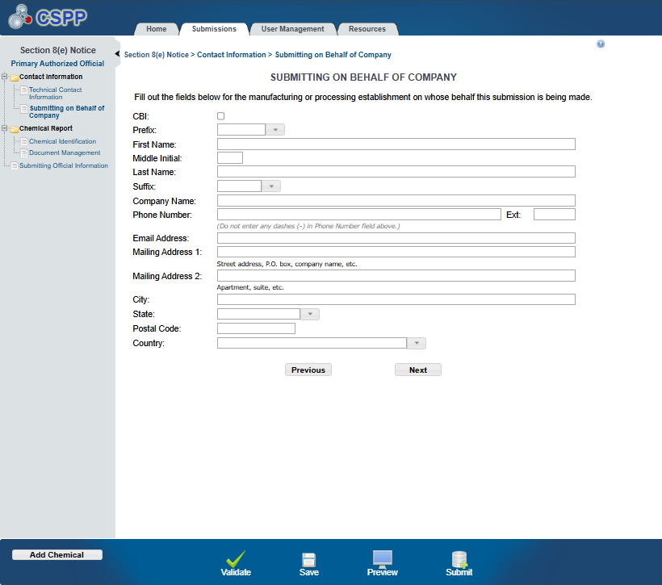
OMB Control No. 2070-0046
Expiration 4/30/2026
EPA Form 9600-030

Slide 13
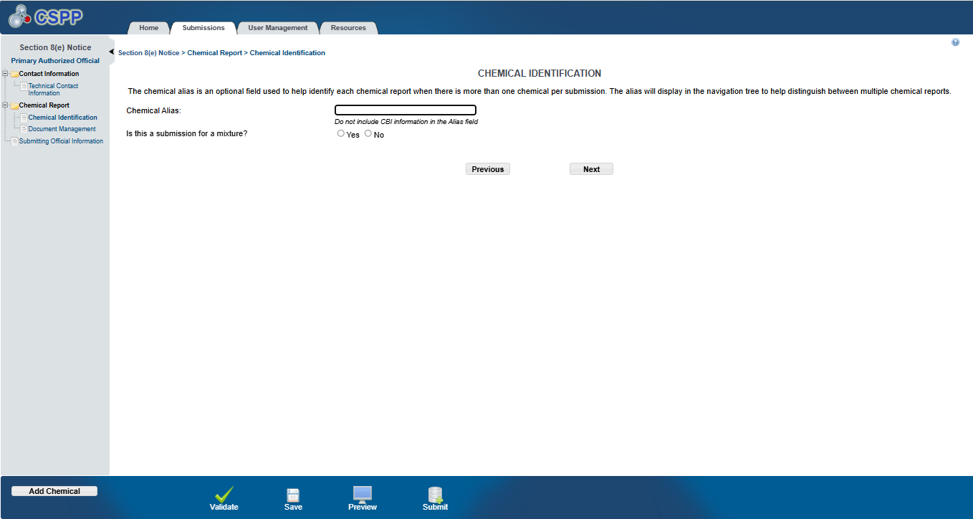
OMB Control No. 2070-0046
Expiration 4/30/2026
EPA Form 9600-030

Slide 14
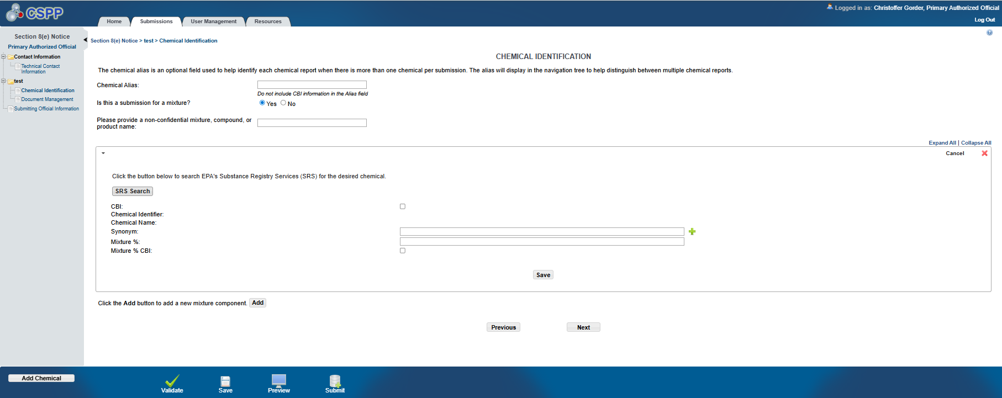
OMB Control No. 2070-0046
Expiration 4/30/2026
EPA Form 9600-030

Slide 15
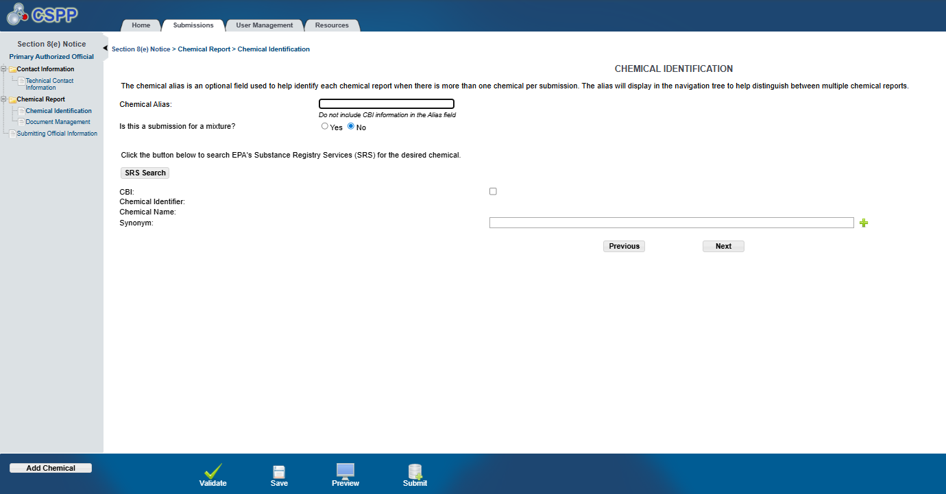
OMB Control No. 2070-0046
Expiration 4/30/2026
EPA Form 9600-030

Slide 16
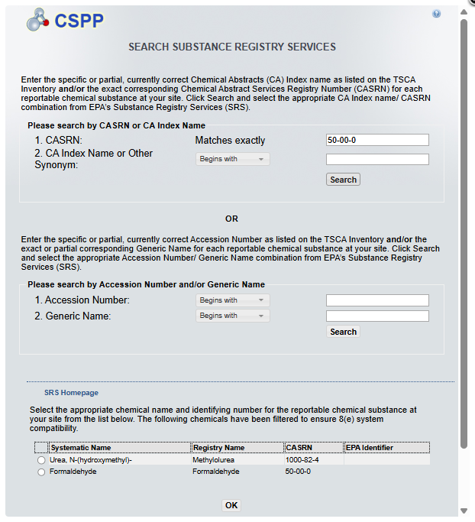
OMB Control No. 2070-0046
Expiration 4/30/2026
EPA Form 9600-030

Slide 17
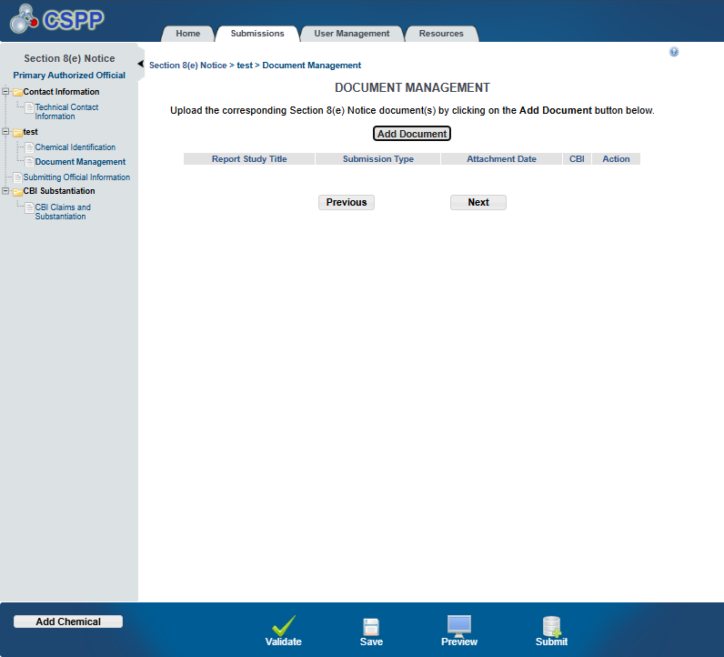
OMB Control No. 2070-0046
Expiration 4/30/2026
EPA Form 9600-030

Slide 18
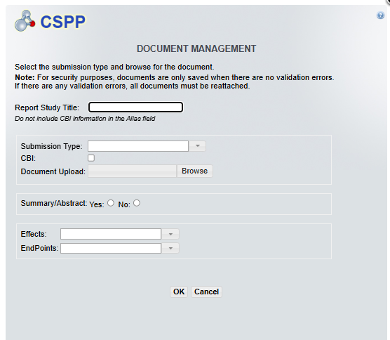
OMB Control No. 2070-0046
Expiration 4/30/2026
EPA Form 9600-030

Slide 19
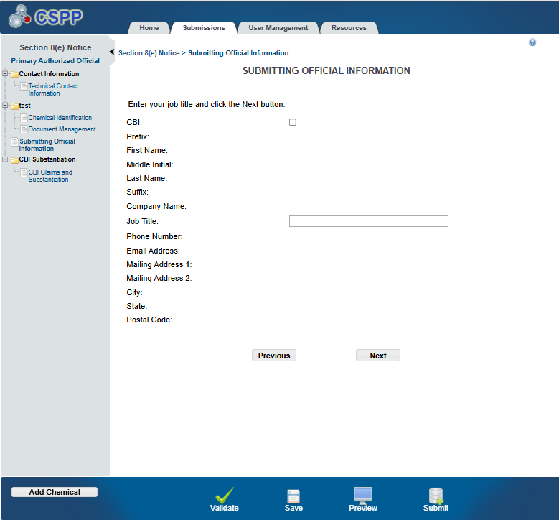
OMB Control No. 2070-0046
Expiration 4/30/2026
EPA Form 9600-030

Slide 20
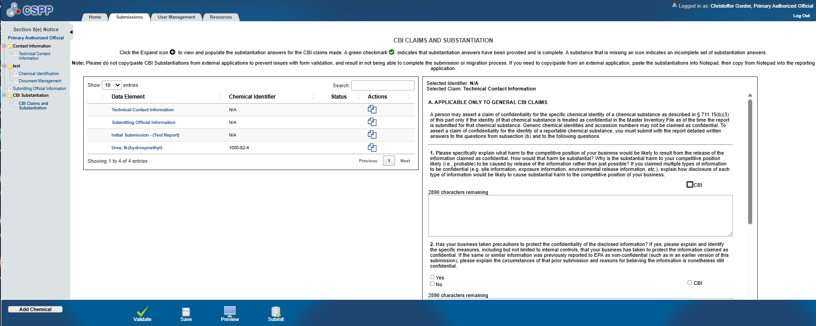
OMB Control No. 2070-0046
Expiration 4/30/2026
EPA Form 9600-030

Slide 21
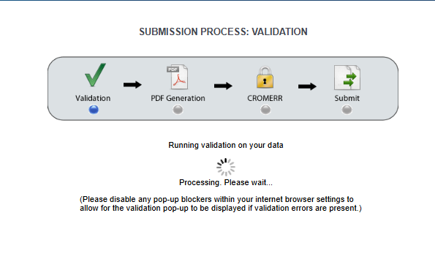
OMB Control No. 2070-0046
Expiration 4/30/2026
EPA Form 9600-030

Slide 22
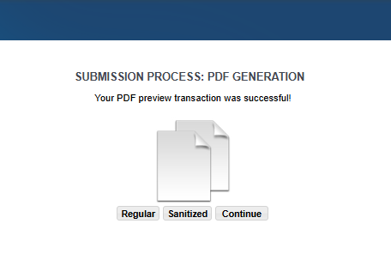
OMB Control No. 2070-0046
Expiration 4/30/2026
EPA Form 9600-030

Slide 23
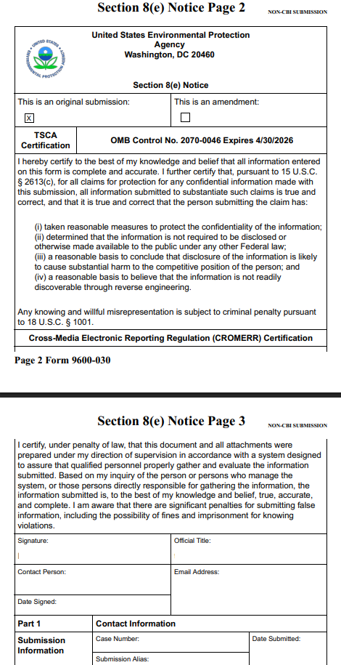
OMB Control No. 2070-0046
Expiration 4/30/2026
EPA Form 9600-030

Slide 24
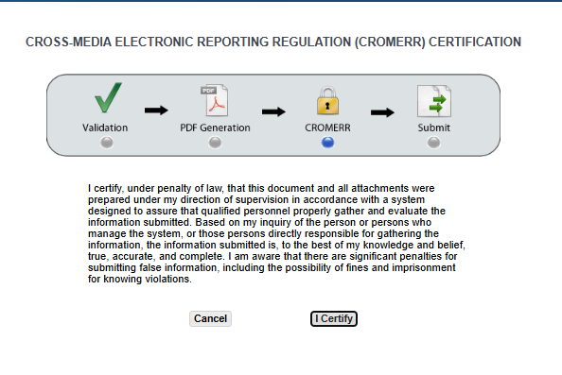
OMB Control No. 2070-0046
Expiration 4/30/2026
EPA Form 9600-030

Slide 25
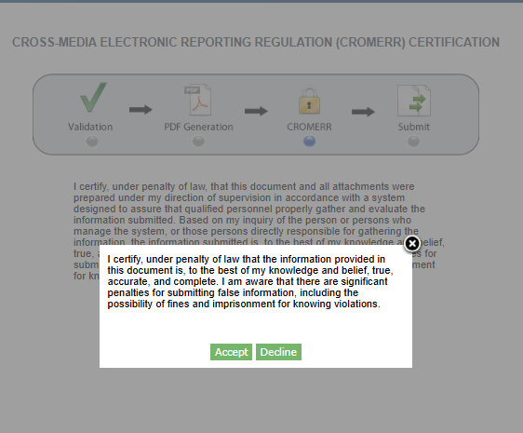
OMB Control No. 2070-0046
Expiration 4/30/2026
EPA Form 9600-030

Slide 26
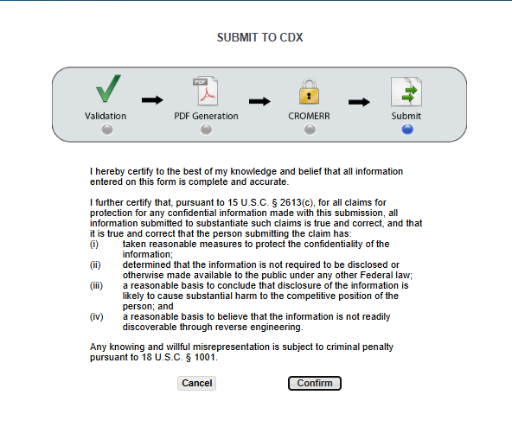
OMB Control No. 2070-0046
Expiration 4/30/2026
EPA Form 9600-030

Slide 27
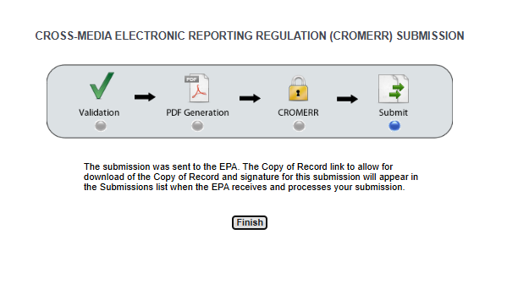
OMB Control No. 2070-0046
Expiration 4/30/2026
EPA Form 9600-030

