Slide 1
TSCA Section 8(d)
Health Safety Data Reporting
Reporting Tool Screen Shots EPA From 9600-032
OMB Control No. 2027-0224
Expiration 4/30/2029

Slide 2
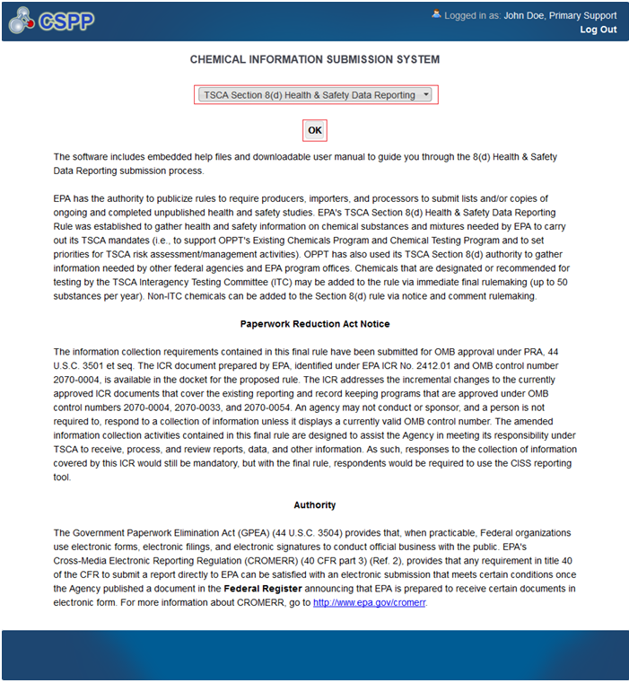
Chemical Information Submission System Screen
OMB No. 2070-0224
Exp 4/30/209
This collection of information is approved by OMB under the Paperwork Reduction Act, 44 U.S.C. 3501 et seq. (OMB Control No. 2070-0224). Responses to this collection of information are mandatory for certain persons, as specified at 40 CFR Part 712. An agency may not conduct or sponsor, and a person is not required to respond to, a collection of information unless it displays a currently valid OMB control number. The public reporting and recordkeeping burden for this collection of information is estimated to be 0.4 to 107.5 hours per response. Send comments on the Agency’s need for this information, the accuracy of the provided burden estimates and any suggested methods for minimizing respondent burden to the Data & Enterprise Programs Deputy Division Director, U.S. Environmental Protection Agency (2821T), 1200 Pennsylvania Ave., NW, Washington, D.C. 20460. Include the OMB control number in any correspondence. Do not send the completed form to this address.
EPA Form 9600-032

Slide 3
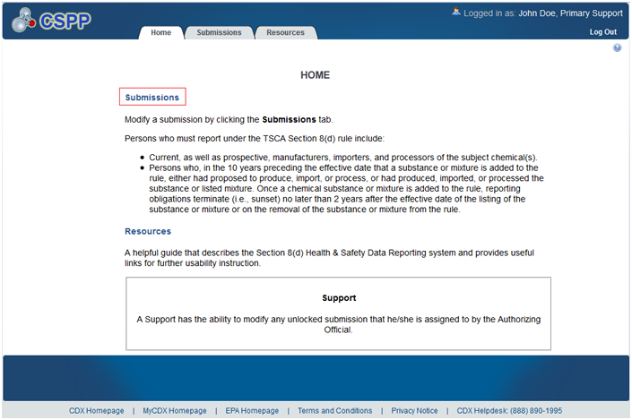
Home Screen
OMB No. 2070-0224
Exp 4/30/2029
EPA Form 9600-032

Slide 4
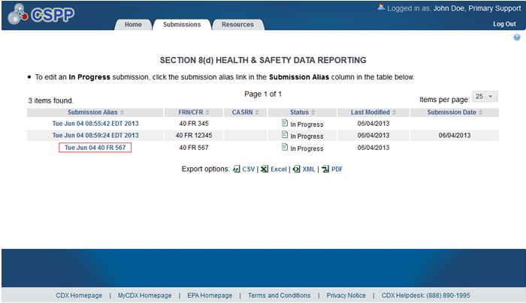
Submissions Screen
OMB No. 2070-0224
Exp 4/30/2029
EPA Form 9600-032

Slide 5
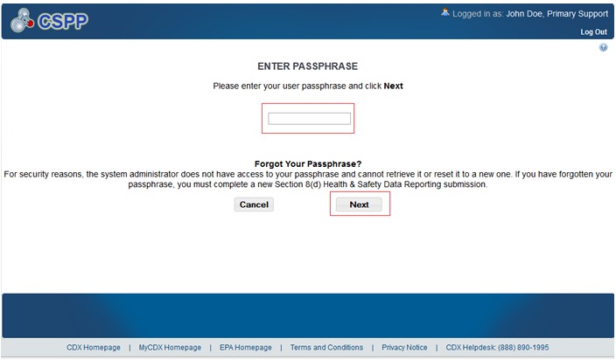
Passphrase Screen
OMB No. 2070-0224
Exp 4/30/2029
EPA Form 9600-032

Slide 6
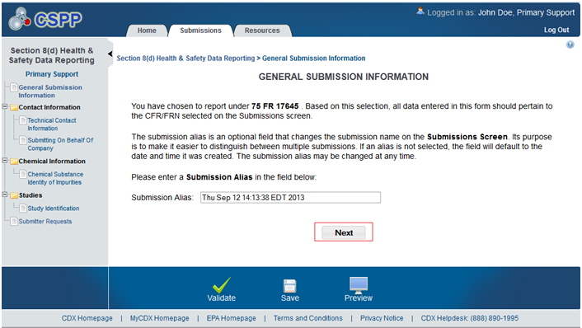
General Submission Information Screen
OMB No. 2070-0224
Exp 4/30/2029
EPA Form 9600-032

Slide 7
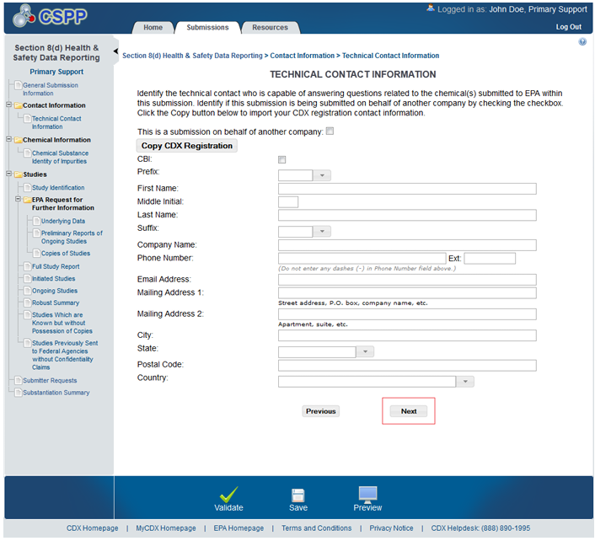
Technical Contact Screen
OMB No. 2070-0224
Exp 4/30/2029
EPA Form 9600-032

Slide 8
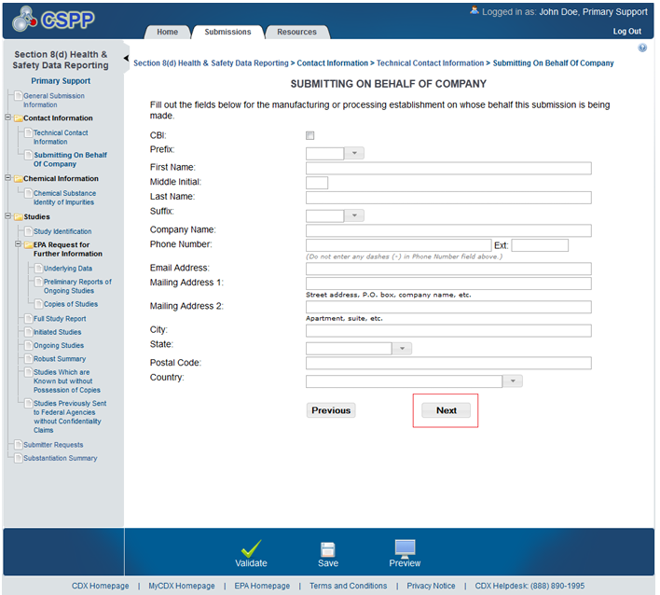
Submitting on Behalf of Company Screen
OMB No. 2070-0224
Exp 4/30/2029
EPA Form 9600-032

Slide 9
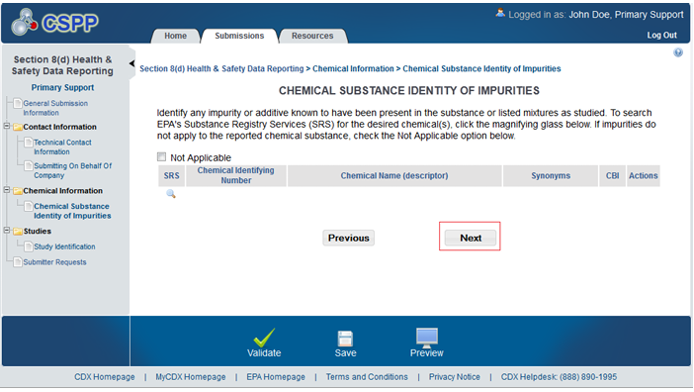
Chemical Substance Identity of Impurities Screen
OMB No. 2070-0224
Exp 4/30/2029
EPA Form 9600-032

Slide 10
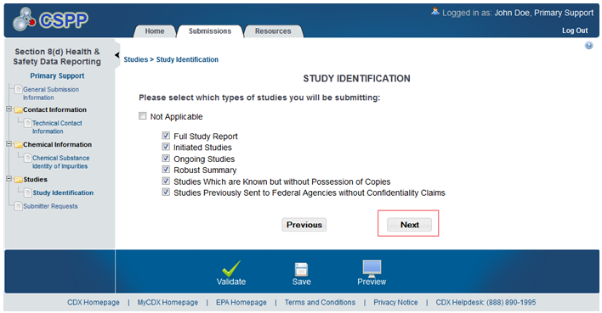
Study Identification Screen
OMB No. 2070-0224
Exp 4/30/2029
EPA Form 9600-032

Slide 11
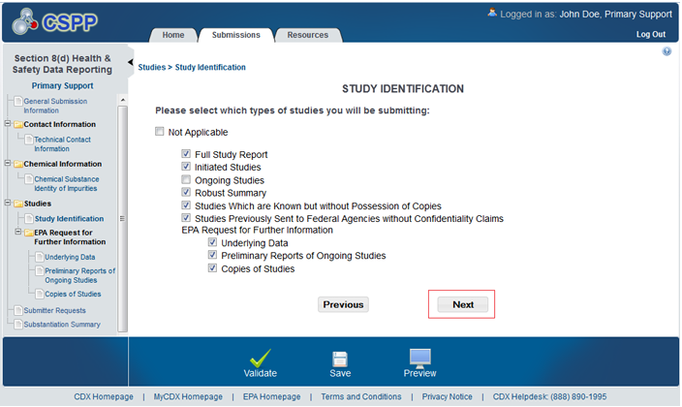
Study Identification Screen for an Amendment
OMB No. 2070-0224
Exp 4/30/2029
EPA Form 9600-032

Slide 12
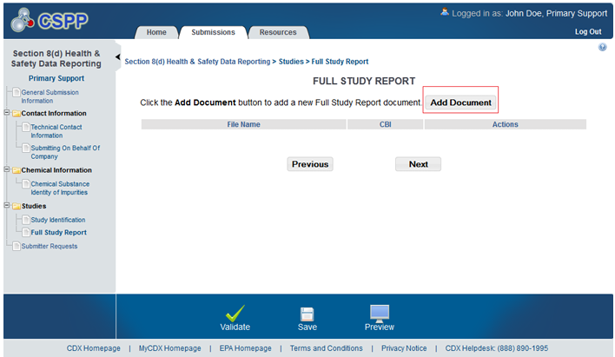
Full Study Report Screen
OMB No. 2070-0224
Exp 4/30/2029
EPA Form 9600-032

Slide 13
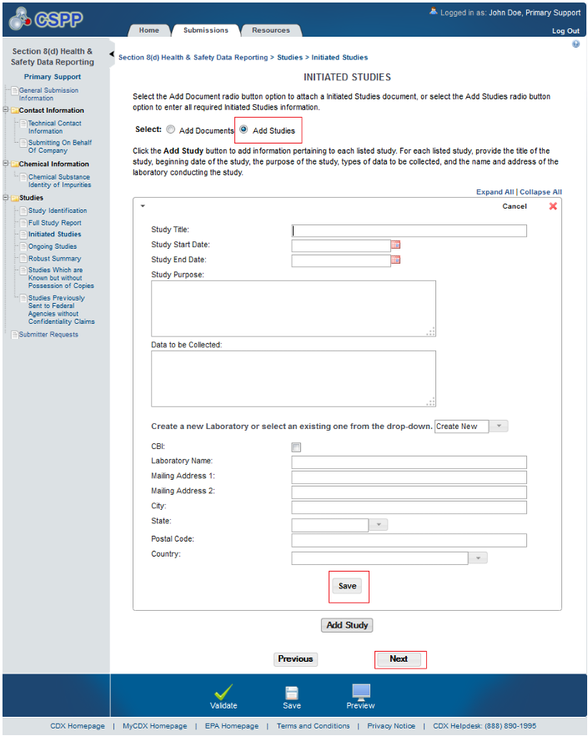
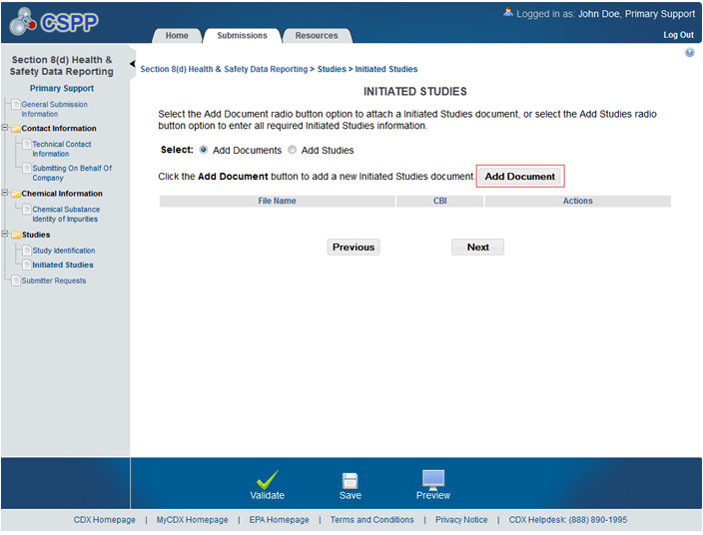
Initiated Studies Screens
OMB No. 2070-0224
Exp 4/30/2029
EPA Form 9600-032

Slide 14
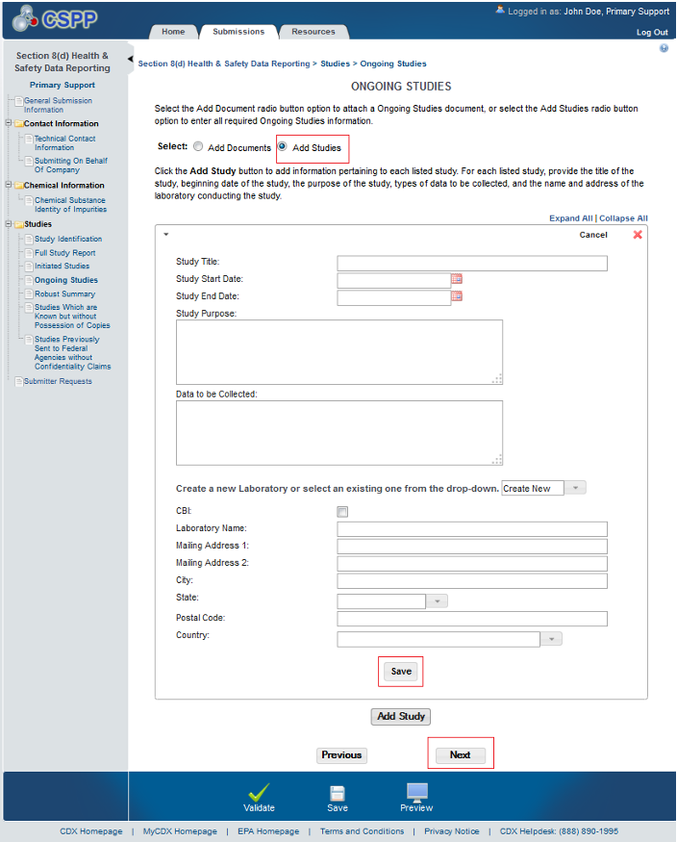
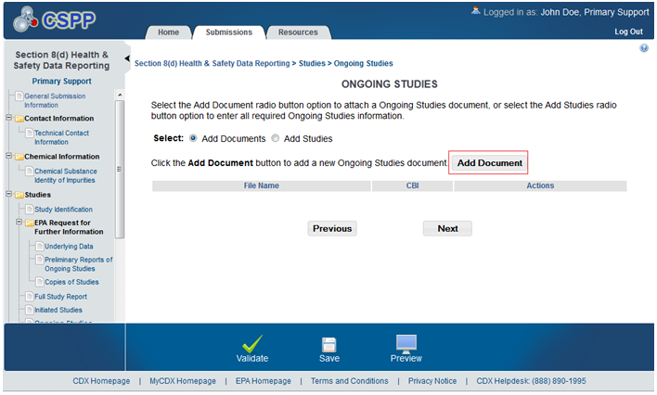
Ongoing Studies Screens
OMB No. 2070-0224
Exp 4/30/2029
EPA Form 9600-032

Slide 15
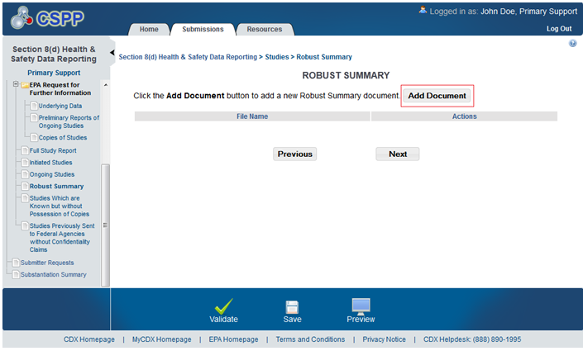
Robust Summary Add Document Screen
OMB No. 2070-0224
Exp 4/30/2029
EPA Form 9600-032

Slide 16
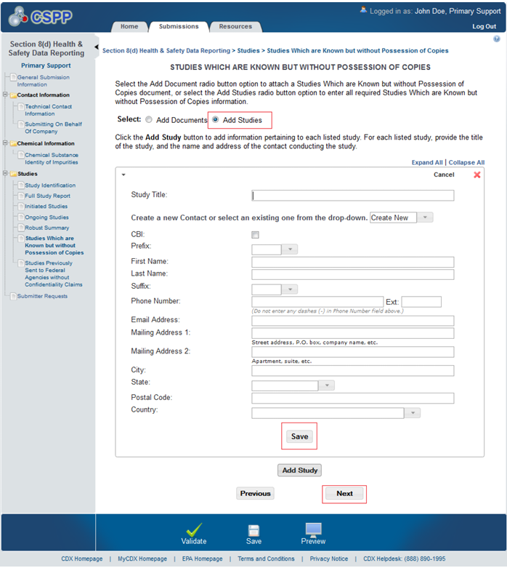
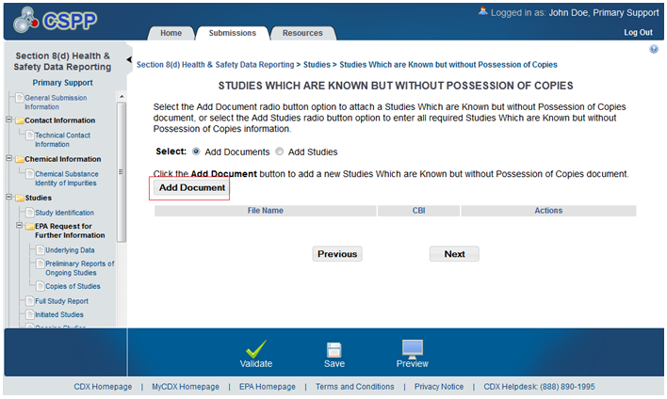
Studies which are Known but Without Possession of Copies Screens
OMB No. 2070-0224
Exp 4/30/2029
EPA Form 9600-032

Slide 17
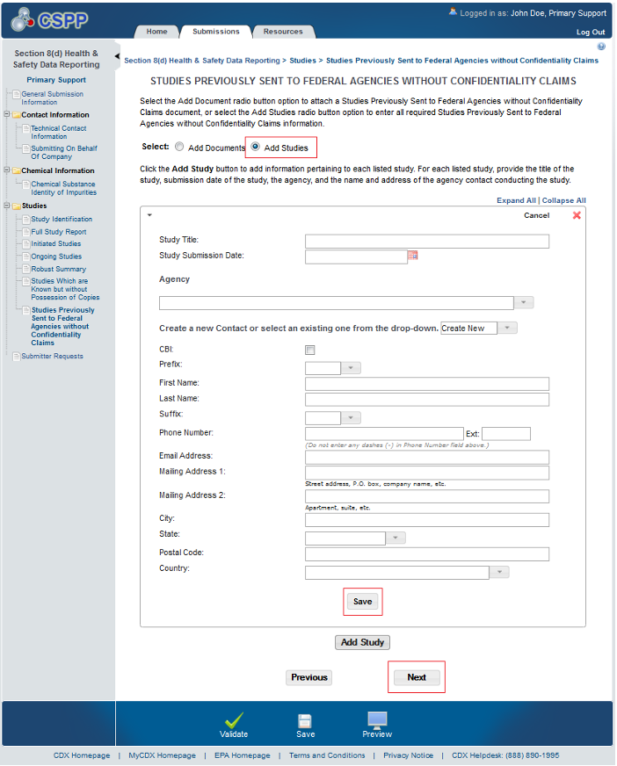
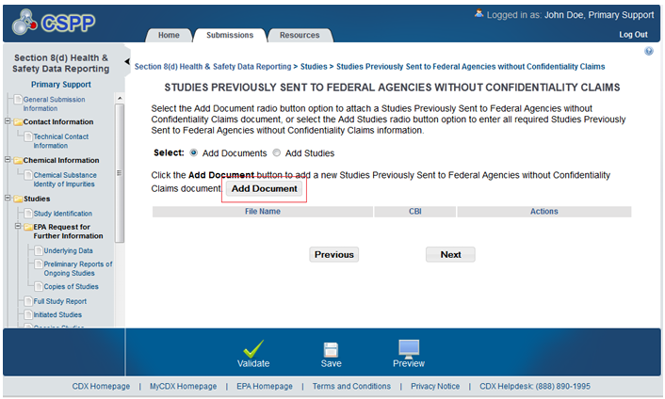
Studies Previously Sent to Federal Agencies without Confidentiality Claims Screens
OMB No. 2070-0224
Exp 4/30/2029
EPA Form 9600-032

Slide 18
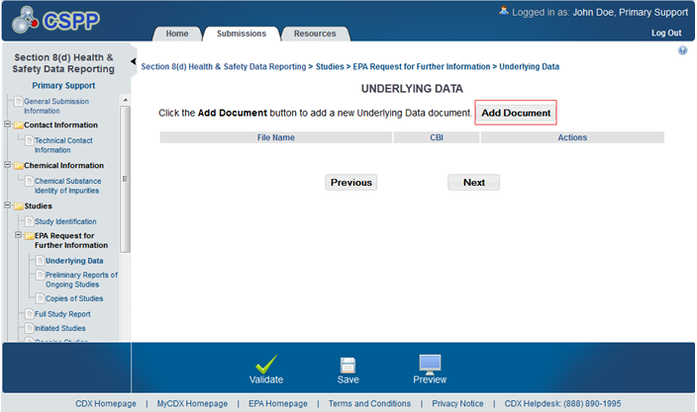
Underlying Data Screen
OMB No. 2070-0224
Exp 4/30/2029
EPA Form 9600-032

Slide 19
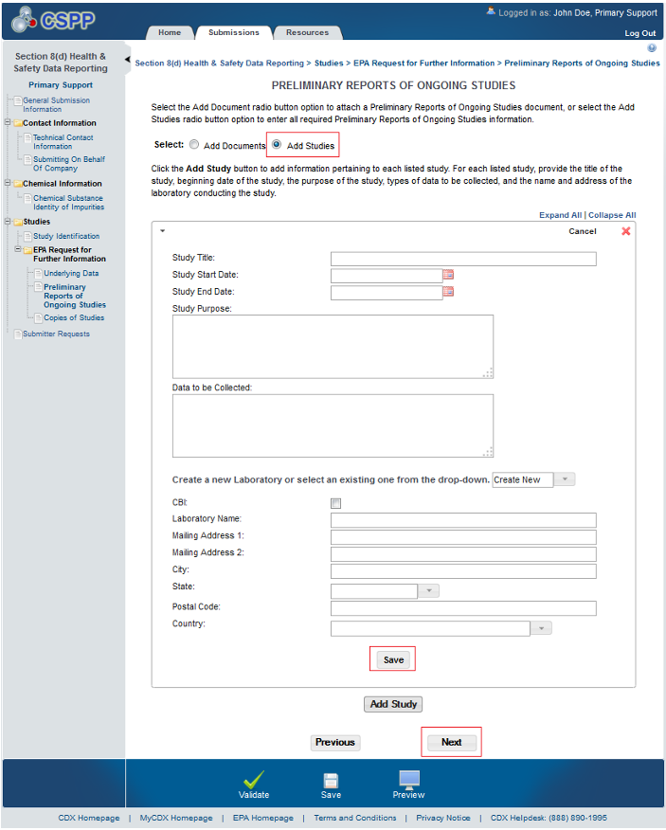
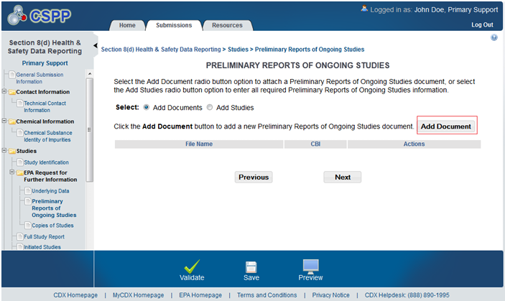
Preliminary Reports of Ongoing Studies Screens
OMB No. 2070-0224
Exp 4/30/2029
EPA Form 9600-032

Slide 20
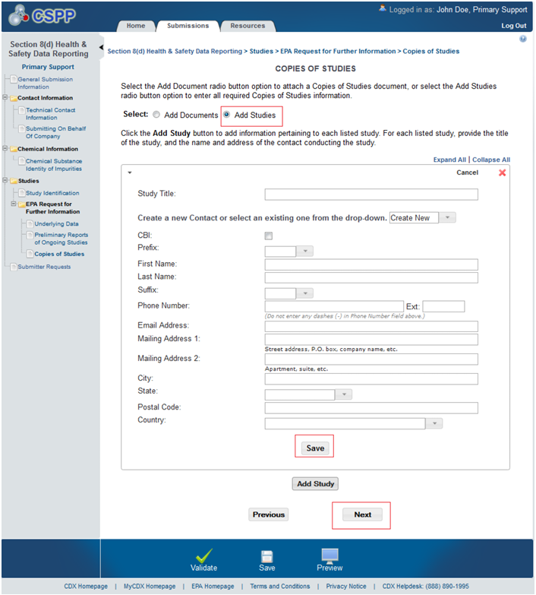
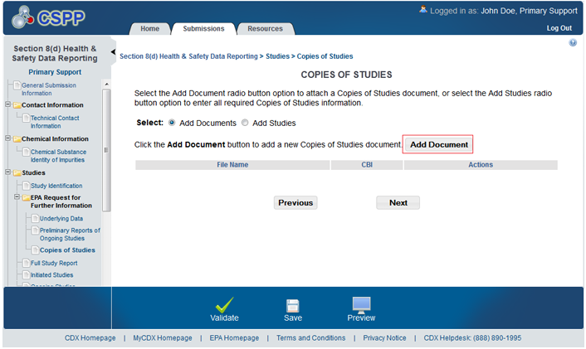
Copies of Studies Screens
OMB No. 2070-0224
Exp 4/30/2029
EPA Form 9600-032

Slide 21
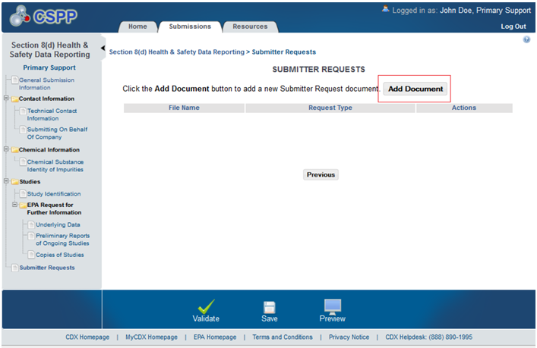
Submitter Requests Screen
OMB No. 2070-0224
Exp 4/30/2029
EPA Form 9600-032

Slide 22
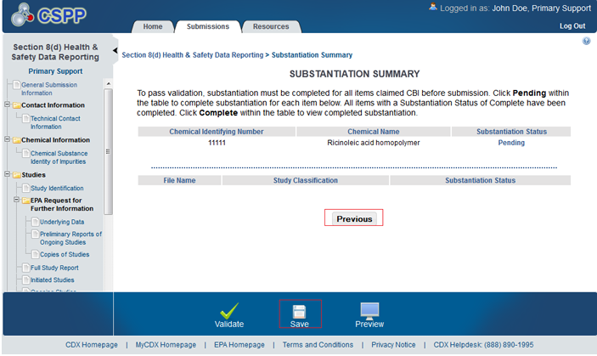
Substantiation Summary Screen
OMB No. 2070-0224
Exp 4/30/2029
EPA Form 9600-032

Slide 23
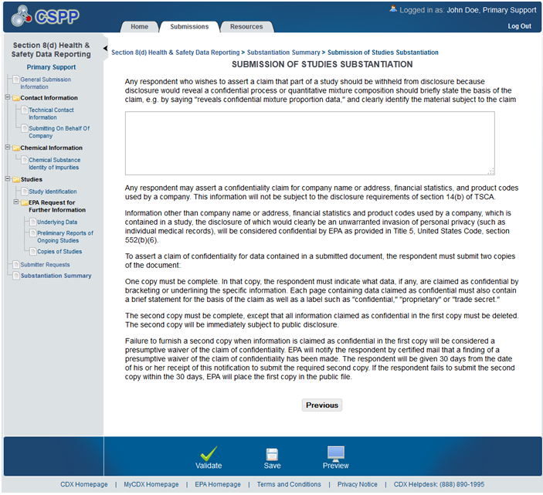
Submission of Studies Substantiation Screen
OMB No. 2070-0224
Exp 4/30/2029

Slide 24
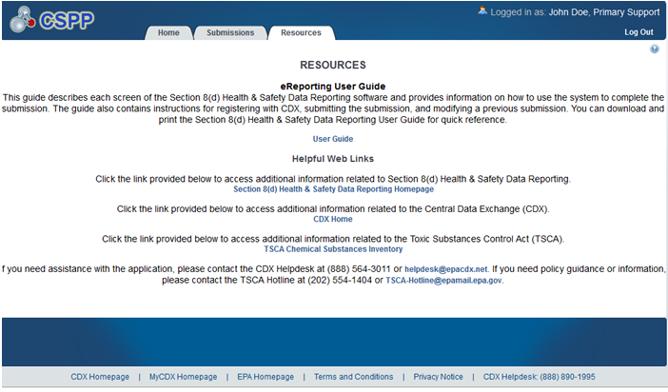
Resources Screen
OMB No. 2070-0224
Exp 4/30/2029
EPA Form 9600-032

