Slide 1
Generic Clearance for TSCA Section 4 Test Rules, Test Orders, Enforceable Consent Agreements (ECAs), Voluntary Data Submissions, and Exemptions from Testing Requirement (Renewal)
Test Order Submission under TSCA Section 4
OMB Control No. 2070-0033
EPA ICR No. 1139.49
Expiration Date March 31, 2027
EPA Form No. 9600-034

Slide 2
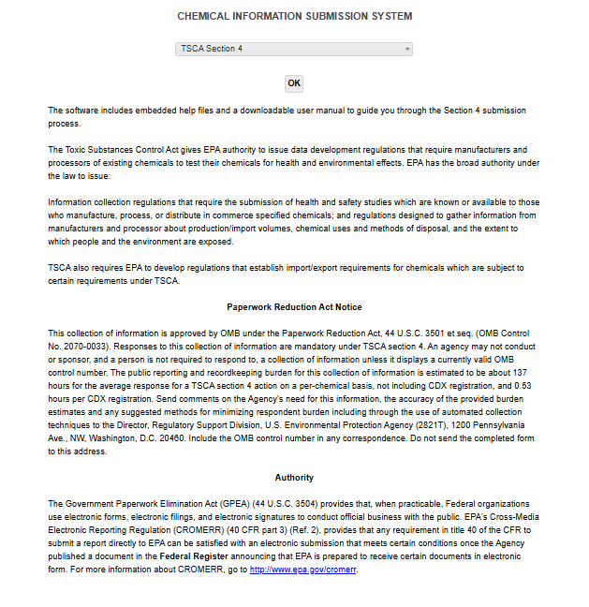
OMB Control No. 2070-0033
Expiration Date 3/31/2027
EPA Form No. 9600-034

Slide 3
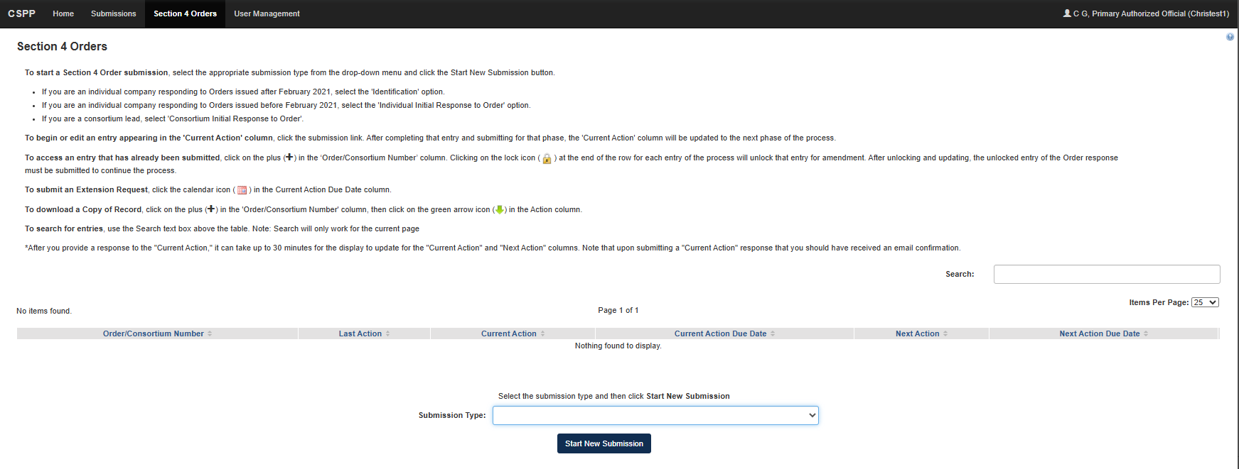
OMB Control No. 2070-0033
Expiration Date 3/31/2027
EPA Form No. 9600-034

Slide 4
OMB Control No. 2070-0033
Expiration Date 3/31/2027
Identification Response Form
EPA Form No. 9600-034

Slide 5
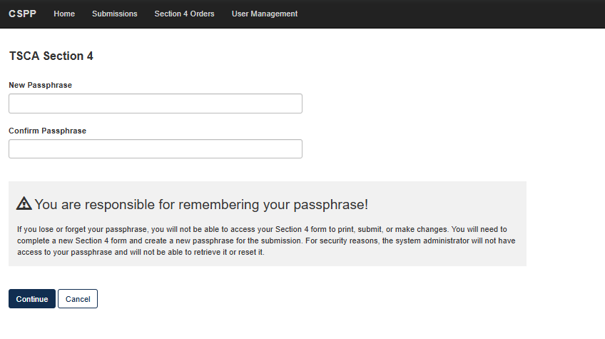
OMB Control No. 2070-0033
Expiration Date 3/31/2027
EPA Form No. 9600-034

Slide 6
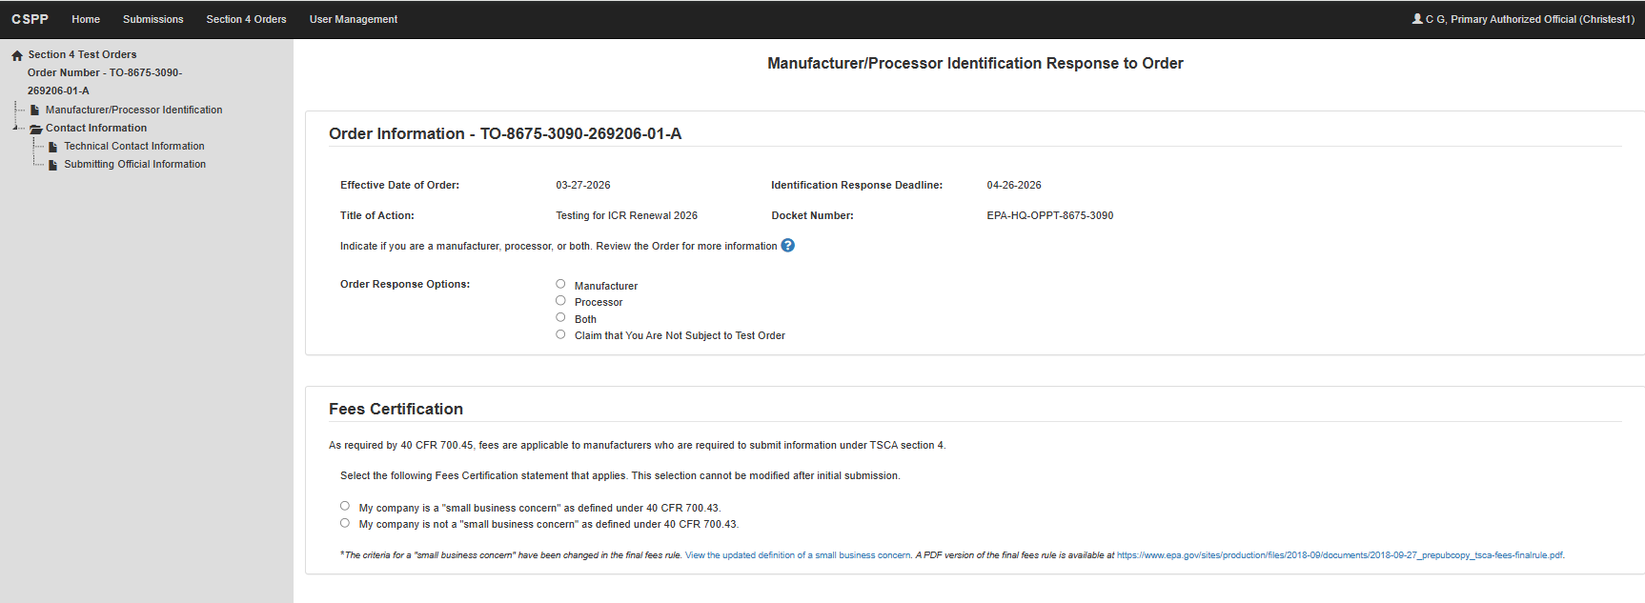
OMB Control No. 2070-0033
Expiration Date 3/31/2027
EPA Form No. 9600-034

Slide 7
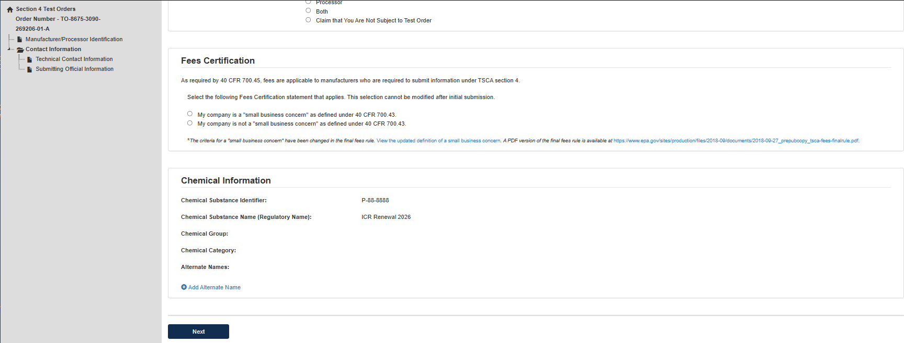
OMB Control No. 2070-0033
Expiration Date 3/31/2027
EPA Form No. 9600-034

Slide 8
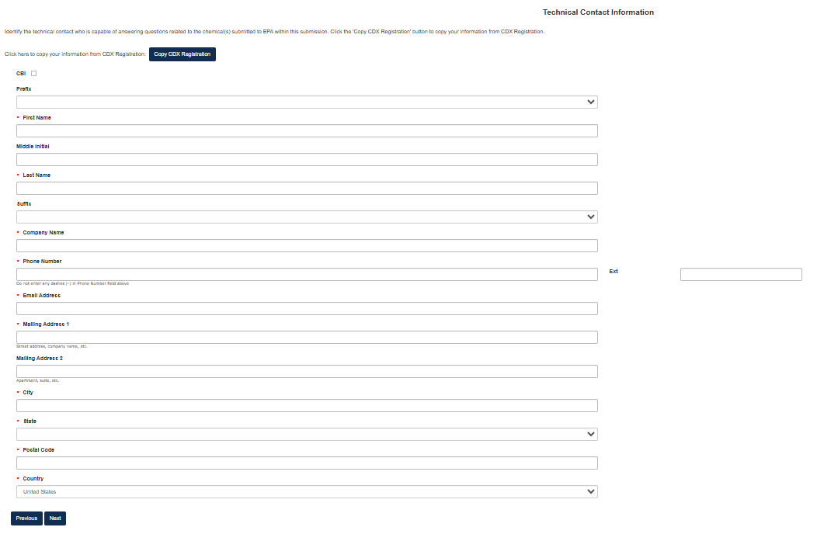
OMB Control No. 2070-0033
Expiration Date 3/31/2027
EPA Form No. 9600-034

Slide 9
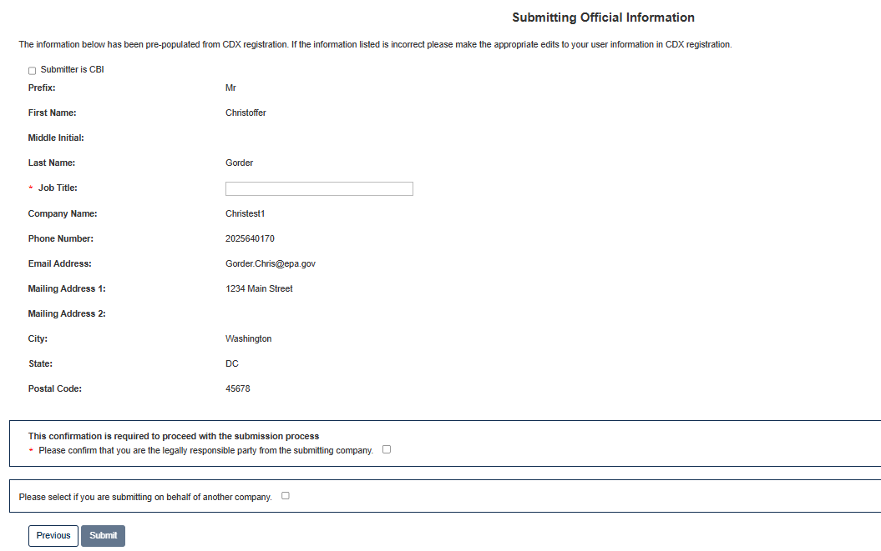
OMB Control No. 2070-0033
Expiration Date 3/31/2027
EPA Form No. 9600-034

Slide 10
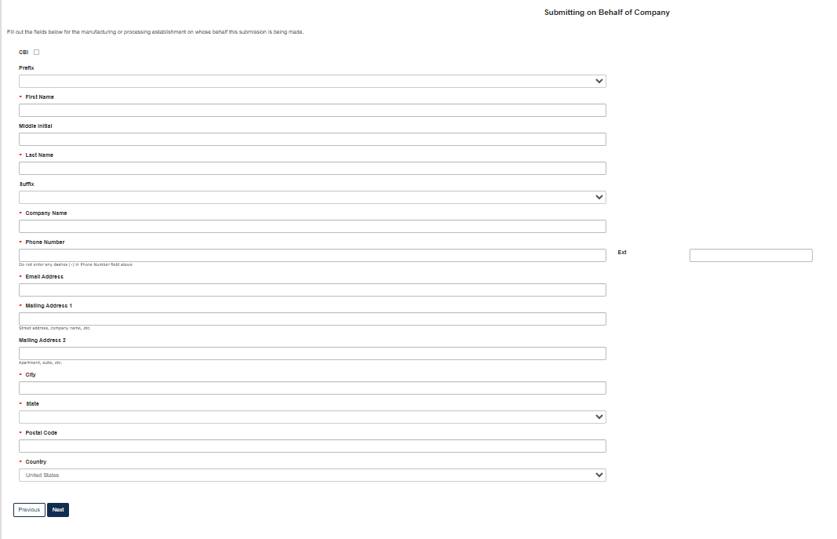
OMB Control No. 2070-0033
Expiration Date 3/31/2027
EPA Form No. 9600-034

Slide 11
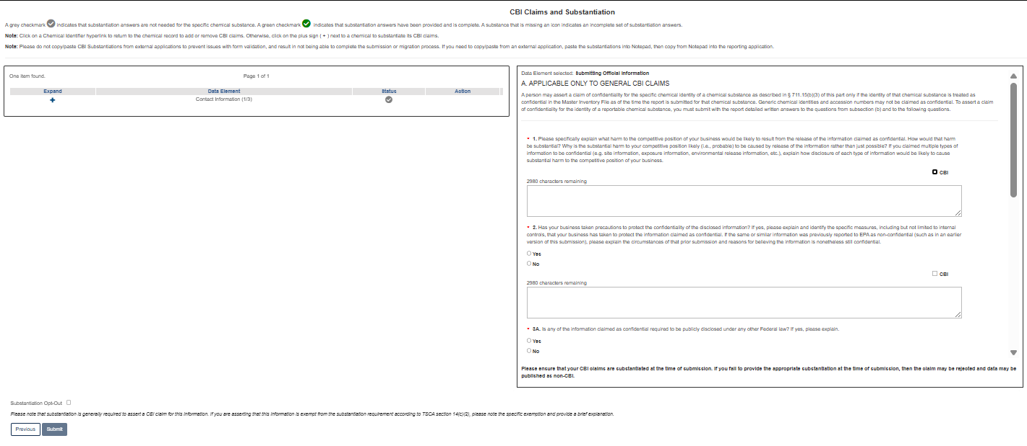
OMB Control No. 2070-0033
Expiration Date 3/31/2027
EPA Form No. 9600-034

Slide 12
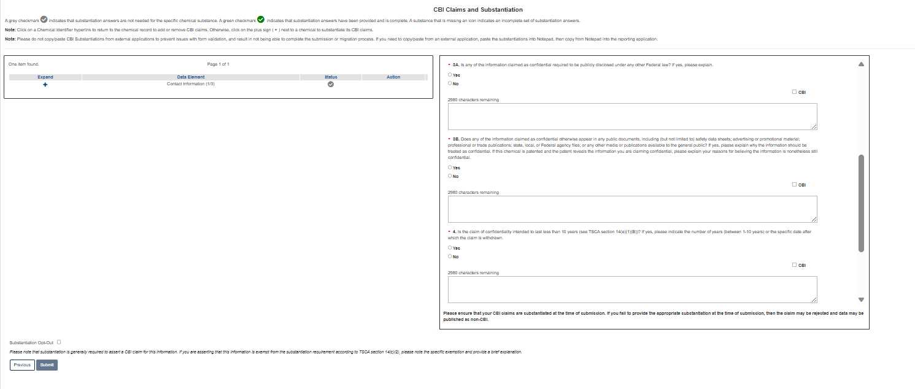
OMB Control No. 2070-0033
Expiration Date 3/31/2027
EPA Form No. 9600-034

Slide 13
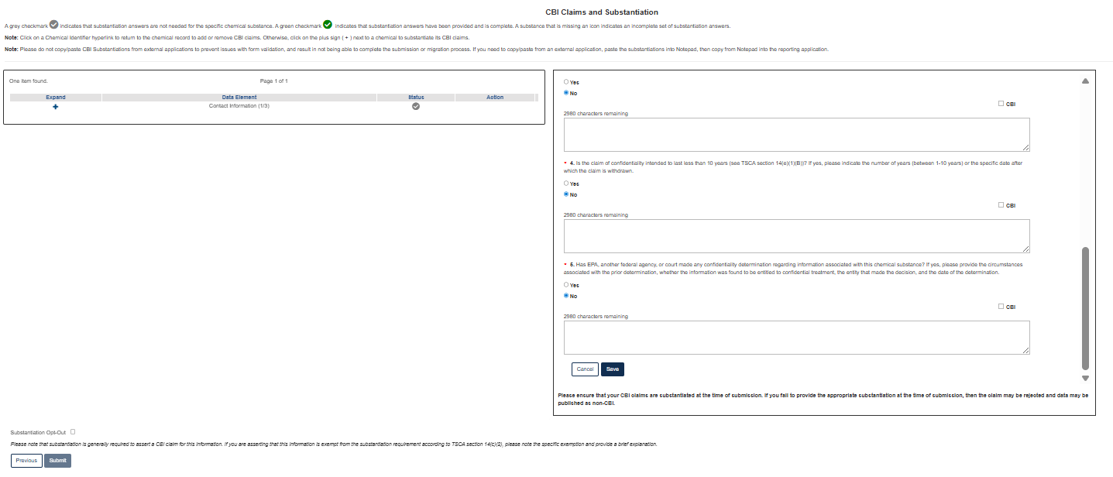
OMB Control No. 2070-0033
Expiration Date 3/31/2027
EPA Form No. 9600-034

Slide 14
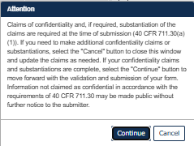
OMB Control No. 2070-0033
Expiration Date 3/31/2027
EPA Form No. 9600-034

Slide 15
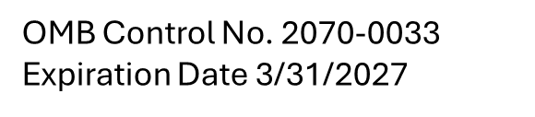
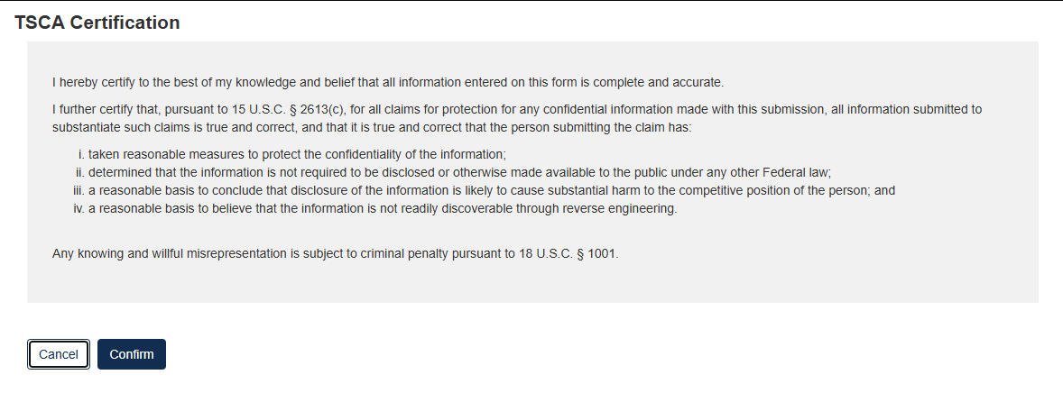
EPA Form No. 9600-034

Slide 16
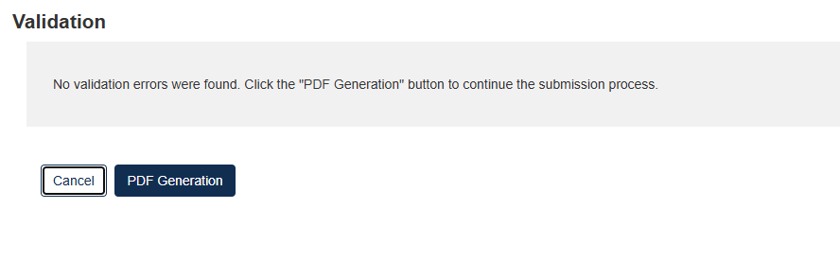
OMB Control No. 2070-0033
Expiration Date 3/31/2027
EPA Form No. 9600-034

Slide 17
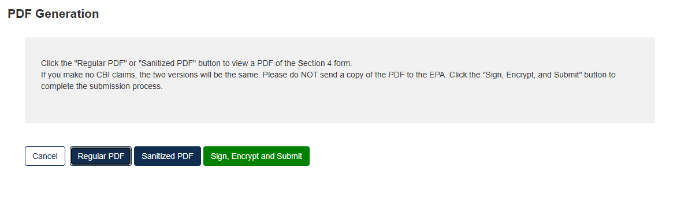
OMB Control No. 2070-0033
Expiration Date 3/31/2027
EPA Form No. 9600-034

Slide 18
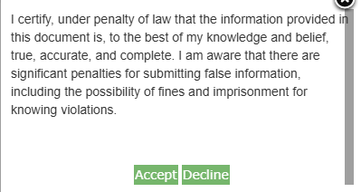
OMB Control No. 2070-0033
Expiration Date 3/31/2027
EPA Form No. 9600-034

Slide 19
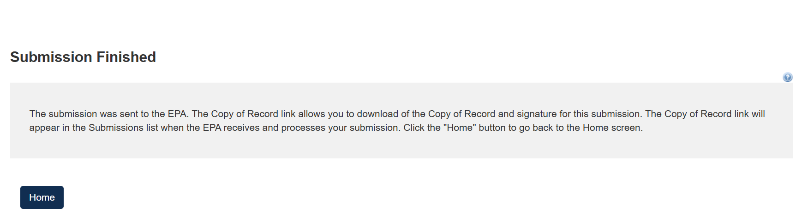
OMB Control No. 2070-0033
Expiration Date 3/31/2027
EPA Form No. 9600-034

Slide 20
OMB Control No. 2070-0033
Expiration Date 3/31/2027
Initial Response Form
EPA Form No. 9600-034

Slide 21
OMB Control No. 2070-0033
Expiration Date 3/31/2027
EPA Form No. 9600-034

Slide 22
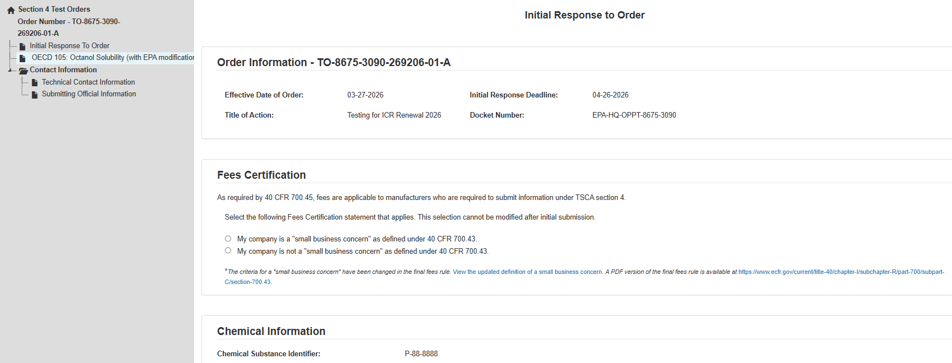
OMB Control No. 2070-0033
Expiration Date 3/31/2027
EPA Form No. 9600-034

Slide 23
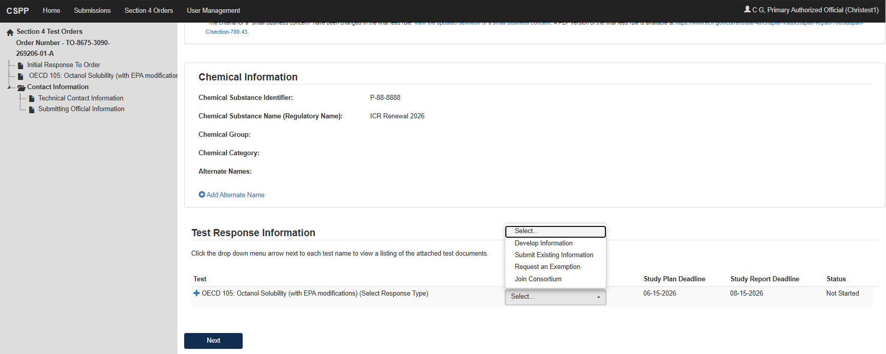
OMB Control No. 2070-0033
Expiration Date 3/31/2027
EPA Form No. 9600-034

Slide 24
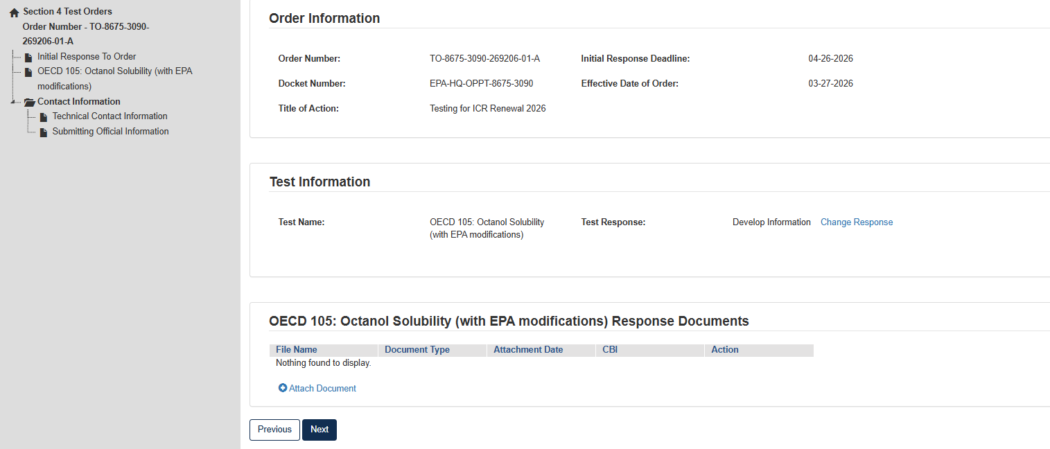
OMB Control No. 2070-0033
Expiration Date 3/31/2027
EPA Form No. 9600-034

Slide 25
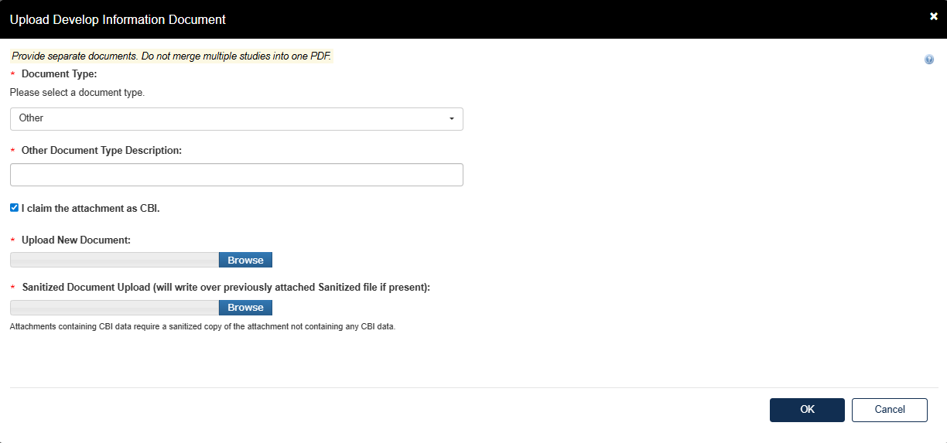
OMB Control No. 2070-0033
Expiration Date 3/31/2027
EPA Form No. 9600-034

Slide 26
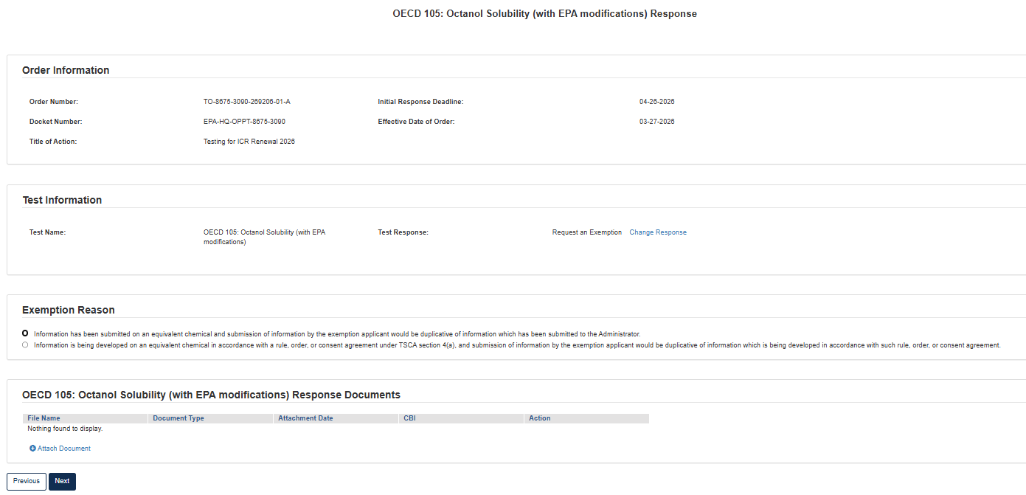
OMB Control No. 2070-0033
Expiration Date 3/31/2027
EPA Form No. 9600-034

Slide 27
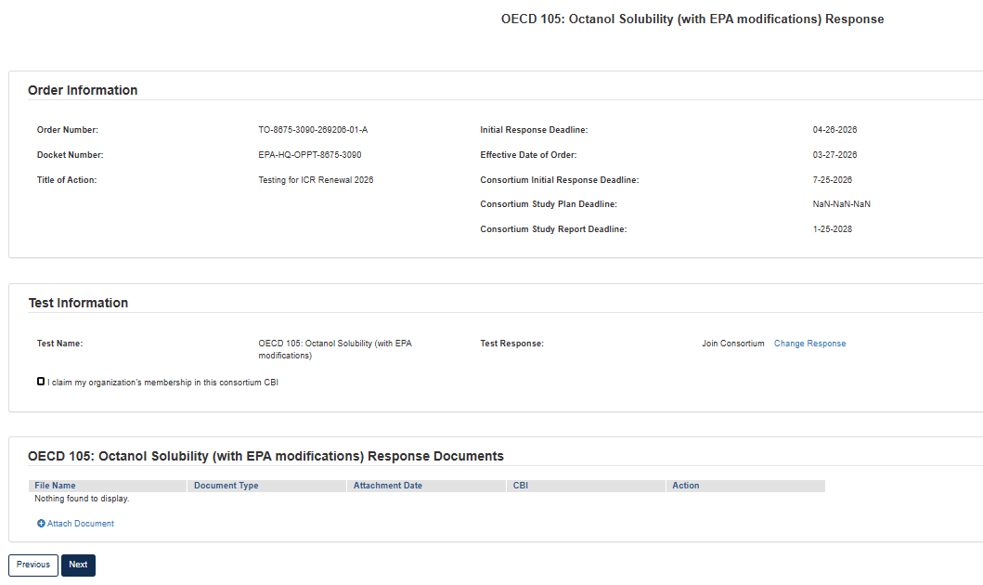
OMB Control No. 2070-0033
Expiration Date 3/31/2027
EPA Form No. 9600-034

Slide 28

OMB Control No. 2070-0033
Expiration Date 3/31/2027
EPA Form No. 9600-034

Slide 29
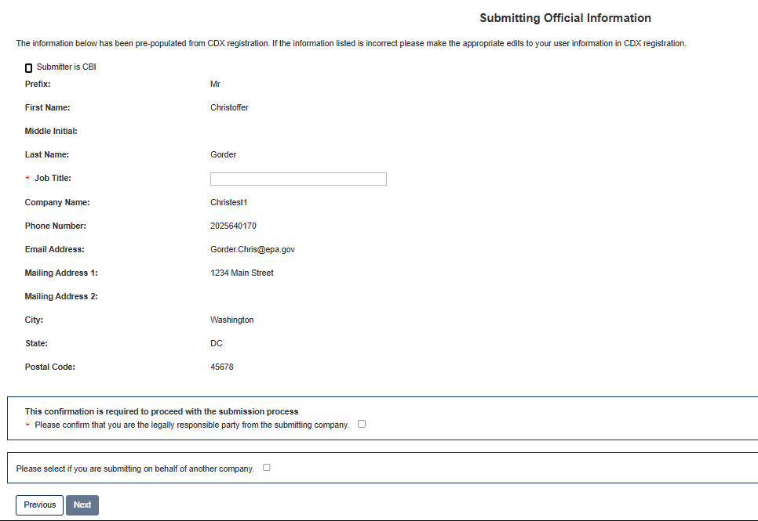
OMB Control No. 2070-0033
Expiration Date 3/31/2027
EPA Form No. 9600-034

Slide 30
OMB Control No. 2070-0033
Expiration Date 3/31/2027
EPA Form No. 9600-034

Slide 31
OMB Control No. 2070-0033
Expiration Date 3/31/2027
EPA Form No. 9600-034

Slide 32
OMB Control No. 2070-0033
Expiration Date 3/31/2027
EPA Form No. 9600-034

Slide 33
OMB Control No. 2070-0033
Expiration Date 3/31/2027
EPA Form No. 9600-034

Slide 34
OMB Control No. 2070-0033
Expiration Date 3/31/2027
EPA Form No. 9600-034

Slide 35
OMB Control No. 2070-0033
Expiration Date 3/31/2027
EPA Form No. 9600-034

Slide 36
OMB Control No. 2070-0033
Expiration Date 3/31/2027
EPA Form No. 9600-034

Slide 37
OMB Control No. 2070-0033
Expiration Date 3/31/2027
EPA Form No. 9600-034

Slide 38
OMB Control No. 2070-0033
Expiration Date 3/31/2027
EPA Form No. 9600-034

Slide 39
OMB Control No. 2070-0033
Expiration Date 3/31/2027
EPA Form No. 9600-034

Slide 40
OMB Control No. 2070-0033
Expiration Date 3/31/2027
Draft/Final Study Plan Form
EPA Form No. 9600-034

Slide 41
OMB Control No. 2070-0033
Expiration Date 3/31/2027
EPA Form No. 9600-034

Slide 42
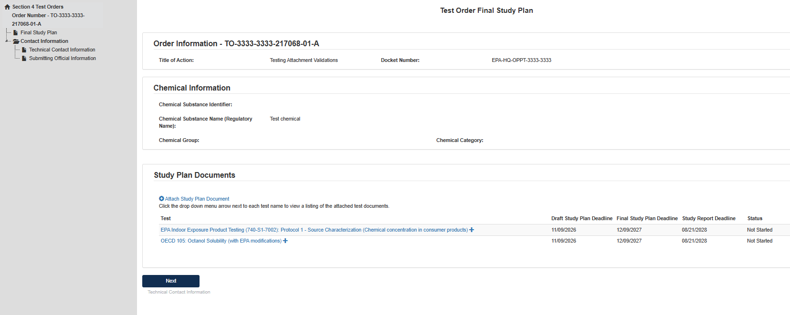
OMB Control No. 2070-0033
Expiration Date 3/31/2027
EPA Form No. 9600-034

Slide 43
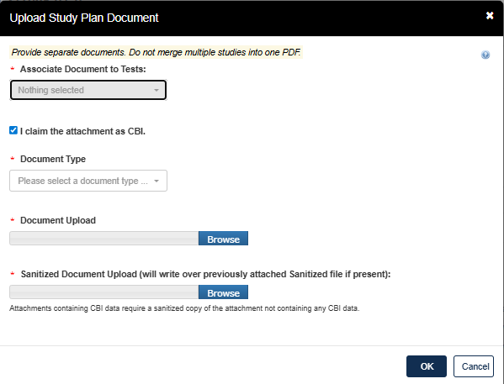
OMB Control No. 2070-0033
Expiration Date 3/31/2027
EPA Form No. 9600-034

Slide 44
OMB Control No. 2070-0033
Expiration Date 3/31/2027
EPA Form No. 9600-034

Slide 45
OMB Control No. 2070-0033
Expiration Date 3/31/2027
EPA Form No. 9600-034

Slide 46
OMB Control No. 2070-0033
Expiration Date 3/31/2027
EPA Form No. 9600-034

Slide 47
OMB Control No. 2070-0033
Expiration Date 3/31/2027
EPA Form No. 9600-034

Slide 48
OMB Control No. 2070-0033
Expiration Date 3/31/2027
EPA Form No. 9600-034

Slide 49
OMB Control No. 2070-0033
Expiration Date 3/31/2027
EPA Form No. 9600-034

Slide 50
OMB Control No. 2070-0033
Expiration Date 3/31/2027
EPA Form No. 9600-034

Slide 51
OMB Control No. 2070-0033
Expiration Date 3/31/2027
EPA Form No. 9600-034

Slide 52
OMB Control No. 2070-0033
Expiration Date 3/31/2027
EPA Form No. 9600-034

Slide 53
OMB Control No. 2070-0033
Expiration Date 3/31/2027
EPA Form No. 9600-034

Slide 54
OMB Control No. 2070-0033
Expiration Date 3/31/2027
EPA Form No. 9600-034

Slide 55
OMB Control No. 2070-0033
Expiration Date 3/31/2027
EPA Form No. 9600-034

