Slide 1


Foreign Purchaser Acknowledgment Statement of Unregistered Pesticides
(Salesforce Application)
OMB Control No. 2070-0027
EPA ICR No. 0161
Attachment A
Form No. 9600-026

Slide 2

Login Screen
Form No. 9600-026

Slide 3
PRA Burden Screen
Paperwork Reduction Notice: This collection of information is approved by OMB under the Paperwork Reduction Act, 44 U.S.C. 3501 et seq. (OMB Control No. 2070-0027). Responses to this collection of information are mandatory for certain persons, as specified at 40 CFR 152.25(f). An agency may not conduct or sponsor, and a person is not required to respond to, a collection of information unless it displays a currently valid OMB control number. The public reporting and recordkeeping burden for this collection of information is estimated to be 1-8 hours per response. Send comments on the Agency’s need for this information, the accuracy of the provided burden estimates and any suggested methods for minimizing respondent burden to the Deputy Director, Data and Enterprise Programs Division, U.S. Environmental Protection Agency (2821T), 1200 Pennsylvania Ave., NW, Washington, D.C. 20460. Include the OMB control number in any correspondence. Do not send the completed form to this address.
Form No. 9600-026

Slide 4
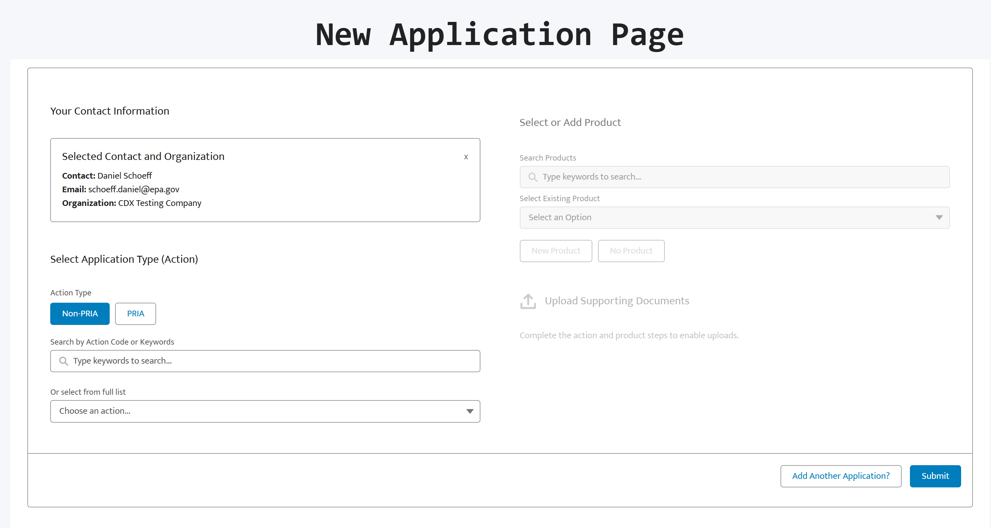
OMB Control No. 2070-0027
EPA ICR No. 0161
Paperwork Reduction Notice: This collection of information is approved by OMB under the Paperwork Reduction Act, 44 U.S.C. 3501 et seq. (OMB Control No. 2070-0027). Responses to this collection of information are mandatory for certain persons, as specified at 40 CFR 152.25(f). An agency may not conduct or sponsor, and a person is not required to respond to, a collection of information unless it displays a currently valid OMB control number. The public reporting and recordkeeping burden for this collection of information is estimated to be 1-8 hours per response. Send comments on the Agency’s need for this information, the accuracy of the provided burden estimates and any suggested methods for minimizing respondent burden to the Deputy Director, Data and Enterprise Programs Division, U.S. Environmental Protection Agency (2821T), 1200 Pennsylvania Ave., NW, Washington, D.C. 20460. Include the OMB control number in any correspondence. Do not send the completed form to this address.
Form No. 9600-026

Slide 5
OMB Control No. 2070-0027
EPA ICR No. 0161
v
3. Respondents would select “No Product”
1. Respondents would select the Action Type
4. Respondents would upload the FPAS
Paperwork Reduction Notice: This collection of information is approved by OMB under the Paperwork Reduction Act, 44 U.S.C. 3501 et seq. (OMB Control No. 2070-0027). Responses to this collection of information are mandatory for certain persons, as specified at 40 CFR 152.25(f). An agency may not conduct or sponsor, and a person is not required to respond to, a collection of information unless it displays a currently valid OMB control number. The public reporting and recordkeeping burden for this collection of information is estimated to be 1-8 hours per response. Send comments on the Agency’s need for this information, the accuracy of the provided burden estimates and any suggested methods for minimizing respondent burden to the Deputy Director, Data and Enterprise Programs Division, U.S. Environmental Protection Agency (2821T), 1200 Pennsylvania Ave., NW, Washington, D.C. 20460. Include the OMB control number in any correspondence. Do not send the completed form to this address.
2. Respondents would select the Action: Foreign Purchaser Acknowledgement Statement
Form No. 9600-026
5. Respondents would click SUBMIT

