Slide 1
Cosmetics Direct
Screenshots of Cosmetic Product Facility Registration and Cosmetic Product Listing
October 2026

Slide 2
Table of Contents
Creating a New Cosmetic Product Facility Registration 5
Creating a New Cosmetic Product Listing 13
Submission Actions and Status 26

Slide 3
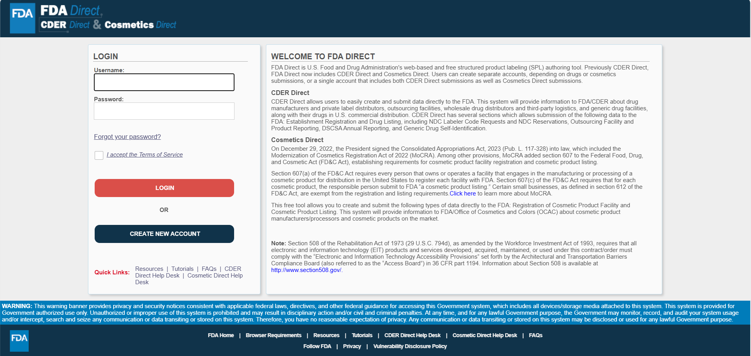
Homepage of Cosmetics Direct
Click here to access the FDA Direct portal.

Slide 4
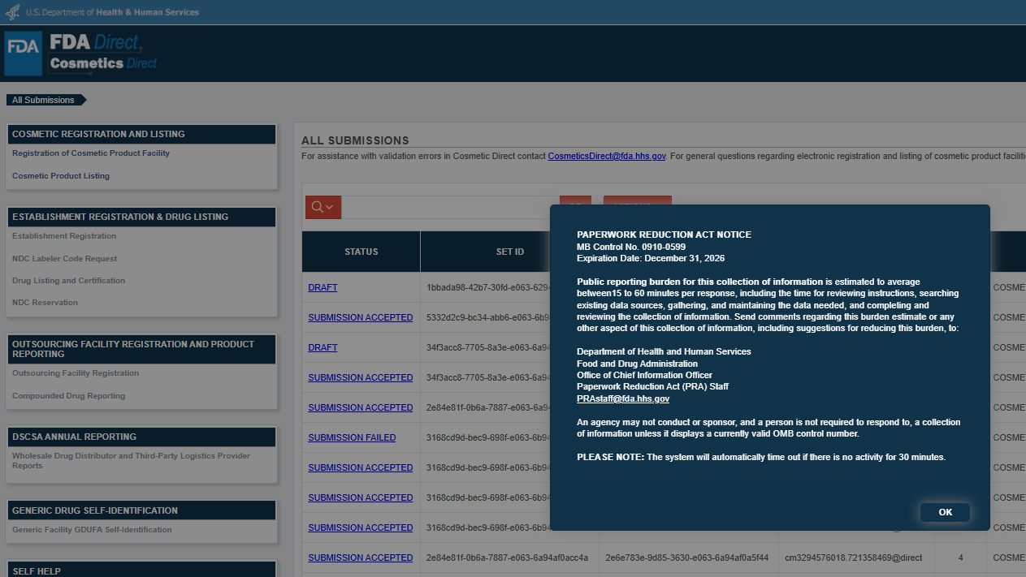
A burden statement and standard PRA information will appear in the welcome pop-up each time a user logs in.

Slide 5
I. CREATING A NEW COSMETIC PRODUCT FACILITY REGISTRATION

Slide 6
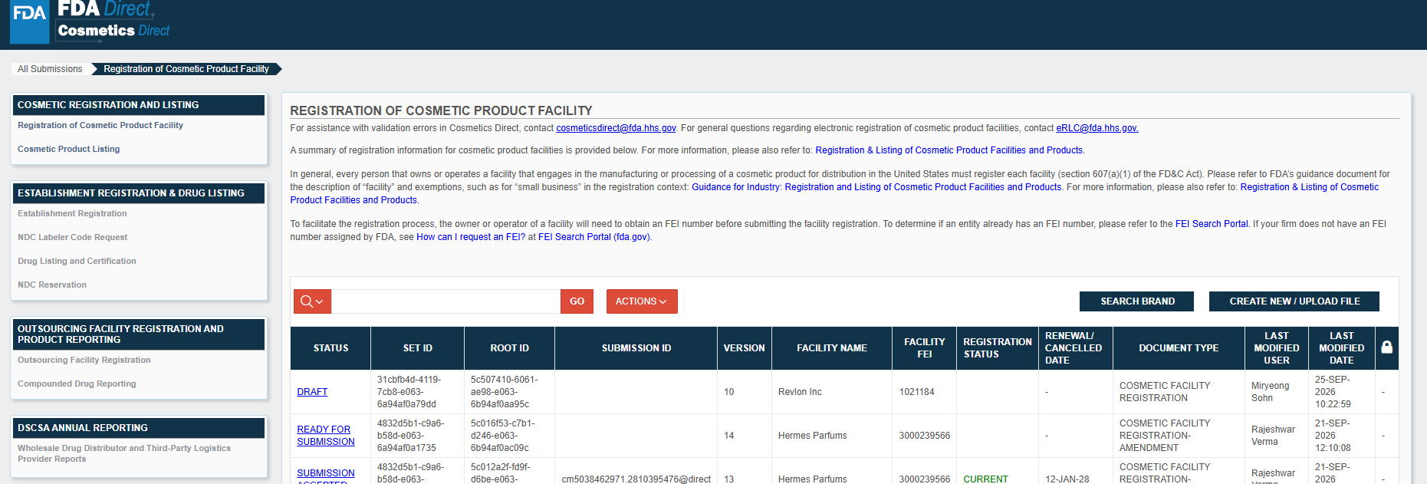
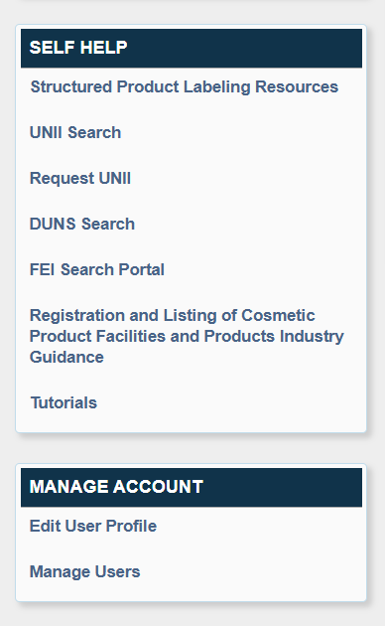
Registration of Cosmetic Product Facility Homepage
The Homepage provides access to Self Help resources, including user guides and tutorials, as well as links to webpages and related guidance for industry.
Click on ‘CREATE NEW/UPLOAD FILE’ to start a new submission.

Slide 7
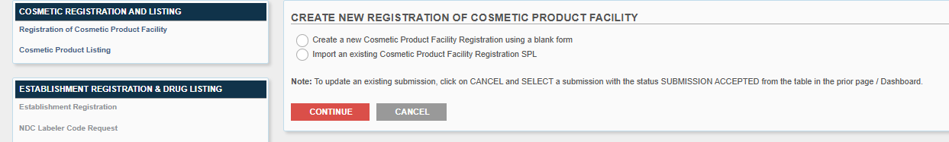
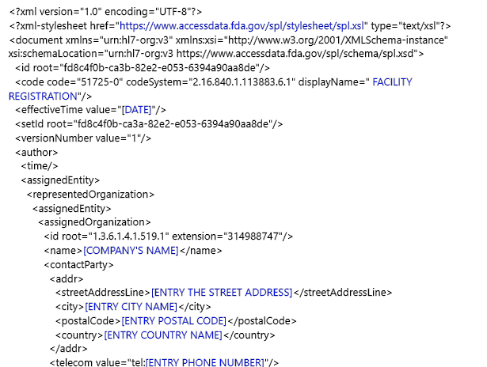
Choose to create a new Facility Registration or import an existing SPL.
Note: A user can upload an existing Cosmetic Product Facility Registration SPL (Structured Product Labeling), a ZIP file that contains the .xml file. SPL is a document markup standard approved by Health Level Seven (HL7) and adopted by FDA as a mechanism for exchanging product and facility information.
Zip File Example: An example to what an .xml format could look like.

Slide 8
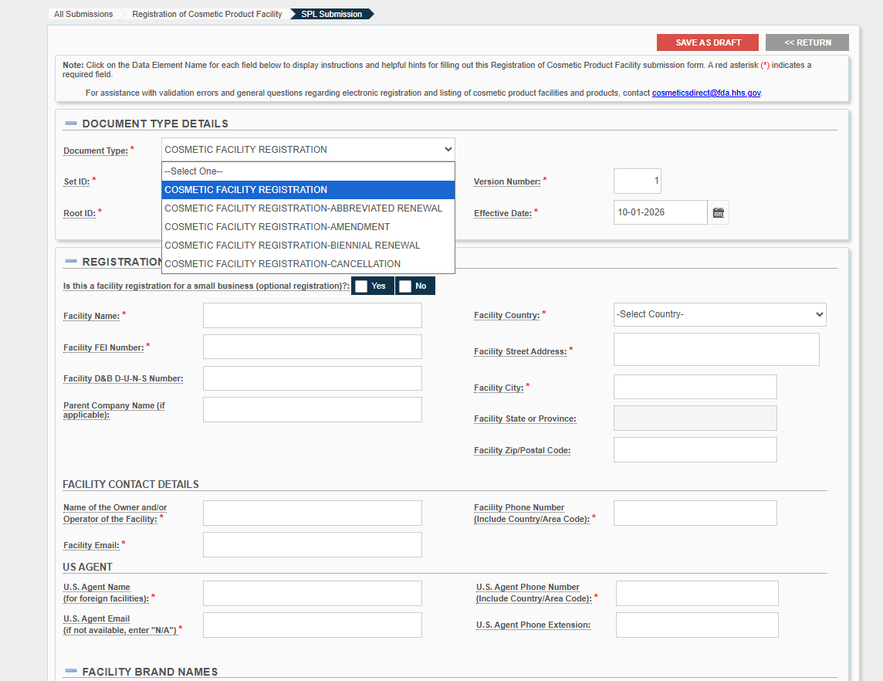
Enter the information in each field. Fields marked with a red asterisk (*) are required.
Choose the appropriate ‘DOCUMENT TYPE’.
Enter the information for ‘U.S. AGENT’ (only for foreign facilities).

Slide 9
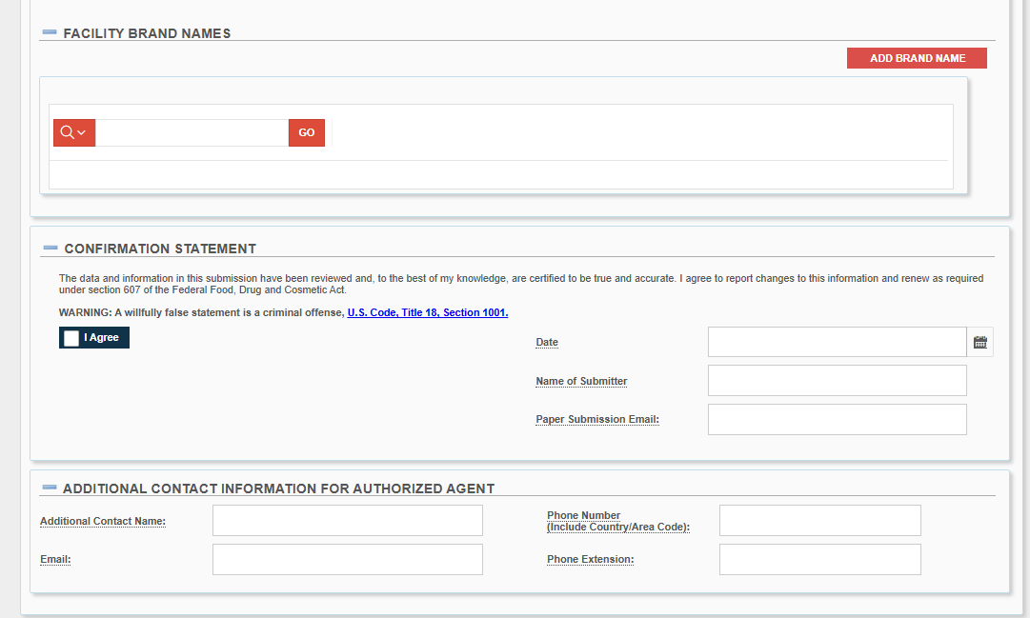
Enter the information in each field. Fields marked with a red asterisk (*) are required.
Click on ‘ADD BRAND NAME’ to enter brand information.

Slide 10
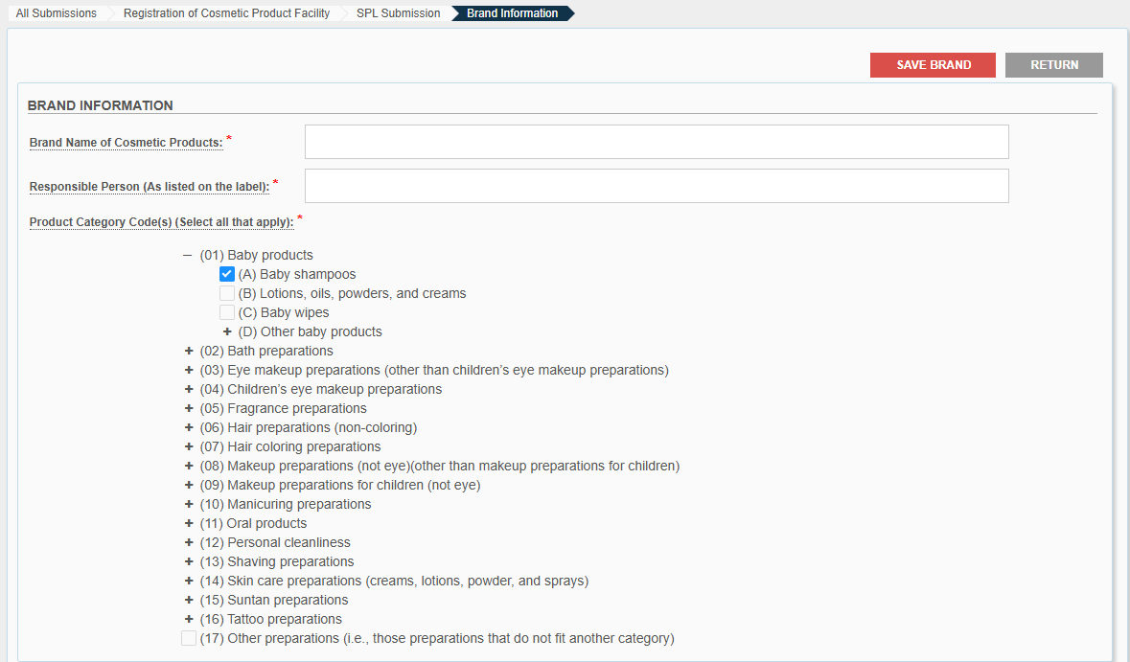
Enter the information in each field. Fields marked with a red asterisk (*) are required.

Slide 11
Enter the information in each field, if applicable.

Slide 12
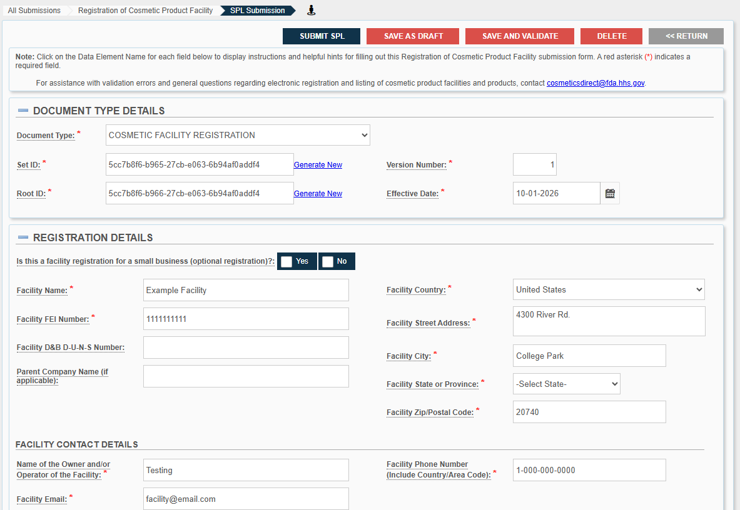
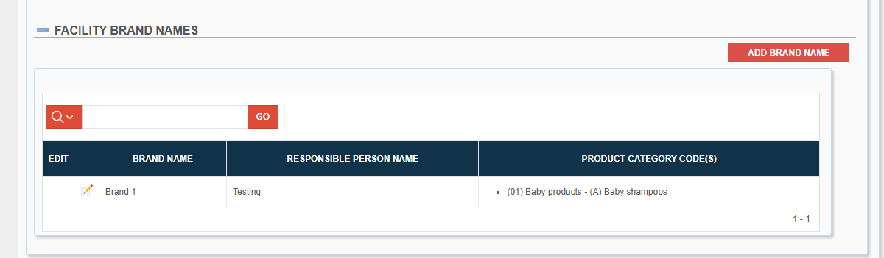
Once you have entered all required information, proceed to Section III for instructions on submission actions and status.

Slide 13
II. CREATING A NEW COSMETIC PRODUCT LISTING

Slide 14
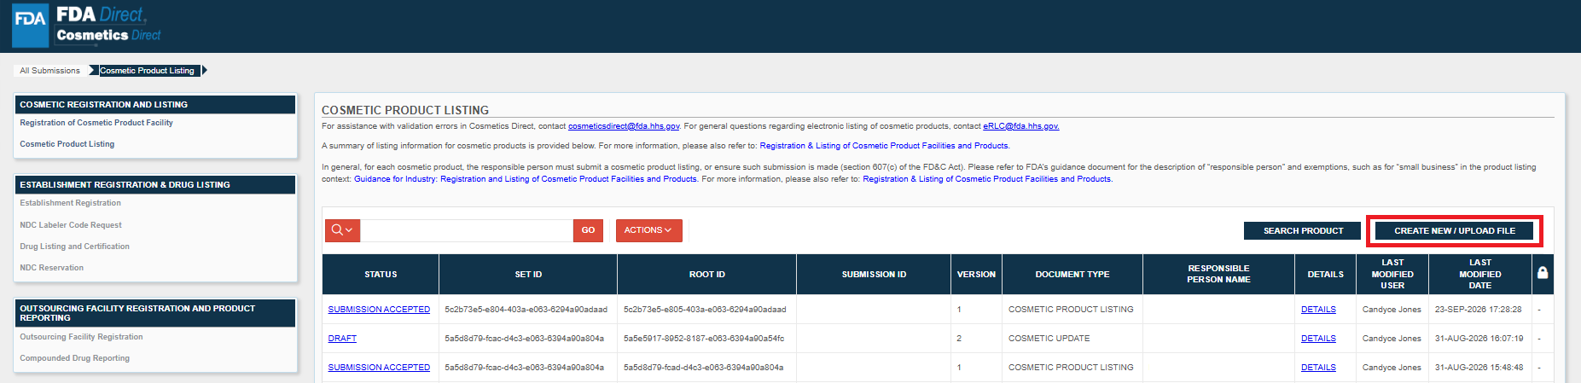
Registration of Cosmetic Product Listing Homepage
The Homepage provides access to Self Help resources, including user guides and tutorials, as well as links to webpages and related guidance for industry.
Click on ‘CREATE NEW/UPLOAD FILE’ to start a new submission.

Slide 15
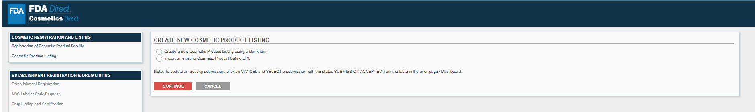
Choose to create a new Product Listing or import an existing SPL.
Note: A user can upload an existing Cosmetic Product Listing SPL (Structured Product Labeling), a ZIP file that contains the .xml file. SPL is a document markup standard approved by Health Level Seven (HL7) and adopted by FDA as a mechanism for exchanging product and facility information.
Zip File Example: An example to what an .xml format could look like.

Slide 16
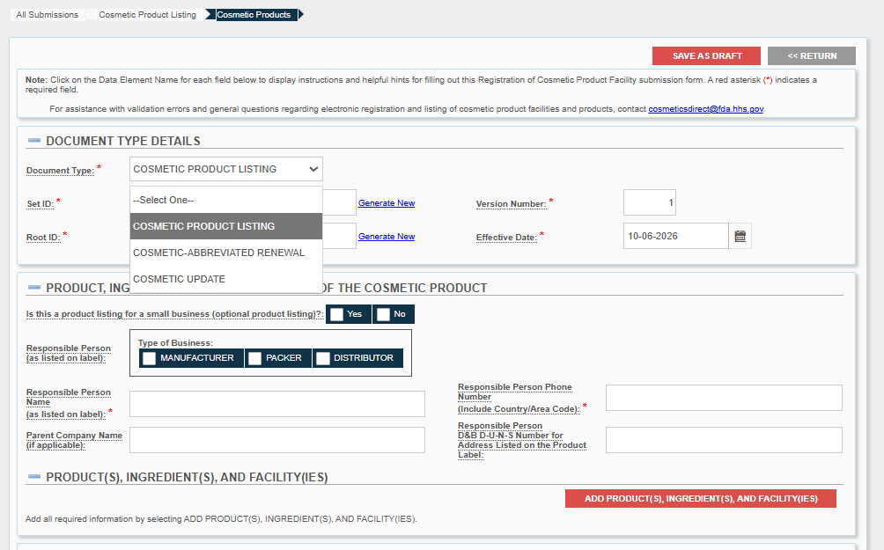
Enter the information in each field. Fields marked with a red asterisk (*) are required.
Choose the appropriate ‘DOCUMENT TYPE’.

Slide 17
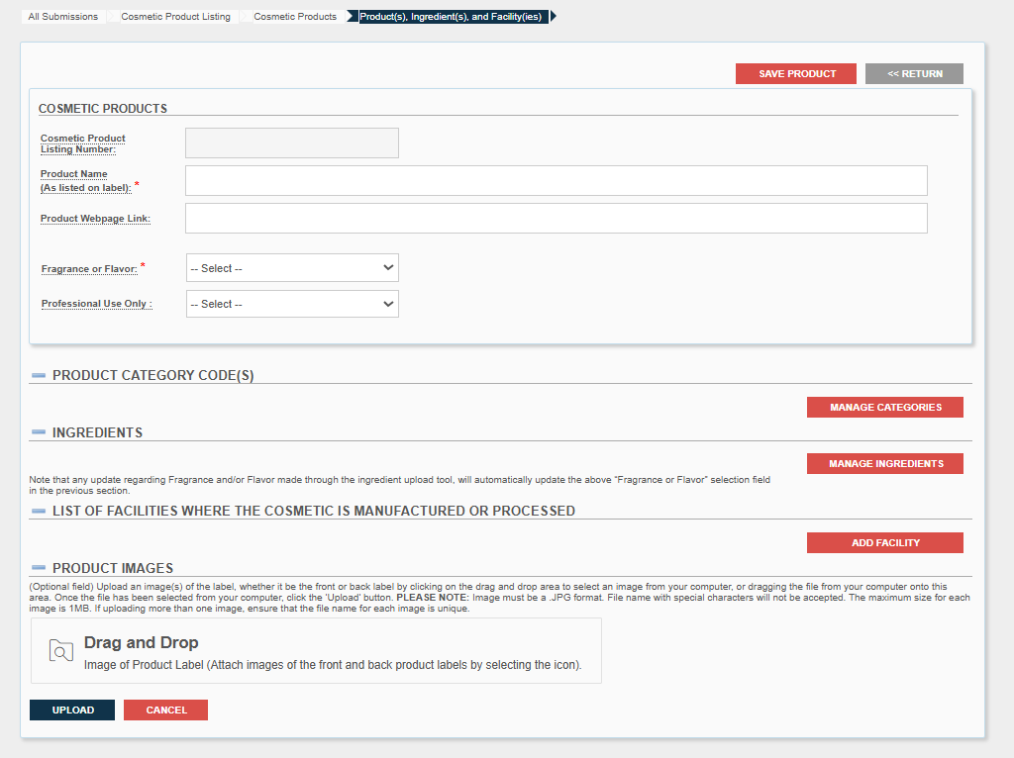
Enter the information in each field. Fields marked with a red asterisk (*) are required.

Slide 18
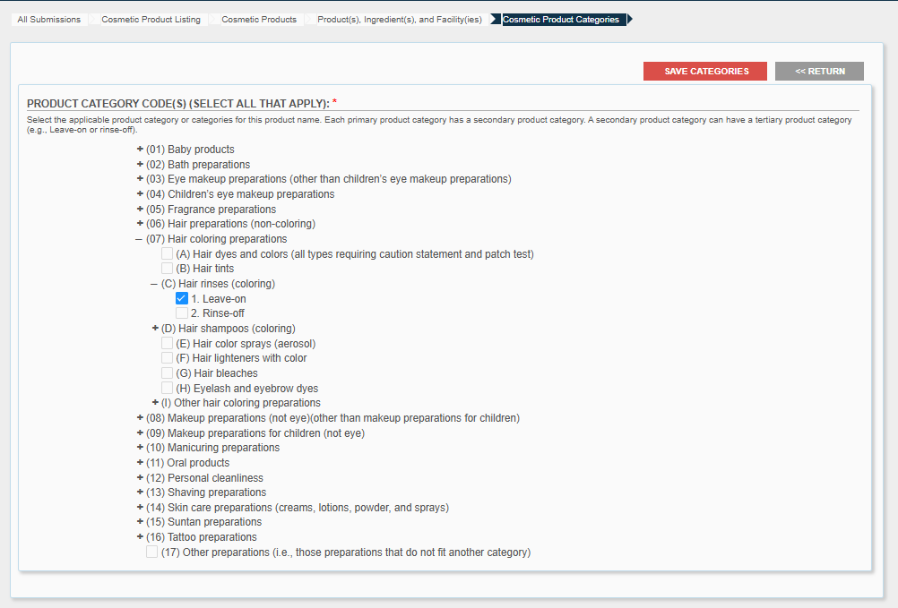
Enter the information in each field. Fields marked with a red asterisk (*) are required.

Slide 19
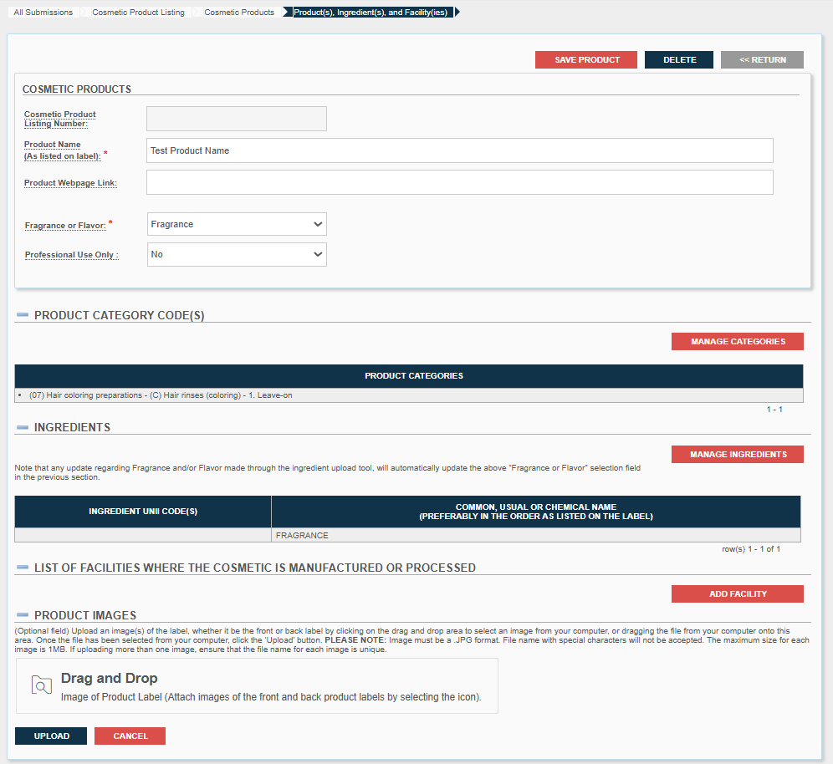
Enter the information in each field. Fields marked with a red asterisk (*) are required.

Slide 20
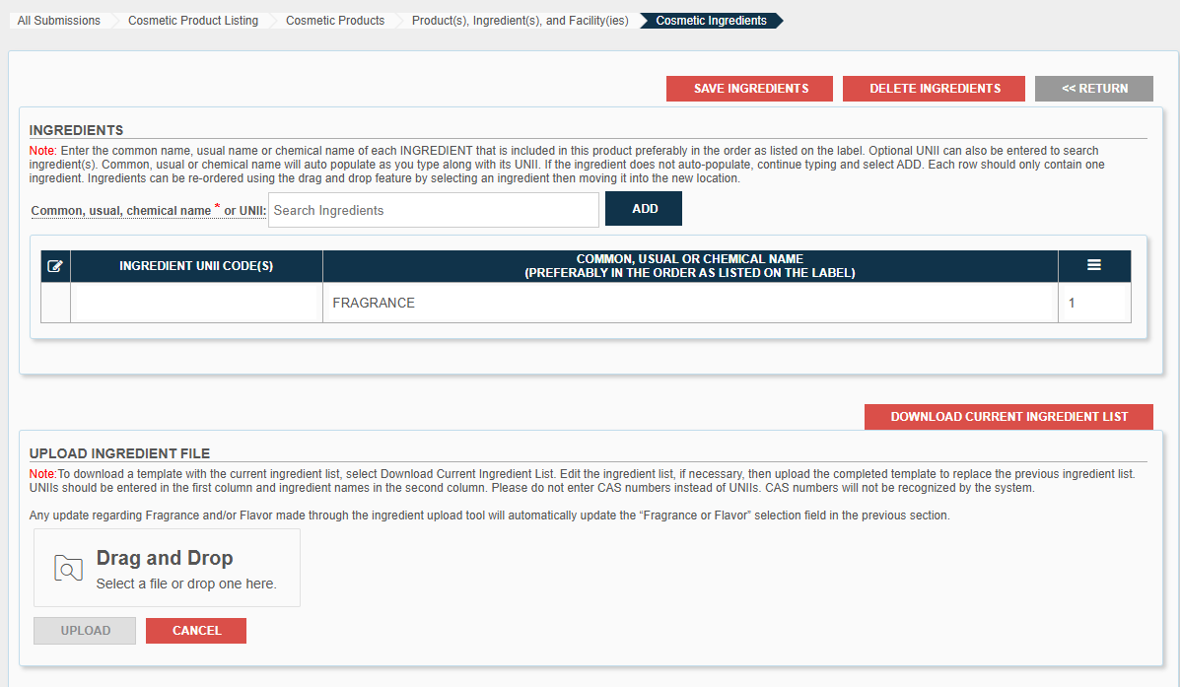
Enter the information in each field. Fields marked with a red asterisk (*) are required.

Slide 21
Enter the information in each field. Fields marked with a red asterisk (*) are required.

Slide 22
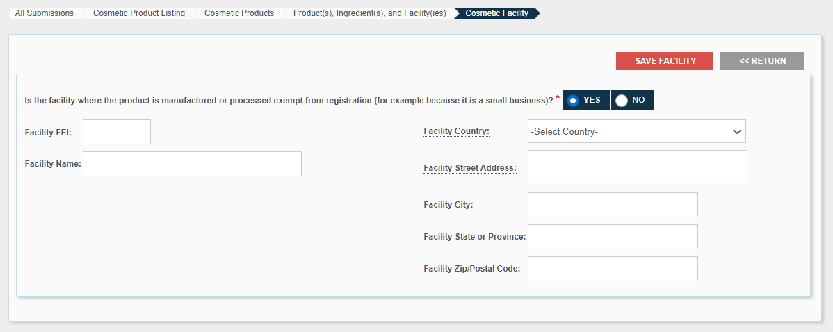
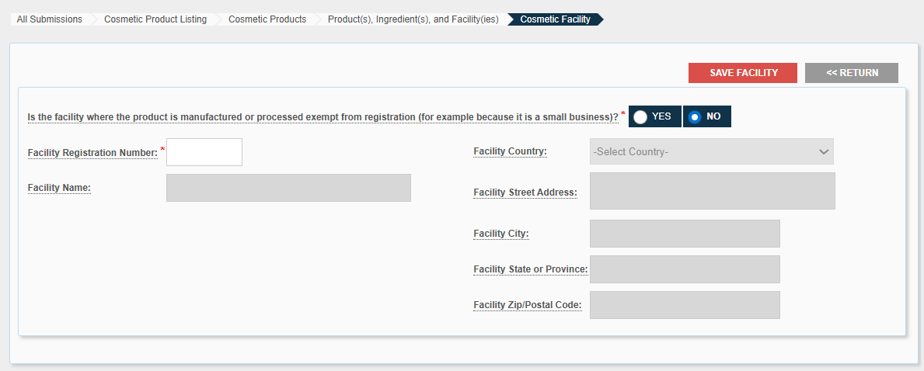
If ‘YES’ is selected for the question, then all fields are optional.
If ‘NO’ is selected for the question, then the ‘Facility FEI’ number is mandatory, and the name/address fields are greyed out.

Slide 23
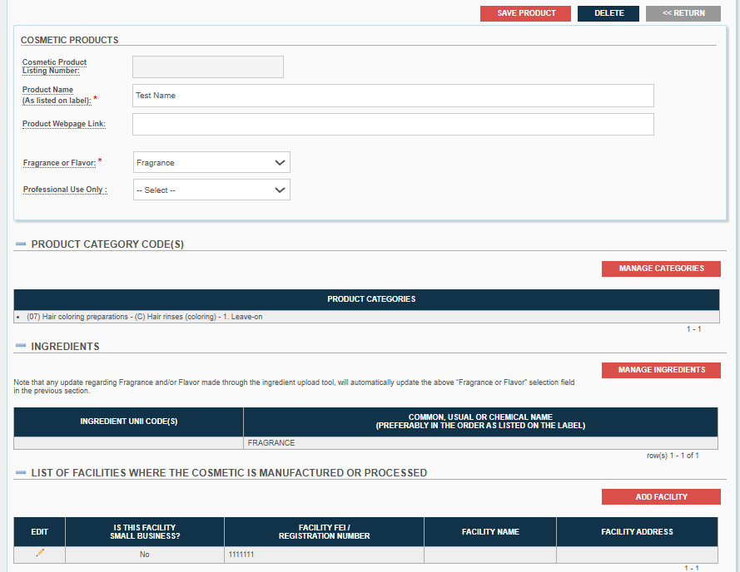
Enter the information in each field. Fields marked with a red asterisk (*) are required.

Slide 24
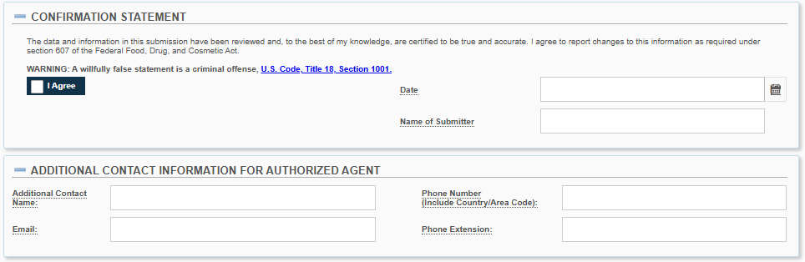
Enter the information in each field, if applicable.

Slide 25
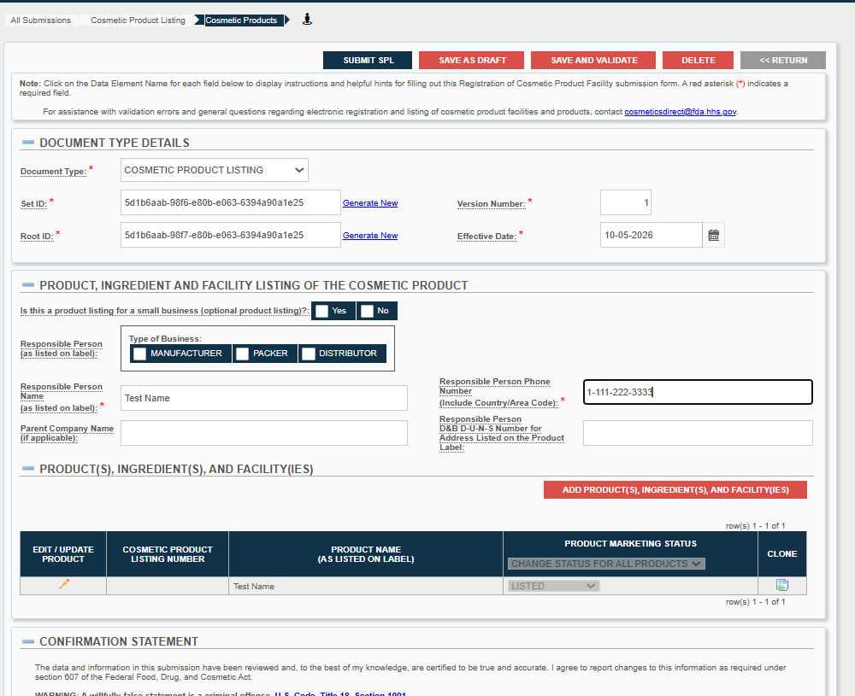
Once you have entered all required information, proceed to Section III for instructions on submission actions and status.

Slide 26
III. SUBMISSION ACTIONS AND STATUS

Slide 27
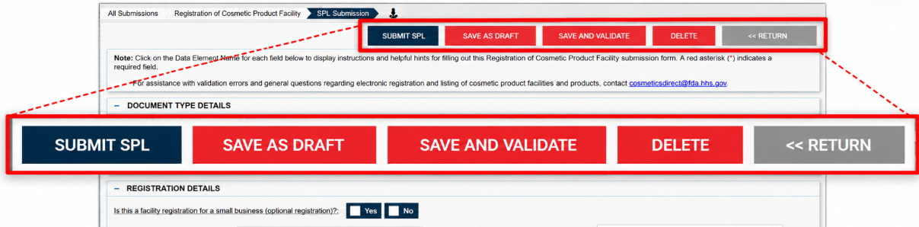
Actions You Can Take on Your Submission
SUBMIT SPL: Submits the SPL to FDA for validation and processing.
SAVE AS DRAFT: Saves your progress without submitting to FDA.
SAVE AND VALIDATE: Checks the SPL for errors before submission. This does not submit the SPL to FDA.
DELETE: Removes the submission from your account.
RETURN: Returns to the Cosmetics Product Listing Submissions home page without saving changes.

Slide 28
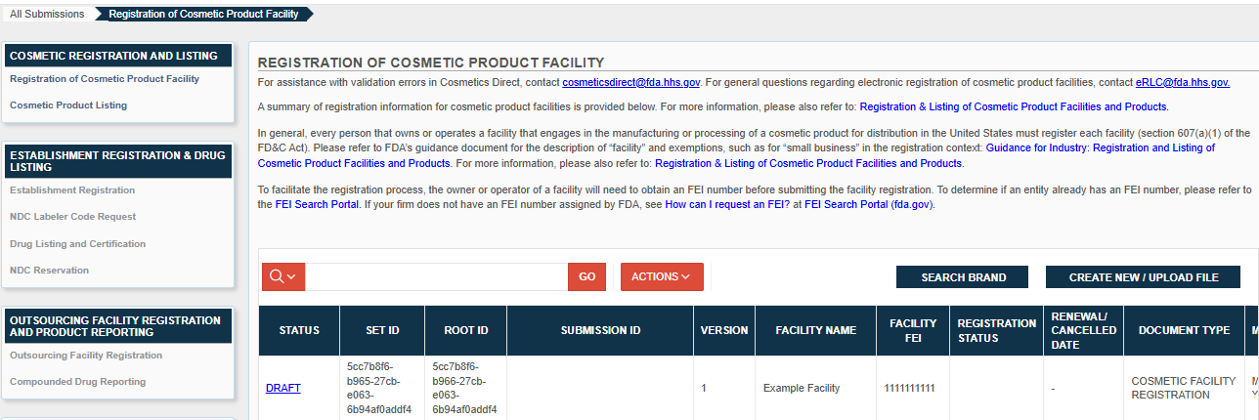
You can view the status of your submission on the homepage
DRAFT: The submission has been saved but not yet validated or submitted.
VALIDATION IN PROGRESS: The system is performing the initial validation.
VALIDATION FAILURE: One or more errors were identified during the initial validation. The submission can be opened to view and correct the identified error(s).
READY FOR SUBMISSION: The initial validation is complete with no errors identified.
AWAITING ACCEPTANCE: The submission has been sent to FDA and is awaiting acceptance.
SUBMISSION ACCEPTED: FDA has successfully accepted the submission.
SUBMISSION FAILED: The submission did not pass validation. The submission can be opened to view and correct the identified error(s).

