Slide 1

Oral Health Illustrations

Slide 2
Blueprint of Oral Health Care
Last updated: July 6th, 2023

Slide 3
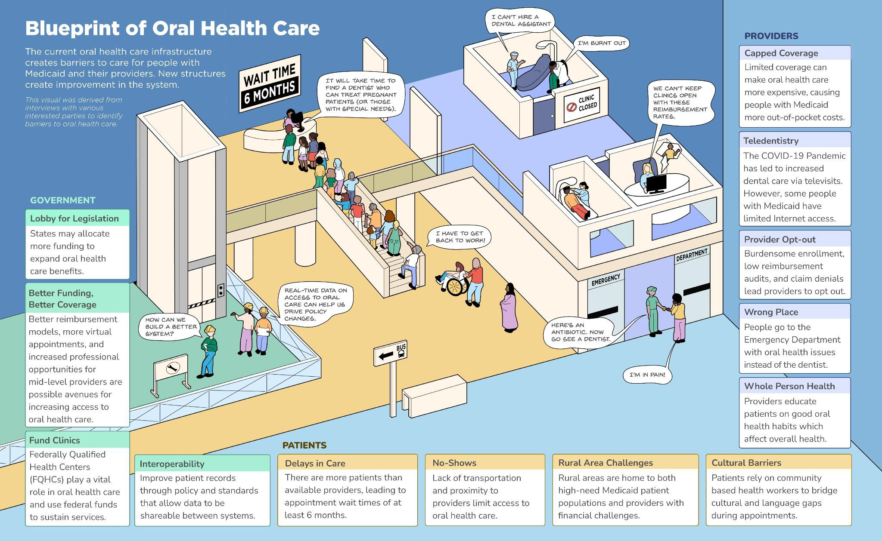

Slide 4
Principles of Oral Health Care
Last updated: July 6th, 2023

Slide 5
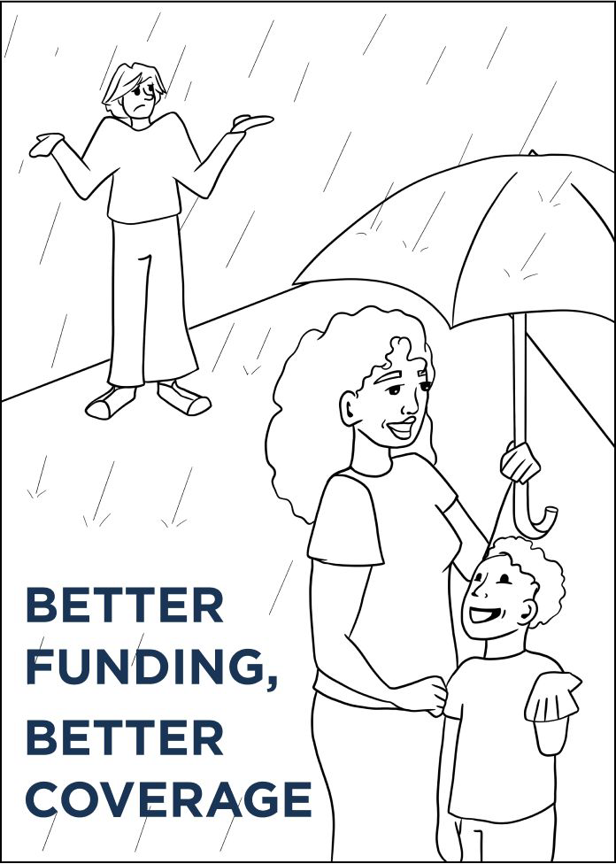
Better Funding, Better Coverage
Adults with Medicaid need better oral health coverage. Limiting services lead to patients paying out-of-pocket costs or avoiding oral health care until there is an emergency. State policy changes can designate funding for expanding oral health covered services

Slide 6
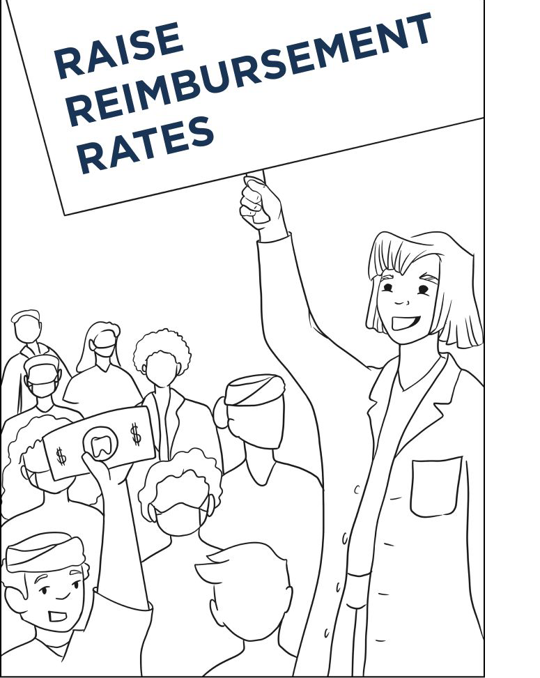
Raise Reimbursement Rates
Oral health care providers want reimbursement rates increased due to inﬂation, supply shortages and labor costs. State policy changes can raise reimbursement rates for Medicaid providers.

Slide 7
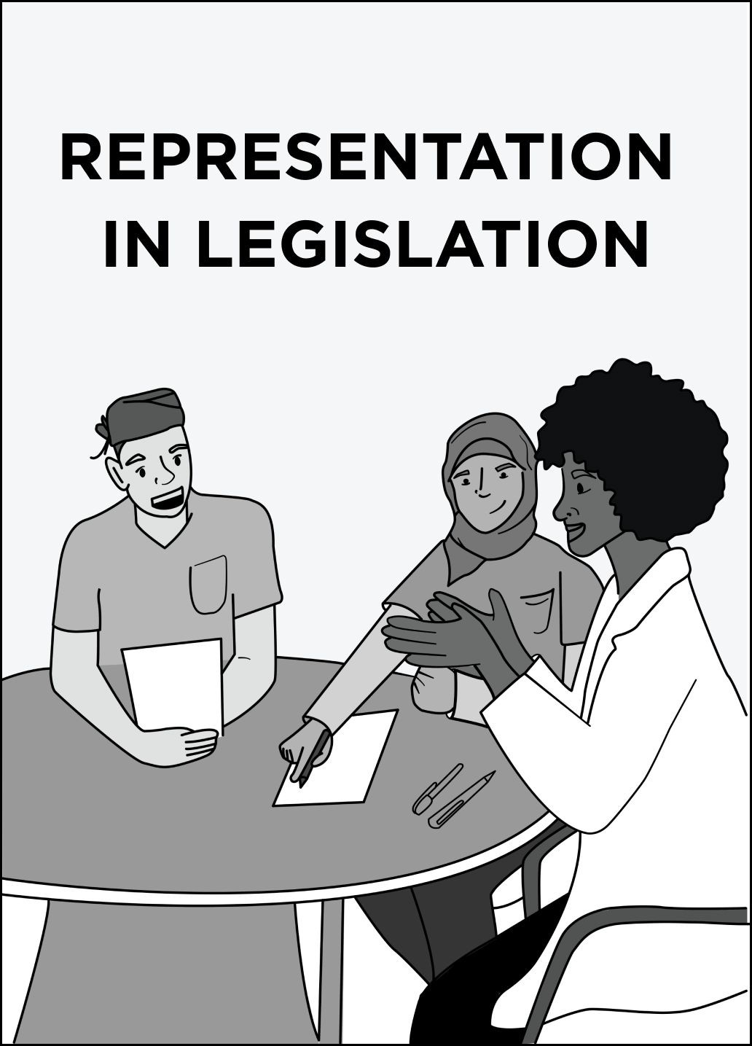
Representation in Legislation
Oral health care providers have ﬁrsthand knowledge of how state legislation affects patients and providers. These experienced individuals must be consulted as states write policies and manage Medicaid oral health care programs. Advocates and community health works should also be involved.

Slide 8
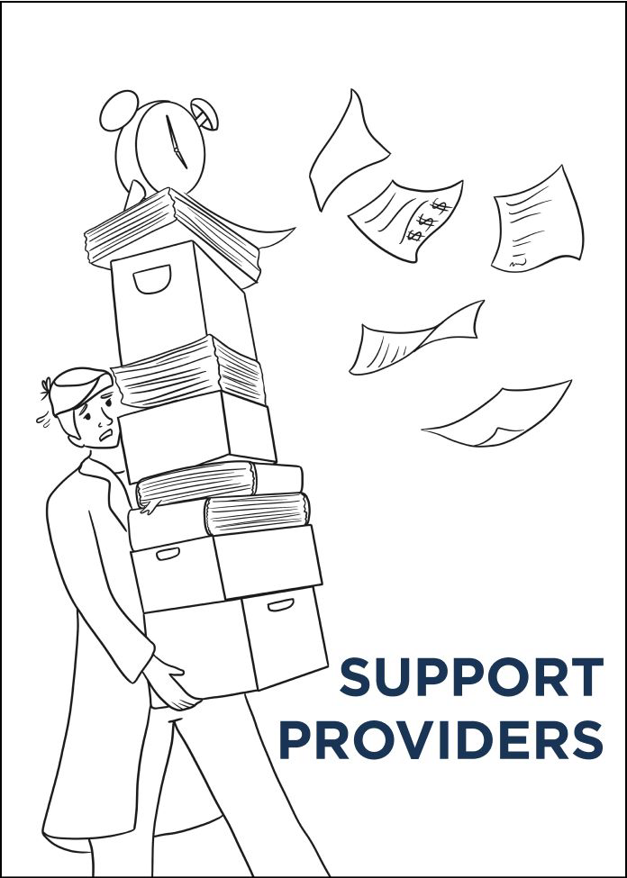
Support Providers
Complicated enrollment, low reimbursement, burdensome audits, and limited access to specialized care can lead providers to opt out of the oral health care Medicaid program. Varying oral health care payment models used by state Medicaid programs complicate matters further.

Slide 9
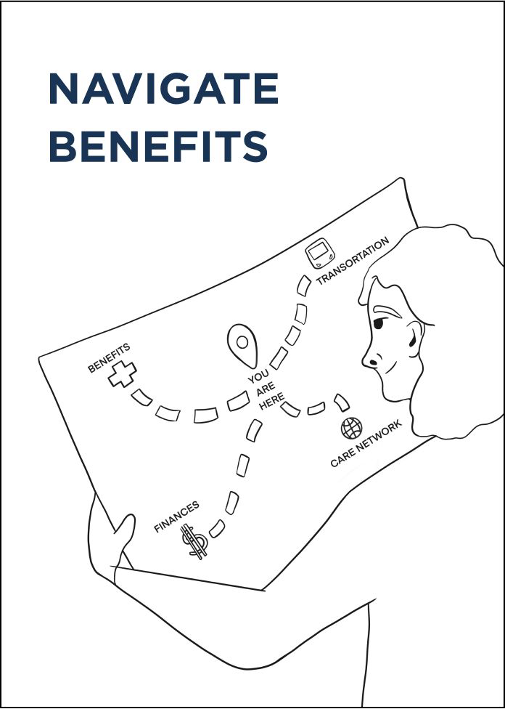
Navigate Beneﬁts
People with Medicaid lack awareness of oral health care beneﬁts and have difﬁculty navigating system complexities. Frequent state policy changes and fear of unexpected charges lead to poor beneﬁt utilization. When there is a difference between what patients expect to be covered and what is realistically covered, this can create frustration and blame towards the provider.

Slide 10
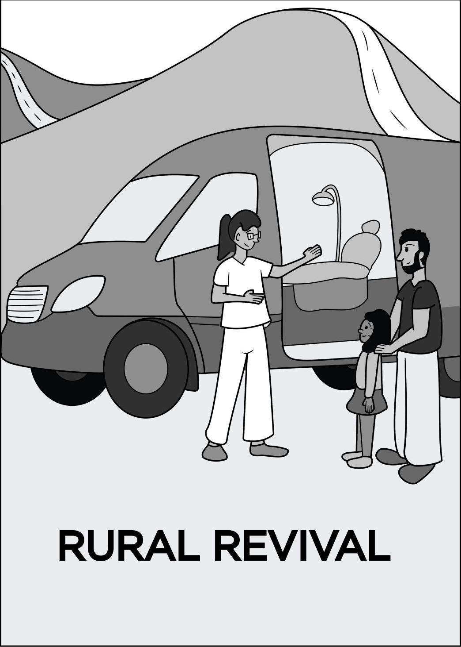
Rural Revival
Oral health care providers lack incentives to serve in rural areas, which often is home for many people with Medicaid and people with higher oral health care needs. Increased avenues for oral health care may include more dental clinics, mobile dentistry programs and community health centers. Creating incentives for providers such as school loan repayment programs could offer an incentive and retention for providers leading to better access to oral health care.

Slide 11
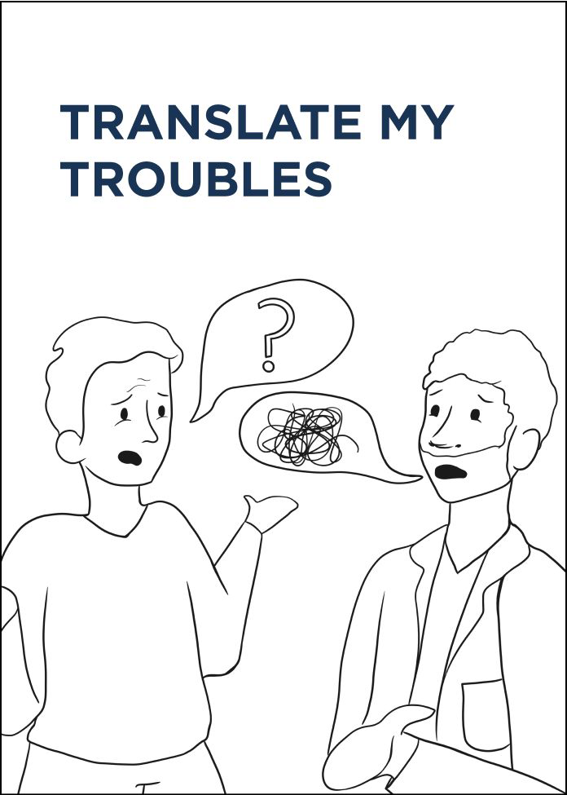
Translate My Troubles
Patients rely on community health workers to bridge cultural and language gaps with their oral health care providers. Interpreter services for certain languages and dialects can be hard to ﬁnd, and unofﬁcial interpreters such as bilingual staff and patient family members may misunderstand key information during oral health care visits due to lack of oral health education.

Slide 12
Know Your Health
Oral health literacy is key to improving patient health outcomes. Providers emphasize the importance of preventive care, particularly in childhood, as there are limited Medicaid preventive beneﬁts for adults. However, It is difﬁcult for some people with Medicaid to change their oral health habits and dental providers experience time constraints when educating patients during visits.

Slide 13
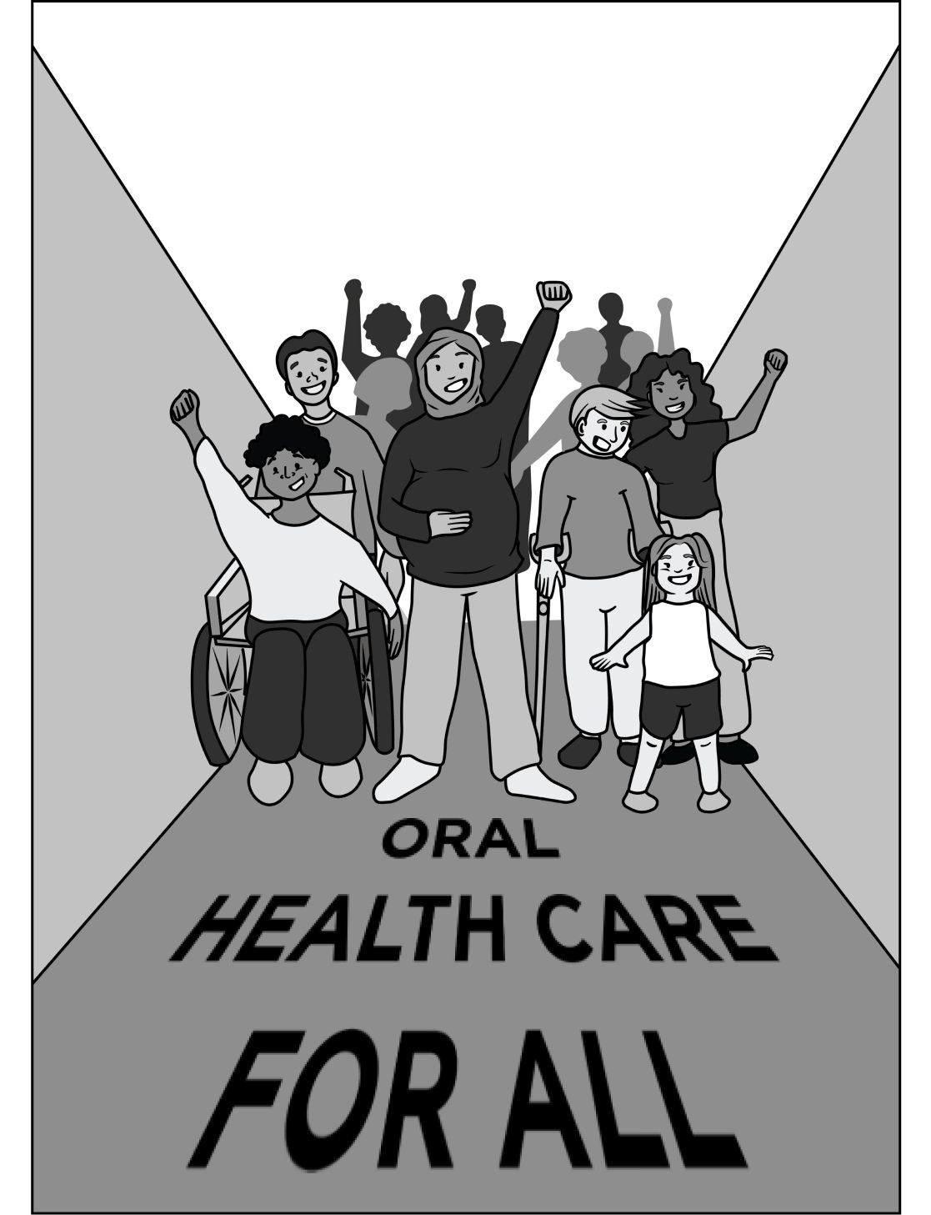
Oral Health Care Equity for All
People with Medicaid face many barriers to care, including transportation issues to far-away clinics. They also have higher rates of missing appointments as they are unable to take time off work and/or lacking childcare options. Dental problems also cause an increase in missed work due to extreme pain, which means loss of money. Providers emphasize the need for specialized training for pregnant women, infants, and patients with special needs.

Slide 14
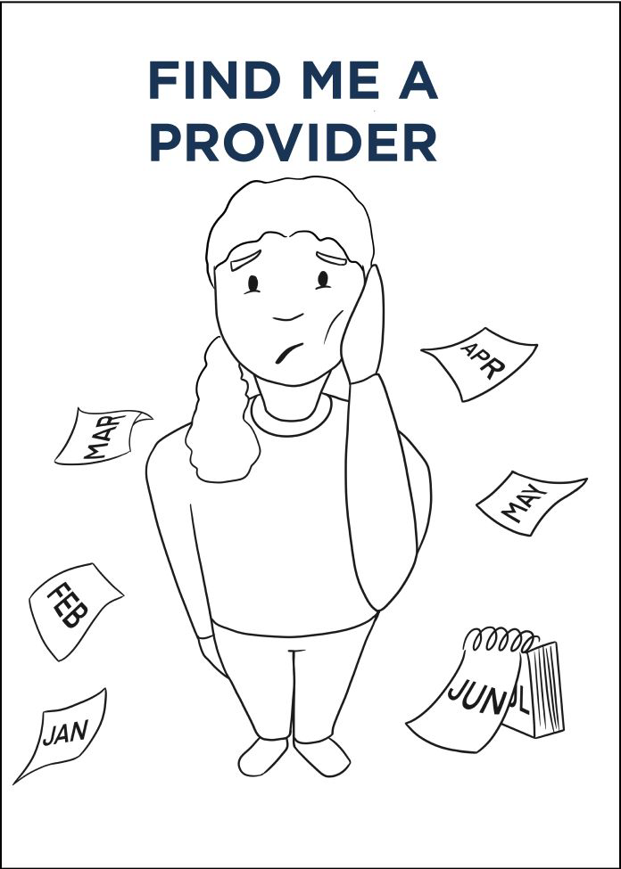
Find Me a Provider
There are more people on Medicaid oral health care programs than available providers, leading to long appointment wait times to get a dental appointment. Oral health care services performed in the operating room also require long wait times, which is challenging for children and individuals with special needs who require sedation for oral health care. Delayed oral health care worsens dental conditions and may negatively impact overall health.

Slide 15
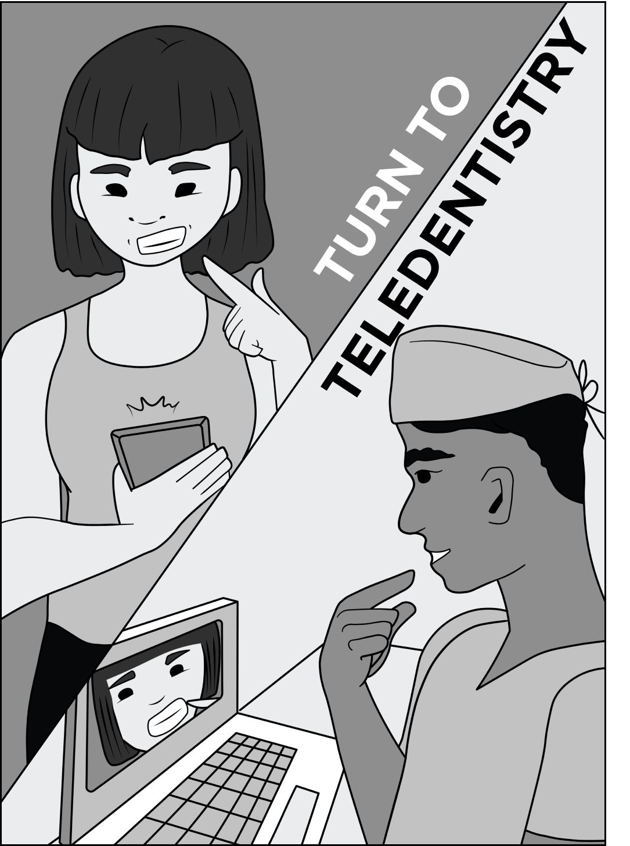
Turn to Teledentistry
Teledentistry can serve as a bridge for patients who cannot get to in-person appointments.
Expanding teledentistry services may include an initial diagnoses, referral to specialists and prescribing treatments.

Slide 16
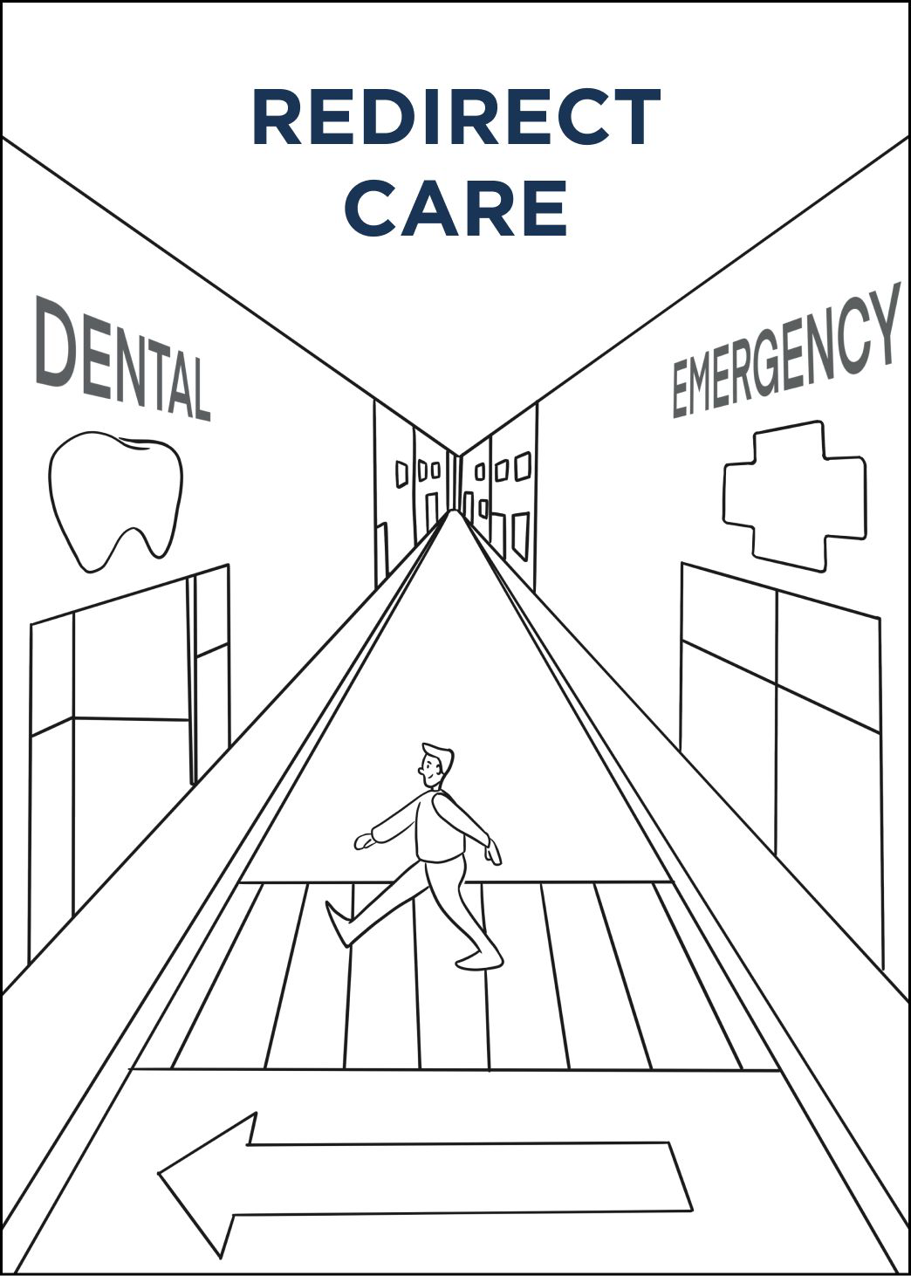
Redirect Care
Delayed care worsens conditions, sometimes becoming life-threatening. However, the ED cannot fully address dental problems.

