Slide 1
Chemical Data Reporting
Primary Submitter
EPA Forms 9600-010
OMB Control No. 2070-0162
Expiration 10/31/2026

Slide 2
Background
The basic 2028 Form U structure is the same as the 2024 Form U structure. The Form U is comprised of one or more Chemical Reports. A Chemical Report contains the manufacturing, processing, and use information for a single chemical. Each site submits one Form U covering all of the chemicals manufactured (including imported) at its site. Note that there are two versions of the Form U – a primary and a secondary version:
This document addresses the primary version, which is for domestic reporters (accessed through the Primary Authorized Official role for the CDX CSPP program service).

Slide 3
Reporting Elements
PRIMARY REPORTING FORM |  | Applicable Slide Numbers
Topic | 2028 Form U Reporting Tool Printout | 9600-010: Primary Manufacture
Parent Company Information | Part I, Section A | Slide 8
Site Information | Part I Section B | Slide 9
Technical Contact information | Part II, Section B | Slide 12
Chemical Identification | Part II, Section A | Slide 11
Manufacturing Information | Part II, Section C Section C.1 Manufacturing Company Section C.2 Contracting Company Section C.3 Producing Company | Slide 13
Process and Use Information | Part II, Section D Section D.1 Industrial Processing and Use Section D.2 Consumer and Commercial Use | Slides 14 - 19
Confidential Business Information Substantiation | Part III | Slide 20

Slide 4
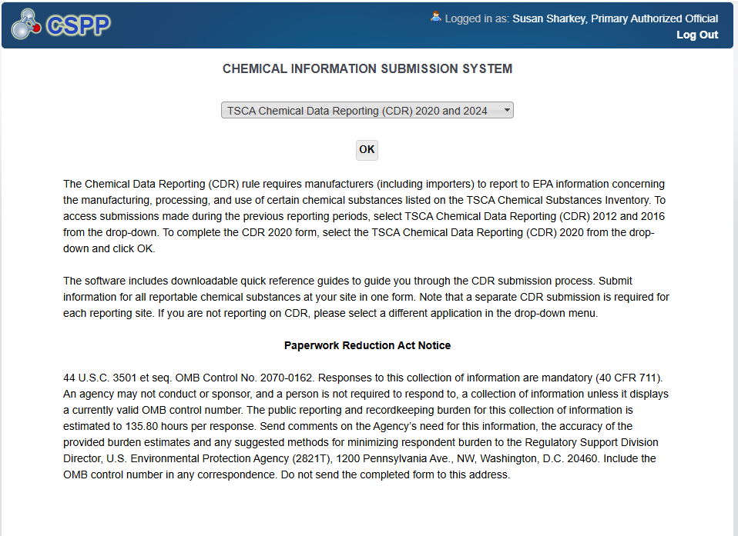
OMB Control No. 2070-0162
Expiration 10/31/2026
EPA Forms 9600-010

Slide 5
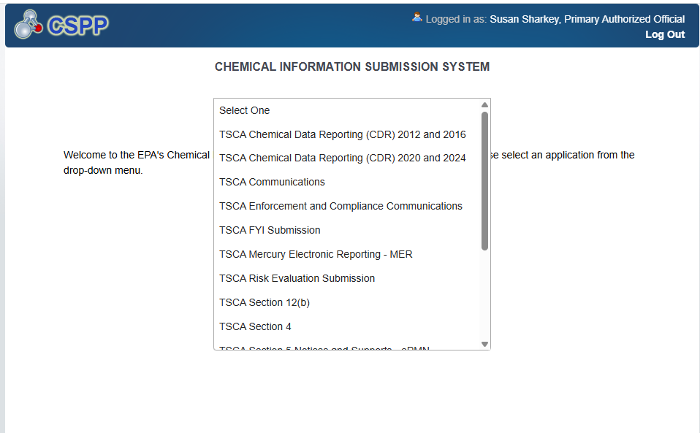
OMB Control No. 2070-0162
Expiration 10/31/2026
EPA Forms 9600-010

Slide 6
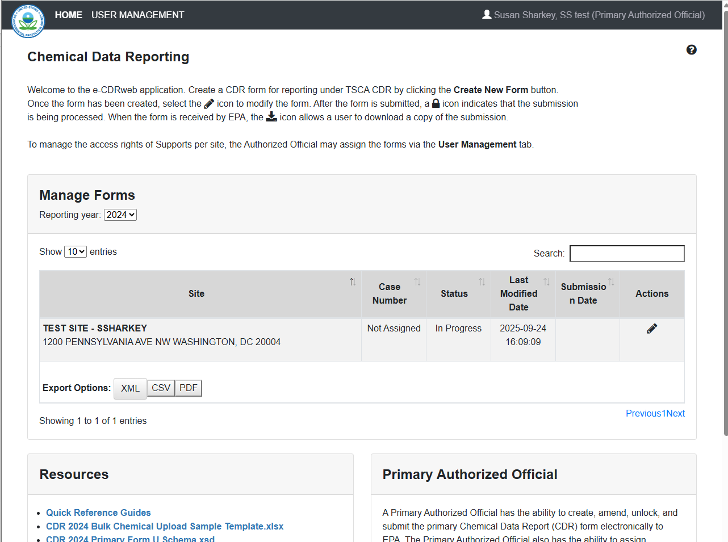
OMB Control No. 2070-0162
Expiration 10/31/2026
EPA Forms 9600-010

Slide 7
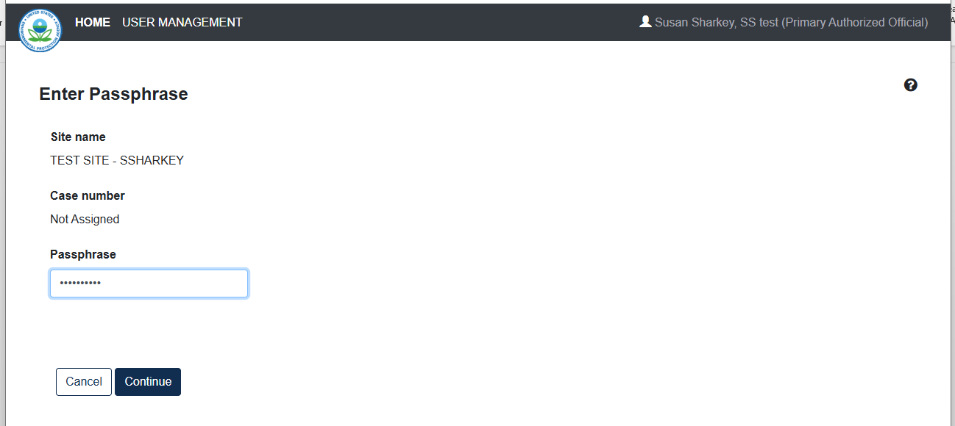
OMB Control No. 2070-0162
Expiration 10/31/2026
EPA Forms 9600-010

Slide 8
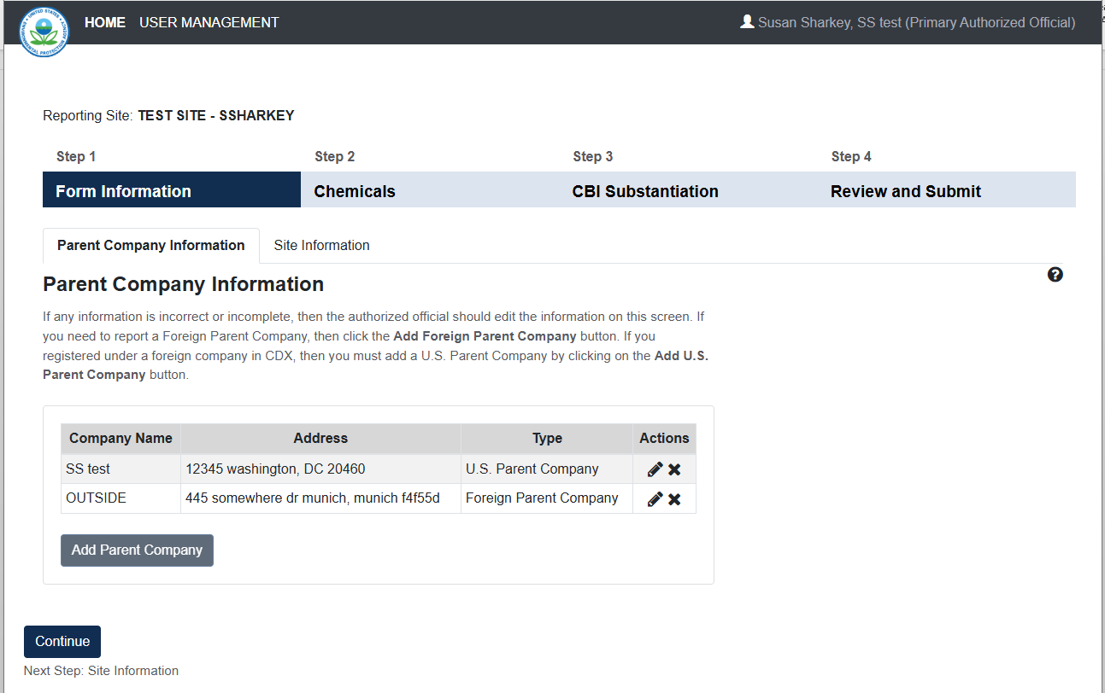
OMB Control No. 2070-0162
Expiration 10/31/2026
EPA Forms 9600-010

Slide 9
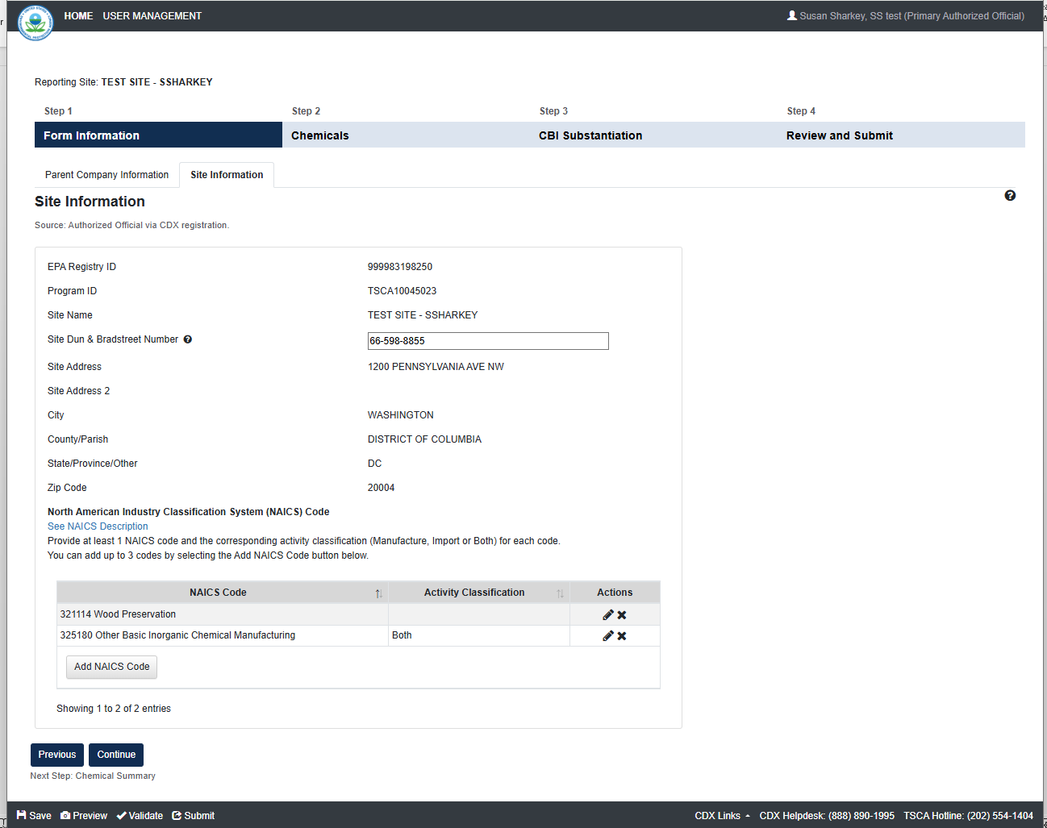
OMB Control No. 2070-0162
Expiration 10/31/2026
EPA Forms 9600-010

Slide 10
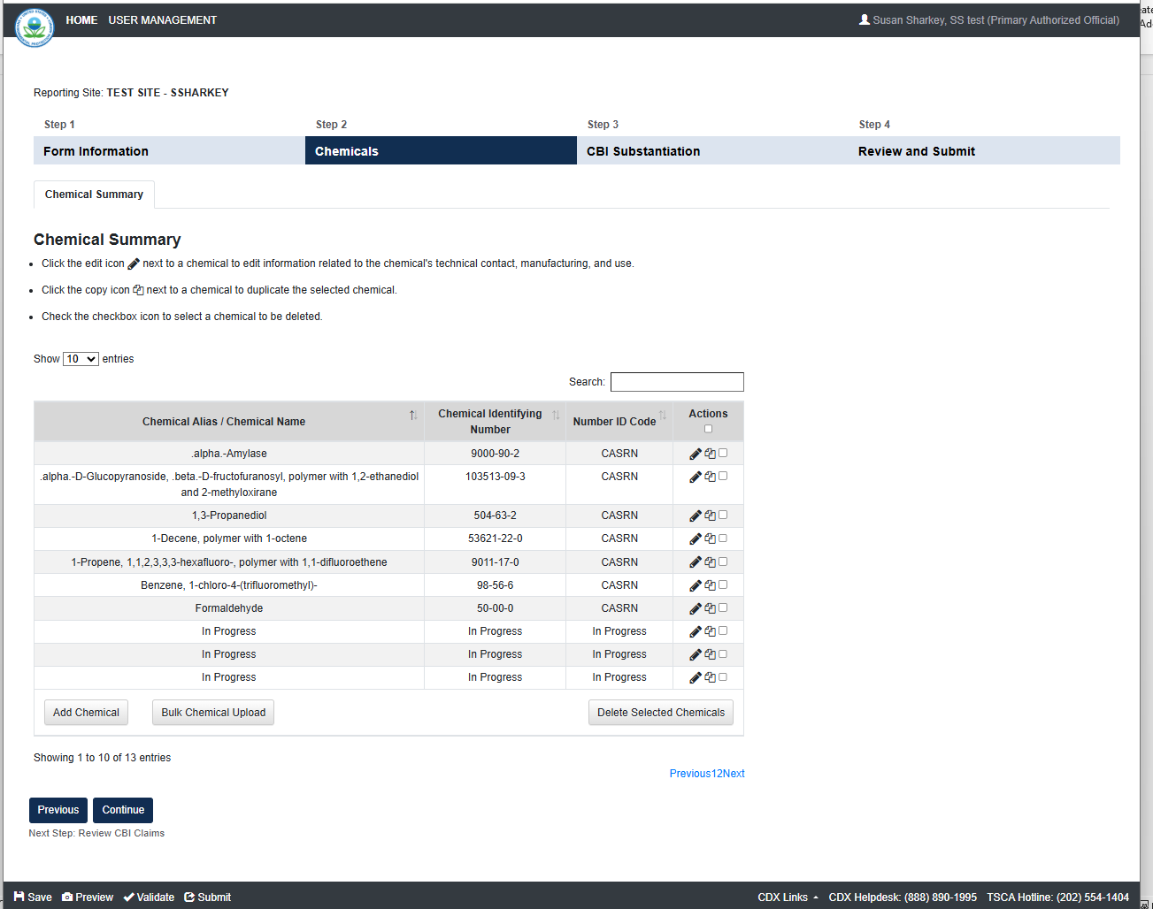
OMB Control No. 2070-0162
Expiration 10/31/2026
EPA Forms 9600-010

Slide 11
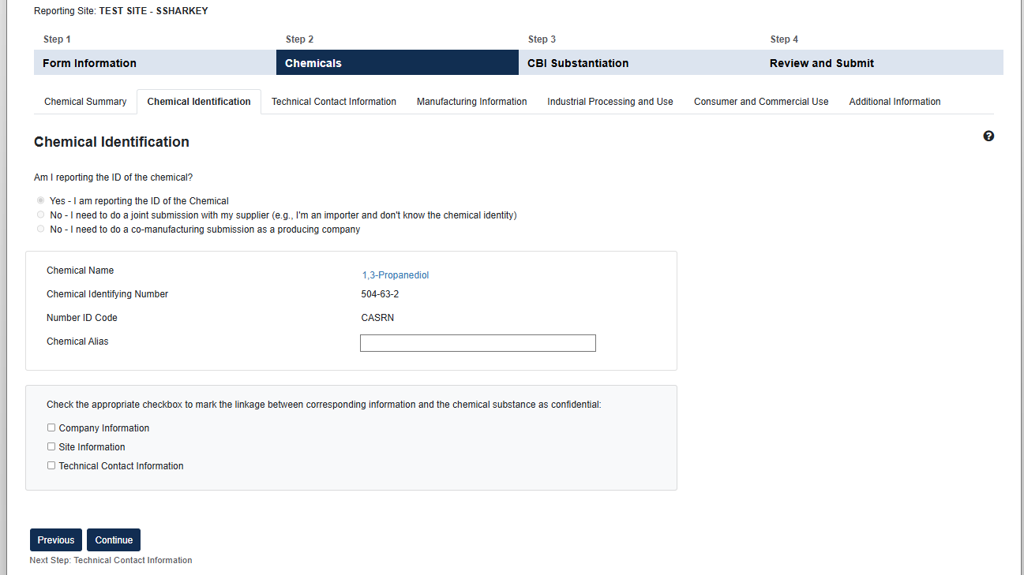
OMB Control No. 2070-0162
Expiration 10/31/2026
EPA Forms 9600-010

Slide 12
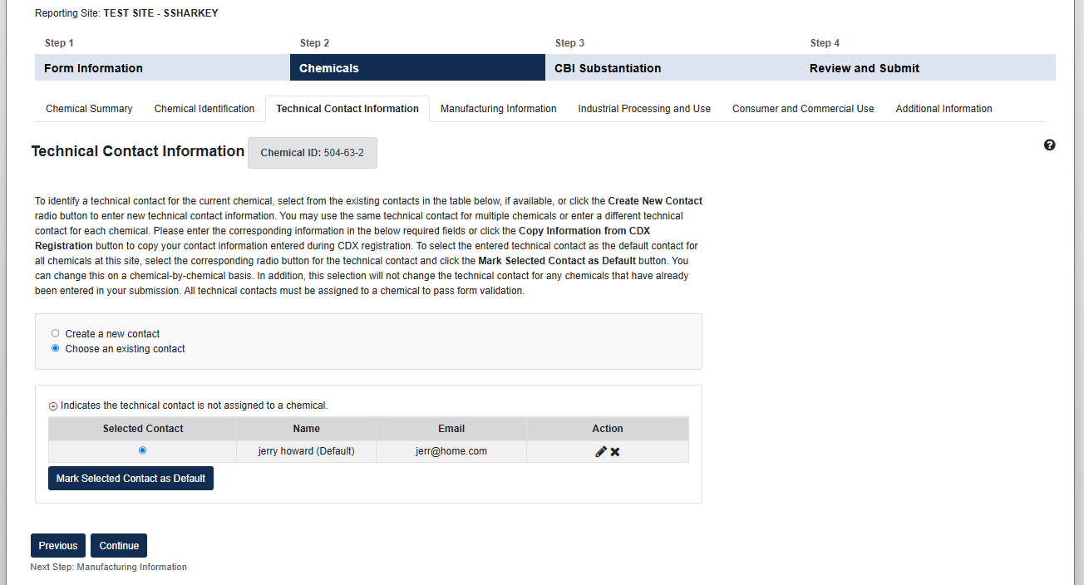
OMB Control No. 2070-0162
Expiration 10/31/2026
EPA Forms 9600-010

Slide 13
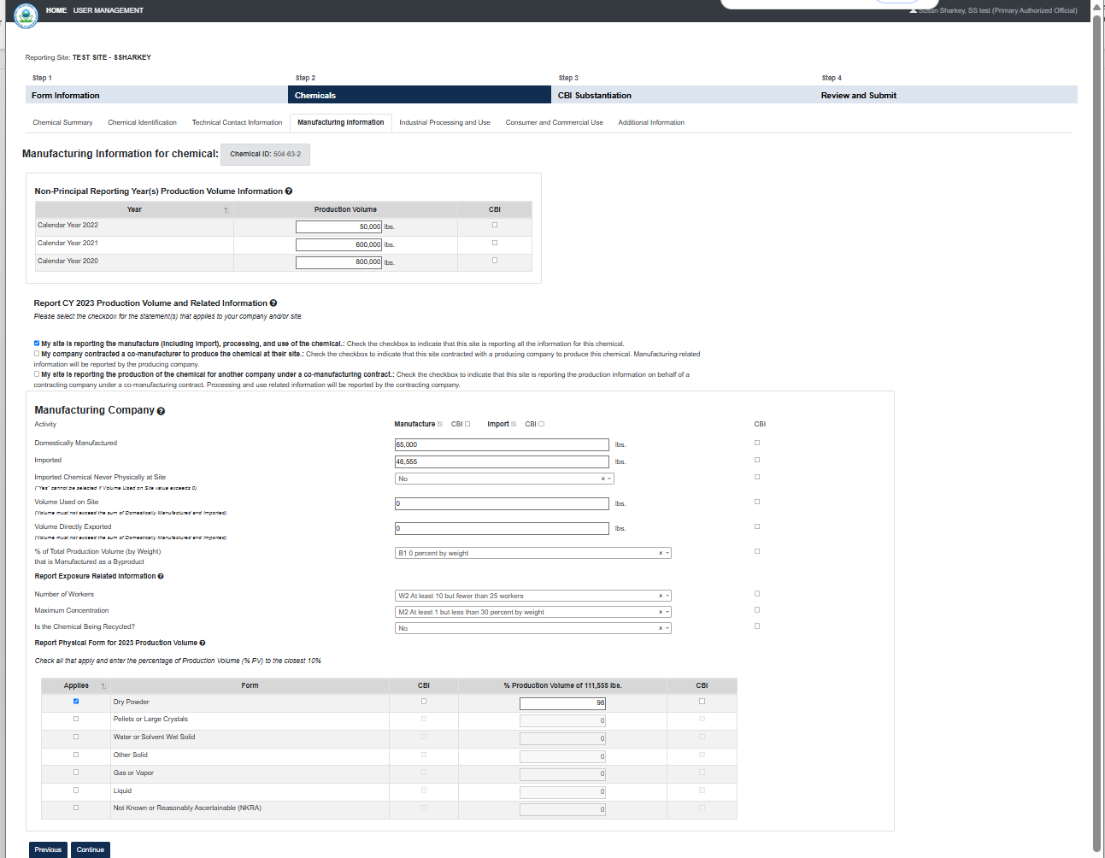
OMB Control No. 2070-0162
Expiration 10/31/2026
EPA Forms 9600-010

Slide 14
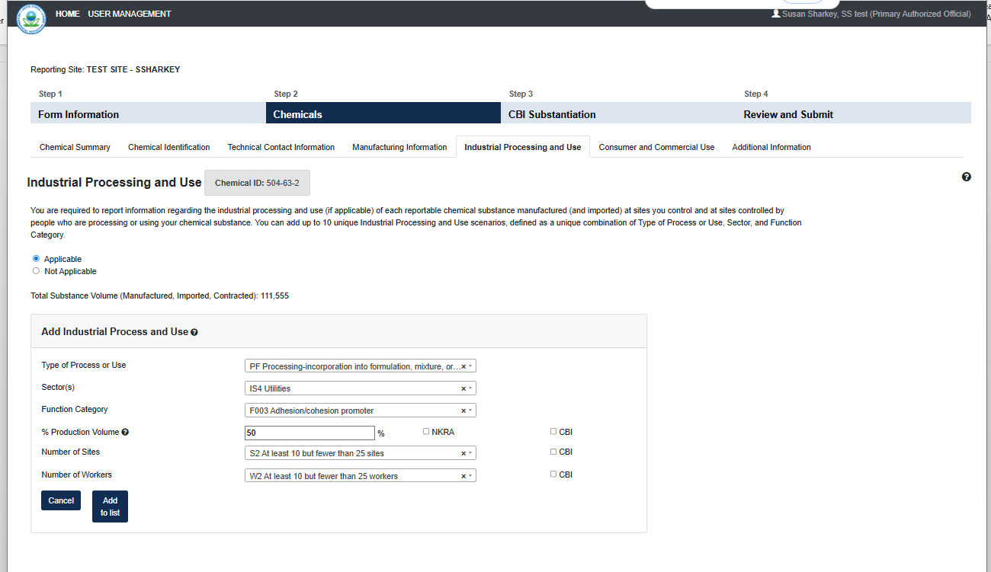
OMB Control No. 2070-0162
Expiration 10/31/2026
EPA Forms 9600-010

Slide 15
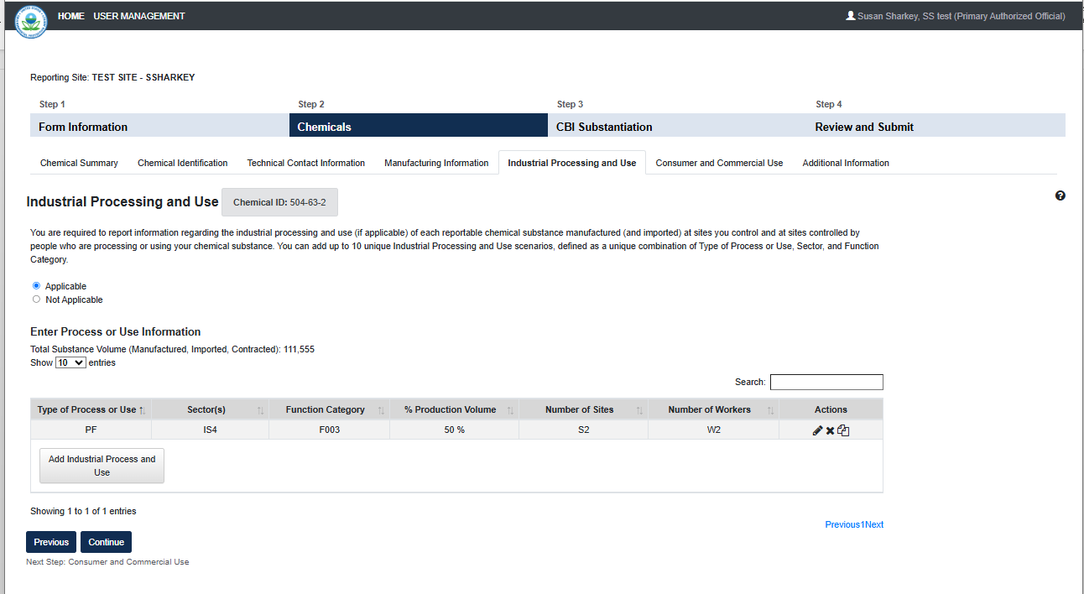
OMB Control No. 2070-0162
Expiration 10/31/2026
EPA Forms 9600-010

Slide 16
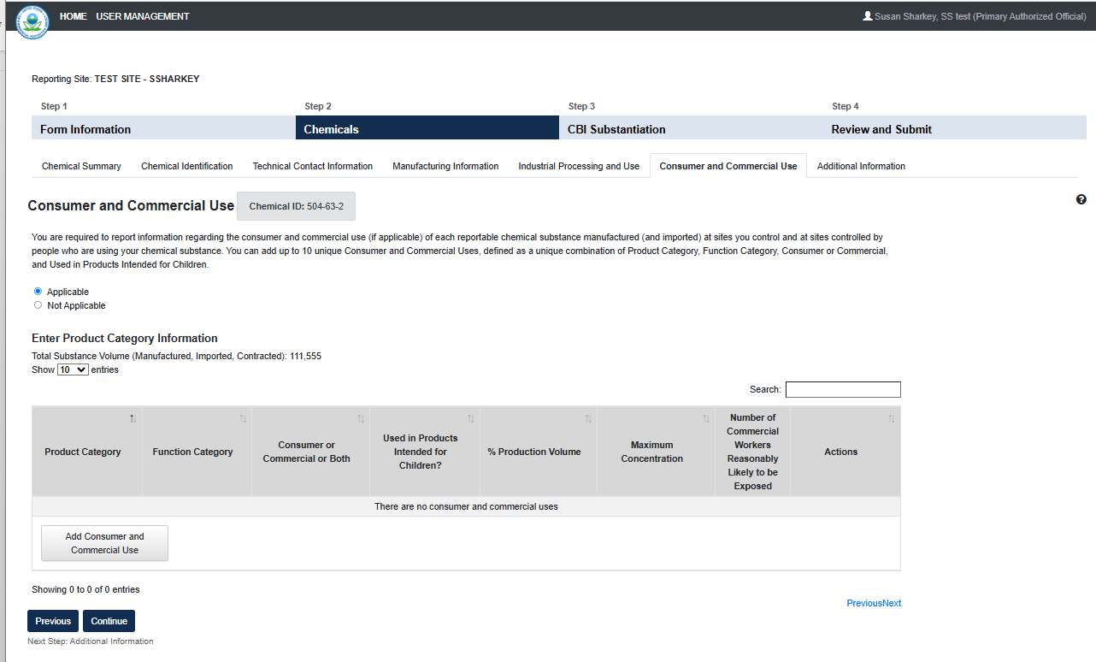
OMB Control No. 2070-0162
Expiration 10/31/2026
EPA Forms 9600-010

Slide 17
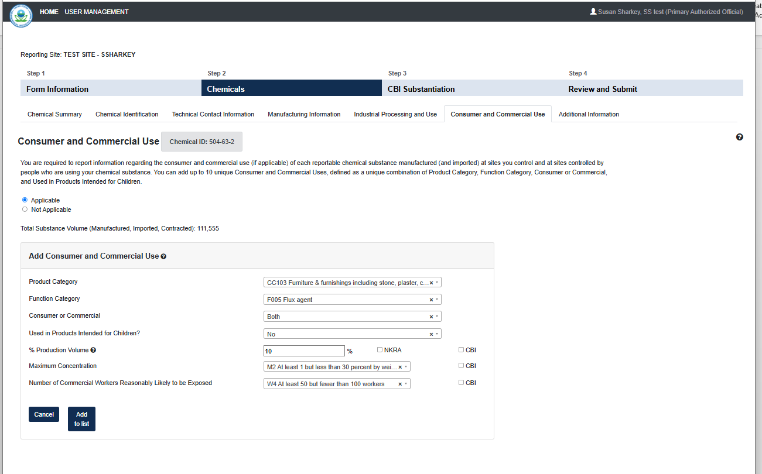
OMB Control No. 2070-0162
Expiration 10/31/2026
EPA Forms 9600-010

Slide 18
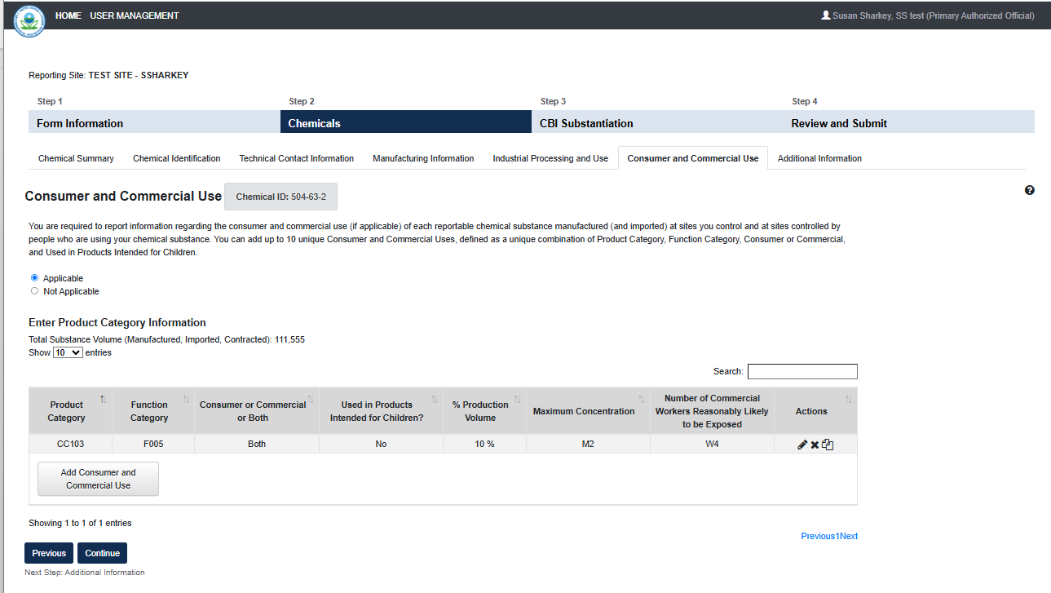
OMB Control No. 2070-0162
Expiration 10/31/2026
EPA Forms 9600-010

Slide 19
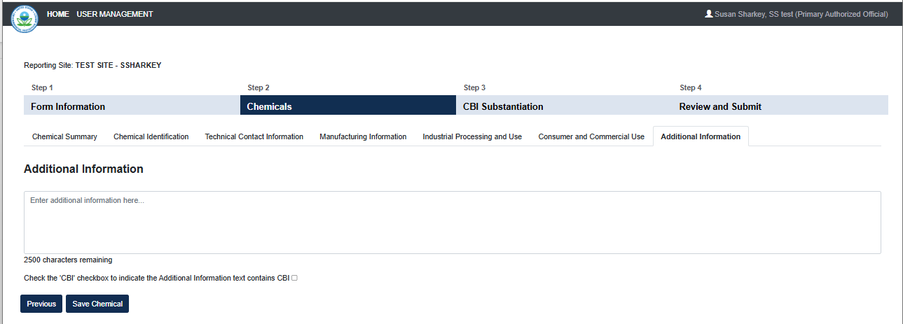
OMB Control No. 2070-0162
Expiration 10/31/2026
EPA Forms 9600-010

Slide 20
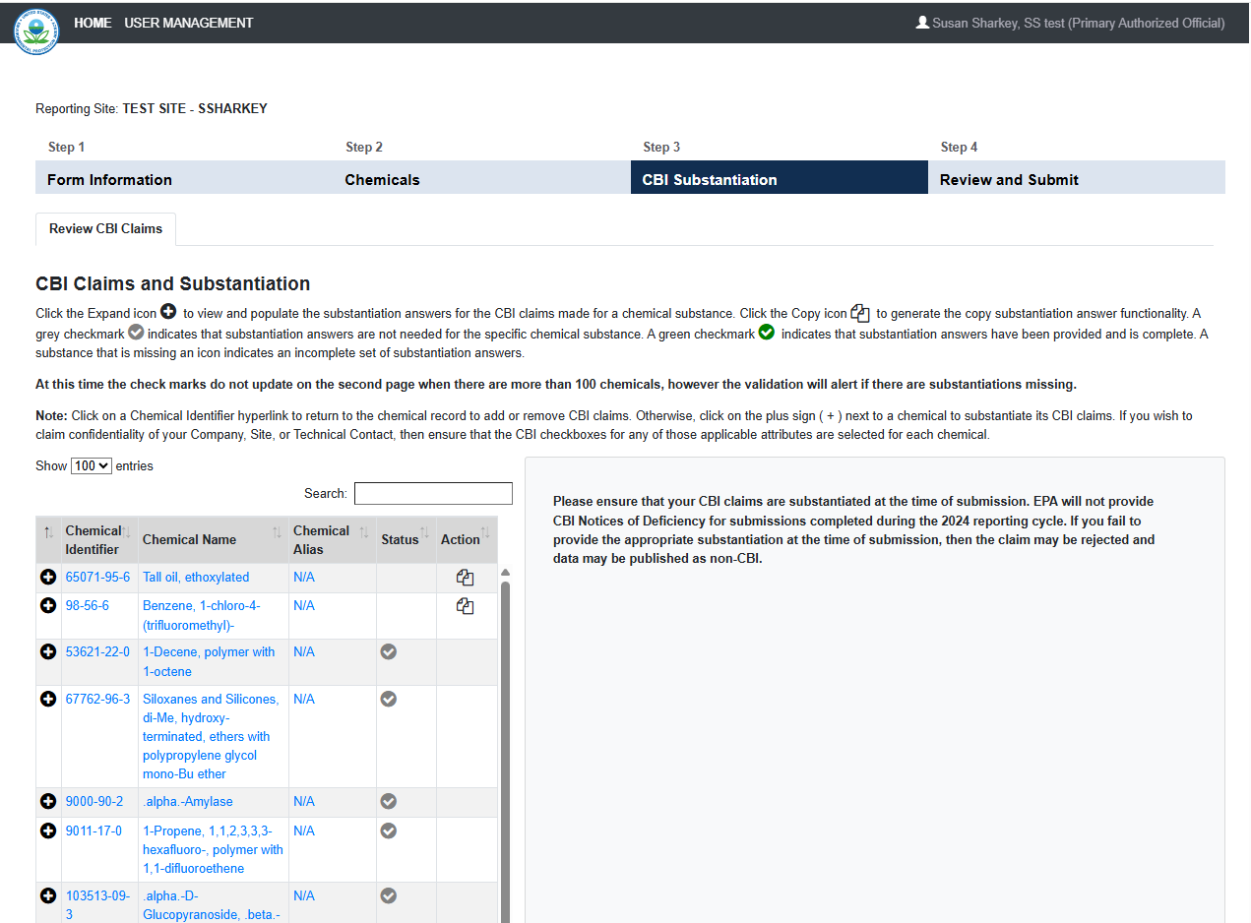
OMB Control No. 2070-0162
Expiration 10/31/2026
EPA Forms 9600-010

Slide 21
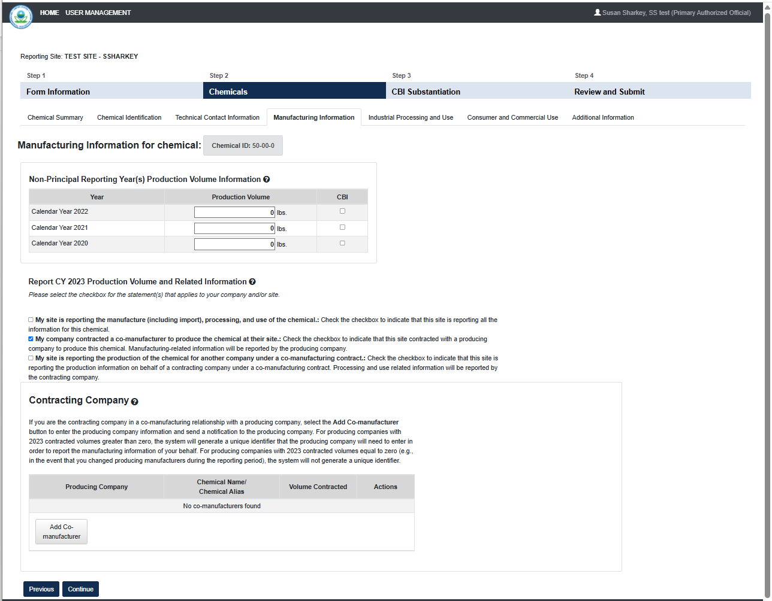
OMB Control No. 2070-0162
Expiration 10/31/2026
EPA Forms 9600-010

Slide 22
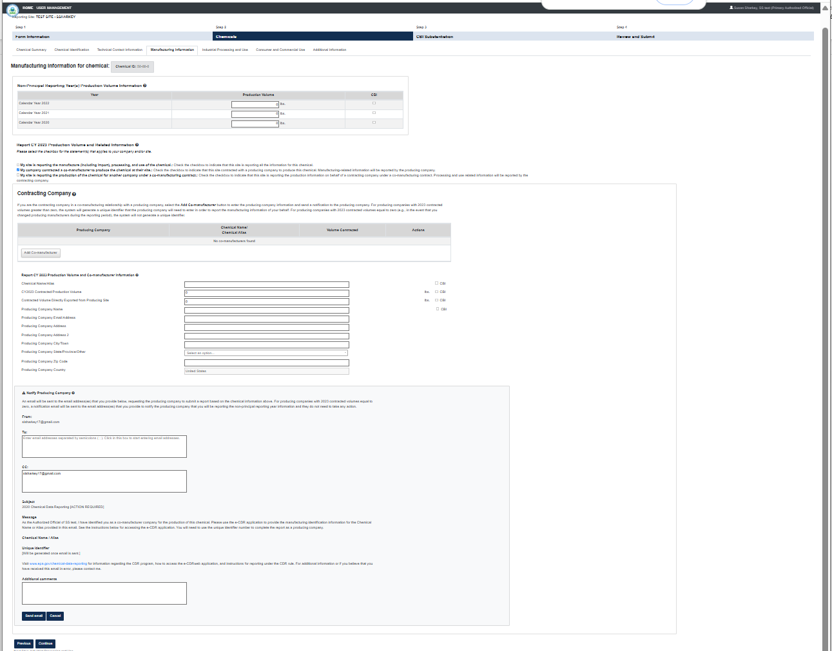
OMB Control No. 2070-0162
Expiration 10/31/2026
EPA Forms 9600-010

Slide 23
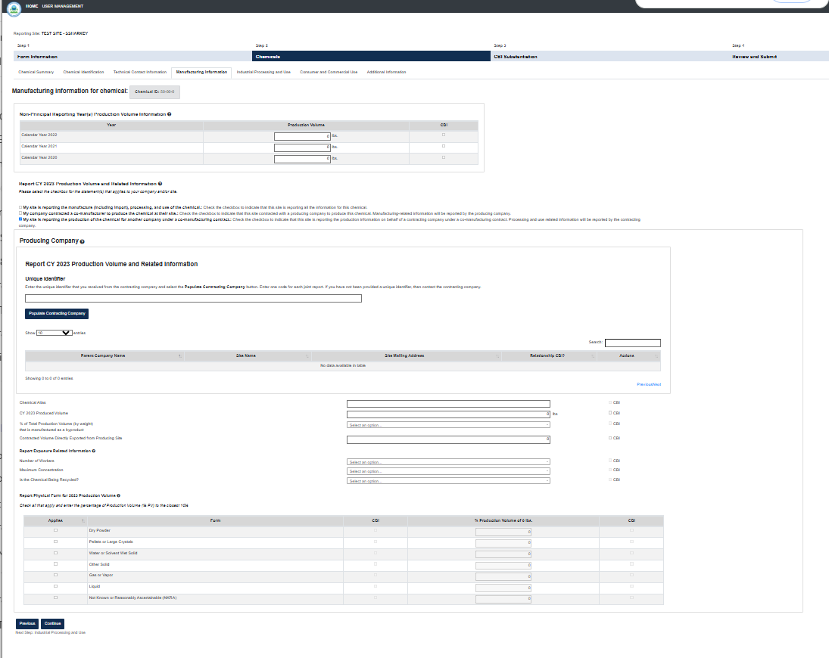
OMB Control No. 2070-0162
Expiration 10/31/2026
EPA Forms 9600-010

Slide 24
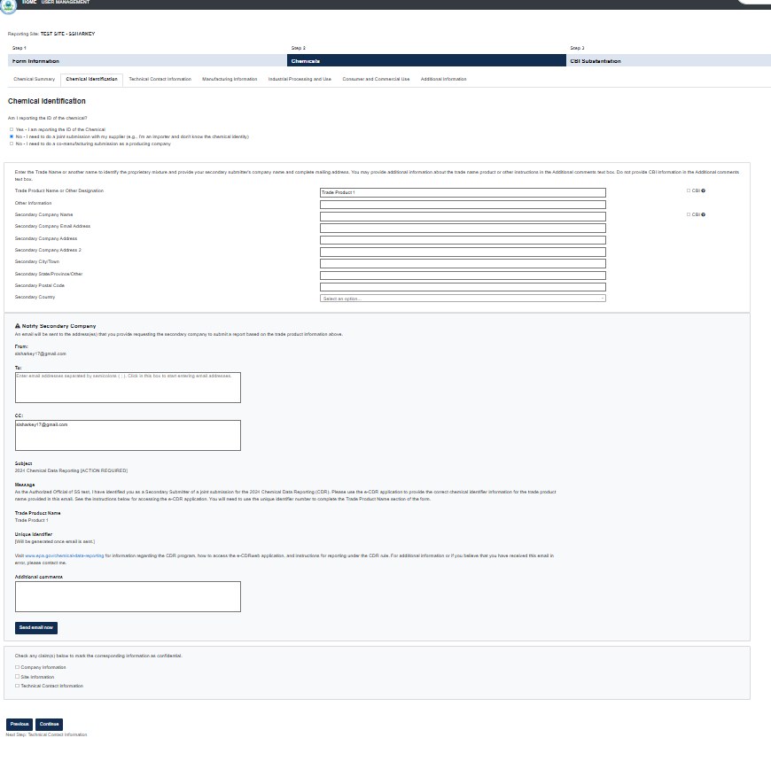
OMB Control No. 2070-0162
Expiration 10/31/2026
EPA Forms 9600-010

